Slide 1
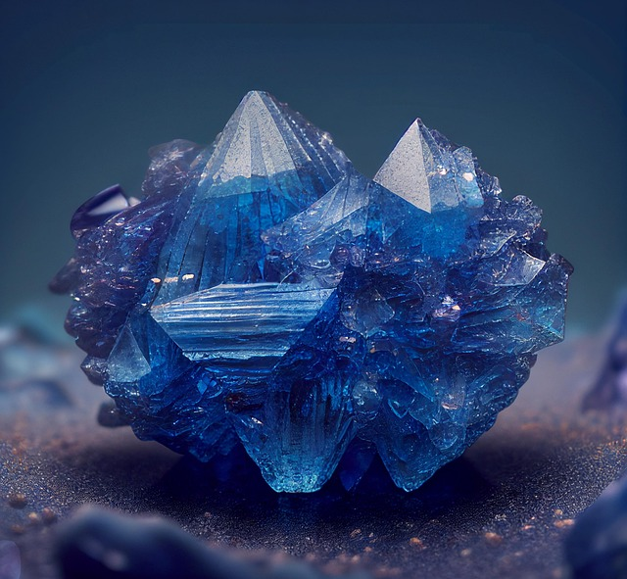
The Multi-Faceted World of Rings

Slide 2
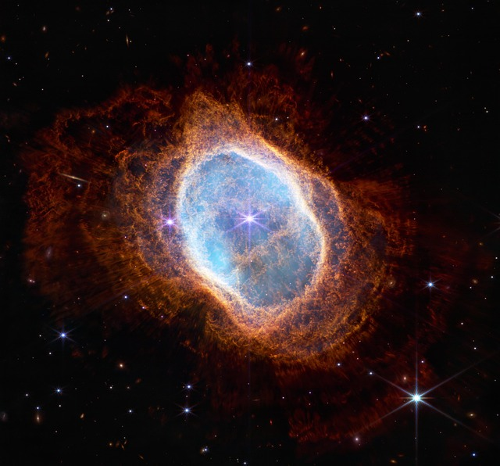
Planetary Rings
Composed of billions of ice and rock particles.
Saturn possesses the most extensive ring system.
Formed from shattered comets, asteroids, or ancient moons.

Slide 3
Nature's History: Tree Rings
Each ring represents one year of a tree's growth.
Width indicates environmental conditions and climate variations.
Used by scientists to reconstruct historical weather patterns.

Slide 4

Algebraic Ring Theory
Abstract structures containing elements with two operations.
Must support addition and multiplication properties.
Fundamental to modern cryptography and computer science.

Slide 5

Symbols of Connection
Circular shape symbolizes eternity, having no beginning or end.
Historically used as seals to authenticate official documents.
Modern exchange signifies commitment, love, and partnership.

Slide 6
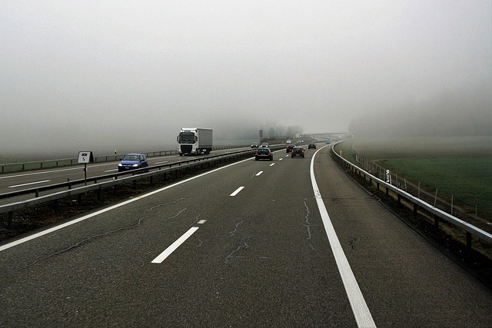
Urban Ring Roads
Circumferential highways designed to bypass congested city centers.
Redirect heavy through-traffic away from urban cores.
Improve regional connectivity and reduce overall travel times.

