Slide 1
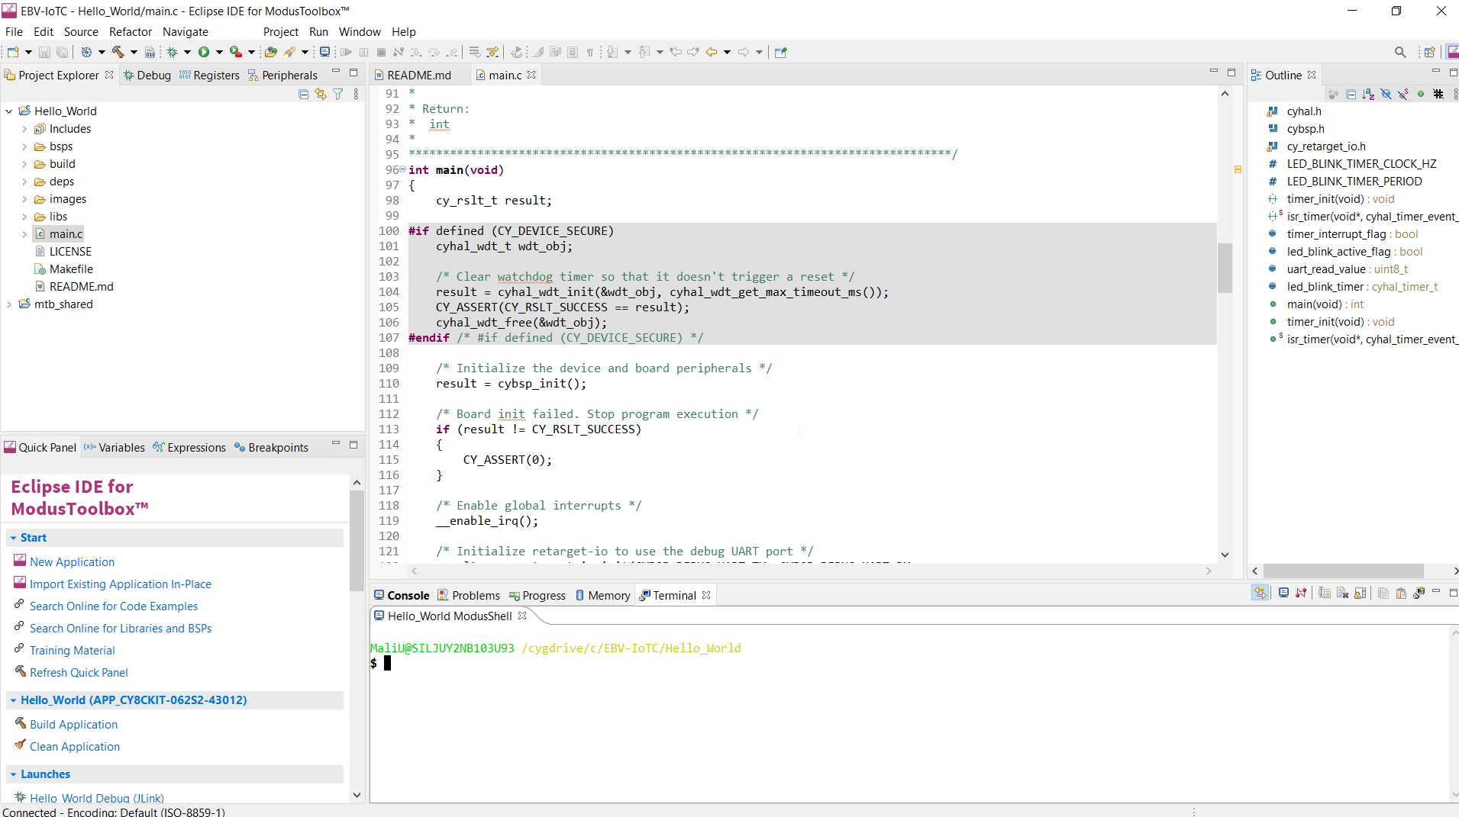
Menus & Toolbars
Project Explorer
Code Editor
Quick Pannel
Console

