Slide 1
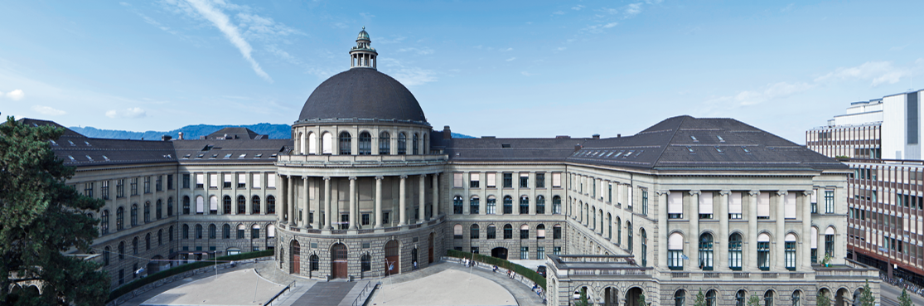
Porting zk-SNARKs to OpenCL
Author: Uroš Tešić
Mentors: Moritz Schneider, Karl Wüst

Slide 2
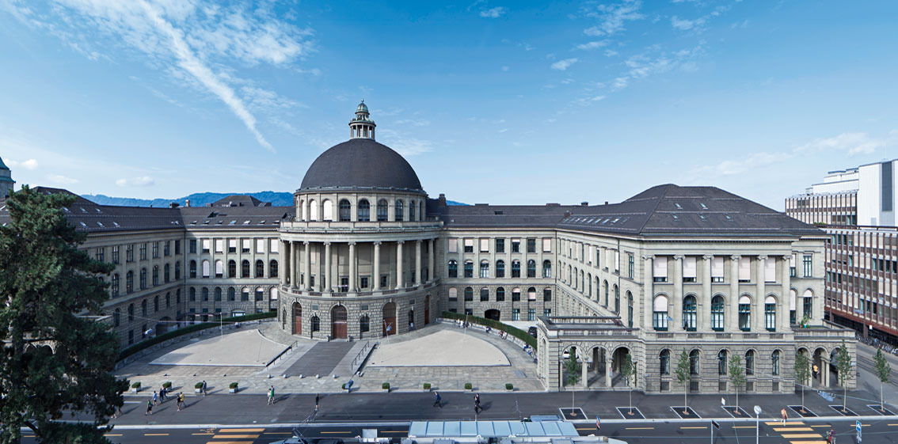
INTRODUCTION

Slide 3



Thesis goals
GPU
Neural Networks
Quantum Chemistry
Cancer Detection
zCash
???
Articles taken from devblogs.nvidia.com

Slide 4
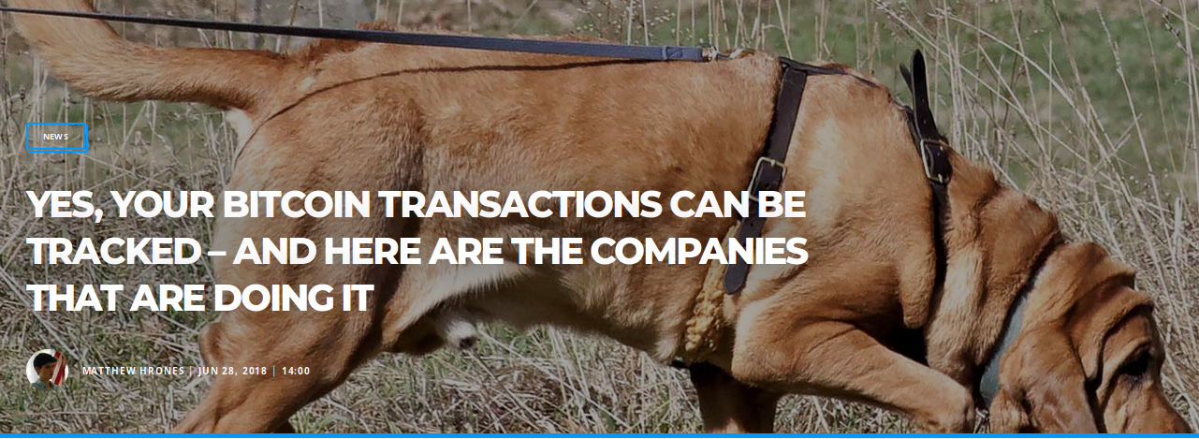
Bitcoin
*they do not use bloodhounds
https://bitcoinist.com/yes-your-bitcoin-transactions-can-be-tracked-and-here-are-the-companies-that-are-doing-it/

Slide 5
zCash
Transparent and shielded transactions
Miner verification
Zero-knowledge proof
People don’t use shielded transaction!!!

Slide 6

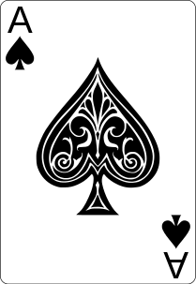


Zero-Knowledge Proof (Interactive)
P picked a black ace
Hey, I have picked a black ace
P
V
Show me the ace of hearts
Here it is
Show me the ace of diamonds
Here it is
*the deck consists of 4 aces

Slide 7
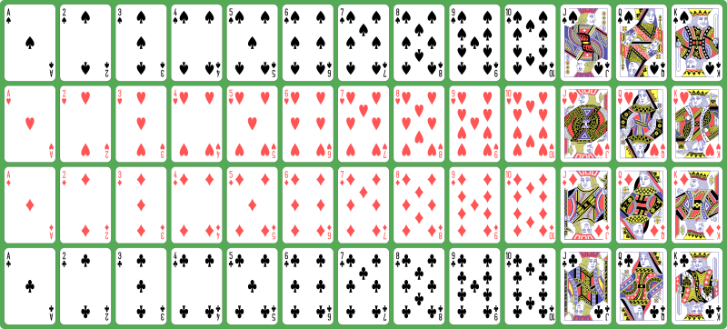
Zero-Knowledge Proof (Non-interactive)
Common Reference String
P picked a black ace
Read CRS
Read CRS
I picked a
black ace
P
V
Proof
«He who controls the CRS controls the Universe.»
Frank Herbert (probably)

Slide 8
Zk-SNARK (Proof used in zCash)
Zero-knowledge
Succinct
Non-interactive
Arguments
Of Knowledge

Slide 9
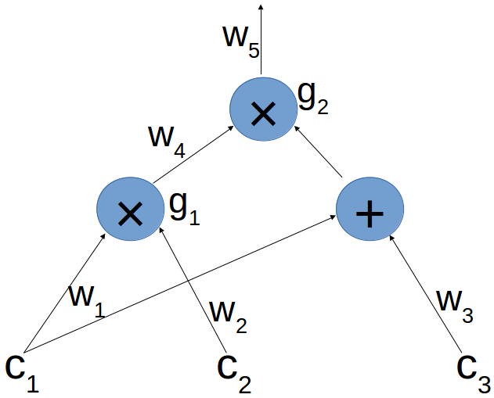
Zk-SNARK
Create an algebraic circuit that verifies our constraints
Example: (c1 * c2) * (c1 + c3)

Slide 10
Zk-SNARK (R1CS form)
C
Convert every gate to R1CS form
g2 | S | A | B | C
1
w1
w2
w3
w4
w5
1
2
3
5
6
42
0
0
0
0
1
0
0
1
0
1
0
0
0
0
0
0
0
1
A
B
(S · A) * (S · B) - (S · C) = 0

Slide 11
Quadratic Arithmetic Program
Convert all gates to R1CS
Perform Lagrangian interpolation
g₂ | S | A | B | C
1 | 1 | 0 | 0 | 0
w1 | 2 | 0 | 1 | 0
w2 | 3 | 0 | 0 | 0
w3 | 5 | 0 | 1 | 0
w4 | 6 | 1 | 0 | 1
w5 | 42 | 0 | 0 | 1
g_{i} | S | A | B | C
1 | 1 | A₁(i) | B₁(i) | C₁(i)
w1 | 2 | A₂(i) | B₂(i) | C₂(i)
w2 | 3 | A₃(i) | B₃(i) | C₃(i)
w3 | 5 | A₄(i) | B₄(i) | C₄(i)
w4 | 6 | A₅(i) | B₅(i) | C₅(i)
w5 | 42 | A₆(i) | B₆(i) | C₆(i)
g₁ | S | A | B | C
1 | 1 | 0 | 0 | 0
w1 | 2 | 1 | 0 | 0
w2 | 3 | 0 | 1 | 0
w3 | 5 | 0 | 0 | 0
w4 | 6 | 0 | 0 | 1
w5 | 42 | 0 | 0 | 0
A(x) * B(x) - C(x) = 0 for x = 1..n
(S · A) * (S · B) - (S · C) = 0

Slide 12
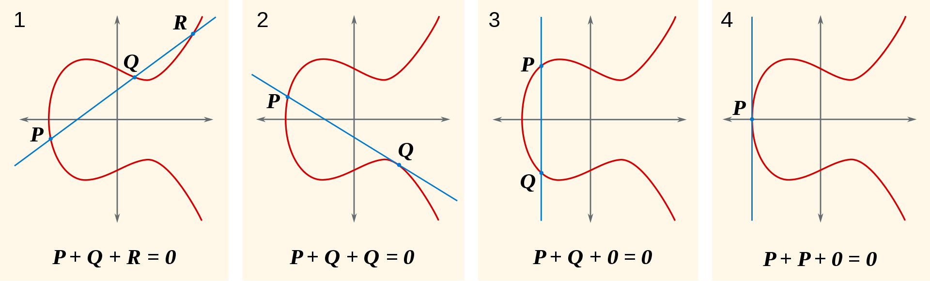
Small detour - Pairing
Dark magic: e(G₁^{x},G₂^{y}) = e(G₁,G₂)^{xy}
Elliptic curves

Slide 13
The Pinocchio Protocol [PGHR13]
QAP reduce to Polynomial division | Verify by pairing
Secret point q
Evaluate A(x), B(x), C(x) using CRS and S
We need elliptic curve points:
CRS: qG, q²G, q³G, q⁴G...

Slide 14
IMPLEMENTATION

Slide 15
Recap
Polynomial division (FFT) and EC operations
Benchmark

Slide 16
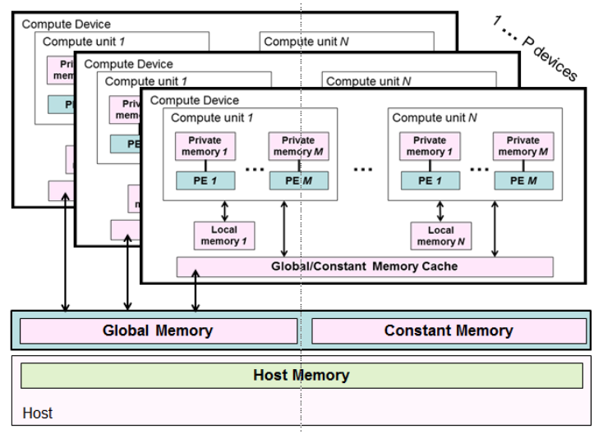
OpenCL
Memory model
Maps to GPU, CPU, FPGA...

Slide 17
OpenCL
CPU
GPU
Core
Core
Registers
Registers
C
C
C
C
C
C
C
C
C
C
C
C
C
C
C
C
C
C
Cache
Cache
C
C
C
C
C
C
C
C
C
R
R
R
R
R
R
R
R
R
R
R
R
R
R
R
R
R
R
R
R
R
R
R
R
R
R
R
Cache
Shared
Shared
Shared
RAM
Global Memory

Slide 18
Exponentiation
2¹³: 1101
2¹
2²
2³
2⁶
2¹²
2¹³
2¹³: 1101
2¹
2²
2³
2³
2¹²
2¹³

Slide 19
Librustzcash Multiexp Algorithm
Let’s calculate (2^15)*(3^12)
The first thread takes a look at low 2 bits of exponents
Create 3 buckets (for values 1, 2, 3)
Load the first base (2), and take a look at the exponent (0xF & 0x3 = 3)
Add the base to bucket 3
Load the second base (3), and take a look at the exponent (0xC & 0x3 = 1)
Add the base to bucket 1
Calculate b[3] + (b[3] + b[2]) + (b[3] + b[2] + b[1])
Merge with the higher thread: result = low + 4*high

Slide 20
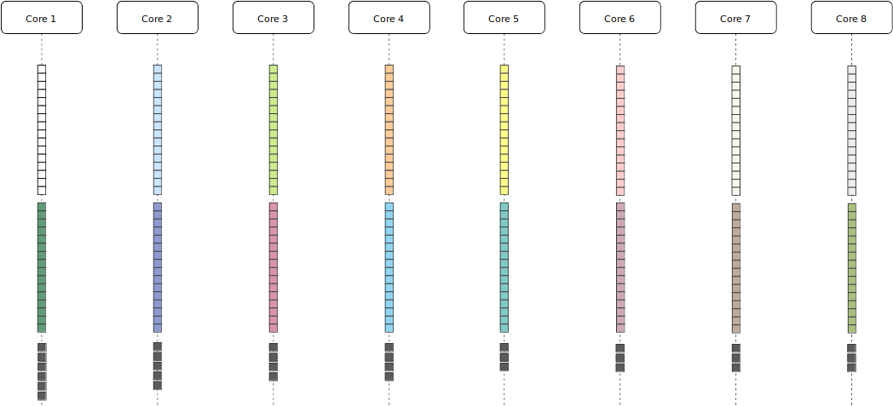
Binary method

Slide 21
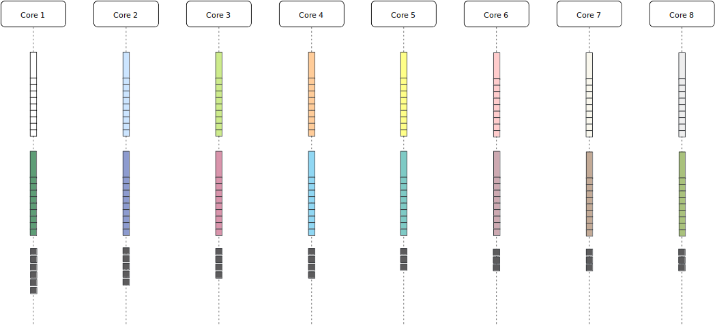
Windowed binary method

Slide 22
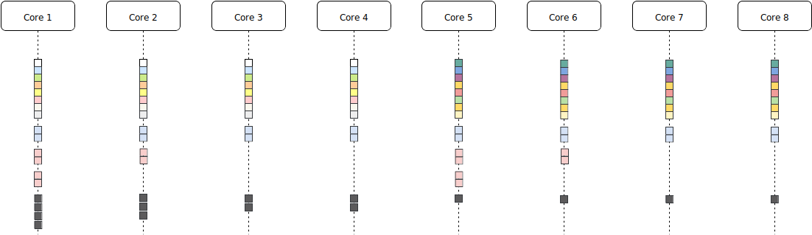
4-bit Pippinger

Slide 23
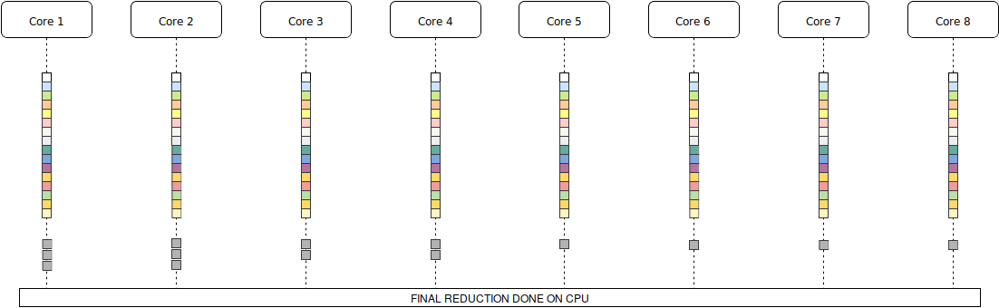
1-bit Pippinger

Slide 24
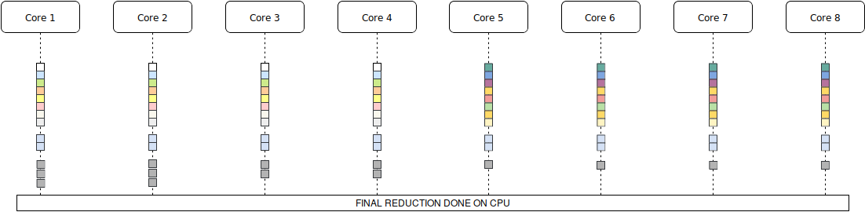
4-bit Pippinger with CPU reduction

Slide 25
Test devices
CPU:
64 bit I7 processor. 4 x 2.8 GHz.
64 bit ARM processor. 4 x 2.7 GHz, 4 x 1.7 GHz.
GPU:
Intel HD Graphics 630. 24 x 350 MHz (1.1 GHz burst).
Mali-G72 MP18. 18 x 850 MHz.
NVIDIA 1060 6GB. 1280 x 1404 MHz (1670 MHz burst)
ATI RX 580 8GB. 2304 x 1257 MHz (1340 MHz burst)

Slide 26
Results CPU – whole proof generation
Intel 64 bit: 1.65-2.30s
Intel 32 bit: ~ 8.50s
ARM 64 bit: ~ 2.95s
ARM 32 bit: ~ 18.6s
Stress test results:
  Intel 64 bit: 2.3s constant
  ARM 64 bit: 3.9s-6.75s max

Slide 27
Results Multiexp
131071 G1 elements: 0.75s on Intel CPU (P), 12.4s (BM)
Intel and Mali GPU: too slow
  46s (BM) on Intel, 10.5s (4B-CPU), 200+ s on Mali
NVIDIA:
  5s (BM), 3s (WM), 2.5s (1-bit P), 1.8s (4-bit P), 1.6s (4-bit CPU red)
ATI:
By combining CPU and GPU, we can get more than 25% improvement :)
Are we cheating? Yes.

Slide 28
Why isn’t it faster?
Improvement comes from the reduced number of operations
Inspecting NVIDIA compilation logs showed generation of stack – NVIDIA wasn’t inlining all functions
All but the simplest kernels had a call stack
Stack gets pushed to global memory
Arrays were also pushed to the stack
Constants were pushed to constant global memory (macros didn’t work)
ATI actually inlined everything, but code was huge (90 KB for a test kernel, only 32 bit instructions)
ATI assembly showed memory accesses in the middle of the kernel
ATI profiler results show high memory and low ALU usage

Slide 29
OpenCL Development Issues
Random compiler errors (NVIDIA and Intel)
API problems (ARM)
Cross-compilation for Android/OpenCL (per device)
Long kernel compilation times (can be cached)
No tools for NVIDIA (assembly dump possible with a hack), lower performance than CUDA
ATI Profiler GUI didn’t work
Fun fact: Almost no one tests their code on devices from 4 different vendors
Sorensen, Tyler, and Alastair F. Donaldson. "The Hitchhiker's Guide to Cross-Platform OpenCL Application Development." Proceedings of the 4th International Workshop on OpenCL. ACM, 2016.

Slide 30
Conclusion
64-bit Android proof generation is quite fast
Word length affects performance significantly
Overheating reduces performance on phones by 100%
GPUs aren’t suitable for accelerating proof generation – small amounts of fast memory and 32-bit instructions, lowering number of ECC operations leads to high memory usage

Slide 31
Further work
What if we had specialized hardware?
Work with 381-bit registers
Custom ALU – addition, multiplication (381-bit or close)
Implement Pippinger
Put it on an FPGA
Possible problems: low frequency, circuit too big

Slide 32
QUESTIONS?

