Slide 1
JetBrainsMSBuild

Slide 2
agenda
INTRODUCTION 3
CORRECT FILE 4
STRUCTURE ERROR 5
SYNTAX ERROR 6

Slide 3
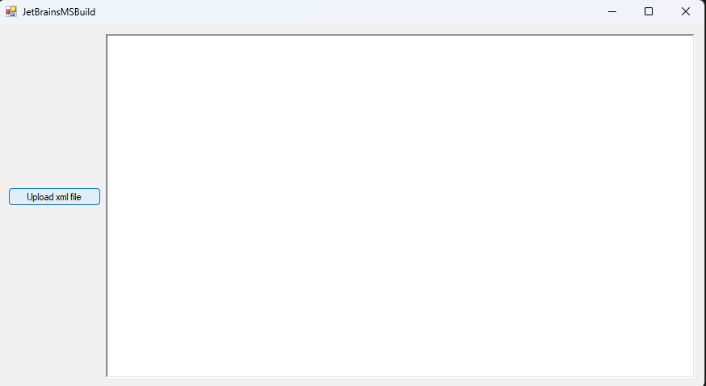
INTRODUCTION
Press the button “Upload xml file” to add file into the program.

Slide 4
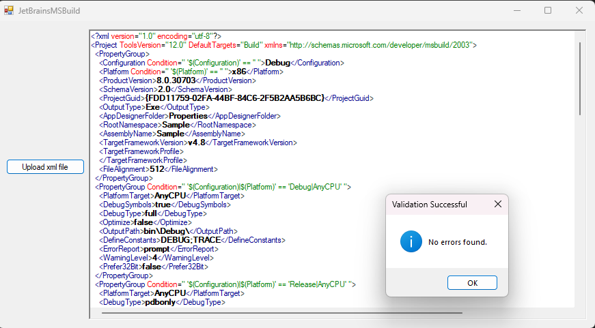
CORRECT FILE

Slide 5
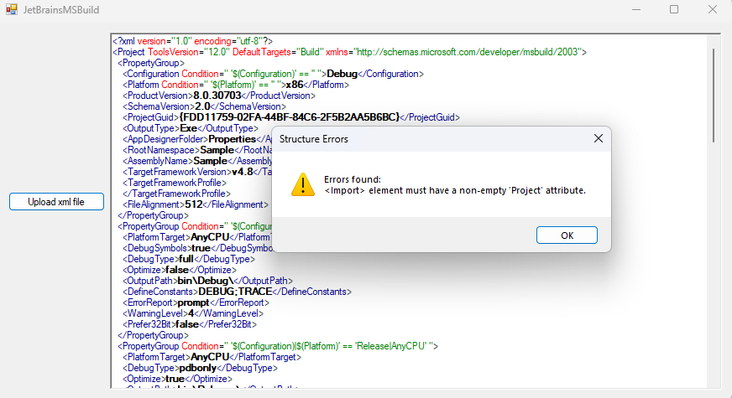
STRUCTURE ERROR

Slide 6
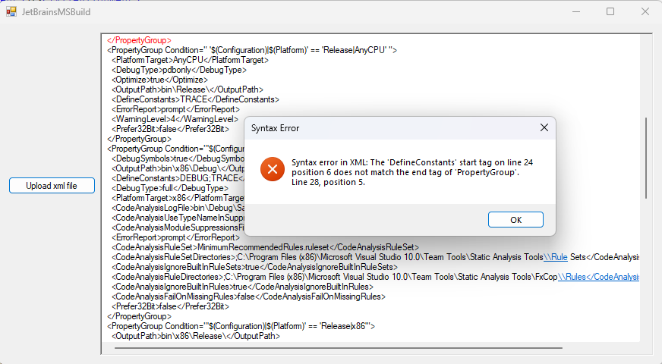
SYNTAX ERROR

Slide 7
thank you
Urošević vera
uv233296m@student.etf.bg.ac.rs
Urosevicv04@gmail..com

