Slide 1

AdmitSure
An admit transfer discharge application for HealthSure Hospitals
By Aditya Pavan Gollapudi

Slide 2

Introduction
Why is this important?
The internet has become bigger in the last ten years, which means more people use it and more information is sent through it. Because of this, companies and groups have created more web applications to make use of the internet's benefits.

Slide 3

Automating healthcare processes:
Improves efficiency,
Saves time
Prioritizes care.

Slide 4
Features
User Registration and Login: Patients can register and log in to the app to access its functionalities.
Admission Form Submission: Patients can submit their admission form through the app for approval.
Room Transfer Request: Once approved, patients can request a room transfer if needed. They can view all available rooms, including details like whether it's an AC or Non-AC room, and the corresponding prices.
Room Allocation: Based on room availability, the admin can allocate a room to the patient.
Discharge Ticket: The admin can generate a discharge ticket for the patient, providing them with details regarding their discharge.
Communication with Third-Party Administrators (TPA): The TPA will receive the patient's discharge and admission details for verification.

Slide 5

JAVA
React JS
GitLab
My SQL
Spring Boot
JavaScript
Postman
Mongo DB
CSS
Swagger
Junit
Backend
Material UI
Docker
Testing & DB
Frontend
Eureka
Integration
Technologies used

Slide 6
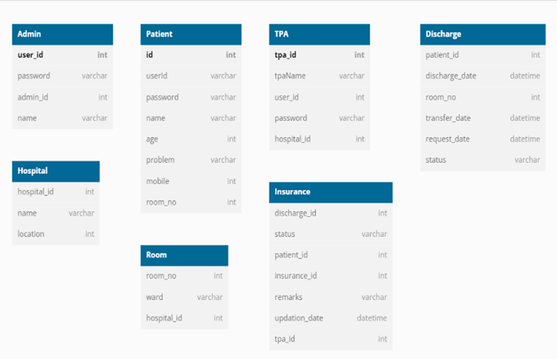
Database Diagram

Slide 7
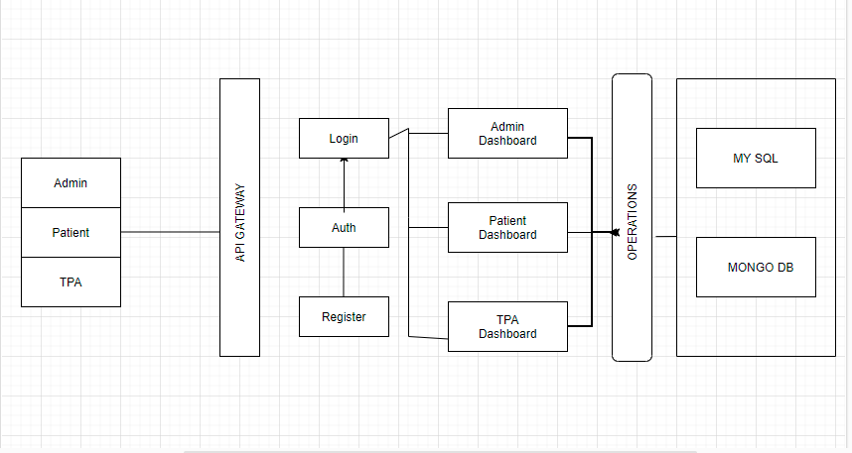
Flow Chart

Slide 8
Plan/Allocate Microservices ,
Create Microservices,
Implement Authentication,
Test Endpoints with Data ,
Create Unit Test Cases
Wireframing ,Allocate React Components ,
Create Components ,
Test Component Functionality and Connectivity
Industry Research ,
Fundamental Requirements ,
Create Base Documentation,
Allocate Roles
PLANNING
BACKEND
FRONTEND
Jenkins pipeline,
Dockerizing and bal unit
Testing, API Gateway integration – 5th May,
Integrate Rest API's with React components,
Improving UI with MUI, create presentation
FUTURE
INTEGRATION
Phases and Timeline Information

Slide 9
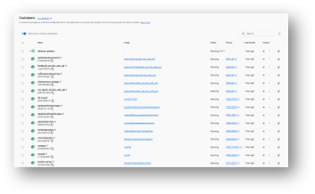
Transaction Completion Status
Throughout the Development Process I have Created: ​
7 Total Microservices
6 Database Tables
3 JWT Used for all User Types (Admin, Patient, TPA)
42 React Components
​
​
​

Slide 10
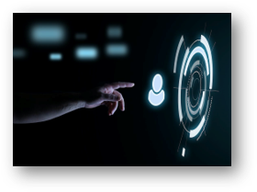
Future Considerations
Add download option for all forms
Add notifications for both app and to user mailbox
Add a virtual assistant to help and guide the users
Add easy Login with Google
Code Improvement
​
​
​

Slide 11

Challenges Faced
Managing multiple React components simultaneously​
Combining Endpoints with multiple request parameters​
While integrating with backend with frontend​

Slide 12

Overall Learnings
Developing in a microservices architecture.​
​
Utilizing Spring Boot to create RESTful APIs.​
​
Containerizing microservices with Docker.​
​
Conducting unit tests.​
​
Connecting the backend to the frontend.​
​
Developing a product using an agile approach.​

Slide 13
It's Demo Time

Slide 14
Thank you for your time and attention​

Slide 15
Any Questions?​

