Slide 1



E-commerce Insights Unlocking Online Shopping Behavior
Muhammad Gilang Mahardika
| mgilangmahardika11@gmail.com
| muhgilangmahardika
| UrsaG7

Slide 2

Table of
CONTENTS
01
02
03
BUSINESS UNDERSTANDING
EXPLORATORY DATA ANALYSIS & INSIGHT
DATA
PRE-PROCESSING
04
05
MODELLING & HYPERTUNING
BUSINESS
RECOMMENDATION

Slide 3
BUSINESS UNDERSTANDING| BACKGROUND
Problem
Out of 12,946 website visitors, only 15.51% generated revenue, with about 2,008 visitors making purchases.
Analyze historical data to gain insights into customer shopping behavior.
Things to do
Goals
Increase the percentage of website visitors who generate revenue for the company.
Develop a predictive model to classify potential customers based on their shopping behavior.
Objective
Business Metric
Conversion Rate: The percentage of visitors who complete a transaction.

Slide 4








EDA & INSIGHT | DESCRIPTIVE ANALYSIS
Summary of General Dataset Overview
Data Length
12.946
Features
18
The feature 'Month' contains only 10 out of the usual 12 months, and the month June is listed as ‘June’, which deviates from the typical three-letter abbreviation.
The Boolean feature 'SpecialDay' is formatted with decimal values instead of whole numbers 1 and 0.
Target
Revenue
About Twelve of the dataset’s features show a rightward skew, indicating data clusters around lower values with a few high-value outliers.
Duplicated Data
711
Four of the dataset’s features have a bimodal distribution, indicating two distinct groups with high data density.
Missing Value
1.981

Slide 5
EDA & INSIGHT | DESCRIPTIVE ANALYSIS
Only 15.51% of visitors are actually generating revenue.
Numerical features make up a significant portion of the total dataset.
84.49%
14
15.51%
2
2
True
False
Boolean
Categorical
Numerical
The dataset is heavily imbalanced, with a ratio of over 1:4
Most numerical features are decimals, with only a few as whole numbers.

Slide 6
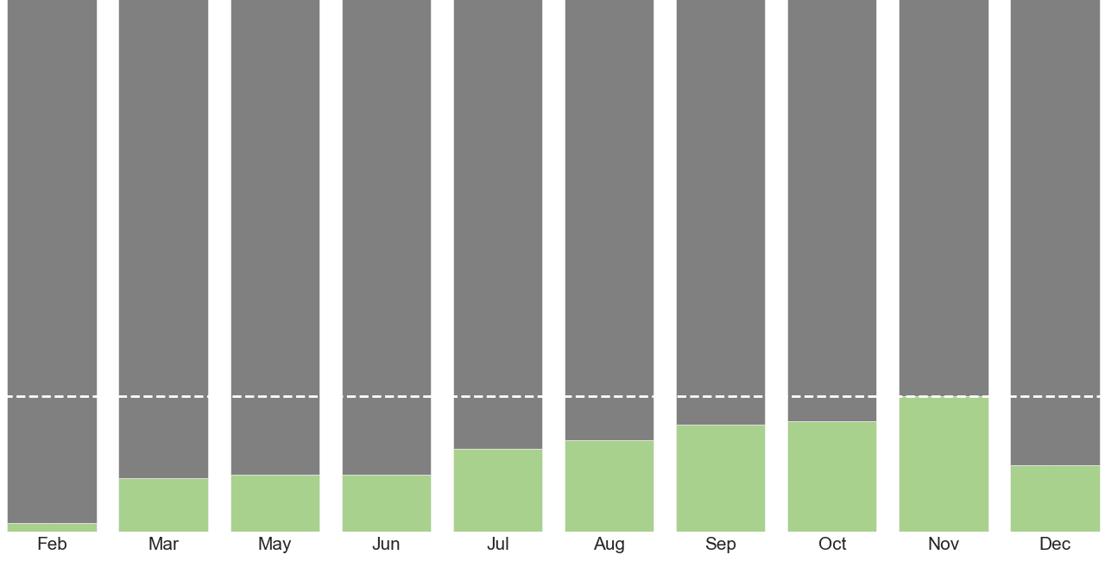
EDA & INSIGHT | UNIVARIATE ANALYSIS
Monthly Performance
November
25.48%
Feb
1.57%
25.48%
12.56%
Average
201
1.57%
Total Revenue increase
+ 11%
February generated the least revenue at just 1.57%, but it then saw a steady increase with an average of 201 customer over the following months, peaking at 25.48% in November. After November, revenue experienced a sharp decline through December, ending at 12.56%.

Slide 7
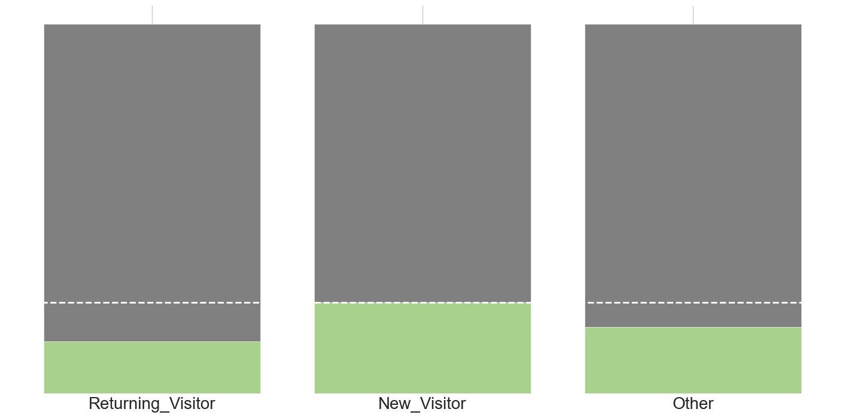
EDA & INSIGHT | UNIVARIATE ANALYSIS
>80%
The majority of the visitor base consists of returning visitors.
±15%
New visitors have the highest purchase rate relative to their size.
73.54%
11.99%
24.65%
3.40%
0.12%
17.98%
14.02%
Returning
New
Other
Returning visitors have a lower purchase rate compared other visitor type, even though they make up over 80% of the total visitor base.
The site shows strong customer retention but struggles with poor conversion rates among returning visitors, leaving significant untapped potential within this group.
The high purchase rate among new visitors indicates successful visitor acquisition strategies and a compelling value proposition.

Slide 8


EDA & INSIGHT | UNIVARIATE ANALYSIS
48.51%
ProductRelated
8.91%
Product-related is the most visited type of page by both buyers and non-buyers, indicating their greater influence on visitors' shopping intentions.
Administrative
6.45%
Informational
2.87%
Buyer
Average Converted
Non-Buyer
Average Potential
The number of buyer is significantly lower regardless the type of page they visited before completing a transaction.
1.365 buyer
Most non-buyers visit product-related pages before deciding not to proceed with their transaction.
6.123
Non-buyer

Slide 9
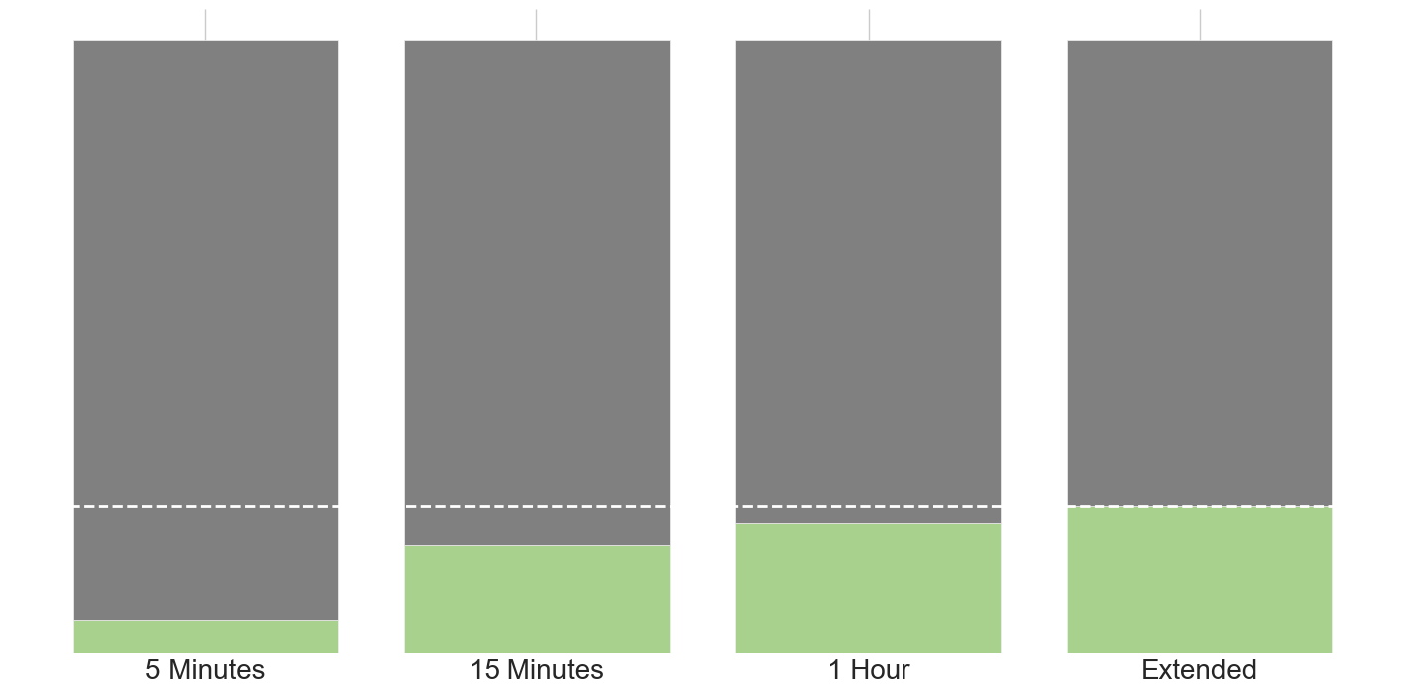
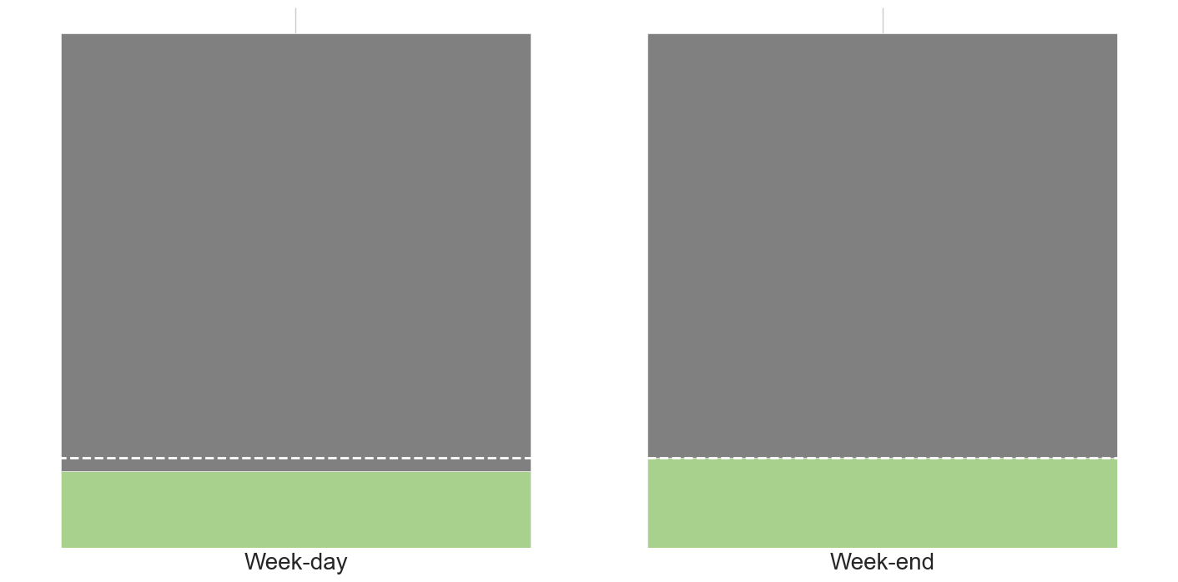
EDA & INSIGHT | UNIVARIATE ANALYSIS
Product Related Session Time Conversion Rate
Day of Week
Conversion Rate
17.65%
21.27%
23.98%
14.91%
17.50%
5.34%
5 Minutes
15 Minutes
1 Hour
Extended
Weekday
Weekend
The longer a visitor spends browsing a product-related page, the more likely they are to make a purchase. This trend is especially noticeable for those who browse for over 5 minutes. At the 15-minute mark, their likelihood of purchasing triples and quadruples at the 1-hour mark, with the probability continuing to increase for those who browse for extended periods.
Purchases are more likely to occur on weekends, leading to a 2.59% increase in the conversion rate despite the relatively lower traffic compared to weekdays, indicating improved conversion efficiency during weekends.

Slide 10



EDA & INSIGHT | UNIVARIATE ANALYSIS
76.34%
The lowest traffic occurs at a moderate distance from a special day, indicating shopping behavior that is highly event-driven.
14.98%
0.42%
0.11%
Close
Far
Moderate
Most visitor traffic occurs close to special days, accounting for over 90% of the total traffic. Traffic significantly diminishes as the date moves further away from any special day.

Slide 11

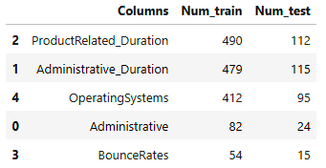

DATA PRE-PROCESSING| DATA ENGINEERING
Handling Missing Value
Splitting Dataset
There are a total of 5 features with missing values:
The column ‘Revenue’ is used as the target variable (y), while the remaining columns serve as predictors (X). The test size is set to 20%.
Feature Encoding
Feature encoding was applied to the categorical features using one-hot encoding, which increased the number of features from 17 to 26.
The Page-type features were replaced with (0), BounceRates were filled with the mean, and OperatingSystems were replaced with their most frequent value.
Handling Outliers
The Interquartile Range (IQR) method was used to assess whether the percentage of outliers in a feature exceeded the acceptable threshold of 5%. Fourteen features were identified as having outliers beyond this limit. Log transformation was then applied to reduce these outliers. For features with remaining outliers, winsorization was applied at the 10th and 90th percentiles, effectively eliminating all remaining outliers.
Handling Duplicates
Duplicate rows are dropped upon discovery since they contains the same values with other rows and might cause bias.
Initial data length : 12.976
Current data length : 12.265

Slide 12



DATA PRE-PROCESSING| DATA ENGINEERING
Feature Selection
Feature Extraction
Criteria used:
p-value < 0.05
correlation coefficient <= 0.7
Bounces-to-exit ratio is created to find the relative frequency of bouncing compared to exiting.
The ANOVA F-statistic is used to determine the p-value for each feature. Features with a p-value below 0.05 are considered to have a significant impact on the target variable, leading to the exclusion of 6 features.
To further reduce multicollinearity, features with a correlation value above 0.7 are also excluded, resulting in the removal of 2 additional columns.
Bounces-to-exit _ratio = BounceRates / ExitRates
SMOTE
To address the imbalanced dataset, the SMOTE oversampling technique was applied. This process generated synthetic data points for the underrepresented class, resulting in a balanced dataset with equal proportions of both classes.
Drop Unnecessary Feature
The visitor’s operating system is considered irrelevant to the target feature.

Slide 13
MODELLING| BASE MODEL
Model: Five Classification Algorithms
Data: Test data
Model | AUC | Recall
Logistic Regression | 0.91 | 0.60
K-Nearest Neighbor | 0.88 | 0.58
Decision Tree | 0.64 | 0.36
Random Forest | 0.92 | 0.52
XGBoost | 0.90 | 0.56
Recall will primarily be used to evaluate the model, as it measures the model's ability to correctly identify all positive instances (1) or visitors who actually generate revenue for the company.
AUC (Area Under the Curve) will also be used to measure how well the model can differentiate between visitors who generate revenue (1) and those who don’t (0).

Slide 14
MODELLING| BASE MODEL
Model | AUC (Vanilla) | AUC (SMOTE) | Recall (Vanilla) | Recall (SMOTE)
Logistic Regression | 0.91 | 0.92 | 0.60 | 0.79
K-Nearest Neighbor | 0.88 | 0.87 | 0.58 | 0.80
Decision Tree | 0.64 | 0.76 | 0.36 | 0.64
Random Forest | 0.92 | 0.92 | 0.52 | 0.72
XGBoost | 0.91 | 0.91 | 0.43 | 0.73
Imbalanced vs Imbalance Data
The model's performance has improved in both recall score and AUC, suggesting that it is better at identifying the positive class and differentiating between classes with a balanced distribution.
Based on the models performance evaluations, Logistic Regression, K-Nearest Neighbor, and Random Forest are chosen to be hyper-tuned later.

Slide 15
MODELLING| HYPERTUNING
Model | Parameter Runtime (s) | Model Runtime (s) | Recall (Train) | Recall (Test)
Logistic Regression | 19.80 | 0.03 | 0.79 | 0.81
K-Nearest Neighbor | 24.76 | 0.91 | 0.99 | 0.73
Random Forest | 51.43 | 1.16 | 0.98 | 0.71
Model Hyper-tuning
GridSearchCV and RandomizedSearch is used to find the optimal combination of parameters for the models by evaluating them across a provided grid of parameters.
Logistic regression was selected as the best model after hyperparameter tuning due to its superior recall score, minimal gap in performance, and faster combined runtime for parameter searching and model fitting compared to other models.

Slide 16
MODELLING| HYPERTUNING
Feature Importance
PageValues
1.01
Month_Nov
Month_may
VisitorType_Returning_Visitor
ProductRelated
0.18
5 column are found with the highest importance value, which suggest that these columns are likely to be the highest determining factor in predicting visitor as potential buyer as the target features. The usage of the these top 5 features as the predictor would possibly suggest better result when it comes to predicting the target feature.

Slide 17
CONCLUSION| BUSINESS RECOMMENDATION
Features related to site pages and their types (PageValues, ProductRelated) are among the most important according to feature importance. This suggests that shopping behavior is significantly influenced by these features.
What the company need to do is:
Provide Social Proof, Using the gathered customer purchase history, the company could create a dedicated section that displays products frequently bought by other customers after purchasing the current product.
Highlight Best-seller, Product order history can be tracked within specific timeframes (e.g., monthly or yearly) to identify best-sellers. The company could then use this information to recommend products based on their type or create a dedicated section highlighting current best-selling products.
Features related to months (e.g., May, November) are among the most important according to feature importance. This suggests that specific months are associated with higher purchase volumes and can help the company anticipate periods of increased customer activity.
What the company need to do is:
Seasonal Campaigns, The company could create special promotions or sales events for May and November, leveraging themes specific to those months. Additionally, the campaign could be teased through social media such as Instagram in the days leading up to the event to build anticipation.
Feature related to visitor type, (Returning Visitor) is among the most important according to feature importance. This indicates that the site's visitor base consists largely of long-time customers, reflecting strong brand loyalty, but also reflect the need to attract more new visitor.
What the company need to do is:
Loyalty Program, Develop a robust loyalty program with positive feedback elements such as points, tiers, and exclusive benefits for those who have been a long time customer to the site.
First-time Incentive, Create offers such as discounts or free shipping for first-time purchasers, while also integrating long-term benefits like a loyalty program into the purchasing flow.

