Slide 1
Chapter 17
Goertzel Algorithm

Slide 2
Learning Objectives
Introduction to DTMF signaling and tone generation.
DTMF tone detection techniques and the Goertzel algorithm.
Implementation of the Goertzel algorithm for tone detection in both fixed and floating point.
Hand optimisation of assembly code.

Slide 3
Introduction
The Goertzel algorithm is mainly used to detect tones for Dual Tone Multi-Frequency (DTMF) applications.
DTMF is predominately used for push-button digital telephone sets which are an alternative to rotary telephone sets.
DTMF has now been extended to electronic mail and telephone banking systems in which users select options from a menu by sending DTMF signals from a telephone.

Slide 4
DTMF Signaling
In a DTMF signaling system a combination of two frequency tones represents a specific digit, character (A, B, C or D) or symbol (* or #).
Two types of signal processing are involved:
  Coding or generation.
  Decoding or detection.
For coding, two sinusoidal sequences of finite length are added in order to represent a digit, character or symbol as shown in the following example.

Slide 5
DTMF Tone Generation
1209Hz
1336Hz
1477Hz
1633Hz
1
1
2
2
3
3
A
697Hz
A
4
4
5
5
6
6
B
770Hz
B
7
7
8
8
9
9
C
852Hz
C
*
*
0
0
#
#
D
941Hz
D
Output
770
770
770
770
1336
1336
1336
1336
Freq (Hz)
Example: Button 5 results in a 770Hz and a 1336Hz tone being generated simultaneously.

Slide 6
DTMF Tone Generation
1209Hz
1336Hz
1477Hz
1633Hz
1
1
2
2
3
3
A
697Hz
A
4
4
5
5
6
6
B
770Hz
B
7
7
8
8
9
9
C
852Hz
C
*
*
0
0
#
#
D
941Hz
D
Click on keypad to generate the sound.

Slide 7
DTMF Tone Detection
Detection of tones can be achieved by using a bank of filters or using the Discrete Fourier Transform (DFT or FFT).
However, the Goertzel algorithm is more efficient for this application.
The Goertzel algorithm is derived from the DFT and exploits the periodicity of the phase factor, exp(-j*2πk/N) to reduce the computational complexity associated with the DFT, as the FFT does.
With the Goertzel algorithm only 16 samples of the DFT are required for the 16 tones (\Links\Goertzel Theory.pdf).

Slide 8
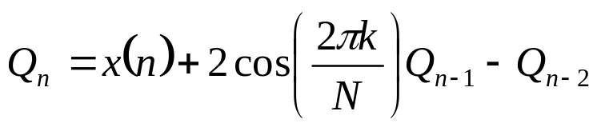
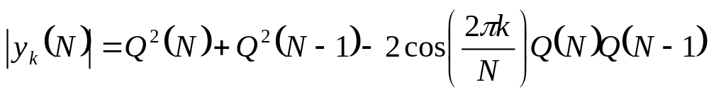
Goertzel Algorithm Implementation
To implement the Goertzel algorithm the following equations are required:
These equations lead to the following structure:

Slide 9
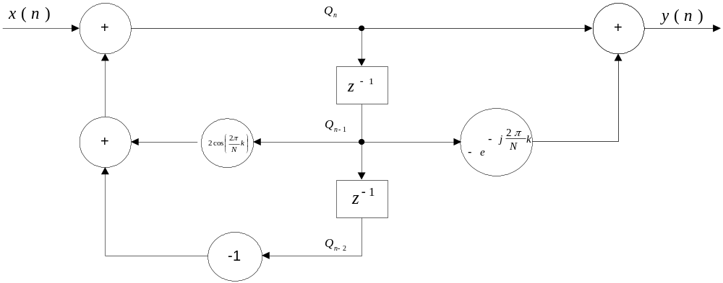
Goertzel Algorithm Implementation

Slide 10
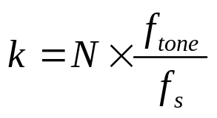
Goertzel Algorithm Implementation
Finally we need to calculate the constant, k.
The value of this constant determines the tone we are trying to detect and is given by:
Where: f_{tone} = frequency of the tone.
f_{s} = sampling frequency.
N is set to 205.
Now we can calculate the value of the coefficient 2cos(2*π*k/N).

Slide 11
Goertzel Algorithm Implementation
Frequency
k
Coefficient
(decimal)
Coefficient
(Q15)
697
18
1.703275
0x6D02*
770
20
1.635585
0x68B1*
N = 205
fs = 8kHz
852
22
1.562297
0x63FC*
941
24
1.482867
0x5EE7*
1209
31
1.163138
0x4A70*
1336
34
1.008835
0x4090*
1477
38
0.790074
0x6521
1633
42
0.559454
0x479C
* The decimal values are divided by 2 to be represented in Q15 format. This has to be taken into account during implementation.

Slide 12
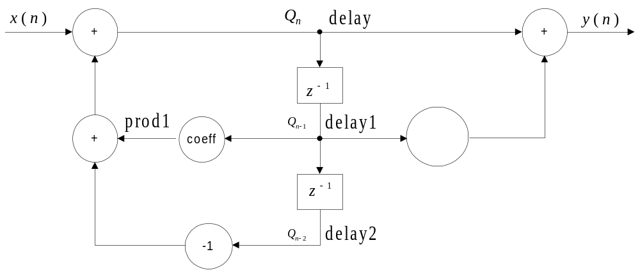
Goertzel Algorithm Implementation
Feedback Feedforward
Q_{n} = x(n) - Q_{n-2} + coeff*Q_{n-1}; 0≤n<N
= sum1 + prod1
Where: coeff = 2cos(2πk/N)
The feedback section has to be repeated N times (N=205).

Slide 13
Goertzel Algorithm Implementation
Feedback Feedforward
Since we are only interested in detecting the presence of a tone and not the phase we can detect the square of the magnitude:
|Y_{k}(N) |² = Q²(N) + Q²(N-1) - coeff*Q(N)*Q(N-1)
Where: coeff = 2*cos(2*π*k/N)

Slide 14
Goertzel Algorithm Implementation
void Goertzel (void)
{
static short delay;
static short delay_1 = 0;
static short delay_2 = 0;
static int N = 0;
static int Goertzel_Value = 0;
int I, prod1, prod2, prod3, sum, R_in, output;
short input;
short coef_1 = 0x4A70; // For detecting 1209 Hz
R_in = mcbsp0_read(); // Read the signal in
input = (short) R_in;
input = input >> 4; // Scale down input to prevent overflow
prod1 = (delay_1*coef_1)>>14;
delay = input + (short)prod1 - delay_2;
delay_2 = delay_1;
delay_1 = delay;
N++;
if (N==206)
{
prod1 = (delay_1 * delay_1);
prod2 = (delay_2 * delay_2);
prod3 = (delay_1 * coef_1)>>14;
prod3 = prod3 * delay_2;
Goertzel_Value = (prod1 + prod2 - prod3) >> 15;
Goertzel_Value <<= 4; // Scale up value for sensitivity
N = 0;
delay_1 = delay_2 = 0;
}
output = (((short) R_in) * ((short)Goertzel_Value)) >> 15;
mcbsp0_write(output& 0xfffffffe); // Send the signal out
return;
}
‘C’ code

Slide 15
Goertzel Algorithm Implementation
.def _gz
.sect "mycode"
_gz .cproc input, coeff, count, mask2
.reg delay1, delay2, x, gzv
.reg prod1, prod2, prod3, sum1, sum2
zero delay1
zero delay2
loop: ldh *input++, x
mpy delay1, coeff, prod1
shr prod1, 14, prod1
sub x, delay2, sum1
mv delay1, delay2
add sum1, prod1, delay1
[count] sub count,1,count
[count] b loop
mpy delay1, delay1, prod1
mpy delay2, delay2, prod2
add prod1, prod2, sum1
mpy delay1, coeff, prod3
shr prod3, 14, prod3
mpy prod3, delay2, prod3
sub sum1,prod3, sum1
shr sum1, 15, gzv
.return gzv
.endproc
Linear assembly (fixed-point)

Slide 16
Goertzel Algorithm Implementation
.def _gz
.sect "mycode"
_gz .cproc input1, coeff, count, mask2
.reg delay1, delay2, x, gzv,test,y
.reg prod1, prod2, prod3, sum1, sum2
zero delay1
zero delay2
loop: ldw *input1++, x
mpysp delay1, coeff, prod1
subsp x, delay2, sum1
mv delay1, delay2
addsp sum1, prod1, delay1
[count] sub count,1,count
[count] b loop
mpysp delay1, delay1, prod1
mpysp delay2, delay2, prod2
addsp prod1, prod2, sum1
mpysp delay1, coeff, prod3
mpysp prod3, delay2, prod3
subsp sum1,prod3, sum1
.return sum1
.endproc
Linear assembly (floating-point)

Slide 17
Hand Optimisation
Implementation of:
Q_{n} = [(coeff*Q_{n-1})>> 14 + x(n)] - Q_{n-2}
Cycle
1
2
3
4
5
6
7
8
9
10
11
LDH
ADD
SUB
MPY
SHR
MV
Q_{n-2}=Q_{n-1}
MV
Q_{n-1}=Q_{n}

Slide 18
Hand Optimisation
Implementation of:
Q_{n} = [(coeff*Q_{n-1})>> 14] + [x(n) - Q_{n-2}]
Cycle
1
2
3
4
5
6
7
8
9
10
11
LDH
SUB
ADD
Q_{n-1}=Q_{n}
MPY
SHR
MV
Q_{n-2}=Q_{n-1}

Slide 19
Hand Optimisation
1
2
3
4
5
6
7
8
9
10
11
LDH
SUB
ADD
MPY
SHR
MV
Now let us consider adding a second iteration.
When can we start the “MPY” of the second iteration?
Q_{n} = [(coeff*Q_{n-1})>> 14] + [x(n) - Q_{n-2}]

Slide 20
Hand Optimisation
1
2
3
4
5
6
7
8
9
10
11
LDH
SUB
ADD
MPY
MPY
SHR
MV
We have to wait until the add has finished as the result of iteration 1 is one of the inputs to the multiply performed in iteration 2.
Q_{n} = [(coeff*Q_{n-1})>> 14] + [x(n) - Q_{n-2}]

Slide 21
Hand Optimisation
1
2
3
4
5
6
7
8
9
10
11
LDH
LDH
SUB
SUB
ADD
ADD
MPY
MPY
SHR
SHR
MV
MV
The other instructions then follow in the same order.
Finally the load of x[1] must have occurred before the sub, therefore the load must take place in cycle 5.

Slide 22
Goertzel Algorithm Implementation
Hand optimised assembly (fixed-point):
; PIPED LOOP PROLOG
LDH .D1T1 *A0++(4),A3
|| [ A1] SUB .L1 A1,0x1,A1
[ A1] B .S1 loop
NOP 1
; PIPED LOOP KERNEL
loop: MPY .M2 B4,B5,B6
[ A1] SUB .L1 A1,0x1,A1
|| LDH .D1T1 *A0++(4),A3
MV .L1X B4,A4
|| SUB .D1 A3,A4,A3
|| SHR .S2 B6,0xe,B4
|| [ A1] B .S1 loop
ADD .L2X A3,B4,B4

Slide 23
Testing the Implementation
Signal Gen
DSK
PC
Osc/Spec Analyser
The input signal is modulated with the square magnitude and sent to the codec.
Therefore when the frequency of the input signal corresponds to the detection frequency, the input tone appears at the output.

Slide 24
Goertzel Code
Code location:
  Code\Chapter 17 - Goertzel Algorithm
Projects:
  Fixed Point in C: \Goertzel_C_Fixed\
  Fixed Point in C with EDMA: \Goertzel_C_Fixed_EDMA\
  Fixed Point in Linear Asm: \Goertzel_Sa_Fixed\
  Floating Point in Linear Asm: \Goertzel_Sa_Float\

Slide 25
Chapter 17
Goertzel Algorithm
- End -

