Slide 1
Solving Crafter
Advanced Artificial Intelligence Techniques
Adrian Dinu Urse

Slide 2
Experiments
Value-based Methods
Deep Q learning Agent
Double Deep Q learning Agent
Categorical Deep Q learning Agent
Rainbow Deep Q learning Agent
Simplified Rainbow Deep Q learning Agent
Policy-based Methods
Reinforce Agent
A2C-GAE Agent

Slide 3
General training parameters
train_steps = 1M
warmup_steps = 50.000
Replay Memory size= 200.000
target_update_interval = 10.000
batch_size = 64
eval_interval = 10.000
lr = 1e-5
gamma = 0.95
epsilon_schedule_decay_steps = 800.000

Slide 4
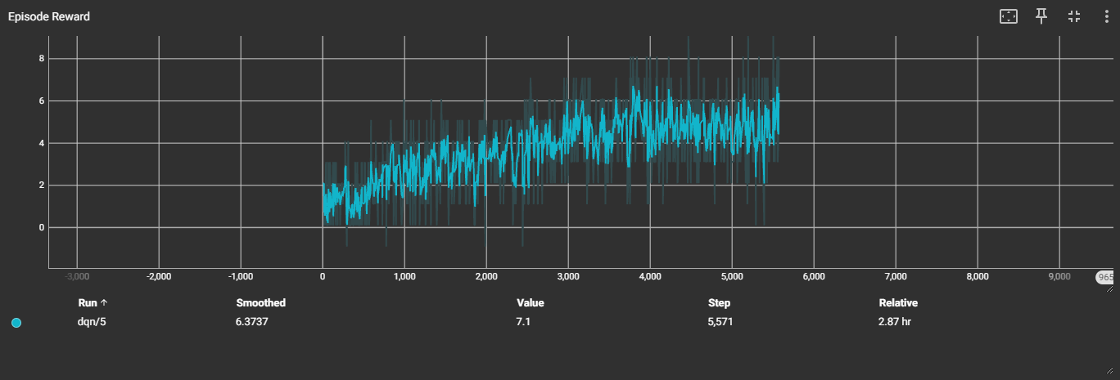
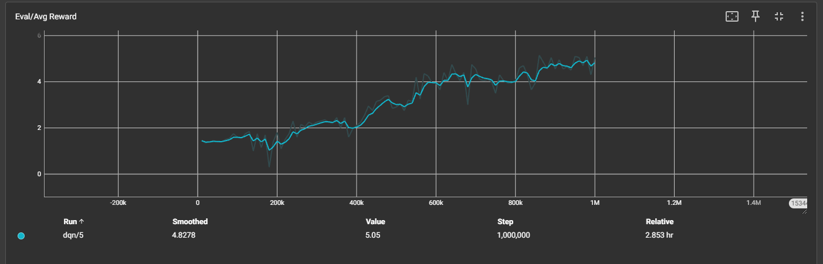
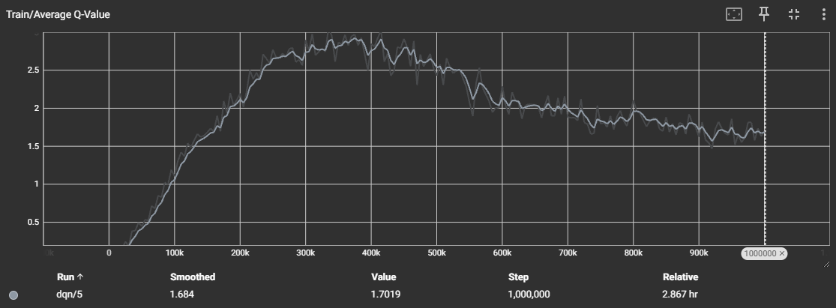
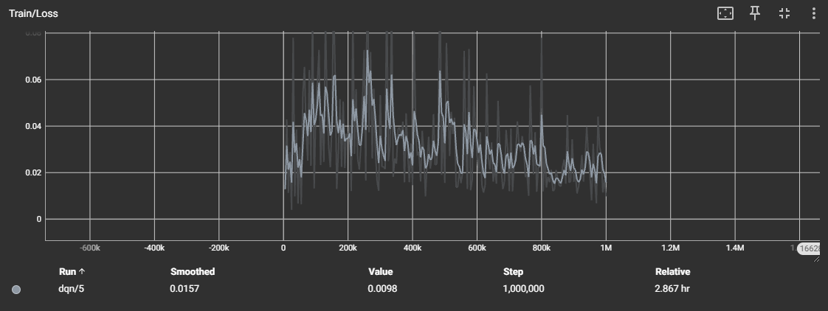
Deep Q learning Agent - Avg reward: 5.62 Min Reward: 1.10 Max Reward: 10.10 Std Dev: 1.862

Slide 5
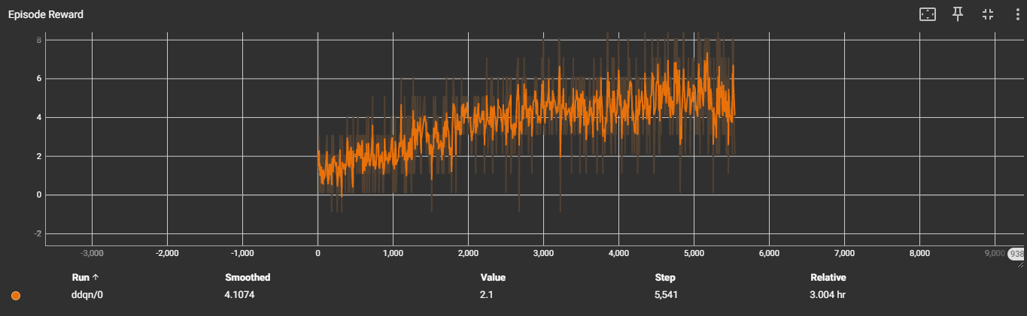
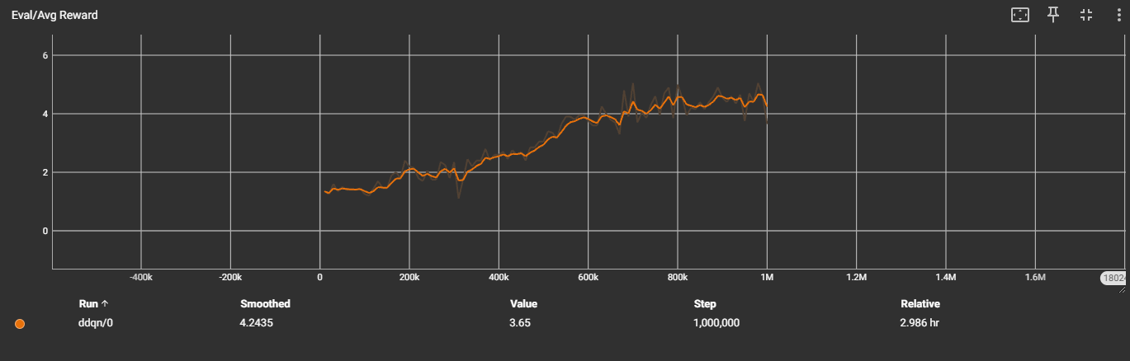
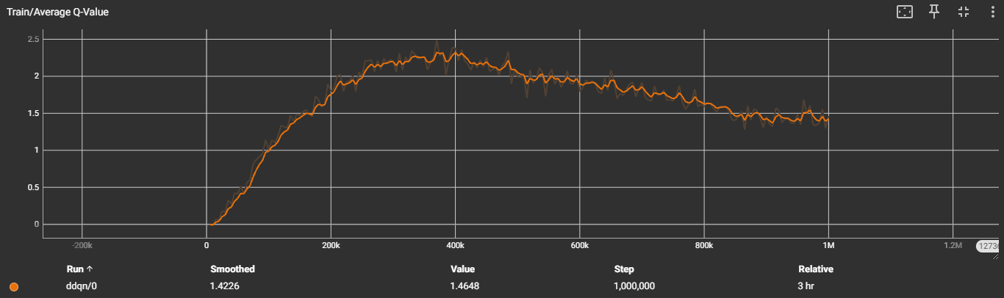
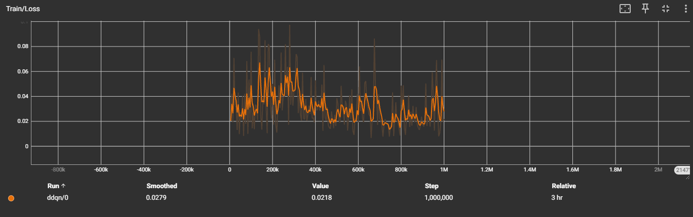
Double Deep Q learning Agent - Avg Reward: 4.73 Min Reward: 1.10, Max Reward: 10.10, Std Dev: 1.847

Slide 6
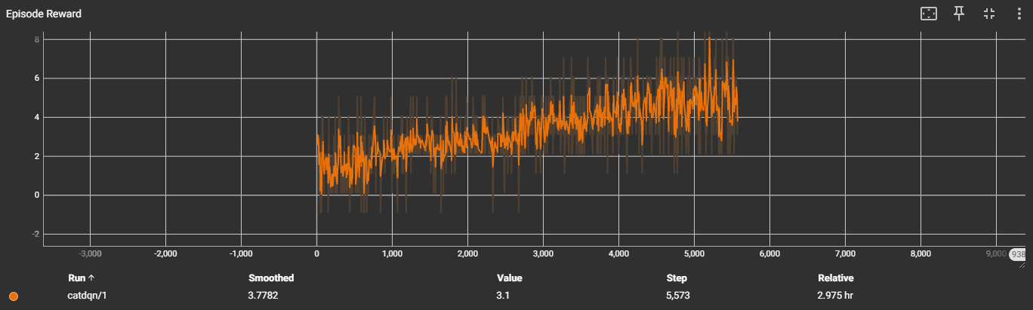
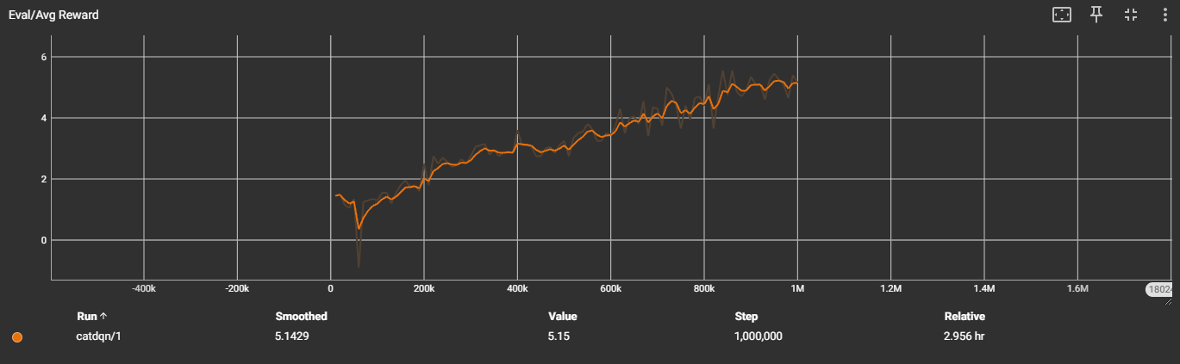
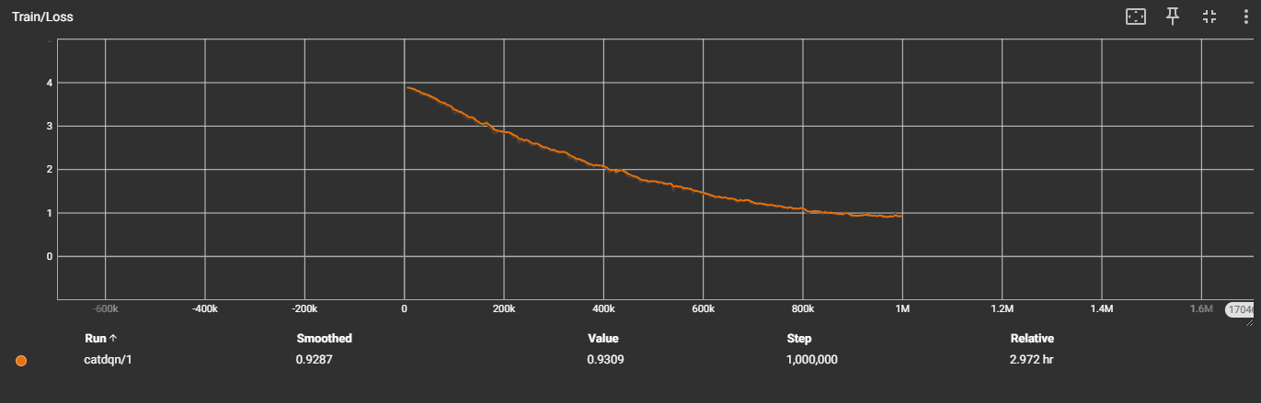
Cat Deep Q learning Agent - Avg Reward: 4.79 Min Reward: 1.1, Max Reward: 9.10, Std Dev: 1.641
V_MIN = -1
V_MAX = 23
NUM_ATOMS = 51

Slide 7
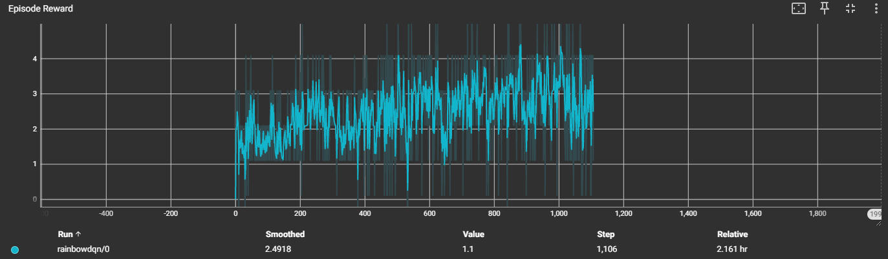
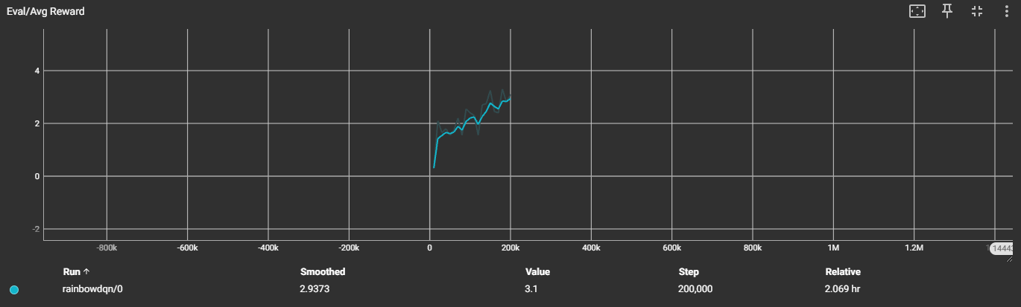
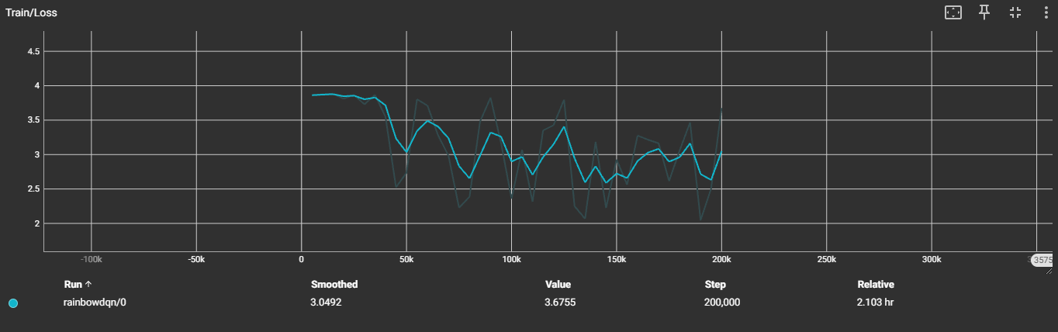
Rainbow Deep Q learning Agent - Avg Reward: 2.55 Min Reward: 0.1, Max Reward: 5.1, Std Dev: 1.251
lr = 1e-4
gamma = 0.99
n_steps = 3
V_MIN = -1
V_MAX = 23
NUM_ATOMS = 51
alpha=0.6
beta_start=0.4
beta_end=1.0
beta_anneal_steps=1.000.000

Slide 8
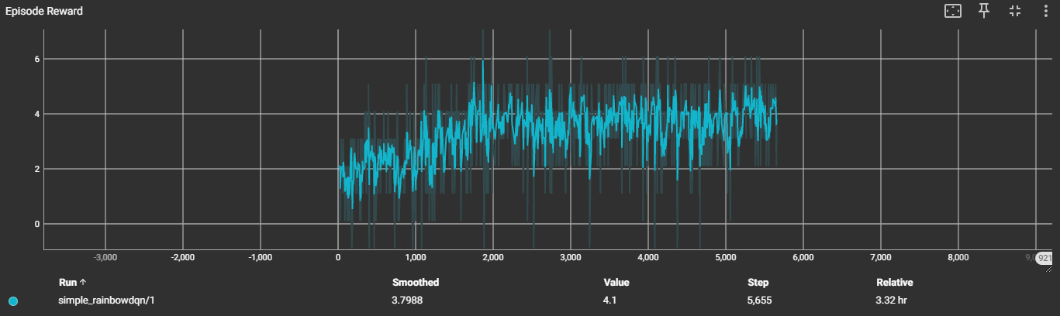
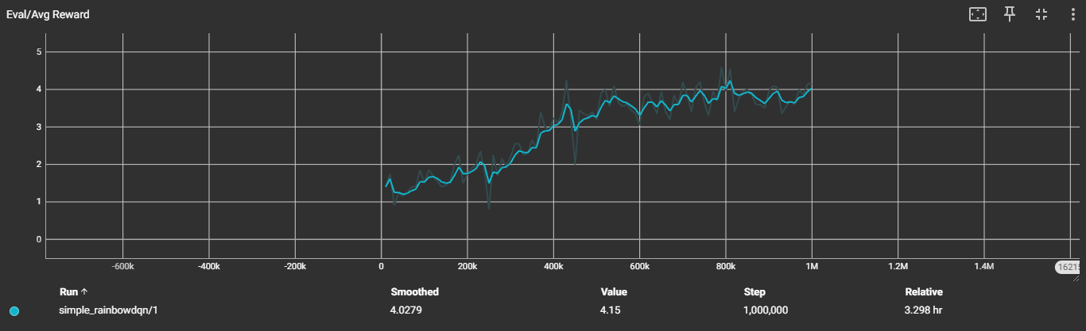
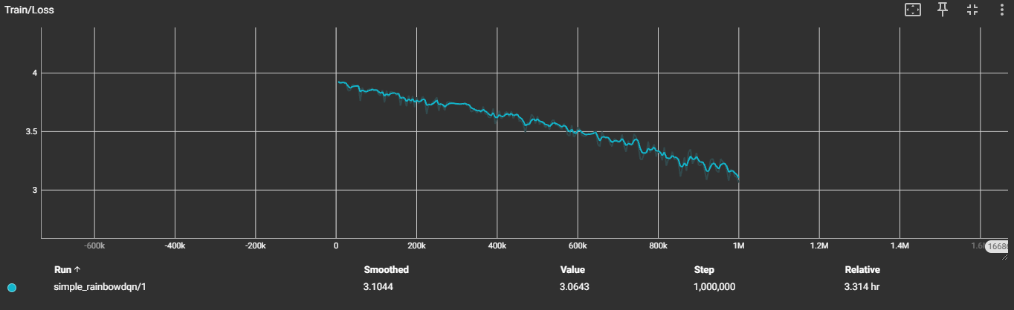
Simplified Rainbow DQ Agent Avg Reward: 4.19 Min Reward: 0.1, Max Reward: 6.1, Std Dev: 1.13
lr = 5e-5
gamma = 0.99
epsilon_schedule = 700.000
V_MIN = -1
V_MAX = 23
NUM_ATOMS = 51

Slide 9
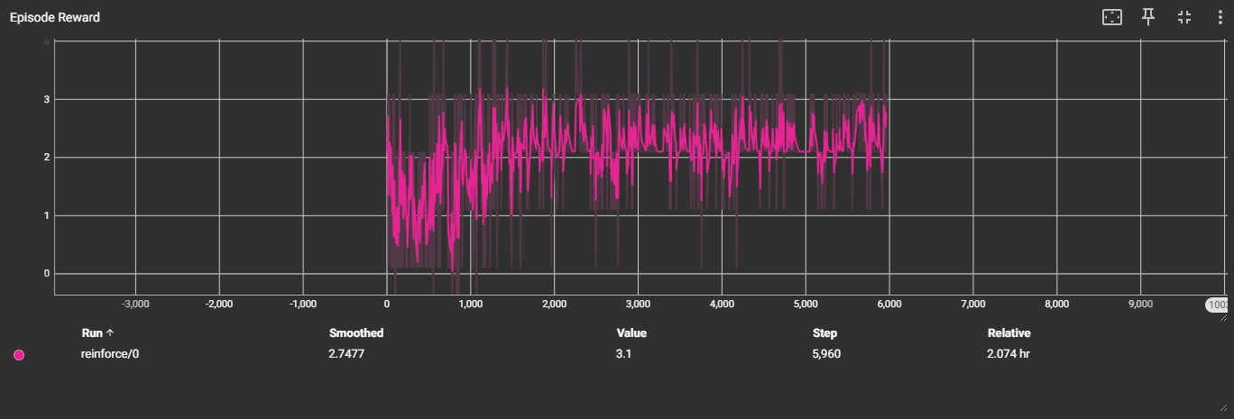
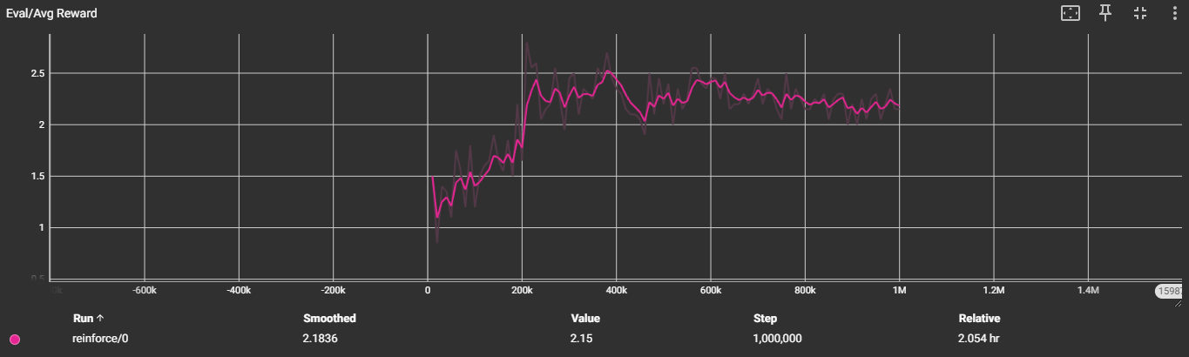
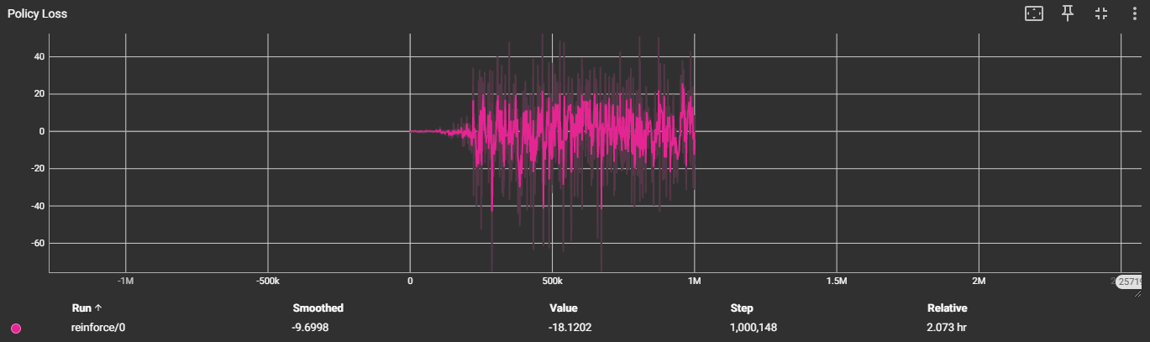
Reinforce Agent
train_steps = 1M
Replay Memory = 200.000
batch_size = 64
lr = 1e-5
gamma = 0.99

Slide 10
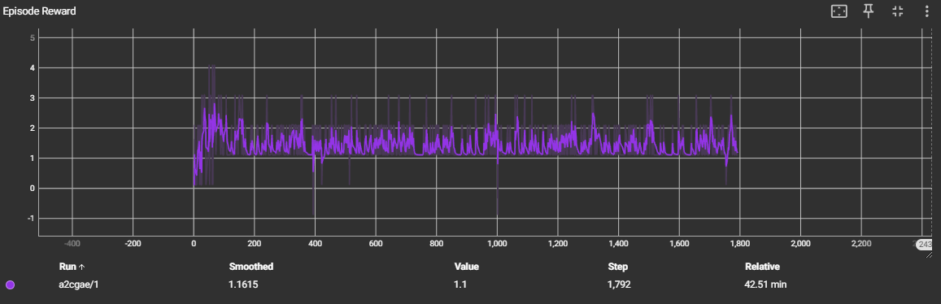
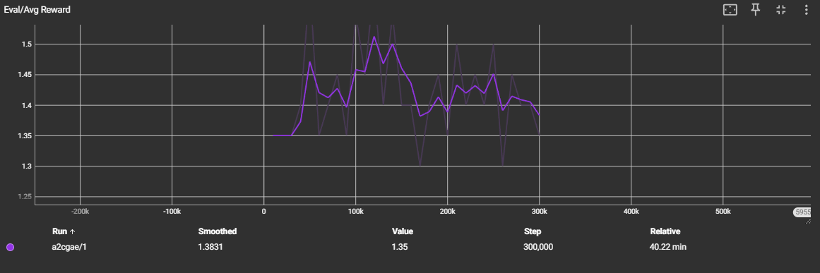
Actor-Critic A2C – Generalized Advantage Estimation
train_steps = 300k
Replay Memory = 200.000
batch_size = 64
lr = 1e-5
gamma = 1e-5
beta = 0.01
tau = 0.95

Slide 11
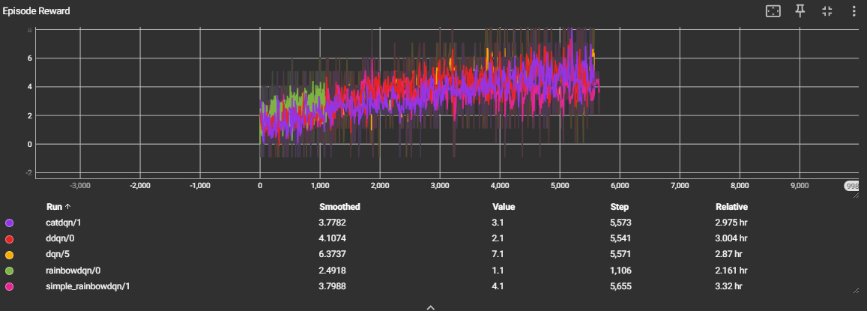
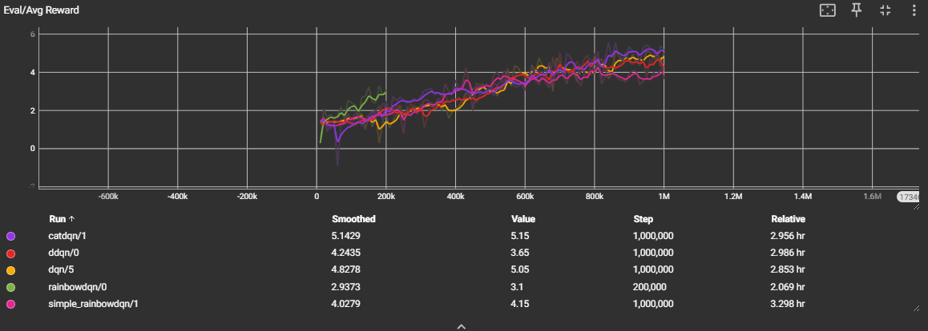
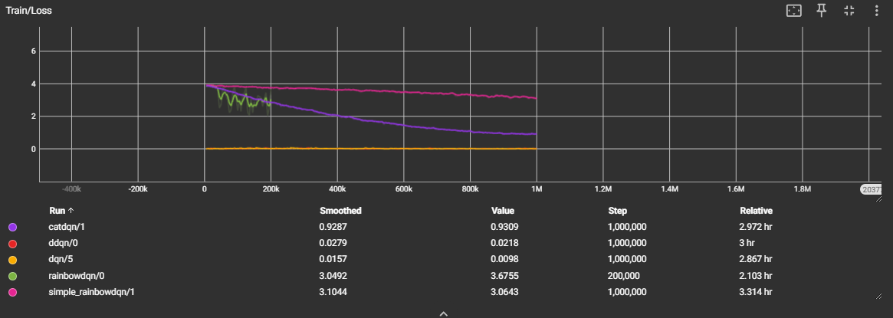
Value Based Methods Comparison

Slide 12
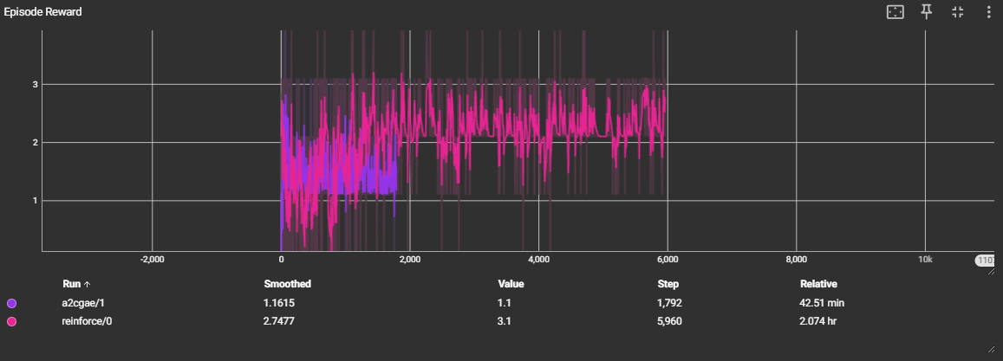
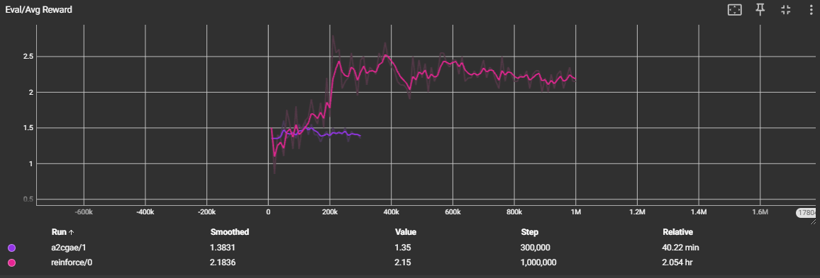
Policy-Based Methods Comparison

Slide 13
Thank you!

