Slide 1
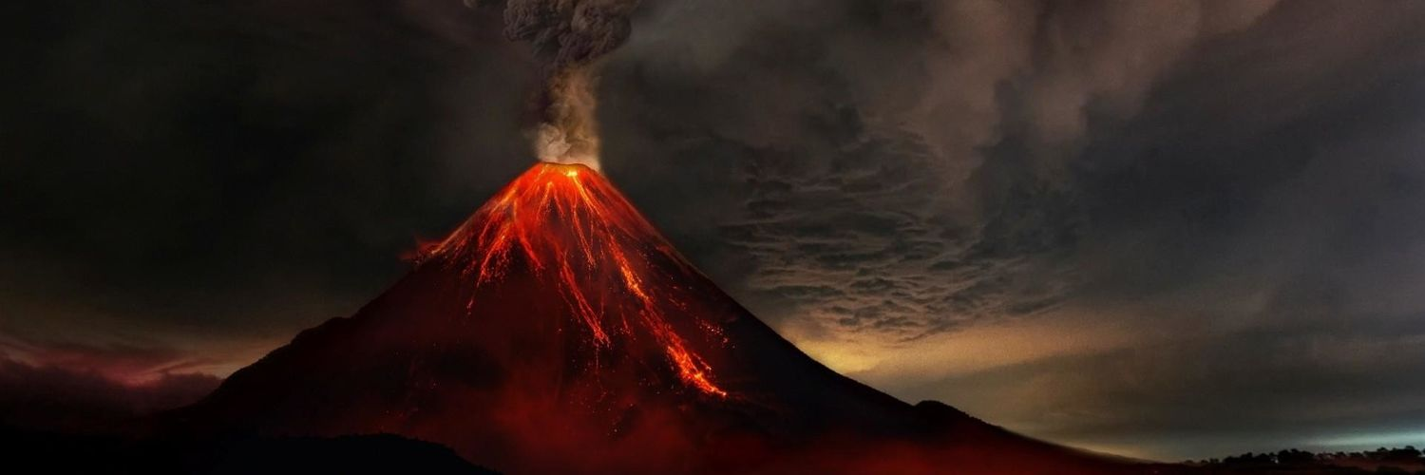
Volcanoes
By: Elon Musk,
student of the International CyberSchool of programming KIBERone

Slide 2
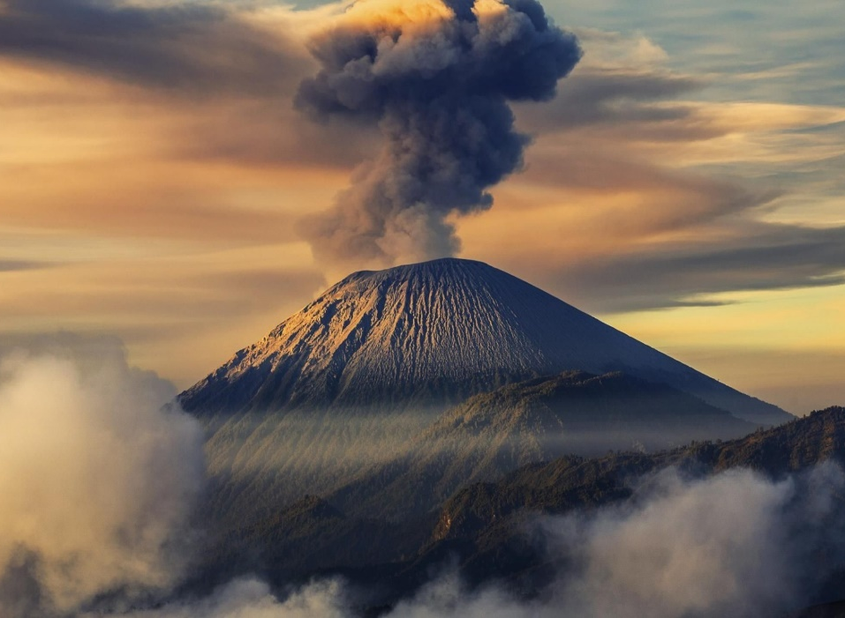
What is a volcano?
Volcano is an opening in the crust of the Earth in which molten rock called magma and gases can escape to the surface or the mountain that is formed from volcanic eruptions.

Slide 3
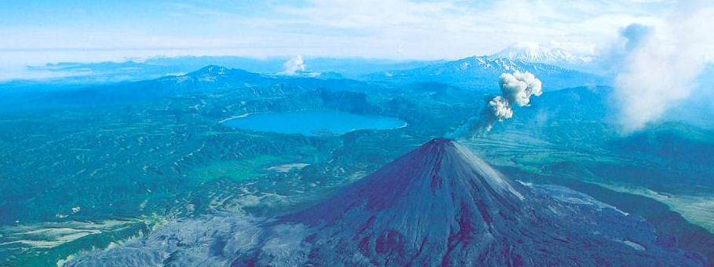
The word volcano is derived from the name of the ancient Roman island of Vulcano which lies off the southwest coast of Italy. The Romans believed that Vulcan, the god of fire and the maker of weapons, used the volcano on that island to forge his weapons.
The most common perception of a volcano is of a conical mountain, spewing lava and poisonous gases from a crater at its summit; however, this describes just one of the many types of volcano

Slide 4
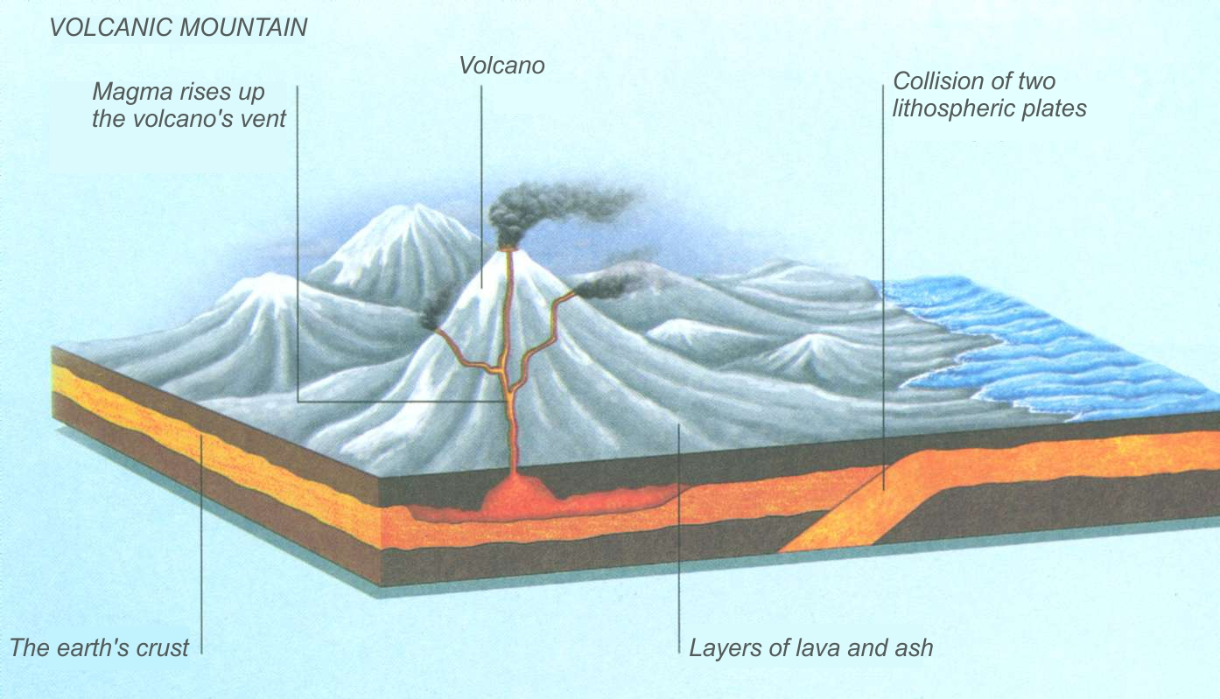
How do volcanoes form?
There is a special layer under the earth's crust consisting of molten rocks, it is called magma.
If cracks begin to appear in the earth's crust, then hills form on the earth's surface.
Through them, magma comes out under strong pressure.

Slide 5
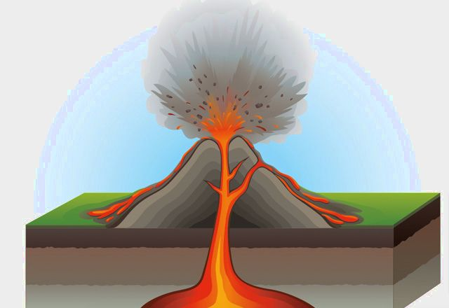
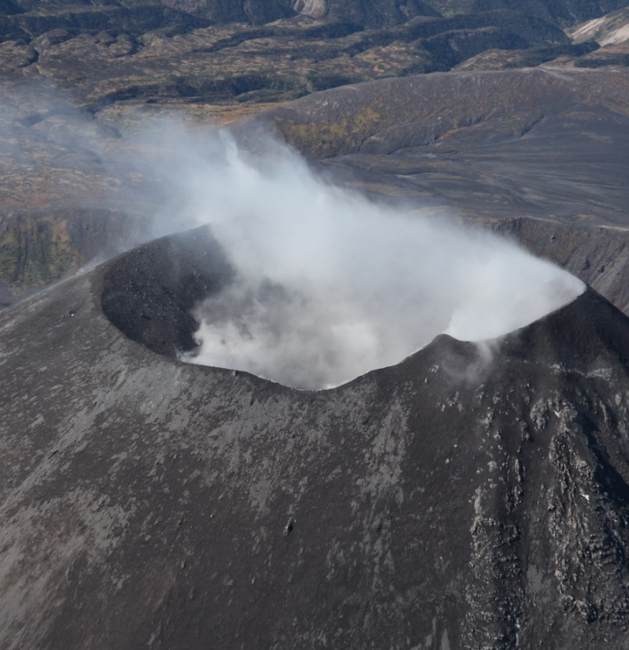
At the surface of the earth, it begins to break up into red-hot lava, which then solidifies, causing the volcanic mountain to become larger and larger.
The resulting volcano becomes so vulnerable on the surface that it spews volcanic gases to the surface with great frequency.

Slide 6
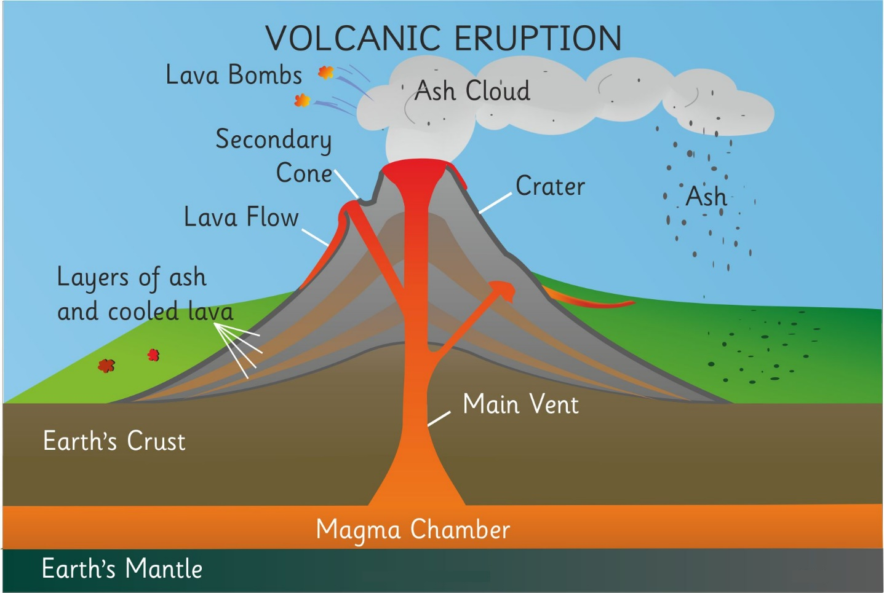
The structure of the volcano
The three main parts of a volcano are the chamber, the vent, and the crater.
The chamber is where the magma is stored.
Hot magma rises up the vent.
A crater is a bowl-shaped depression on the surface of a volcano. The diameter of the crater can reach several kilometers
.

Slide 7
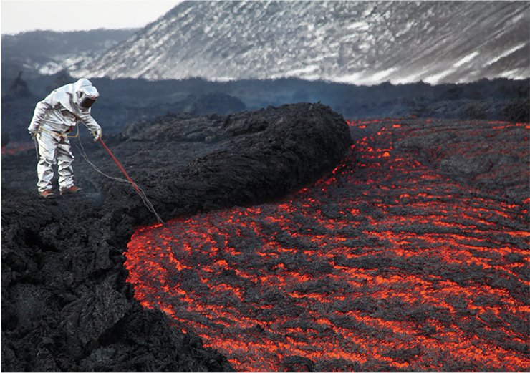
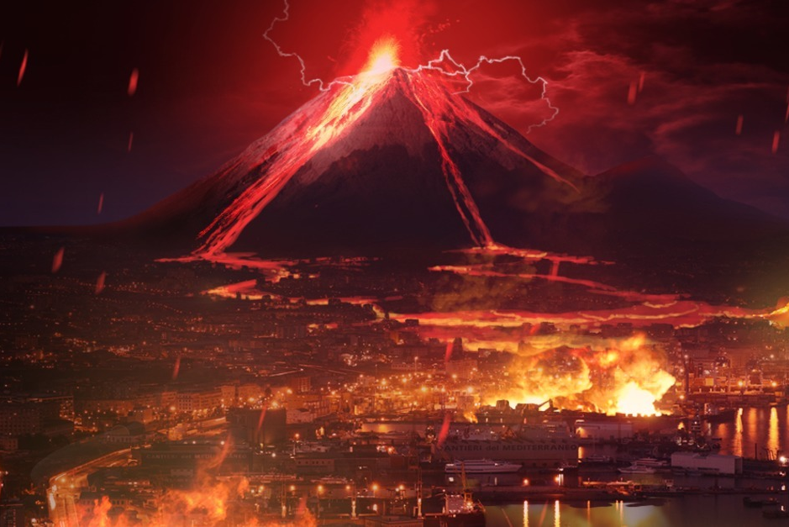
The power of the eruption
In some volcanoes, magma oozes so slowly that you can walk on them safely.
However, there are also such volcanoes, the eruption of which in a matter of minutes destroys everything in its path, within a radius of several kilometers.

Slide 8
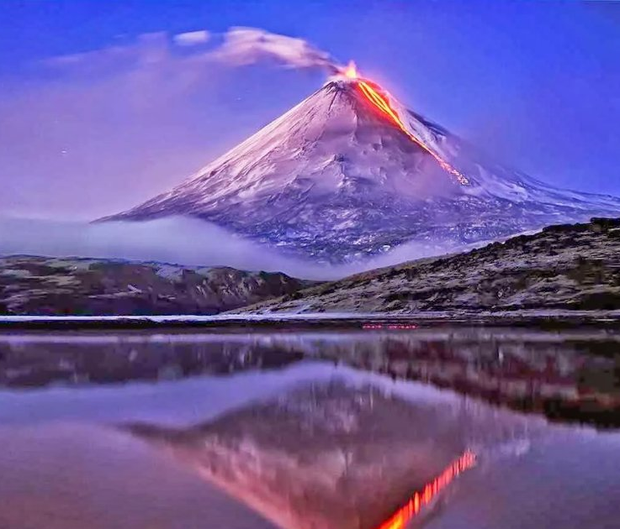
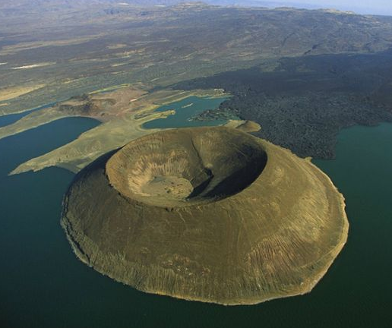
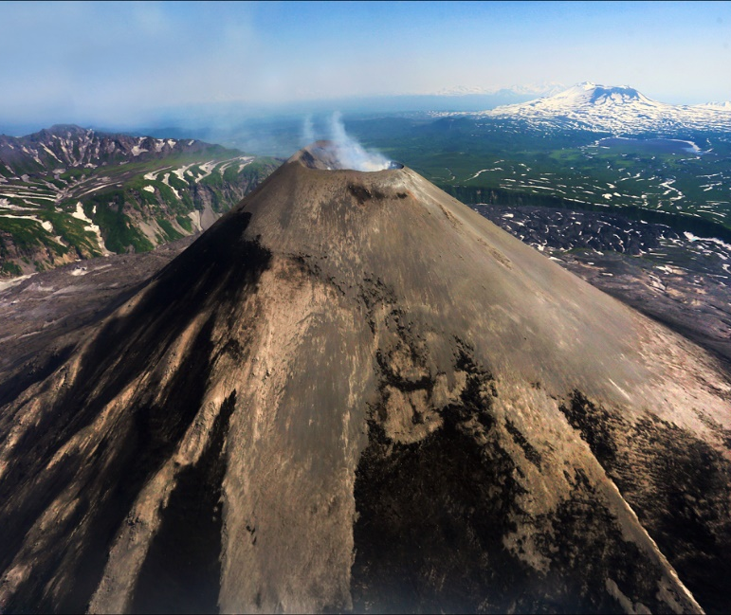
Types of volcanoes
Active
Extinct
Dormant
Either currently erupting or have erupted in recorded history
Have not erupted in recorded history and are not expected to erupt again
Not currently erupting but are considered likely to do so

Slide 9
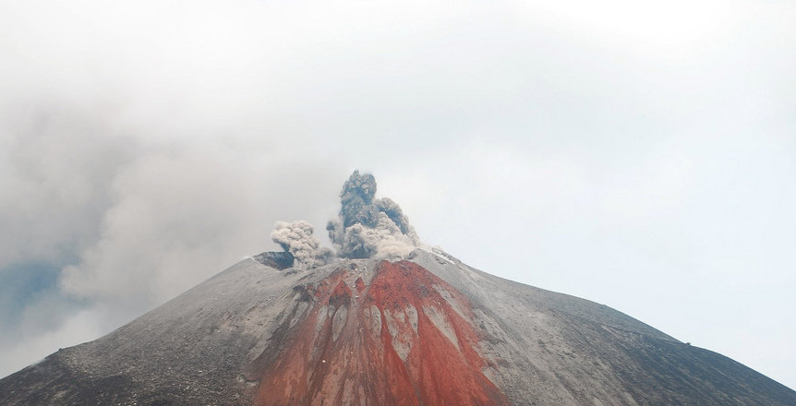
What makes volcano dangerous?
Active volcanoes are dangerous for a number of reasons. The dormant volcano itself is very dangerous. It can "wake up" at any time and start spewing lava flows that spread for many kilometers.
Therefore, you should not settle near such volcanoes. If an erupting volcano is located on the island, such a dangerous phenomenon as a tsunami may occur.

Slide 10
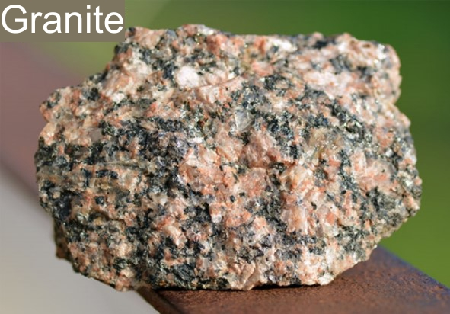
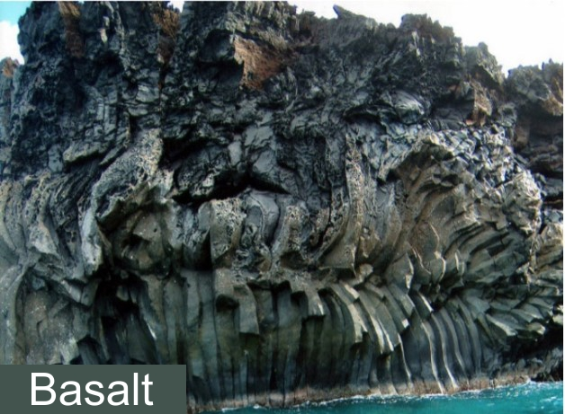
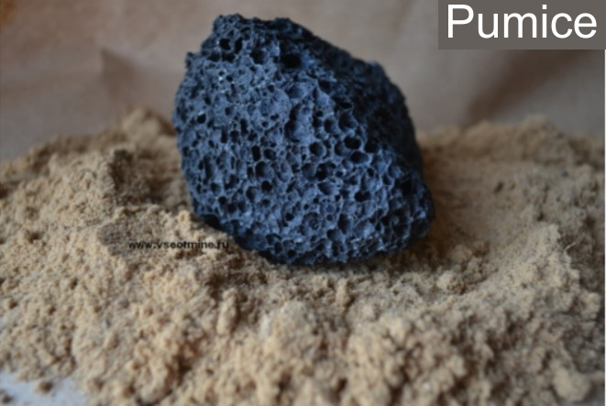
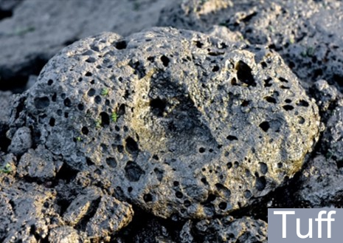
What are the benefits of volcanoes?
During the eruption, a large number of metals that can be used in industry appear.
The volcano generates the strongest rocks that can be used for construction.

Slide 11
Conclusion
We studied such issues as the formation, structure, and types of volcanoes.
In conclusion, we can say that volcanoes arise from the movement of tectonic plates and represent the release of magma, which, in turn, is a molten mantle.
Volcanoes consist of a chamber, a vent, and a crater.
They can bring both a destructive effect and benefits for different areas of industry.
Thank you for your attention!

