Slide 1
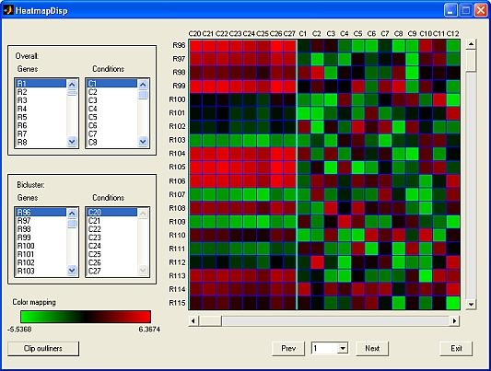
X
≈
S
x
A
samples
METAGENE
METASAMPLE
sample projection into component C1
genes
≈
x
+
+
…
C_{K}
contribution of genes to component C1
gene expression matrix

