Slide 1
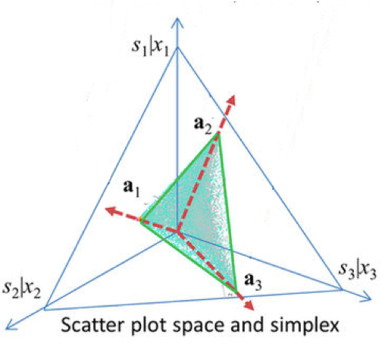
PCA does not ‘sees’ the data structure
Independent components are
directions of non-gaussianity
NMF components are non-negative
Fitting data to a
convex hull shape
PC1
IC2
IC1
NF2
NF1
PC2
Gaussian ellipsoid

Slide 2
QUESTIONS
QUESTIONS
QUESTIONS
C)
Mathematical theory
Are results numerically valid?
Are the results reproducible?
Are the results interpretable?
Can we learn something new from the results?
Can we answer the biological problem?
Can I use this data as an input of my model?
Are results numerically valid?
Are the results reproducible?
Are the results interpretable?
Is is giving expected result in controlled conditions?
Can we learn something new from the result?
Are results numerically valid?
In the (almost) ideal conditions, are the results coherent?
Are the results reproducible?
GOAL
model
Show the model is better (faster, more accurate) than others
GOAL
DATA CHARACTERISTICS
Solve a complex biological problem
GOAL
Demonstrate validity of the method on real data with a validation
Compare with other methods
(almost) perfect for the model
implementation
DATA CHARACTERISTICS
Data not perfect for the algorithm
a lot of noise
Only partial/no validation available
DATA CHARACTERISTICS
Simulated data
Easier than in context A
Cheaper than in context A
More accessible than in context A
D)
Can it work with simulated data?
Biological context A
Biological context B
Biological problem 1
Biological problem 1
A)
experiment
B)
experiment
E)
raw real data
Transformed real data
Can it work with real data?
Cleaning
Normalization
Analysis

Slide 3
Other context
Bio context
Mathemathical theory
Easier
Cheaper
Accessible
Bio problem
experiment
experiment
Perfect for the model
Simulated data
implementation
Show the model is better (faster, more accurate) than others
Actual complex problem
data
Is it valid to apply to this data (statistically)
Are results numerically valid?
Are the results reproducible
Are the results interpretable
Can we learn something from the results
Can we answer the biological problem
Cleaning, Normalization
Is data form good for my method?
data
Transformed data
Is is giving expected result in controlled conditions?
Cleaning, Normalization
Is it applicable in other context?
Transformed data
Analysis
Can I replicate the analysis using the same data (are they accessible, is the full pipeline available?)
Can I apply it to my data? (the same context, the same problem)
Can I apply to a different context?

