Slide 1
Data Mapping Scratch to Advanced
Hibernate, Mapping Data, ORM
OneToOne, OneToMany, ManyToMany
@Urunov

Slide 2
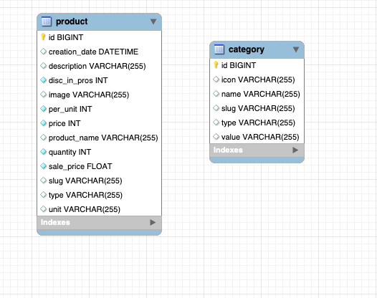
Hibernate : Mapping
MySQL configuration
spring.datasource.url = jdbc:mysql://localhost:3306/orm?useSSL=false&serverTimezone=UTC spring.datasource.username=root spring.datasource.password=root spring.jpa.properties.hibernate.dialect = org.hibernate.dialect.MySQL5InnoDBDialect spring.jpa.hibernate.ddl-auto=update spring.jpa.show-sql=true spring.datasource.driver-class-name=com.mysql.cj.jdbc.Driver
Spring Boot Source code
No Mapping
@Data @Setter @Getter @ToString @AllArgsConstructor @NoArgsConstructor @Entity @Table(name = "product") public class Product implements Serializable { /*** Declare Variables*/ @Id private Long id; private String productName; private String image; private String slug; private String type; private String unit; private int price; private float salePrice; // nullable=true private int disc_in_pros; // default =0 private int per_unit; // default =1 private int quantity; // private String description; private Date creation_date;
@Data @AllArgsConstructor @NoArgsConstructor @ToString @Entity @Table(name = "category") public class Category implements Serializable { @Id @GeneratedValue(strategy = GenerationType.IDENTITY) @Column(name = "ID", nullable = false, unique = true) private Long categoryId; private String name; private String value; private String type; private String icon; private String slug;

Slide 3
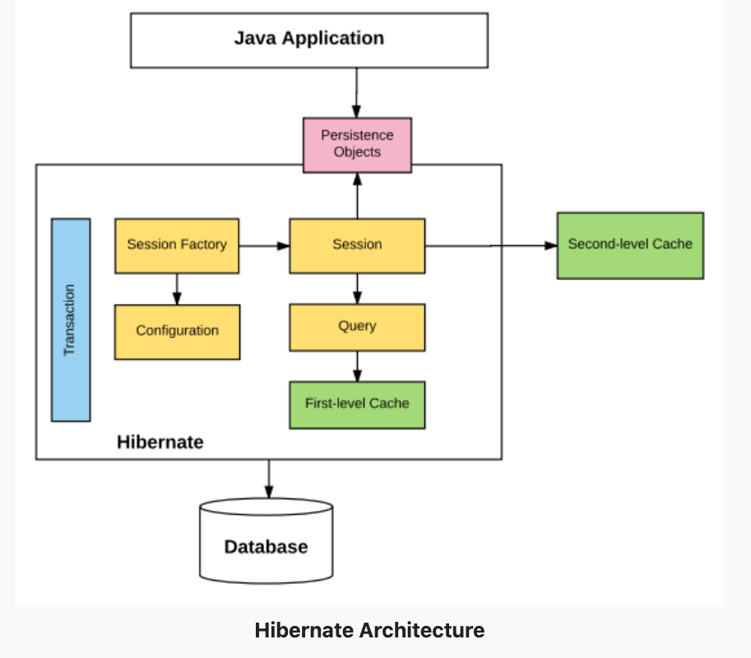
Hibernate. Hibernate Architecture
Hibernate is an open source Java persistence framework project.
It performs powerful object-relational mapping and query databases using HQL and SQL. Hibernate is a great tool for ORM mappings in Java.
It can cut down a lot of complexity and thus defects as well from your application, which may otherwise find a way to exist.
This is specially boon for developers with limited knowledge of SQL.
https://howtodoinjava.com/hibernate-tutorials/

Slide 4
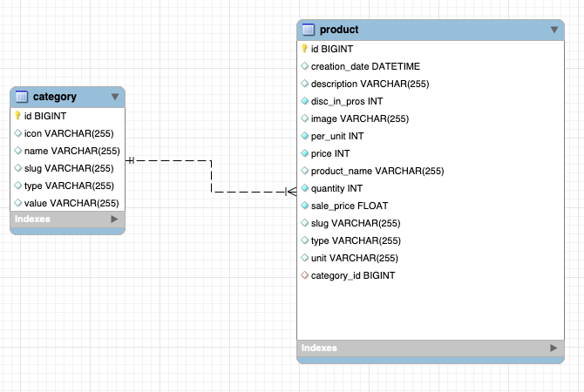
Hibernate : Mapping-2
Mapping: OneToMany
MySQL Mapping EER Diagram
Product
@Data @Setter @Getter @ToString @AllArgsConstructor @NoArgsConstructor @Entity @Table(name = "product") public class Product implements Serializable { /*** Declare Variables*/ @Id private Long id; private String productName; private String image; private String slug; private String type; private String unit; private int price; private float salePrice; // nullable=true private int disc_in_pros; // default =0 private int per_unit; // default =1 private int quantity; // private String description; private Date creation_date;
@ManyToOne private Category category;
Category
Spring Boot Source code
@Data @AllArgsConstructor @NoArgsConstructor @ToString @Entity @Table(name = "category") public class Category implements Serializable { @Id @GeneratedValue(strategy = GenerationType.IDENTITY) @Column(name = "ID", nullable = false, unique = true) private Long categoryId; private String name; private String value; private String type; private String icon; private String slug;
@OneToMany(cascade = CascadeType.ALL) @JoinColumn(name = "category_id")
private List<Product> products;

Slide 5
Hibernate : Mapping-2
Mapping: ManyToMany
MySQL Mapping EER Diagram
Order
Customer
@Data @Getter @Setter @AllArgsConstructor @NoArgsConstructor @Entity public class Order implements Serializable { /*** Declare Variables*/ @Id @GeneratedValue(strategy = GenerationType.IDENTITY) private Long orderId; private Double amount; private String paymentMethod; private String contactNumber; private String deliveryAddress; private String status; private String description; private String discount; private Double deliveryFee; private Date creationDate; /*** Mapping Technic and Hibernate**/ @ManyToMany(cascade = CascadeType.ALL) @JoinTable(name = "custom_order", joinColumns = {@JoinColumn(name = "order_Id")}, inverseJoinColumns = {@JoinColumn(name = "customer_Id")}) private Collection<Customer> customers = new ArrayList<>();
@Data @Getter @Setter @AllArgsConstructor @NoArgsConstructor @ToString @Entity public class Customer implements Serializable { @Id @GeneratedValue(strategy = GenerationType.IDENTITY) private Long customerId; private String name; private String image; private String email; private int totalOrder; private int totalOrderAmount; private String address; @ManyToMany(mappedBy = "customers", cascade = CascadeType.ALL, fetch = FetchType.EAGER) private Collection<Order> orders = new ArrayList<>();
Spring Boot Source code

