Slide 1


Insurance Hub
Phase 1 - Project Description and Requirement Specifications
Team 5:
Diksha Sharma
Shikhar Saraswat
Urva Surti
Team 5:
Diksha Sharma: A20523396
Shikhar Saraswat: A20514418
Urva Surti: A20505142

Slide 2
Project Overview
EInsurance is an innovative project aimed at creating a comprehensive and user-friendly online Insurance Hub.
This hub will serve as a one-stop digital platform for insurance providers and customers to interact, manage policies, and access a wide range of insurance-related services.
EInsurance seeks to revolutionize the insurance industry by leveraging technology to streamline processes, enhance customer experiences, and promote transparency.

Slide 3
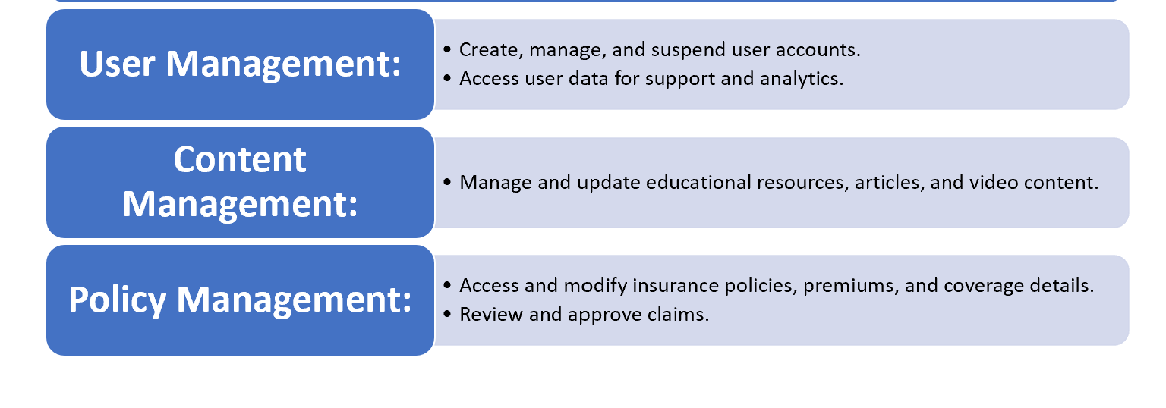
Application Requirements:
User Registration and Authentication:
Users can create accounts with personal information and secure authentication methods.
Two-factor authentication for enhanced security.
Profile Management:
Users can update their personal information and preferences.
Upload and manage necessary identification documents.
Policy Management:
Access to view, modify, and renew insurance policies.
Upload and store policy documents.
Notifications and Alerts:
Receive policy renewal reminders, important updates, and personalized insurance recommendations.
User Requirements:
General Features:
Responsive Web Design:
Ensure a seamless user experience on various devices (desktop, mobile, tablet).
2.Search and Filters:
Users can search for insurance products and apply filters (e.g., coverage type, provider, price) to find the most relevant policies.
3.Document Management:
Users can upload and store policy documents, identification, and claim-related paperwork.
4.Feedback and Ratings:
Allow users to leave reviews and ratings for insurance providers and policies.

Slide 4
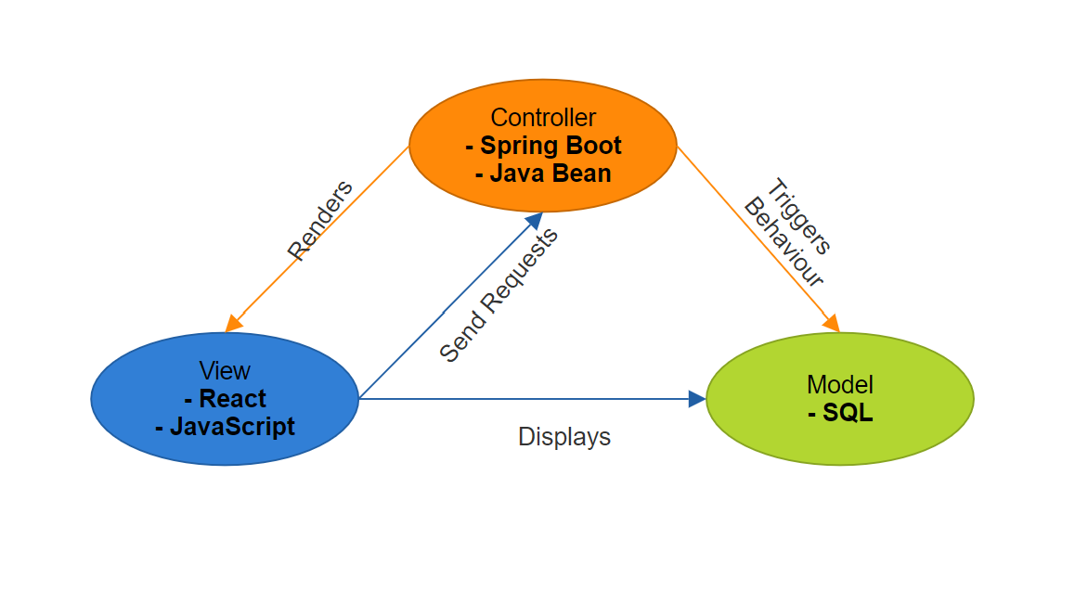
Architecture and Design

Slide 5
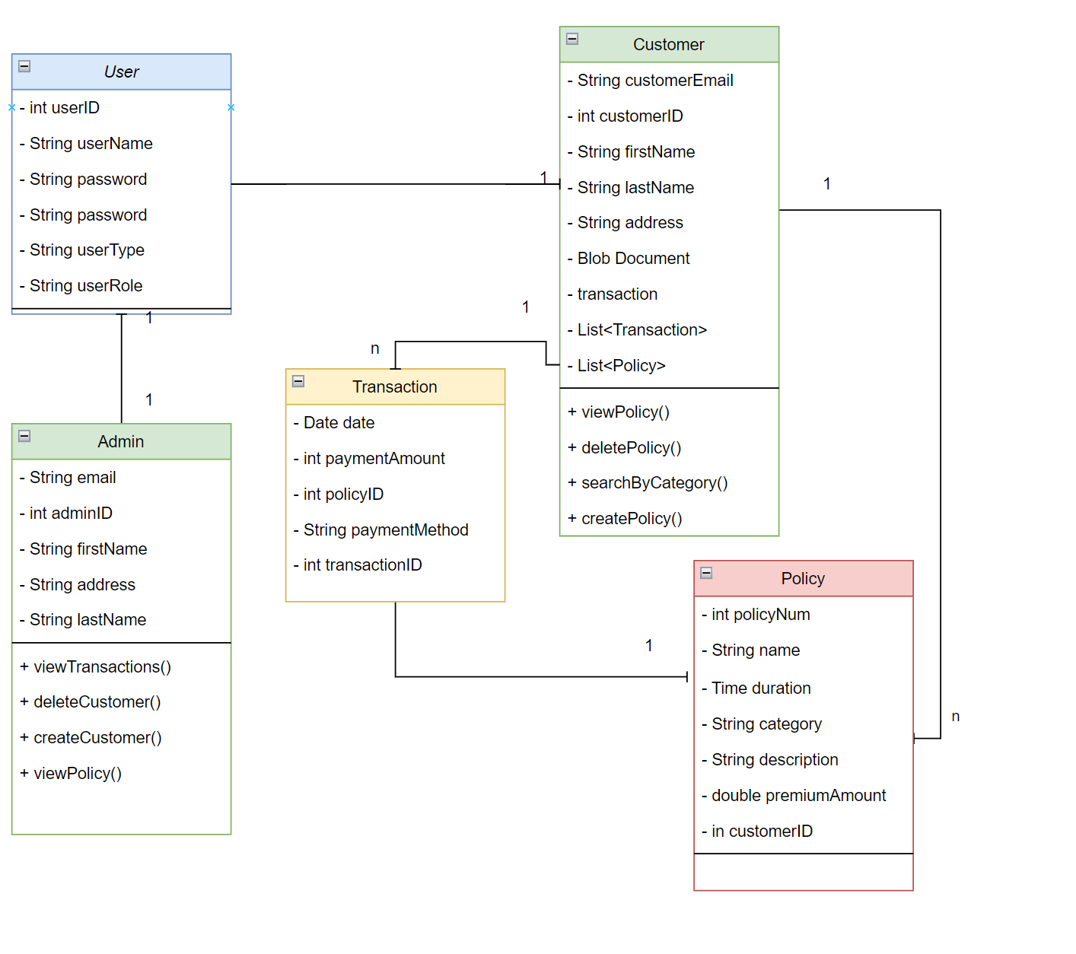
CLASS DIAGRAM

Slide 6
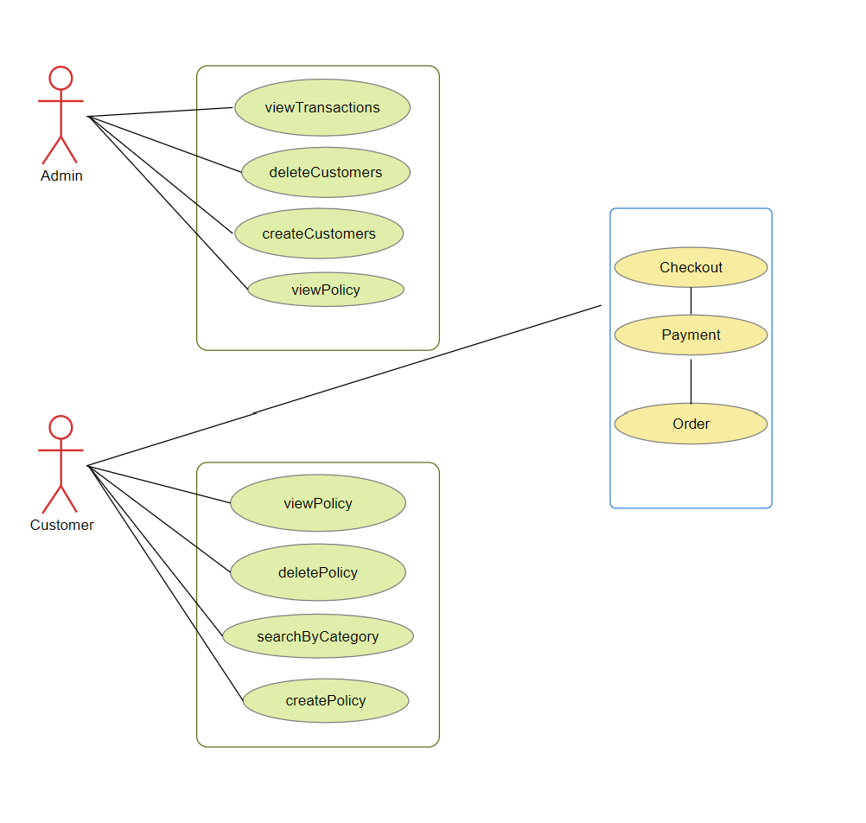
USE CASE DIAGRAM

Slide 7
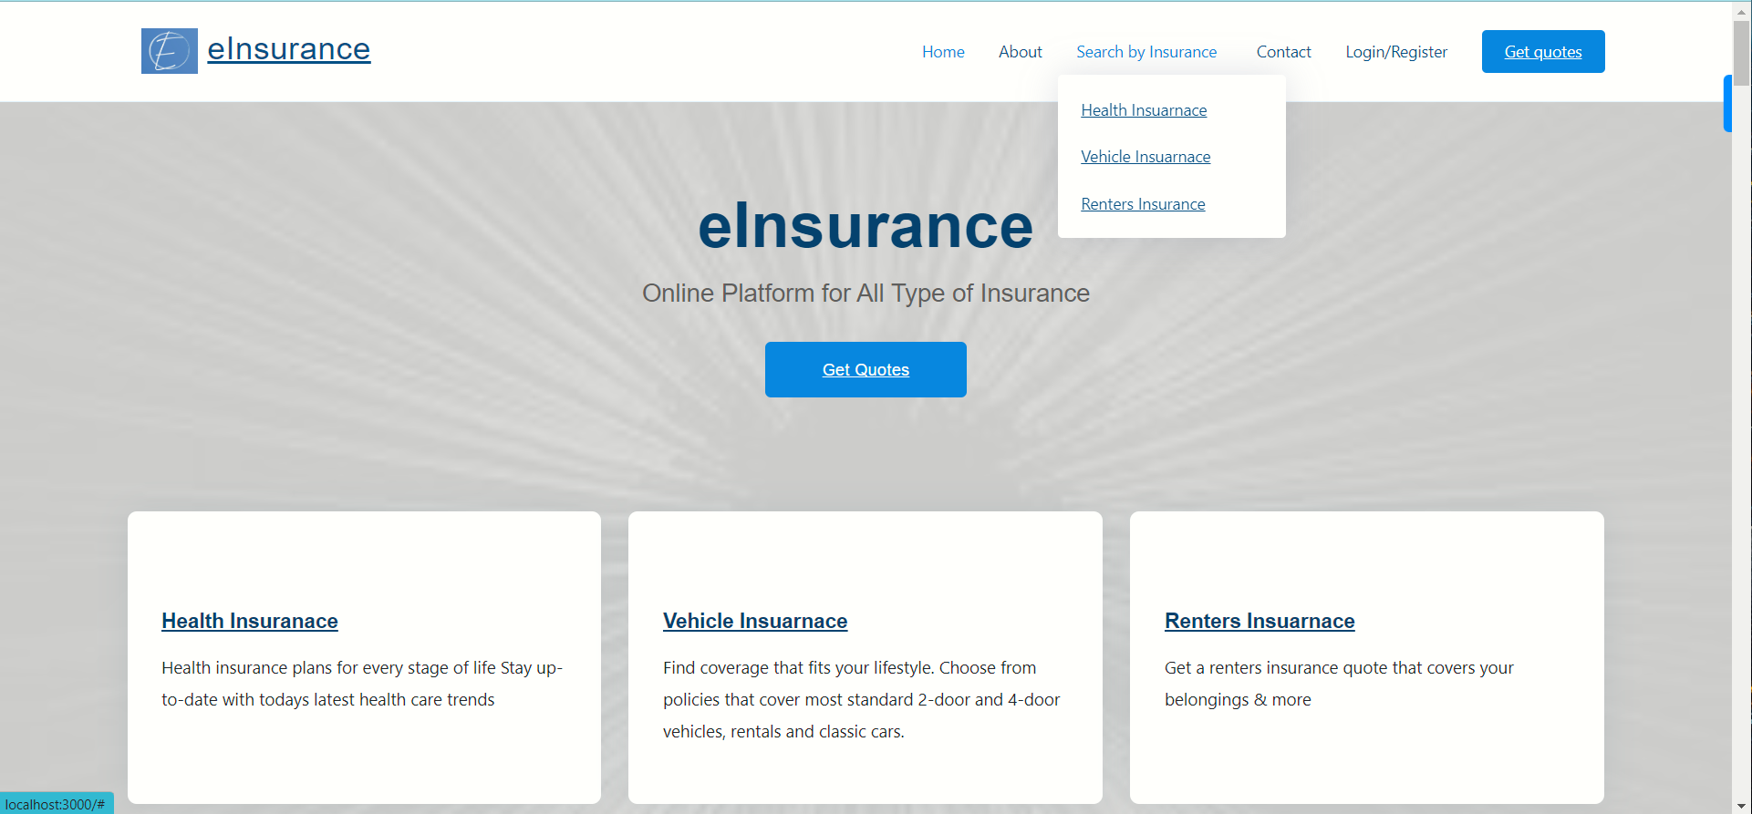
HOME PAGE

Slide 8
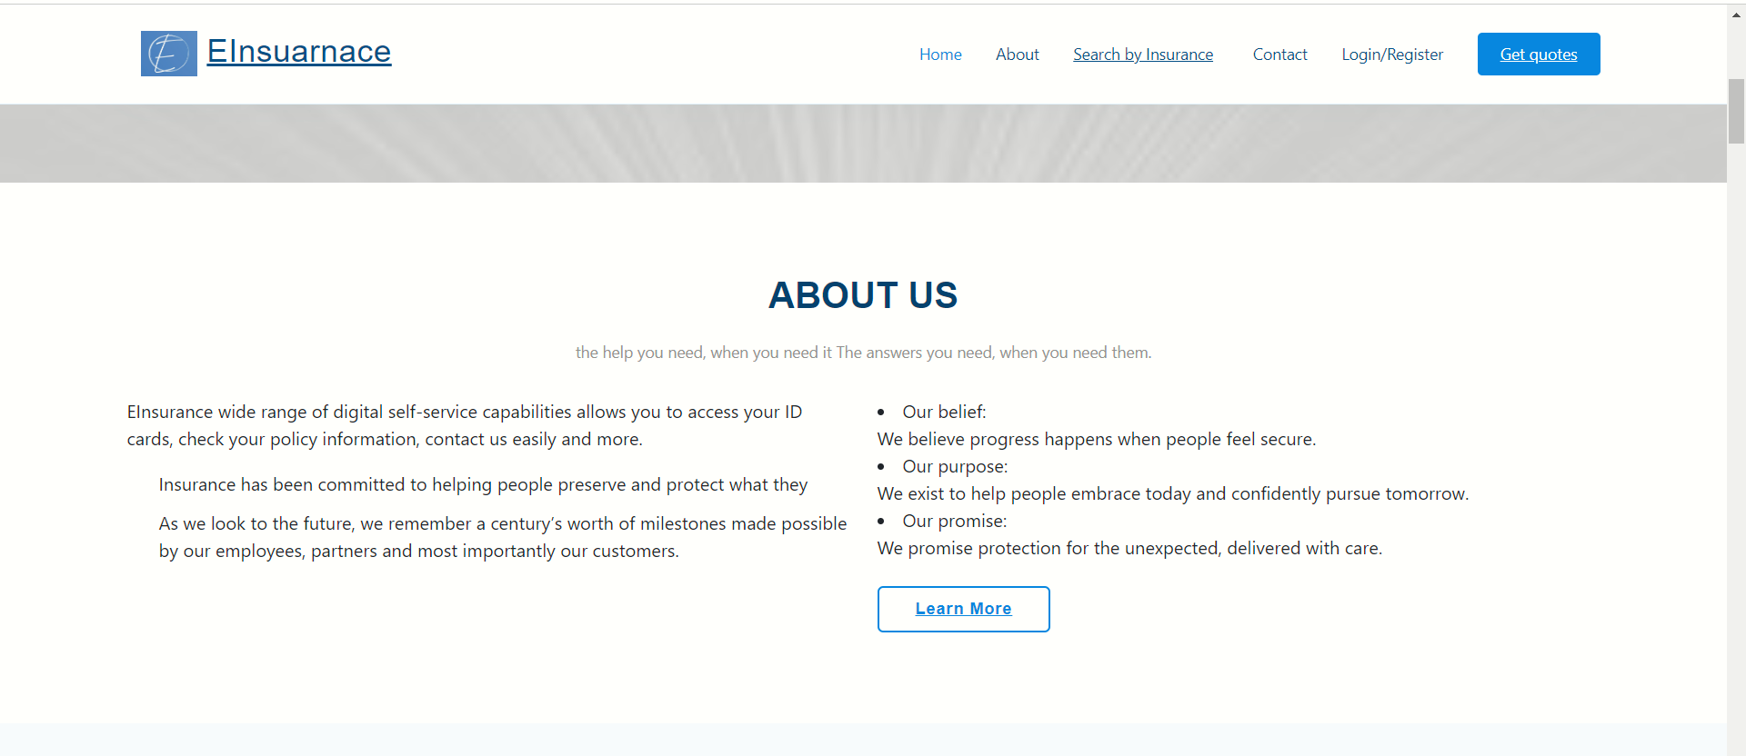
ABOUT PAGE

Slide 9
Thank you

