Slide 1


Insurance Hub
Phase 2 - Project Demonstration
Team 5:
Diksha Sharma
Shikhar Saraswat
Urva Surti
Team 5:
Diksha Sharma: A20523396
Shikhar Saraswat: A20514418
Urva Surti: A20505142

Slide 2
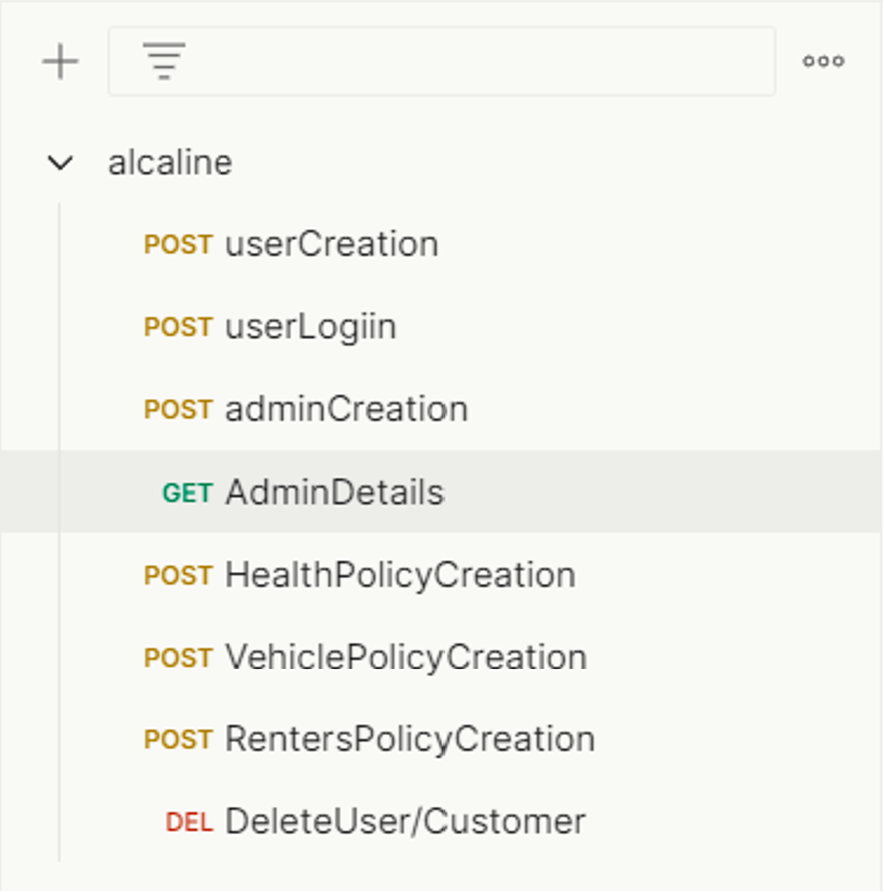
List of API

Slide 3
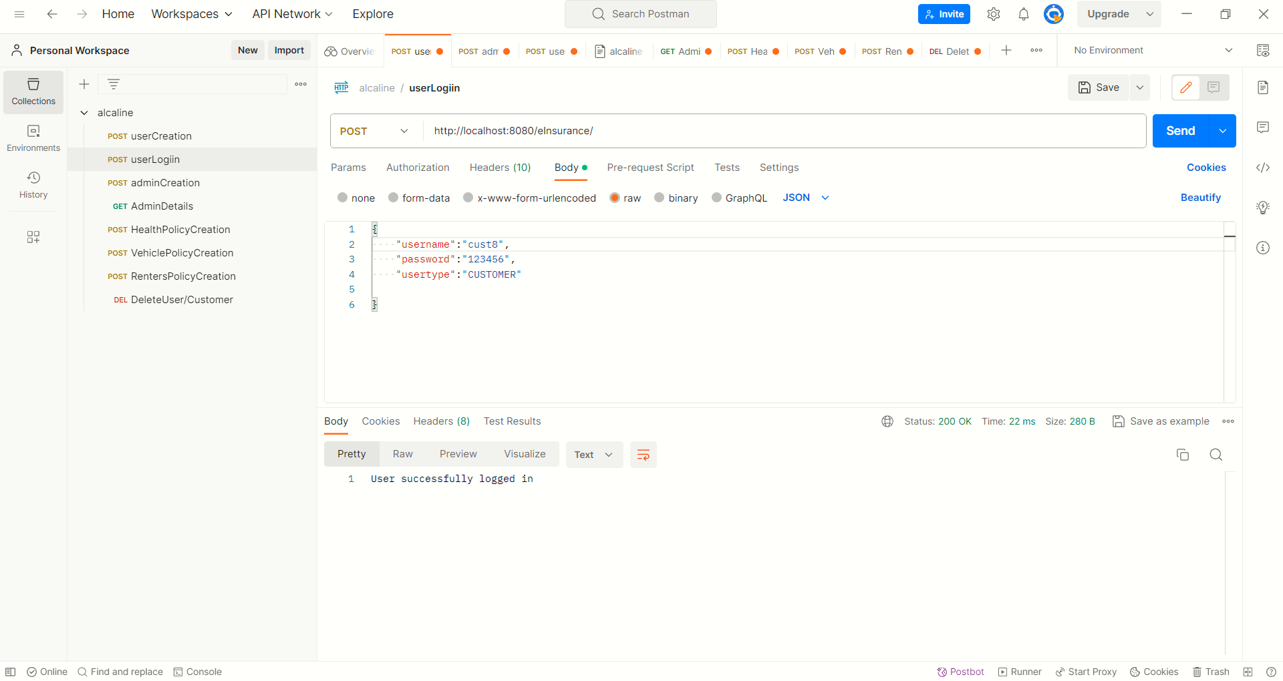
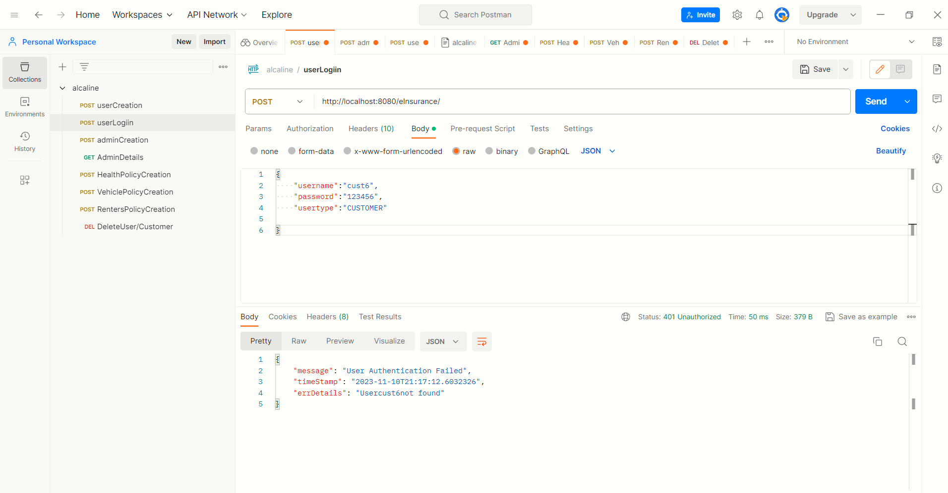
Login – Success and Handling

Slide 4
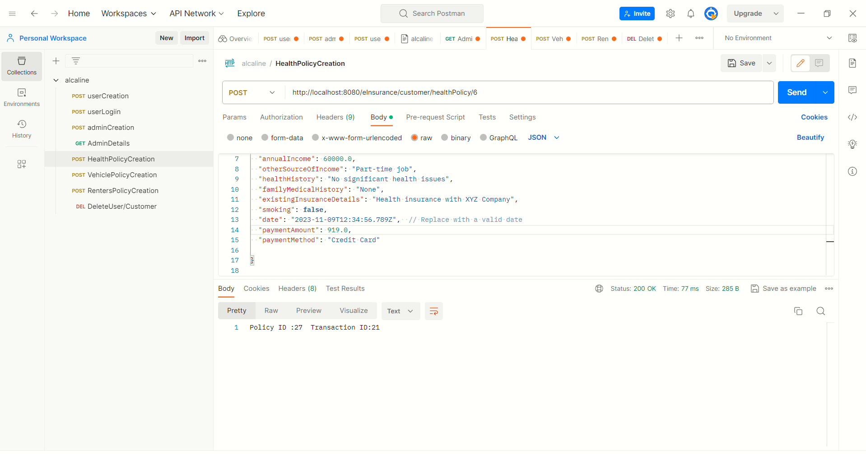
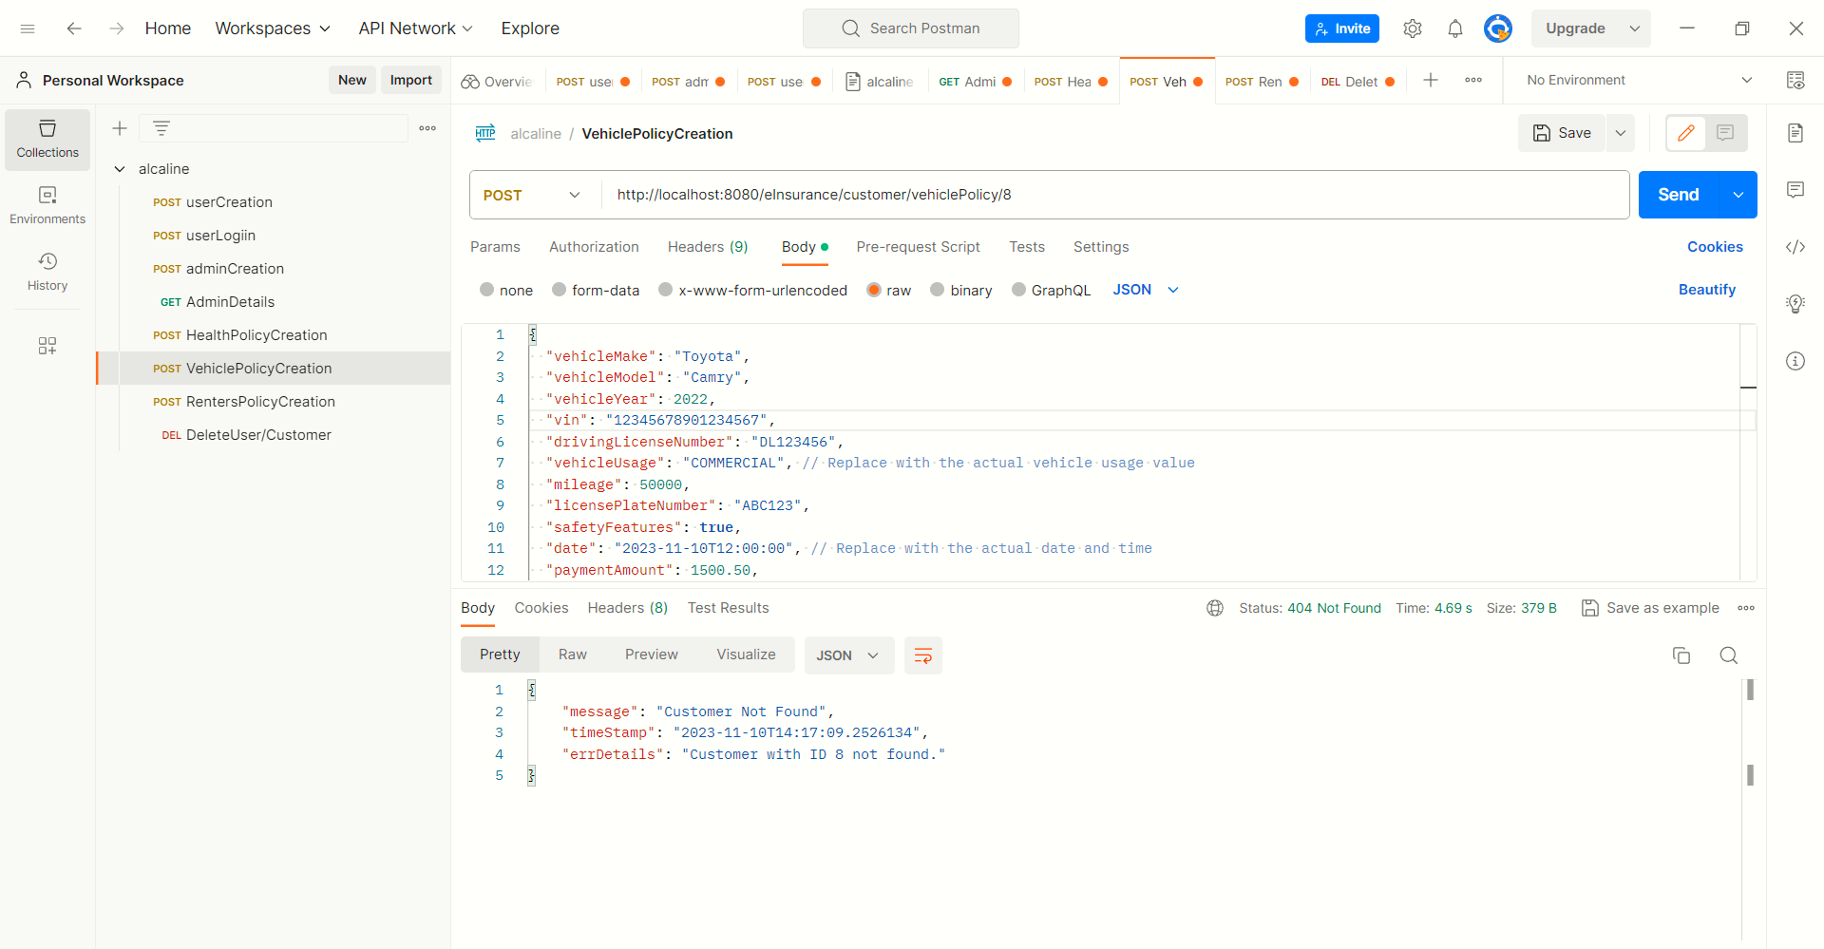
Policy – Success and Handling

Slide 5
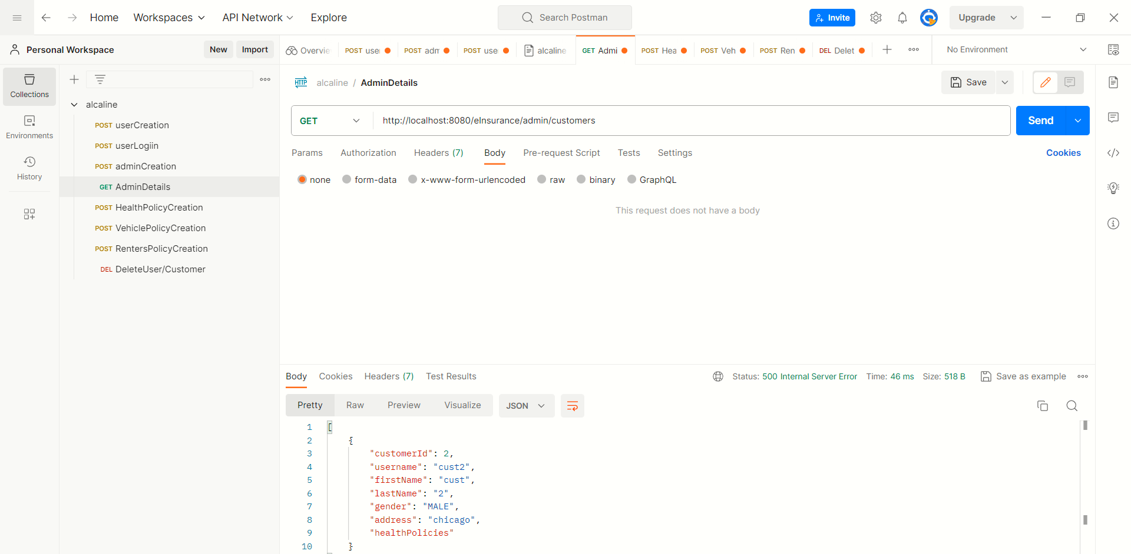
Get Customers

Slide 6
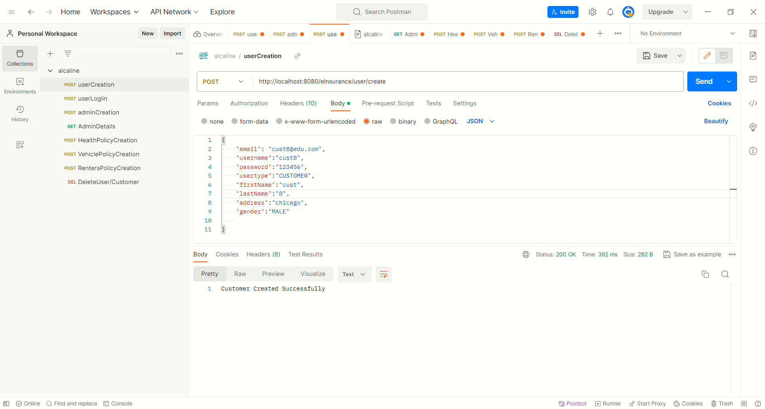
Create Customers

Slide 7
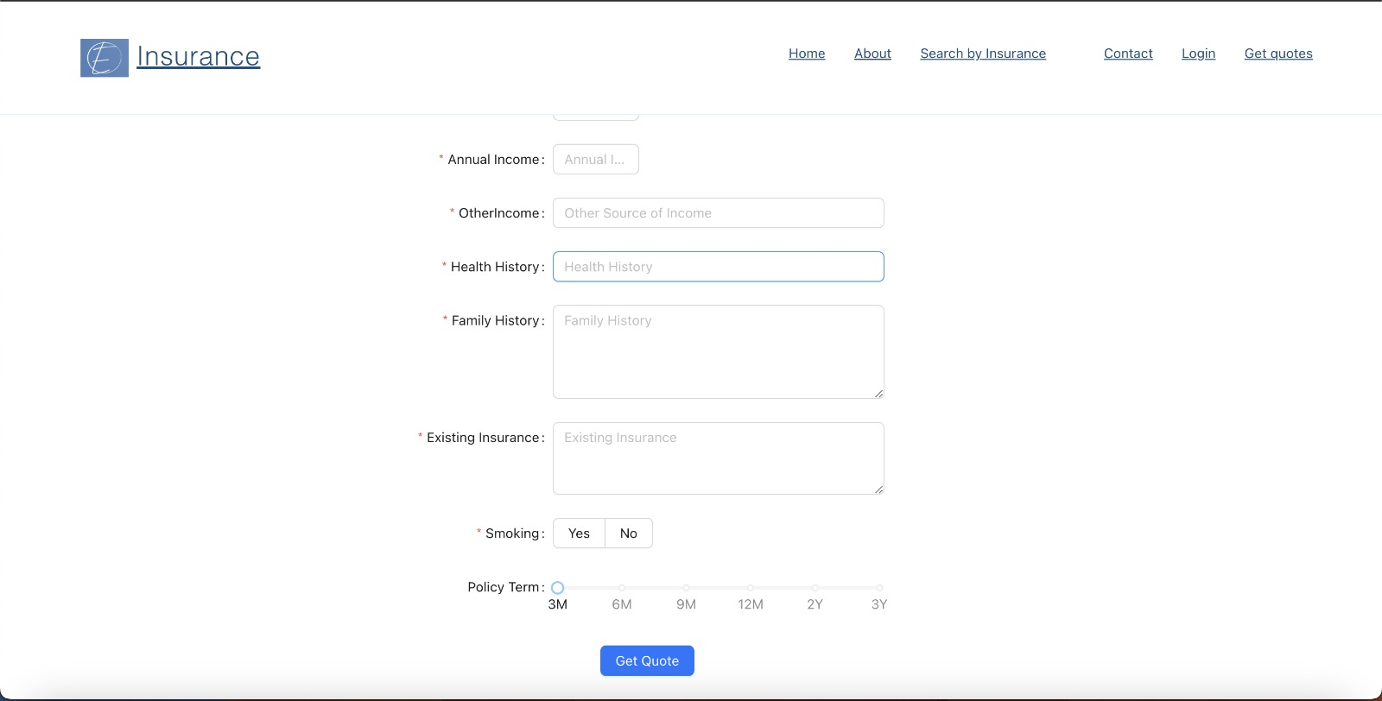
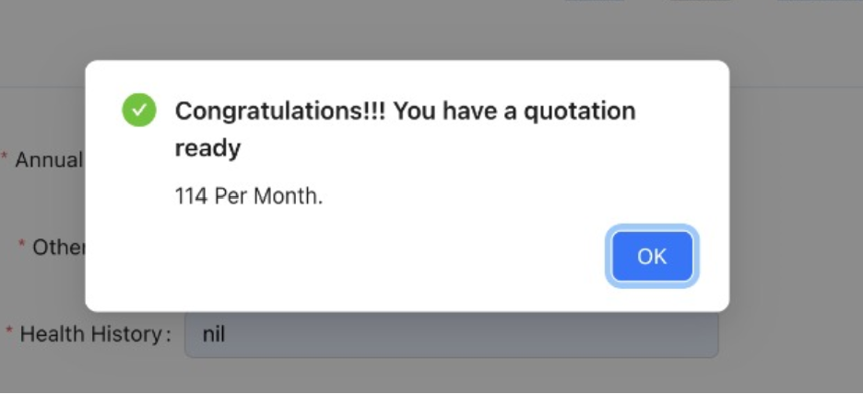
Get Quotes

Slide 8
Thank you

