Slide 1
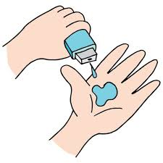
Project Title – Seasonal Agriculture Perfomance Analysis
Student Name – Parmar Urvashi
College Name- K.S School Of Business Management And Information Technology
AICTE STU ID : STU6a65a2e9904901785045737

Slide 2

PROBLEM STATEMENT
Agricultural activities are influenced by seasonal variations in environmental conditions, farming practices, resource availability and market conditions. As a result, agricultural performance may differ from one season to another. However, raw agricultural data does not clearly explain how agricultural performance changes across seasons or what patterns can be observed in different seasonal conditions. The problem is to analyze the given agricultural dataset and investigate seasonal differences in agricultural performance by identifying meaningful patterns, trends, relationships and variations within the available data.

Slide 3
Project Description
Project Title: Seasonal Agriculture Performance Analysis
Scope: Analyzed 4,000 farm records across 28 attributes (Kharif, Rabi, Zaid seasons).
Objective: Evaluate how weather, soil health, and irrigation methods impact crop yield and profitability.
Key Steps: Data Cleaning ➔ Univariate/Bivariate/Multivariate Analysis (EDA) ➔ Strategic Insights.
Tech Stack: Python (Pandas, Seaborn, Matplotlib) on Google Colab.

Slide 4

WHO ARE THE END USERS?
Farmers: Crop selection, profit optimization, and yield improvement.
Agronomists & Advisors: Data-backed farming recommendations.
Policy Makers: Regional agricultural policy & water resource management.
Agri-Tech Companies: Input demand forecasting & smart irrigation solutions.

Slide 5

Technology Used
Programming Language: Python 3
Development Environment: Google Colab
Data Processing & Manipulation: Pandas, NumPy
Data Visualization: Matplotlib, Seaborn
Version Control & Documentation: GitHub, Markdown

Slide 6
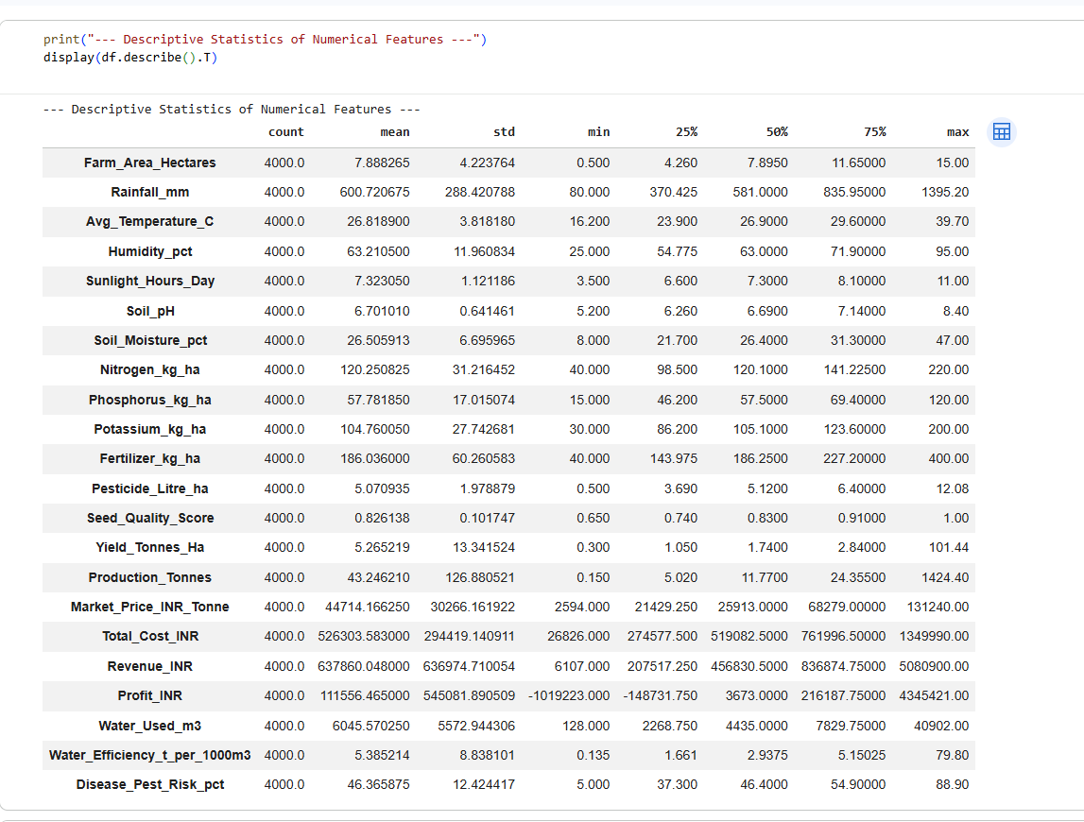
RESULTS

Slide 7
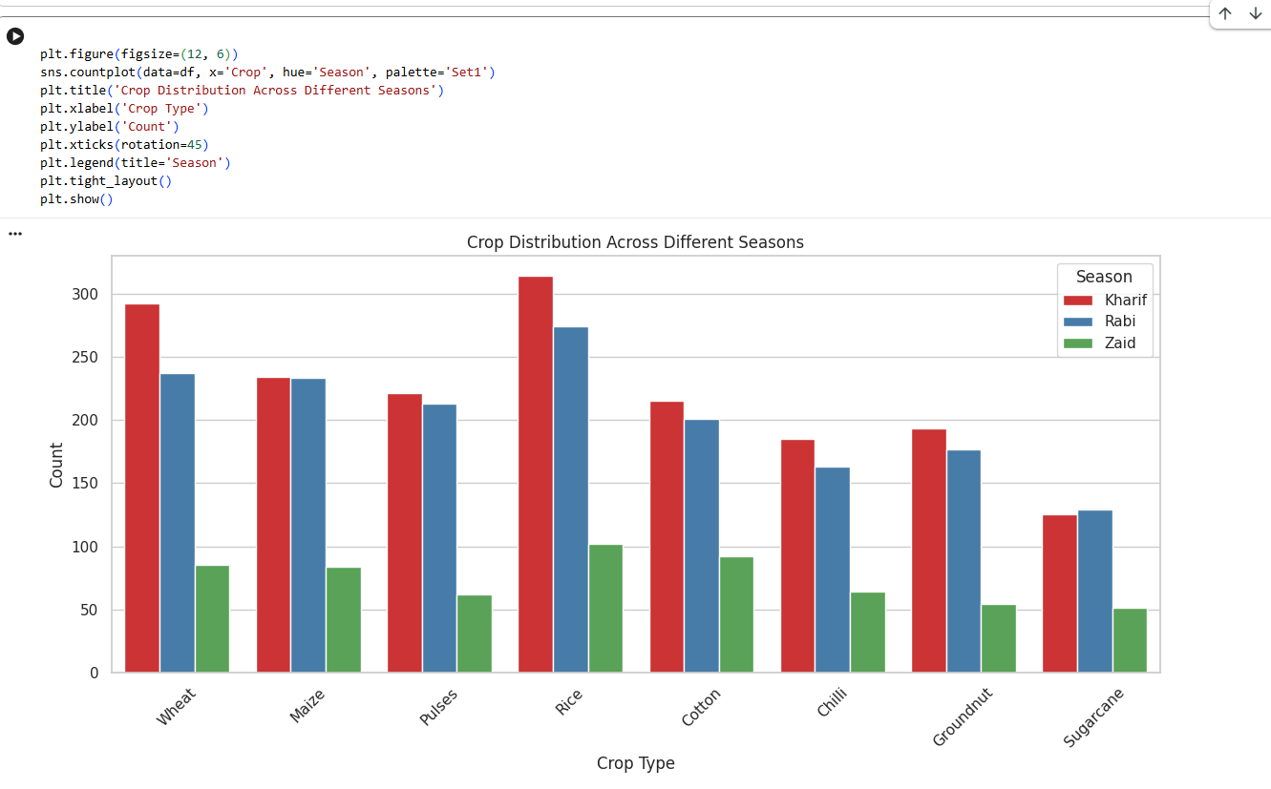
RESULTS

Slide 8
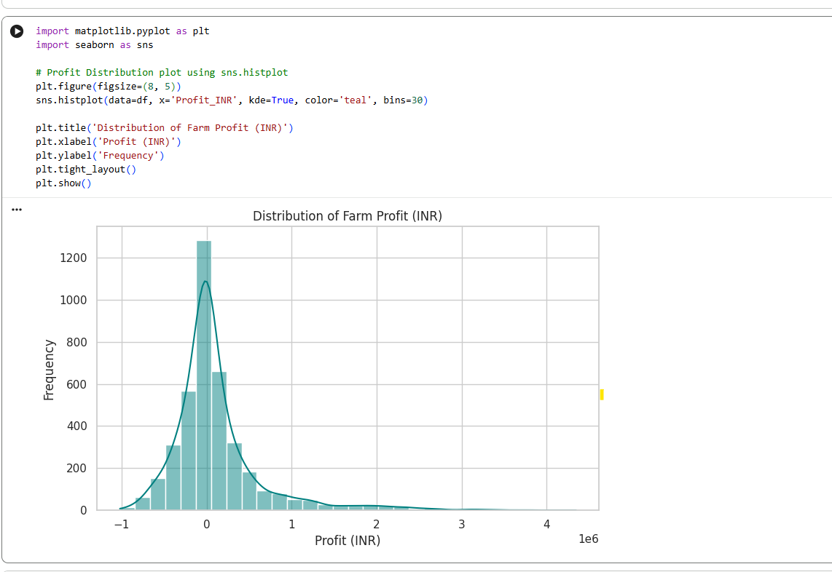
RESULTS

Slide 9
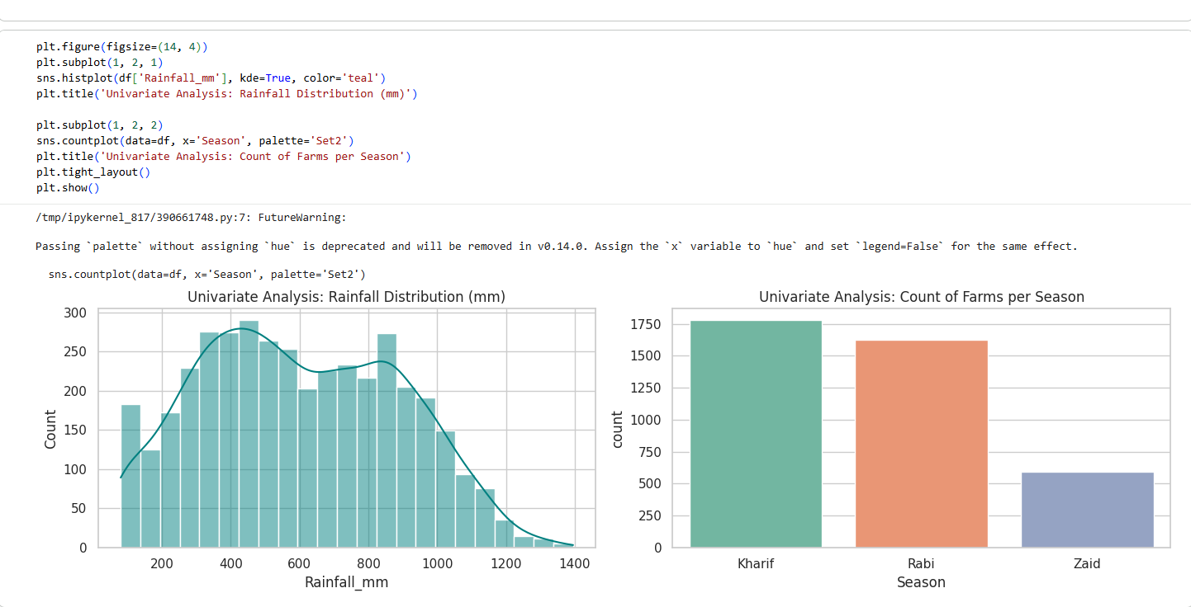
RESULTS

Slide 10
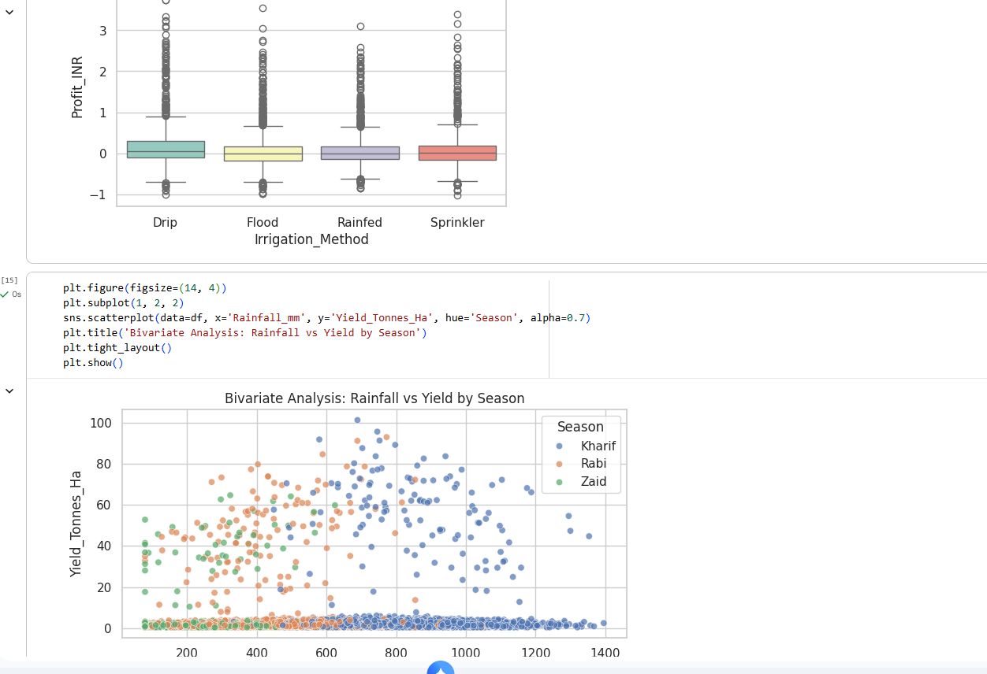
RESULTS

Slide 11
Future scope
Machine Learning Integration: Build predictive models for yield & profit forecasting.
IoT & Live Weather APIs: Real-time monitoring of soil conditions and rainfall data.
GIS & Satellite Mapping: Spatial analysis for precision agriculture and crop monitoring.
Farmer-Centric Mobile App: Multilingual dashboard for localized agricultural guidance.
Smart Recommendation System: AI-driven optimization for fertilizer and water usage.

Slide 12
GitHub Link
https://github.com/Urvashi1824/Seasonal-Agriculture-Perfomance-Analysis

Slide 13
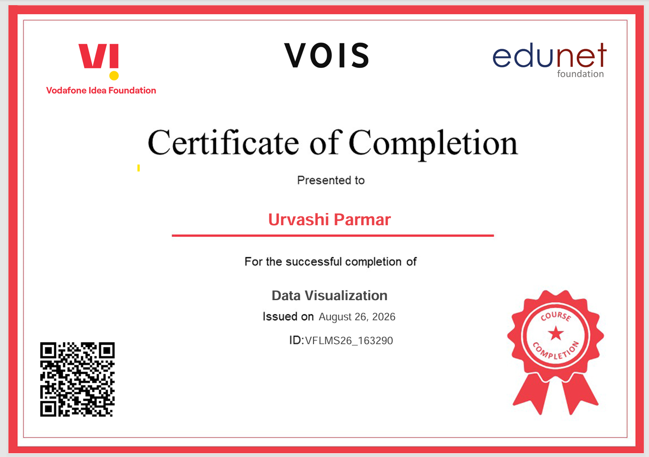
VOIS Course completion certificate - Course name- Data Visualization

Slide 14
Thank you
.
.

