Slide 1

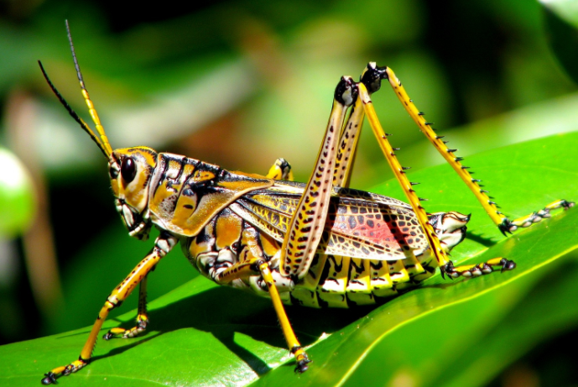
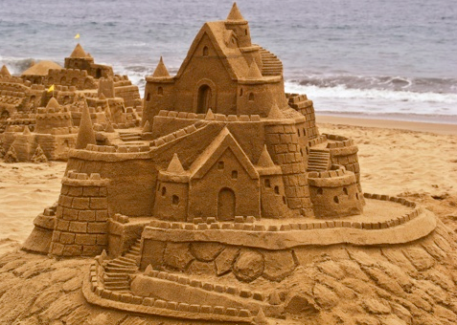

CAPILLARY BRIDGES BETWEEN A PLANE AND A CYLINDRICAL WALL
Etienne Reyssat
(Journal of fluid mechanics)
Urvashi Gupta 2015CH10141
Surbhi Jain 2015CH10945
Simran Malik 2015CH10132
Sushree Jagriti Sahoo 2015CH10138

Slide 2

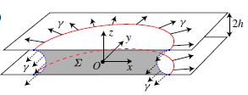
OBJECTIVE OF THE RESEARCH
The aim of this research is to study the phenomenon of formation of capillary bridges between a plane surface and a cylindrical wall and to determine the shape of the bridge formed. The study compares the shape of the menisci formed using the experimental results with the results obtained using theoretical analysis of the problem and by numerically solving the differential equation derived in the paper.
Side view of the circular liquid drop having equatorial radius R and O as its center, bridging two parallel plates separated by a distance of 2h
Cross-sectional view of the liquid drop

Slide 3
Importance of the paper
Formation of capillary bridges is an important phenomena that has been studied for the last two hundred years. This research has been done to analyse and study several systems which involve formation of capillary bridges for example- wetting of powders, capillary condensation, water saturation in soils and adhesive forces in moist and unconsolidated porous media where formation of capillary bridges has been observed. Capillary bridges can also be found in living organisms. Bugs and flies are able to stay on vertical surfaces because they inject a wetting liquid on the contact area.
Interestingly, this can even be observed while building sand castles at the beach!

Slide 4



Methodology used
When a fluid drop is placed between 2 parallel plates, 2 radii of curvatures are obtained at liquid/air interface. We find the pressure difference across the interface by equating pressure force to the capillary force(due to surface tension). This pressure difference is given as:
Shape of this static drop can be considered as a surface of revolution with constant mean curvature (accounts for the coupling between the in-plane and transverse curvatures) given as:
Here we’ve considered only first order development in the pressure because of small h/R.
We will have to evaluate higher order terms if the bounding plates separate i.e. h increases.
In this paper, shape of the drop of a liquid is determined when placed between a flat plate and a cylinder of radius ⍴. The gap distance between these two at a distance x from the line of closest gap is given by:

Slide 5
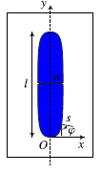


Theoretical Prediction of the Shape
At equilibrium, pressure in the drop is assumed to be constant. Curvature of the projected shape in OXY plane is given by:
Hence the mean curvature can be written as:
In the figure given on right, s is defined as the curvilinear coordinate measured along the contour of the drop. 𝝓 is the angle made by the horizontal normal at any point to the y axis.

Slide 6



As this mean curvature is constant throughout, origin is taken as the reference point where ɸ=0 and s=0. Thus equating the curvature at the origin to any general point gives the equation:
Considering (d𝝓/ds) at s=0 equal to ϵ_{o}. While solving the problem numerically, we select the value of ϵ_{o} such that the length of the computed profile matches that of the experiment.
If in the above case we neglect the coupling between the in-plane and transverse curvature and take: 𝛋 = 1/h - 1/R
Then the equation changes to:

Slide 7
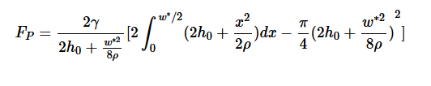



In case of large drops, their width saturates to w* measured at the apparent contact line. To find w* as a function of h_{o} and ⍴, we calculate the pressure forces on the half section of the drop as:
where ΔP = 2ɣ/𝛅 (ɣ= surface tension due to the liquid)
Surface tension forces are given as:
Due to mechanical equilibrium these two quantities are equal and hence we find w* considering the fact that ⍴ >> w* >> h_{o}
Asymptotic value of ϵ_{o} (dΨ/ds =0) is given by

Slide 8
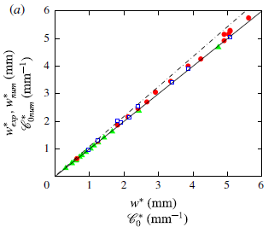
Outcome Of The Research
The shapes of the drops trapped between the plane wall and the horizontal cylinder were determined experimentally and numerically as an outcome of this research. These results were plotted against theoretically predicted shape and then the plots were compared. According to the research, the numerical values were a perfect match to the theoretical values when accounting the coupling between the in-plane and the transverse curvature. If these effects were not considered a deviation of about 8% was observed in the asymptotic width. Moreover when large drops are present, their width saturates to w* measured along apparent contact line and this is called as the asymptotic value of w.
The above graph was obtained in this research. It can be seen that the numerical prediction slightly overestimates the experimental produced results. The continuous line is for w*_{exp}= w*. The dashed line is for w*_{num}=1.084w*.

Slide 9
How is this outcome helping the motive
The forces exerted by the capillary bridges dominate the force of cohesion. They affect the adhesion or friction between surfaces and have an impact on small-scale applications.
For example, the adhesion of the insects to the walls rely on the presence and the control of capillary bridges between the atomic force microscope tip and the printed surface. For such applications, shapes of liquid menisci are crucial.
Granulation process- In this process, the powder particles are made to adhere to form multiparticle entities. On replacing the air between the particles, the capillary state is reached. Hence, the particles are held together by capillary suction at liquid-air interface which is now at the granule surface. The forces can be studied using this research.
These dynamic properties play a dominant role in microscoping the mechanical behaviour of the materials.

Slide 10


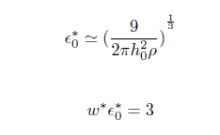
Future Work
In this term paper, we tried to derive and produce the results for capillary bridge between a wall and a horizontal cylinder. Working on the extension of this paper we have tried to derive and produce the results for capillary bridge between two cylindrical surfaces with horizontal axis. The results obtained are as follows: (The symbols have their usual meaning)
(The extension of this research will lead to better prediction of the results as most of the surfaces in real world are curved and not plane. )

Slide 11
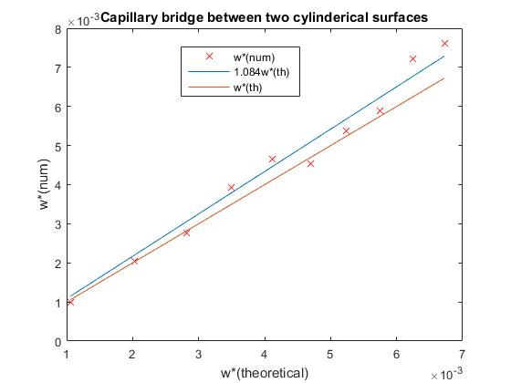
The above graph was plotted in MATLAB after making changes in the value of the thickness by which the two surfaces are separated. The thickness is taken as twice the value of the previous case. It can be seen in this result that the numerical values of w* are very close to the coreesponding theoretical values.

Slide 12
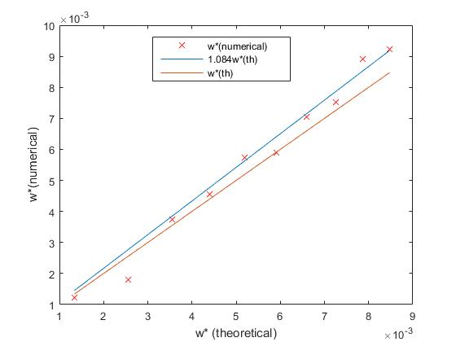
Replication of the research
As expected from the original research, the values for w* (numerical) mostly lie between w* (theoretical) and 1.084 w* (theoretical).
This graph was plotted after solving the differential equation in MATLAB. The expalination of the code is given on the PDF file attached alongwith.

