Slide 1






COMP 5112 Research Methodology
Winter 2021

Slide 2
Face Detection and Recognition Using OpenCV
Created By :-
Group No:- 9
Name:- Urvil Ashokkumar Patel
Student Id:- 1131703
Name:- Jhanvi Dilipkumar Upadhyay
Student Id:- 1159217
Guided By :- Dr. Jinan Fiaidhi

Slide 3
Content
Objective
Problem Definition
What is face detection and Recognition
Block diagram
Implementation of face recognition
Image Acquisition
Image Processing
Face Detection
Extraction of a Facial features
Feature Matching
Why OpenCV?
Face detection using Haar Cascades

Slide 4
Content
Why NumPy
Why TensorFlow
Local Binary Pattern Histogram (LBPH) Algorithm

Slide 5
Objective
Face detection and picture recognition is currently a trending technology that captures the attention of today’s IT professionals.
In this project, We will go to use face detection and recognition technology which helps us to build an automated attendance system, which is more secure and easier than manual as well as other means of attendance system.

Slide 6
Problem Definition
Nowadays, in most of the schools and colleges, student’s attendance is taken by manually by using attendance sheet in classroom, which is time consuming as well as it increase the workload of a teacher.
Moreover, it is very difficult to verify one by one student in a large classroom whether the authenticated students are actually responding or not.

Slide 7
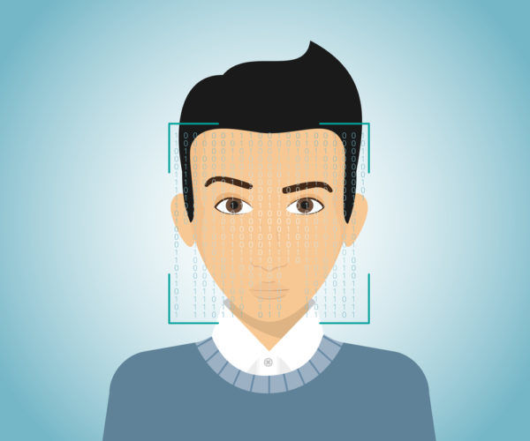

What is Face Detection & Face Recognition
Face Detection: Face detection is an artificial intelligence based computer technology used to identify only human faces in digital images.
Face Recognition: Face Recognition is the task of identifying an already detected face as a known or unknown face, and in more advanced cases telling exactly whose face it is.

Slide 8
Implementation of Face Recognition
Image acquisition
Image Processing
Facial Image classification
Recognize face

Slide 9
Block Diagram
Face of a person
Face Image
Find face location, texture, size
Image Acquisition or Detect any face
Image Processing
Extraction of a facial features
Face ID
Feature matching
Find successfully
Comparing with Database
Compare using Face ID
Database of Enrolled Users
Marking the attendance in Excel sheet

Slide 10
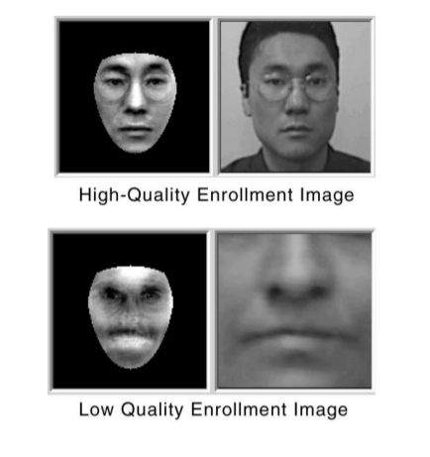
Image Acquisition
Image acquisition can accomplished by capturing real-time images of any object using a high-optical camera and generates images of a sufficient quality and resolution.
High quality image is necessary for detecting any facial characteristics, which can used in further face recognition process.

Slide 11
Image Processing
Image processing is the process of performing certain operations on an image to improve its quality or to extract features of that image. This can be used for further analysis and decision making.
When the camera detects a face and converts it into an image, the image will be cropped and converted from RGB to grayscale because it is easy to detect faces in grayscale.

Slide 12
Face Detection
Face detection is a technique that identifies the location and sizes of human faces in digital images and probably extract them to be used by the face recognition algorithm. It will detect only facial features and ignores everything else like road, tree, bungalow etc.
OpenCV already has some pre trained classifiers, which is:
Haar cascade classifier
Local Binary Pattern (LBP) classifier
Principal Component Analysis (PCA)

Slide 13
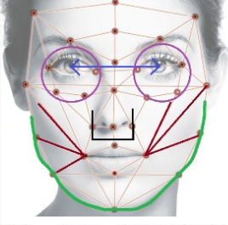
Extraction of Facial Features
This module is responsible for extracting a features that is well enough to identify as the face image. The goal of this module is to extract relevant data from the capture image.
Features:
Distance between the eyes
Width of the nose
Length of Jaw line
Chin

Slide 14
Feature Matching or Face Recognition
The last step is to compare the image with a database of known faces.
In the automatic attendance system, registered student faces are trained and stored in the database. Therefore, when the camera captures the face of any student, it will compare it with the known face database by using the student ID, and this process will return matches or potential matches close to the image in the database. Then, the attendance is automatically marked in the excel worksheet.

Slide 15

Why OpenCV ?
An OpenCV is an open-source and cross-platform library using which we can develop real-time computer vision applications.
OpenCV (Open Source Computer Vision Library) is an open source computer vision and machine learning software library.
The library has more than 2500 optimized algorithms.
It has C++, Python, Java and MATLAB interfaces and supports Windows, Linux, Android and Mac OS.
OpenCV is written in C/C++

Slide 16
Algorithms
Some of the best face recognition algorithms are:-
Viola-Jones Algorithm
Local Binary Pattern Histogram (LBPH)
Principal Component Analysis (PCA)

Slide 17
Viola-Jones Algorithm for Face Recognition
Developed by Paul Viola and Michael Jones back in 2001
Haar Cascade is a machine learning-based approach where a lot of positive and negative images are used to train the classifier.
Positive images – These images contain the images which we want our classifier to identify.
Negative Images – Images of everything else, which do not contain the object we want to detect.

Slide 18
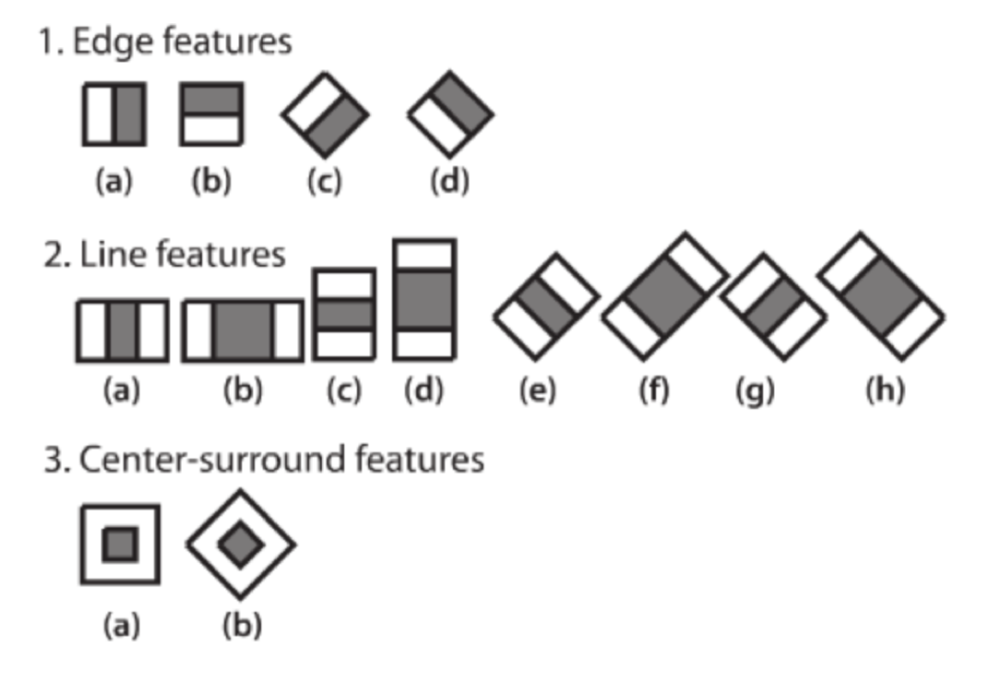
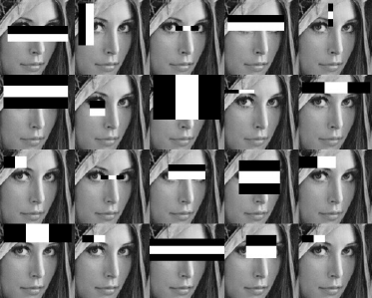
Viola-Jones Algorithm for Face Recognition(Continue…)
In order to extract the features from an image, Haar cascades provides three basic Haar features as shown :

Slide 19
Viola-Jones Algorithm for Face Recognition(Continue…)
0 | 0 | 1 | 1
0 | 0 | 1 | 1
0 | 0 | 1 | 1
0 | 0 | 1 | 1
0.18 | 0.25 | 0.55 | 0.85
0.25 | 0.38 | 0.8 | 0.7
0.20 | 0.12 | 0.8 | 0.72
0.25 | 0.12 | 0.55 | 0.9
This algorithms will compare how close the real scenario is to the ideal case.
The value of the feature is calculated as: sum of black pixel intensities minus the sum of white pixel intensities.
For Ideal Haar-feature value is: 1-0 = 1
For the real image value is: 0.73375 - 0.21875 = 0.515
Ideal Haar-feature
Pixel Intensities
Real values detected on image

Slide 20

Why NumPy
NumPy, which stands for Numerical Python, is the fundamental package for scientific computing in Python.
NumPy was created by Travis Oliphant in 2005 .
NumPy is a library for the Python programming language, adding support for large, multi-dimensional arrays and matrices, along with a large collection of high-level mathematical functions to operate on the arrays.

Slide 21
Why NumPy (Cont…)
Using NumPy, we can perform the following operations −
Mathematical and logical calculations on arrays.
Fourier transforms and routines for shape manipulation.
It has built-in functions for linear algebra and random number generation.
It has also used for scientific calculations.
Faster than python list.
It is fast because it is associated with C programming.

Slide 22

Why TensorFlow
TensorFlow is a open source Python-friendly library for numerical computation that makes machine learning faster and easier.
TensorFlow allows developers to create data flow graphs and structures that describe how data moves through a graph, or a series of processing nodes.
It Provides both C++ and Python API’s that makes it easier to work on.
It has a faster compilation time than other Deep Learning libraries like Keras and Torch.

Slide 23
Why TensorFlow (Cont…)
Main Use Cases of TensorFlow
Voice/Sound Recognition
Text Based Applications
Image Recognition & Video Detection
Benefits
The single biggest benefit TensorFlow provides for machine learning development is abstraction.
The TensorBoard visualization suite lets you inspect and profile the way graphs run by way of an interactive, web-based dashboard.

Slide 24
Local Binary Pattern Histogram (LBPH) Algorithm
Local Binary Pattern (LBP) is a simple yet very efficient texture operator which labels the pixels of an image by thresholding the neighborhood of each pixel and considers the result as a binary number.
LBP is one of the efficient algorithm for texture classification and it further combined with Histogram, which improves the detection performance on datasets.
The Local Binary Pattern Histogram(LBPH) algorithm is a simple solution on face recognition problem, which can recognize both front face and side face.

Slide 25
LBPH Algorithm (Cont…)
In first stage, we need to define the parameters (radius, neighbour, grind x, grind y). If we not set the parameters, algorithm will use default parameters.
Secondly, We need to train algorithm. To do that, we need a facial image dataset and unique ID for each image, so the algorithm will use that ID to recognize an input image with the images stored in the database and give the output according to the match.
Then, the algorithm will generates new image that describe the original image in a better way, by highlighting the facial features or characterises.

Slide 26
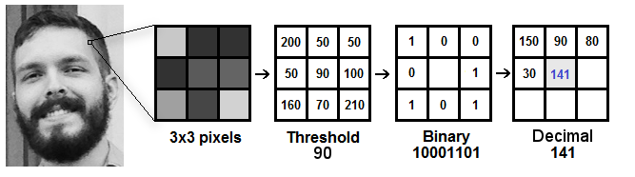
Computational steps of the LBPH Algorithm
The first computational step of the LBPH is to create an intermediate image that describes the original image in a better way, by highlighting the facial characteristics.
For each neighbours, condition is:
put 1 when central value <= neighbour value
put 0 when central value > neighbour value

Slide 27
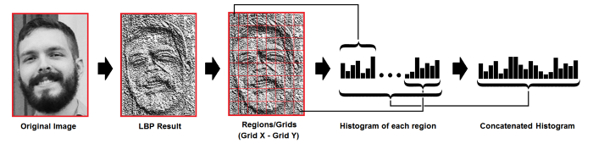
Computational steps of the LBPH Algorithm (Cont…)
Now, the matrix will contain only binary values and convert that binary value into a decimal value as a clockwise direction.
The decimal value we get is set to the central value of the matrix, which is actually a pixel from the original image.
Now using that image, we use grind x and grind y parameters to divide the image into multiple grids.

Slide 28
LBPH Algorithm (Cont…)
Performing the face recognition:
Each histogram created is used to represent each image from the training dataset.
So, given an input image, we perform the steps again for this new image and creates a histogram which represents the image.
So to find the image that matches the input image we just need to compare two histograms and return the image with the closest histogram.

Slide 29
References
Ali Tarhini, “Face Recognition: An Introduction”: https://alitarhini.wordpress.com/2010/12/05/face-recognition-an-introduction/#:~:text=Image%20acquisition%3A&text=The%20most%20existing%20facial%20recognition,angle%2C%20the%20recognition%20rate%20decreases
Implementation of face recognition: https://www.slideshare.net/Nikyaa7/automatic-attendance-system-using-facial-recognition
Information about OpenCV: https://opencv.org/about/
Haar Cascade in OpenCV: https://opencv-python-tutroals.readthedocs.io/en/latest/py_tutorials/py_objdetect/py_face_detection/py_face_detection.html
Divyansh Dwivedi, “Face Detection For Beginners” : https://towardsdatascience.com/face-detection-for-beginners-e58e8f21aad9

Slide 30
References
Face detection (image): https://krazytech.com/technical-papers/face-identification-recognition
Image Acquisition (image): https://www.slideshare.net/gsantosh031/face-recognition-ppt
NumPy: https://en.wikipedia.org/wiki/NumPy
https://numpy.org/devdocs/user/whatisnumpy.html
TensorFlow: https://www.exastax.com/deep-learning/top-five-use-cases-of-tensorflow/
Kelvin Salton do Prado, “Face Recognition: Understanding LBPH Algorithm” : https://towardsdatascience.com/face-recognition-how-lbph-works-90ec258c3d6b

Slide 31
Thank You

