Slide 1






COMP 5112 Research Methodology
Winter 2021

Slide 2
Face Detection and Recognition Using OpenCV
Created By :-
Group No:- 9
Name:- Urvil Ashokkumar Patel
Student Id:- 1131703
Name:- Jhanvi Dilipkumar Upadhyay
Student Id:- 1159217
Guided By :- Dr. Jinan Fiaidhi

Slide 3
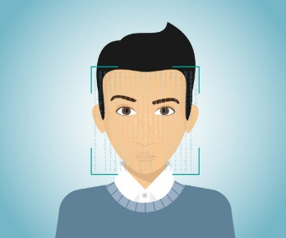


Objective
Our main objective is to detect and recognize the human face by using various algorithms and classifiers. We build an automated attendance system by using this technology and mark the attendance in an excel sheet. This mode of attendance system is more secure and easier than the manual as well as other means of attendance system.
Detect Face
Recognize face
Mark the attendance in an excel sheet

Slide 4
Problem Definition
Nowadays, in most of the schools and colleges, student’s attendance is taken by manually by using attendance sheet in classroom, which is time consuming as well as it increase the workload of a teacher.
Moreover, it is very difficult to verify one by one student in a large classroom whether the authenticated students are actually responding or not.

Slide 5
Re-cap
In our previous presentations, we discuss about two terms: face detection and face recognition.
Then we discuss the whole process of how the face is detected and recognize by using various algorithms and classifiers.
After that we explained the some basic libraries and algorithms that we are going to use in this research.
Libraries: OpenCV, NumPy
Algorithms: Viola-Jones Algorithm and LBPH (Local Binary Pattern Histogram) Algorithm

Slide 6
Block Diagram
Face of a person
Face Image
Find face location, texture, size
Image Acquisition or Detect any face
Image Processing
Extraction of a facial features
Face ID
Feature matching
Find successfully
Comparing with Database
Compare using Face ID
Database of Enrolled Users
Marking the attendance in Excel sheet

Slide 7
Implementation of the research
Step 1: Install necessary libraries by using pip command or we can directly install them in our PyCharm IDE.
Step 2: import necessary libraries required to run the program.
Step 3: Detect human faces by using sensors (camera) then converted from RGB to grayscale image and stored it into the located database.
Step 4: Train the dataset by using LBPH algorithm and create one trainer.yml file.
Step 5: Using that trainer file, recognize the person face by using unique ID in our datasets.
Step 6: When the face is found, it will automatically mark the attendance in an excel sheet along with the name of the person and current date.

Slide 8
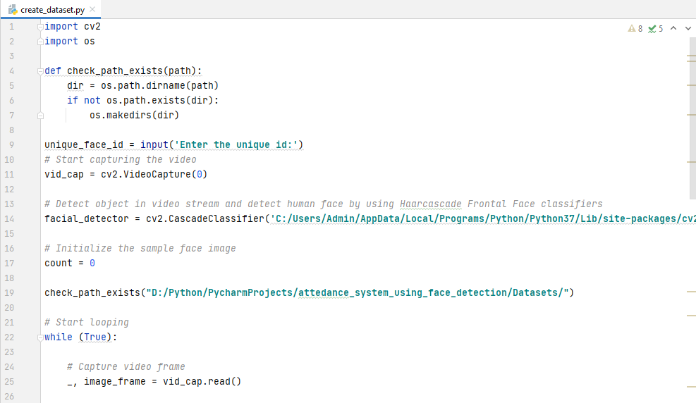
Implementation for step 2 & 3

Slide 9
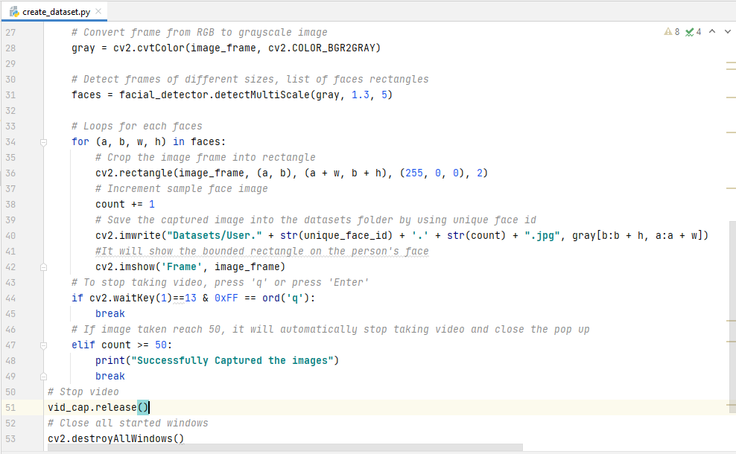
Implementation for step 2 & 3 Continue…

Slide 10
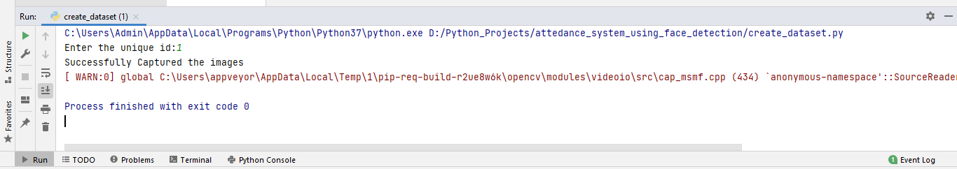
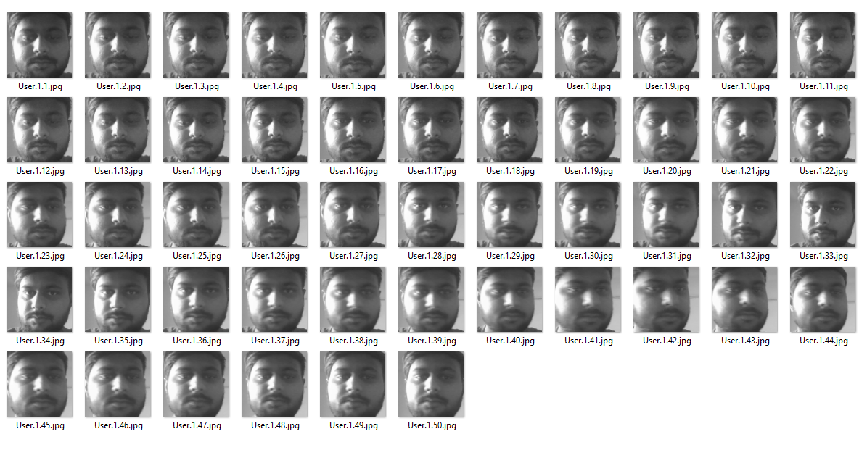
Output
Captured Images

Slide 11
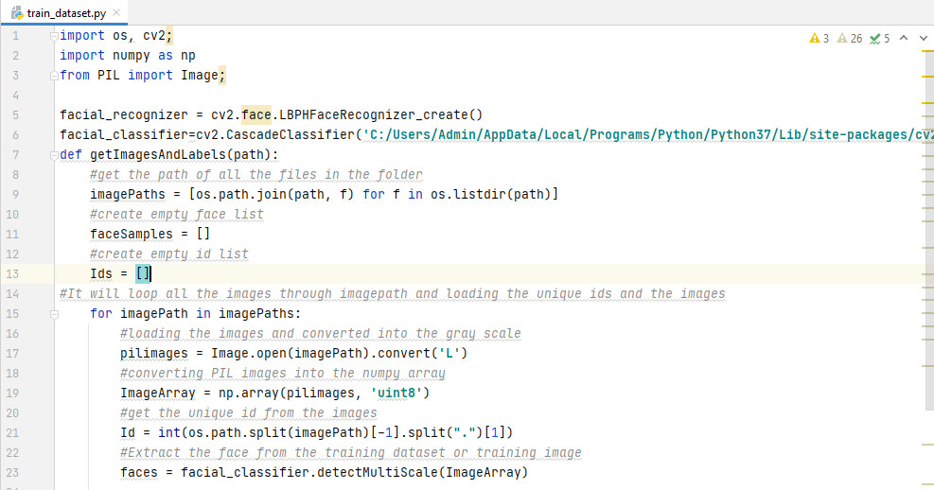
Implementation for step 4

Slide 12
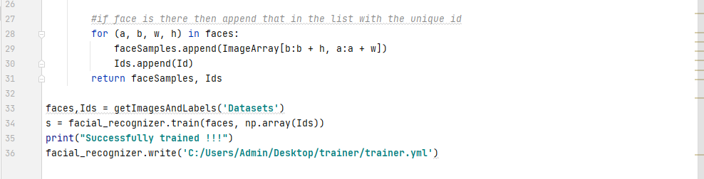
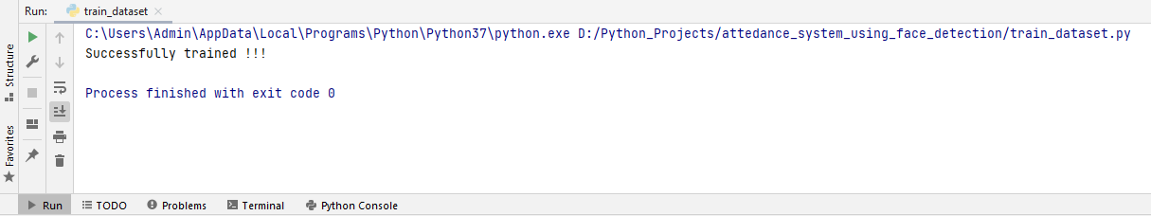
Implementation for step 4 Continue…
Output 1

Slide 13
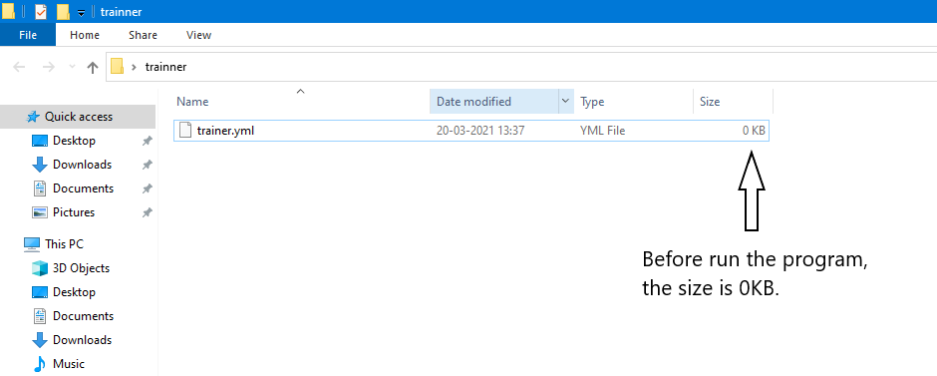
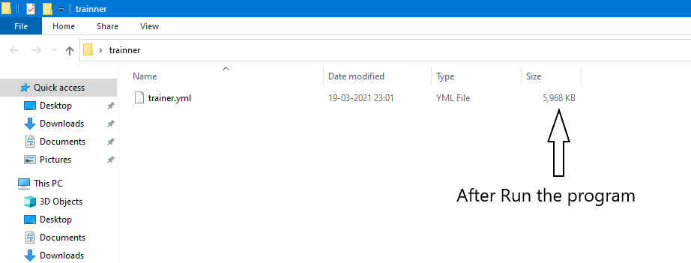
Output 2

Slide 14
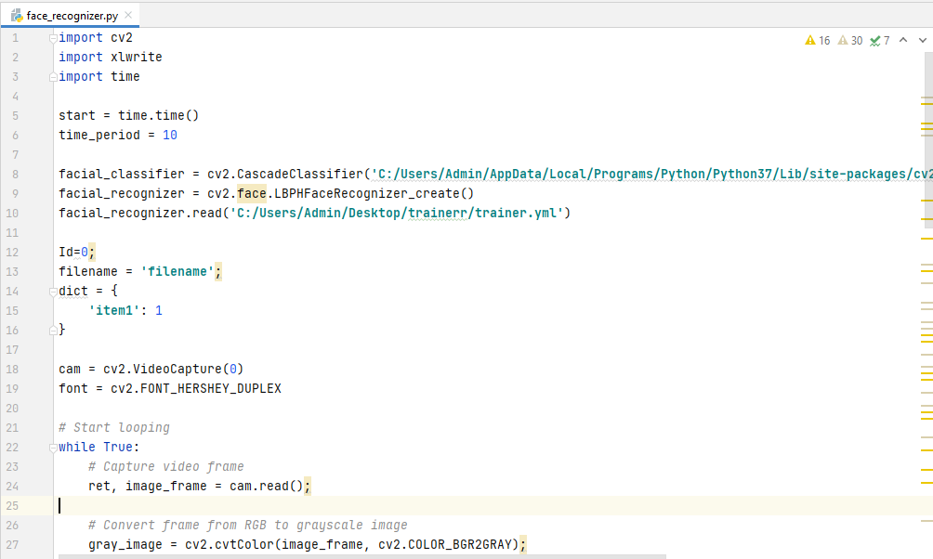
Implementation for step 5

Slide 15
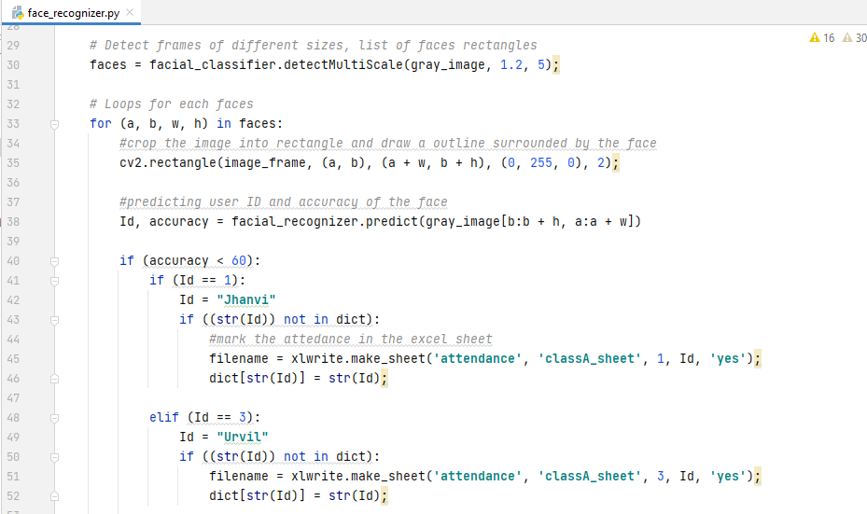
Implementation for step 5 Continue…

Slide 16
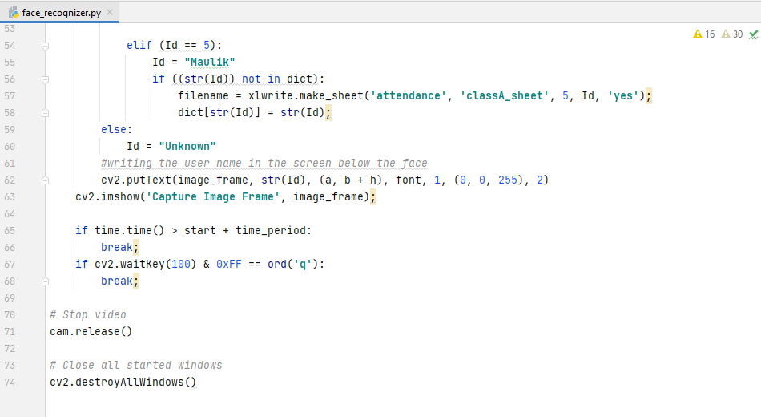
Implementation for step 5 Continue…

Slide 17
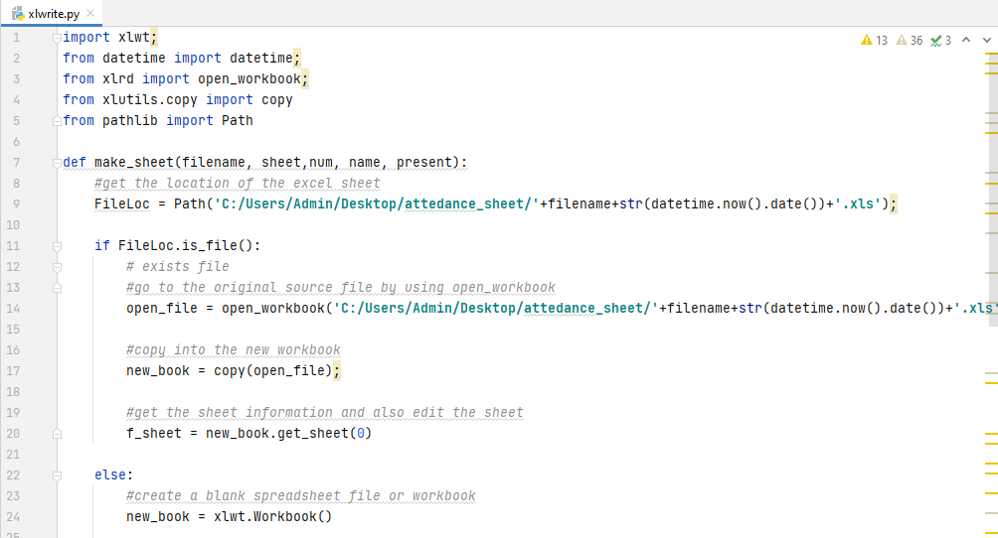
Implementation for step 6

Slide 18
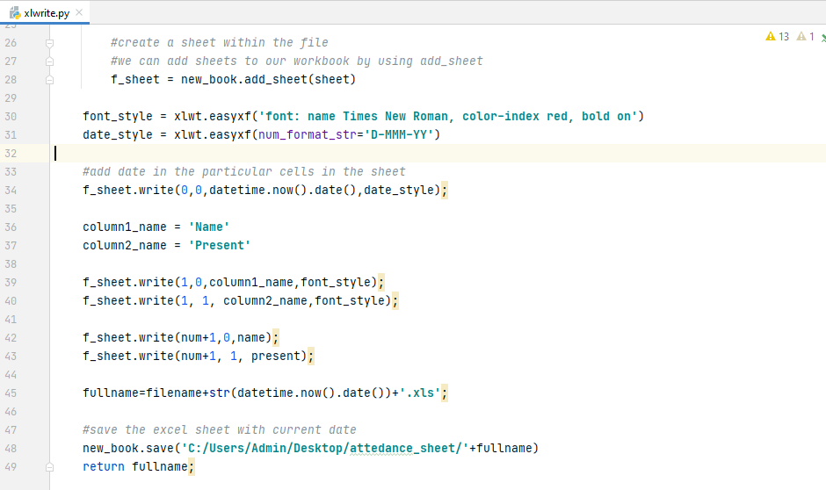
Implementation for step 6 Continue…

Slide 19
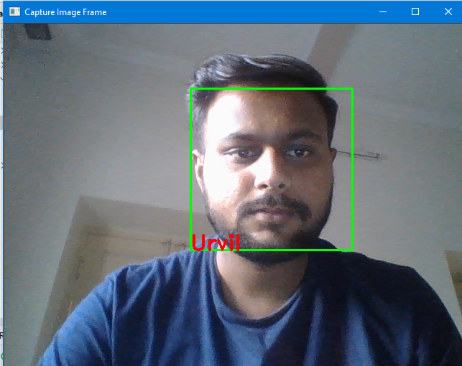
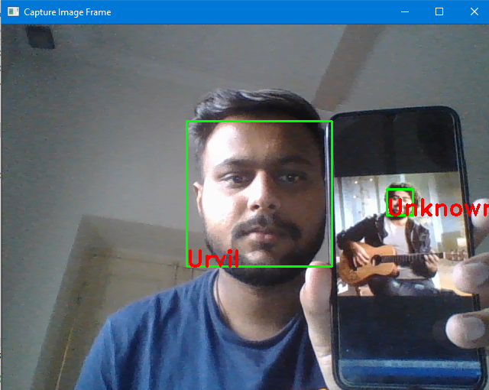
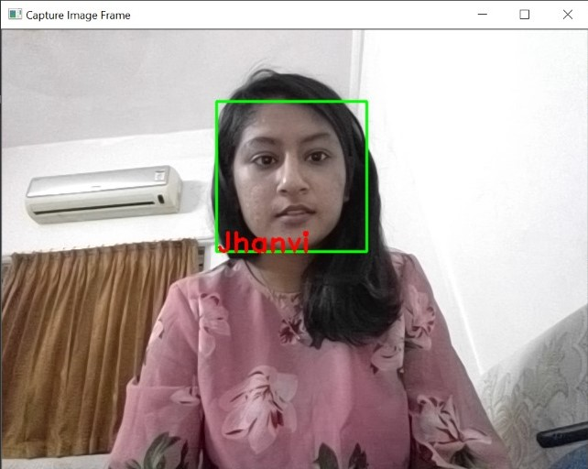
Output

Slide 20

Output

Slide 21
References
Face detection (image): https://krazytech.com/technical-papers/face-identification-recognition
Face recognition (image): https://images.app.goo.gl/8g6ENJrs7HEKYsu48
Excel sheet logo (image): https://images.app.goo.gl/ux4UR2qe4twdL51r5
Ali Tarhini, “Face Recognition: An Introduction”: https://alitarhini.wordpress.com/2010/12/05/face-recognition-an-introduction/#:~:text=Image%20acquisition%3A&text=The%20most%20existing%20facial%20recognition,angle%2C%20the%20recognition%20rate%20decreases
Divyansh Dwivedi, “Face Detection For Beginners” : https://towardsdatascience.com/face-detection-for-beginners-e58e8f21aad9
Implementation of face recognition: https://www.slideshare.net/Nikyaa7/automatic-attendance-system-using-facial-recognition

Slide 22
Thank You

