Slide 1
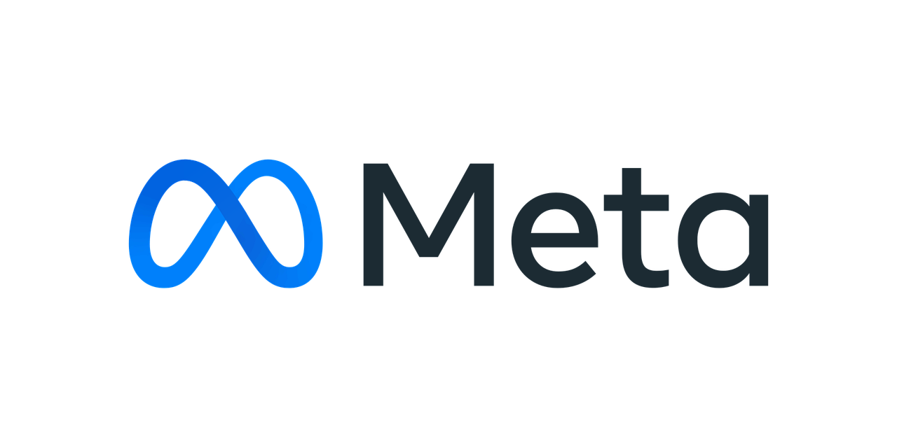
Social Media Analysis Project
Urvish Tiwari DS-May 2024

Slide 2
Table Of Contents
What is Meta ?
Introduction with Problem Statement
Data Overview
Methodology
Engagement metrics
User Segmentation
Content Performance
Marketing Strategy
Ad Campaigns & Financial Projections
Insights and recommendations
Conclusion

Slide 3
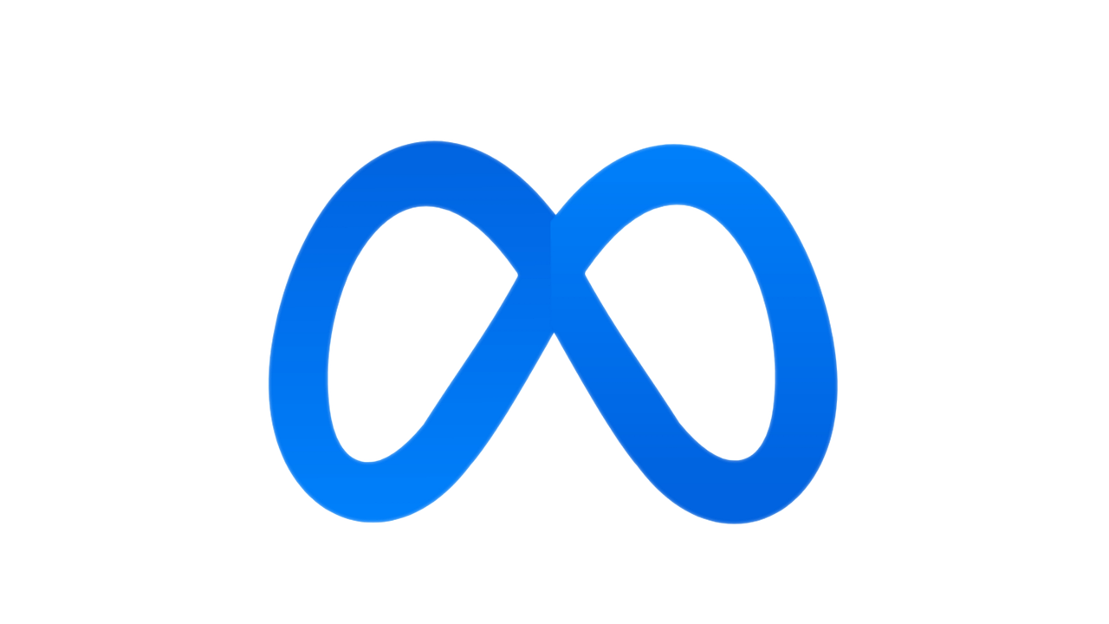



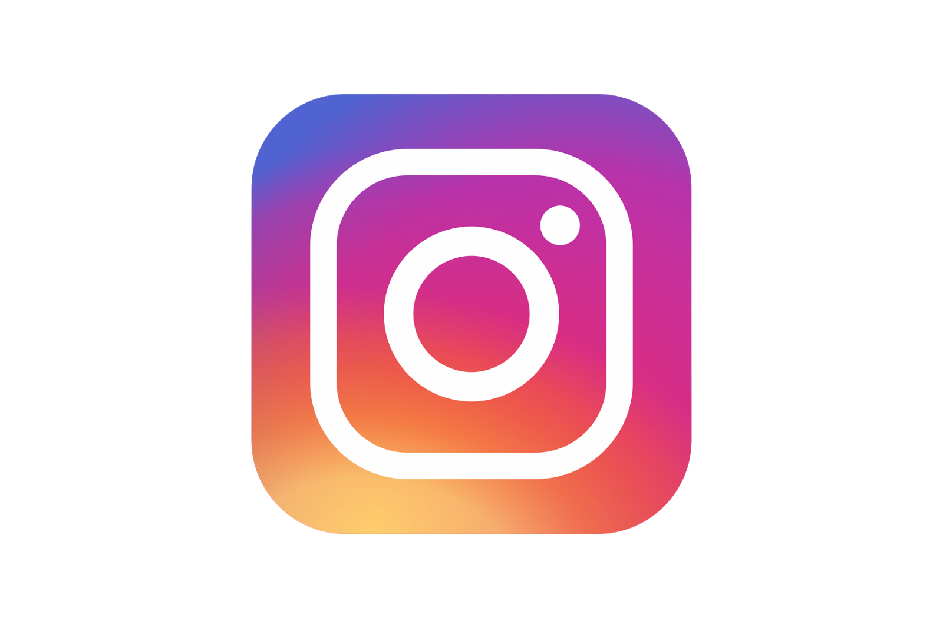
What is Meta ?
This company owns and operates Facebook, Instagram, WhatsApp and Threads, among other product and services.
Meta Platforms doing business as Meta, and formerly named Facebook which is based in California, America.
Meta’s vision is to bring metaverse to life for helping peoples.
Meta’s mission is to give people the power to build community and bring the world closer together.

Slide 4

Introduction with Problem Statement
You are hired as a data analyst at Meta and asked to collaborate with Marketing team. Marketing teams wants to leverage Instagram's user data to develop targeted marketing strategies that will increase user engagement, retention, and acquisition.
Provide insights and recommendations to address the following objectives

Slide 5

Data Overview
Total number of users are 100
Total number of Posts which are being posted across the platform is 257
Total number of Likes done by the users are 8782
Total number of Comments done by the users are 7488
Number of Engagements that are sum of likes and comments
Engagement rate is engagements divided by posts
Posts: 257
Likes: 8782
Comments:7488

Slide 6
Methodology
Data Cleaning: Check for duplicate values and also for null values for each table
Trend Analysis: Check the latest trend and hashtags
User Engagement: Check user is engaging on which hashtags and on which type of content
User Segmentation: Segment the users on the basis of user engagement across different segments
Visualization: Make charts for the different scenario and visualize the data as interactively you can.
Data Cleaning
Trend Analysis
User Engagement
User Segmentation
Visualization

Slide 7
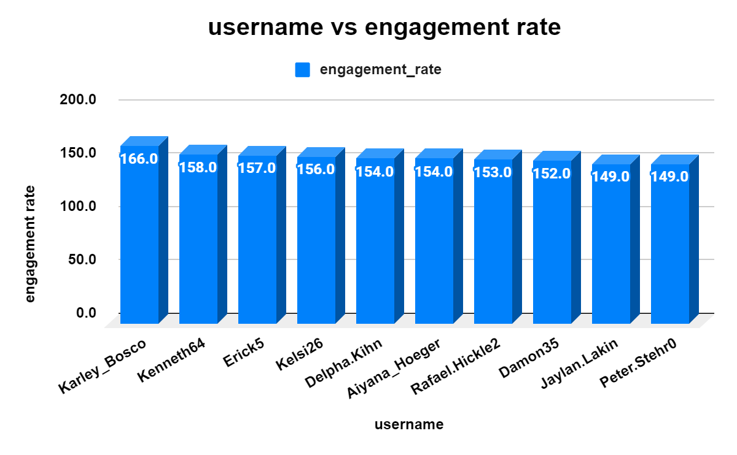
Engagement Metrics
Calculate total user engagement for every users and then select some top users on the basis of the engagement rate.
After Calculating we got some top users who have done well we have selected them for target marketing
Karley_Bosco have highest user_engagement rate of 166.0
For target marketing we will approach Karley personally for collaboration and content creation

Slide 8
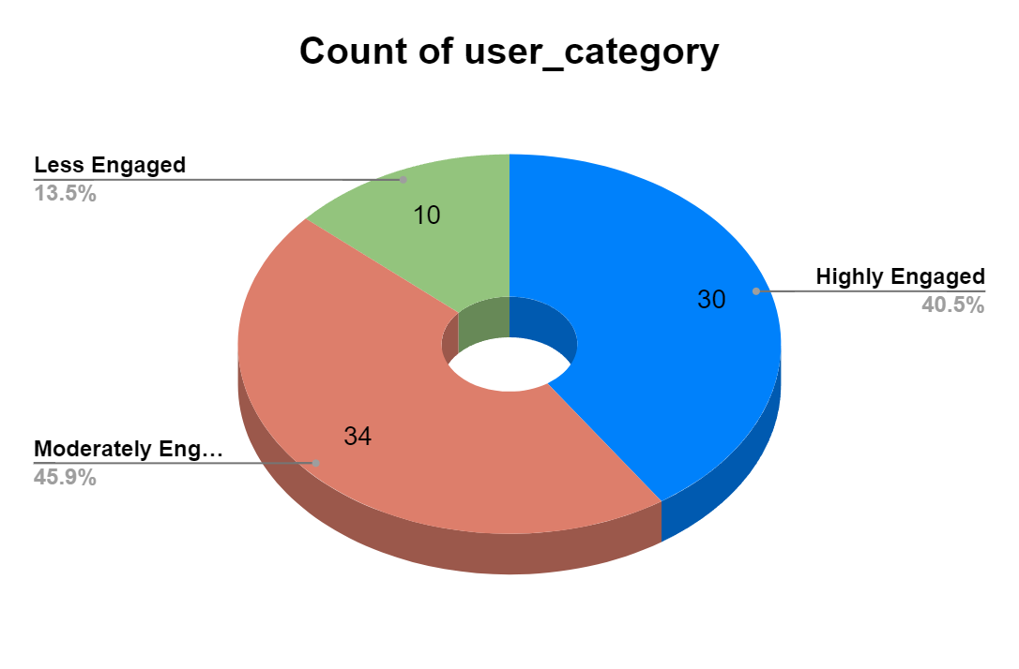
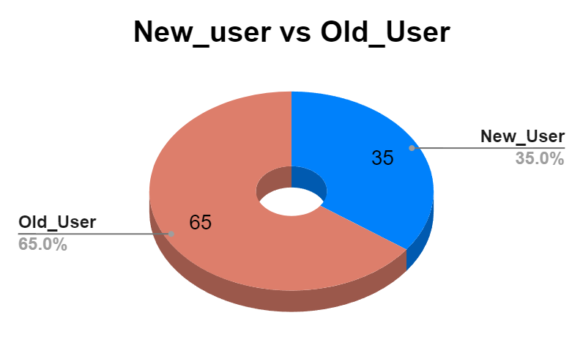
User Segmentation
High Engagement Influencers: The users who are actively posting and are getting more likes and comments here it is 40.5%
Moderate Users: The users who are more active they are on the platform frequently here it is 45.9%
Less Engaged Users: The users who are not posting or liking the content here it is 13.5%
New Users: Recently joined users are 35%
Content Consumers: The users are there on the platform consuming contents but not posting anything are old users , it is 65%

Slide 9

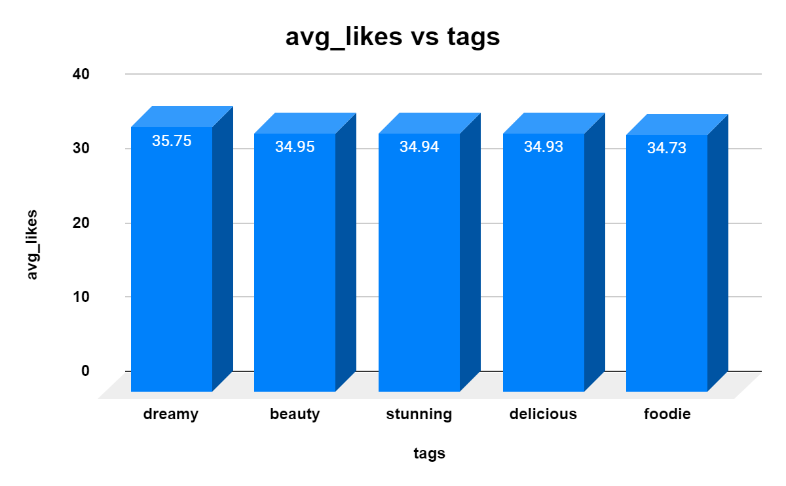
Content Performance
Which content is getting how much engagement, it will be beneficial for us to focus on which area more.
And who are getting engagement check what hashtags they are using and calculate average likes per hashtags.
Most liked hashtags was dreamy with 35.75%, and second best was beauty with 34.95%.
We will see where are the scope of improvements here it is on landscape that is 33.59%

Slide 10
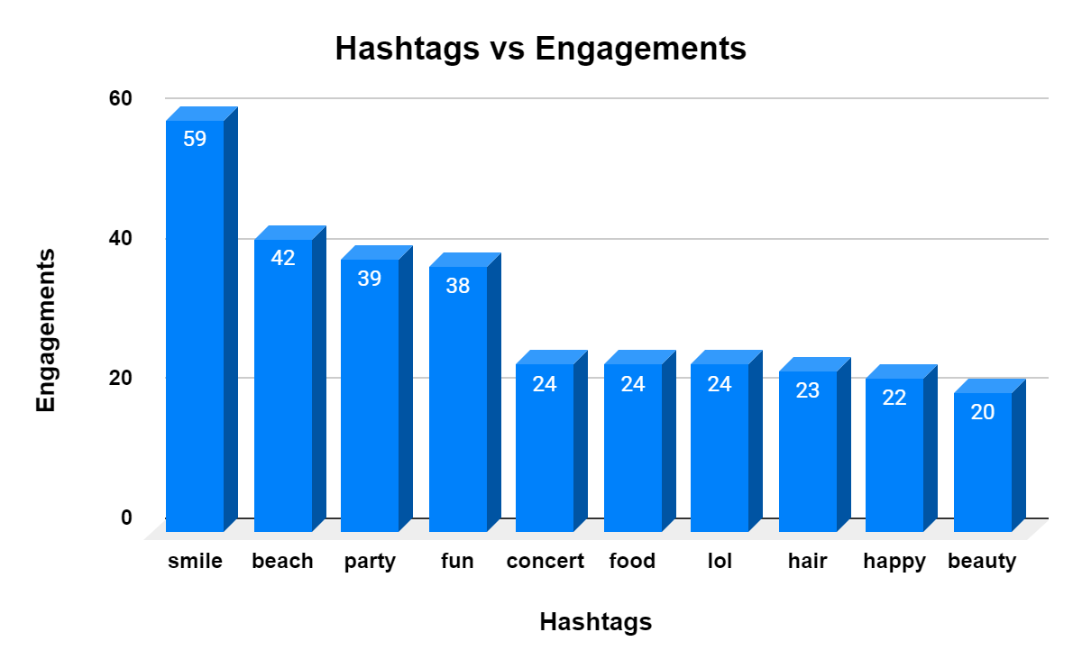
Content Performance
Likes
User Engagement
What are the user engagements across all the hashtags and which users have most used .
The smile hashtag is used 59 times, Beach is used 42 times and party with 39 times.
So these hashtags are working good for the user engagement.
We will Analyze one more thing that how much the engagement is divided amongst the photos.
Comments

Slide 11
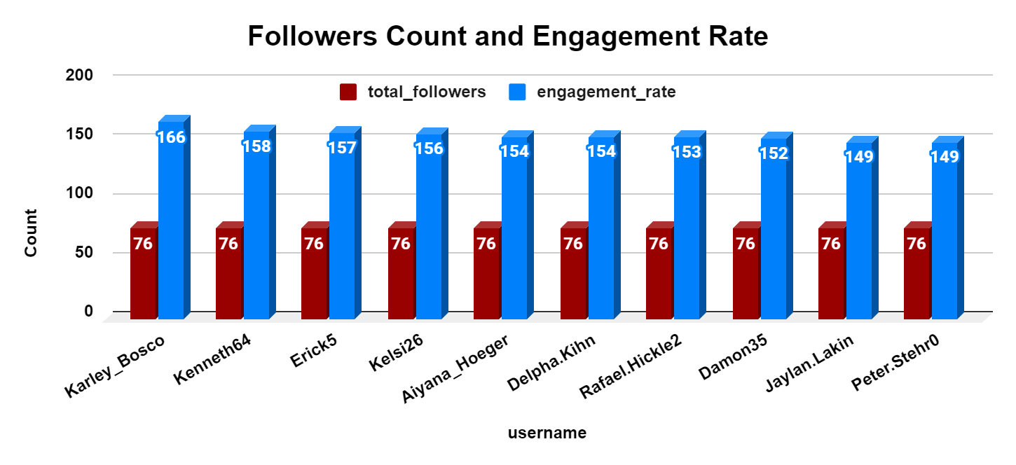
Marketing Strategy
Ad campaigns should run on the basis of needs and user segments.
Leveraging User Data for Personalized Ad Content, what type of content they are consuming more show them recommendations, give them notifications related to that.
Collaborate with the highly engaged users such as Karley_Bosco, Kenneth 64, Erick 5 and create content to encourage others and motivate them to re-engage on the platform.

Slide 12

Ad Campaigns & Financial Projections
Email campaigns should run for re-engaging the potential users
Target the audience on the basis of content they are going through on different platforms
Personalised notifications for every inactive users to feel them connected
Notifications should be catchy, unique and interactive
Spend more on that Ad campaigns which are engaging less, find ways how to improve more in that case
Users collaboration should focused, pay the collaborator good who are getting more engagement for better reach on the platform.

Slide 13

Insights and recommendations
Insights:
Hashtag drives good engagements
Post with trending hashtags have more engagements.
Photos are less time consuming than reels and videos.
During Holidays there are more travel photos
Recommendations:
Balance the contents and prioritize reels because they get more engagements.
Focus on trends and continuously monitor these things.
Optimize hashtags by regularly updating hashtags for aligning them with trending topics

Slide 14



Conclusion
The analysis of Instagram's user data has provided valuable insights into user behavior, engagement and content performance
Here we got Karley_Bosco, Kenneth 64, Erick 5 have good engagements
There is good engagement on Smile,Beach, Party, Fun, Dreamy these hashtags , so we can improve on others.
Kennen Schamberger 60 have highest engagement of 173 but he posted only once.
It’s important to continuously monitor content performance, follow trends, and modify our strategies to stay ahead in the dynamic social media landscape.

Slide 15
