Slide 1


Restaurant Analysis Project
Urvish Tiwari
DS-May 2024

Slide 2

TABLE OF CONTENT
Introduction and Problem Statement
Market Research
Target Countries
Competitors in the Market
Financial Projections
Marketing Strategy
Competitors in the Market
Dashboard
Conclusion and key Insights

Slide 3

Introduction with Problem Statement
Zomato team wants to expand own business, opening new restaurants in different country to capture the maximum customers of different prize range and cuisines according to country.
A dataset of food industry(restaurants) is Analysed and insights & information is derived from the data .
Purpose of the study is to initially analyse the data and draw certain information from it .

Slide 4
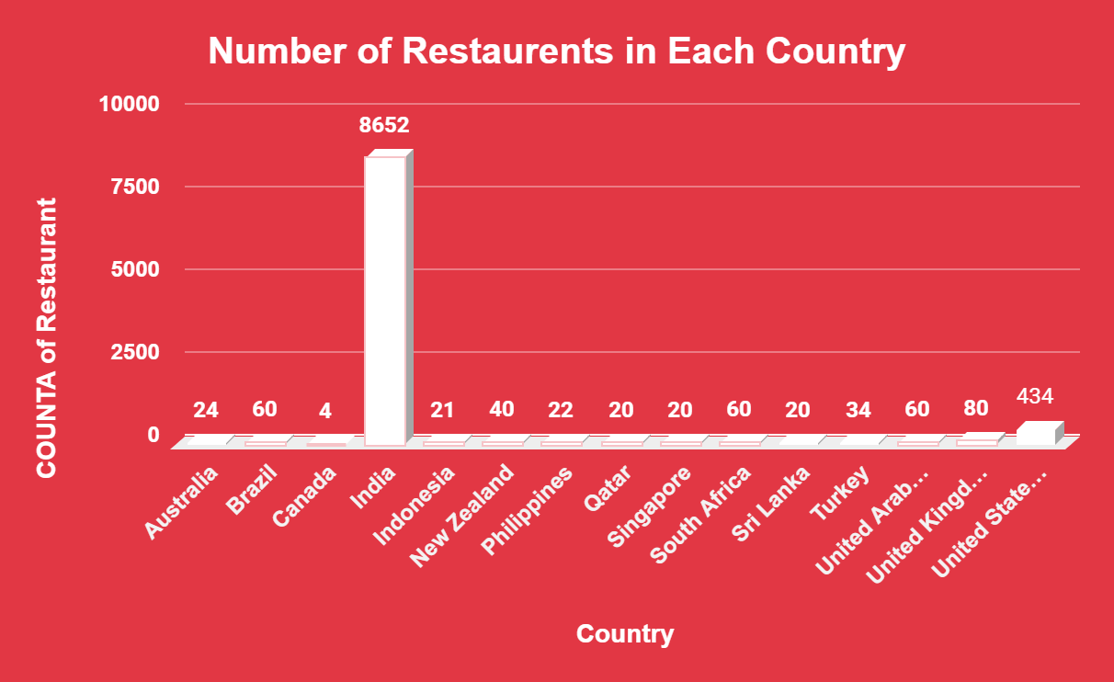
Market Research
Total Country -15
In all over world there are 9551 restaurants.
Total Number of Cuisines 1826.
Highest Number of Restaurants seen in India-8652.
Lowest Number of Restaurants seen in Canada- 4
And 388 restaurants having above than Price range 4 in India.

Slide 5
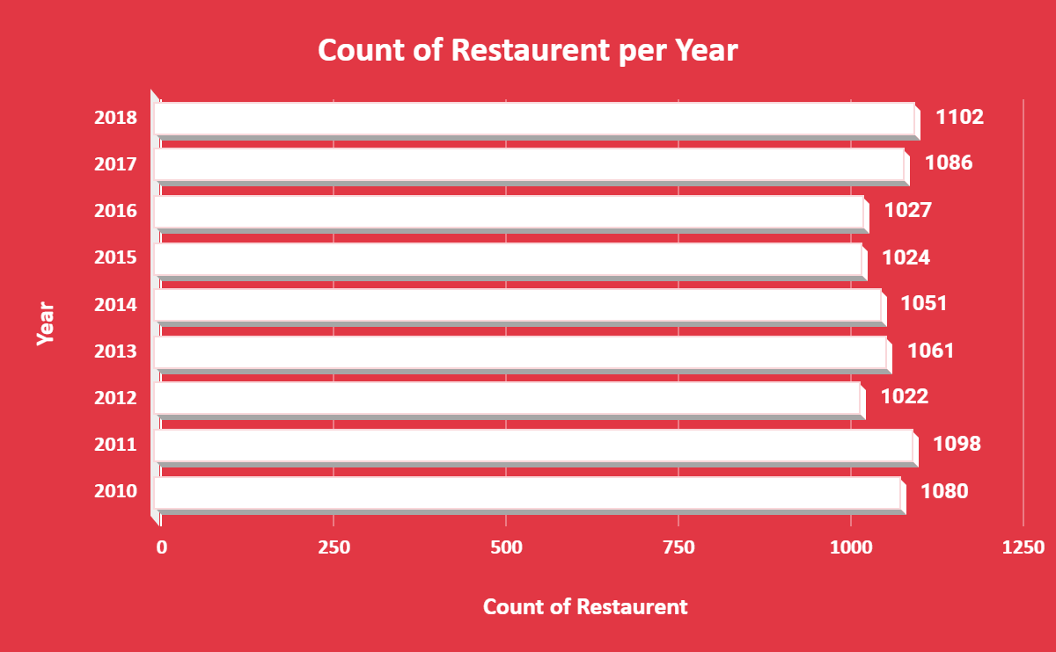
Market Research
According to our data, Every year more than 1000 restaurants are open all over the country from 2010 to 2018.
In Year 2018 had the highest opening of restaurants
There was a slowdown in openings
1000
1102
2012–2016
1027
2010
In Year 2012 had the lowest openings
of restaurants
In 2010, 2011 has good number of opening restaurants.

Slide 6
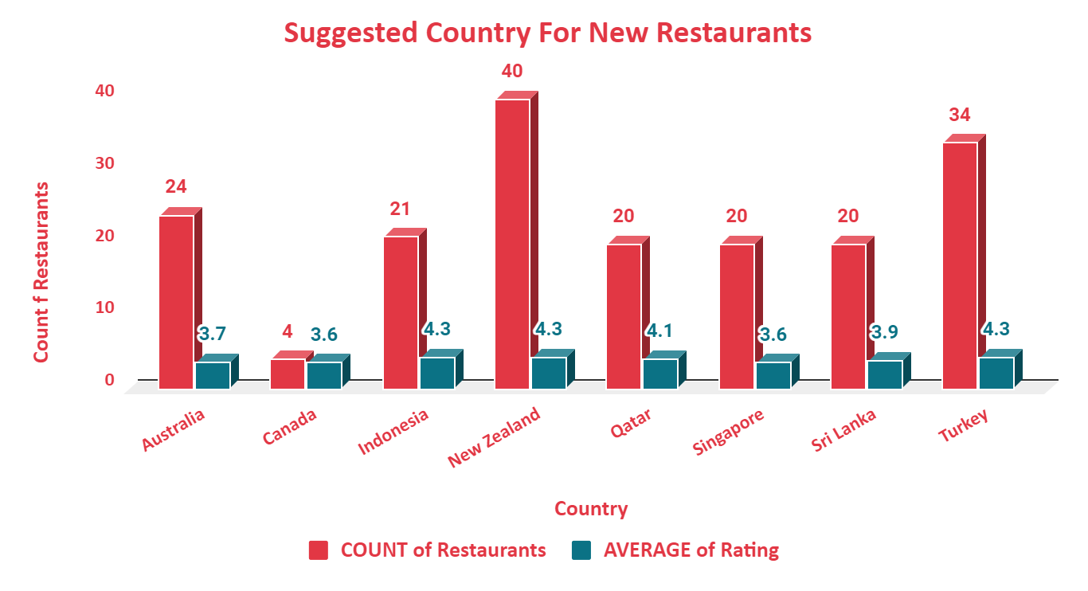
Target Countries
According to our analysis we find some country there less than 40 restaurants are opened and average rating below than 4.5.
Canada have only 4 restaurants and have only 3.6 average rating this is best country to expend business.
Qatar, Singapore, Sri Lanka have 20 restaurants with good rating, so these country have our next target.

Slide 7
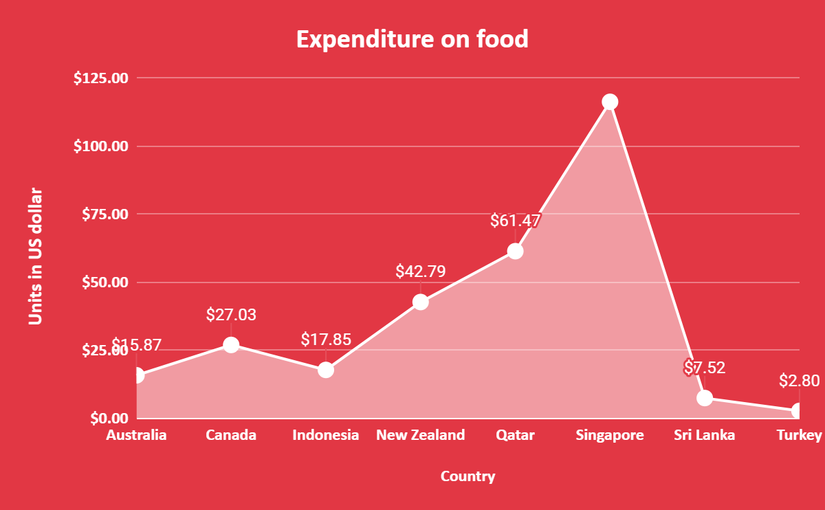
Financial projections
On the basis of our analysis, we can control the expenditure on food to know the average prize of two people spent on food.
We convert the all the country currency in US Doller.
Country | Currency
Australia | Dollar($)
Canada | Dollar($)
Indonesia | Indonesian Rupiah(IDR)
New Zealand | Dollar($)
Philippines | Botswana Pula(P)
Qatar | Qatari Rial(QR)
Singapore | Dollar($)
Sri Lanka | Sri Lankan Rupee(LKR)
Turkey | Turkish lira
In Singapore we need to spend $116.34 as average money for two people.
In Turkey people need to spend $2.80 per two personal
So, we can serve the food under that budget.

Slide 8
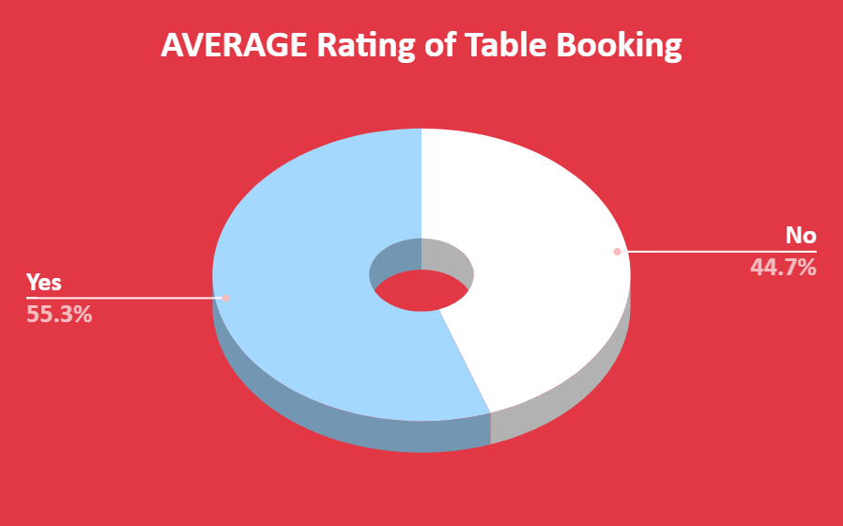
Marketing Strategy
Newer restaurants also offers the table booking option because the table booking affects the rating.
Average rating of table booking is 3.5 (55.3%).
Average rating of not booking table is 2.8 (44.7%)
So, People wants table booking system in new restaurants and the rating is also higher.
It can be Concluded – Table bookings should be offered and has direct relationship with ratings.

Slide 9
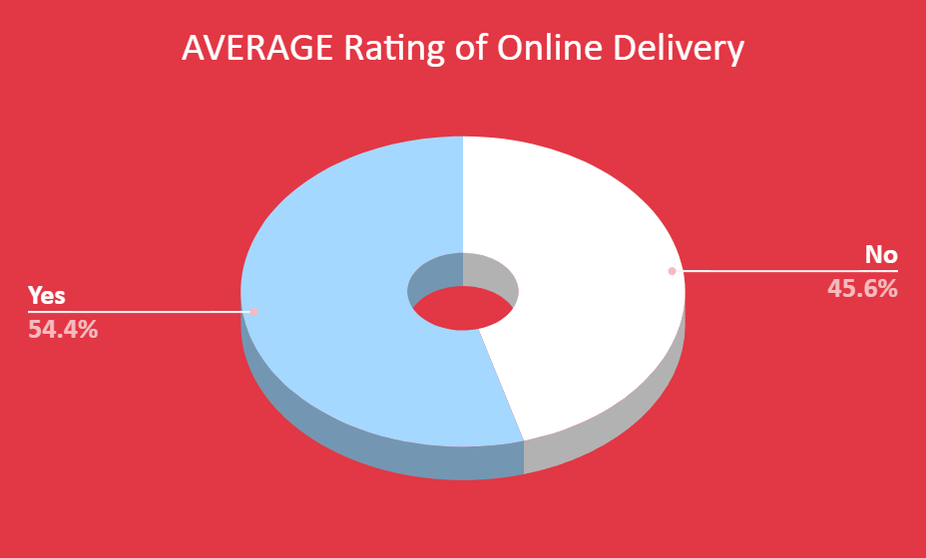
Marketing Strategy
We can also provide online delivery option because it also affects the rating of restaurants.
Average rating of Online delivery is 3.5 (54.4%).
Average rating of not having online delivery is 2.8 (45.6%)
So, People wants table booking system in new restaurants and the rating is also higher.
It can be Concluded – Table bookings and Online delivery should be offered and has direct relationship with ratings.

Slide 10
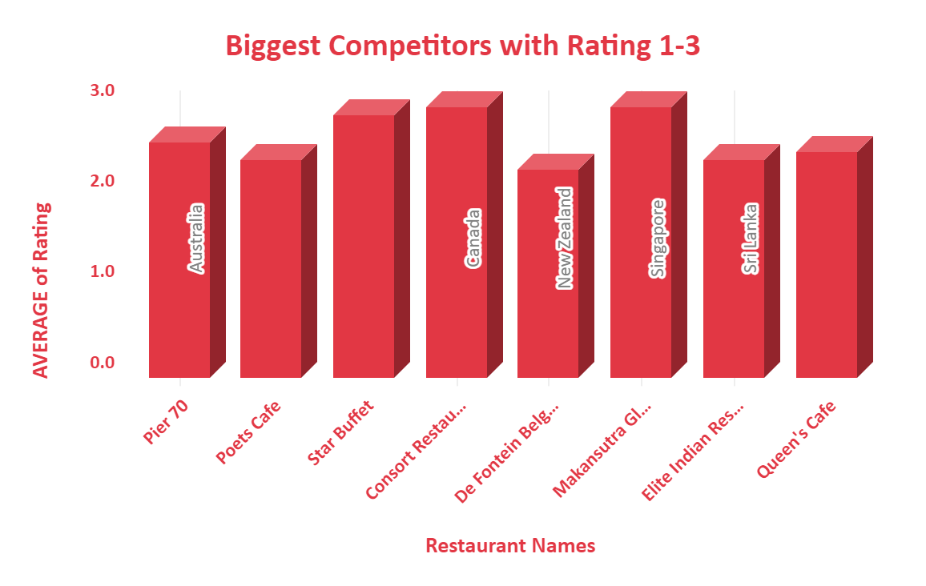
Competitors in the Market
There are some states where we will get a lot of competition in the market.
In the suggested countries there are 8 restaurants in the lower rating bracket .
Australia and Sri Lanka have most 3 & 2 respectively.

Slide 11
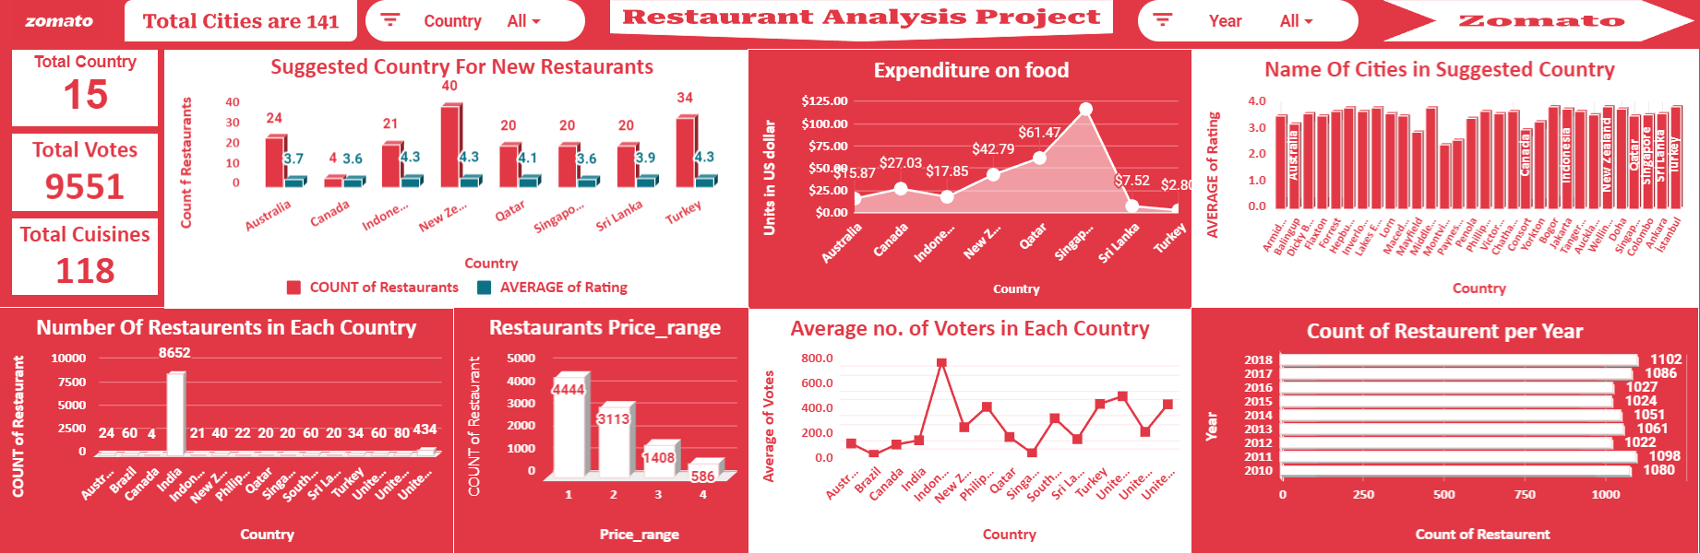
Dashboard

Slide 12

Conclusion and key Insights
Australia, Canada, Indonesia, New Zealand , Qatar , Singapore , Sri Lanka , Turkey are the potential opportunities where the management can look upon to invest. As well India can be looked upon but utmost strategy with quality concerns should exist to plan a restaurant to surpass other’s competition.
Services and quality in terms of food ,ambience, taste is more important compared to strategizing on cuisine type.
Online food delivery & table booking services has a direct effect on ratings of a restaurant.
For price range, by a good strategy if in a moderate price range if good services are provided still the restaurant can be profitable.

Slide 13


