Slide 1
CARPOOL MANAGEMENT
By: Huzaifa Jawad, Usaid Rehan, Umer Wasi

Slide 2



TABLE OF CONTENTS
01
02
03
Abstract
Details
Conclusion
Introduction
Stakeholders
SDLC Model
Technology
Features
UML Models
Client-Side
Server-Side
Conclusion

Slide 3
Abstract
01
You can enter a subtitle here if you need it

Slide 4
—Product Manager
“Economical and One-Stop Model for Efficient Ridesharing in any Organization”

Slide 5
Stakeholders
Course Instructor
Organization Commuters
Concepts of Software Design and Analysis
Comprises of Faculty, Staff and Students with Variety of Preferences, divided into, Drivers and Passengers

Slide 6

SDLC Model
Waterfall
Each development phase clearly defined and completed before next begin. It is easy for low-budget projects, to organize tasks and create the SRS documentation.
Purpose of Use:
All requirements clear and fixed in proposal
The technology was fixed
No feature could be developed without its previous

Slide 7
02 Details

Slide 8
Technology Stack
HTML/CSS/Js
Node
Express
MySQL
Client-Side
Server-Side
Server Management
Database

Slide 9
Features
Sign-up/in using Organization Email
Create Profile with Identity and Preference Details
Create a Semester or a One-Time Group as Driver
Join and Leave any Group with Real-Time Transactions
Dropdown Filter Group by Details or Preferences
Records History for Violators to be banned by Administrator
Advertisement Monetization covers Hosting
Data-Intensive so can handle 15,000 Requests per Second
Notification Button
Potential Routes Visualization

Slide 10
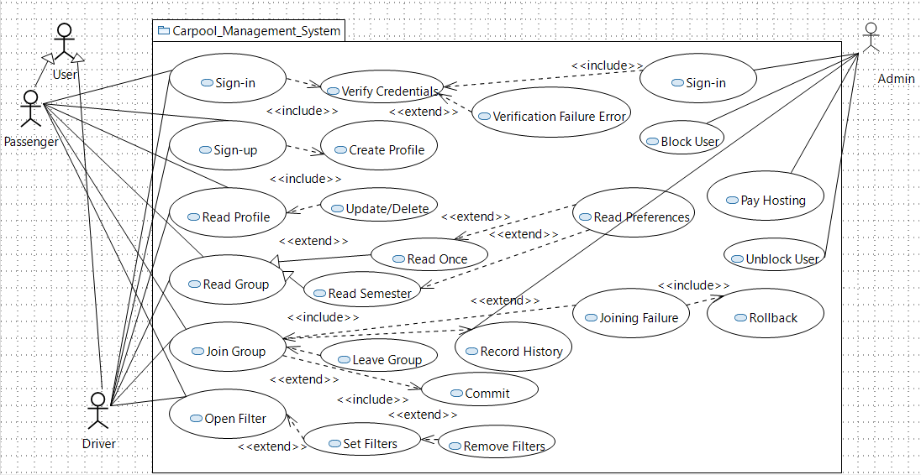
Use-Case Diagram

Slide 11
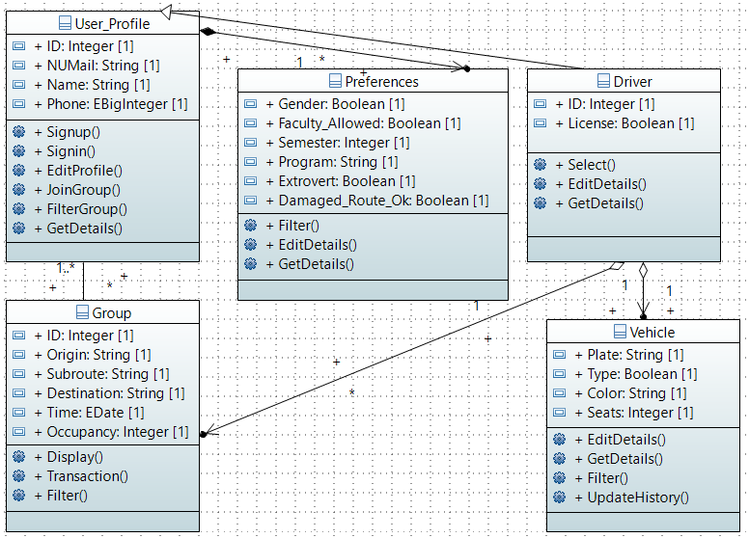
Class Diagram

Slide 12
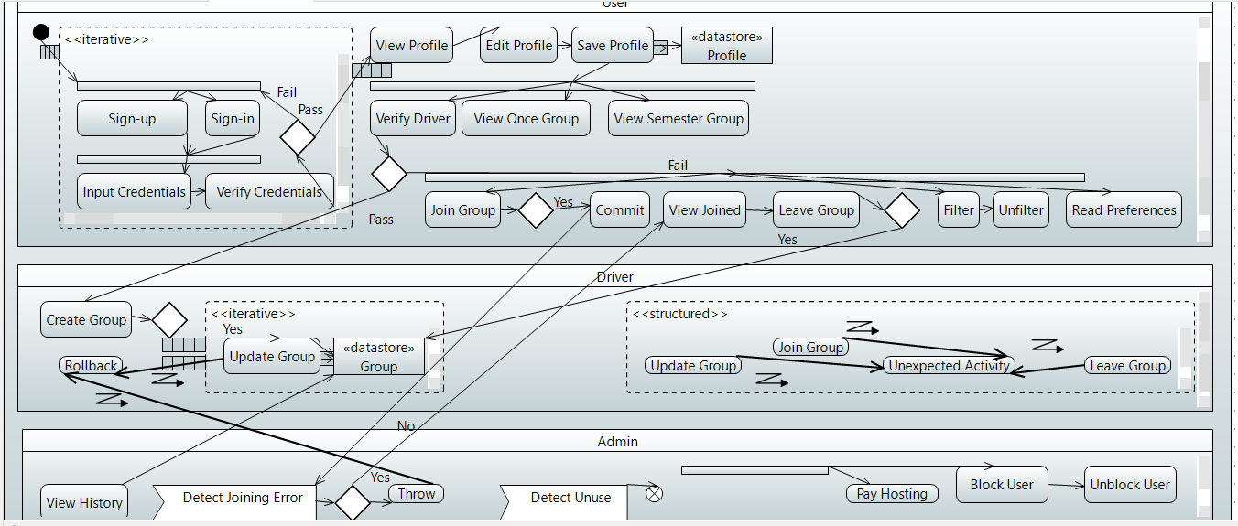
Activity Diagram

Slide 13
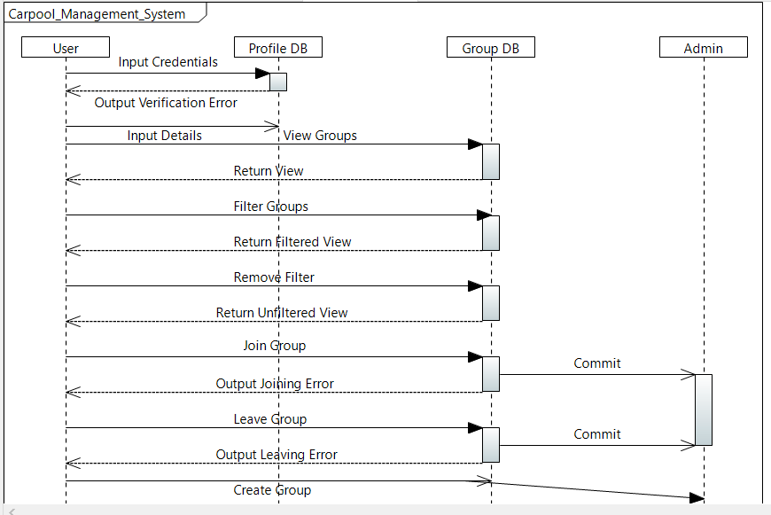
Sequence Diagram

Slide 14
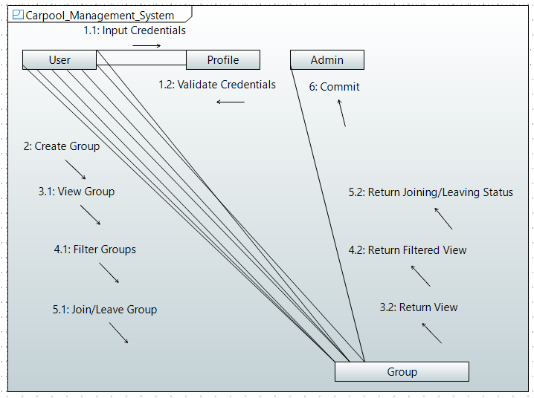
Communication Diagram

Slide 15
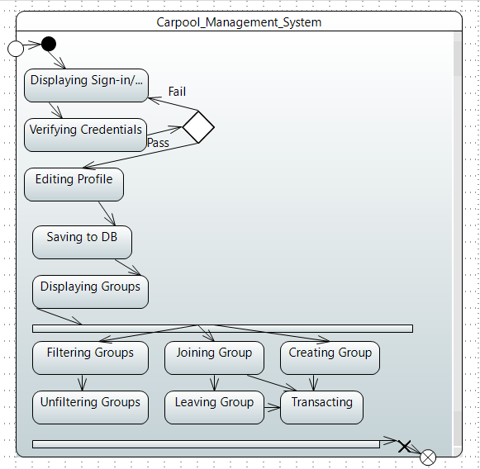
State Diagram

Slide 16
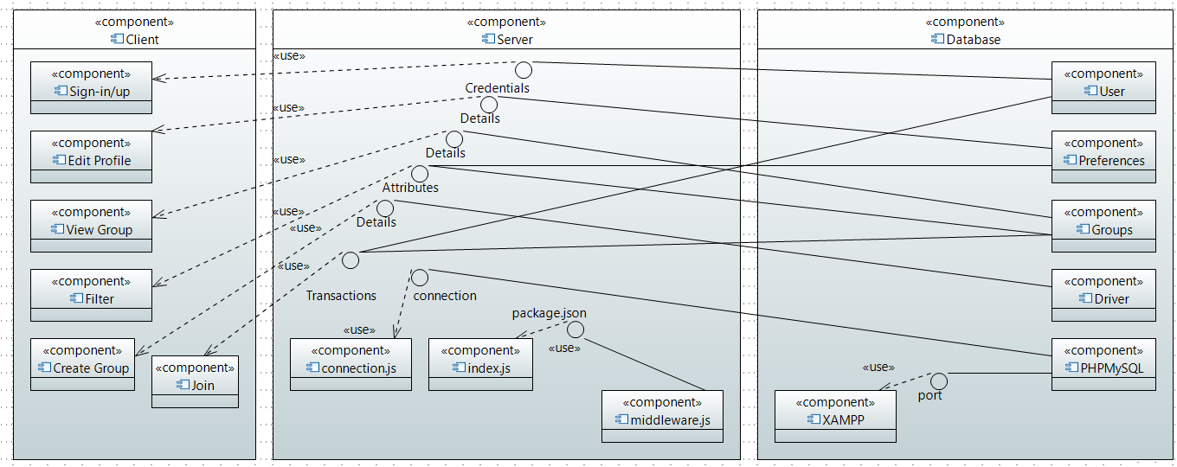
Component Diagram

Slide 17
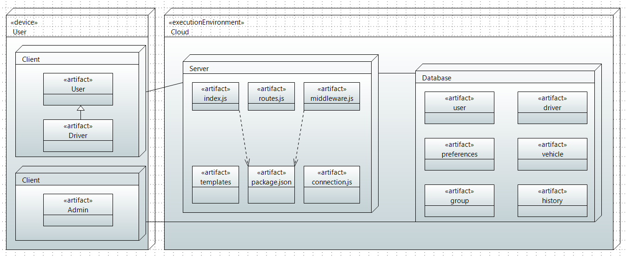
Deployment Diagram

Slide 18



03 Conclusion

