Slide 1



DATABASE
PROJECT
GENERALELECTION2024

Slide 2

GROUP MEMBERS
Usaira Shahbaz
Laraib Sultana
Dawood Habbib
NUM-BSCS-2022-27
NUM-BSCS-2022-06
NUM-BSCS-2022-31

Slide 3

CONTENT
01
INTRODUCTION
02
GOALS AND OBJECTIVES
03
APPROACH
04
TOOLS USED
05
LEARNING
06
CHALLENGING
07
FUTURE WORK

Slide 4


01
02
03
04
13TH,MARCH
22TH,APRIL
10TH,JUNE
30TH,JUNE
Project proposal
Conceptual database design
Logical database design
Integrating of GUI with mysql database
Physical database design

Slide 5
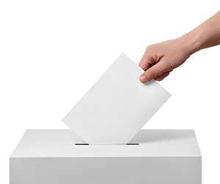


INTRODUCTION
Detailed insight into the electoral process
Identify winning candidates
Organizing electoral information into structured database format
User can easily track performance of political parties

Slide 6





GOALS AND OBJECTIVES
Objective 1,2
Objective 3,4
Objective 5
·1. Winners of each National Assembly (NA) constituency across every province
3. Province-wise voter statistics.
5. Each party name, party leader name and their positions in NA
4. Each winning candidate name
2. Each province seats distributions

Slide 7

APPROACH MILESTONES
Develop a normalized database schema to eliminate redundancy and ensure data integrity. Use entity-relationship diagrams (ERDs) to plan the relationships between different entities.
Gather data from official election commission of Pakistan website, ensuring it includes all necessary details like party ID, name, and all other necessary details.
Creating an GUI for users to interact with the database. This includes searching in specific table, displaying of data and example queries.

Slide 8

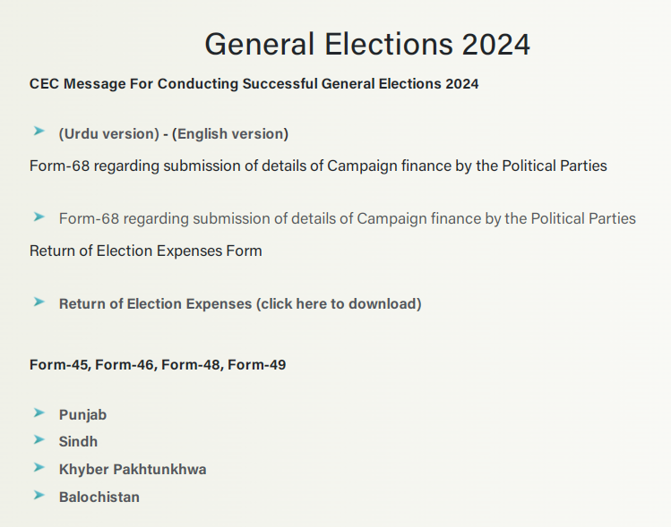
COLLECTION OF DATA

Slide 9
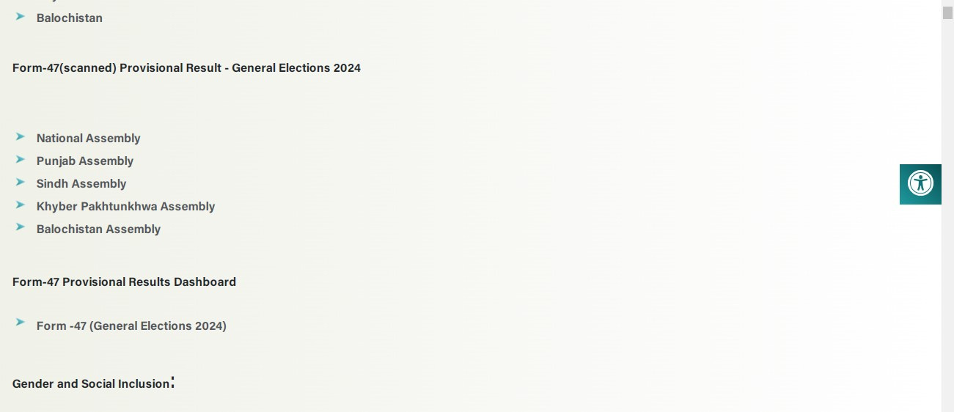
COLLECTION OF DATA

Slide 10
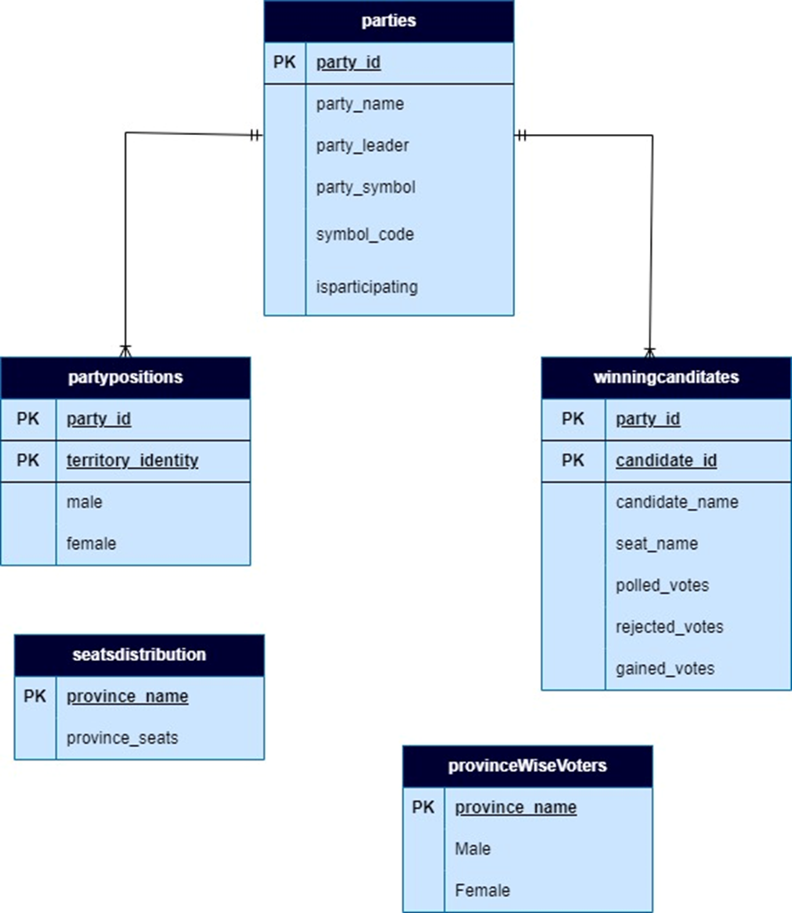
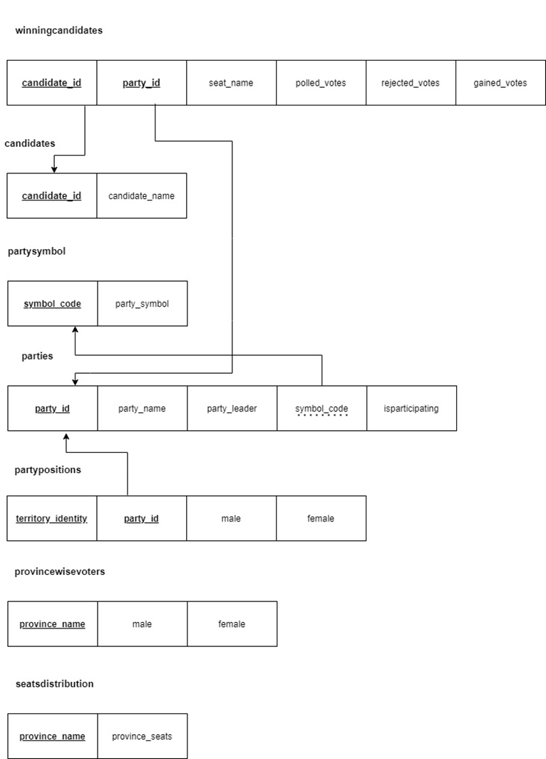
ER DIAGRAM AND NORMALIZED FORM
ER DIAGRAM
NORMALIZED SCHEMA

Slide 11
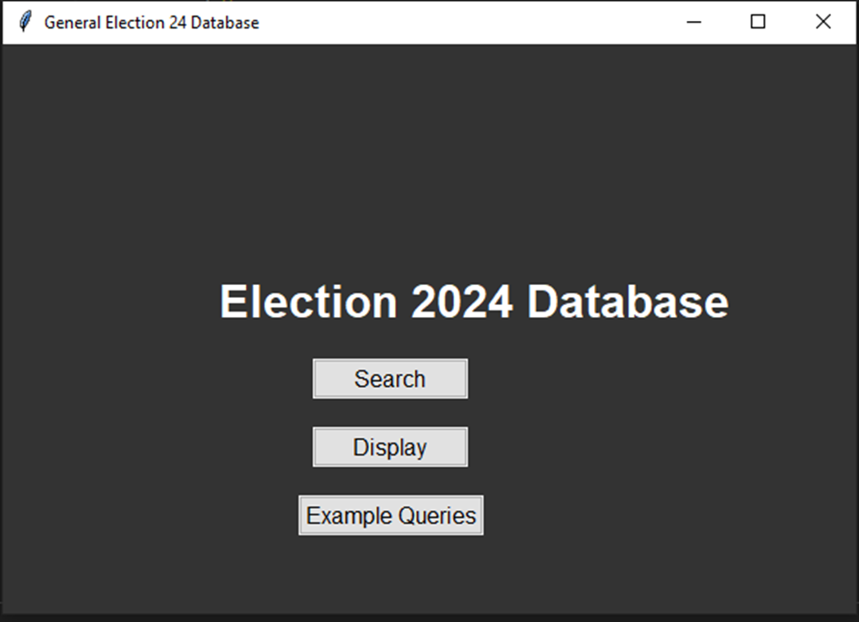
MAIN INTERFACE GUI

Slide 12
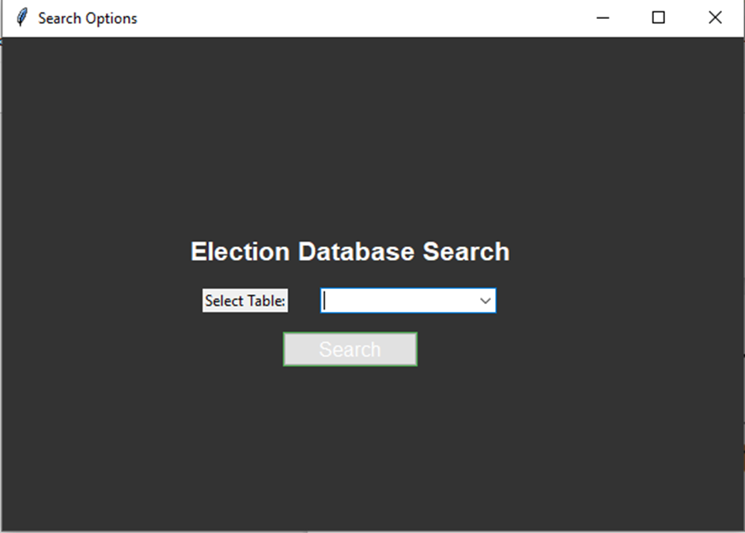
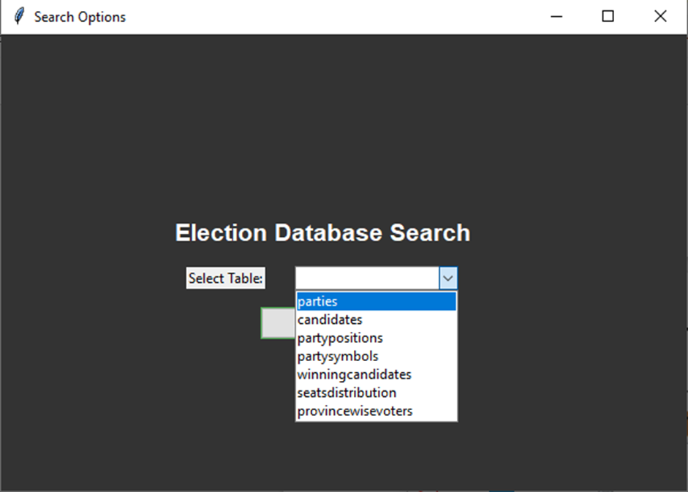
SEARCH INTERFACE GUI

Slide 13
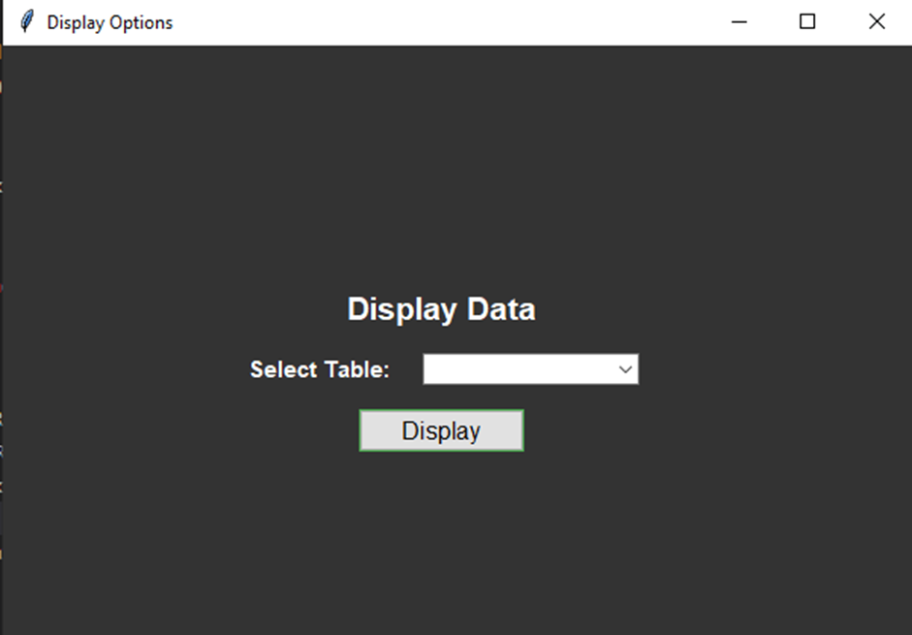
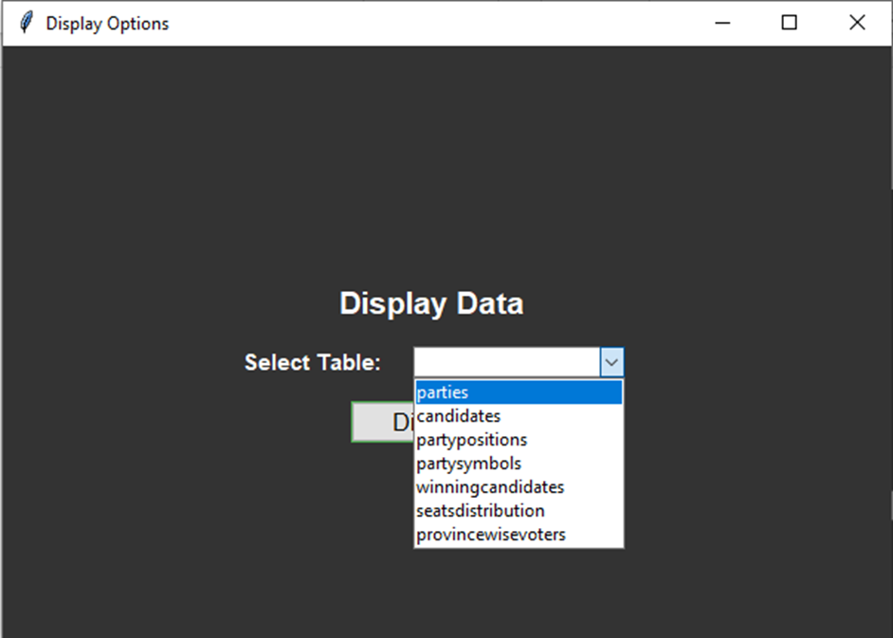
DISPLAY INTERFACE GUI

Slide 14
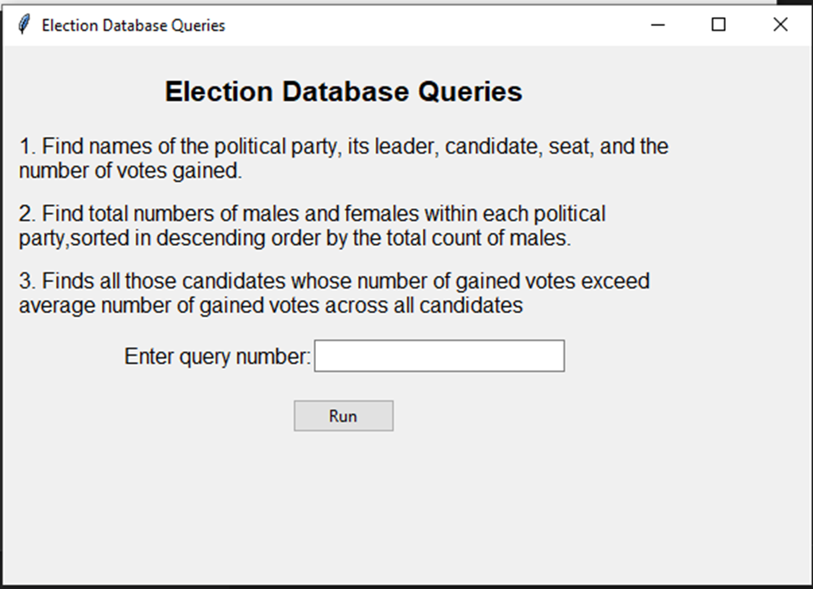
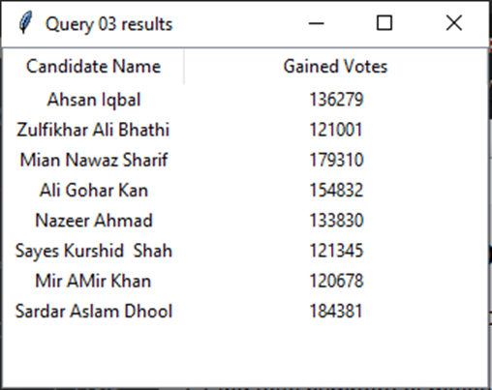
QUERIES INTERFACE GUI

Slide 15
TOOLS USED
ER Diagram and Relational Schema
SQL Language
Graphical User Interface
Draw.io
MySQL Workbench
GUI with Tkinter

Slide 16

WHY USED TKINTER
Our requirement to provide only search options according to our database structure, Tkinter is the best choice than to create a full web application

Slide 17
LEARNING
Developing a Graphic User Interface (GUI) for the first time and integrating with database
Project based on our interests enabled us to create an accurate and reliable database.
Milestone-Based Approach

Slide 18
CHALLENGINGS
Collection of data
Developing a GUI and integration with mysql database
Making of relationship and normalization process

Slide 19
FUTURE WORK
Integrate libraries like Matplotlib or Plotly to create dynamic charts and graphs for data visualization
Expand the database to cover provincial and local elections

Slide 20
THANKS

