Slide 1

BMW Data Grid
Universal Data Management System
Aptitude Test for BMW IT Internship Position
Muhammad Usama Fiaz

Slide 2
Project Overview
Generic DataGrid App
A flexible, reusable DataGrid that handles dynamic data structures.
Integrated with a backend to support real-time search, filtering, and row-level actions. Designed to be user-friendly and adaptable across use cases.

Slide 3
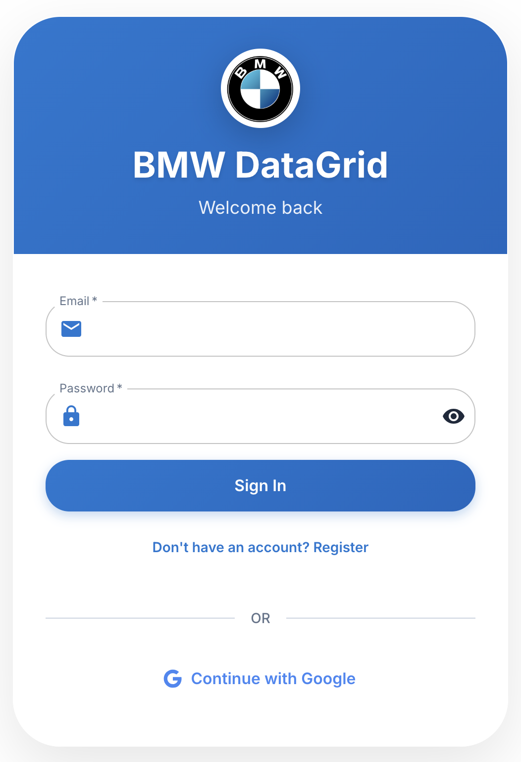
User Management
Managing a list of users
Users have fields like Name, Email, Role, Status
Grid is used to display and interact with this data
Features like search, filter, view, and delete are built around this use case

Slide 4
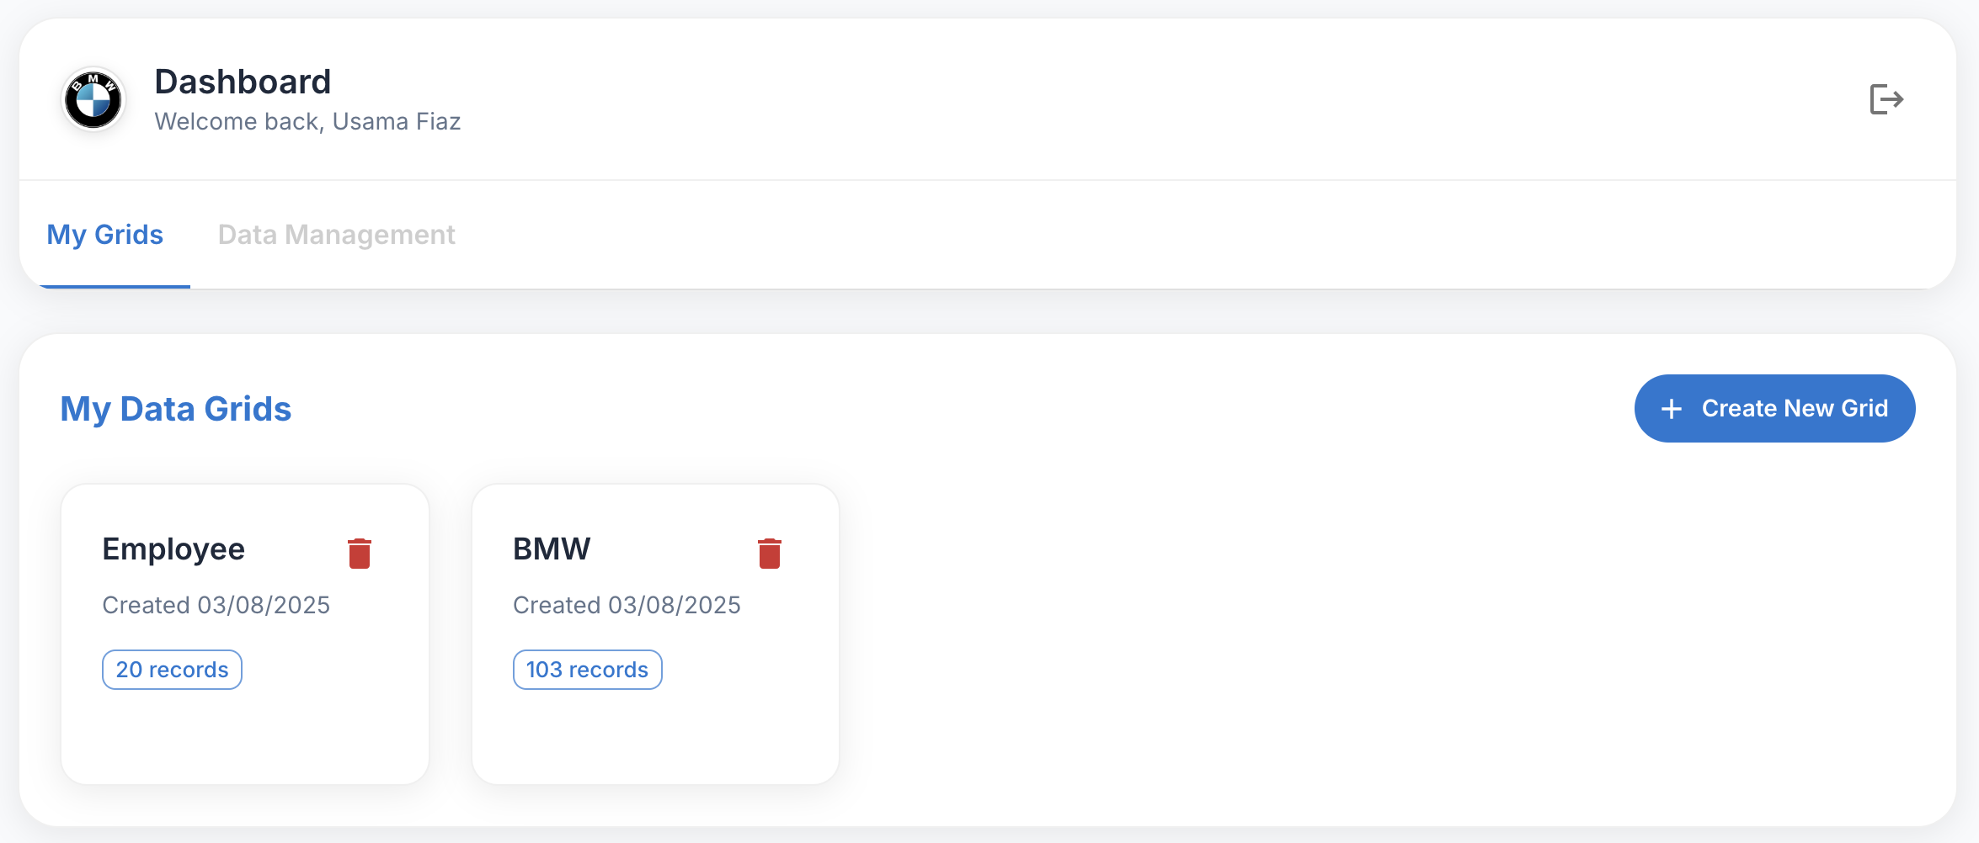
Multiple Grids Support
Supports managing multiple grids (datasets)
Can add, edit, delete, and fetch entries for any grid.
Each grid behaves independently with its own structure.
Easily display new data types without changing component logic.

Slide 5
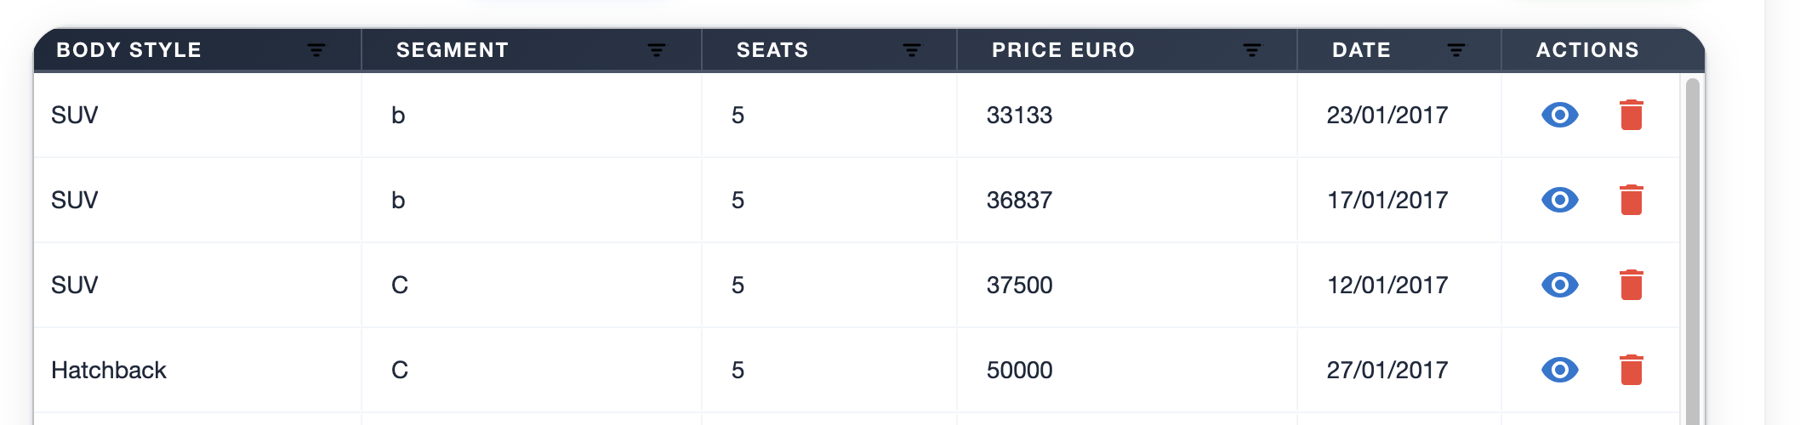
Row Actions
Each row includes:
View: Opens detail page
Delete: Removes the row via backend API

Slide 6
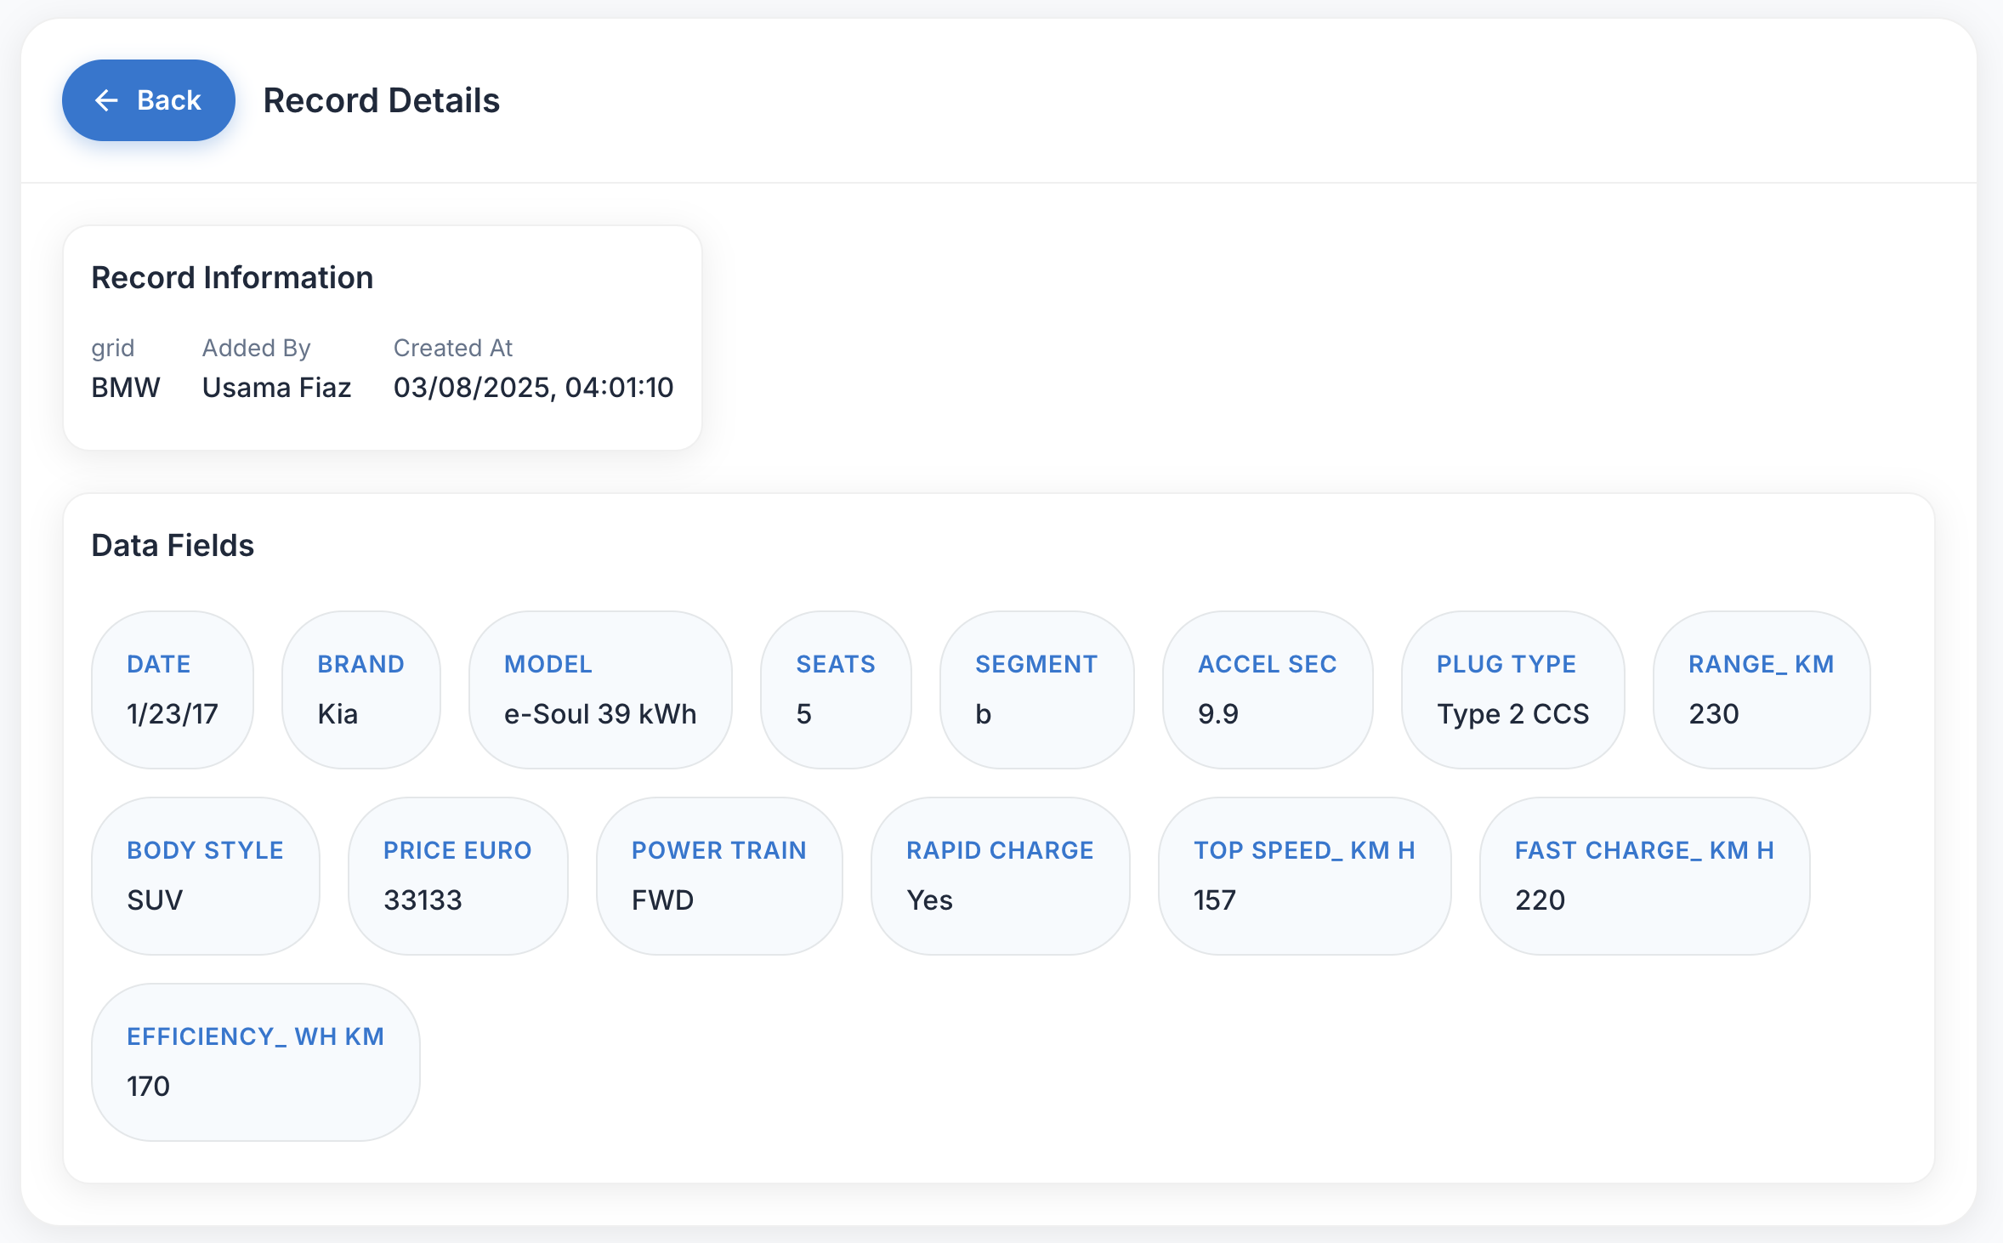
User Detail View
When “View” is clicked:
Full data shown for that specific entry
Includes a Back button to return to grid

Slide 7
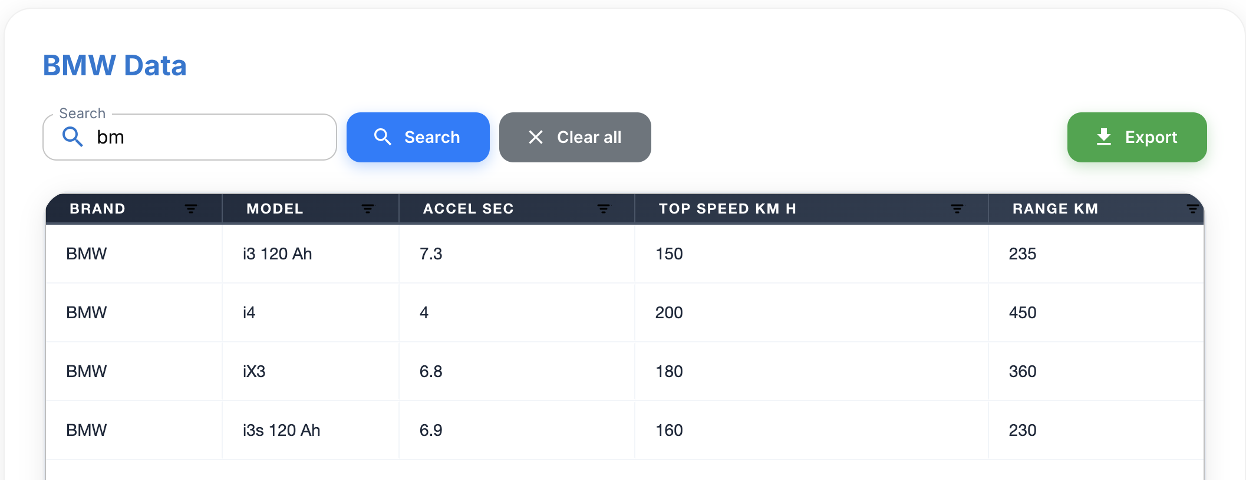
Server-side Search Functionality
Backend-based search
Matches the input against all columns
Case-insensitive and supports partial matches
Fetches filtered results directly from the backend

Slide 8
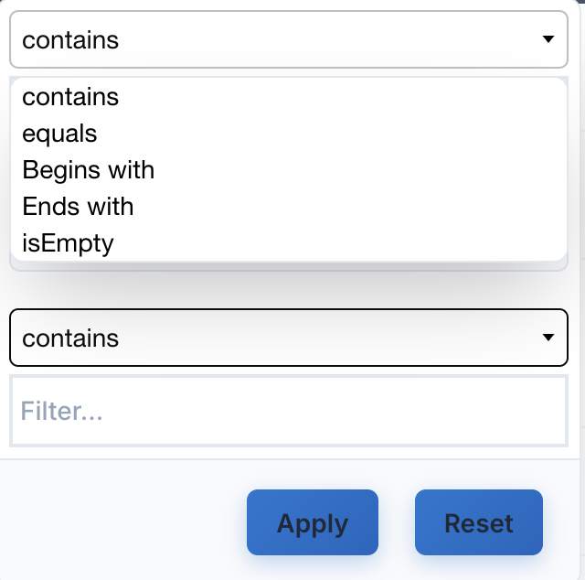
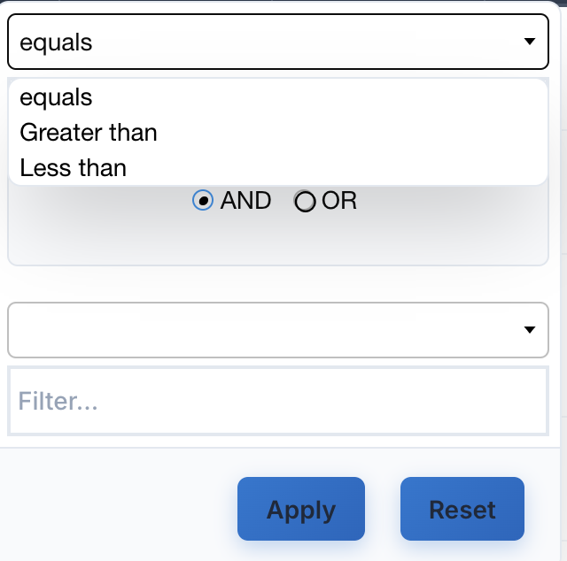
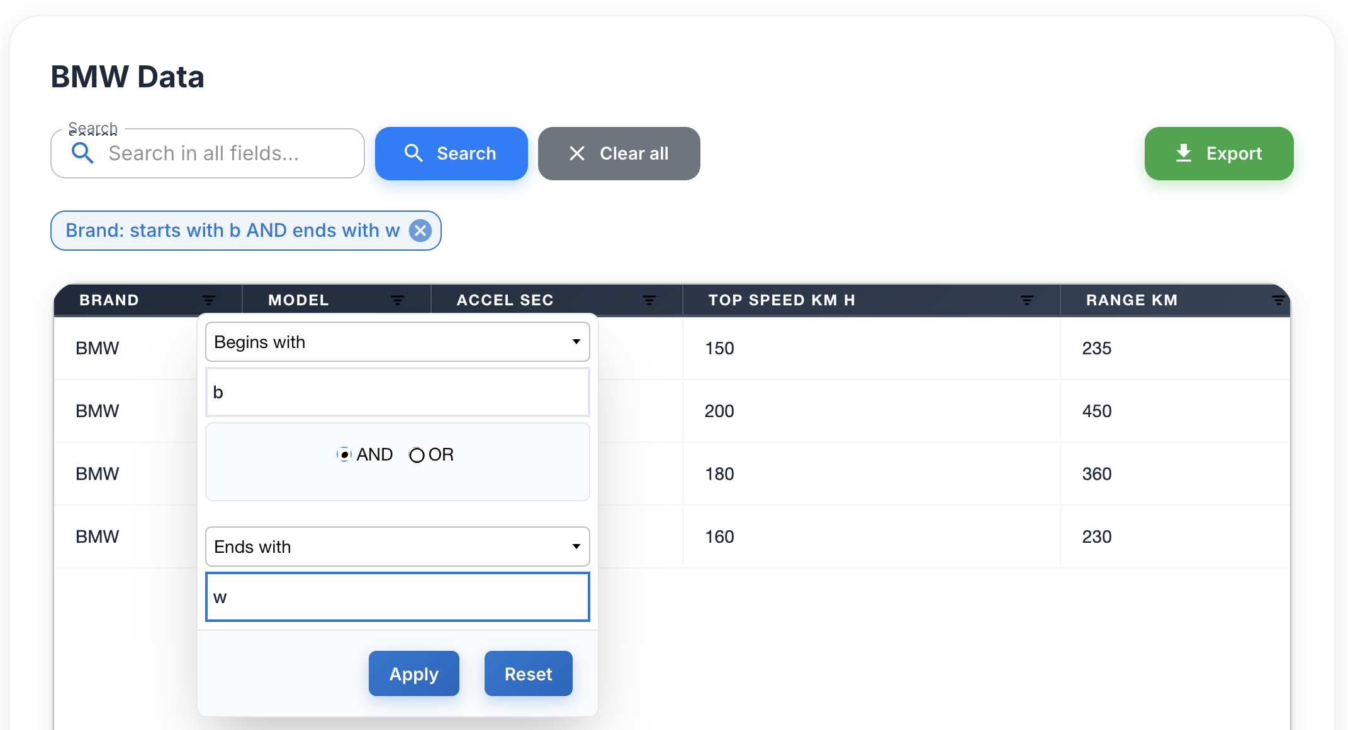
Server-side Column Filtering
Advanced column filters powered by backend logic
Filter types supported: • Contains / Equals • Starts with / Ends with • Is Empty • Greater than / Less than
AG Grid handles UI → sends filter input to backend
Express API processes filters → returns matching rows only

Slide 9
AG Grid Advantage
Dynamic column rendering out of the box
Built-in UI for sorting and filter triggers
Integrated smoothly with custom server-side pagination
Flexible architecture for adding features like CSV export in the future

Slide 10
Thank You!
BMW DataGrid - Universal Data Management System
Ready for your review and consideration!

