Slide 1
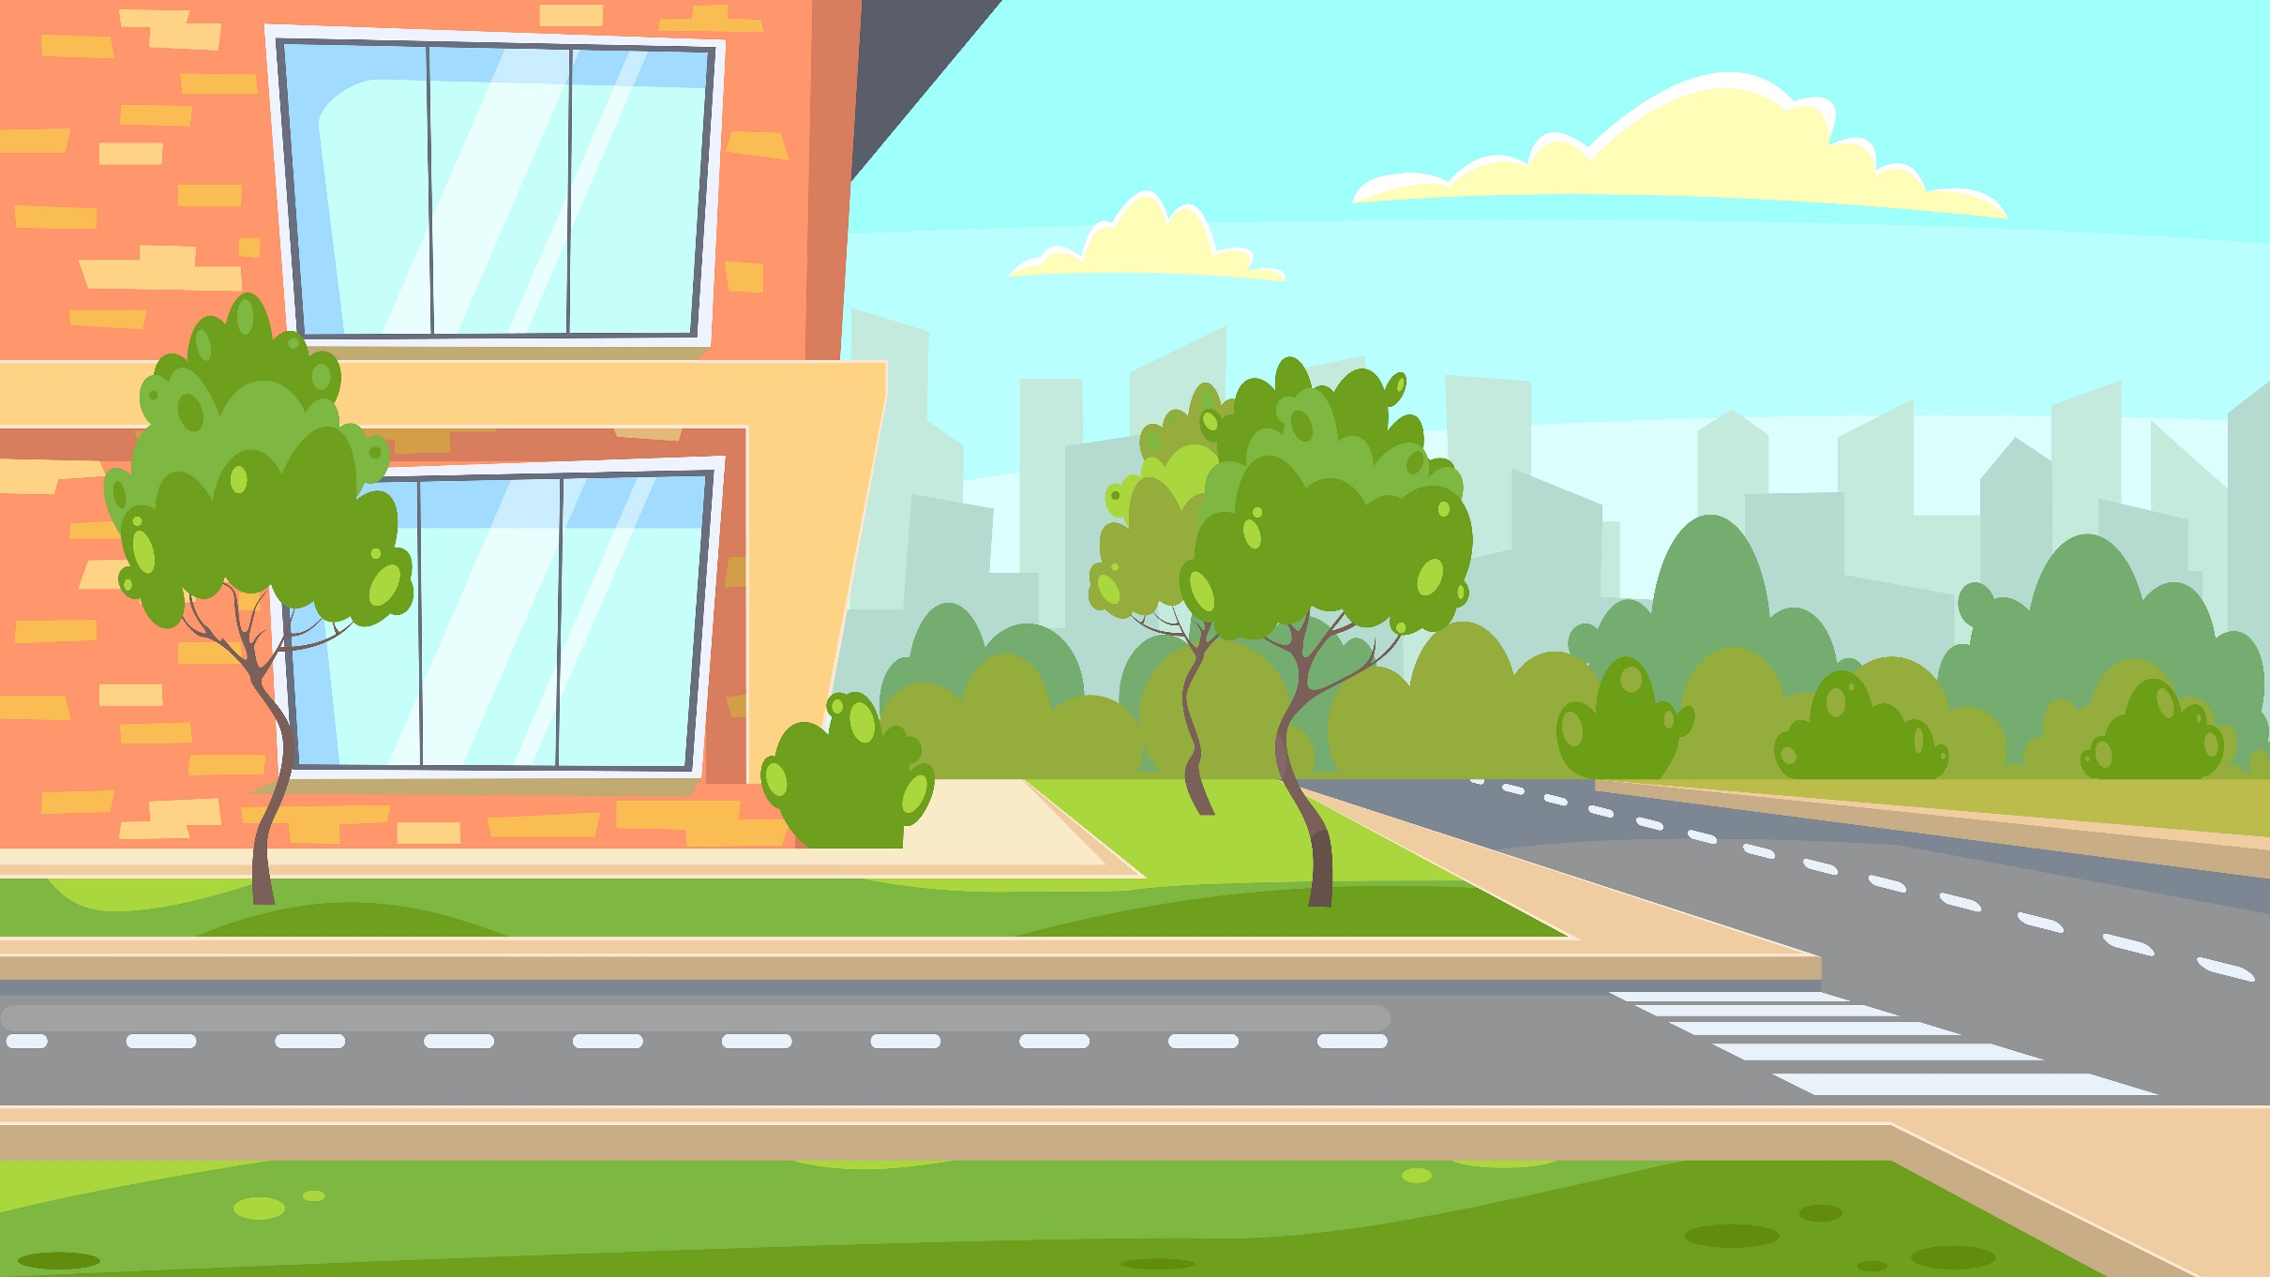



Slide 2
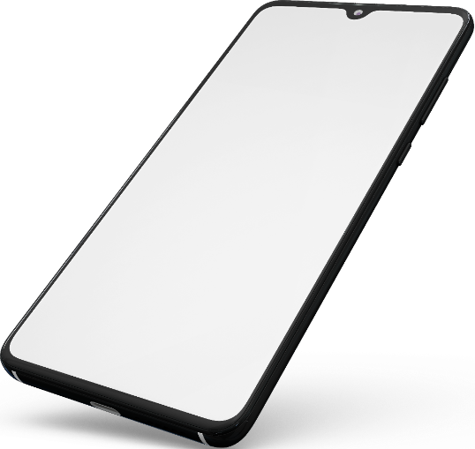

So many locations to deliver on to….
Order to Dispatch
Location A
Location B Location C
Location D

Slide 3
So many locations to deliver on to….
Order to Dispatch
Location A
Location B Location C
Location D

Slide 4
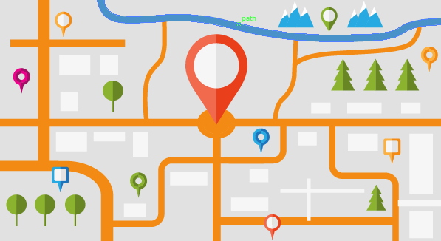
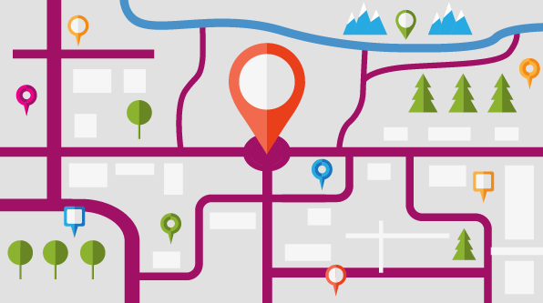
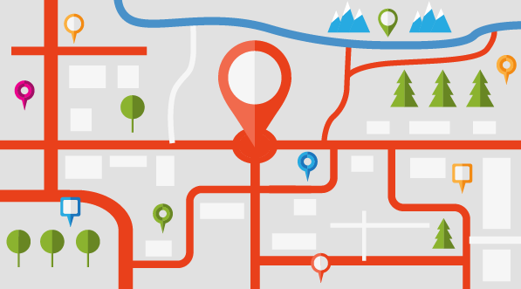

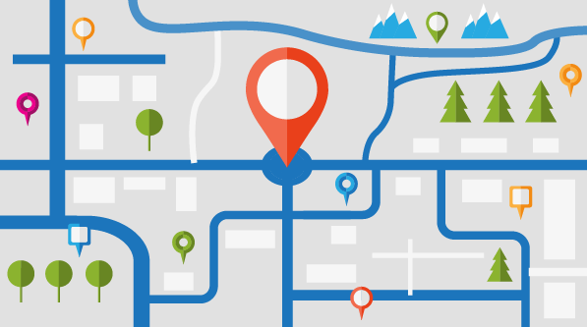
So many possible routes! Which one to take…???

Slide 5
So many possible routes! Which one to take…???

Slide 6
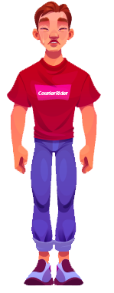

Slide 8

Thanks to this deliveries planning service…???
Plan

Slide 9
Thanks to this deliveries planning service…???
Plan

Slide 10
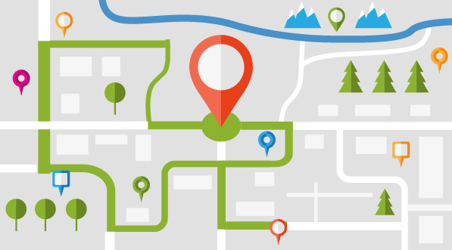
That seems to be a much better route plan…!!

Slide 11
That seems to be a much better route plan…!!

Slide 12
On the way to deliver the day…!!

Slide 13
Time is money; Optimize it!

