Slide 1
Final Year Project – II
Project Title
Routing Optimization System
Supervisor:
Dr. Atiya
Prepared By:
Usama Bin Sultan (43144)
Hanzalah Ahmed Khurshid (44818)
M. Waleed Iqbal (44826)
S. M. Hamza Hussain (45006)

Slide 2
Introduction
The project aims at designing an algorithm that would optimize the delivery of orders by suggesting the best possible rider for a particular order and also suggesting the best possible shortest route for that particular rider to complete its set of deliveries.

Slide 3
Problem Statement
The delivery industry is growing massively as the new newly "online" trend has started especially due to the Covid. Most of the businesses have now shifted to "online" platforms. This increased the demand for the packages to be delivered.
Finding an optimized route for delivering the packages has become more critical and harder than ever for delivery businesses.
We are going to design an algorithm that would optimize the delivery of orders by suggesting the best possible rider for a particular order and also suggesting the best possible shortest route for that particular rider to complete its set of deliveries.

Slide 4
Proposed Solution
We have proposed the following algorithm for optimizing the deliveries:

Slide 5
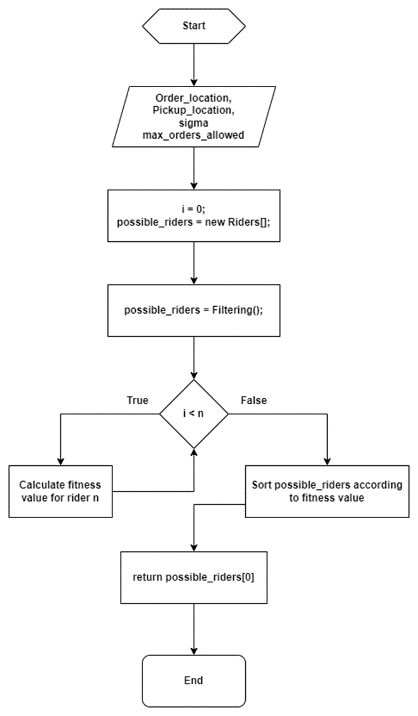
Proposed Solution

Slide 6
State of the Art
History: A lot of work has been carried out by a number of scientists around the world but the problem still remains a critical subject in the field of optimization, especially when it comes to multidimensional optimization.
What is being done Now? The scientist around the globe at present are trying to propose better solutions to solve the problem by applying techniques such as GP, Evolutionary computing, etc.

Slide 7
Proposed Solution
Mission Statement: The aim of our project is to design an algorithm that would optimize the route for deliveries and suggest best possible riders at a particular time.
Scope of the Project:
Design the algorithm.
Implement the algorithm in C# using ASP.Net Web API.
Objectives:
To collect data related to VRP.
To minimize time by formulating an algorithm to suggest the best possible routes.
To develop a web API that would implement the designed algorithm.
Benefits:
Reduce human error.
Save fuel and other operational costs by using efficient resources.

Slide 8
Proposed Solution
Outcomes/Final Product:
As our project was based on research, so the main product of this project was the algorithm that we designed using which, the delivery industry can benefit a lot and ultimately increase revenues by decreasing their operational costs.

Slide 9
Proposed Solution
Challenges:
The major challenging part here is the data collection. To carry out experiments on our formulated algorithm, we need some real-time data. Getting this real-time data is very difficult as no company will be willing to provide its data due to security reasons.

Slide 10
Proposed Solution
Plattforms/Technologies used:
Visual Studio
ASP.Net
MSSQL Server

Slide 11
Target Market
Our main target market is the delivery industry especially companies who work on pickup and delivery model. These include but not limited to food delivery companies such as Foodpanda and UberEats, etc.

Slide 12
Conclusion
In this presentation we discussed about what is the importance of a routing optimization system and what are the challenges faced by us. We also discussed the solution that we came up with.
This is an ongoing and an ever improving problem. Scientists around the globe are still using different techniques such as GP and Evolutionary computing to propose better solutions.

Slide 13
Thank You!

