Slide 1
Route and delivery optimization
Supervisor
Dr. Atiya Masood

Slide 2
Introduction

Slide 3
Background of the study
What is Route Optimization?
NP-Hard Problem
VRP (Vehicle Routing Problem)
TSP (Travelling Salesman Problem)
ACO (Ant Colony Optimization)
PSO (Particle Swarm Optimization)
Local Search

Slide 4

Problem Statement
Consider an environment having a set of Riders $R=\left\{R_{1}, R_{2}, R_{3},...,R_{N}\right\},$ some Restaurants$P=\left\{P_{1}, P_{2}, P_{3},...,P_{M}\right\}$, also known as Pickup locations in our context, and some Orders$O=\left\{O_{1}, O_{2}, O_{3},...,O_{K}\right\}$.
The orders are being received continuously at a central point knowns as hub.
The hub has to decide which rider should be assigned what order and what should be its sequence of deliveries, such that the overall time to complete all the jobs is minimized.
When an Order $O_{n}$ arrives at the hub for a pickup location$P_{k}$, the hub filters out the riders that are near to the pickup location $P_{k}$ and for each rider$r_{i}$, a fitness value $f$ and the total time${rt}_{i}$, that the rider will take to complete its job after the assignment of the current order, is calculated to find the best possible rider.
The above process is dynamic i.e. if another order$O_{n+x}$ arrives for the same pickup location, while the earlier one(s) were being processed, the fitness value and the total time to complete all the jobs, with respect to the new order will also be calculated for all the filtered riders. On the basis of the fitness value of all the riders, the hub will decide which rider is to be assigned what order.

Slide 5
Research Objectives
To minimize time by formulating an algorithm that would suggest the best possible route given the locations for pickup and delivery and the capacity of the delivery entity (i.e. the delivery van or the rider).
To minimize time by selecting the optimal rider for the delivery.
To suggest shortest route or a sequence of jobs that would get the job done in least time.

Slide 6
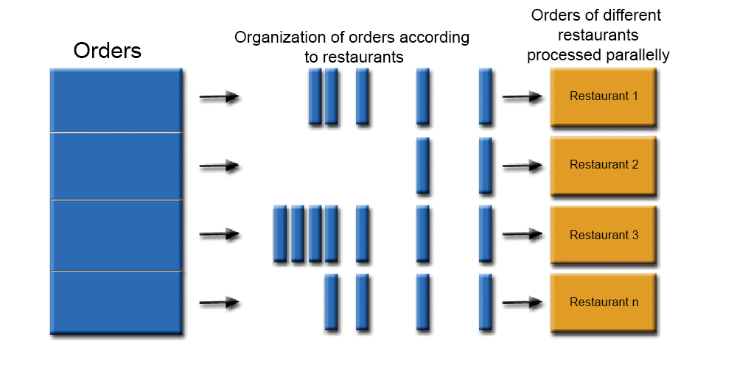
Current progress

Slide 7
Current progress
Organize order into restaurants
For every restaurant:
Add new orders to the order queue.
Predict future orders.
Filter riders
If a rider falls in two or more subsets, then the one with the minimized time will be selected.
Calculate Fitness values for the riders. (based on current position, current order count and total job completion time of the rider. We might also consider order received and order ready time.)
Two possibilities:
Either run the algorithm on time limit(e.g. for orders in one minute only)
Or limit the number of orders in one execution.
The order will be assigned to the rider with the best fitness value.
Any rider with maximum order limit reached after assignment, will be removed from the queue.

Slide 8
Benefits of the study
Effective route planning.
Cost Effective.
Time Efficient.
Less fuel consumption.
Increase business.

Slide 9
Limitations of the study
Experimental data available for select places only.
Following things are not considered:
Road condition (e.g. road closures, work in progress, weather effects etc.)
Real-time traffic conditions.

Slide 10
Dataset
The dataset used for this project:
https://www.kaggle.com/datasets/nosbielcs/brazilian-delivery-center
Contains data for the following:
Deliveries
Orders
Riders
Stores (we are taking stores as delivery locations)
Hubs (pickup locations in our case)

Slide 11
Thank You!

