Slide 1
Drone Detection
Computer Vision
Muhammad Usama

Slide 2
Introduction
With the surge in the use of commercial drones for various applications, there has also been a rise in their use for illegal activities. In order to regulate the illegal use of these drones, this project presents single shot detection frameworks: YOLOv8 architectures to help in detecting drones.

Slide 3
Problem Statement
With increase incidence of crimes and terroristic attacks using commercial drones, it has become important to develop effective and affordable counter measures to report a drone flying over restricted areas

Slide 4
Methodology
Database Acquisition
Pre-processing
(Image Resizing & Labelling of 2000 Images)
YOLOv8

Slide 5
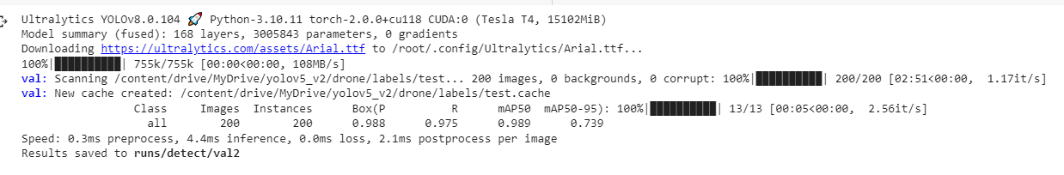
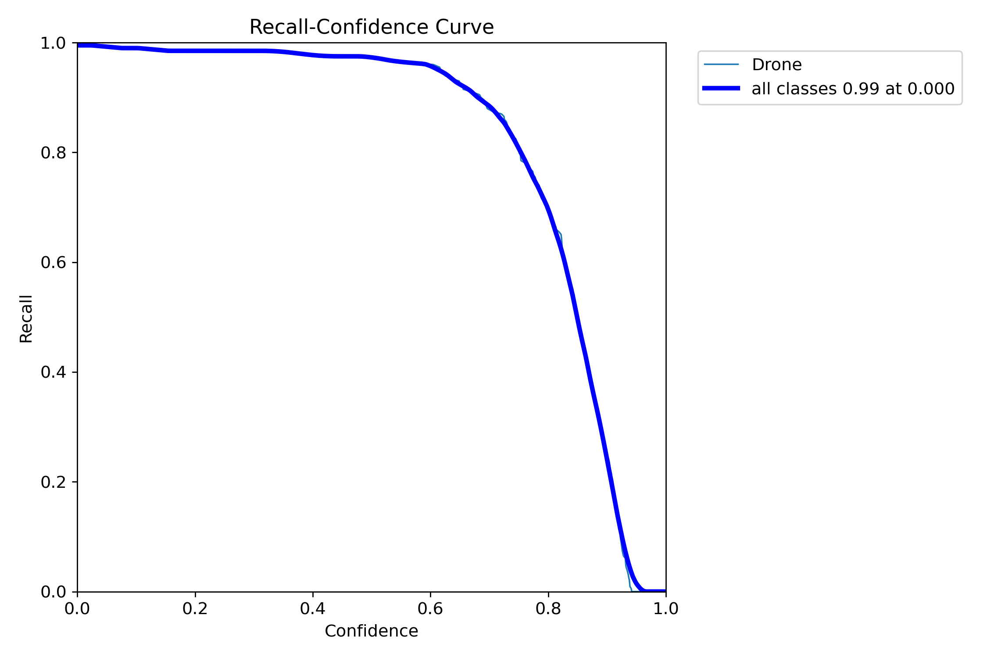
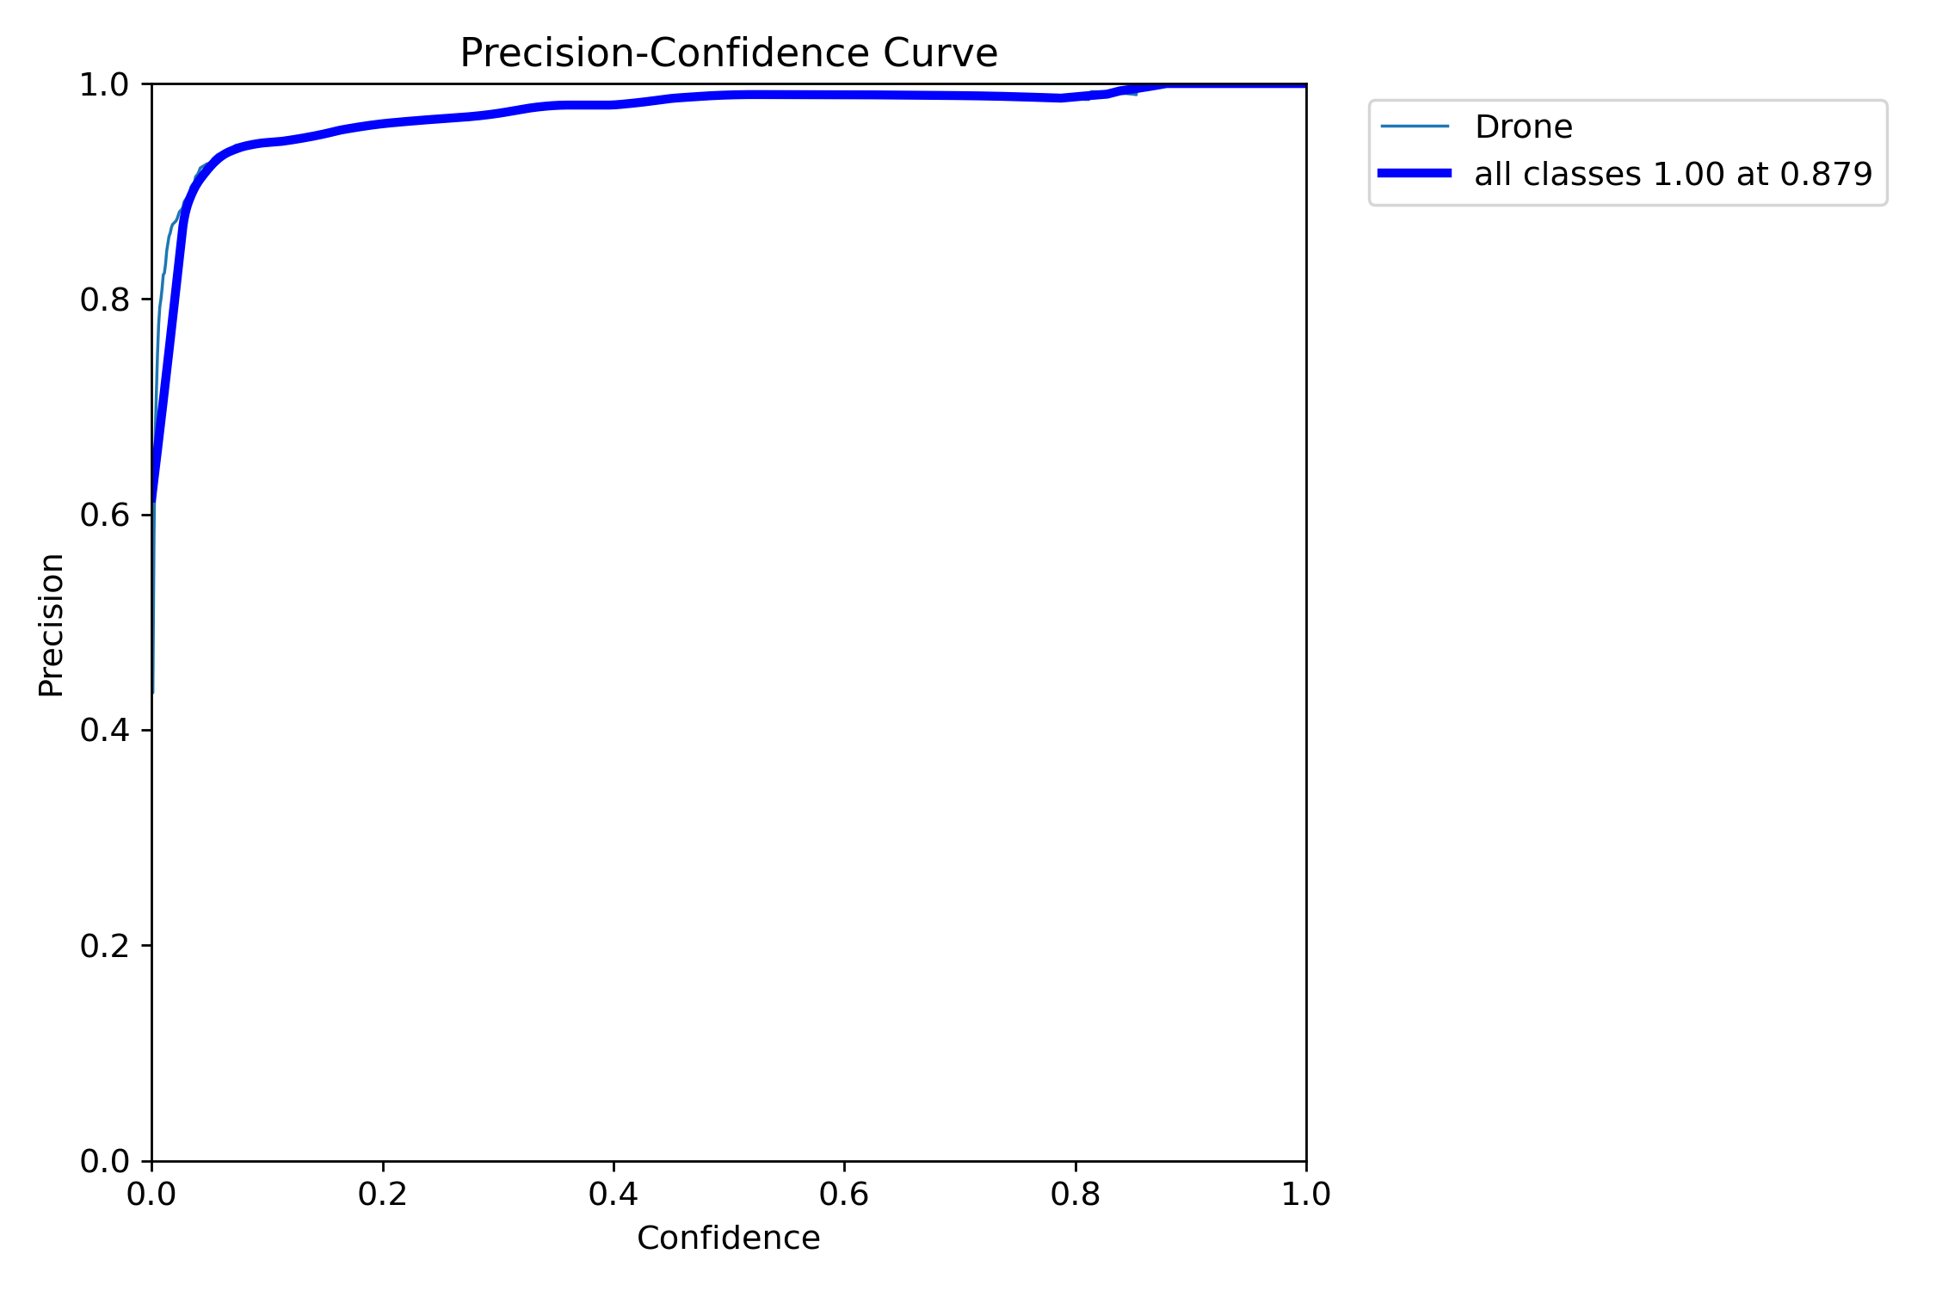
Results

Slide 6
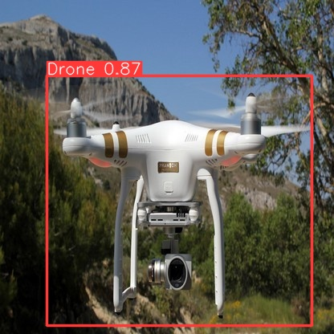
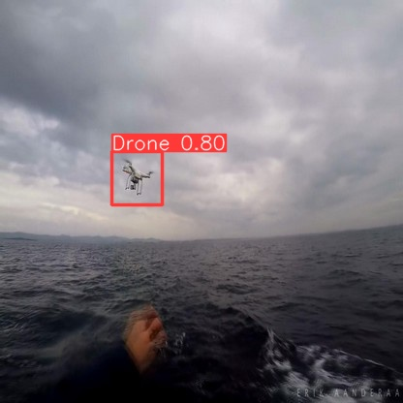
Results (Cont.…)

Slide 7
Thanks

