Slide 1








We aspire to be the LEADING PROVIDERS of INNOVATIVE AND IMPACTFUL SOLUTIONS that solve diverse and complex problems in the DIGITAL PAYMENTS and FINANCIAL SERVICES Sectors the World Over.
OPENACS SOLUTION
ACS 3DS

Slide 2


Content
Paysys Open ACS Soluton
01
Introduction of Paysys Labs
02
OpenACS Overview
03
OpenACS Back-office

Slide 3
OPENACS OVERVIEW, FEATURES & ADD-ON

Slide 4















OPENACS OVERVIEW
ACS Journey
CARDHOLDER
MERCHANT
PAYMENT GATEWAY
ACQUIRER BANK
ISSUER BANK
3DS SERVER
CARD NETWORK DIRECTORY SERVER
Risk Based
Authentication
Multi Factor Authentication
Multi Channel

Slide 5


OPEN ACS OVERVIEW
Open ACS Core Features
Our product OpenACS provides clients with 3D Secure 1.0.2 verified by VISA, MASTERCARD & UNION PAY.
Core Features
Add Ons
Built on industry standard EMV® 3-D Secure (2.0) and 3-D Secure1.0 protocol
Multi-channel support that authenticates payments from any device
Holistic risk assessment that calls out suspicious activities to enable risk-based authentication
Flexible rule definition to align with risk appetite
Ability to support offline and multi-factor authentication
Customized dashboards and advanced analytics for better risk decisioning
Scheduled reports to bank
Switch on/off recuring transaction
Multilingual Support for transactions
No Build deployment for static UI
Customization
Card holder Enrollment options in IVS
Configurable challenge screens
through admin portal
Dynamically configurable ACS screen with customization UI

Slide 6













OPEN ACS OVERVIEW
Payment Security Platform – 3DS 2.0
Admin Portal Monitoring & Reports
Ready for Hosted and On-Prem
8 Digit BIN
Continuous Availability
Architecture
Best In Class Approval Rates
OPEN ACS FEATURES
Processing Centre
Benchmarking 1000 TPS
Standard Offering in 5
Business Days
Support for PSD2

Slide 7
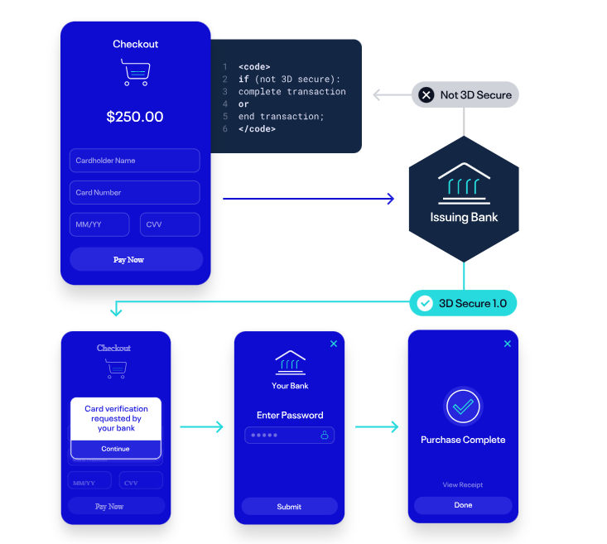
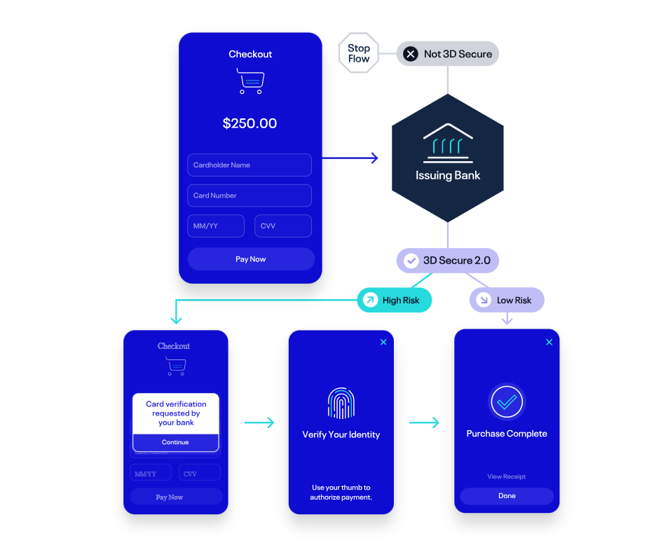
OPENACS OVERVIEW
Risk Based Authentication (3DS 1.0 & 3DS 2.0)
3DS 1.0
3DS 2.0

Slide 8
OPENACS BACK OFFICE

Slide 9

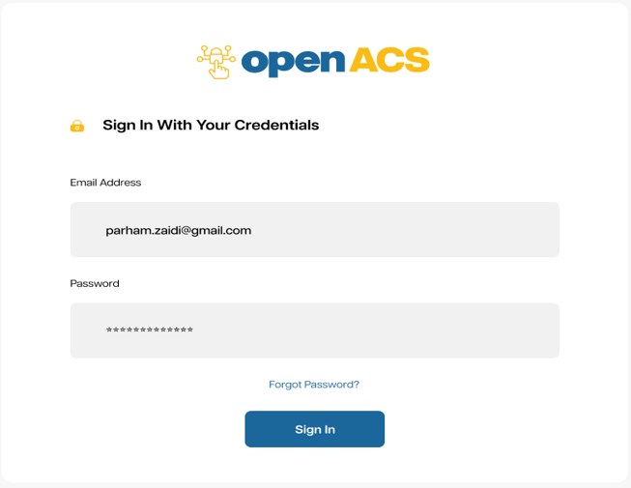
OPENACS BACK OFFICE
Login Page
Overview:
Login page
Dashboard
Transaction Reports
Transaction Details
Monitoring Dashboards

Slide 10
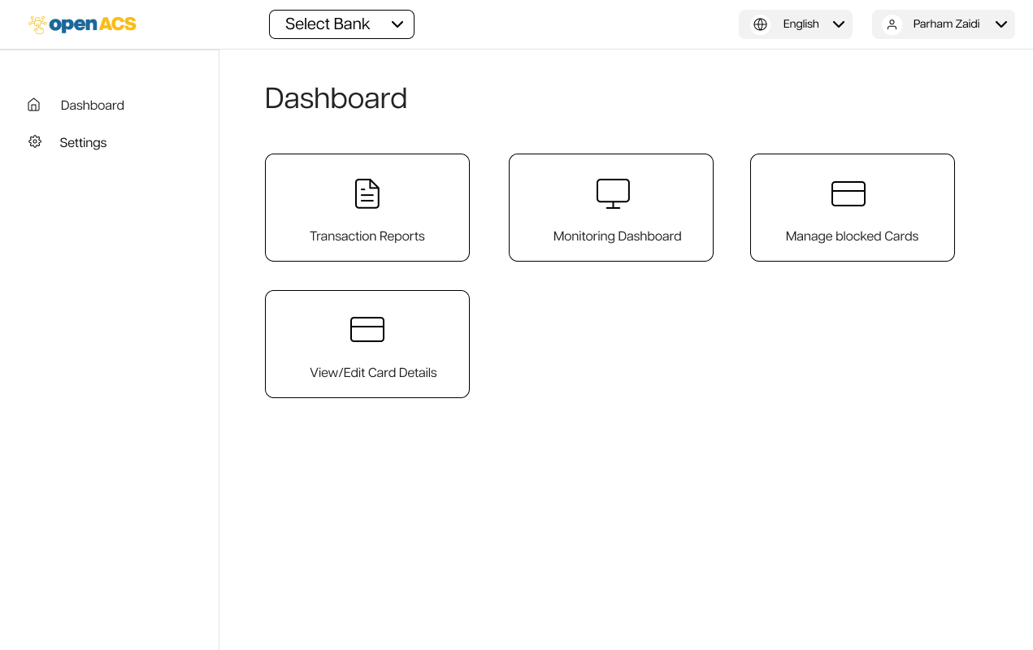
OPENACS BACK OFFICE
Login Page
Dashboard:
Customizeable dashboards and advanced analytics for better overview and control.

Slide 11
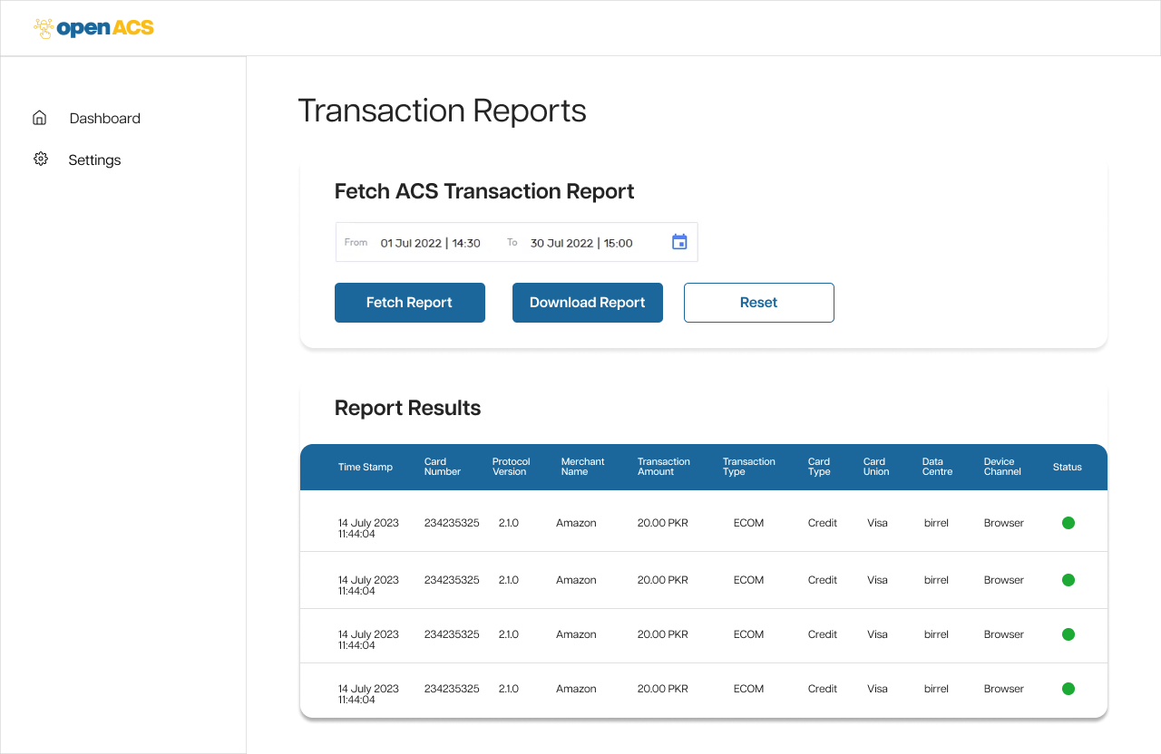
OPENACS BACK OFFICE
Login Page
Transaction Reports:
List of transactions showing details of customers, you can apply filters for accurate results.

Slide 12
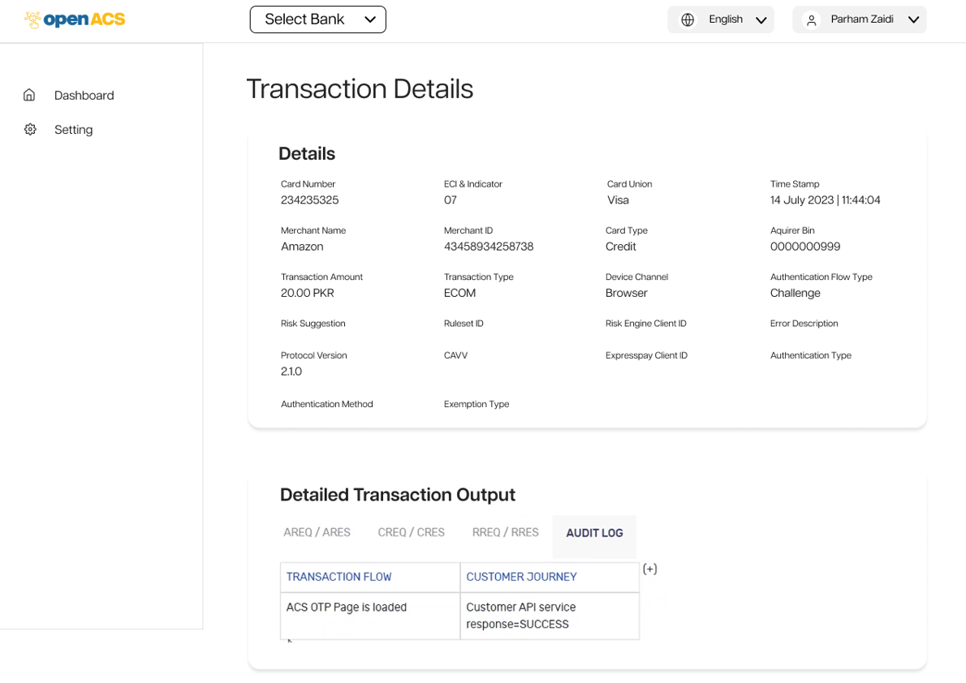
OPENACS BACK OFFICE
Login Page
Transaction Details:
Details of selected transactions

Slide 13
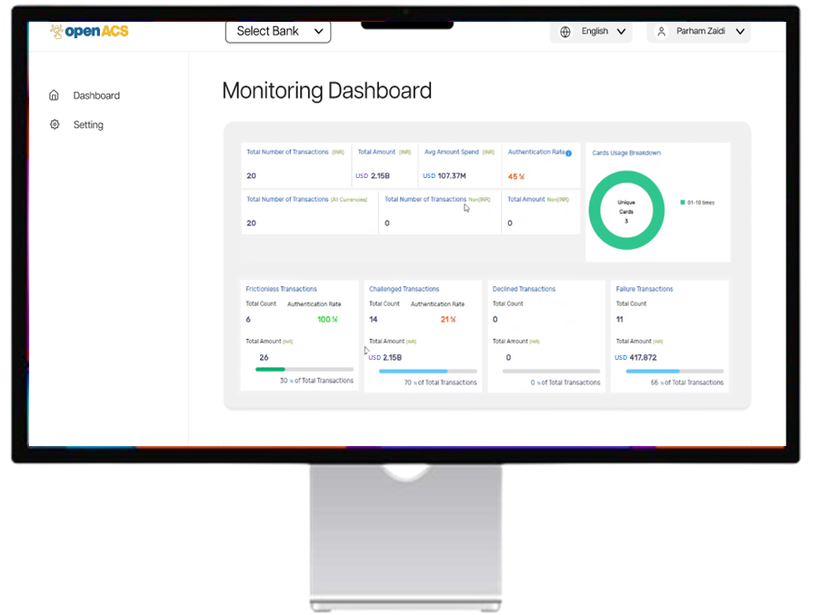
OPENACS BACK OFFICE
Login Page
Monitoring Dashboards:
Monitoring dashboards shows your total portfolio.

Slide 14
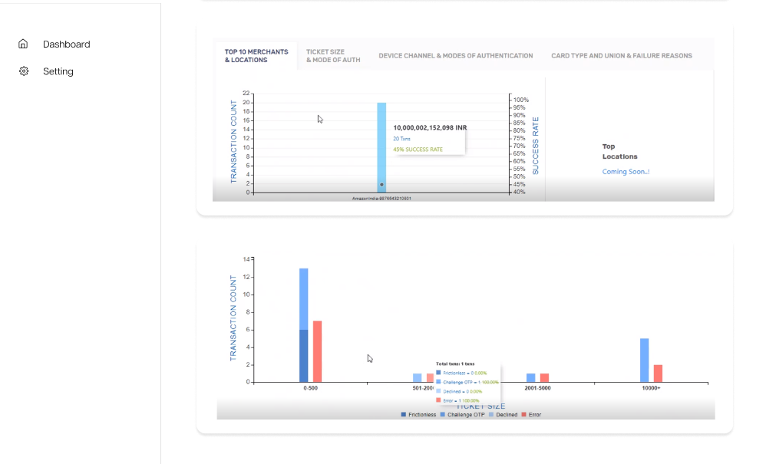
OPENACS BACK OFFICE
Login Page
Monitoring Dashboards:
Also includes analytical graph for better understanding and visualization.

