Slide 1
Currency EXchange
&
E-Banking

Slide 2
Team Details:
TY IT Div:B
Sahid Midda (SR21BSIT092)
Subrata Chhat (SR21BSIT016)
Usama Driver (SR21BSIT026)

Slide 3
Includes:
Definition, Objective, Outcome​
Requirement Analysis
​Entities and Functionality
Tech Stack
​Database Design​

Slide 4
Project Definition
A futuristic currency exchange website that lets users to observe the live rates and convert currencies of over 160+ countries around the world. The application also allows users to login/register in order to access a wide range of other services such as currency booking in advance, money transfer to other accounts, etc. Additionally the application also features an Admin Panel that can be used to attend user queries, change service rates, etc.

Slide 5
Objective
The main objective of this site is to help users seamlessly get the currency rates of the country of their choice and also to give a simulation of E-Banking to the users.

Slide 6
Entities
Normal Site Visitor
Registered User
Admin

Slide 7
Functionalities
* RU indicates only for registered users
Convert 1 currency to another by selecting both the countries from 160+ options using dropdown
Get Live Rate of selected currency
Submit contact form
Register & Login
User Dashboard (RU)
Book specific amount of a selected currency for a future date (RU)
Transfer money to other user by entering their email and the amount to send (RU)
View all the transactions of logged in user (RU)
View all the contact requests made by self (RU)
View all the booking requests made by self (RU)

Slide 8
Functionalities
* AO indicates accessible by Admin only
Admin Panel (AO)
Change service rates such as platform fees and gst (AO)
See all the contact queries and mark them as Attended or Not i.e. Change their status (AO)
See all the booking queries and mark them as Attended or Not i.e Change their status (AO)
View all the registered users and their details (AO)
View the company earnings made through platform fees and gst applied on each transaction (AO)
Logout

Slide 9
Tech Stack
Frontend
HTML
CSS
Bootstrap
Backend
JavaScript (Promises, API)
PHP
Phpmyadmin (as database)

Slide 10
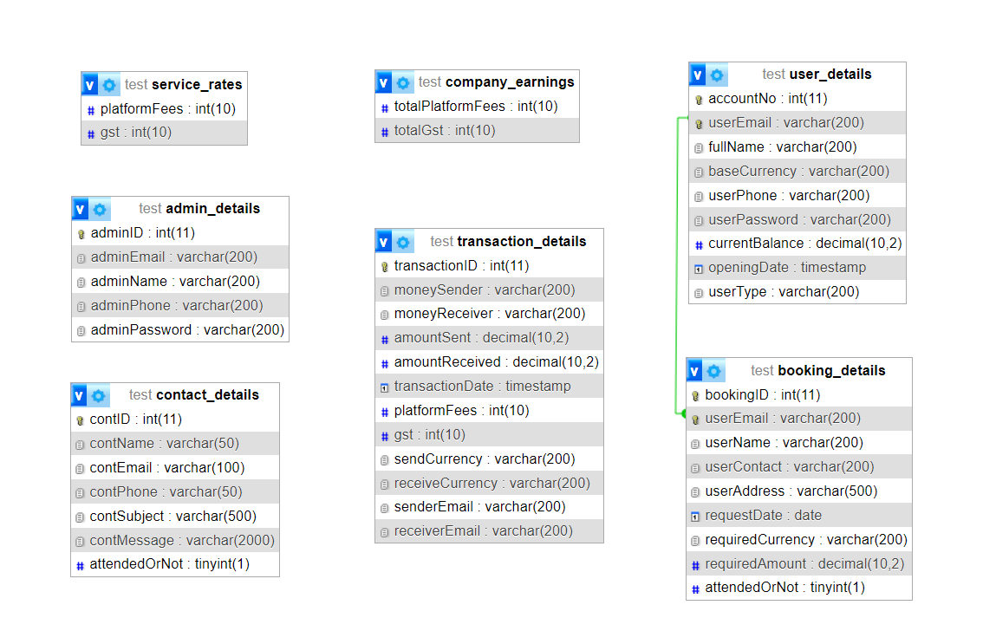
Database Design

Slide 11
THANK YOU

