Slide 1
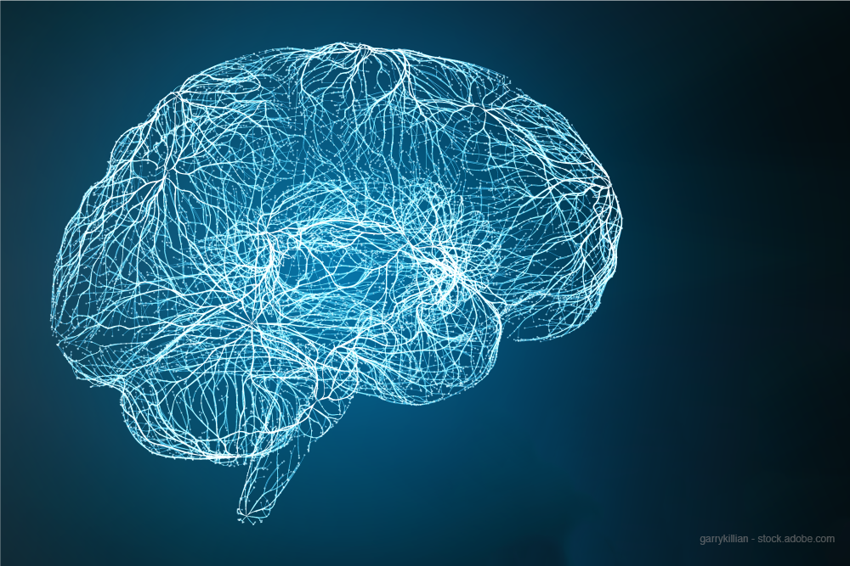
Automated
EEG Pathology Detection
Team Members:
Hira Tanveer
Rahat Ul Ain
Advisors:
Hassan Aqeel
Faisal Shafiat
Adnan Ul Hasan

Slide 2
Testimonial
1) FYP report reviewed by the Advisor (Yes)
2) FYP Report uploaded on PMS (Yes)
3) FYP Demo reviewed by the advisor (Yes)
4) FYP Demo uploaded on PMS (Yes)
5) Course feedback of all courses submitted on CMS (Yes)

Slide 3
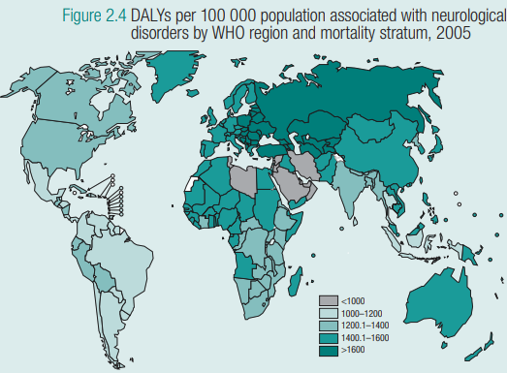
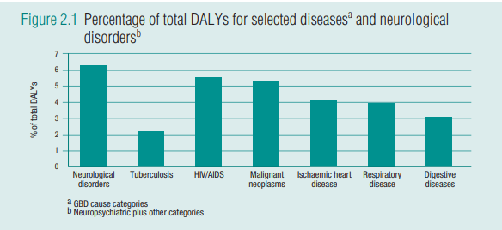
Neurological Disorders
Disability-adjusted life years

Slide 4
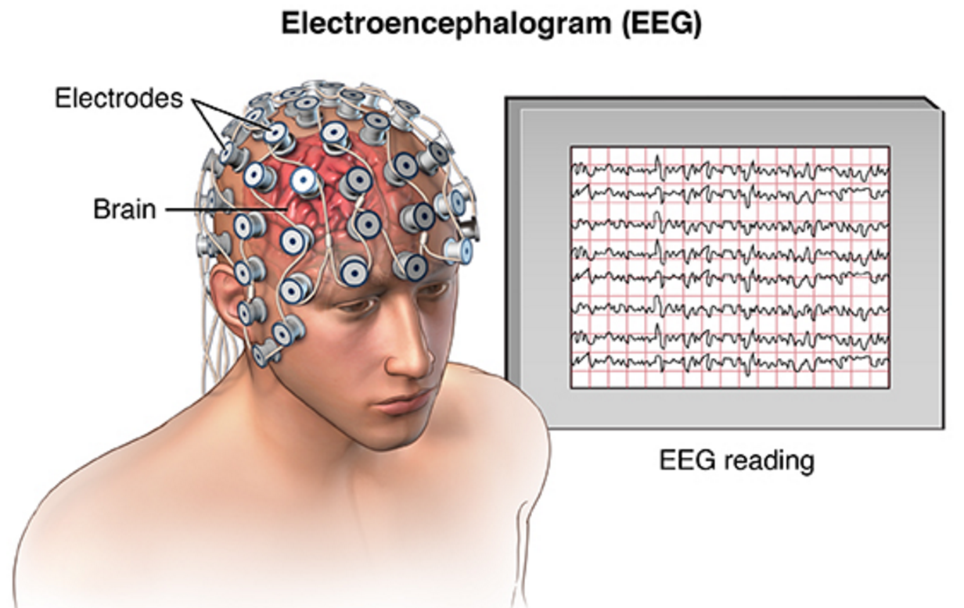
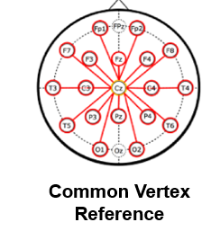
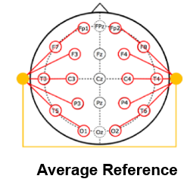
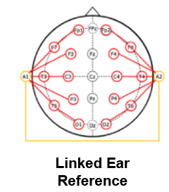
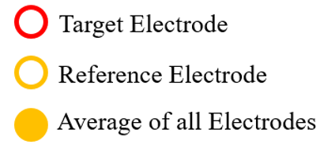
Electroencephalography
EEG refers to the recording of electrical activity of neurons along the scalp
Standard (10-20) uni-polar Montages of EEG

Slide 5
Why Automate EEG Diagnosis
Require highly trained neurologists
Low Inter-rater agreement
Time consuming
Human Error
Expensive
1 : 1 million
150

Slide 6

Spectral Characteristics
Reactivity: Response to certain physiological changes or provocations.
Alpha Rhythm: Waves originated in the occipital lobe, between 8-13 Hz and 15 to 45 $μ$V.
Mu Rhythm: Central rhythm of alpha activity commonly between 8-10 Hz visible in 17% to 19% of adults.
Beta Activity: Activities in the frequency bands of 18-25 Hz, 14-16 Hz and 35-40 Hz.
Theta Activity: Traces of 6-7 Hz activity present in the frontal regions of the brain.

Slide 7
Related Work
Automated identification of abnormal adult EEGs 2017 | k-Nearest Neighbor (kNN) and Random Forest Ensemble Learning (RF) Error 26% GMM/HMM 21.2% CNN+ MLP 41.8% kNN 31.7% RF | Base line oh TUH MFCC and PCA for features Used only T5_O1 Beside CNN+MLP

Slide 8
Deep learning with convolutional neural networks for decoding and visualization of EEG pathology 2018 | Classify EEG by using deep CNN to produce state of the art results(85%) | Visualizations cropped training method loss function
Chrononet: a deep recurrent neural network for abnormal EEG identification 2018 | Convolutional Inception Densely Connected Gated Recurrent Neural Network | Not explainable use time information and data augmentation

Slide 9
Cognitive smart healthcare for pathology detection and monitoring | Alex net and VGG-16 for feature extraction SVM with RBF kernel as classifier | 87% accurate Use 10000 more recordings
EEG Pathology Detection Based on Deep Learning 2019 | Alex net on 3 band limited signals in frequency domain(after downsampling to 100) + MLP | 89% accurate Use 10000 more normal recordings
Detecting abnormal EEG using deep convolutional networks | Deep CNN + LSTM used with private Massachusetts General Hospital Dataset | 82% accurate 8000 recordings

Slide 10
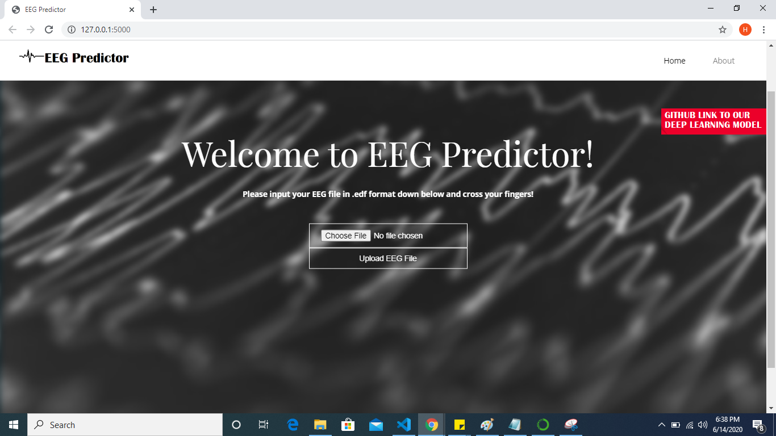
Proposed Solution

Slide 11
Materials

Slide 12
Datasets
Temple University Hospital (TUH)
Military Hospital (MH)
 | abnormal | normal
train | 1270 | 1275
test | 127 | 150
 | abnormal | normal
train | 480 | 1995
test | 90 | 95

Slide 13
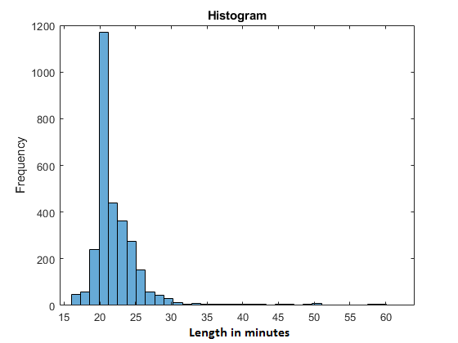
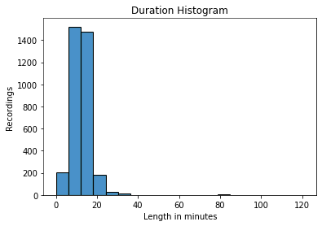
Dataset Statistics
MH
TUH

Slide 14
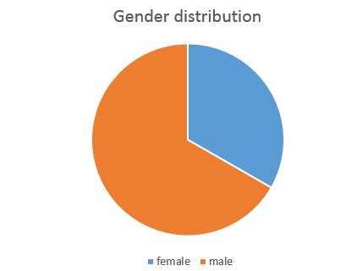
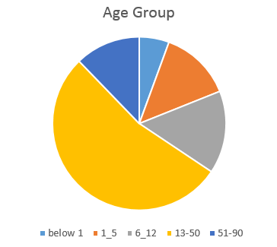
MH Demographic Statistics

Slide 15
Preprocessing
Referenced to average from linked ear reference
Down sampled to 100 Hz
Clipping the magnitude to ±800 mV
Training data is balanced by oversampling of abnormal recordings
Age limit is applied on TUH data while MH data has all age groups

Slide 16
Architecture

Slide 17
Model Architecture
Deep CNN : Spatial and temporal filters followed by 3 Conv-Pool blocks
Shallow CNN : Filter bank common spatial pattern
Chrononet: Inception Convolutional Densely Connected Gated Recurrent Neural Network

Slide 18
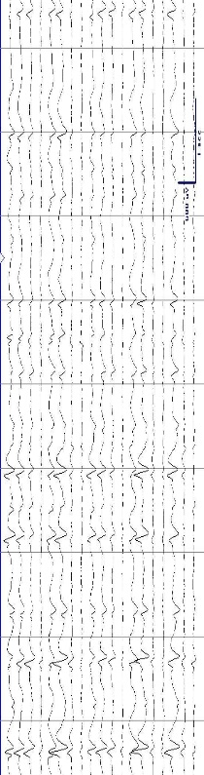
Hybrid CNN + LSTM
EEG
Feature Extraction
Context Learning Sequence Classification
1 min crops
CNN
CNN
CNN
1 min crops
CNN
Concatenate
Normal/abnormal
CNN
LSTM
CNN
1 min crops
CNN
CNN
CNN

Slide 19
Performance

Slide 20
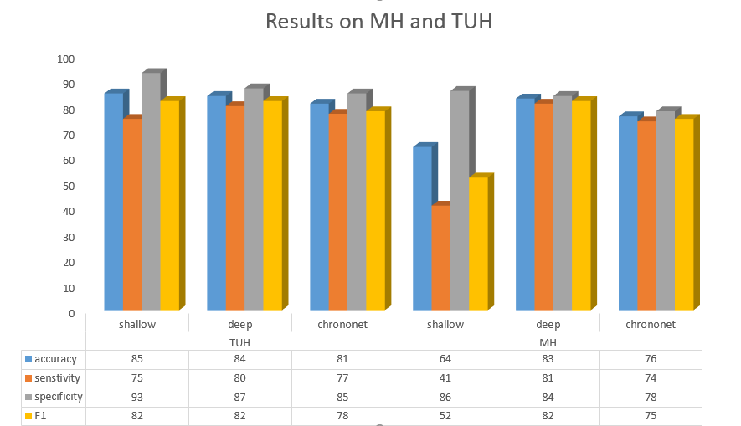
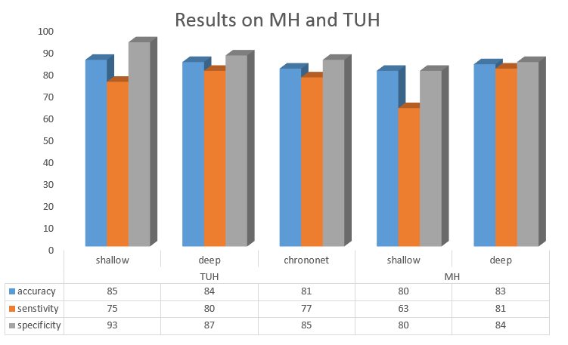
Performance Evaluation

Slide 21
Confusion Matrix for Hybrid Network
Using complete session to avoid EEG yield Problem
TUH | Actual pathological | Actual normal | Metrics
pathological | 105 | 20 | Accuracy: 0.85
normal | 21 | 130 | Roc-AUC: 0.94
Sensitivity/ Specificity | 0.83 | 0.87 | F1 Score: 0.84
MH | Actual pathological | Actual normal | Metrics
pathological | 74 | 14 | Accuracy: 0.84
normal | 16 | 81 | Roc-AUC: 0.85
Sensitivity/ Specificity | 0.82 | 0.85 | F1 Score: 0.83
predictions

Slide 22

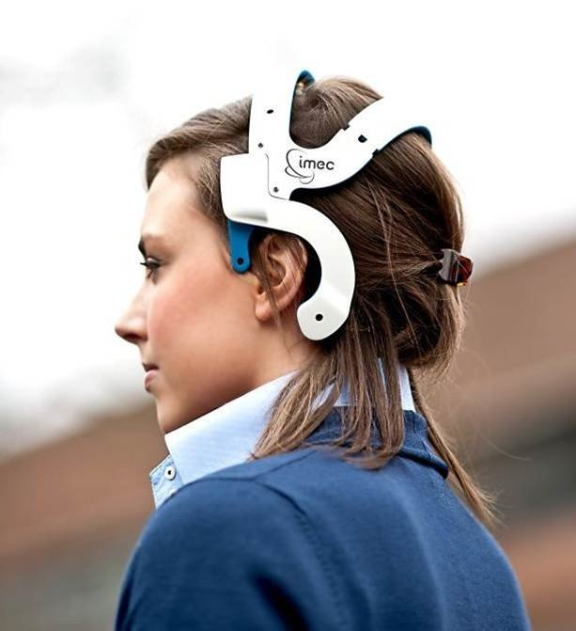
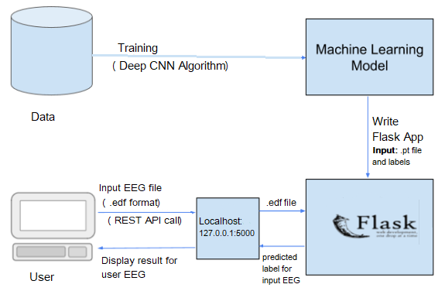
Application Programming interface (API)

Slide 23
Future Direction
Testing API on real time data for better performance evaluation
Collecting further data to expand the model capability
Semantic labeling of time segments in EEG recordings
Publication of our study on Abnormal EEG classification in a reputed peer reviewed journal/conference

Slide 24
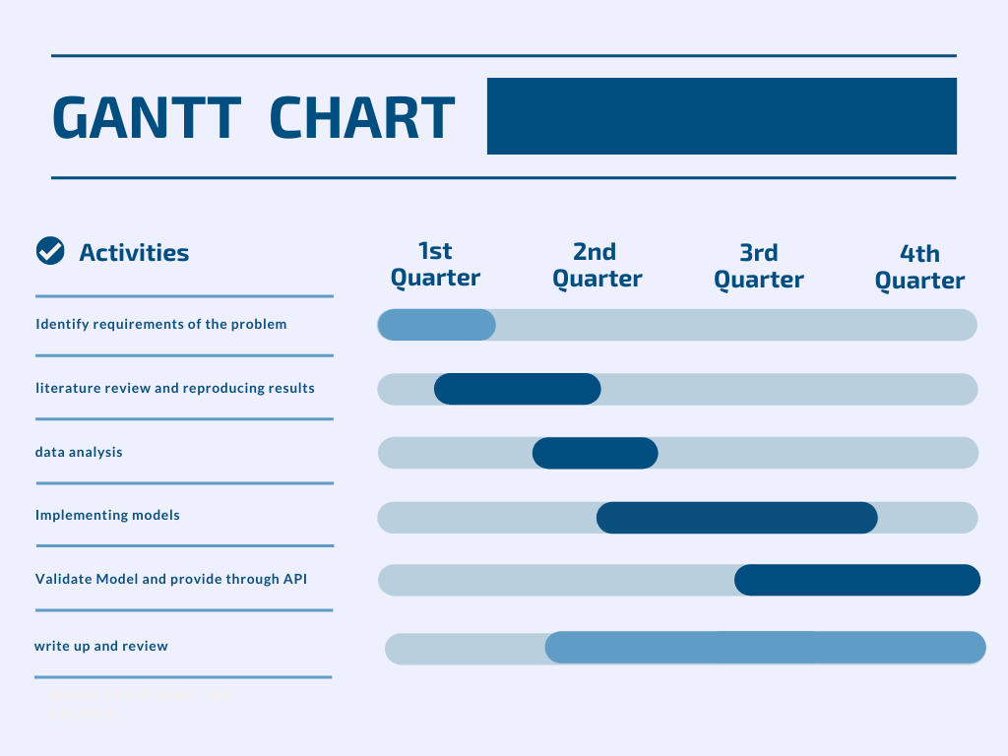
Work Division
Hira Tanveer
Literature review
Documentation
Preprocessing
API(App interface)
Rahat Ul Ain
Literature review
Training and validation
Documentation

Slide 25
Questions

Slide 26
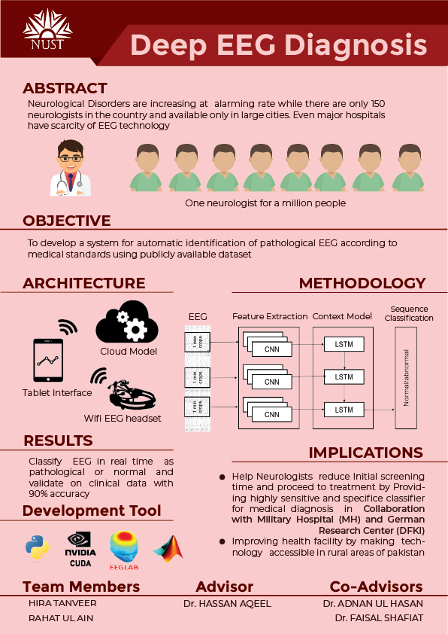

Slide 27
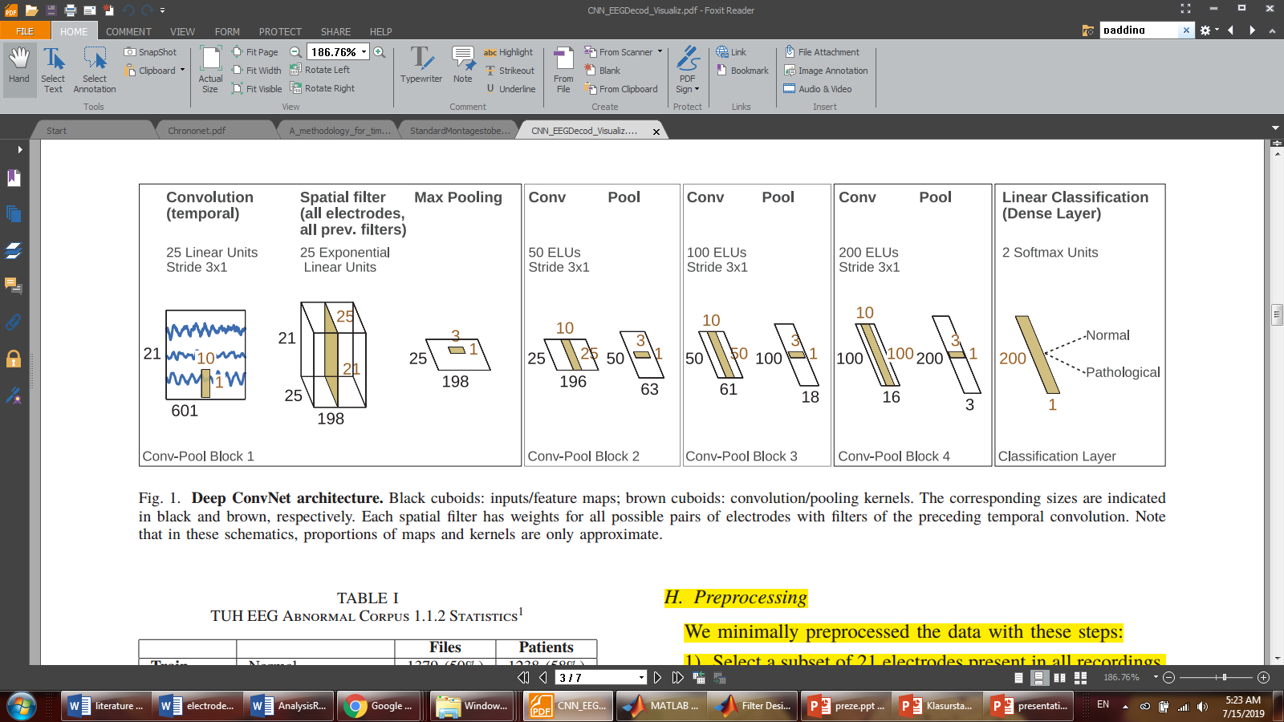
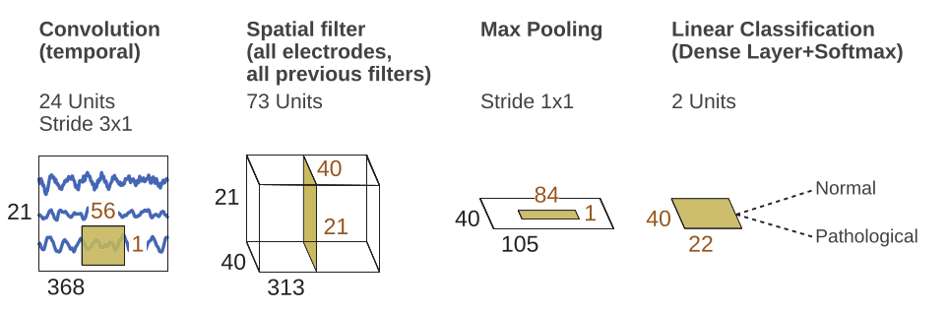
Convolutional Neural Network
Deep
CNN
Shallow
CNN

Slide 28
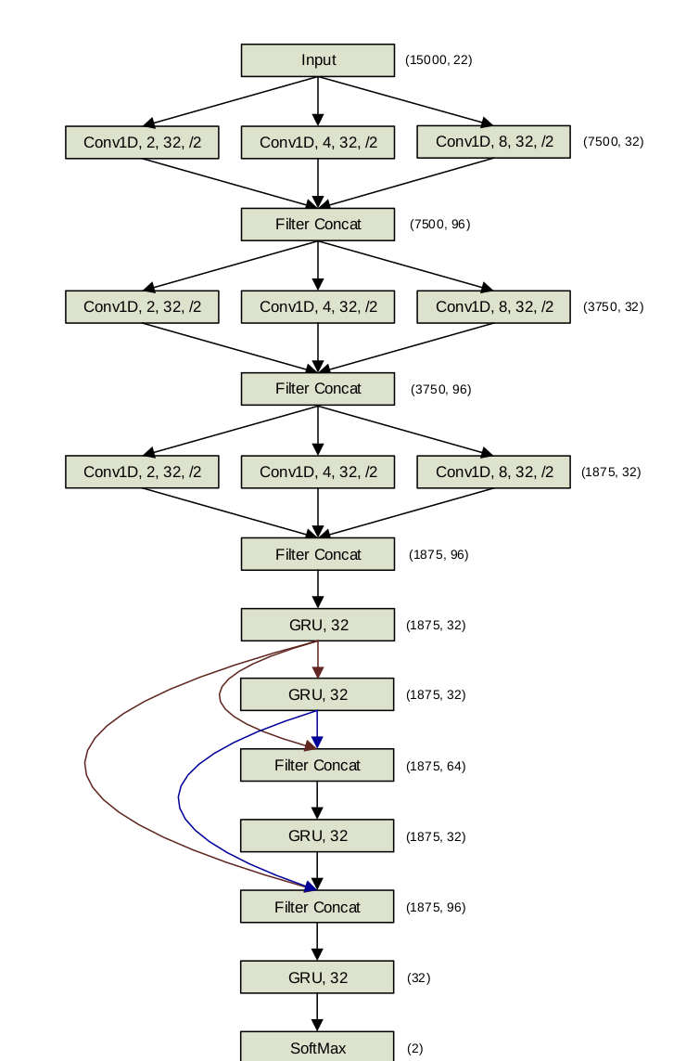
Chrononet
Chrononet claimed 86% accurate diagnosis as reported by R. Subhrajit et al.
Used inception with 1D convolution of varying length followed by densely connected gated recurrent neural network
TCP montage with 22 channels is used
Max normalization over the dataset
Data augmentation by using one minute as an example

Slide 29
References
https://www.who.int/mental_health/neurology/neurological_disorders_report_web.pdf
S. Lopez, I. Obeid, and J. Picone, “Automated interpretation of abnormal adult electroencephalograms,” MS Thesis, Temple University, 2017
R. Schirrmeister, L. Gemein, K. Eggensperger, F. Hutter, T. Ball, "Deep learning with convolutional neural networks for decoding and visualization of EEG pathology", Proc. IEEE Signal Process. Med. Biol. Symp. (SPMB), pp. 1-7, Dec. 2017.
Roy, Subhrajit & Kiral-Kornek, F. Isabell & Harrer, Stefan. (2019). ChronoNet: A Deep Recurrent Neural Network for Abnormal EEG Identification. 10.1007/978-3-030-21642-9_8.
Amin, S. U., Hossain, M. S., Muhammad, G., Alhussein, M., and Rahman, M. A. (2019). Cognitive smart healthcare for pathology detection and monitoring. IEEE Access, 7:10745–10753.
Alhussein, M., Muhammad, G., and Hossain, M. S. (2019). EEG pathology detection based on deep learning. IEEE Access, 7:27781–27788.
https://youtu.be/FYbgrVNFngk

