Slide 1

Introduction To jQuery
write less, do more

Slide 2
What is jQuery?
jQuery is a lightweight, "write less, do more", JavaScript library.
The purpose of jQuery is to make it much easier to use JavaScript on your website.
jQuery takes a lot of common tasks that require many lines of JavaScript code to accomplish, and wraps them into methods that you can call with a single line of code.
jQuery also simplifies a lot of the complicated things from JavaScript, like AJAX calls and DOM manipulation.
The jQuery library contains the following features:
HTML/DOM manipulation
CSS manipulation
HTML event methods
Effects and animations
AJAX
Utilities

Slide 3
jQuery Syntax
The jQuery syntax is tailor-made for selecting HTML elements and performing some action on the element(s).
Basic syntax is: $(selector).action()
A $ sign to define/access jQuery
A (selector) to "query (or find)" HTML elements
A jQuery action() to be performed on the element(s)

Slide 4
The Document Ready Event
This is to prevent any jQuery code from running before the document is finished loading (is ready).
It is good practice to wait for the document to be fully loaded and ready before working with it. This also allows you to have your JavaScript code before the body of your document, in the head section.
$(document).ready(function(){ // jQuery methods go here... });

Slide 5
jQuery Selectors
jQuery selectors allow you to select and manipulate HTML element(s).
jQuery selectors are used to "find" (or select) HTML elements based on their name, id, classes, types, attributes, values of attributes and much more. It's based on the existing CSS Selectors, and in addition, it has some own custom selectors.
All selectors in jQuery start with the dollar sign and parentheses: $().

Slide 6
Types of Selector
Syntax: $(selector).action()
$(“ClassName”).action()
$(“IdName”).action()
$(“SelectorName”).action()

Slide 7
Element, Class and ID Selector
$(document).ready(function(){ $("button").click(function(){ $("#test").hide(); }); });
$(document).ready(function(){ $("button").click(function(){ $(“.test").hide(); }); });
$(document).ready(function(){ $("button").click(function(){ $(“p").hide(); }); });
$(document).ready(function(){ $("button").click(function(){ $(“ul li").hide(); }); });

Slide 8
jQuery Event Methods
Mouse Events | Keyboard Events | Form Events | Document/Window Events
click | keypress | submit | load
dblclick | keydown | change | resize
Mouseenter | keyup | focus | scroll
Mouseleave |  | blur | unload

Slide 9
jQuery Syntax For Event Methods
$("p").click(function(){ // action goes here!! });
The following example says: When a click event fires on a <p> element; hide the current <p> element:
$("p").click(function(){ $(this).hide(); });

Slide 10
jQuery Syntax For Event Methods
Similarly, other events can be called by changing event name.
$("p"). click(function(){ $(this).hide(); });

Slide 11
jQuery Effects

Slide 12
jQuery hide() and show()
With jQuery, you can hide and show HTML elements with the hide() and show() methods:
Syntax:
$(selector).hide(speed,callback);
$(selector).show(speed,callback);
The optional speed parameter specifies the speed of the hiding/showing, and can take the following values: "slow", "fast", or milliseconds.
The optional callback parameter is a function to be executed after the hide() and show() methods.

Slide 13
Example
$(document).ready(function(){
$("#hide").click(function(){
$("p").hide();
});
$("#show").click(function(){
$("p").show();
});
});

Slide 14
jQuery toggle()
You can also toggle between hiding and showing an element with the toggle() method.
Syntax:
$(selector).toggle(speed,callback);
The optional speed parameter can take the following values: "slow", "fast", or milliseconds.
Example:
$("button").click(function(){ $("p").toggle(); });

Slide 15
jQuery Fading Methods
With jQuery you can fade an element in and out of visibility.
jQuery has the following fade methods:
fadeIn()
fadeoOut()
fadeToggle()
fadeTo()
Syntax:
$(selector).fadeIn(speed,callback);
$(selector).fadeOut(speed,callback);
$(selector).fadeToggle(speed,callback);
$(selector).fadeTo(speed,opacity,callback);

Slide 16
Examples:
$("button").click(function(){ $("#div1").fadeIn(); $("#div2").fadeIn("slow"); $("#div3").fadeIn(3000); });
$("button").click(function(){ $("#div1").fadeOut(); $("#div2").fadeOut("slow"); $("#div3").fadeOut(3000); });
$("button").click(function(){ $("#div1").fadeToggle(); $("#div2").fadeToggle("slow"); $("#div3").fadeToggle(3000); });
$("button").click(function(){ $("#div1").fadeTo("slow“,0.15); $("#div2").fadeTo("slow“,0.5); $("#div3").fadeTo("slow“,0.9); });

Slide 17
jQuery Sliding Methods
With jQuery you can create a sliding effect on elements.
jQuery has the following slide methods:
slideUp()
slideDown()
slideToggle()
Syntax:
$(selector). slideUp(speed,callback);
$(selector). slideDown(speed,callback);
$(selector). slideToggle(speed,callback);

Slide 18
jQuery Animations - The animate() Method
The jQuery animate() method is used to create custom animations.
Syntax:
$(selector).animate({params},speed,callback);
The required params parameter defines the CSS properties to be animated.
The optional speed parameter specifies the duration of the effect. It can take the following values: "slow", "fast", or milliseconds.
The optional callback parameter is a function to be executed after the animation completes.
The following example demonstrates a simple use of the animate() method; it moves a <div> element to the right, until it has reached a left property of 250px:

Slide 19
Examples
$("button").click(function(){ $("div").animate({left: '250px'}); });
Notice that multiple properties can be animated at the same time:
$("button").click(function(){ $("div").animate({ left: '250px', opacity: '0.5', height: '150px', width: '150px' }); });

Slide 20
jQuery animate() - Using Pre-defined Values
You can even specify a property's animation value as hide(), show() or toggle():
$("button").click(function(){ $("div").animate({ height: 'toggle' }); });

Slide 21
jQuery animate() - Uses Queue Functionality
By default, jQuery comes with queue functionality for animations.
This means that if you write multiple animate() calls after each other, jQuery creates an "internal" queue with these method calls. Then it runs the animate calls ONE by ONE.
So, if you want to perform different animations after each other, we take advantage of the queue functionality:

Slide 22
Example
<button>Start Animation</button>
<div style="background:#98bf21;height:100px;width:100px;position:absolute;"></div>
$(document).ready(function(){
$("button").click(function(){
var div = $("div");
div.animate({height: '300px', opacity: '0.4'}, "slow");
div.animate({width: '300px', opacity: '0.8'}, "slow");
div.animate({height: '100px', opacity: '0.4'}, "slow");
div.animate({width: '100px', opacity: '0.8'}, "slow");
});
});

Slide 23
jQuery stop() Method
The jQuery stop() method is used to stop an animation or effect before it is finished.
The stop() method works for all jQuery effect functions, including sliding, fading and custom animations
Syntax:
$(selector).stop(stopAll,goToEnd);
The optional stopAll parameter specifies whether also the animation queue should be cleared or not. Default is false, which means that only the active animation will be stopped, allowing any queued animations to be performed afterwards.
The optional goToEnd parameter specifies whether or not to complete the current animation immediately. Default is false.
So, by default, the stop() method kills the current animation being performed on the selected element.

Slide 24
Example
$("button").click(function(){ $(“#para").stop(); });
$(document).ready(function(){
$(“button").click(function(){
$("#btn").slideDown(5000);
});
$("#stop").click(function(){
$("#panel").stop();
});
});

Slide 25
jQuery HTML

Slide 26
jQuery Get
jQuery - Get Content and Attributes
Get Content - text(), html(), and val()
Three simple, but useful, jQuery methods for DOM manipulation are:
text() - Sets or returns the text content of selected elements
html() - Sets or returns the content of selected elements (including HTML markup)
val() - Sets or returns the value of form fields

Slide 27
Example
The following example demonstrates how to get content with the jQuery text() and html() methods:
$("#btn1").click(function(){ alert("Text: " + $("#test").text()); }); $("#btn2").click(function(){ alert("HTML: " + $("#test").html()); });

Slide 28
Example
The following example demonstrates how to get the value of an input field with the jQuery val() methods:
$("#btn1").click(function(){ alert("Value: " + $("#test").val()); });

Slide 29
Get Attributes - attr()
The jQuery attr() method is used to get attribute values.
Example:
$("button").click(function(){ alert($("a").attr("href")); });

Slide 30
Set Content - text(), html(), and val()
We will use the same three methods from the get content to set content:
Example:
$("#btn1").click(function(){ $("#test1").text("Hello world!"); }); $("#btn2").click(function(){ $("#test2").html("<b>Hello world!</b>"); }); $("#btn3").click(function(){ $("#test3").val("Dolly Duck"); });

Slide 31
jQuery - Add Elements
append() - Inserts content at the end of the selected elements
prepend() - Inserts content at the beginning of the selected elements
Example:
$("p").append(“Text Appended");
$("p").prepend(“Text Prepended");

Slide 32
jQuery - Remove Elements
Remove Elements/Content
To remove elements and content, there are mainly two jQuery methods:
remove() - removes the selected element (and its child elements)
empty() - Removes the child elements from the selected element
Example:
$("#div1").remove(); OR $("#div1").remove(“AnySelector”);

Slide 33
jQuery - Get and Set CSS Classes
jQuery Manipulating CSS
jQuery has several methods for CSS manipulation. We will look at the following methods:
addClass() - Adds one or more classes to the selected elements
removeClass - Removes one or more classes from the selected elements
toggleClass() - Toggles between adding/removing classes from the selected elements
css() Sets or returns the style attribute

Slide 34
jQuery addClass() Method
CSS
.important {
font-weight: bold;
font-size: xx-large;
}
.blue {
color: blue;
}
HTML
<h1>Heading 1</h1>
<h2>Heading 2</h2>
<p>This is a paragraph.</p>
<p>This is another paragraph.</p>
<div>This is some important text!</div><br>
<button>Add classes to elements</button>
jQuery
$(document).ready(function(){
$("button").click(function(){
$("h1, h2, p").addClass("blue");
$("div").addClass("important");
});
});

Slide 35
jQuery removeClass() Method
$("button").click(function(){ $("h1, h2, p").removeClass("blue"); });

Slide 36
jQuery toggleClass() Method
This method toggles between adding/removing classes from the selected elements:
$("button").click(function(){ $("h1, h2, p").toggleClass("blue"); });

Slide 37
jQuery - css() Method
The css() method sets or returns one or more style properties for the selected elements.
Syntax:
$(‘Selector’).css("propertyname","value");
Example:
$(“h1").css("background-color", “blue");

Slide 38
Set Multiple CSS Properties
Syntax:
css({"propertyname":"value","propertyname":"value",...});
Example:
$("p").css({"background-color": "yellow", "font-size": "200%"});

Slide 39
jQuery - AJAX Introduction
AJAX is the art of exchanging data with a server, and updating parts of a web page - without reloading the whole page.
What is AJAX?
AJAX = Asynchronous JavaScript and XML.
In short; AJAX is about loading data in the background and display it on the webpage, without reloading the whole page.
Examples of applications using AJAX: Gmail, Google Maps, YouTube, and Facebook tabs.

Slide 40
What About jQuery and AJAX?
jQuery provides several methods for AJAX functionality.
With the jQuery AJAX methods, you can request text, HTML, XML, or JSON from a remote server using both HTTP Get and HTTP Post - And you can load the external data directly into the selected HTML elements of your web page!

Slide 41
jQuery load() Method
The jQuery load() method is a simple, but powerful AJAX method.
Load() method loads data from a server and puts the returned data into the selected element.
Syntax:
$(selector).load(URL,data,callback);
The required URL parameter specifies the URL you wish to load.
The optional data parameter specifies a set of query string key/value pairs to send along with the request.
The optional callback parameter is the name of a function to be executed after the load() method is completed.

Slide 42
Example
$('button').click(function(){
$('#data').load('data.txt')
});});

Slide 43
jQuery - AJAX get() and post() Methods
The jQuery get() and post() methods are used to request data from the server with an HTTP GET or POST request.
HTTP Request: GET vs. POST
Two commonly used methods for a request-response between a client and server are: GET and POST.
GET - Requests data from a specified resource
POST - Submits data to be processed to a specified resource
GET is basically used for just getting (retrieving) some data from the server. Note: The GET method may return cached data.
POST can also be used to get some data from the server. However, the POST method NEVER caches data, and is often used to send data along with the request.

Slide 44
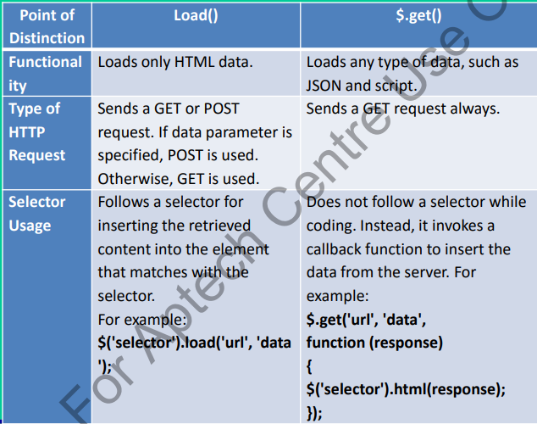
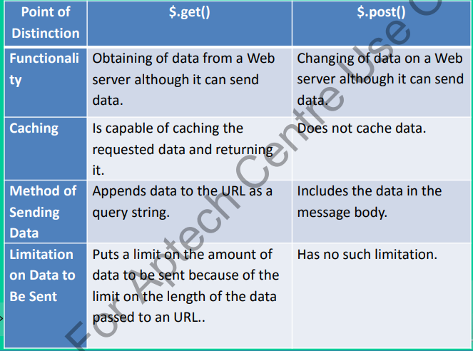
jQuery $.get() Method

Slide 45
jQuery $.get() Method
Get() method requests data from the server with an HTTP GET request.
Syntax:
$.get(URL,callback);
Example:
$("button").click(function(){ $.get(“data.asp", function(data, status){ alert("Data: " + data + "\nStatus: " + status); }); });

Slide 46
jQuery $.post() Method
Post() method requests data from the server using an HTTP POST request.
Syntax:
$.post(URL,data,callback);
Example
$("button").click(function(){ $.post("data.asp", { name: "Donald Duck", city: "Duckburg" }, function(data, status){ alert("Data: " + data + "\nStatus: " + status); }); });

Slide 47
jQuery - Interactions
Interactions could be added basic mouse-based behaviors to any element. Using with interactions, We can create sortable lists, resizable elements, drag & drop behaviors. Interactions also make great building blocks for more complex widgets and applications.
jQuery – Interactions

Slide 48
jQuery - Widgets
a jQuery UI widget is a specialized jQuery plug-in . Using plug-in, we can apply behaviors to the elements. However, plug-ins lack some built-in capabilities, such as a way to associate data with its elements, expose methods, merge options with defaults, and control the plug-in's lifetime.
jQuery - Widgets

