Slide 1
Introduction to
Databases with SQL
Querying

Slide 2
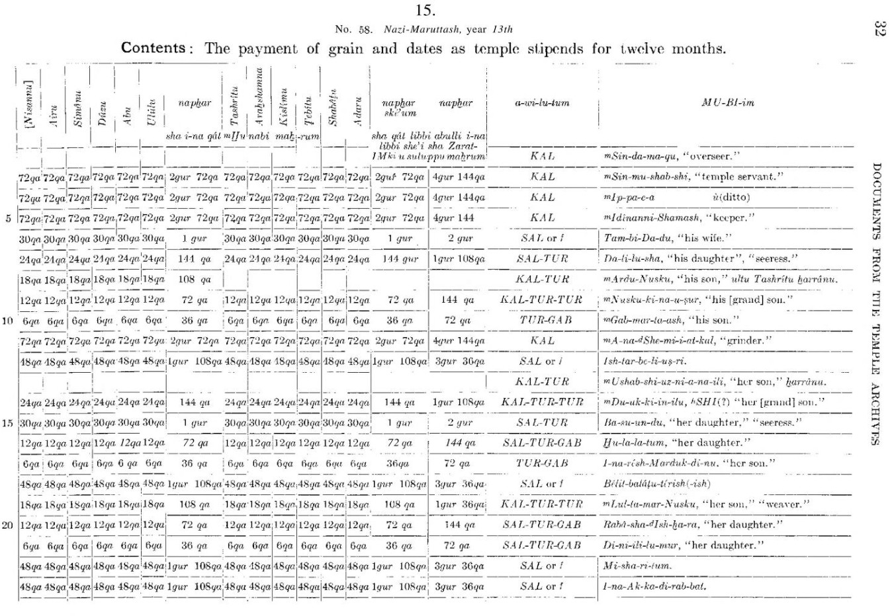

Slide 3
Song of Solomon
Pat Conroy
Goodnight Moon
Prince of Tides
Le Petit Prince
F. Scott Fitzgerald
Antoine de Saint-Exupéry
The Overstory
Toni Morrison Richard Powers
The Great Gatsby
Frankenstein
Margaret Wise Brown
Mary Shelley

Slide 4
title
author
Song of Solomon
Toni Morrison
Goodnight Moon
Margaret Wise Brown
The Overstory
Richard Powers
The Great Gatsby
F. Scott Fitzgerald
Frankenstein
Mary Shelley
Le Petit Prince
Antoine de Saint-Exupéry
Prince of Tides
Pat Conroy

Slide 5
Apple Numbers Google Sheets Microsoft Excel
…

Slide 6
Scale

Slide 7
Scale Frequency

Slide 8
Scale Frequency Speed

Slide 9
Database
A collection of data organized for creating, reading, updating, and deleting.

Slide 10
Database Management System
Software via which you can interact with a database.

Slide 11
MySQL
Oracle PostgreSQL SQL
…

Slide 12
SQL
A language via which you can create, read, update, and delete data in a database.

Slide 13
Structured Query Language
A language via which you can create, read, update, and delete data in a database.

Slide 14
SQL
A language via which you can create, read, update, and delete data in a database.

Slide 15
Querying

Slide 16
What's the most-liked post on our platform?

Slide 17
Is our number of daily users growing or shrinking?

Slide 18
Which songs are most like the song a user just played?

Slide 19


Slide 20
Tool for SQL
SQL Server Management
…

Slide 21
Phones

Slide 22
Desktop

Slide 23
Websites

Slide 24
What data is in our database?

Slide 25
SELECT

Slide 26
SELECT column FROM table;

Slide 27
LIMIT

Slide 28
OFFSET

Slide 29
WHERE

Slide 30
SELECT column FROM table WHERE condition;

Slide 31
=
!=
<>

Slide 32
SELECT column FROM table WHERE column = value;

Slide 33
NOT

Slide 34
Style

Slide 35
SELECT "title" FROM "longlist"
WHERE "author" = 'Fernanda Melchor';

Slide 36
SELECT "title" FROM "longlist"
WHERE "author" = 'Fernanda Melchor';

Slide 37
SELECT "title" FROM "longlist"
WHERE "author" = 'Fernanda Melchor';

Slide 38
NULL

Slide 39
IS NULL
IS NOT NULL

Slide 40
LIKE

Slide 41
SELECT column FROM table WHERE column LIKE pattern;

Slide 42
%
_

Slide 43
AND OR ()

Slide 44
SELECT column FROM table
WHERE condition0 AND condition1;

Slide 45
SELECT column FROM table
WHERE condition0 OR condition1;

Slide 46
>
<
>=
<=

Slide 47
BETWEEN … AND …

Slide 48
ORDER BY

Slide 49
ORDER | BY | … | ASC
ORDER | BY | … | DESC

Slide 50
SELECT column FROM table WHERE condition
ORDER BY column;

Slide 51
SELECT column FROM table WHERE condition
ORDER BY column;

Slide 52
COUNT AVG MIN MAX SUM

Slide 53
ROUND

Slide 54
DISTINCT

Slide 55
SELECT COUNT(column) FROM table;

Slide 56
SELECT AVG(column) FROM table;

Slide 57
Introduction to
Databases with SQL
Querying

