Slide 1
Introduction to
Databases with SQL
Relating

Slide 2


Slide 3
Relational Databases

Slide 4
authors
books
name
title
Eva Baltasar
Boulder
Han Kang
The White Book
Gauz
Standing Heavy
Olga Tokarczuk
Flights

Slide 5
name
title
Eva Baltasar
Boulder
Han Kang
The White Book
Gauz
Standing Heavy
Olga Tokarczuk
Flights

Slide 6
name
title
Eva Baltasar
Boulder
Han Kang
The White Book
Gauz
Standing Heavy
Olga Tokarczuk
Flights
Olga Tokarczuk
The Books of Jacob

Slide 7
authors
books
name
title
Eva Baltasar
Boulder
Han Kang
The White Book
Gauz
Standing Heavy
Olga Tokarczuk
Flights

Slide 8
book
author

Slide 9
books
author

Slide 10
books
authors

Slide 11
One-to-one One-to-many Many-to-many

Slide 12
Entity Relationship Diagrams

Slide 13
ER Diagrams

Slide 14
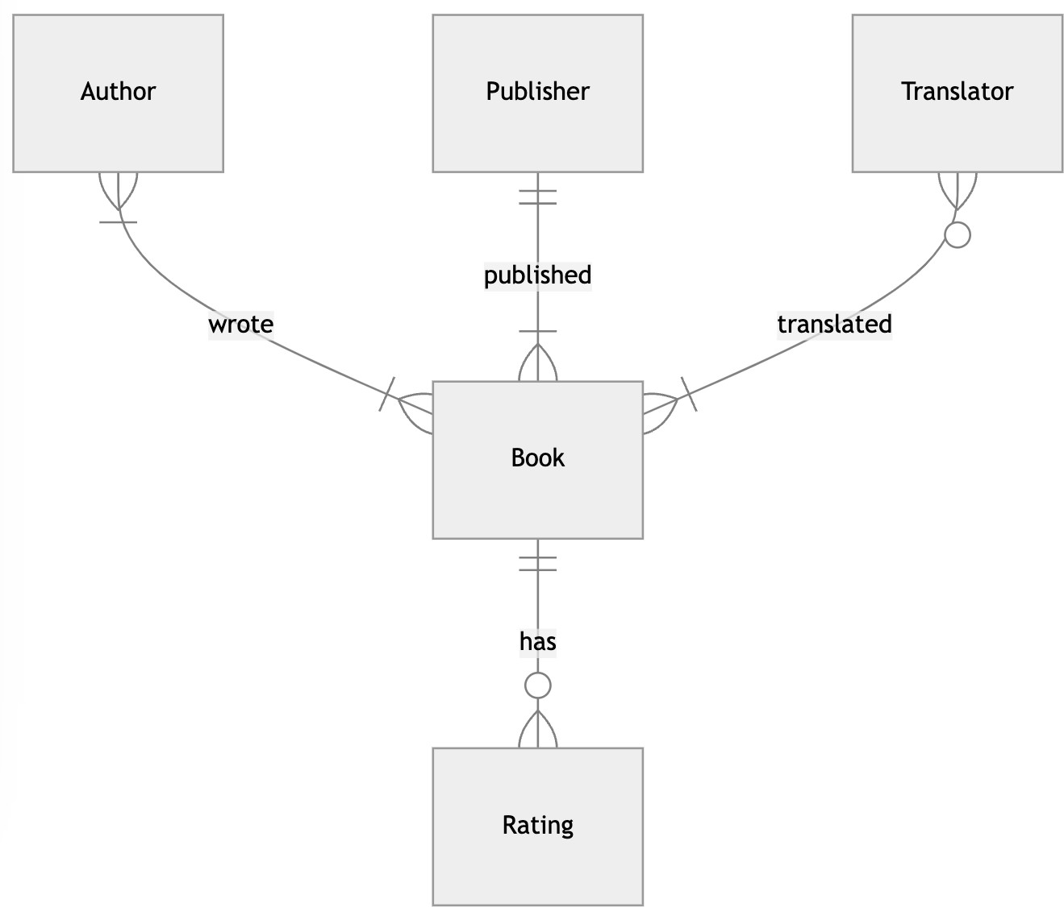

Slide 15
Zero
One
Many

Slide 16
Book
Author

Slide 17
Book
Author

Slide 18
Book
Author

Slide 20
Keys

Slide 21
The Birthday Party
The Birthday Party
Wendy Dranfield | Paperback
The Birthday Party
Laurent Mauvignier | Hardcover

Slide 22
The Birthday Party by Laurent Mauvignier
The Birthday Party
Laurent Mauvignier | Hardcover
The Birthday Party
Laurent Mauvignier | Paperback

Slide 23
The | Birthday | Party | by | Laurent | Mauvignier
in | paperback
The Birthday Party
Laurent Mauvignier | Paperback | 1st edition
The Birthday Party
Laurent Mauvignier | Paperback | 2nd edition

Slide 24
ISBN

Slide 25
978-1-80427-022-6

Slide 26
Primary Key

Slide 27
books
isbn
title
9788439736967
Boulder
9780525573067
The White Book
9781529414431
Standing Heavy
9781910695432
Flights

Slide 28
Foreign Key

Slide 29
ratings
isbn
rating
books
9788439736967
4
9788439736967
3
isbn
title
9788439736967
9788439736967
5
Boulder
9780525573067
2
9780525573067 The White Book
9780525573067
3
9781529414431
Standing Heavy
9781910695432
Flights
9781529414431
4
9781910695432
5
9781910695432
4

Slide 30
One-to-many

Slide 31
ratings
isbn
rating
books
9788439736967
4
9788439736967
3
isbn
title
9788439736967
9788439736967
5
Boulder
9780525573067
2
9780525573067 The White Book
9780525573067
3
9781529414431
Standing Heavy
9781910695432
Flights
9781529414431
4
9781910695432
5
9781910695432
4

Slide 32
978-1-80427-022-6

Slide 33
9781804270226

Slide 34
1

Slide 35
ratings
isbn
rating
books
9788439736967
4
9788439736967
3
isbn
title
9788439736967
9788439736967
5
Boulder
9780525573067
2
9780525573067 The White Book
9780525573067
3
9781529414431
Standing Heavy
9781910695432
Flights
9781529414431
4
9781910695432
5
9781910695432
4

Slide 36
ratings
book_id
rating
books
1
4
id
isbn
title
1
3
1
9788439736967
Boulder
1
5
9780525573067
74
2
74
The White Book
9781529414431
74
3
4
Standing Heavy
78
9781910695432
Flights
4
4
78
5
78
4

Slide 37
Many-to-many

Slide 38
books
authors
authored
id | name |  |  | author_id | book_id |  |  |  | id | isbn | title
23 | Eva Baltasar |  |  | 23 | 1 |  |  |  | 1 | ... | Boulder
31 | Han Kang |  |  | 31 | 74 |  |  |  | 74 | ... | The White Book
27 | Gauz |  |  | 27 | 4 |  |  |  | 4 | ... | Standing Heavy
58 | Olga Tokarczuk |  |  | 58 | 78 |  |  |  | 78 | ... | Flights

Slide 39
Subqueries

Slide 40
One-to-many

Slide 41
books
publisher_id
title
5
Minor Detail
5
Paradais
33
Love in the New …
…
…

Slide 42
publishers
books
id
publisher
publisher_id
title
5
Fitzcarraldo Editions
5
Minor Detail
22
Seagull Books
5
Paradais
33 Yale University Press
33
Love in the New …
…
…
…
…

Slide 43
publishers
books
id
publisher
publisher_id
title
5
Fitzcarraldo Editions
5
Minor Detail
22
Seagull Books
5
Paradais
33 Yale University Press
33
Love in the New …
…
…
…
…

Slide 44
publishers
books
id
publisher
publisher_id
title
5
Fitzcarraldo Editions
5
Minor Detail
22
Seagull Books
5
Paradais
33 Yale University Press
33
Love in the New …
…
…
…
…

Slide 45
SELECT "id" FROM "publishers"
WHERE "publisher" = 'Fitzcarraldo Editions';

Slide 46
SELECT "title" FROM "books" WHERE "publisher_id" = 5;

Slide 47
SELECT "title" FROM "books" WHERE "publisher_id" = (
SELECT "id" FROM "publishers"
WHERE "publisher" = 'Fitzcarraldo Editions'
);

Slide 48
Many-to-many

Slide 49
books
authors
authored
id | name |  | author_id | book_id |  | id | isbn | title
23 | Eva Baltasar |  | 23 | 1 |  | 1 | ... | Boulder
31 | Han Kang |  | 31 | 74 |  | 74 | ... | The White Book
27 | Gauz |  | 27 | 4 |  | 4 | ... | Standing Heavy
58 | Olga Tokarczuk |  | 58 | 78 |  | 78 | ... | Flights

Slide 50
books
authors
authored
id | name |  | author_id | book_id |  |  | id | isbn | title
23 | Eva Baltasar |  | 23 | 1 |  |  | 1 | ... | Boulder
31 | Han Kang |  | 31 | 74 |  |  | 74 | ... | The White Book
27 | Gauz |  | 27 | 4 |  |  | 4 | ... | Standing Heavy
58 | Olga Tokarczuk |  | 58 | 78 |  |  | 78 | ... | Flights

Slide 51
books
authors
authored
id | name |  | author_id | book_id |  |  |  | id | isbn | title
23 | Eva Baltasar |  | 23 | 1 |  |  |  | 1 | ... | Boulder
31 | Han Kang |  | 31 | 74 |  |  |  | 74 | ... | The White Book
27 | Gauz |  | 27 | 4 |  |  |  | 4 | ... | Standing Heavy
58 | Olga Tokarczuk |  | 58 | 78 |  |  |  | 78 | ... | Flights

Slide 52
books
authors
authored
id | name |  |  | author_id | book_id |  |  |  | id | isbn | title
23 | Eva Baltasar |  |  | 23 | 1 |  |  |  | 1 | ... | Boulder
31 | Han Kang |  |  | 31 | 74 |  |  |  | 74 | ... | The White Book
27 | Gauz |  |  | 27 | 4 |  |  |  | 4 | ... | Standing Heavy
58 | Olga Tokarczuk |  |  | 58 | 78 |  |  |  | 78 | ... | Flights

Slide 53
books
authors
authored
id | name |  |  | author_id | book_id |  |  |  | id | isbn | title
23 | Eva Baltasar |  |  | 23 | 1 |  |  |  | 1 | ... | Boulder
31 | Han Kang |  |  | 31 | 74 |  |  |  | 74 | ... | The White Book
27 | Gauz |  |  | 27 | 4 |  |  |  | 4 | ... | Standing Heavy
58 | Olga Tokarczuk |  |  | 58 | 78 |  |  |  | 78 | ... | Flights

Slide 54
SELECT "id" FROM "books" WHERE "title" = 'Flights';

Slide 55
SELECT "author_id" FROM "authored" WHERE "book_id" = (
SELECT "id" FROM "books" WHERE "title" = 'Flights'
);

Slide 56
SELECT "name" FROM "authors" WHERE "id" = (
SELECT "author_id" FROM "authored" WHERE "book_id" = (
SELECT "id" FROM "books" WHERE "title" = 'Flights'
)
);

Slide 57
IN

Slide 58
books
authors
authored
id | name |  | author_id | book_id |  | id | isbn | title
23 | Eva Baltasar |  | 23 | 1 |  | 1 | ... | Boulder
31 | Han Kang |  | 31 | 74 |  | 74 | ... | The White Book
27 | Gauz |  | 27 | 4 |  | 4 | ... | Standing Heavy
58 | Olga Tokarczuk |  | 58 | 78 |  | 78 | ... | Flights

Slide 59
books
authors
authored
id | name |  | author_id | book_id |  | id | isbn | title
23 | Eva Baltasar |  | 23 | 1 |  | 1 | ... | Boulder
31 | Han Kang |  | 31 | 74 |  | 74 | ... | The White Book
27 | Gauz |  | 27 | 4 |  | 4 | ... | Standing Heavy
58 | Olga Tokarczuk |  | 58 | 78 |  | 78 | ... | Flights

Slide 60
books
authors
authored
id | name |  |  | author_id | book_id |  | id | isbn | title
23 | Eva Baltasar |  |  | 23 | 1 |  | 1 | ... | Boulder
31 | Han Kang |  |  | 31 | 74 |  | 74 | ... | The White Book
27 | Gauz |  |  | 27 | 4 |  | 4 | ... | Standing Heavy
58 | Olga Tokarczuk |  |  | 58 | 78 |  | 78 | ... | Flights

Slide 61
books
authors
authored
id | name |  |  | author_id | book_id |  |  | id | isbn | title
23 | Eva Baltasar |  |  | 23 | 1 |  |  | 1 | ... | Boulder
31 | Han Kang |  |  | 31 | 74 |  |  | 74 | ... | The White Book
27 | Gauz |  |  | 27 | 4 |  |  | 4 | ... | Standing Heavy
58 | Olga Tokarczuk |  |  | 58 | 78 |  |  | 78 | ... | Flights

Slide 62
books
authors
authored
id | name |  |  | author_id | book_id |  |  |  | id | isbn | title
23 | Eva Baltasar |  |  | 23 | 1 |  |  |  | 1 | ... | Boulder
31 | Han Kang |  |  | 31 | 74 |  |  |  | 74 | ... | The White Book
27 | Gauz |  |  | 27 | 4 |  |  |  | 4 | ... | Standing Heavy
58 | Olga Tokarczuk |  |  | 58 | 78 |  |  |  | 78 | ... | Flights

Slide 63
Joins

Slide 64
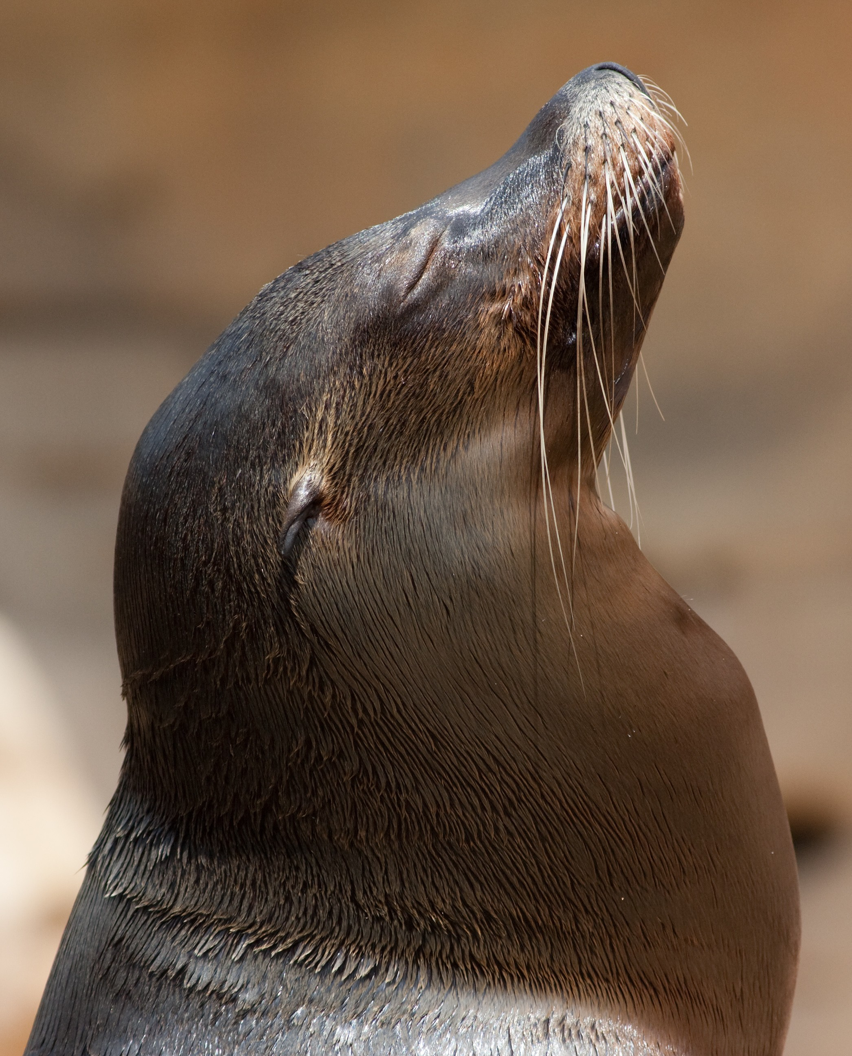

Slide 65
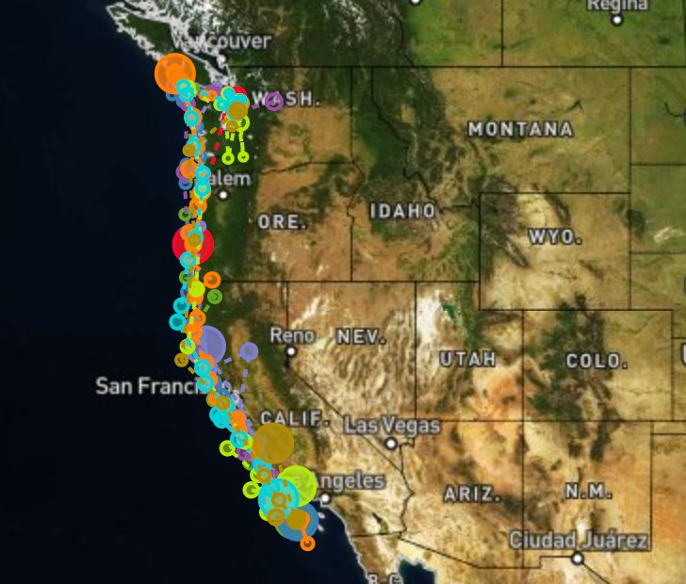

Slide 66
migrations
sea lions
id name
10484 Ayah
11728 Spot
11729 Tiger
11732 Mabel
11734 Rick
11790 Jolee
id | distance | days
10484 | 1000 | 107
11728 | 1531 | 56
11729 | 1370 | 37
11732 | 1622 | 62
11734 | 1491 | 58
11735 | 2723 | 82
11736 | 1571 | 52
11737 | 1957 | 92

Slide 67
migrations
sea lions
 | id | distance | days
 | 10484 | 1000 | 107
 | 11728 | 1531 | 56
 | 11729 | 1370 | 37
 | 11732 | 1622 | 62
 | 11734 | 1491 | 58
 | 11735 | 2723 | 82
 | 11736 | 1571 | 52
 | 11737 | 1957 | 92
id
name
10484
Ayah
11728
Spot
11729
Tiger
11732
Mabel
11734
Rick
11790
Jolee

Slide 68
sea lions JOIN migrations
 | id | name | id | distance | days
 | 10484 | Ayah | 10484 | 1000 | 107
 | 11728 | Spot | 11728 | 1531 | 56
 | 11729 | Tiger | 11729 | 1370 | 37
 | 11732 | Mabel | 11732 | 1622 | 62
 | 11734 | Rick | 11734 | 1491 | 58

Slide 69
JOIN

Slide 70
INNER JOIN

Slide 71
id | name
10484 | Ayah
11728 | Spot
11790 | Jolee
id | distance
10484 | 1000
11728 | 1531
11735 | 2723

Slide 72
id | name | id | distance
10484 | Ayah | 10484 | 1000
11728 | Spot | 11728 | 1531
11790 | Jolee | 11735 | 2723

Slide 73
id | name | id | distance
10484 | Ayah | 10484 | 1000
11728 | Spot | 11728 | 1531

Slide 74
LEFT JOIN RIGHT JOIN FULL JOIN

Slide 75
LEFT OUTER JOIN RIGHT OUTER JOIN FULL OUTER JOIN

Slide 76
LEFT OUTER JOIN

Slide 77
id | name
10484 | Ayah
11728 | Spot
11790 | Jolee
id | distance
10484 | 1000
11728 | 1531
11735 | 2723

Slide 78
id | name | id | distance
10484 | Ayah | 10484 | 1000
11728 | Spot | 11728 | 1531
11790 | Jolee
 |  | 11735 | 2723

Slide 79
id | name | id | distance
10484 | Ayah | 10484 | 1000
11728 | Spot | 11728 | 1531
11790 | Jolee | NULL | NULL
NULL | NULL | 11735 | 2723

Slide 80
id | name | id | distance
10484 | Ayah | 10484 | 1000
11728 | Spot | 11728 | 1531
11790 | Jolee | NULL | NULL

Slide 81
RIGHT OUTER JOIN

Slide 82
id | name
10484 | Ayah
11728 | Spot
11790 | Jolee
id | distance
10484 | 1000
11728 | 1531
11735 | 2723

Slide 83
id | name | id | distance
10484 | Ayah | 10484 | 1000
11728 | Spot | 11728 | 1531
11790 | Jolee
 |  | 11735 | 2723

Slide 84
id | name | id | distance
10484 | Ayah | 10484 | 1000
11728 | Spot | 11728 | 1531
11790 | Jolee | NULL | NULL
NULL | NULL | 11735 | 2723

Slide 85
id | name | id | distance
10484 | Ayah | 10484 | 1000
11728 | Spot | 11728 | 1531
NULL | NULL | 11735 | 2723

Slide 86
FULL JOIN

Slide 87
id | name
10484 | Ayah
11728 | Spot
11790 | Jolee
id | distance
10484 | 1000
11728 | 1531
11735 | 2723

Slide 88
id | name | id | distance
10484 | Ayah | 10484 | 1000
11728 | Spot | 11728 | 1531
11790 | Jolee
 |  | 11735 | 2723

Slide 89
id | name | id | distance
10484 | Ayah | 10484 | 1000
11728 | Spot | 11728 | 1531
11790 | Jolee | NULL | NULL
NULL | NULL | 11735 | 2723

Slide 90
NATURAL JOIN

Slide 91
Break

Slide 92
Sets

Slide 93
Translator: Sophie Hughes

Slide 94
Translator: Margaret Jull Costa
Margaret Jull Costa

Slide 95


Translators
Authors

Slide 96

Translators
Authors

Slide 97

Translators
Authors

Slide 98

Translators
Authors

Slide 99
Authors
Translators
Authors INTERSECT Translators

Slide 100
SELECT "book_id" FROM "translated"
WHERE "translator_id" = (
SELECT "id" from "translators"
WHERE "name" = 'Sophie Hughes'
)
INTERSECT …

Slide 101
SELECT "book_id" FROM "translated"
WHERE "translator_id" = (
SELECT "id" from "translators"
WHERE "name" = 'Margaret Jull Costa'
);

Slide 102

Translators
Authors

Slide 103
Authors
Translators
Authors UNION Translators

Slide 104
SELECT 'author' AS "profession", "name"
FROM "authors"
UNION
SELECT 'translator' AS "profession", "name"
FROM "translators";

Slide 105

Translators
Authors

Slide 106
Authors
Translators
Authors EXCEPT Translators

Slide 107

Translators
Authors

Slide 108
Authors
Translators
Translators EXCEPT Authors

Slide 109
SELECT "name" FROM "authors"
EXCEPT
SELECT "name" FROM "translators";

Slide 110

Translators
Authors

Slide 111
Groups

Slide 112
book_id | rating
1 | 4
1 | 3
1 | 4
2 | 2
2 | 3

Slide 113
book_id | rating
1 | 4
1 | 3
1 | 4
2 | 2
2 | 3

Slide 114
book_id
rating
1
43
2
32

Slide 115
book_id
average rating
1
3.67
2
2.5

Slide 116
GROUP BY

Slide 117
SELECT "book_id", AVG("rating") AS "average rating"
FROM "ratings"
GROUP BY "book_id";

Slide 118
HAVING

Slide 119
SELECT "book_id", ROUND(AVG("rating"), 2) AS "average rating"
FROM "ratings"
GROUP BY "book_id"
HAVING "average rating" > 4.0;

Slide 120
Introduction to
Databases with SQL
Relating

