Slide 1
Introduction to
Databases with SQL
Designing

Slide 2


Slide 3
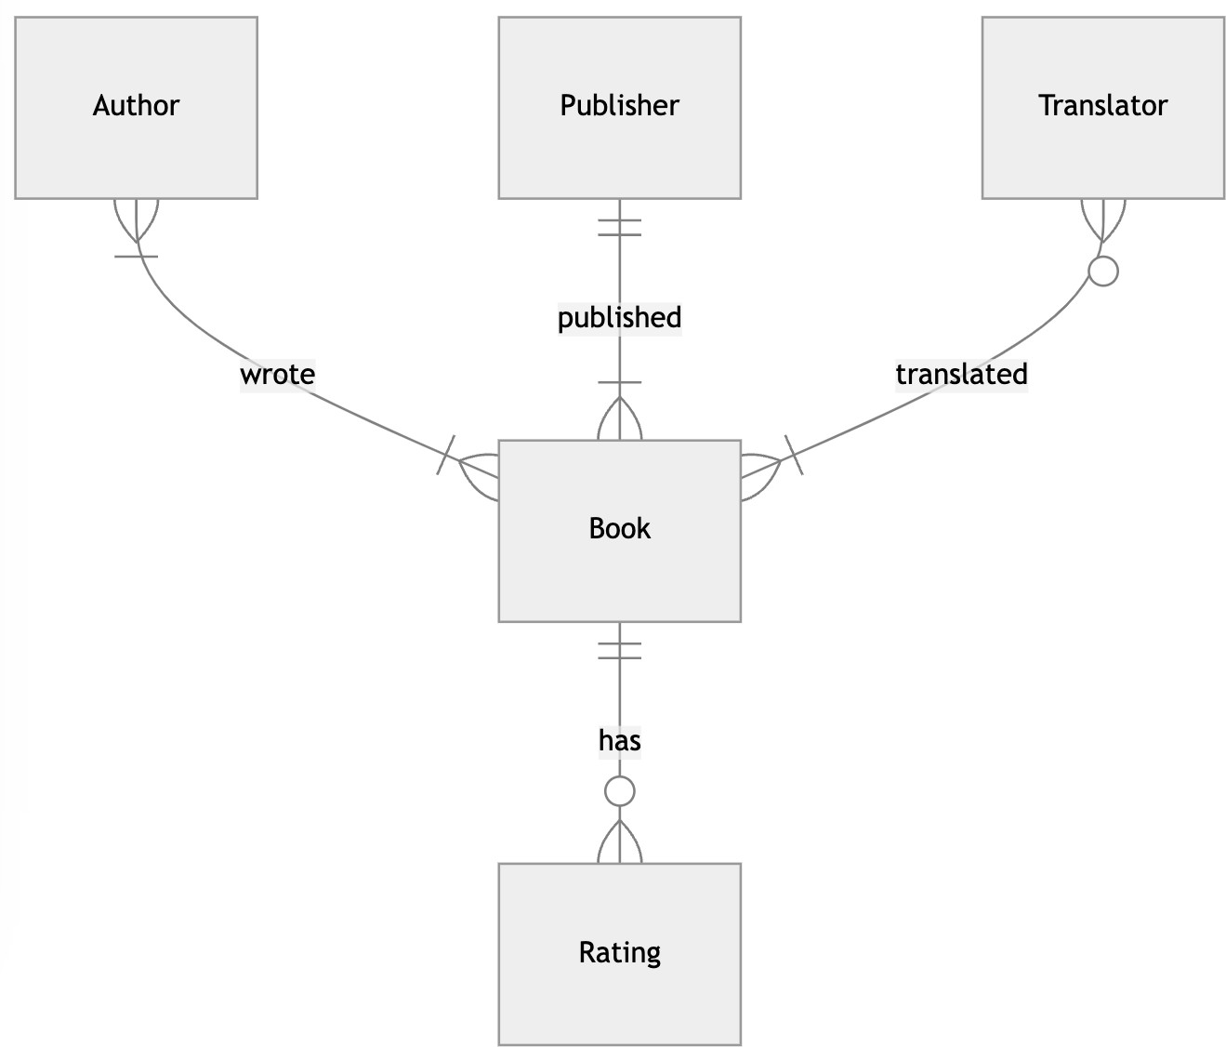

Slide 4
DATABASE DESIGN | SCHEMA

Slide 5
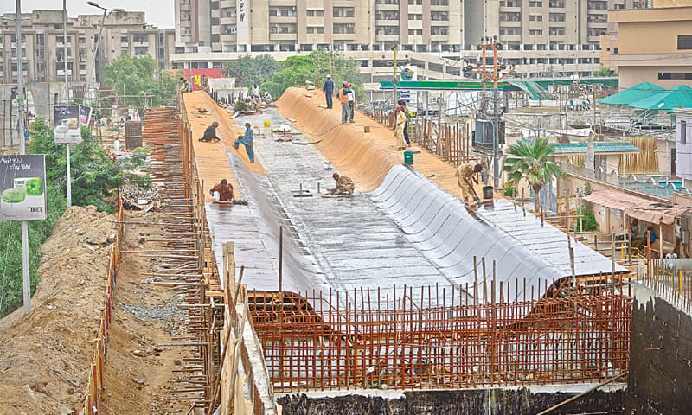

Slide 6
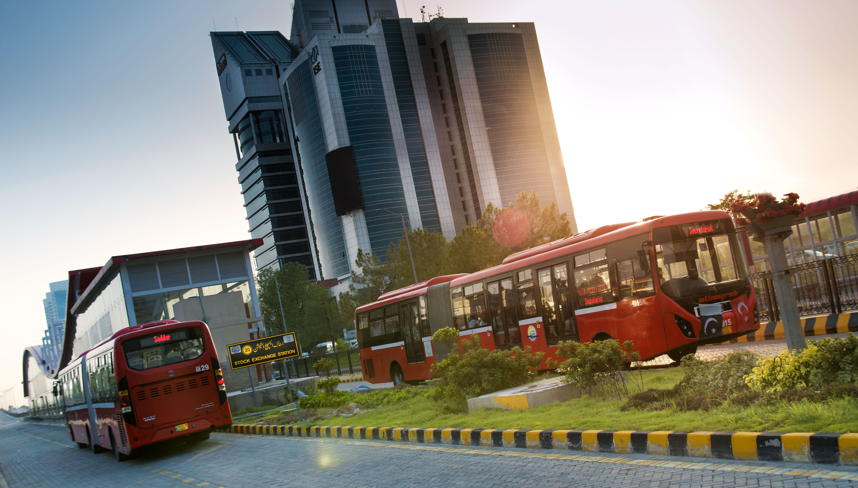

Slide 7
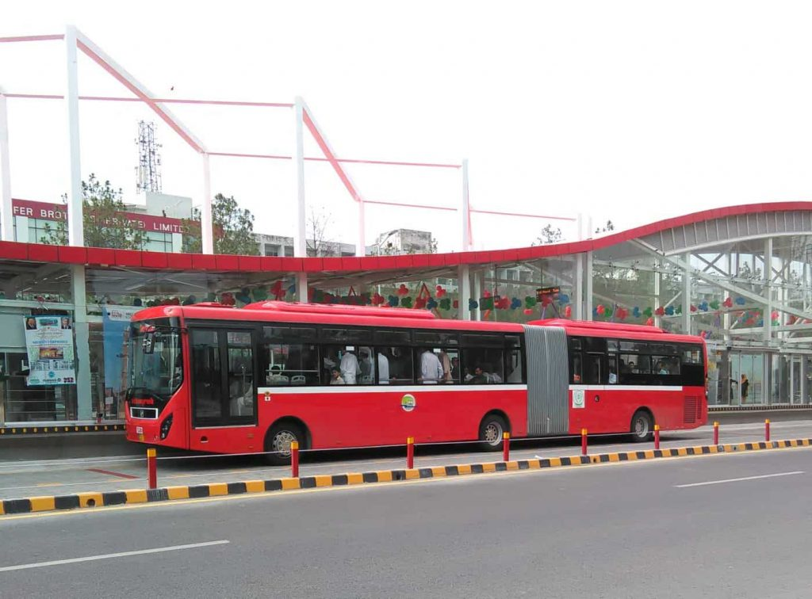
https://www.flickr.com/photos/cityofbostonarchives/17616149584/in/album-72157653252196618/

Slide 8
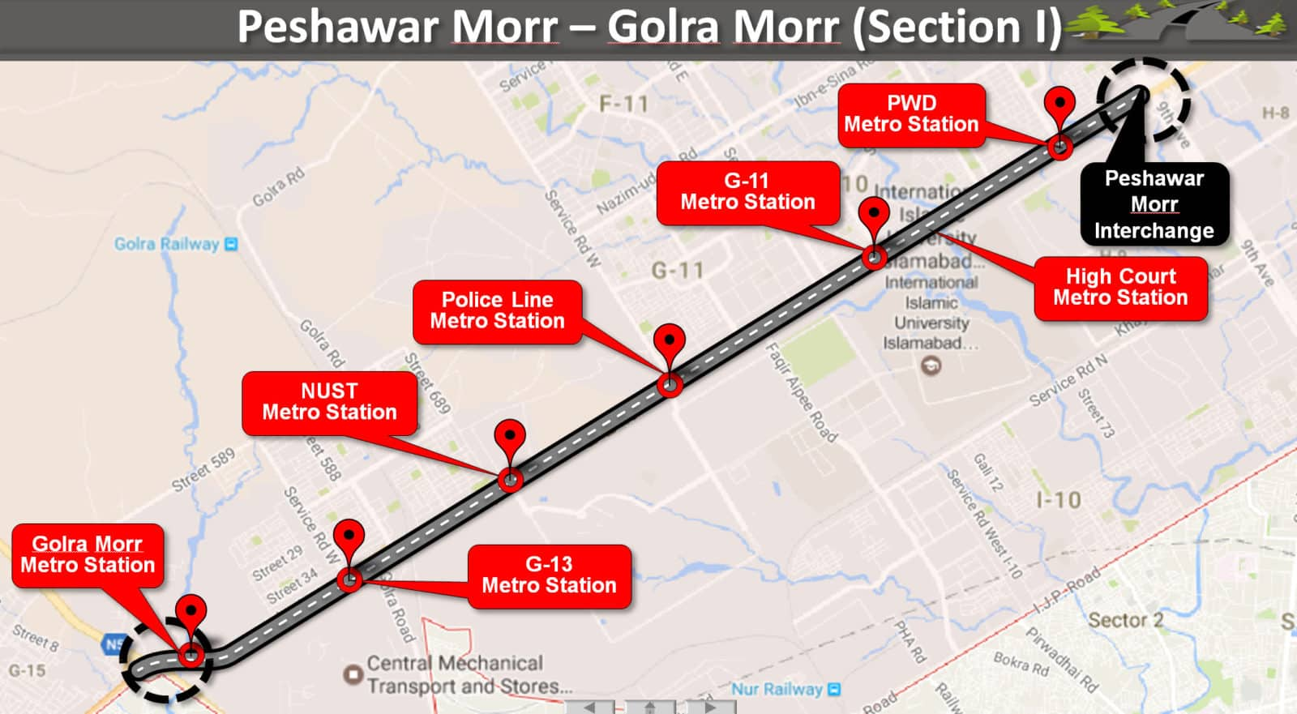

Slide 9
Schema

Slide 10
 | name | station
 | Zohaib | High Court

Slide 11
 | name | station | action
 | Zohaib | High Court | enter

Slide 12
 | name | station | action | fare
 | Zohaib | High Court | enter | 10

Slide 13
 | name | station | action | fare | balance
 | Zohaib | High Court | enter | 10 | 5

Slide 14
 | name | station | action | fare | balance
 | Zohaib | High Court | enter | 10 | 5
 | Haris | G11 | exit | 5 | 0

Slide 15
 | name | station | action | fare | balance
 | Zohaib | High Court | enter | 10 | 5
 | Haris | G11 | exit | 5 | 0
 | Maheer | NUST | enter | 10 | 20

Slide 16
name | station | action | fare | balance
Zohaib | High Court | enter | 10 | 5
Haris | G11 | exit | 5 | 0
Maheer | NUST | enter | 10 | 20
Maheer | G13 | exit | 5 | 15

Slide 17
name | station | action | fare | balance
Zohaib | High Court | enter | 10 | 5
Haris | G11 | exit | 5 | 0
Maheer | NUST | enter | 10 | 20
Maheer | G13 | exit | 5 | 15
Basheer | Golra Morr | enter | 10 | 30

Slide 18
name | station | action | fare | balance
Zohaib | High Court | enter | 10 | 5
Haris | G11 | exit | 5 | 0
Maheer | NUST | enter | 10 | 20
Maheer | G13 | exit | 5 | 15
Basheer | Golra Morr | enter | 10 | 30
Basheer | G13 | exit | 10 | 20

Slide 19
id | name | station | action | fare | balance
1 | Zohaib | High Court | enter | 10 | 5
2 | Haris | G11 | exit | 5 | 0
3 | Maheer | NUST | enter | 10 | 20
4 | Maheer | G13 | exit | 5 | 15
5 | Basheer | Golra Morr | enter | 10 | 30
6 | Basheer | G13 | exit | 10 | 20

Slide 20
id | name | station | action | fare | balance
1 | Zohaib | High Court | enter | 10 | 5
2 | Haris | G11 | exit | 5 | 0
3 | Maheer | NUST | enter | 10 | 20
4 | Maheer | G13 | exit | 5 | 15
5 | Basheer | Golra Morr | enter | 10 | 30
6 | Basheer | G13 | exit | 10 | 20

Slide 21
id | name | station | action | fare | balance
1 | Zohaib | High Court | enter | 10 | 5
2 | Haris | G11 | exit | 5 | 0
3 | Maheer | NUST | enter | 10 | 20
4 | Maheer | G13 | exit | 5 | 15
5 | Basheer | Golra Morr | enter | 10 | 30
6 | Basheer | G13 | exit | 10 | 20

Slide 22
id | name | station | action | fare | balance
1 | Zohaib | High Court | enter | 10 | 5
2 | Haris | G11 | exit | 5 | 0
3 | Maheer | NUST | enter | 10 | 20
4 | Maheer | G13 | exit | 5 | 15
5 | Basheer | Golra Morr | enter | 10 | 30
6 | Basheer | G13 | exit | 10 | 20

Slide 23
id | name | station | action | fare | balance
1 | Zohaib | High Court | enter | 10 | 5
2 | Haris | G11 | exit | 5 | 0
3 | Maheer | NUST | enter | 10 | 20
4 | Maheer | G13 | exit | 5 | 15
5 | Basheer | Golra Morr | enter | 10 | 30
6 | Basheer | G13 | exit | 10 | 20

Slide 24
Normalizing

Slide 26
1NF

Slide 27
1NF
2NF
Partial
Dependency

Slide 28
1NF
3NF
Transitive
Dependency
2NF

Slide 29
1NF
BCNF
3NF
2NF

Slide 30
Employees
 | Employee_Name | Project | Department
 | Zohaib | ProjectA | IT
 | Haris | ProjectB | HR
 | Maheer | ProjectA | IT

Slide 31
Employees
 | Employee_Name | Project | Department
 | Zohaib | ProjectA | IT
 | Haris | ProjectB | HR
 | Maheer | ProjectA | IT

Slide 32
Employees
 | Employee_ID | Employee_Name | Project | Department
 | 1 | Zohaib | ProjectA | IT
 | 2 | Haris | ProjectB | HR
 | 3 | Maheer | ProjectA | IT

Slide 33
Employees
 | Employee_ID | Employee_Name | Project | Department
 | 1 | Zohaib | ProjectA | IT
 | 2 | Haris | ProjectB | HR
 | 3 | Maheer | ProjectA | IT

Slide 34
Employees
 | Employee_ID | Employee_Name | Project | Department
 | 1 | Zohaib | ProjectA | IT
 | 2 | Haris | ProjectB | HR
 | 3 | Maheer | ProjectA | IT

Slide 35
Employees
 | Employee_ID | Employee_Name
 | 1 | Zohaib
 | 2 | Haris
 | 3 | Maheer
 | Project | Department
 | ProjectA | IT
 | ProjectB | HR
 | ProjectA | IT

Slide 36
Employees
 | Employee_ID | Employee_Name
 | 1 | Zohaib
 | 2 | Haris
 | 3 | Maheer
 | Employee_ID | Project | Department
 | 1 | ProjectA | IT
 | 2 | ProjectB | HR
 | 3 | ProjectA | IT

Slide 37
Back to Metro Schema…

Slide 38
riders
 | id | name
 | 1 | Zohaib
 | 2 | Haris
 | 3 | Maheer

Slide 39
stations
 | id | location
 | 1 | High Court
 | 2 | G11
 | 3 | NUST

Slide 40
Relating

Slide 41


stations
riders

Slide 42
station
rider

Slide 43
stations
rider

Slide 44
stations
riders

Slide 45
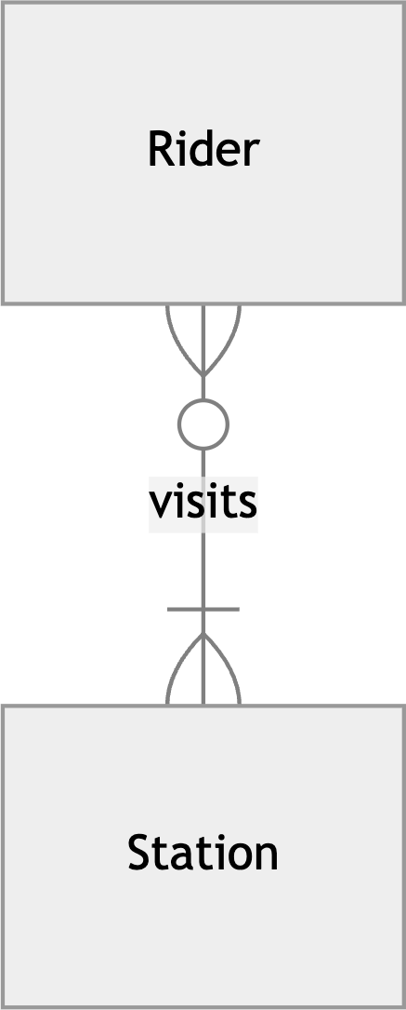

Slide 46
CREATE TABLE

Slide 47
Data Types

Slide 48
Exact numerics

Slide 49
BIGINT NUMERIC
DECIMAL INTEGER
TINYINT

Slide 50
Approximate numerics

Slide 51
FLOAT
REAL

Slide 52
Date and Time

Slide 53
DATE
DATETIME
TIME

Slide 54
Character strings

Slide 55
CHAR
VARCHAR
TEXT

Slide 56
Binary strings

Slide 57
BINARY
IMAGE
VARBINARY

Slide 58
"Capital Development Authority (CDA)"

Slide 59
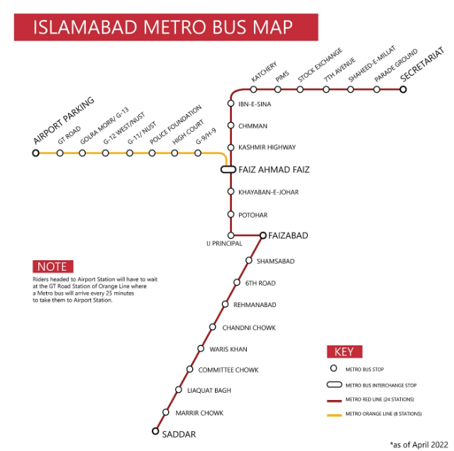
METRO MAP

Slide 60
10

Slide 61
$0.10

Slide 62
0.10

Slide 63
Type Aﬃnities

Slide 64
TEXT NUMERIC INTEGER REAL

Slide 65
amount
id
10

Slide 66
id
amount
1
"10"

Slide 67
amount
id
1
"10"
25

Slide 68
id
amount
1
"10"
2
"25"

Slide 69
amount
id
"10"

Slide 70
id
amount
1
10

Slide 71
amount
id
1
10
"25"

Slide 72
id
amount
1
10
2
25

Slide 73
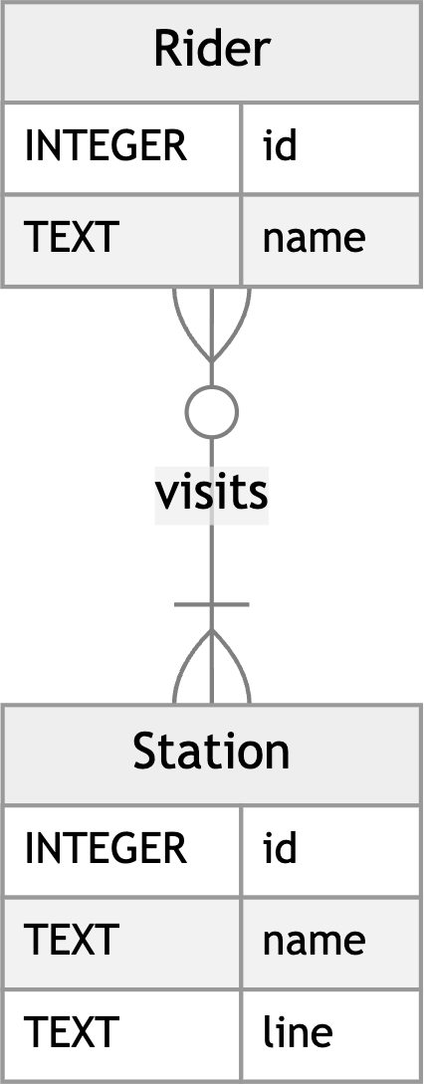

Slide 74
CREATE TABLE riders ( "id" INTEGER, "name" TEXT, PRIMARY KEY("id") );

Slide 75
CREATE TABLE stations ( "id" INTEGER, "name" TEXT, "line" TEXT, PRIMARY KEY("id") );

Slide 76
Table Constraints

Slide 77
PRIMARY KEY FOREIGN KEY

Slide 78
Column Constraints

Slide 79
CHECK DEFAULT NOT NULL UNIQUE

Slide 80
CREATE TABLE "stations" ( "id" INTEGER, "name" TEXT NOT NULL UNIQUE, "line" TEXT NOT NULL, PRIMARY KEY("id") );

Slide 82
CREATE TABLE visits ( "rider_id" INTEGER, "station_id" INTEGER, FOREIGN KEY("rider_id") REFERENCES "riders"("id"), FOREIGN KEY("station_id") REFERENCES "stations"("id") );

Slide 83


Slide 84
Schema

Slide 85
card
rider

Slide 86
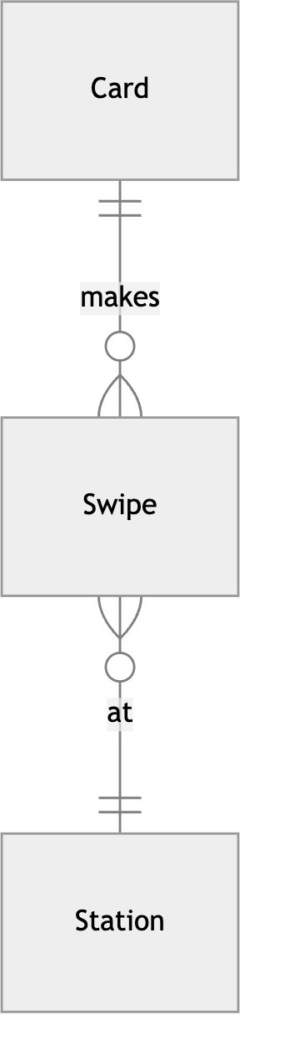

Slide 87
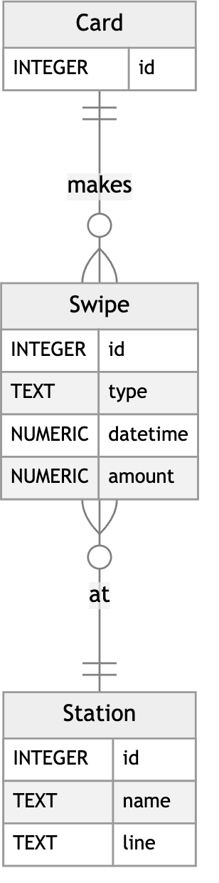

Slide 88
CREATE TABLE "swipes" ( id INT, card_id INT, station_id INT, type VARCHAR(10) NOT NULL CHECK(type IN ('enter', 'exit', 'deposit')), datetime DATETIME NOT NULL DEFAULT GETDATE(), amount NUMERIC NOT NULL CHECK(amount != 0), …

Slide 89
PRIMARY KEY("id"), FOREIGN KEY("station_id") REFERENCES "stations"("id"), FOREIGN KEY("card_id") REFERENCES "cards"("id") );

Slide 90
Altering Tables

Slide 91
DROP TABLE

Slide 92
ALTER TABLE …

Slide 93
ADD …
… DROP COLUMN …

Slide 94
ADD CONSTRAINT …
… DROP CONSTRAINT …

Slide 95
SELECT … INTO new_table FROM old_table;

Slide 96
INSERT INTO new_table SELECT … FROM old_table; ;

Slide 97
Stored Procedures

Slide 98
SP_COLUMNS …
SP_RENAME …

Slide 99
EXEC sp_rename 'old_column_name', 'new_column_name', 'COLUMN';

Slide 100
Introduction to
Databases with SQL
Designing

