Slide 1
Introduction to
Databases with SQL
Writing

Slide 2
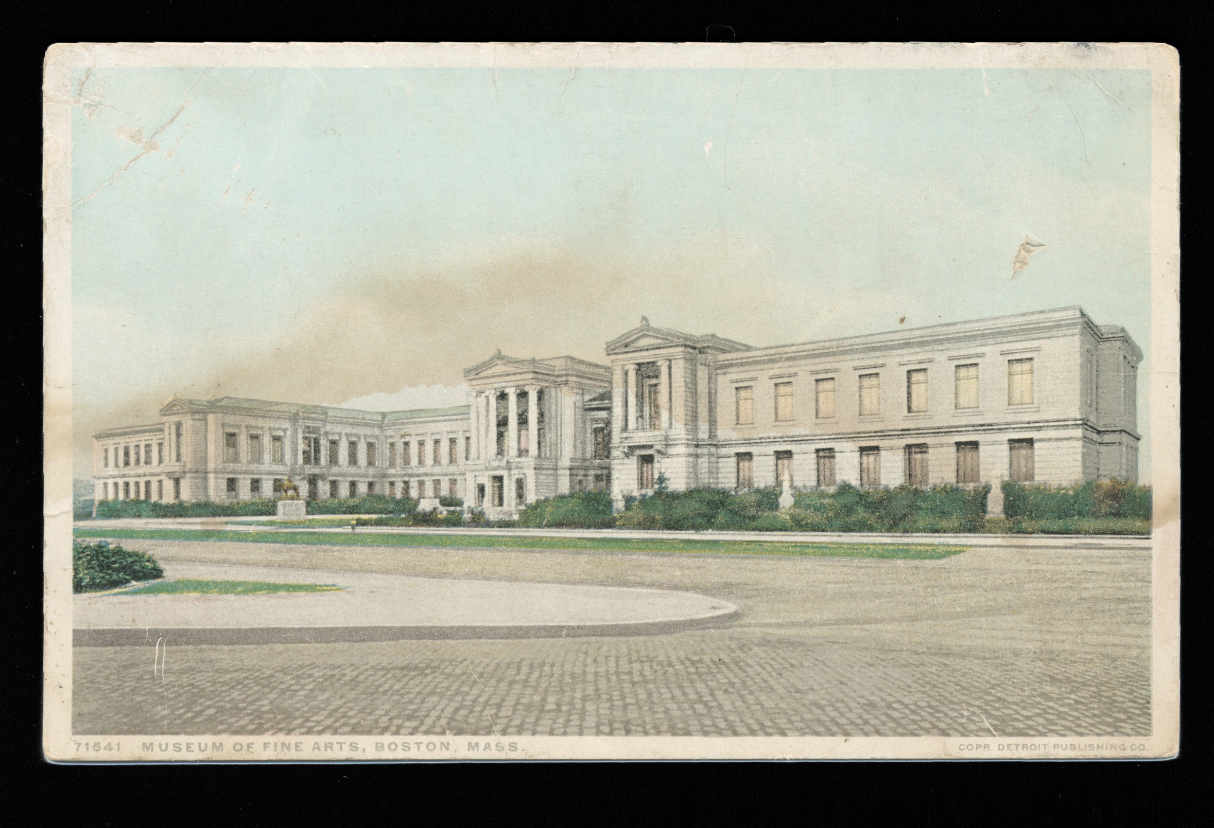

Slide 3
Create Read Update Delete

Slide 4
Insert

Slide 5
 | id | title | accession_number | acquired

Slide 6
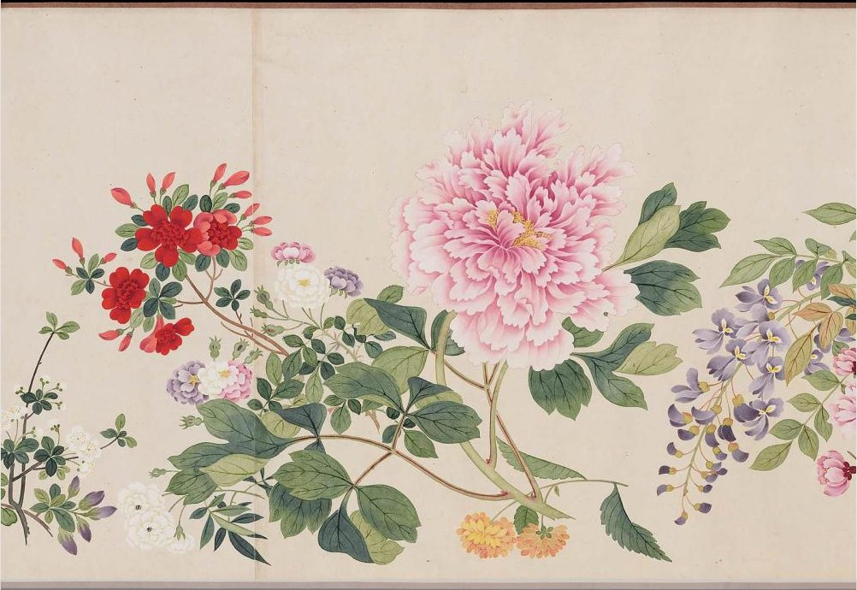
Profusion of flowers

Slide 7
 | id | title | accession_number | acquired
 | 1 | Profusion of flowers | 56.257 | 1956-04-12

Slide 8
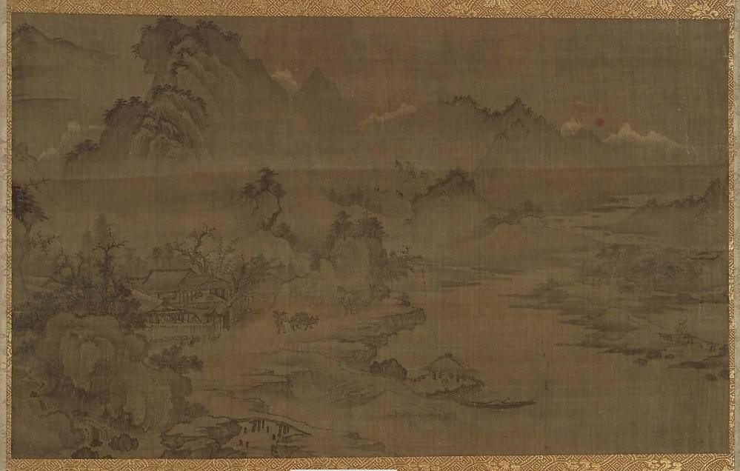
Farmers working at dawn

Slide 9
 | id | title | accession_number | acquired
 | 1 | Profusion of flowers | 56.257 | 1956-04-12
 | 2 | Farmers working at dawn | 11.6152 | 1911-08-03

Slide 10
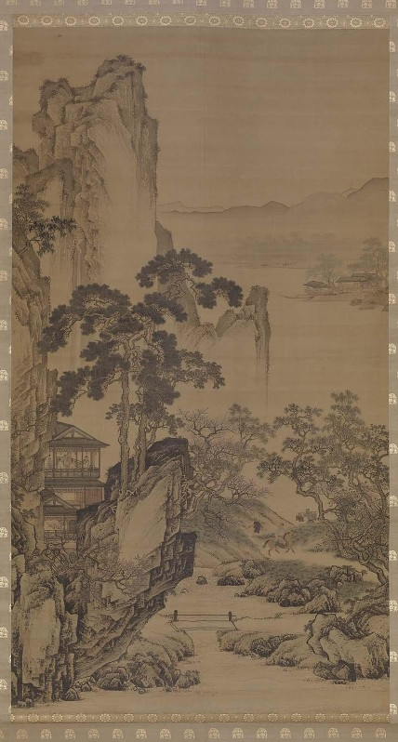
Spring outing

Slide 11
 | id | title | accession_number | acquired
 | 1 | Profusion of flowers | 56.257 | 1956-04-12
 | 2 | Farmers working at dawn | 11.6152 | 1911-08-03
 | 3 | Spring outing | 14.76 | 1914-01-08

Slide 12
INSERT INTO table (column0, …) VALUES
(value0, …);

Slide 13
INSERT INTO table (column0, …) VALUES
(value0, …),
(value1, …),
…;

Slide 14
id,title,accession_number,acquired 1,Profusion of flowers,56.257,1956-04-12 2,Farmers working at dawn,11.6152,1911-08-03 3,Spring outing,14.76,1914-01-08 4,Imaginative landscape,56.496,
5,Peonies and butterfly,06.1899,1906-01-01

Slide 15
.import

Slide 16
.import --csv --skip 1

Slide 17
id,title,accession_number,acquired 1,Profusion of flowers,56.257,1956-04-12 2,Farmers working at dawn,11.6152,1911-08-03 3,Spring outing,14.76,1914-01-08 4,Imaginative landscape,56.496,
5,Peonies and butterfly,06.1899,1906-01-01

Slide 18
title,accession_number,acquired Profusion of flowers,56.257,1956-04-12
Farmers working at dawn,11.6152,1911-08-03 Spring outing,14.76,1914-01-08
Imaginative landscape,56.496,
Peonies and butterfly,06.1899,1906-01-01

Slide 19
INSERT INTO table0 (column0, …) SELECT column0, … FROM table1;

Slide 20
Delete

Slide 21
id | title | accession_number | acquired
1 | Profusion of flowers | 56.257 | 1956-04-12
2 | Farmers working at dawn | 11.6152 | 1911-08-03
3 | Spring outing | 14.76 | 1914-01-08
4 | Imaginative landscape | 56.496 | NULL
5 | Peonies and butterfly | 06.1899 | 1906-01-01
6 | Tile Lunette | 06.2437 | 1906-11-08
7 | Statuette of a shrew | 01.105 | 1901-02-11

Slide 22
id |  | title | accession_number | acquired
1 |  | Profusion of flowers | 56.257 | 1956-04-12
2 |  | Farmers working at dawn | 11.6152 | 1911-08-03
 | 3 | Spring outing | 14.76 | 1914-01-08
4 |  | Imaginative landscape | 56.496 | NULL
5 |  | Peonies and butterfly | 06.1899 | 1906-01-01
6 |  | Tile Lunette | 06.2437 | 1906-11-08
7 |  | Statuette of a shrew | 01.105 | 1901-02-11

Slide 23
id | title | accession_number | acquired
1 | Profusion of flowers | 56.257 | 1956-04-12
2 | Farmers working at dawn | 11.6152 | 1911-08-03
4 | Imaginative landscape | 56.496 | NULL
5 | Peonies and butterfly | 06.1899 | 1906-01-01
6 | Tile Lunette | 06.2437 | 1906-11-08
7 | Statuette of a shrew | 01.105 | 1901-02-11

Slide 24
DELETE FROM table WHERE condition;

Slide 25
id | title | accession_number | acquired
1 | Profusion of flowers | 56.257 | 1956-04-12
2 | Farmers working at dawn | 11.6152 | 1911-08-03
5 | Peonies and butterfly | 06.1899 | 1906-01-01
6 | Tile Lunette | 06.2437 | 1906-11-08
7 | Statuette of a shrew | 01.105 | 1901-02-11

Slide 26
id |  | title | accession_number | acquired
1 |  | Profusion of flowers | 56.257 | 1956-04-12
2 |  | Farmers working at dawn | 11.6152 | 1911-08-03
 | 5 | Peonies and butterfly | 06.1899 | 1906-01-01
 | 6 | Tile Lunette | 06.2437 | 1906-11-08
 | 7 | Statuette of a shrew | 01.105 | 1901-02-11

Slide 27
 | id | title | accession_number | acquired
 | 1 | Profusion of flowers | 56.257 | 1956-04-12
 | 2 | Farmers working at dawn | 11.6152 | 1911-08-03

Slide 28
Foreign Key Constraints

Slide 29


Slide 30
collections
artists
created
id | name |  | artist_id | collection_id |  | id | title
1 | Li Yin |  | 1 | 2 |  | 1 | Farmers working …
2 | Qian Weicheng |  | 2 | 3 |  | 2 | Imaginative land…
3 | Unidentified artist |  | 3 | 1 |  | 3 | Profusion of …
4 | Zhou Chen |  | 4 | 4 |  | 4 | Spring outing

Slide 31
collections
artists
created
id | name |  |  | artist_id | collection_id |  | id | title
1 | Li Yin |  |  | 1 | 2 |  | 1 | Farmers working …
2 | Qian Weicheng |  |  | 2 | 3 |  | 2 | Imaginative land…
3 | Unidentified artist |  |  | 3 | 1 |  | 3 | Profusion of …
4 | Zhou Chen |  |  | 4 | 4 |  | 4 | Spring outing

Slide 32
collections
artists
created
id | name |  | artist_id | collection_id |  | id | title
1 | Li Yin |  | 1 | 2 |  | 1 | Farmers working …
2 | Qian Weicheng |  | 2 | 3 |  | 2 | Imaginative land…
4 | Zhou Chen |  | 3 | 1 |  | 3 | Profusion of …
 |  |  | 4 | 4 |  | 4 | Spring outing

Slide 33
collections
artists
created
id | name |  |  | artist_id | collection_id |  | id | title
1 | Li Yin |  |  | 1 | 2 |  | 1 | Farmers working …
2 | Qian Weicheng |  |  | 2 | 3 |  | 2 | Imaginative land…
4 | Zhou Chen |  |  | 3 | 1 |  | 3 | Profusion of …
 |  |  |  | 4 | 4 |  | 4 | Spring outing

Slide 34
FOREIGN KEY("artist_id") REFERENCES "artists"("id")

Slide 35
FOREIGN KEY("artist_id") REFERENCES "artists"("id") ON DELETE …

Slide 36
FOREIGN KEY("artist_id") REFERENCES "artists"("id") ON DELETE RESTRICT

Slide 37
FOREIGN KEY("artist_id") REFERENCES "artists"("id") ON DELETE NO ACTION

Slide 38
FOREIGN KEY("artist_id") REFERENCES "artists"("id") ON DELETE SET NULL

Slide 39
FOREIGN KEY("artist_id") REFERENCES "artists"("id") ON DELETE SET DEFAULT

Slide 40
FOREIGN KEY("artist_id") REFERENCES "artists"("id") ON DELETE CASCADE

Slide 41
collections
artists
created
id | name |  | artist_id | collection_id |  | id | title
1 | Li Yin |  | 2 | 3 |  | 1 | Farmers working …
2 | Qian Weicheng |  | 3 | 1 |  | 2 | Imaginative land…
3 | Unidentified artist |  | 1 | 2 |  | 3 | Profusion of …
4 | Zhou Chen |  | 4 | 4 |  | 4 | Spring outing

Slide 42
collections
artists
created
id | name |  |  | artist_id | collection_id |  | id | title
1 | Li Yin |  |  | 2 | 3 |  | 1 | Farmers working …
2 | Qian Weicheng |  |  | 3 | 1 |  | 2 | Imaginative land…
3 | Unidentified artist |  |  | 1 | 2 |  | 3 | Profusion of …
4 | Zhou Chen |  |  | 4 | 4 |  | 4 | Spring outing

Slide 43
collections
artists
created
id | name |  | artist_id | collection_id |  | id | title
1 | Li Yin |  | 2 | 3 |  | 1 | Farmers working …
2 | Qian Weicheng |  | 3 | 1 |  | 2 | Imaginative land…
4 | Zhou Chen |  | 1 | 2 |  | 3 | Profusion of …
 |  |  | 4 | 4 |  | 4 | Spring outing

Slide 44
collections
artists
created
id | name |  | artist_id | collection_id |  | id | title
1 | Li Yin |  | 2 | 3 |  | 1 | Farmers working …
2 | Qian Weicheng |  | 1 | 2 |  | 2 | Imaginative land…
4 | Zhou Chen |  | 4 | 4 |  | 3 | Profusion of …
 |  |  |  |  |  | 4 | Spring outing

Slide 45
Update

Slide 46
collections
artists
created
id | name |  | artist_id | collection_id |  | id | title
1 | Li Yin |  | 2 | 3 |  | 1 | Farmers working …
2 | Qian Weicheng |  | 3 | 1 |  | 2 | Imaginative land…
3 | Unidentified artist |  | 1 | 2 |  | 3 | Profusion of …
4 | Zhou Chen |  | 4 | 4 |  | 4 | Spring outing

Slide 47
collections
artists
created
id | name |  |  | artist_id | collection_id |  |  |  | id | title
1 | Li Yin |  |  | 2 | 3 |  |  |  | 1 | Farmers working …
2 | Qian Weicheng |  |  | 3 | 1 |  |  |  | 2 | Imaginative land…
3 | Unidentified artist |  |  | 1 | 2 |  |  |  | 3 | Profusion of …
4 | Zhou Chen |  |  | 4 | 4 |  |  |  | 4 | Spring outing

Slide 48
collections
artists
created
id | name |  |  | artist_id | collection_id |  |  |  | id | title
1 | Li Yin |  |  | 2 | 3 |  |  |  | 1 | Farmers working …
2 | Qian Weicheng |  |  | 1 | 1 |  |  |  | 2 | Imaginative land…
3 | Unidentified artist |  |  | 1 | 2 |  |  |  | 3 | Profusion of …
4 | Zhou Chen |  |  | 4 | 4 |  |  |  | 4 | Spring outing

Slide 49
UPDATE table
SET column0 = value0, … WHERE condition;

Slide 50
Triggers

Slide 51
collections
transactions
id
title
id
title
action
1 Farmers working …
2 Imaginative land…
3
Profusion of …
4
Spring outing

Slide 52
collections
transactions
id
title
id
title
action
1 Farmers working …
2 Imaginative land…
3
Profusion of …
4
Spring outing

Slide 53
transactions
collections
 | id | title
 | 1 | Farmers working …
 | 2 | Imaginative land…
 | 3 | Profusion of …
 | id | title | action

Slide 54
collections
transactions
id
title
id
title
action
1 Farmers working …
1
Spring outing
sold
2 Imaginative land…
3
Profusion of …

Slide 55
collections
transactions
id
title
id
title
action
1 Farmers working …
1
Spring outing
sold
2 Imaginative land…
3
Profusion of …

Slide 56
collections
transactions
id
title
id
title
action
1 Farmers working …
1
Spring outing
sold
2 Imaginative land…
3
Profusion of …
4
Peonies and …

Slide 57
collections
transactions
id
title
id
title
action
1 Farmers working …
1
Spring outing
sold
2 Imaginative land…
2
Peonies and …
bought
3
Profusion of …
4
Peonies and …

Slide 58
CREATE TRIGGER name

Slide 59
CREATE TRIGGER name ON table

Slide 60
CREATE TRIGGER name ON table INSTEAD OF

Slide 61
CREATE TRIGGER name ON table FOR

Slide 62
CREATE TRIGGER name ON table AFTER

Slide 63
CREATE TRIGGER name ON table AFTER INSERT

Slide 64
CREATE TRIGGER name ON table AFTER UPDATE

Slide 65
CREATE TRIGGER name ON table AFTER DELETE

Slide 66
CREATE TRIGGER name ON table AFTER DELETE AS

Slide 67
CREATE TRIGGER name ON table AFTER DELETE AS BEGIN

Slide 68
CREATE TRIGGER name ON table AFTER DELETE AS BEGIN … END;

Slide 69
CREATE TRIGGER SELL ON collections AFTER DELETE AS BEGIN INSERT INTO transactions(title,action) SELECT title, 'Sold' FROM DELETED END;

Slide 70
Soft Deletions

Slide 71
collections
id | title | deleted
1 | Farmers working … | 0
2 | Imaginative land… | 0
3 | Profusion of … | 0
4 | Peonies and … | 0

Slide 72
collections
id | title | deleted
1 | Farmers working … | 0
2 | Imaginative land… | 0
3 | Profusion of … | 0
4 | Peonies and … | 0

Slide 73
collections
id | title | deleted
1 | Farmers working … | 1
2 | Imaginative land… | 0
3 | Profusion of … | 0
4 | Peonies and … | 0

Slide 74
Introduction to
Databases with SQL
Writing

