Slide 1
Explainable AI Labs Portfolio
Assignments 1–8
What was required, implementation approach, and key results
Student project report

Slide 2
Overview
8 labs completed across causal XAI, symbolic planning, and neuro-symbolic RL
Each lab includes: objective, implementation, and result artifacts
Visual evidence: plots/images from results folders
Structured metrics: CSV tables and JSON summaries

Slide 3
Lab 1 — Causal Forecasting
Asked:
Predict `cooling_demand` using causal features vs TCN baseline.
How we did it:
Tigramite `Prediction` + LinearRegression; compare to dilated TCN.
Results:
Causal predictors: **6** (vs **32** TCN)
NMAE causal: **0.096** | NMAE TCN: **0.130**
Takeaway:
Causal model is sparser and more accurate — interpretable predictors (humidity, past demand, pricing).

Slide 4
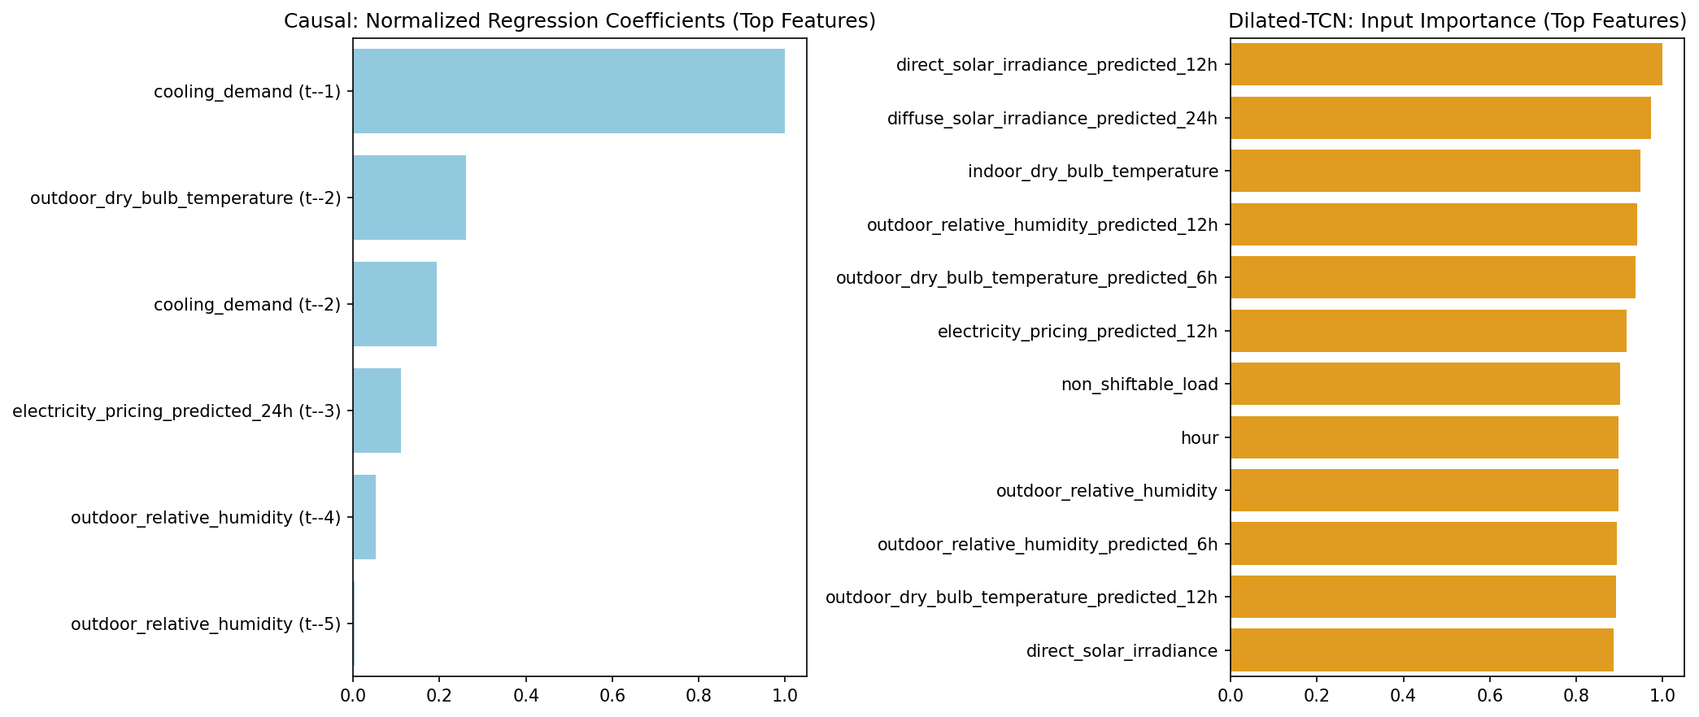
Lab 1 — Result Plot
Causal Forecasting: feature_importance.png

Slide 5
Lab 1 — CSV Metrics Table
Causal Forecasting: causal_predictors.csv
variable | lag
cooling_demand | -1
cooling_demand | -2
outdoor_relative_humidity | -4
outdoor_relative_humidity | -5
electricity_pricing_predicted_24h | -3
outdoor_dry_bulb_temperature | -2

Slide 6
Lab 2 — Explainable Anomaly Detection
Asked:
Detect Pepper robot attacks online using causal coefficient drift.
How we did it:
PCMCI offline model + sliding-window coefficient monitoring.
Results:
Precision: **0.64** | Recall: **0.89** | F1: **0.75**
Takeaway:
Broken causal coefficients explain which sensors/actuators changed during each attack type.

Slide 7
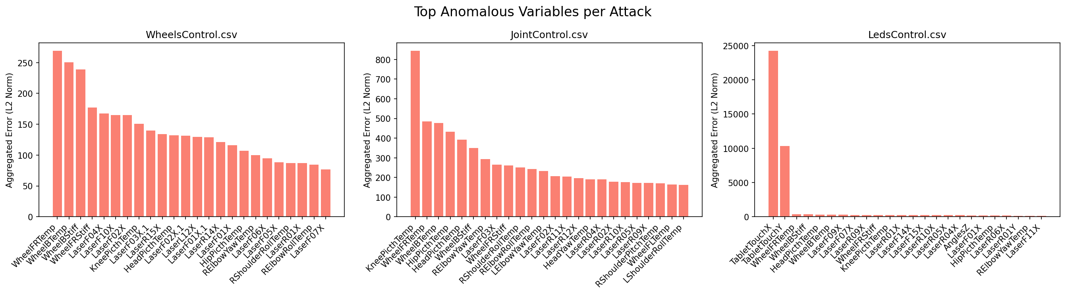
Lab 2 — Result Plot
Explainable Anomaly Detection: feature_importance.png

Slide 8
Lab 2 — CSV Metrics Table
Explainable Anomaly Detection: metrics_summary.csv
precision | recall | f1 | false_positives_normal
0.643312101910828 | 0.8938053097345132 | 0.7481481481481481 | 56

Slide 9
Lab 3 — ASP Rocksample Planning
Asked:
Find plans that sample all good rocks using Answer Set Programming.
How we did it:
Implemented `#program step(t)` in `rocksample.lp` (moves + sample + constraints).
Results:
Multiple valid plans (5 saved in `plans.txt`)
Samples good rocks 0 and 1
Takeaway:
Symbolic planning — no ML training; Clingo searches action sequences.

Slide 10
Lab 4 — ILASP + ASP Planning
Asked:
Learn which rocks are good from `dist`/`guess`, then plan to sample them.
How we did it:
Mode bias in `ilasp_task.las`; rules in `rocksample_ilp.lp` + ASP `step(t)`.
Results:
Plans sample **rock 2** (`guess(2,90) > 80`)
5 plans in `plans.txt`
Takeaway:
Logic learns goodness under uncertainty; ASP executes the policy.

Slide 11
Lab 5 — Activation Rate (Explain RL)
Asked:
Measure how often logical rules match MAPPO agent actions on RWARE warehouse.
How we did it:
`_does_rule_activate` in `parallel_runner.py`; compare obs atoms to rule bodies.
Results:
(checkpoint 1M, theory index 0)
Agent 0: forward ~4.5%, left ~8.6%, right ~9.9%
Agent 1: load ~1.0%, right ~11.3%
Takeaway:
Return alone doesn't explain policy — activation rate shows which rules drive which actions.

Slide 12
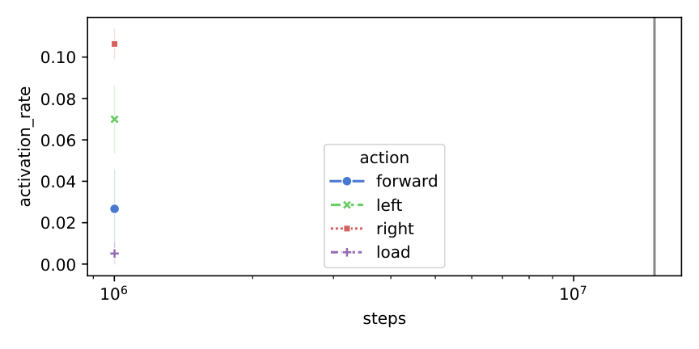
Lab 5 — Result Plot
Activation Rate (Explain RL): plot_activation_rate.png

Slide 13
Lab 5 — CSV Metrics Table
Activation Rate (Explain RL): activation_rate_20260616005507.csv
index | seed | env_theory | env_test | steps | agent
0 | 0 | rware-img-3-tiny-2ag-v2 | rware-img-3-tiny-2ag-v2 | 1001000 | 0
1 | 0 | rware-img-3-tiny-2ag-v2 | rware-img-3-tiny-2ag-v2 | 1001000 | 0
2 | 0 | rware-img-3-tiny-2ag-v2 | rware-img-3-tiny-2ag-v2 | 1001000 | 0
3 | 0 | rware-img-3-tiny-2ag-v2 | rware-img-3-tiny-2ag-v2 | 1001000 | 0
4 | 0 | rware-img-3-tiny-2ag-v2 | rware-img-3-tiny-2ag-v2 | 1001000 | 0
0 | 0 | rware-img-3-tiny-2ag-v2 | rware-img-3-tiny-2ag-v2 | 1001000 | 1
1 | 0 | rware-img-3-tiny-2ag-v2 | rware-img-3-tiny-2ag-v2 | 1001000 | 1
2 | 0 | rware-img-3-tiny-2ag-v2 | rware-img-3-tiny-2ag-v2 | 1001000 | 1

Slide 14
Lab 6 — SR-DQN (NeSy DQN)
Asked:
DoorKey task: guide DQN exploration with symbolic heuristics (SR-DQN).
How we did it:
Implemented `_get_random_action()` — weighted sampling: `conf_level` on suggested actions, rest uniform. Trained DQN vs SR-DQN on MiniGrid-DoorKey-5x5-v0 (100k steps).
Results:
**SR-DQN** learns and reaches reward **~0.7** by end of training
**DQN** baseline stays near **0** (sparse reward, random exploration fails)
SR-DQN clearly outperforms standard DQN on this task
Takeaway:
Symbolic heuristics during exploration help the agent discover the sparse +1 reward; explainable logic shapes learning, not just the final policy.

Slide 15
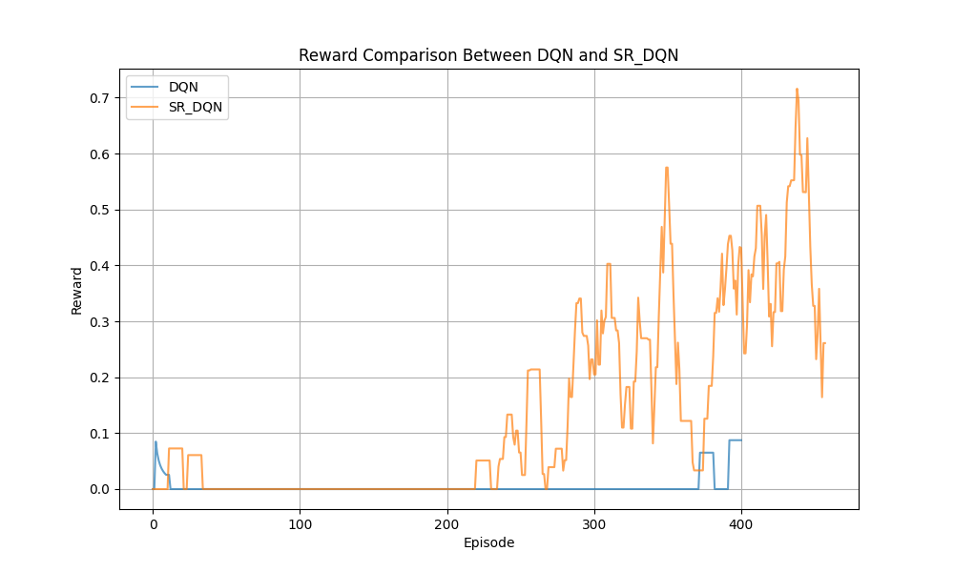
Lab 6 — Result Plot
SR-DQN (NeSy DQN): rewards.png

Slide 16
Lab 7 — H-C51 (Distributional NeSy RL)
Asked:
Combine **C51** (distributional DQN) with logical heuristics by modulating return distributions for rule-suggested actions (DoorKey 5×5).
How we did it:
Implemented the product in `h_c51_product.py` `get_action()`:
Multiply PMFs of rule-suggested actions by `1 + ε · rule_pmf`
Renormalize over atoms
Results:
**H-C51** learns quickly and sustains returns **~0.5–0.8**
**C51 baseline** drops to **~0** after early episodes (sparse reward)
H-C51 clearly outperforms standard C51 on DoorKey
Takeaway:
Distributional RL + symbolic heuristics shifts probability mass toward high-return atoms for suggested actions, improving learning under sparse rewards.

Slide 17
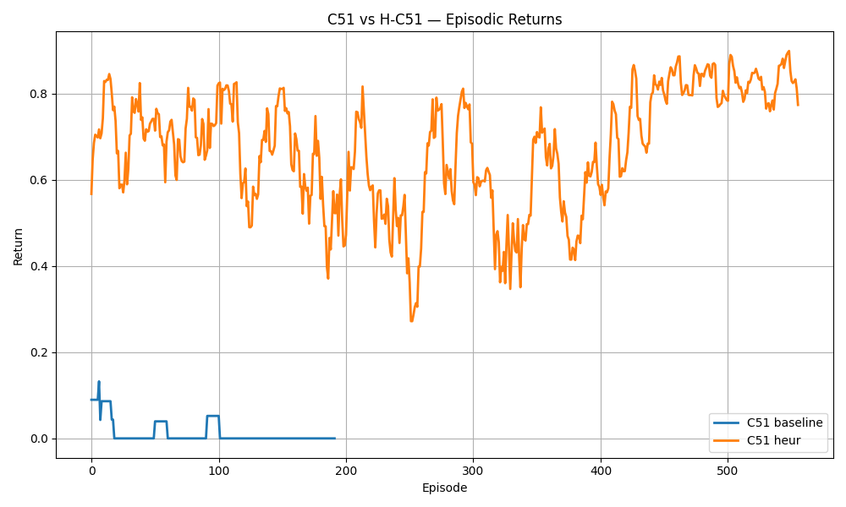
Lab 7 — Result Plot
H-C51 (Distributional NeSy RL): c51_vs_hc51_returns.png

Slide 18
Lab 7 — CSV Metrics Table
H-C51 (Distributional NeSy RL): metrics_summary.csv
env | steps_per_model | models | output_plot | note
MiniGrid-DoorKey-5x5-v0 | 50000 | ['C51', 'H-C51'] | c51_vs_hc51_returns.png | H-C51 sustains ~0.5-0.8 return; C51 baseline near 0

Slide 19
Lab 8 — STL-constrained RL (Pendulum)
Asked:
Use **STL robustness** as cost signals in **Lagrangian TRPO** to constrain angular velocity and torque on the Pendulum swing-up task.
How we did it:
Implemented `step()` in `stl_rl/env/Pendulum.py`:
Clip torque and build a τ-horizon trajectory `[thetadot, torque]`
Compute STL robustness via RTAMT (`compute_robustness_dense`)
Results:
(50 episodes, seed 47)
**Our (STL TRPO)** — return improves to **~-18**; total cost rises toward **0** (constraints better satisfied)
**Reward shaping** — return plateaus around **~-65**; cost stays **~-180** (weaker constraint satisfaction)
Takeaway:
Explicit STL costs in Lagrangian RL give better constraint satisfaction than naive reward shaping on the same Pendulum task.

Slide 20
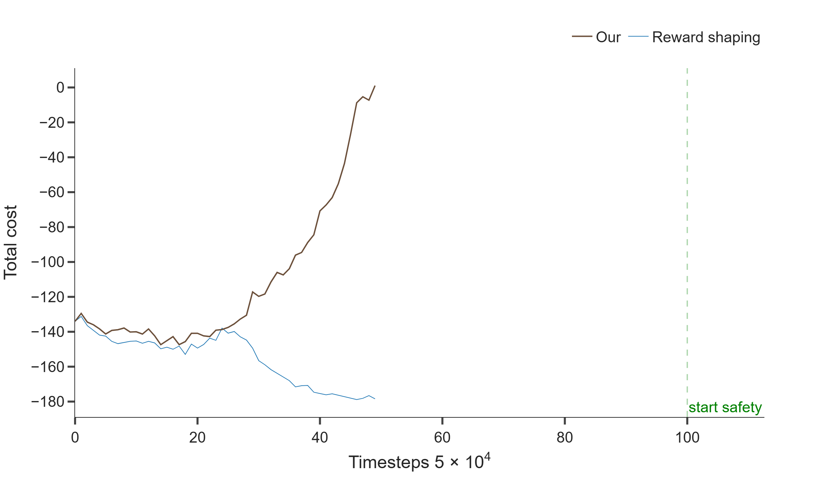
Lab 8 — Result Plot
STL-constrained RL (Pendulum): pendulum_cost.png

Slide 21
Final Notes
All 8 assignments are completed with saved artifacts.
Each lab has README + SUMMARY + results folder for reproducibility.
Portfolio index and artifacts are in assignments/portfolio/.

