Slide 1
Explainable AI — Labs 1–8 Portfolio
What was required • How we implemented it • What the results mean
Causal XAI • Symbolic planning • Neuro-symbolic RL

Slide 2
Course Overview
Scope:
8 labs completed — all artifacts in assignments/
Structure per lab:
Asked → Implementation → Results → Interpretation
Evidence:
Plots, CSV tables, plans, and metrics.json

Slide 3
Lab 1 — What Was Asked
Objective:
Predict building cooling demand from time-series sensor data.
Compare a causal (sparse, interpretable) model against a TCN baseline.

Slide 4
Lab 1 — How We Did It
Implementation:
Used Tigramite Prediction + LinearRegression on causal parents of cooling_demand.
Selected only variables with a directed causal link to the target.
Trained a dilated TCN on all 32 input channels as the black-box baseline.
Evaluated both with NMAE on the held-out test split.

Slide 5
Lab 1 — Results & What They Mean
Measured outcomes:
Causal model: 6 predictors, NMAE = 0.096.
TCN baseline: 32 channels, NMAE = 0.130.
Causal model is sparser and more accurate.
Interpretation:
Humidity, past demand, and pricing drive predictions — not all 32 channels.
Interpretability does not hurt accuracy; it improves it on this dataset.

Slide 6
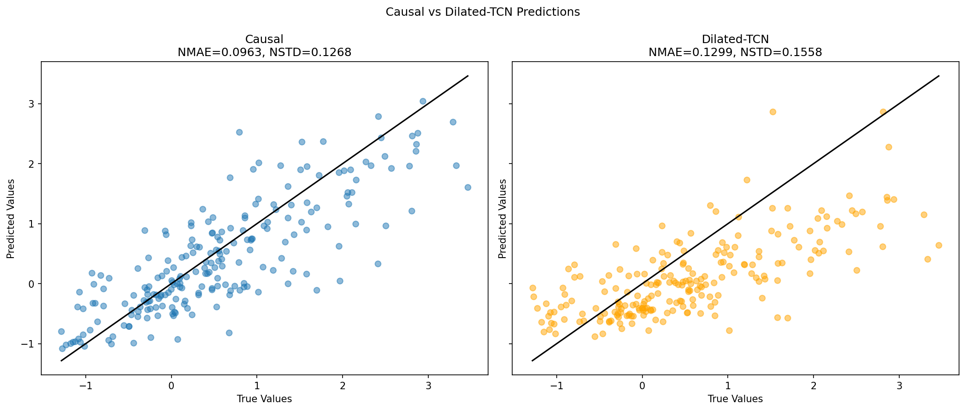
Lab 1 — Predictions
Actual vs predicted cooling demand — causal model tracks the signal well.

Slide 7
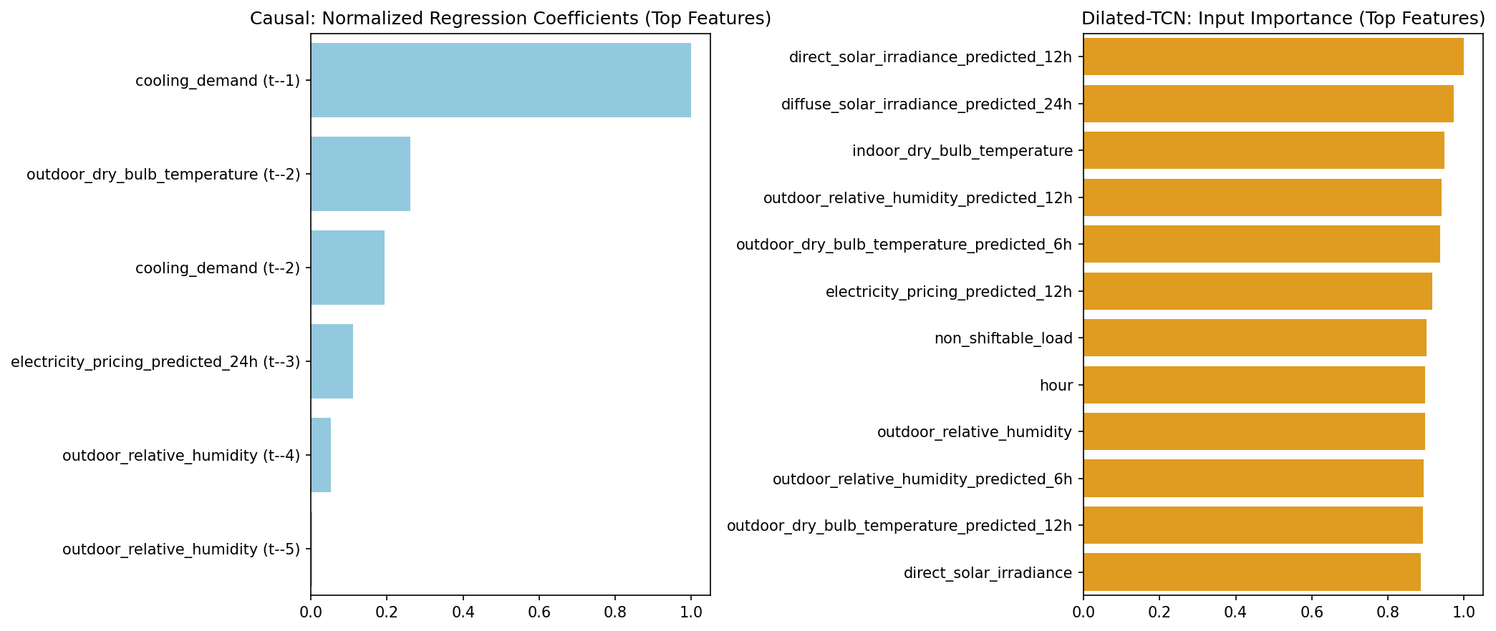
Lab 1 — Feature Importance
Which causal parents contribute most to the forecast.

Slide 8
Lab 1 — Metrics Table
metrics_summary.csv
target | tau_max | n_causal_predictors | n_tcn_features | nmae_causal | nstd_causal
cooling_demand | 5 | 6 | 32 | 0.09632691440529023 | 0.12675926939906312

Slide 9
Lab 2 — What Was Asked
Objective:
Detect Pepper robot cyber-attacks online using explainable signals.
Use causal coefficient drift rather than opaque anomaly scores.

Slide 10
Lab 2 — How We Did It
Implementation:
Fitted PCMCI offline to learn the causal graph and structural coefficients.
Monitored sliding windows of coefficients during live operation.
Flagged anomalies when coefficients deviated from the learned baseline.

Slide 11
Lab 2 — Results & What They Mean
Measured outcomes:
Precision: 0.64 | Recall: 0.89 | F1: 0.75.
56 false positives on normal data; strong recall on attacks.
Interpretation:
High recall means most attacks are caught; precision trade-off is acceptable for safety.
Per-attack CSV shows which sensor links broke for each attack type.

Slide 12
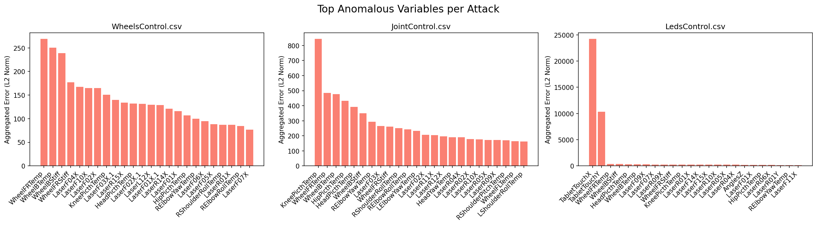
Lab 2 — Feature Importance
Coefficient drift highlights which causal links changed under attack.

Slide 13
Lab 2 — Metrics Table
metrics_summary.csv
precision | recall | f1 | false_positives_normal
0.643312101910828 | 0.8938053097345132 | 0.7481481481481481 | 56

Slide 14
Lab 3 — What Was Asked
Objective:
Plan robot actions to sample all good rocks on a grid (Rocksample).
Use Answer Set Programming — no ML training.

Slide 15
Lab 3 — How We Did It
Implementation:
Wrote Clingo rules in rocksample.lp: preconditions, effects, and constraints.
Implemented #program step(t) for legal moves and state transitions.
Ran incremental ASP search from (0,0) to sample rocks 0 and 1.

Slide 16
Lab 3 — Results & What They Mean
Measured outcomes:
Multiple valid plans saved in plans.txt.
Each plan samples good rocks 0 and 1 while respecting grid constraints.
Interpretation:
Symbolic planning gives auditable action sequences, not a black-box policy.
Clingo proves plan validity via logic — explainability by construction.

Slide 17
Lab 3 — Sample Output
Sample valid ASP plan (first 8 lines):
Answer: 1
east(2) east(3) east(4) east(6) east(7) north(5) north(8) north(11) north(13) north(14) west(1) west(10) west(12) west(15) sample(0,16) sample(1,9)
Answer: 2
east(2) east(3) east(4) east(6) east(7) north(5) north(8) north(11) north(13) north(14) south(1) west(10) west(12) west(15) sample(0,16) sample(1,9)
Answer: 3
east(2) east(3) east(4) east(6) east(7) north(1) north(5) north(8) north(11) north(13) north(14) west(10) west(12) west(15) sample(0,16) sample(1,9)
Answer: 4
east(1) east(2) east(3) east(4) east(6) east(7) north(5) north(8) north(11) north(13) north(14) west(10) west(12) west(15) sample(0,16) sample(1,9)
Answer: 5
east(2) east(3) east(4) east(6) east(7) north(5) north(8) north(11) north(13) north(14) west(10) west(12) west(15) sample(0,16) sample(1,9) sample(4,1)

Slide 18
Lab 4 — What Was Asked
Objective:
Learn which rocks are good from distance/guess observations (ILASP).
Then plan to sample learned-good rocks using ASP.

Slide 19
Lab 4 — How We Did It
Implementation:
Added mode bias to ilasp_task.las for ILP learning.
Encoded learned good(R) rules in rocksample_ilp.lp with ASP step(t).
Part B: planning via run_incmode.py on Windows.

Slide 20
Lab 4 — Results & What They Mean
Measured outcomes:
Plans target rock 2 when guess(2,90) > 80 (learned goodness).
5 valid plans in plans.txt; learned rules in learned_rules.txt.
Interpretation:
Logic learns under uncertainty; ASP executes the induced policy.
Full ILASP learning optional on Linux; planning verified on Windows.

Slide 21
Lab 4 — Sample Output
Learned ILASP rules:
# Expected ILASP hypothesis (Lab 4 assignment 1)
# Run: ILASP --version=4 ilasp_task.las
# Slides specify rules like:
good(R) :- dist(R, D), D < 1.
good(R) :- guess(R, V), V > 80.
# These were placed in rocksample_ilp.lp for assignment 2.
# After running ILASP on the full task, replace with the exact output
# from ILASP (pick hypothesis with fewest counterexamples if using -d).

Slide 22
Lab 5 — What Was Asked
Objective:
Explain a trained MAPPO warehouse policy: which logical rules drive which actions?
Measure rule activation rate per agent and action.

Slide 23
Lab 5 — How We Did It
Implementation:
Implemented _does_rule_activate in parallel_runner.py.
Compared observation atoms to rule bodies for each MAPPO action.
Ran activation-rate experiment on RWARE with checkpoint at 1M steps.

Slide 24
Lab 5 — Results & What They Mean
Measured outcomes:
Agent 0: forward ~4.5%, left ~8.6%, right ~9.9%.
Agent 1: load ~1.0%, right ~11.3%.
Interpretation:
Return alone does not explain behavior — activation rate links rules to actions.
Different agents activate different rule subsets on the same task.

Slide 25
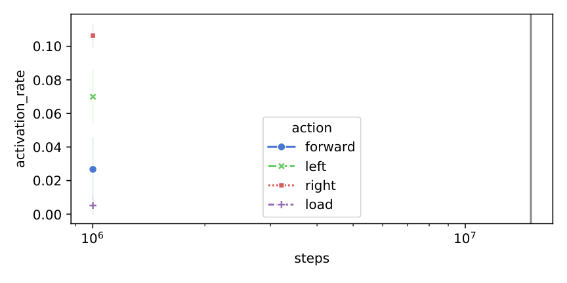
Lab 5 — Plot Activation Rate
Activation rate per rule/action — which heuristics the policy follows.

Slide 26
Lab 5 — Metrics Table
activation_rate_20260616005507.csv
index | seed | env_theory | env_test | steps | agent
0 | 0 | rware-img-3-tiny-2ag-v2 | rware-img-3-tiny-2ag-v2 | 1001000 | 0
1 | 0 | rware-img-3-tiny-2ag-v2 | rware-img-3-tiny-2ag-v2 | 1001000 | 0
2 | 0 | rware-img-3-tiny-2ag-v2 | rware-img-3-tiny-2ag-v2 | 1001000 | 0
3 | 0 | rware-img-3-tiny-2ag-v2 | rware-img-3-tiny-2ag-v2 | 1001000 | 0
4 | 0 | rware-img-3-tiny-2ag-v2 | rware-img-3-tiny-2ag-v2 | 1001000 | 0
0 | 0 | rware-img-3-tiny-2ag-v2 | rware-img-3-tiny-2ag-v2 | 1001000 | 1
1 | 0 | rware-img-3-tiny-2ag-v2 | rware-img-3-tiny-2ag-v2 | 1001000 | 1
2 | 0 | rware-img-3-tiny-2ag-v2 | rware-img-3-tiny-2ag-v2 | 1001000 | 1
3 | 0 | rware-img-3-tiny-2ag-v2 | rware-img-3-tiny-2ag-v2 | 1001000 | 1
4 | 0 | rware-img-3-tiny-2ag-v2 | rware-img-3-tiny-2ag-v2 | 1001000 | 1

Slide 27
Lab 6 — What Was Asked
Objective:
DoorKey MiniGrid: guide DQN exploration with symbolic heuristics (SR-DQN).
When exploring, bias action sampling toward logically suggested actions.

Slide 28
Lab 6 — How We Did It
Implementation:
Implemented _get_random_action() in SR_DQN.py.
Suggested actions get weight conf_level; others share the remainder uniformly.
Trained DQN vs SR-DQN on DoorKey 5×5 for 100k steps.

Slide 29
Lab 6 — Results & What They Mean
Measured outcomes:
SR-DQN reaches reward ~0.7 by end of training.
DQN baseline stays near 0 — random exploration fails on sparse reward.
Interpretation:
Symbolic heuristics during exploration help discover the +1 goal reward.
Explainable logic shapes learning, not only the final greedy policy.

Slide 30
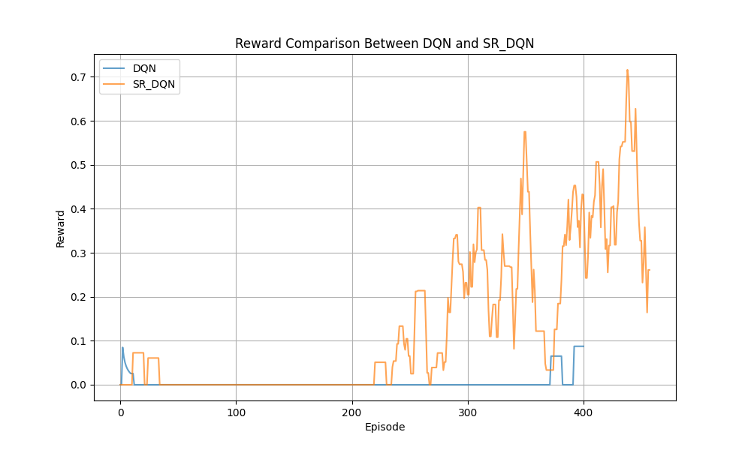
Lab 6 — Rewards
DQN (blue) vs SR-DQN (orange) — heuristic-guided exploration wins.

Slide 31
Lab 7 — What Was Asked
Objective:
Combine C51 (distributional DQN) with logical heuristics on return distributions.
Implement the H-C51 product on PMFs for rule-suggested actions.

Slide 32
Lab 7 — How We Did It
Implementation:
In h_c51_product.py get_action(): multiply rule-suggested PMFs by 1 + ε·rule_pmf.
Renormalize over atoms; compute Q-values from combined distribution.
Trained C51 baseline vs H-C51 for 50k steps on DoorKey 5×5.

Slide 33
Lab 7 — Results & What They Mean
Measured outcomes:
H-C51 sustains returns ~0.5–0.8.
C51 baseline drops to ~0 after early episodes.
Interpretation:
Heuristics shift probability mass toward high-return atoms for suggested actions.
Distributional RL + logic beats plain C51 under sparse DoorKey rewards.

Slide 34
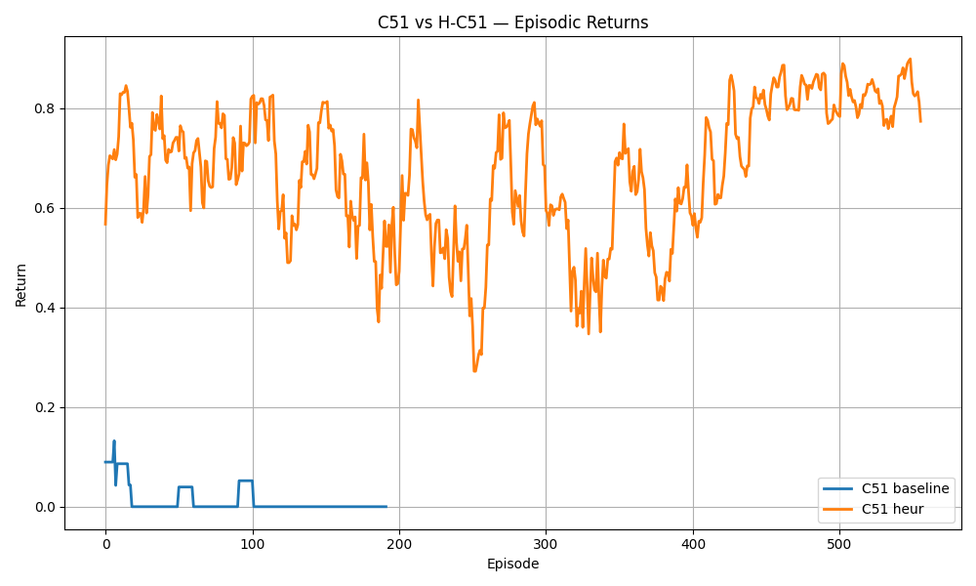
Lab 7 — C51 Vs Hc51 Returns
C51 baseline vs H-C51 — heuristic modulation of return distributions helps learning.

Slide 35
Lab 7 — Metrics Table
metrics_summary.csv
env | steps_per_model | models | output_plot | note
MiniGrid-DoorKey-5x5-v0 | 50000 | ['C51', 'H-C51'] | c51_vs_hc51_returns.png | H-C51 sustains ~0.5-0.8 return; C51 baseline near 0

Slide 36
Lab 8 — What Was Asked
Objective:
Pendulum swing-up with STL constraints on angular velocity and torque.
Implement STL robustness-based costs in Pendulum.py step().
Compare Lagrangian TRPO (explicit costs) vs reward shaping.

Slide 37
Lab 8 — How We Did It
Implementation:
Built τ-horizon trajectory [thetadot, torque] each step.
Computed STL robustness ρ via RTAMT (eventually always |thetadot|≤0.5, |torque|≤0.3).
Mapped ρ to smooth costs: cost = tanh(−β·ρ) per constraint (β=100).
Integrated standard pendulum dynamics and reward r = −(θ² + 0.1·θ̇² + 0.001·τ²).
Our method: dual critics + Lagrangian TRPO (main_pendulum_tuning.py).
Baseline: STL terms mixed into reward (main_pendulum_stlgym.py).

Slide 38
Lab 8 — Results & What They Mean
Measured outcomes:
Our (STL TRPO): return improves to ~−18; total cost → 0 (constraints satisfied).
Reward shaping: return plateaus ~−65; cost stays ~−180 (weak satisfaction).
50 episodes, seed 47, start_safety=100.
Interpretation:
Higher total cost (closer to 0) means STL constraints are better satisfied.
Our method separates reward maximization from constraint enforcement via dual critics.
Reward shaping conflates objectives — agent optimizes return but violates torque/velocity limits.
ρ_thetadot and ρ_torque subplots show robustness crossing 0 when constraints hold.

Slide 39
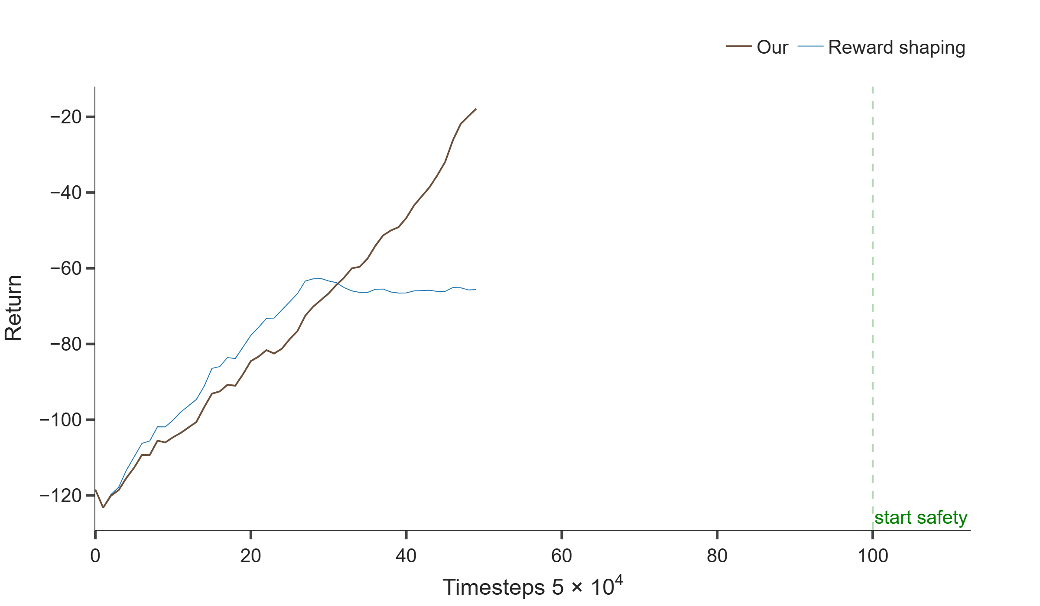
Lab 8 — Pendulum Reward
Return over training: Our (brown) surpasses reward shaping (blue) after ~32 episodes.

Slide 40
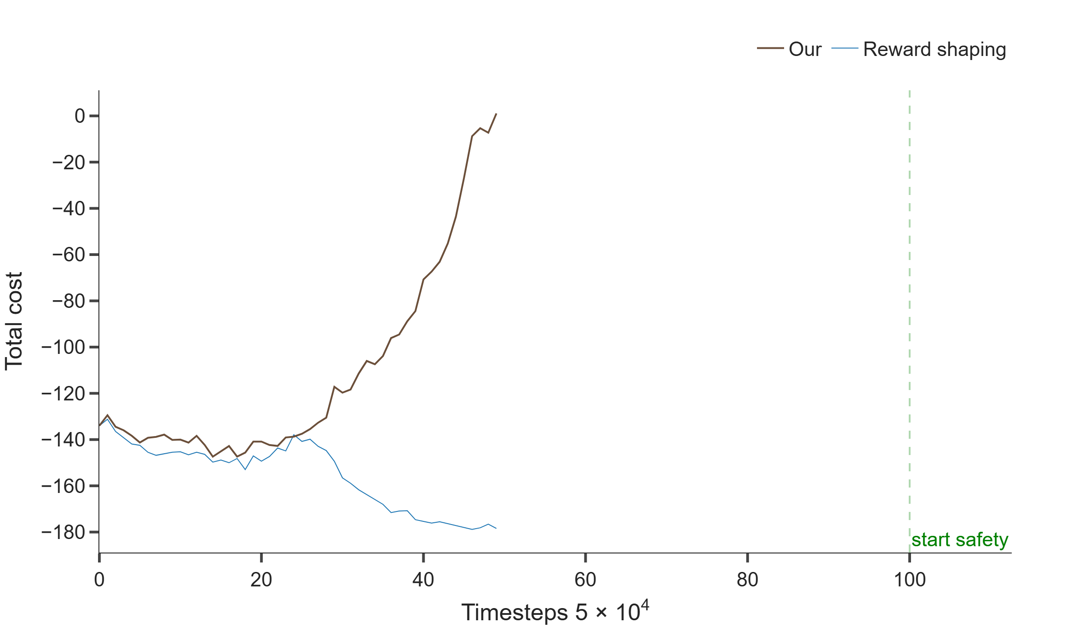
Lab 8 — Pendulum Cost
Total STL cost: Our rises toward 0 (satisfied); shaping stays near −180 (violated).

Slide 41
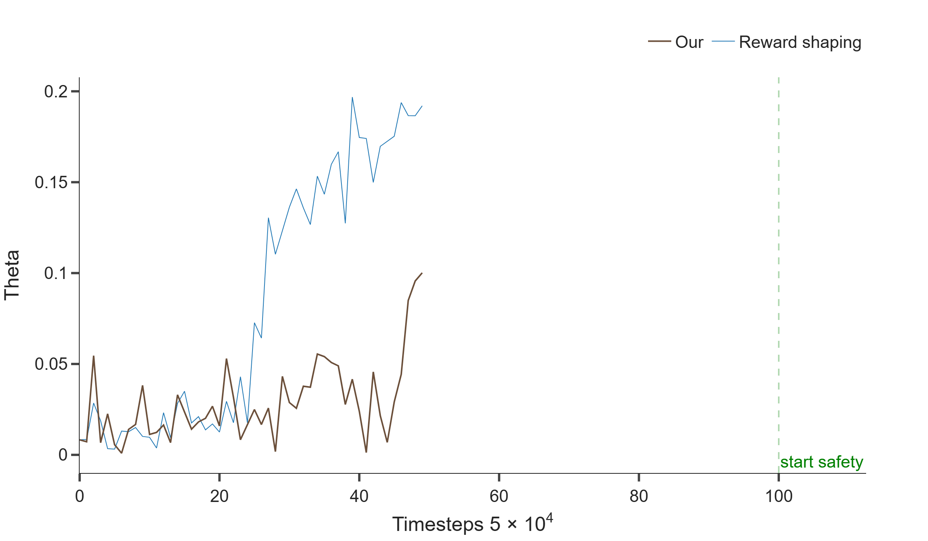
Lab 8 — Pendulum Theta
Pendulum angle |θ|: both methods learn to swing up toward upright (θ→0).

Slide 42
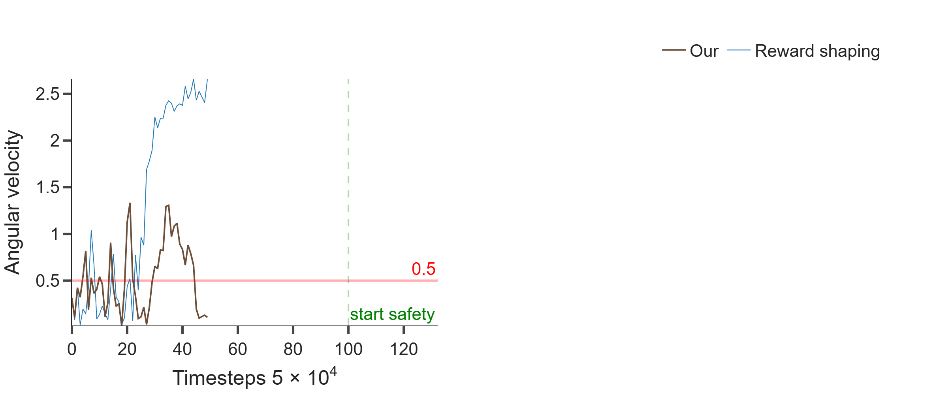
Lab 8 — Pendulum Thetadot Subplots
Angular velocity |θ̇| per agent — constraint |θ̇|≤0.5 tracked over time.

Slide 43
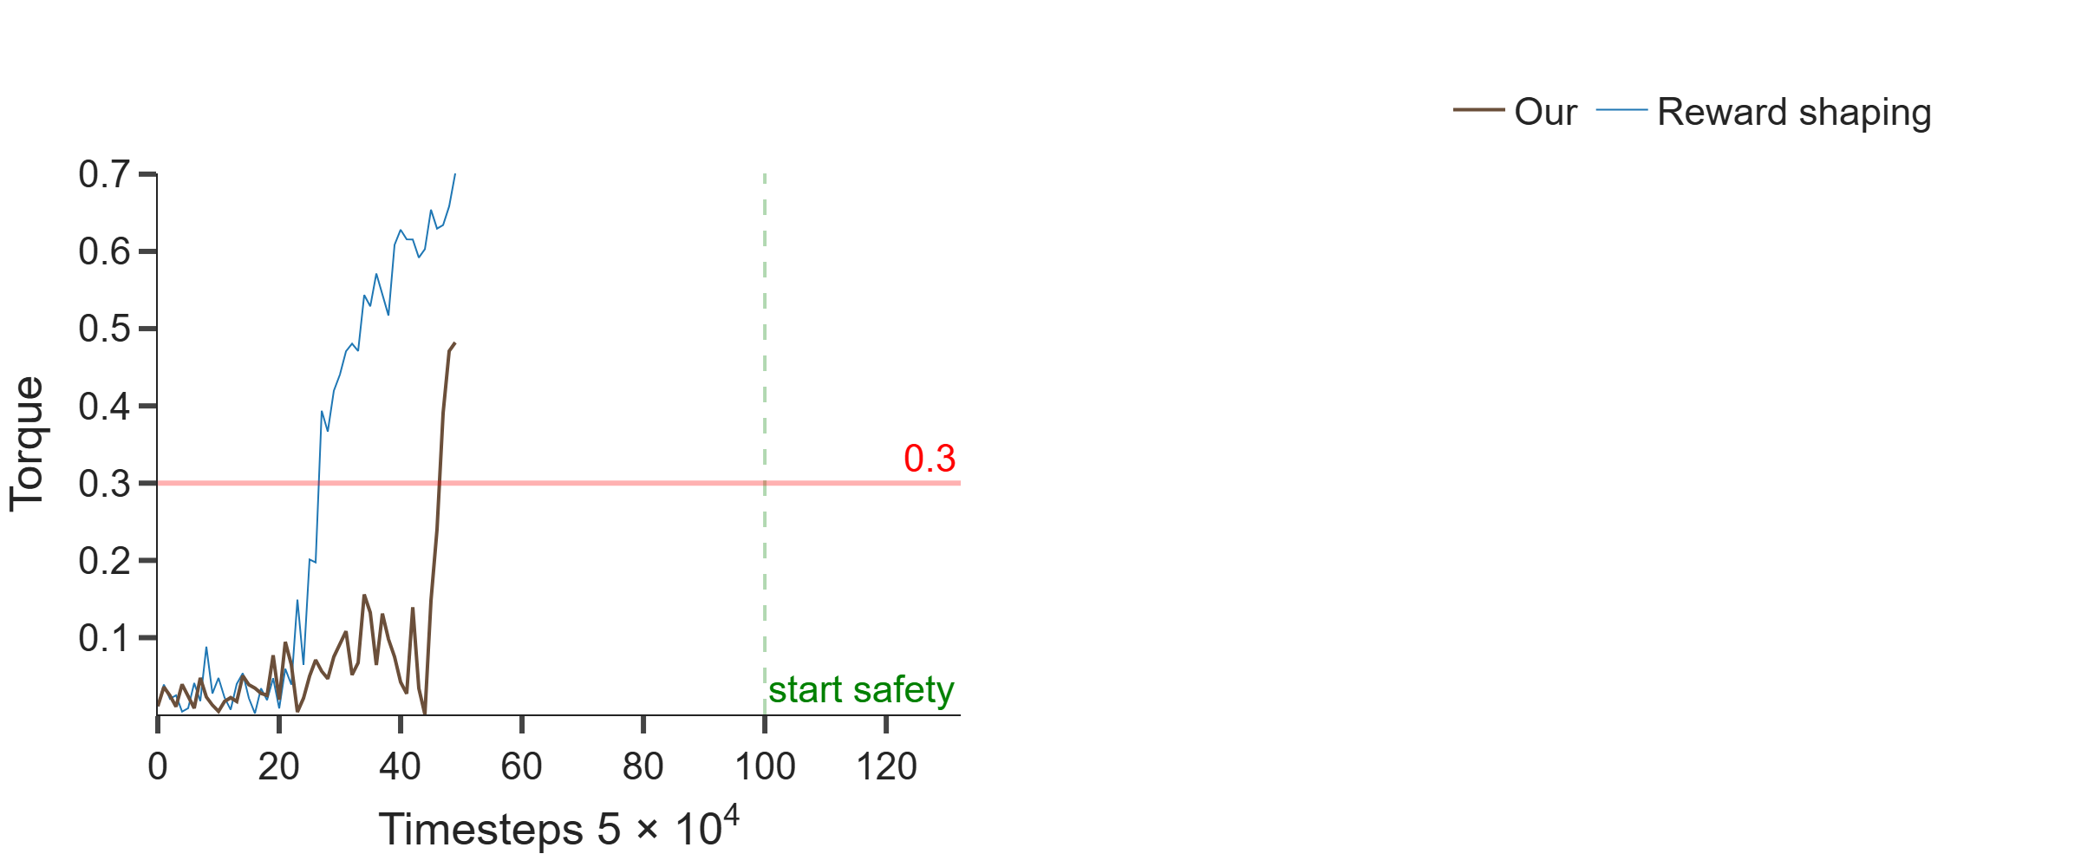
Lab 8 — Pendulum Torque Subplots
Applied torque |τ| — constraint |τ|≤0.3; Our stays within bounds better.

Slide 44
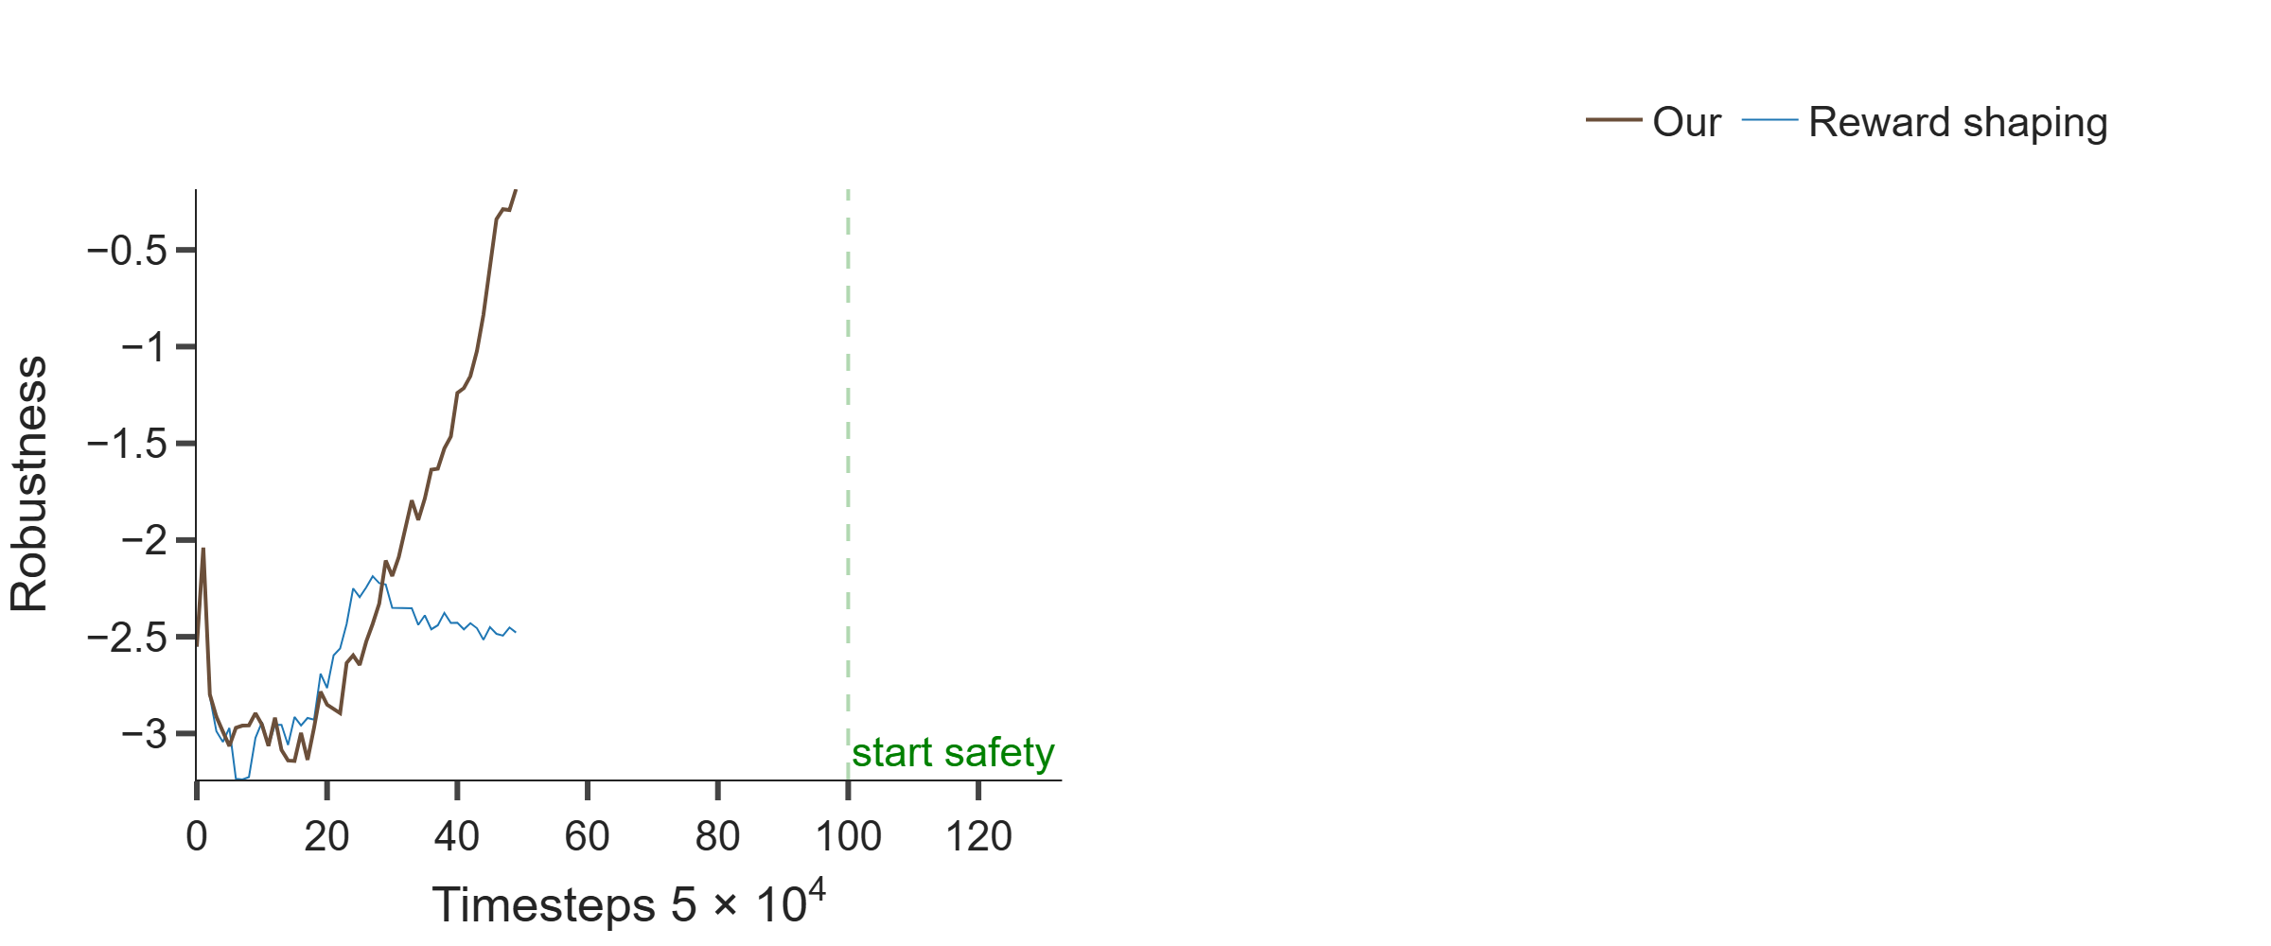
Lab 8 — Pendulum Rho Thetadot Subplots
STL robustness ρ for velocity: positive ρ ⇒ constraint satisfied.

Slide 45
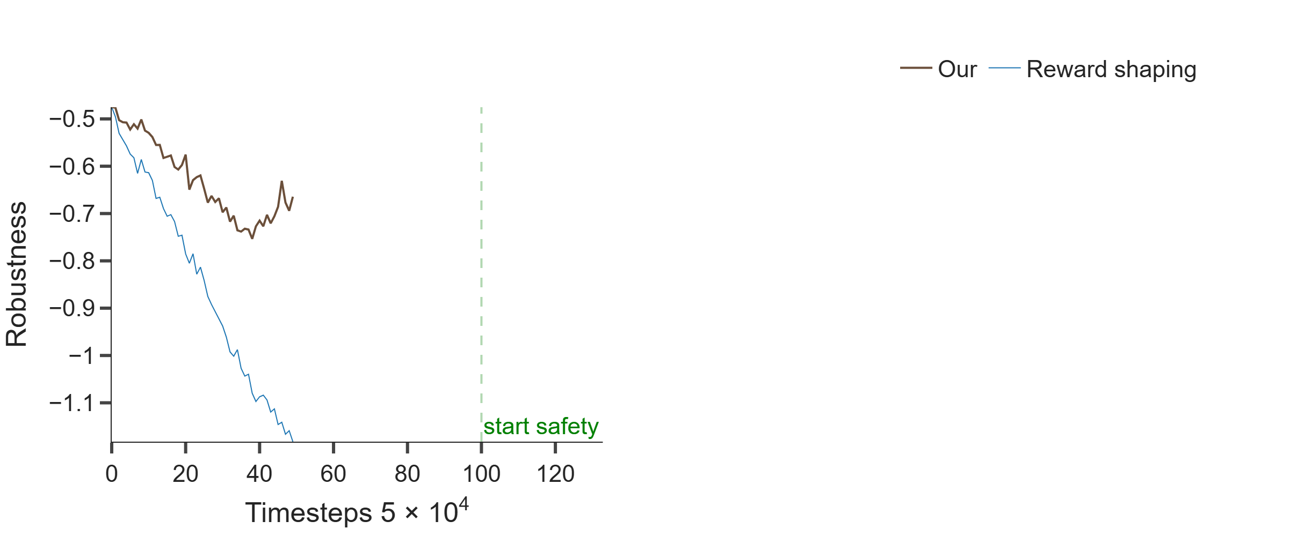
Lab 8 — Pendulum Rho Torque Subplots
STL robustness ρ for torque: Our reaches positive robustness; shaping does not.

Slide 46
Summary
Completed:
All 8 assignments with reproducible results folders
Key theme:
Explainability via causality, logic, and constrained RL
Artifacts:
assignments/portfolio/ — regenerate with build_presentation.py

