Slide 1
Wonder Beauty Soap

Slide 2
Site structure: 5 tabs, in this order
1
Home
Welcome, mission and vision, numbers, products, where we are sold
2
Our Story
Who we are, why Wonder, the story, team, Director and CEO notes
3
The Collection
Rose, Lavender, Aloe Vera, Lemon, Coconut
4
Around the World
Global presence through pictures and videos
5
Get in Touch
Query form and socials
Notes:
Current site tab "In the city" is renamed "Around the World".

Slide 3
Home: sections in order
Welcome note (summary of the company)
Mission
visual
Vision
visual
Products: all 5 packs, each linking to The Collection
Visuals of where Wonder is sold: photo strip or short video, linking to Around the World
Hero line suggestion: "Scent. Lather. Wonder.“
Add multiple tag lines throughout

Slide 4
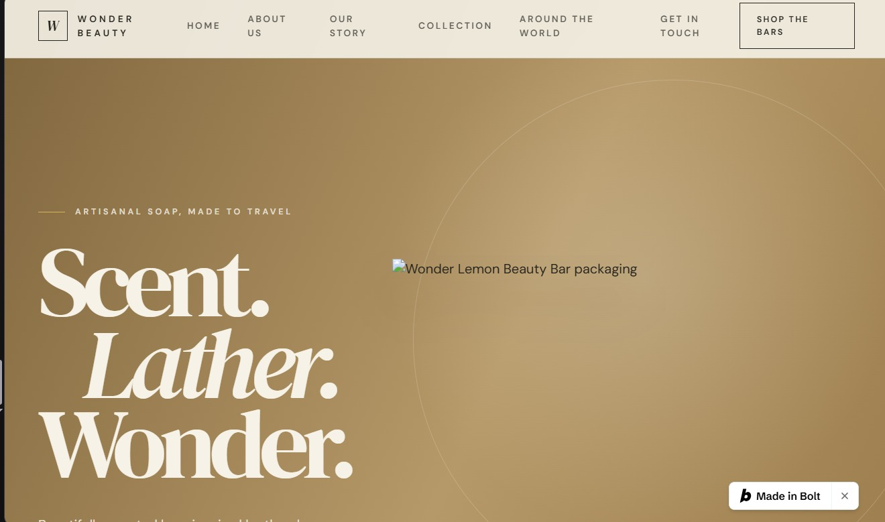
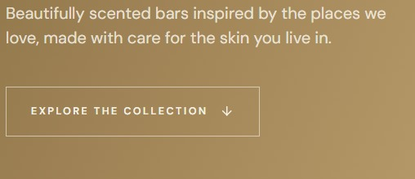
KEEP THE OPENING AS IS
THE TOP PANEL NEEDS TO B CHNAGED

Slide 5
Home: Welcome note (1 of 2)
Wonder is a Pakistani artisan soap brand, made with meticulous attention to detail and with both skin comfort and sensory pleasure in mind.
Our soaps are made with carefully selected ingredients, including fragrant flowers and botanicals, and packed with care by our own people, for you.
Wonder is about innovation, experimentation and design in everyday beauty. We want every bar to be a small multisensory experience: rich lather, a lovely scent and a feel that stays with you.
Notes:
First line is the bold heading.

Slide 6
Home: Welcome note (2 of 2)
Elegance and design go into every pack, so your soap feels like a little luxury and not just a bathroom basic.
A better way to wrap luxury. Instead of traditional wrappers and plastic packaging, Wonder comes in eco-friendly box packaging. It helps reduce our carbon footprint and gives you a luxury experience at an affordable price, because every customer matters to us.
We love quality and beauty, and we want you to find both in every bar.
Every scent tells a story.
ADD VISUALS INBETWEEN BOTH WELCOME NOTES
U CAN BREAK IT DOWN
NO PARAGRAPHS
Notes:
"A better way to wrap luxury" works as a sub-heading. "Every scent tells a story." is the closing tagline.

Slide 7
Home: Mission
MISSION
To make everyday luxury accessible to all, with a gentle, moisturising, beautifully scented beauty bar made with care for every skin type, at a price everyone can afford.
Notes:
Optional second vision line: "To become the most loved everyday beauty bar in the region, and a name that travels."

Slide 8
Home: Vision
VISION
Our vision is to offer products you can trust. In a world full of big claims and marketing gimmicks, Wonder promises to stay honest: quality ingredients, careful craftsmanship and a product we are proud to stand behind. From us to you.
Notes:
Optional second vision line: "To become the most loved everyday beauty bar in the region, and a name that travels."

Slide 9
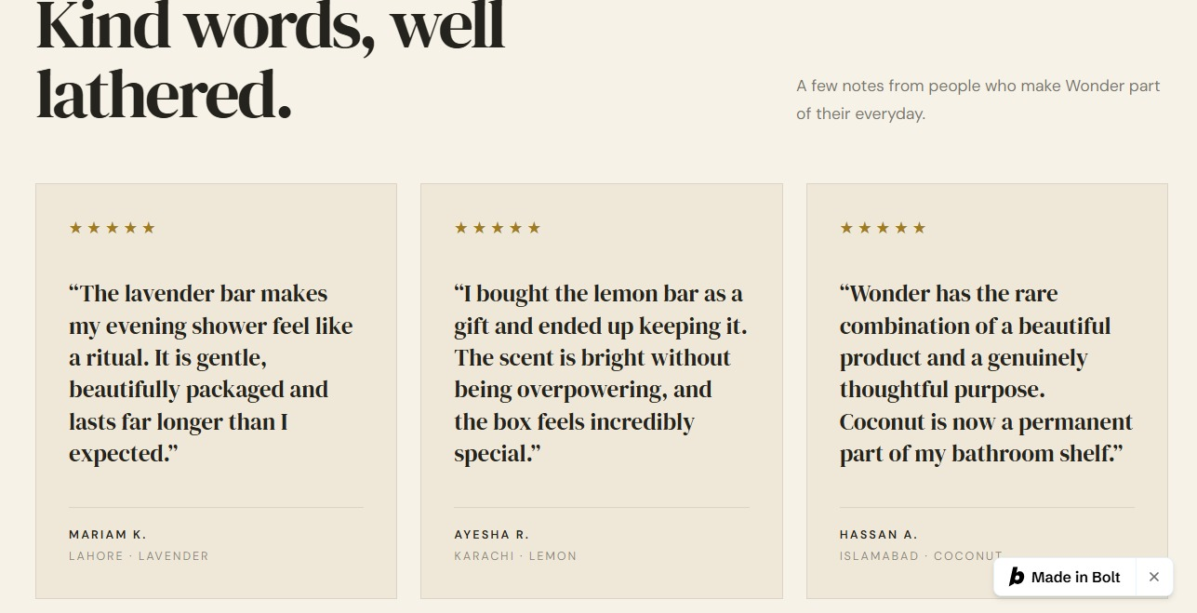
CUSTOMER REVIEWS AT THE END

Slide 10
Our Story: page structure
Who we are
OUR VALUES
Why Wonder?
Wonder Room (this is where we add Where the idea of Wonder came from)
A note from the Founder
CEO's promise

Slide 11
Our Story: Who we are, and Why Wonder?
WHO WE ARE
At Royal Basket, our philosophy is to create premium quality soap that leaves your skin hydrated and happy, at a price that’s easy on the pocket.
We believe a daily ritual should feel special, smell wonderful, and be kind to your skin.
WHY WONDER? (three columns or icons)
One bar does it all
Affordability
Nourshing
Intentionally crafted for everyday care, with thoughtful ingredients and scents to help you glow, hydrate and protect.
From the beginning, we wanted to make premium everyday care more affordable, without compromising on quality.
Gentle everyday cleansing that helps maintain your skin’s natural moisture, leaving it feeling soft and cared for.

Slide 12
OUR VALUES
Simplicity. Affordability. Authenticity. Quality. Transparency.

Slide 13
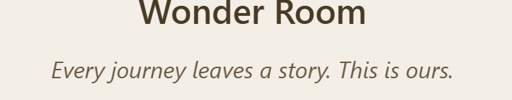
Every journey has a story. This is ours.
The layout would not b like this this just the text for u
Lemon · Amalfi, Italy
Wonder was born in Amalfi, on a sunny afternoon, while I was eating a lemon sorbet. The fresh, bright citrus stopped me in my tracks. I thought: I want my soap to smell like this.
Lavender · Surrey, UK
I spent years living in the UK, where I discovered rows of purple lavender stretching to the horizon. Mayfield Lavender in Surrey is one of the best-known lavender fields in the country. That calm, quiet feeling became our Lavender bar.
Rose · Paris, France
Paris, the city of love, is where I met my wife. How could I not make a Rose? Soft, romantic and timeless.
Aloe Vera · Korea
As a skincare enthusiast, aloe vera had to be part of the collection. Korean skincare introduced me to aloe vera as a staple for soothing, fresh and hydrated-feeling skin.
Coconut · Bali, Indonesia
Bali was our honeymoon. Warm sand, ocean air and coconut everywhere. I can't imagine travelling without coconut, so it came home with me, in a bar.

Slide 14
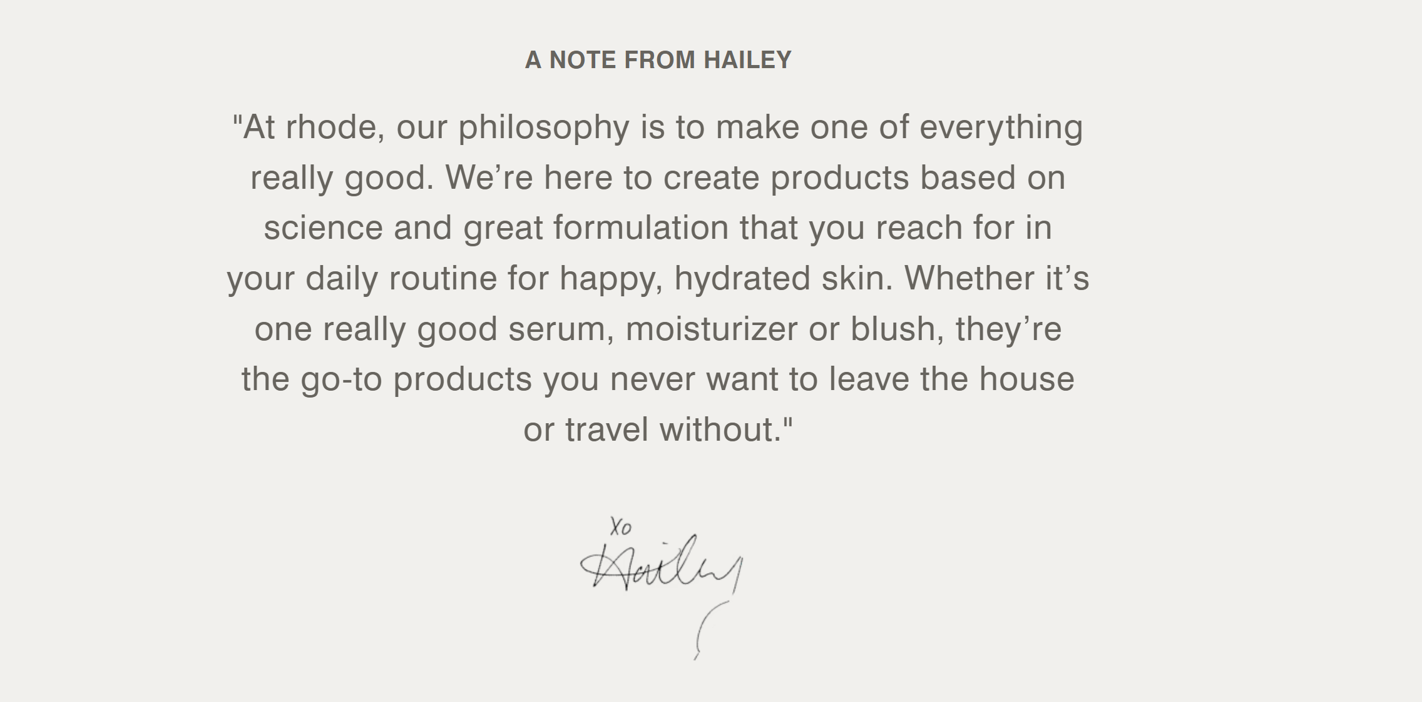
VISUAL REFRENCE OF NOTE FROM FOUNDER

Slide 15
A note from the founder
I’ve always been a one-bar person.
Soap for my hair. My body. My hands. My face. I never understood why we needed ten different bottles when one good bar could do it all.
So I made it.
One bar you never want to travel without.
Premium quality that leaves your skin soft and happy, and stays easy on your pocket. That’s my promise.
Founder,
Royal Basket Group

Slide 16
CEO's promise
At Wonder, we believe the things we use every day should be kind to us.
Soap is the simplest ritual there is. You use it every morning, every night, and it touches the skin of everyone you love. So it should be good: gentle, honest, and within reach for everyone, not just a few.
That’s the standard our whole team works to, every day.
My promise to you: gentle on your skin, honest in what we make, and always affordable. Every bar of Wonder is made with the same care we would want for our own families.
Thank you for letting Wonder be part of your day.
CEO,
Royal Basket Group
Notes:
Draft wording. Ali to approve.

Slide 17
The Collection: 5 products
Flavour | Origin of the idea | Tagline
Rose | Paris, France | Softly romantic
Lavender | Surrey, UK | Calm in a bar
Aloe Vera | Seoul, Korea | Fresh, soothing moisture
Lemon | Amalfi, Italy | A citrus afternoon
Coconut | Bali, Indonesia | The island daydream
Each product page needs: pack photo, name, scent description, "Best for" line, a "Bulk orders, talk to us" button linking to Contact. Optional: a different accent colour per flavour.

Slide 18
Around the World
Hero banner: "Wonder, wherever you are."
Gallery grouped by country or city: shelf shots, store visits, people holding the product, landmark shots
Short video reel (customer and retailer clips)
Simple map or list of countries where Wonder is available
Closing line: "Don't see your country yet? Talk to us."
Optional: map linking each scent to its origin place

Slide 19
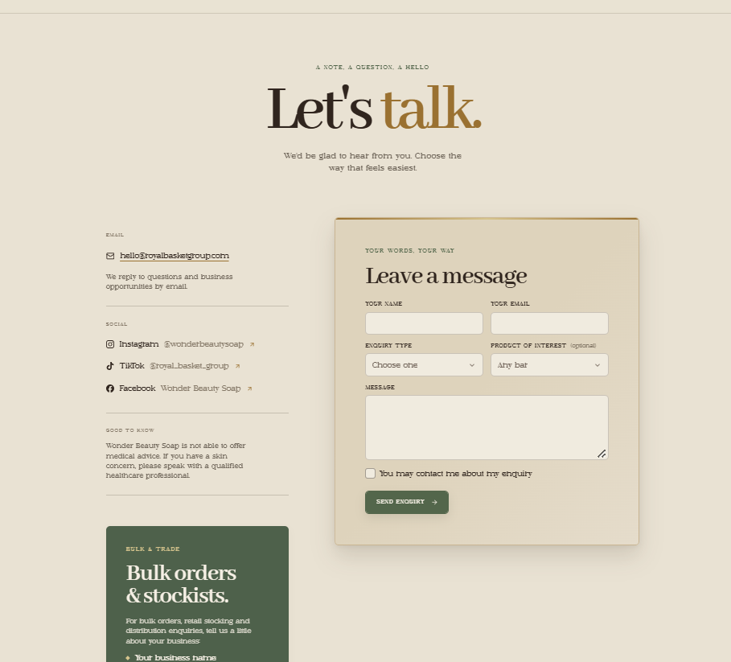
Get in Touch
DETAILS AND SOCIALS
Email: hello@royalbasketgroup.com
Instagram: @wonderbeautysoap
TikTok: @royal_basket_group
Facebook page
Address and map:
Footer line: "Made with care, from us to you."

Slide 20
Taglines and lines to place on the site
Home hero: "Scent. Lather. Wonder."
Under welcome note: "Every scent tells a story."
Rose: "Softly romantic" · Lavender: "Calm in a bar" · Aloe Vera: "Fresh, soothing moisture"
Lemon: "A citrus afternoon" · Coconut: "The island daydream"
Brand promises: Fragrance · Premium quality · Good lather
Other options: "Everyday luxury, within reach." · "Lather that feels like a little celebration." ·

Slide 21
Notes for the designer
Mobile-first layout: most visitors will come from social media
Rename the "In the city" tab to "Around the World"
Each flavour can have its own accent colour
Eco-friendly box packaging is a selling point: give it space on Home
Add Cosmetic safety report
Add AI videos

Slide 22
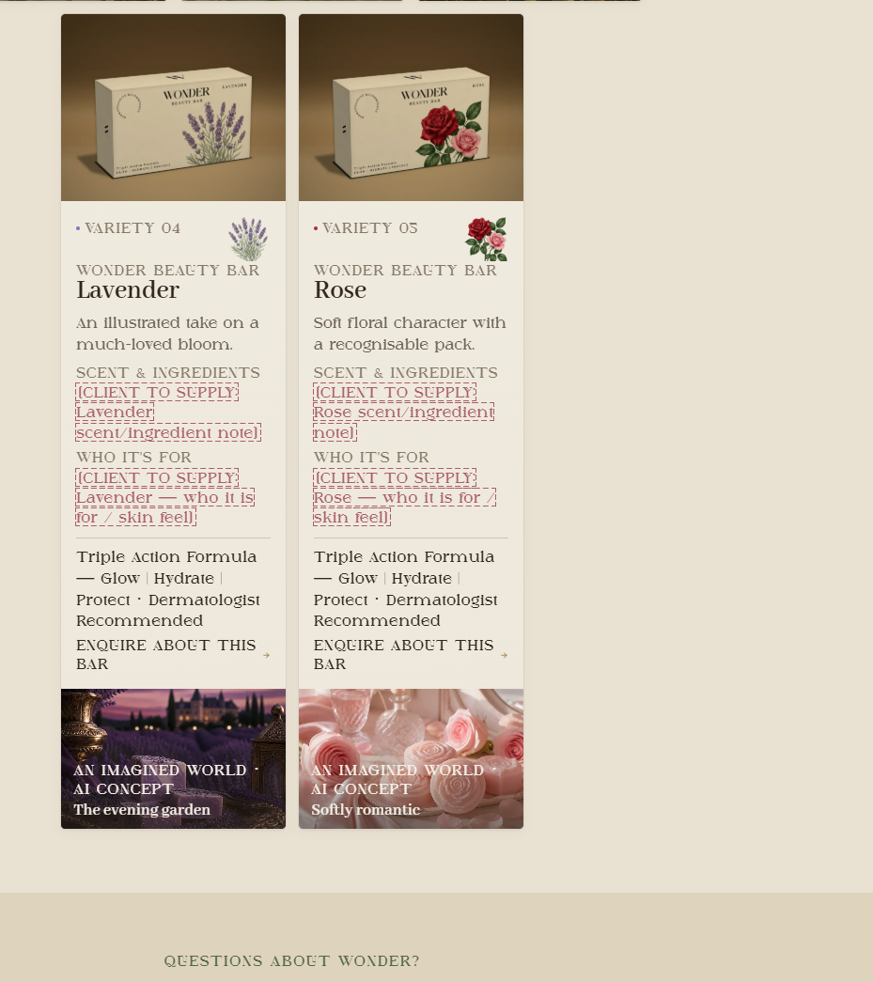
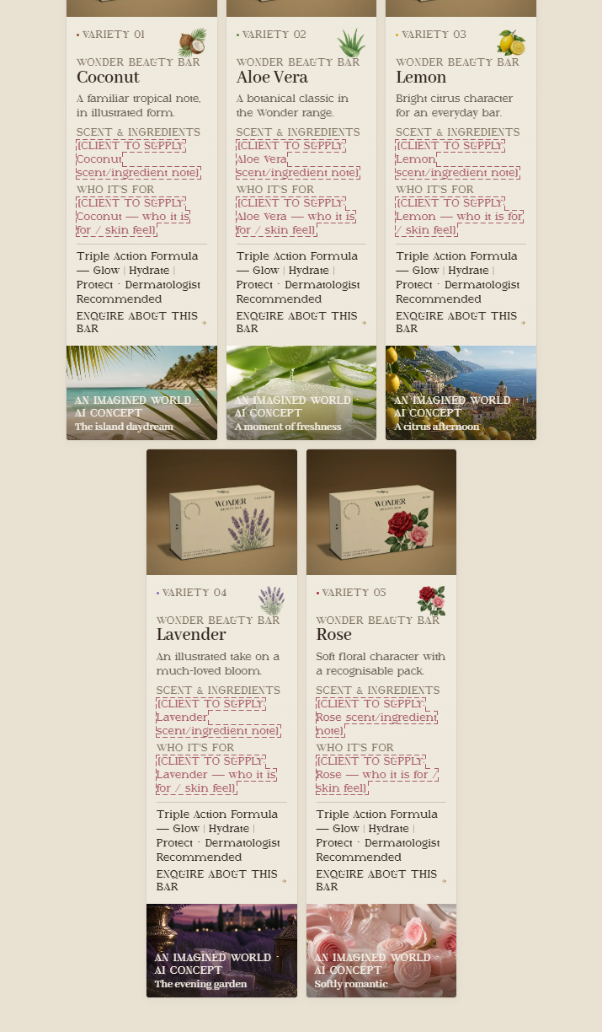
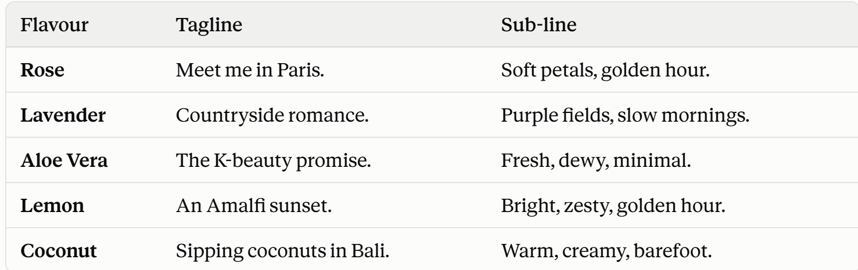
All 5 FLAVORS

Slide 23
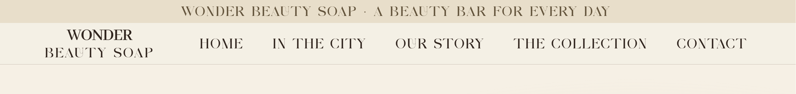


ADD LOGO
LOGOS

Slide 24
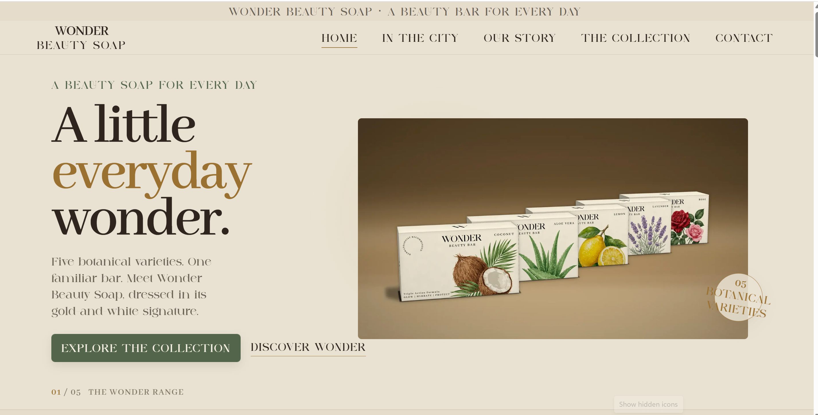
ADD THE BARS TOO AS DROP DOWN
Add new PICTURE
ADD MISSION + VISION ON HOME PAGE

Slide 25
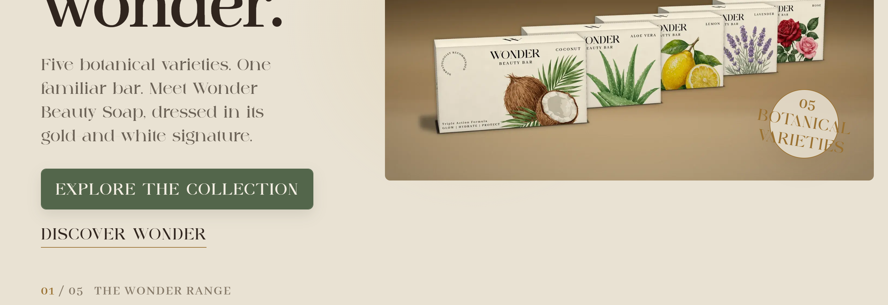
Brand promises:
SCENT GLOW
WONDER

Slide 26
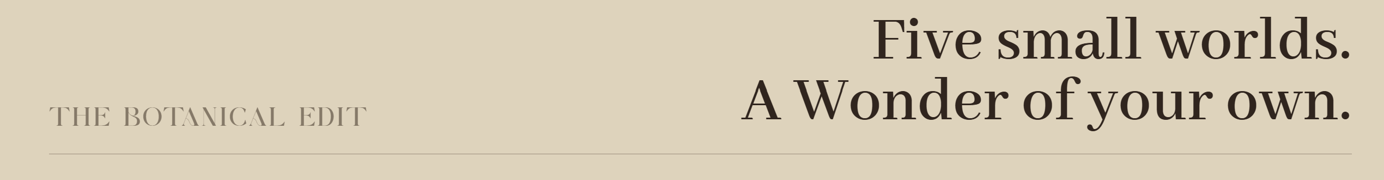
WONDER, wherever you are.

Slide 27
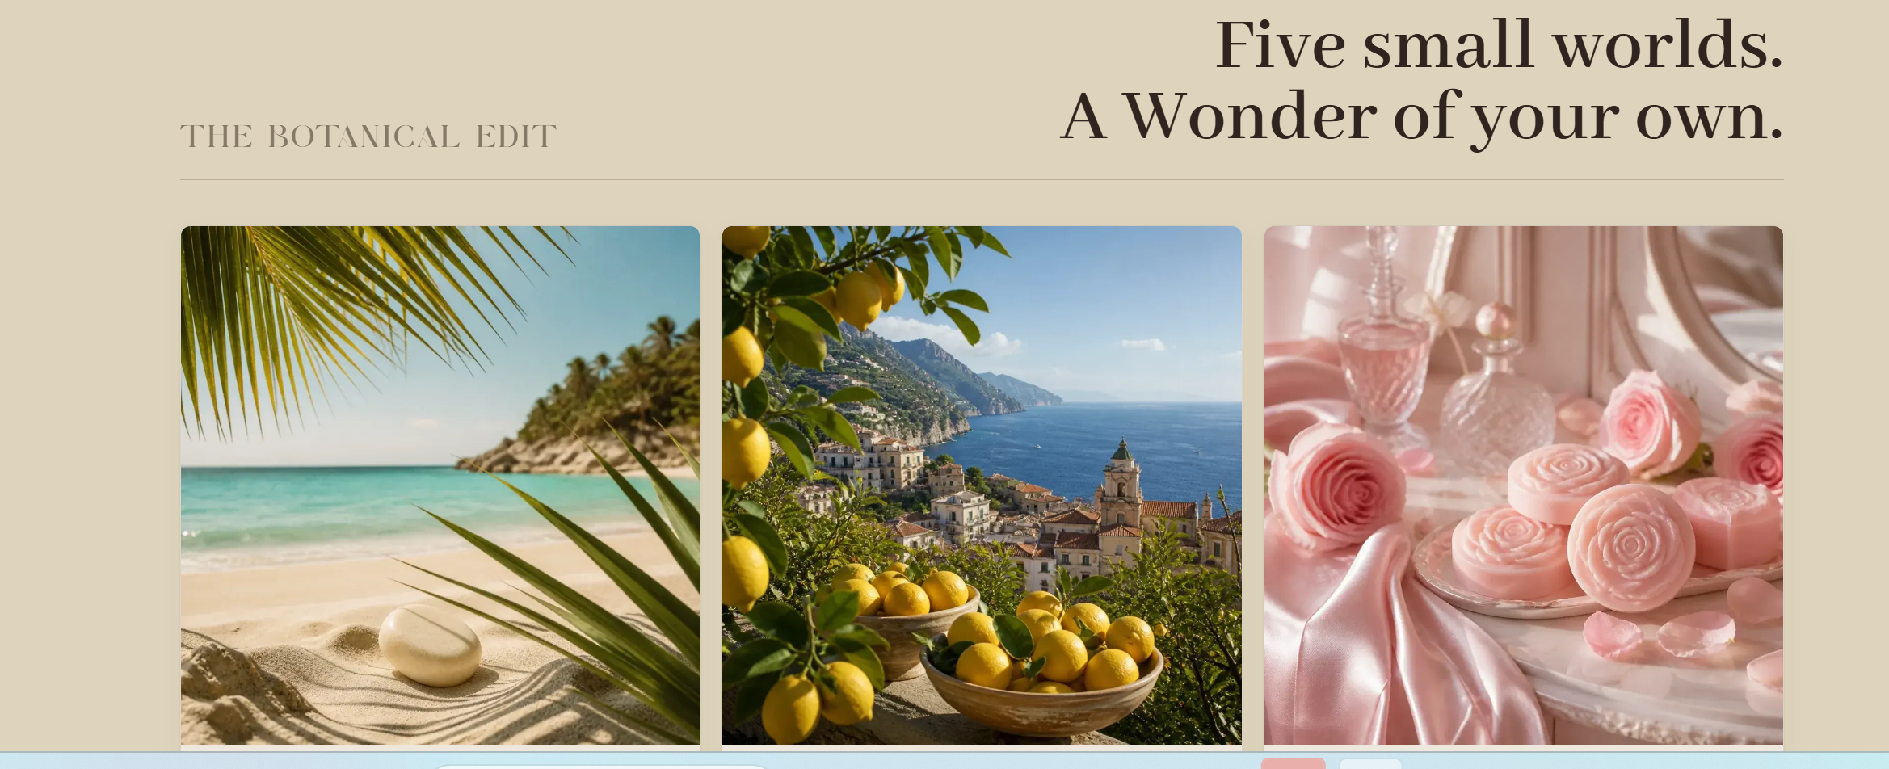
Every scent tells a story- ADD THIS LINE
ADD NEW IMAGES

Slide 28
CHANGE BACKGROUND COLOR TO BOLT

Slide 29

FOR ORDERS SPEAK TO US

Slide 30
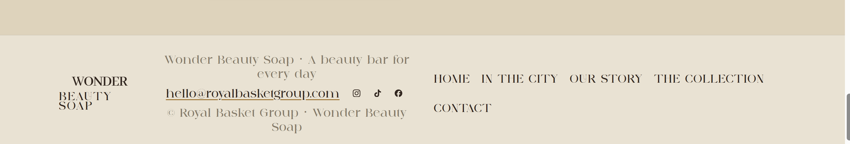
PLEASE WORK ON ITS ALIGNMNET.

Slide 31
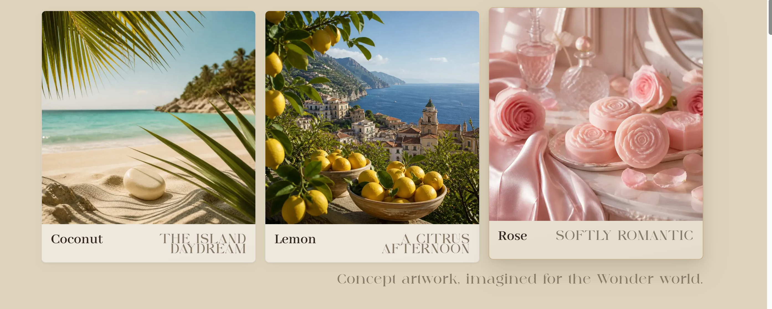
ADD ALL 5 FLAVORS. SHOW SOAP IN ALL 5 PICTURES.

Slide 32
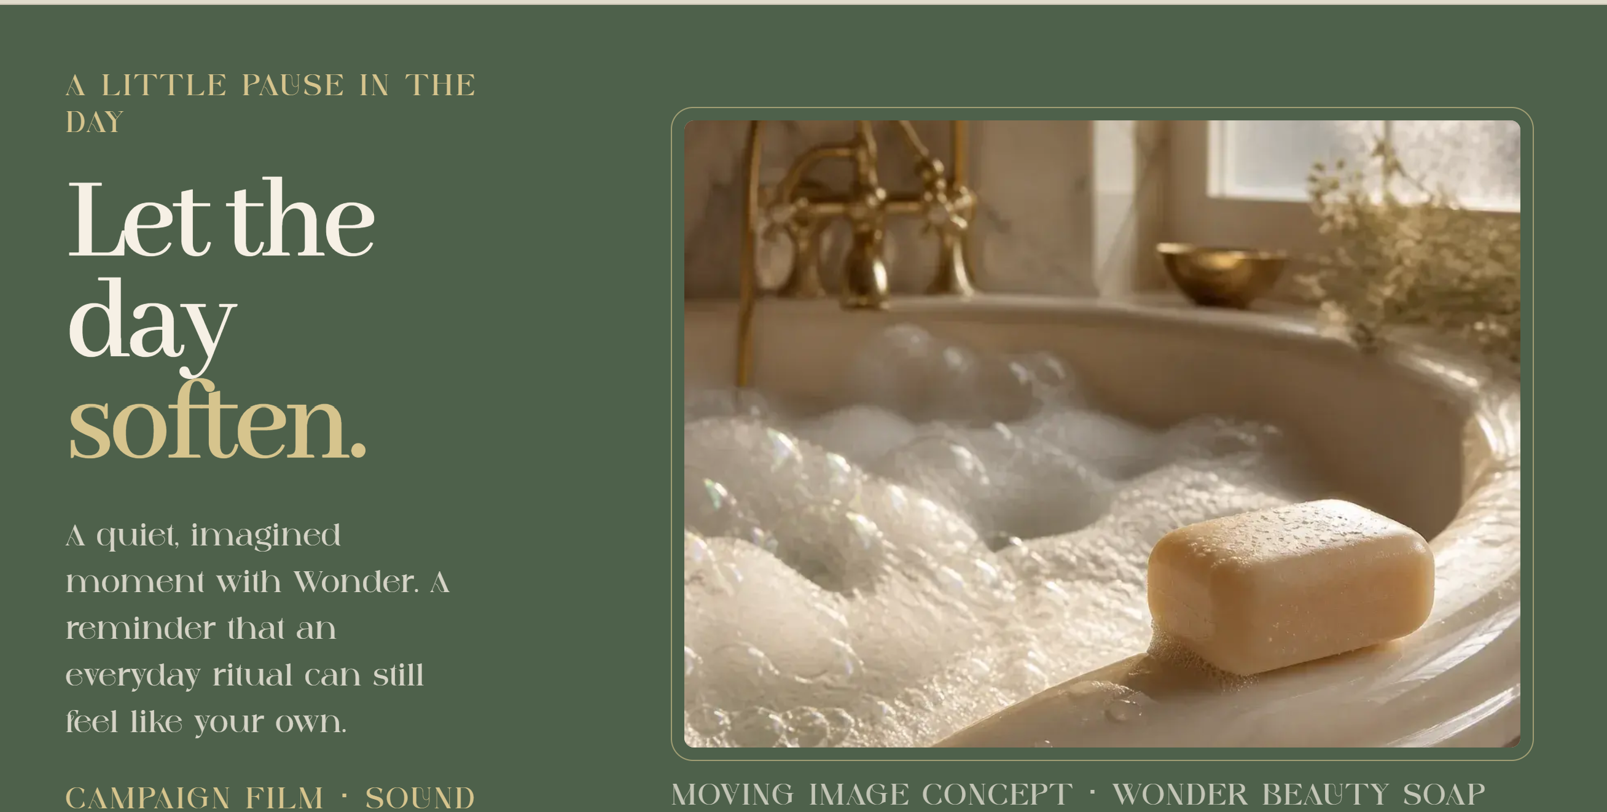
AI VIDEO
video

Slide 33
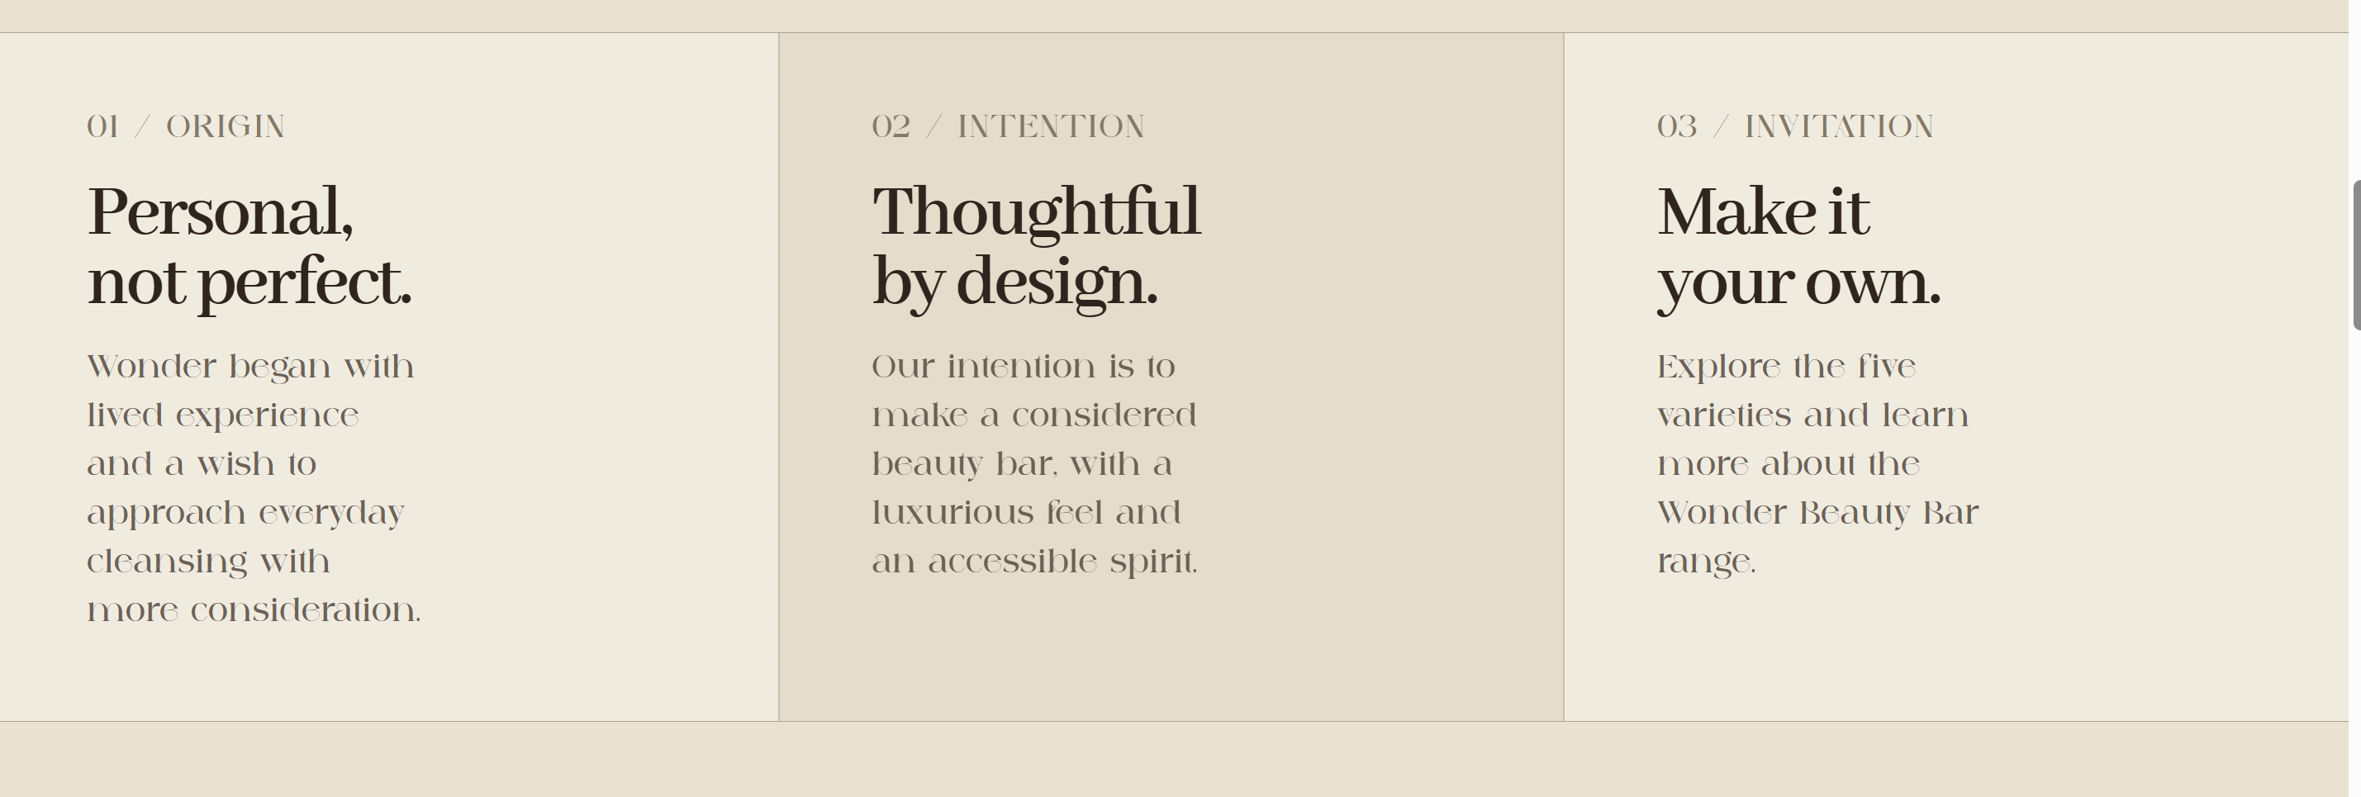
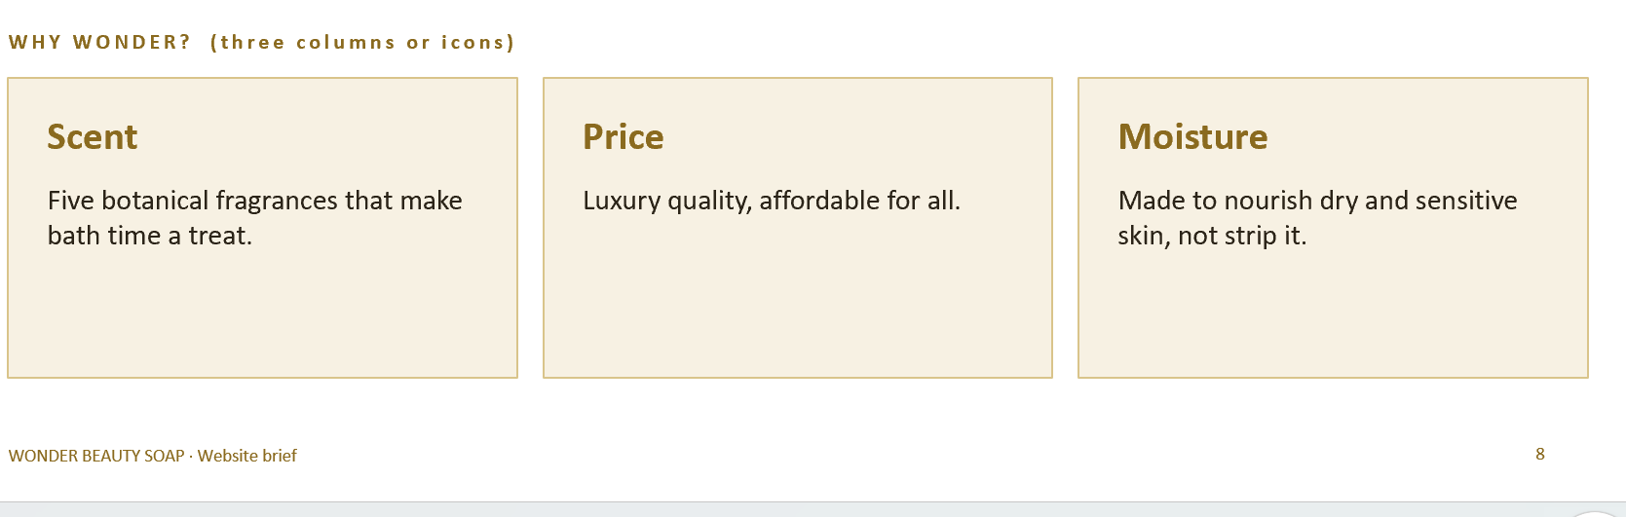
OLD

