Slide 1
Brain Tumor Classification Using Convolutional Neural Networks
Prepared by Usama Latif Virk

Slide 2
Background — key statistics—
Brain tumors affect ~300,000 people/year globally
5-year survival rate for glioblastoma: only ~5%
Early detection can improve survival by up to 3×
MRI scans are the gold standard for diagnosis
Manual diagnosis takes 30–60 min per scan
Radiologist error rate: up to 30% under fatigue

Slide 3
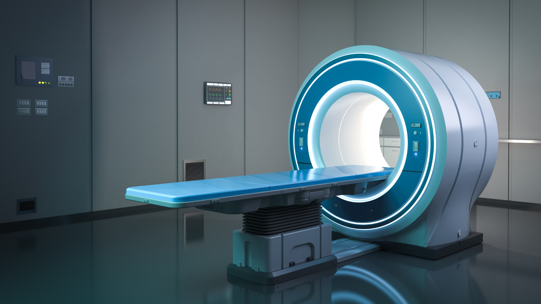
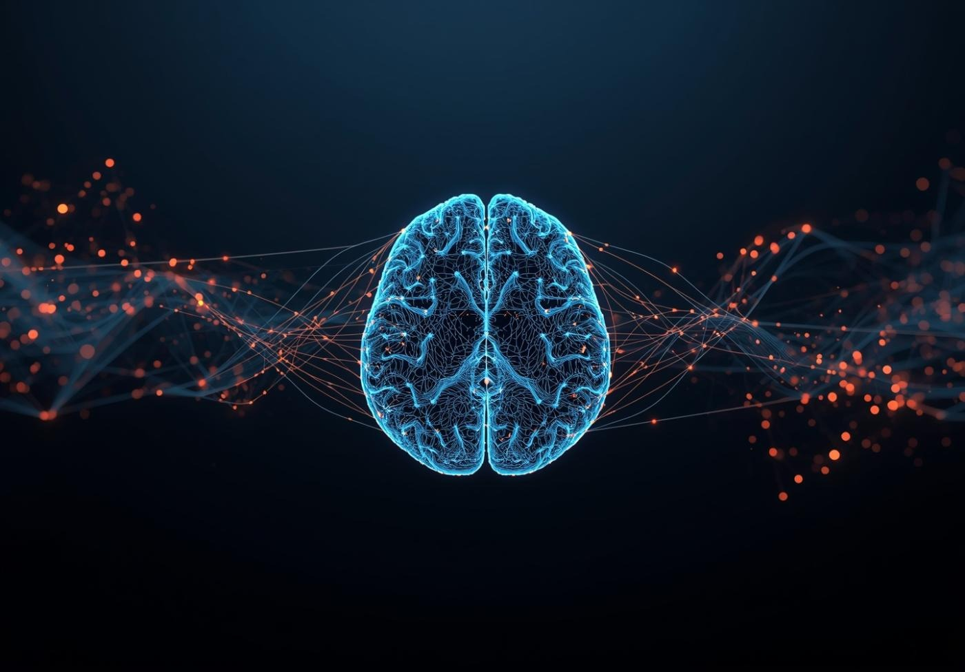
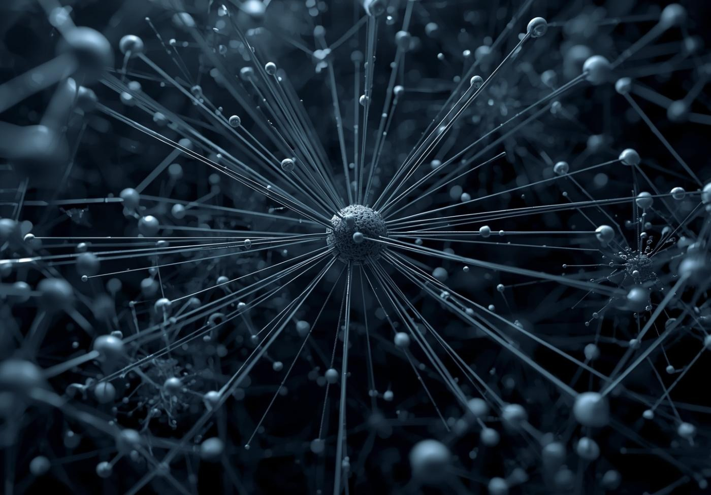
Problem statement
Full Given a brain MRI Image, classify it as tumor-positive or tumor-negative
INPUT The initial MRI scan data is collected.
MODEL AI algorithms analyze the scanned images.
OUTPUT The initial MRI scan data is collected.

Slide 4
DATA & augmentation
RandomVerticalFlip — mirrors the image top to bottom (30% chance)
Initial Dataset 253 total images — 155 tumor (yes), 98 no tumor (no).
Augmentation Methods Used:
RandomHorizontalFlip — mirrors the image left to right (50% chance)
RandomVerticalFlip — mirrors the image top to bottom (30% chance)
RandomRotation — rotates up to ±20 degrees
ColorJitter — varies brightness and contrast to simulate different MRI scanner settings
RandomResizedCrop — randomly zooms and crops between 75%–100% of the original
RandomGrayscale — converts to grayscale 5% of the time

Slide 5
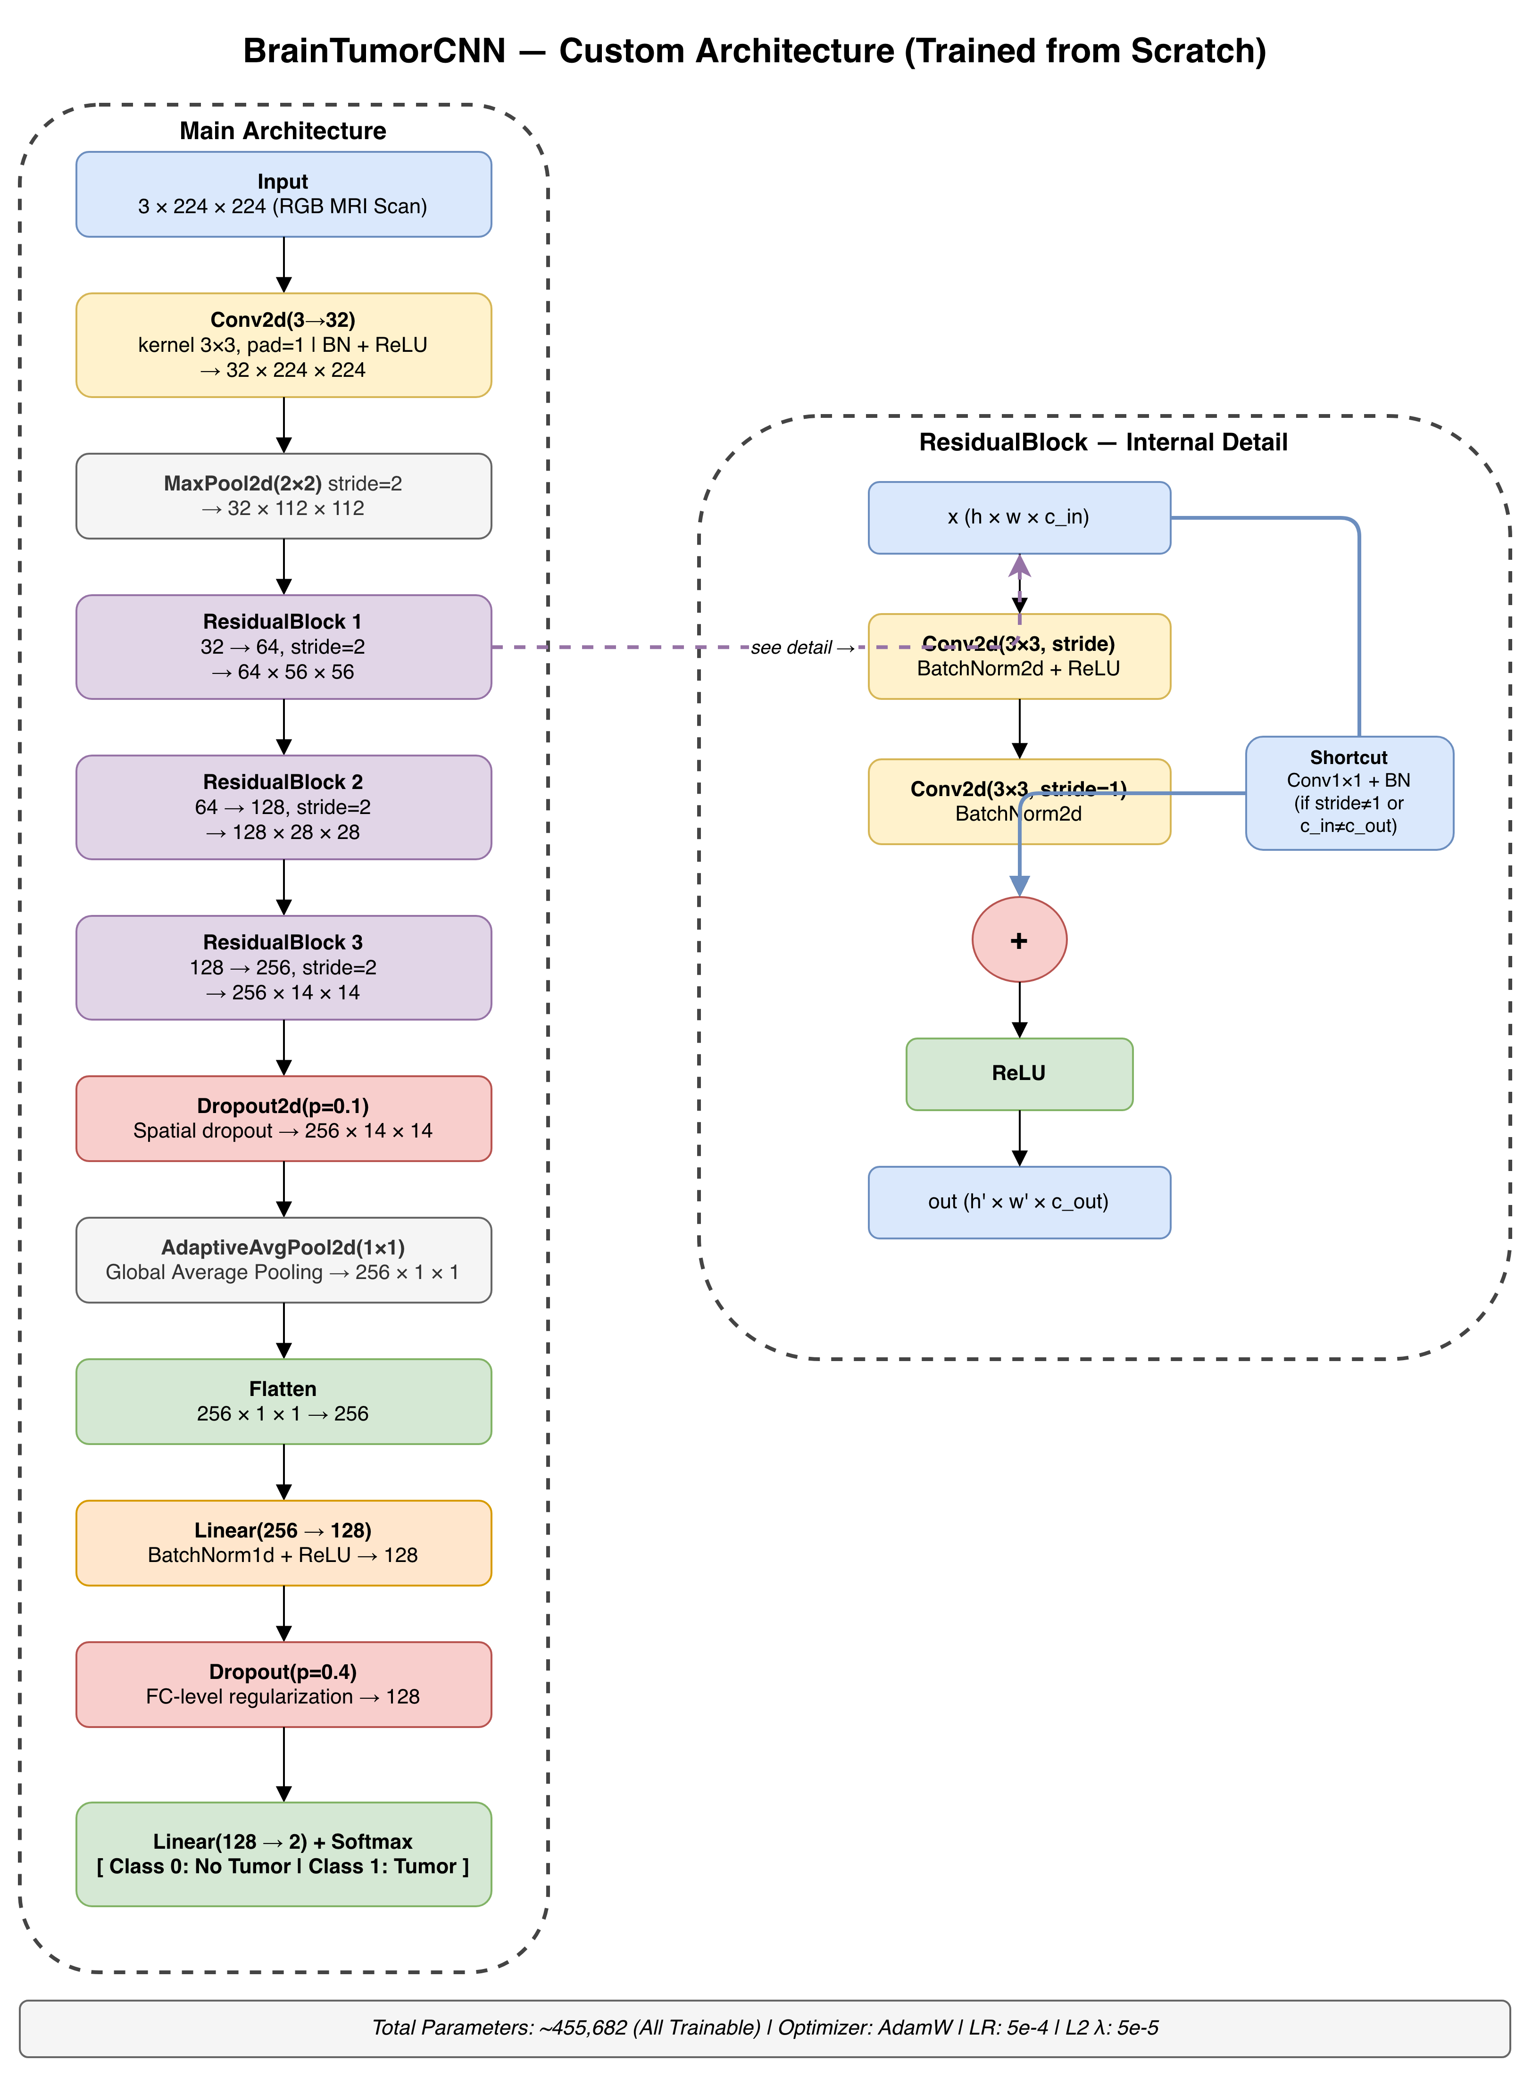
Training process & configuration
RandomVerticalFlip — mirrors the image top to bottom (30% chance)

Slide 6
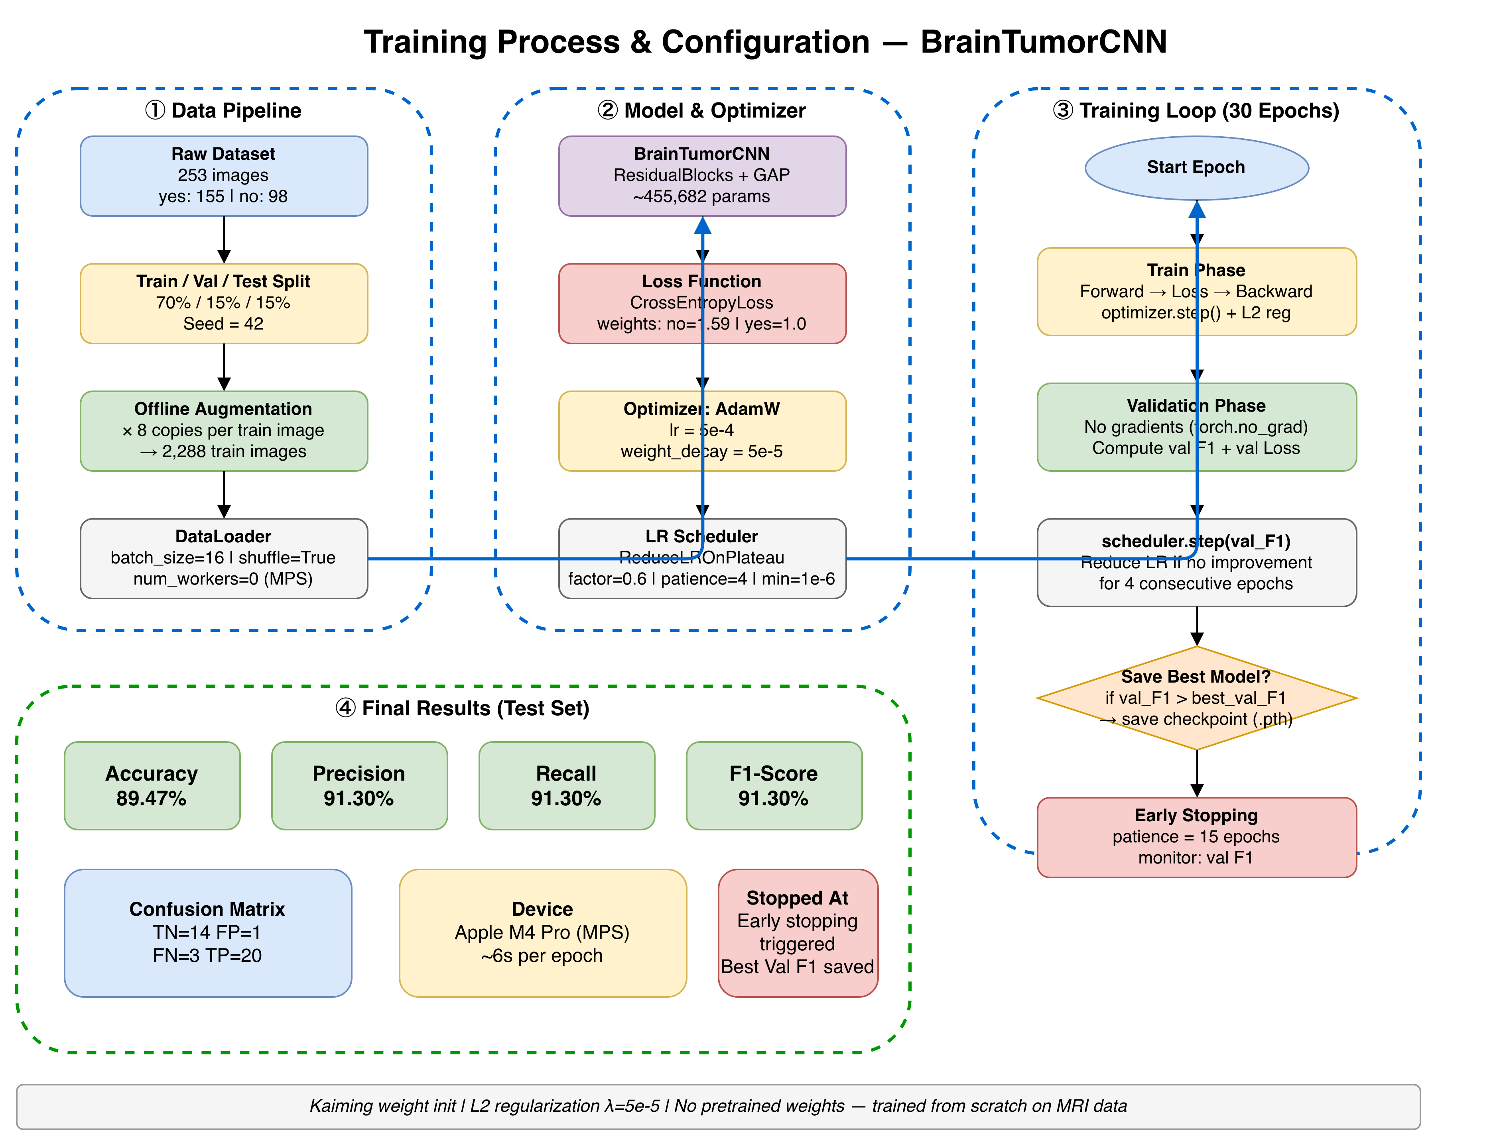
Training process & configuration
RandomVerticalFlip — mirrors the image top to bottom (30% chance)

Slide 7
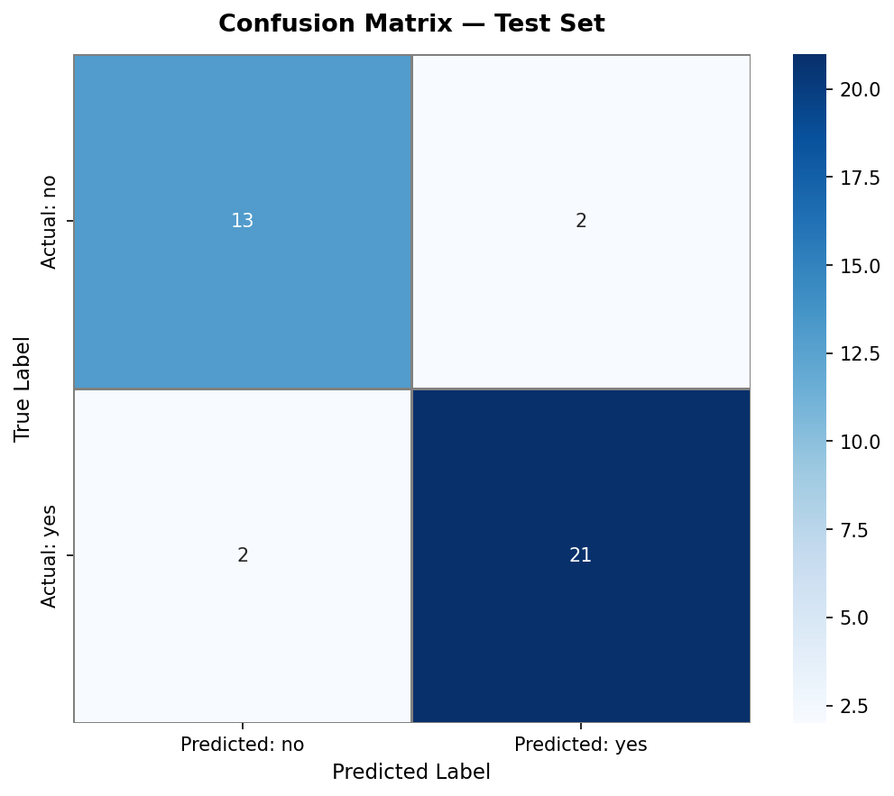
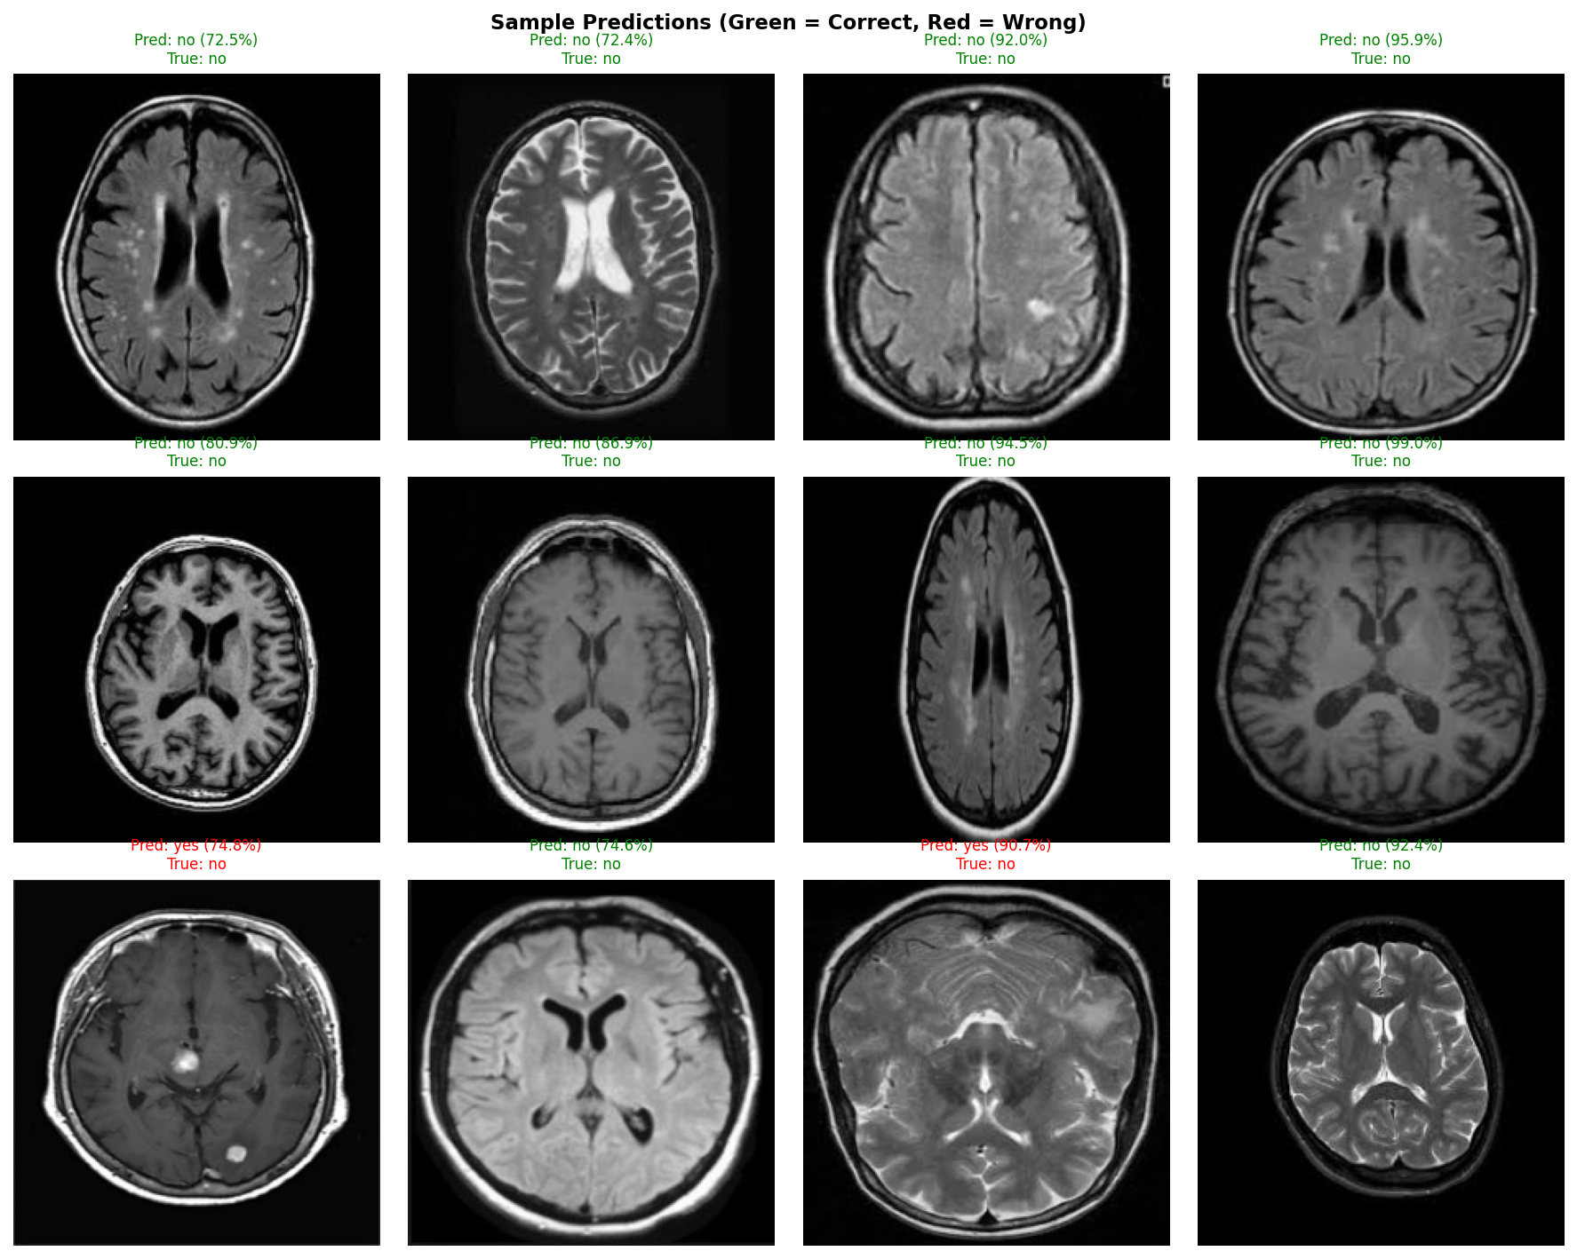
Results
RandomVerticalFlip — mirrors the image top to bottom (30% chance)

Slide 8
Challenges
RandomVerticalFlip — mirrors the image top to bottom (30% chance)
1. Small Dataset Only 253 original images — far too few for a CNN from scratch. Most medical imaging models use thousands.
2. Class Imbalance 155 tumor vs 98 no-tumor images — required class weights in the loss function to prevent the model from being biased toward the majority class.
3. Overfitting With so few images, the model memorized training data. Addressed with residual blocks, dropout (0.1 + 0.4), L2 regularization, and data augmentation.
4. Offline Augmentation Limitation Generating fixed augmented copies on disk caused the model to memorize those specific copies too — because the same images repeated every epoch.
5. Noisy Validation Accuracy With only 38 val/test images, each single wrong prediction = 2.63% accuracy swing, making metrics unstable across runs.
6. Training from Scratch No pretrained weights (e.g. ImageNet) allowed — every feature had to be learned purely from MRI data, which is much harder than fine-tuning a pretrained model.

Slide 9
Thank you

