Slide 1
Brain Tumor Classification Using Convolutional Neural Networks
Prepared by Usama Latif Virk

Slide 2
Table of Contents
Problem Statement & Motivation
Dataset Description
Data Preprocessing & Augmentation
Model Architecture
Training Configuration
Experimental Results
Conclusion & Future Work

Slide 3
Problem Statement & Motivation
Brain tumors are one of the most life-threatening neurological conditions worldwide
Manual MRI analysis by radiologists is time-consuming and prone to human error
Deep learning offers automated, fast, and consistent diagnosis support
Goal: Build a binary CNN classifier to detect the presence of brain tumors in MRI scans
Input: Brain MRI image (JPG, resized to 224×224, RGB)
Output: Class 0 = No Tumor | Class 1 = Tumor Detected
Approach: Custom CNN trained from scratch — no pretrained weights

Slide 4
Dataset Description
Source: Kaggle Brain MRI Images for Brain Tumor Detection
Total Images: 253
Class Distribution: Yes (Tumor) = 155 | No (Tumor) = 98
Class Imbalance: 1.58 : 1 ratio — addressed using class weights in loss function
Split: Train 70% / Validation 15% / Test 15% — fixed seed = 42 for reproducibility
After Augmentation: Train set expanded to 2,288 images (×8 offline augmentation)
All images converted to RGB and resized to 224×224 pixels

Slide 5
Data Preprocessing & Augmentation
Why Augmentation? Only 177 training images — insufficient for training a deep CNN from scratch
Method: Offline augmentation — 8 new copies generated per training image and saved to disk
Augmentation techniques applied to training set only:
RandomHorizontalFlip (p=0.5) — mirrors image left to right
RandomVerticalFlip (p=0.3) — mirrors image top to bottom
RandomRotation (±20°) — simulates different scan angles
ColorJitter (brightness=0.25, contrast=0.25) — simulates scanner variation
RandomResizedCrop (scale 75–100%) — random zoom and crop
RandomGrayscale (p=0.05) — rare grayscale simulation
Val/Test: No augmentation applied — Resize(224) + Normalize only
Normalization: ImageNet mean=[0.485,0.456,0.406], std=[0.229,0.224,0.225]

Slide 6
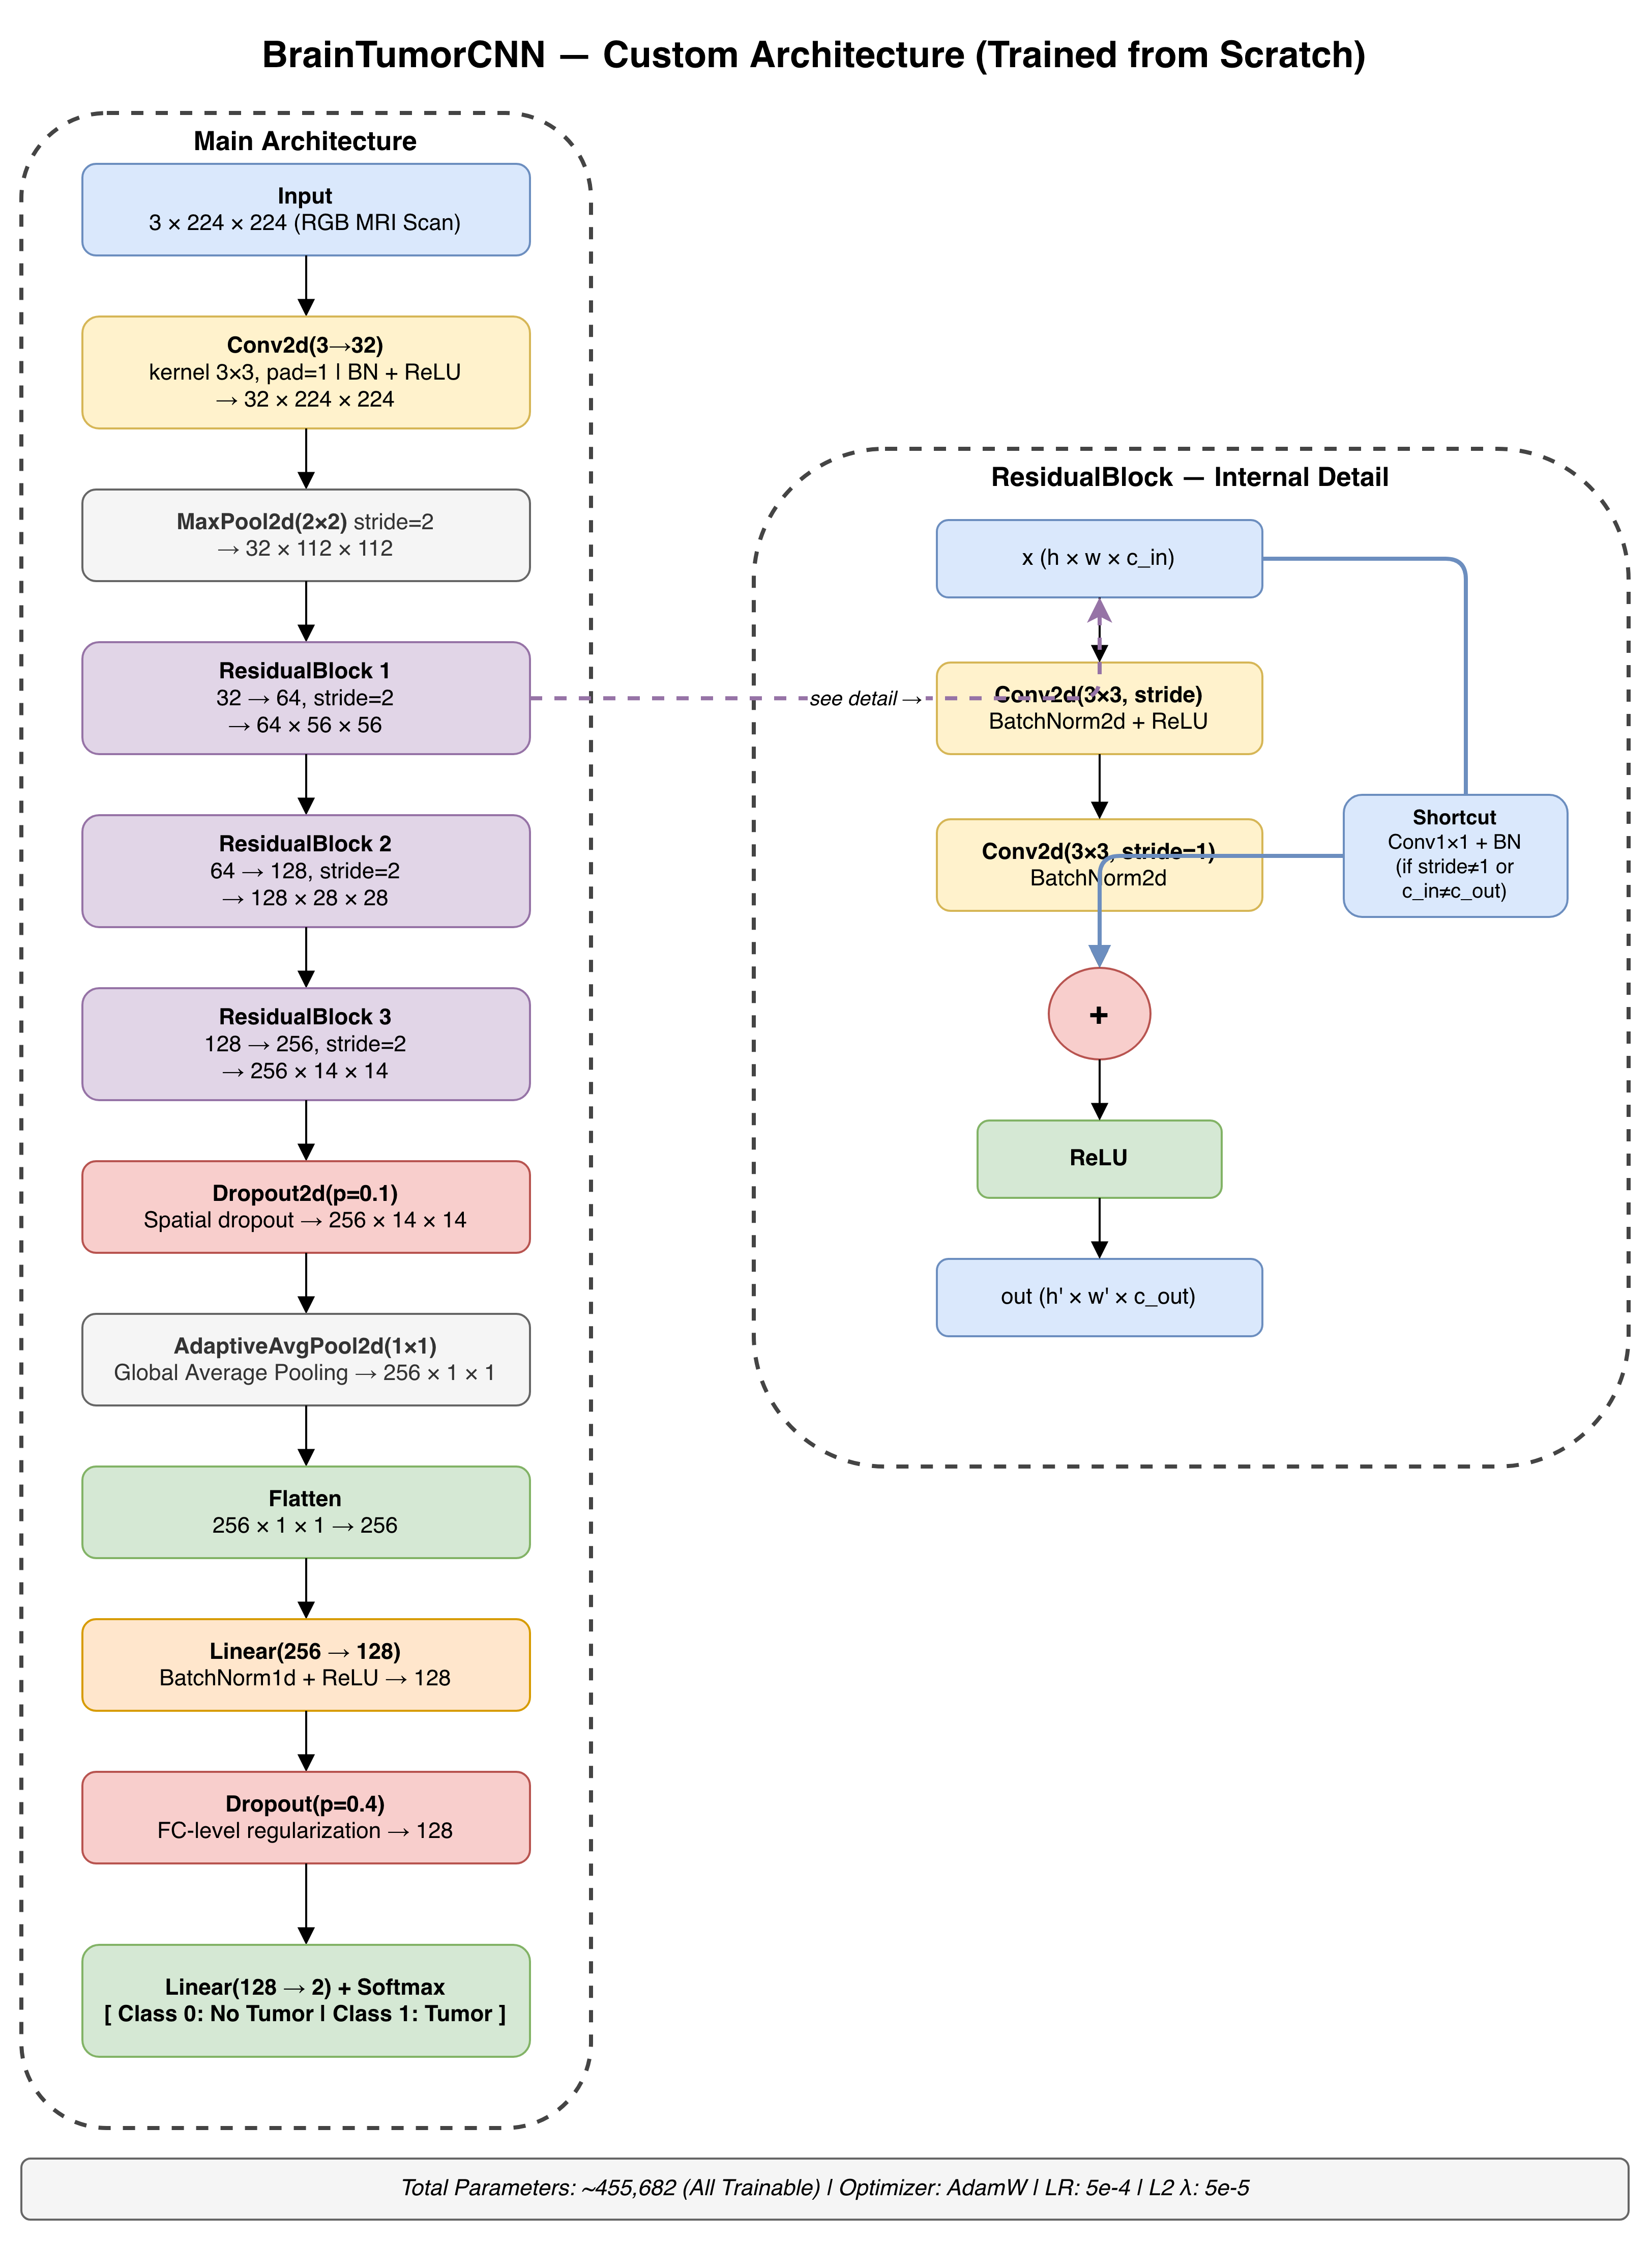
Model Architecture
Key design decisions:
Residual (skip) connections prevent vanishing gradients
Global Average Pooling reduces parameters vs Flatten
Two-level Dropout prevents overfitting
Kaiming weight initialization for stable training
Custom CNN: BrainTumorCNN — designed for small medical imaging datasets
Total parameters: ~455,682 (all trainable)
Layer-by-layer:
Input: 3×224×224
Conv2d(3→32, 3×3) + BatchNorm + ReLU → MaxPool → 32×112×112
ResidualBlock 1: 32→64, stride=2 → 64×56×56
ResidualBlock 2: 64→128, stride=2 → 128×28×28
ResidualBlock 3: 128→256, stride=2 → 256×14×14
Dropout2d(p=0.1) — spatial regularization
AdaptiveAvgPool2d(1×1) — Global Average Pooling → 256
Flatten → 256
Linear(256→128) + BatchNorm1d + ReLU
Dropout(p=0.4)
Linear(128→2) + Softmax → [No Tumor, Tumor]

Slide 7
Training Configuration
Parameter | Value
Optimizer | AdamW
Learning Rate | 5e-4
Weight Decay (L2) | 5e-5
Batch Size | 16
Epochs | 30
Loss Function | CrossEntropyLoss
Class Weights | No=1.59, Yes=1.0
LR Scheduler | ReduceLROnPlateau (factor=0.6, patience=4)
Early Stopping | Patience=15, monitor val F1
Device | Apple M4 Pro (MPS) ~6s/epoch
Best Model Saved By | Validation F1 Score

Slide 8
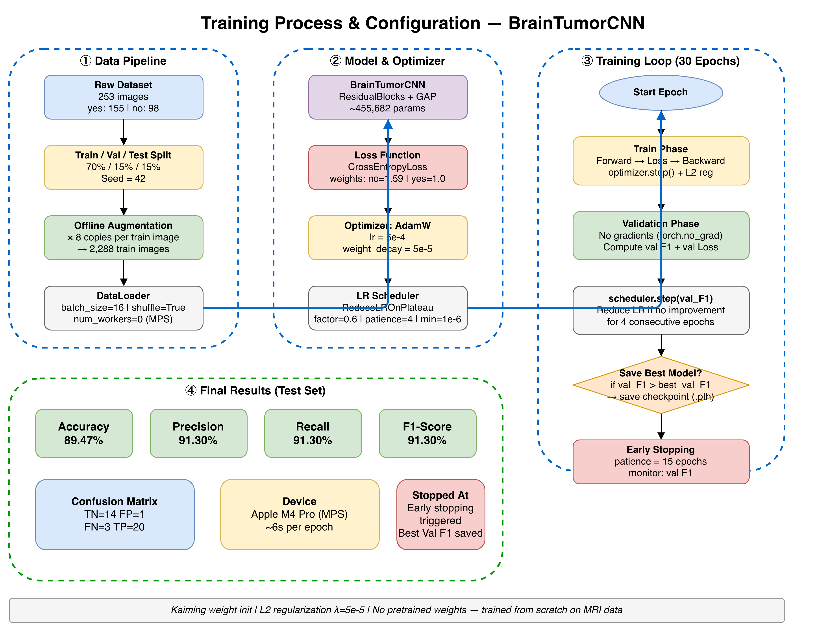
Training process & configuration
RandomVerticalFlip — mirrors the image top to bottom (30% chance)

Slide 9
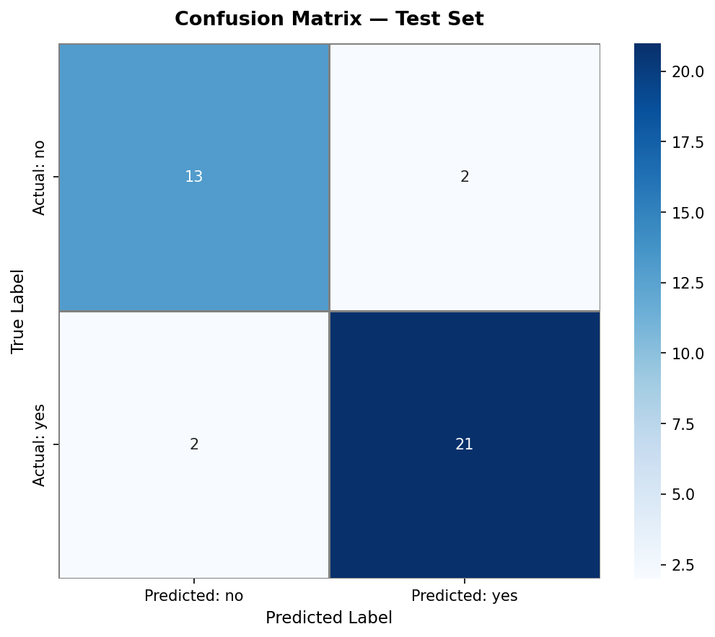
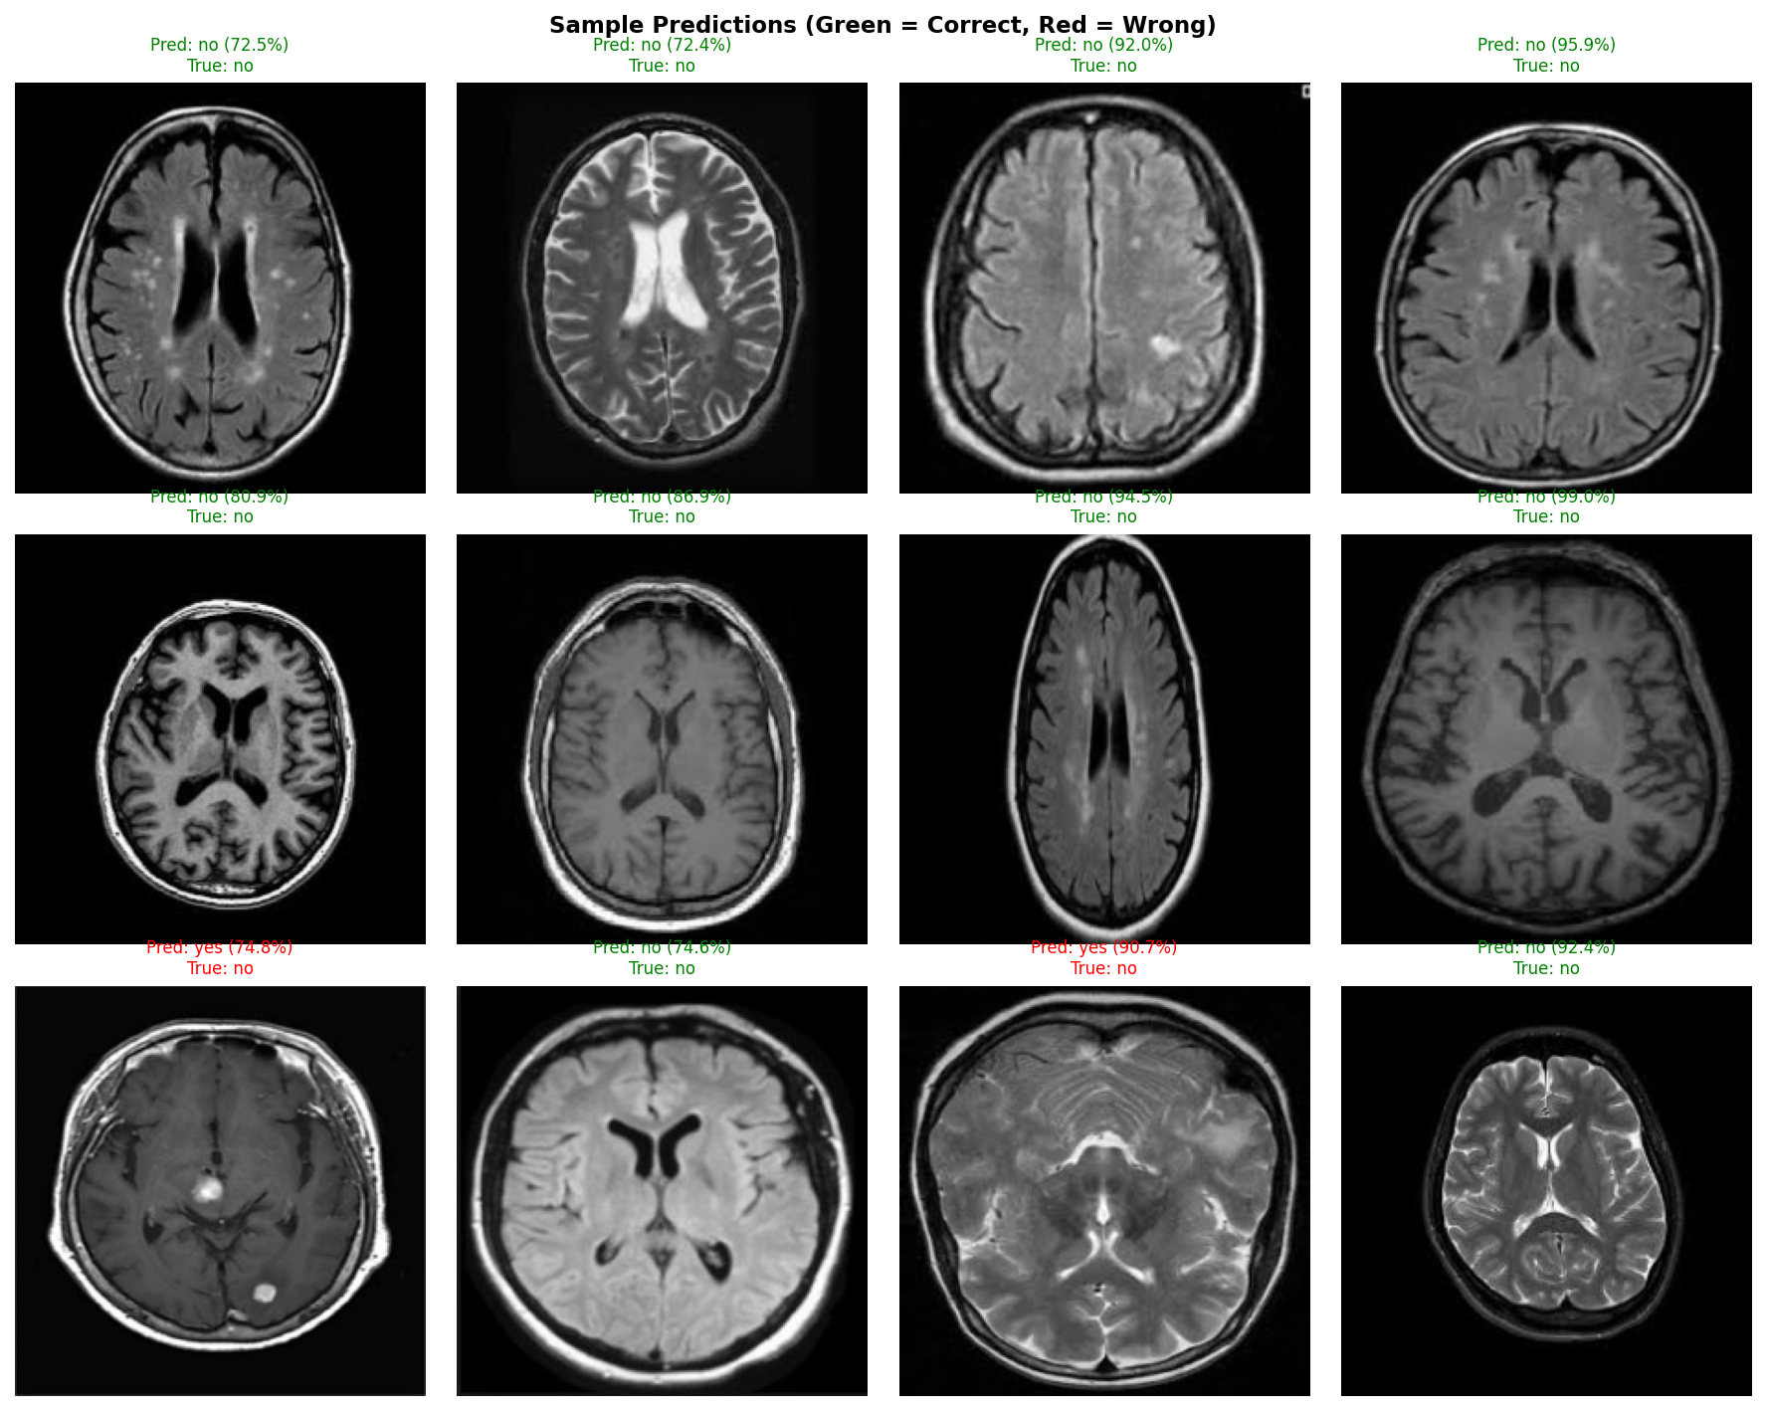
Experimental Results
Metric | Value
Test Accuracy | 89.47%
Precision (Yes Tumor) | 91.30%
Recall (Yes Tumor) | 91.30%
F1-Score (Yes Tumor) | 91.30%
Precision (No Tumor) | 86.67%
Recall (No Tumor) | 86.67%
Weighted F1 | 0.90
Confusion Matrix:
True Negative (TN) = 14 — correctly identified no tumor
False Positive (FP) = 1 — said tumor when there was none
False Negative (FN) = 3 — missed a real tumor
True Positive (TP) = 20 — correctly detected tumor

Slide 10
Conclusion & Future Work
Conclusion:
Successfully built a custom CNN from scratch achieving 89.47% test accuracy
Residual blocks and Global Average Pooling were critical to performance
Offline data augmentation expanded dataset from 253 to 2,364 images
Model demonstrates clinically useful recall of 91.30% for tumor detection
Future Work:
Apply transfer learning (ResNet-50, EfficientNet) with ImageNet pretrained weights
Collect more MRI data to reduce dependency on augmentation
Implement Grad-CAM visualization to show which regions the model focuses on
Extend to multi-class classification (glioma, meningioma, pituitary)
Deploy as a web application for real-time MRI screening

Slide 11
Thank you

