Slide 1

Retrieval-Augmented Generation (RAG) and Local AI Architecture
Integrating data retrieval with localized AI computing systems
Notes:
AI-generated content may be incorrect. ---

Slide 2
Foundations of RAG
Notes:
Understanding Retrieval-Augmented Generation, Core RAG Pipeline Components, Benefits of RAG in Enterprise Environments, Challenges and Limitations of RAG

Slide 3

Understanding Retrieval-Augmented Generation
RAG Enhances LLMs
RAG improves large language models by grounding answers in external data sources, reducing hallucinations.
Embedding and Retrieval Process
Documents and queries are converted into vector embeddings and matched in vector databases to find relevant data.
Applications in Enterprises
RAG is used in industries like healthcare, legal, and finance for accurate, real-time knowledge-based responses.
Notes:
Retrieval-Augmented Generation (RAG) is a hybrid AI architecture that enhances large language models (LLMs) by grounding their responses in external knowledge sources. Traditional LLMs rely solely on their training data, which leads to hallucinations when answering questions outside their knowledge scope. RAG addresses this limitation by dynamically retrieving relevant data from external sources such as enterprise documents, databases, or knowledge repositories. The process begins by converting documents into vector embeddings using models like BGE Large or MiniLM. These embeddings are stored in vector databases such as FAISS or ChromaDB. When a user query is submitted, it is also embedded and compared against stored vectors to retrieve the most relevant chunks. These retrieved chunks are then passed to the LLM as contextual input, allowing it to generate accurate and grounded responses. For example, in a corporate compliance system, instead of relying on outdated model knowledge, RAG retrieves the latest policy documents before generating answers. Companies like Microsoft and OpenAI have integrated RAG into enterprise solutions to improve reliability in knowledge-intensive domains. The approach is especially valuable for industries like healthcare, legal, and finance, where accuracy is critical. By combining retrieval with generation, RAG creates a powerful system that reduces hallucinations, improves factual correctness, and enables real-time knowledge integration without retraining models.

Slide 4
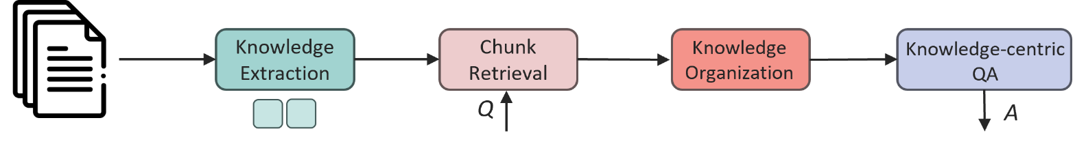
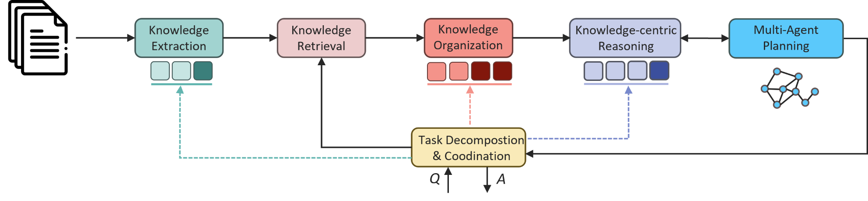

Slide 5
Building a RAG system
Question : What did Paul Graham do after RICS?
Router
Retrieve (multiple)
Summarize
Answer
Data store (index)
Vector index
Retrieve
Answer
Summary tree

Slide 6
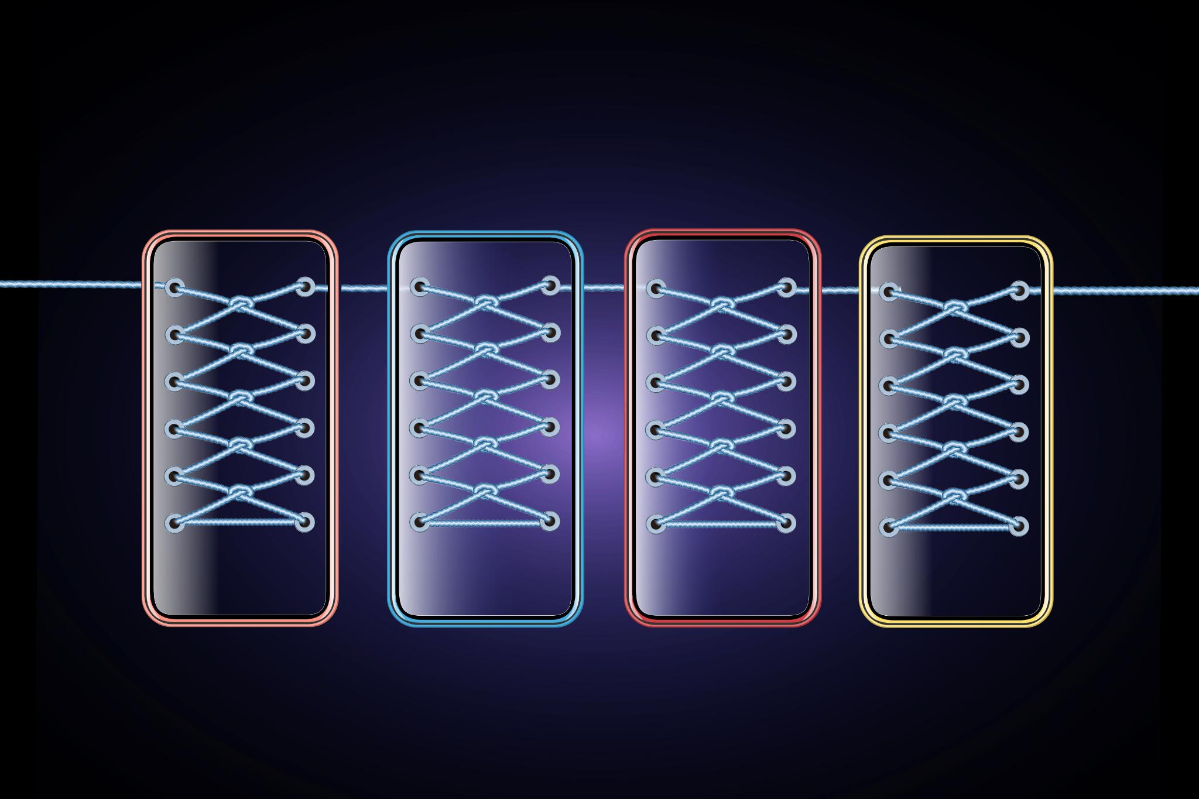
Core RAG Pipeline Components
Document Ingestion and Embeddings
Collecting and preprocessing data from sources, then converting text into numerical embeddings for analysis.
Vector Database Storage
Storing embeddings efficiently using vector databases enabling quick similarity searches across data.
Retrieval Layer Algorithms
Using similarity search and hybrid methods to find the most relevant data chunks quickly and accurately.
Generation with Large Language Models
Generating context-aware responses using LLMs based on the retrieved relevant information.
Notes:
The RAG pipeline consists of four essential components that work together to deliver accurate and context-aware responses. First, document ingestion involves collecting and preprocessing data from sources such as PDFs, databases, and APIs. These documents are then converted into embeddings using models like E5 Large or GTE Large, transforming textual information into numerical vectors. The second component is the vector database, which stores embeddings and allows efficient similarity search. Tools like Qdrant, Milvus, and ChromaDB are commonly used in enterprise deployments. Third, the retrieval layer searches for the most relevant chunks using algorithms such as cosine similarity or approximate nearest neighbor search. Hybrid retrieval methods combine vector search with keyword-based techniques to improve accuracy. Finally, the generation component uses an LLM, such as Qwen or LLaMA, to produce responses based on retrieved context. For example, a customer support chatbot may retrieve troubleshooting guides from internal documentation before generating a response. This pipeline ensures that outputs are both contextually relevant and grounded in authoritative data. The effectiveness of each component directly impacts overall system performance, making optimization critical. Techniques like chunking strategies, embedding selection, and retrieval tuning play a significant role in achieving high-quality results. Enterprises often customize each stage to meet specific requirements, ensuring scalability, performance, and compliance with data privacy regulations.

Slide 7
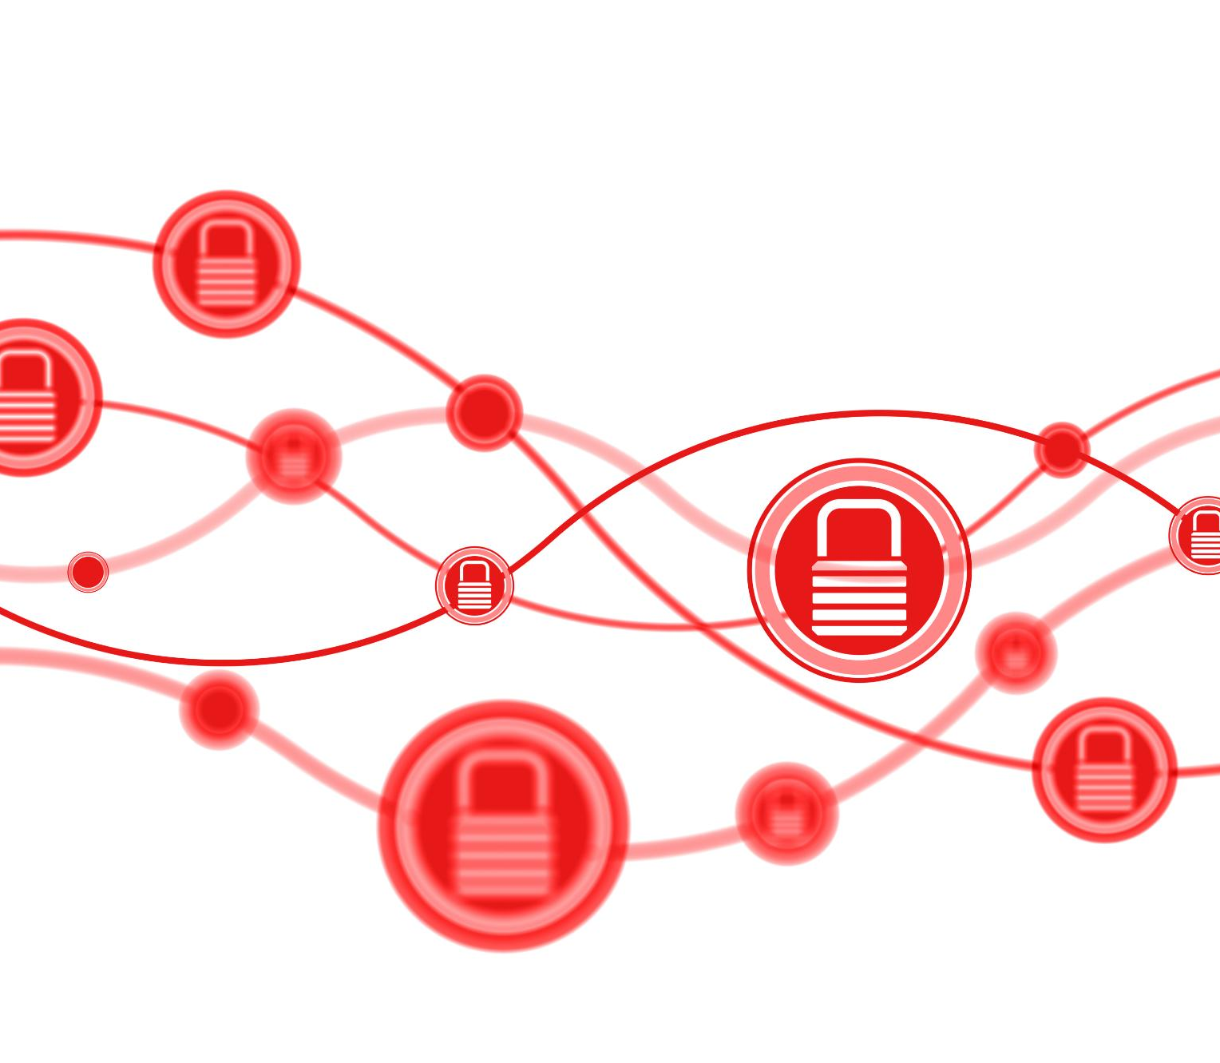
Benefits of RAG in Enterprise Environments
Reduced Hallucinations
RAG reduces hallucinations by retrieving real data, ensuring accuracy in sensitive sectors like finance and law.
Real-Time Knowledge Updates
RAG allows immediate access to updated information without retraining, enabling dynamic enterprise support.
Data Privacy and Compliance
On-premise RAG deployments ensure sensitive data remains secure within organizational infrastructure.
Cost Efficiency and Personalization
RAG reduces retraining costs and supports personalized responses using user-specific data.
Notes:
RAG provides significant advantages for enterprise AI deployments, particularly in environments requiring high accuracy, data privacy, and scalability. One key benefit is the reduction of hallucinations, as the system retrieves real data rather than relying solely on pre-trained knowledge. This is crucial in industries like finance and legal services, where incorrect information can have serious consequences. Another advantage is real-time knowledge updates. Unlike fine-tuned models, which require retraining to incorporate new data, RAG systems can immediately access updated information from connected sources. For example, a telecom company can update its support knowledge base without retraining its chatbot. Additionally, RAG supports data privacy and compliance by enabling on-premise deployments. Organizations in regions like the UAE or UK can keep sensitive data within their infrastructure, avoiding cloud-based risks. Cost efficiency is another benefit, as RAG reduces the need for expensive model retraining. Instead, improvements can be made by optimizing retrieval strategies or updating data sources. Furthermore, RAG enables personalization by tailoring responses based on user-specific data. For instance, a banking assistant can retrieve customer-specific financial records to provide contextual advice. These advantages make RAG a preferred solution for enterprise AI, offering a balance between flexibility, accuracy, and security while supporting diverse use cases across industries.

Slide 8

Challenges and Limitations of RAG
Retrieval Accuracy Challenges
Retrieving irrelevant or low-quality data leads to incorrect responses, mitigated by re-ranking and hybrid search.
Latency and Performance
Additional computation in retrieval causes latency; optimized vector databases and inference engines reduce delays.
Data Preprocessing and Chunking
Proper document structuring and chunking are critical to maintain context and retrieval precision in RAG.
Security and System Complexity
Security concerns and system complexity increase with multi-tenant setups and advanced RAG techniques.
Notes:
Despite its advantages, RAG introduces several challenges that must be addressed to ensure reliable performance. One major limitation is retrieval accuracy. If the system retrieves irrelevant or low-quality data, the generated response may still be incorrect. This issue is often mitigated through re-ranking techniques and hybrid search methods. Another challenge is latency, as the retrieval process adds additional computation compared to standard LLM inference. High-performance vector databases like Qdrant and optimized inference engines such as vLLM can help reduce delays. Data preprocessing is also critical; poorly structured documents can lead to ineffective embeddings and retrieval errors. Additionally, RAG systems require careful chunking strategies. For example, splitting documents into overly small chunks may lose context, while large chunks may reduce retrieval precision. Security and access control present another concern, particularly in multi-tenant environments. Enterprises must ensure that sensitive data is only accessible to authorized users. Furthermore, system complexity increases with advanced RAG techniques such as agentic workflows or graph-based retrieval. Maintaining and debugging these systems requires specialized expertise. Finally, evaluation remains a challenge, as measuring the quality of generated responses involves both retrieval accuracy and generation performance. Tools like Ragas and DeepEval are often used to assess system effectiveness. Addressing these challenges is essential for building robust and scalable RAG solutions that meet enterprise requirements.

Slide 9
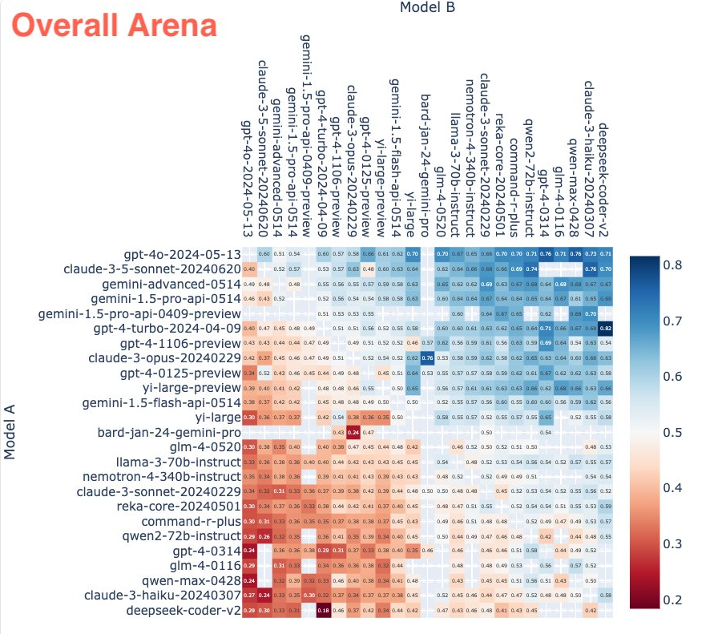
Which model should I use?
Source: https://lmsys.org/

Slide 10
Model choice matters in the real world
ADVANCE PROJECT
ADVANCE PROJECT
Monitoring
Capacity and cost trade offs
Security and data privacy
Deploy LLM App/UI
Model selection
Content Filtering
Techniques - Prompt Engineering, RAG, Fine-tuning
Establish feasibility
Define use cases
Pick a flagship model
Build prototypes
Can AI solve my use case?
What is the best model for my use case?
Can I scale for real-world workloads?
REVERT PROJECT
REVERT PROJECT
Prototype
Optimize
Operationalize

Slide 11
Types of RAG Architectures
Notes:
Basic and Advanced RAG, RAG Fusion and Multi-Query Retrieval, Graph-Based RAG for Complex Data, Agentic and Memory-Driven RAG

Slide 12
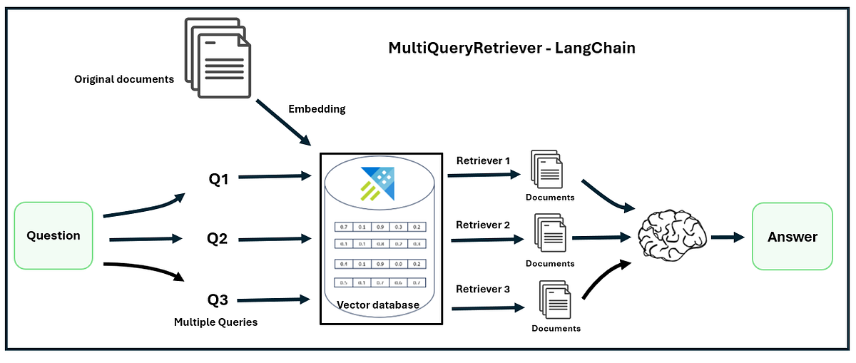
RAG Fusion and Multi-Query Retrieval
Multiple Query Generation
RAG Fusion generates multiple semantically related queries to capture diverse relevant information beyond single query limits.
Merged and Refined Results
The system merges and refines results from various queries to produce a comprehensive and accurate answer.
Applications and Challenges
RAG Fusion enhances retrieval in complex, multilingual domains but requires optimizations to manage computational overhead.
Notes:
RAG Fusion is an advanced retrieval technique designed to improve recall by generating multiple variations of a user query and combining the results. Instead of relying on a single query, the system creates multiple semantically related queries, each retrieving its own set of relevant documents. These results are then merged and refined to produce a comprehensive answer. This approach addresses the limitations of traditional RAG, where a single query may fail to capture all relevant information. For example, a legal research assistant might generate queries using synonyms or different phrasing to ensure comprehensive coverage of case law. Multi-query retrieval is particularly effective in domains with complex or ambiguous language. It also improves performance in multilingual environments by generating queries in multiple languages. However, RAG Fusion introduces additional computational overhead, as multiple retrieval operations are required. Optimizations such as parallel processing and efficient vector indexing can mitigate this challenge. This technique is widely used in research and enterprise applications where completeness is critical. By combining multiple perspectives, RAG Fusion enhances the depth and breadth of retrieved information, resulting in more accurate and informative responses.

Slide 13
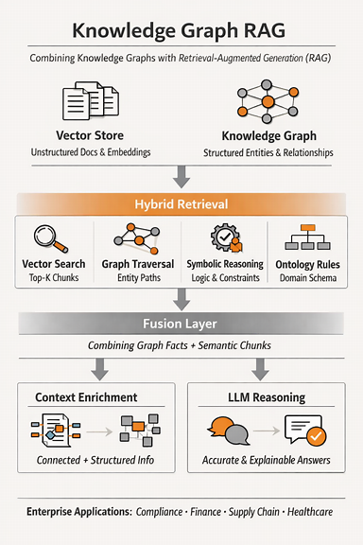
Graph-Based RAG for Complex Data
Knowledge Graph Modeling
Graph RAG uses knowledge graphs to represent entities and their structured relationships, enabling deeper reasoning.
Graph Traversal for Queries
Queries traverse the graph to identify relevant paths, delivering context-rich and accurate responses.
Application in Complex Domains
Graph RAG is effective in complex sectors like healthcare, compliance, and telecommunications requiring relationship understanding.
Challenges and Benefits
Building graphs demands data extraction and entity mapping; however, it enables multi-hop reasoning and improved accuracy.
Notes:
Graph RAG represents a sophisticated evolution of retrieval-augmented generation, leveraging knowledge graphs to model relationships between entities. Unlike traditional vector-based approaches, which focus on semantic similarity, graph-based retrieval captures structured relationships, enabling deeper reasoning. In this approach, documents are transformed into nodes and edges, representing entities and their connections. For example, in a financial system, a graph may link companies, transactions, and regulatory requirements. When a query is submitted, the system traverses the graph to identify relevant paths and relationships, providing context-rich responses. Companies like Microsoft have explored Graph RAG for enterprise applications involving complex datasets. This approach is particularly effective in domains such as healthcare, compliance, and telecommunications, where understanding relationships is critical. However, building and maintaining knowledge graphs requires significant effort, including data extraction, entity recognition, and relationship mapping. Graph RAG also introduces computational complexity, as graph traversal can be resource-intensive. Despite these challenges, the approach offers unparalleled accuracy for complex queries, enabling multi-hop reasoning and contextual understanding that traditional RAG cannot achieve.

Slide 14
KG‑RAG vs Standard RAG (Infographic Table)
Feature | Standard RAG | KG‑Enhanced RAG
Semantic Search | Yes | Yes
Structured Reasoning | No | Yes
Explainability | Low | High
Multi‑Hop Logic | Weak | Strong
Entity Linking | No | Yes
Best For | General Q&A | Enterprise, compliance, finance, supply chain

Slide 15
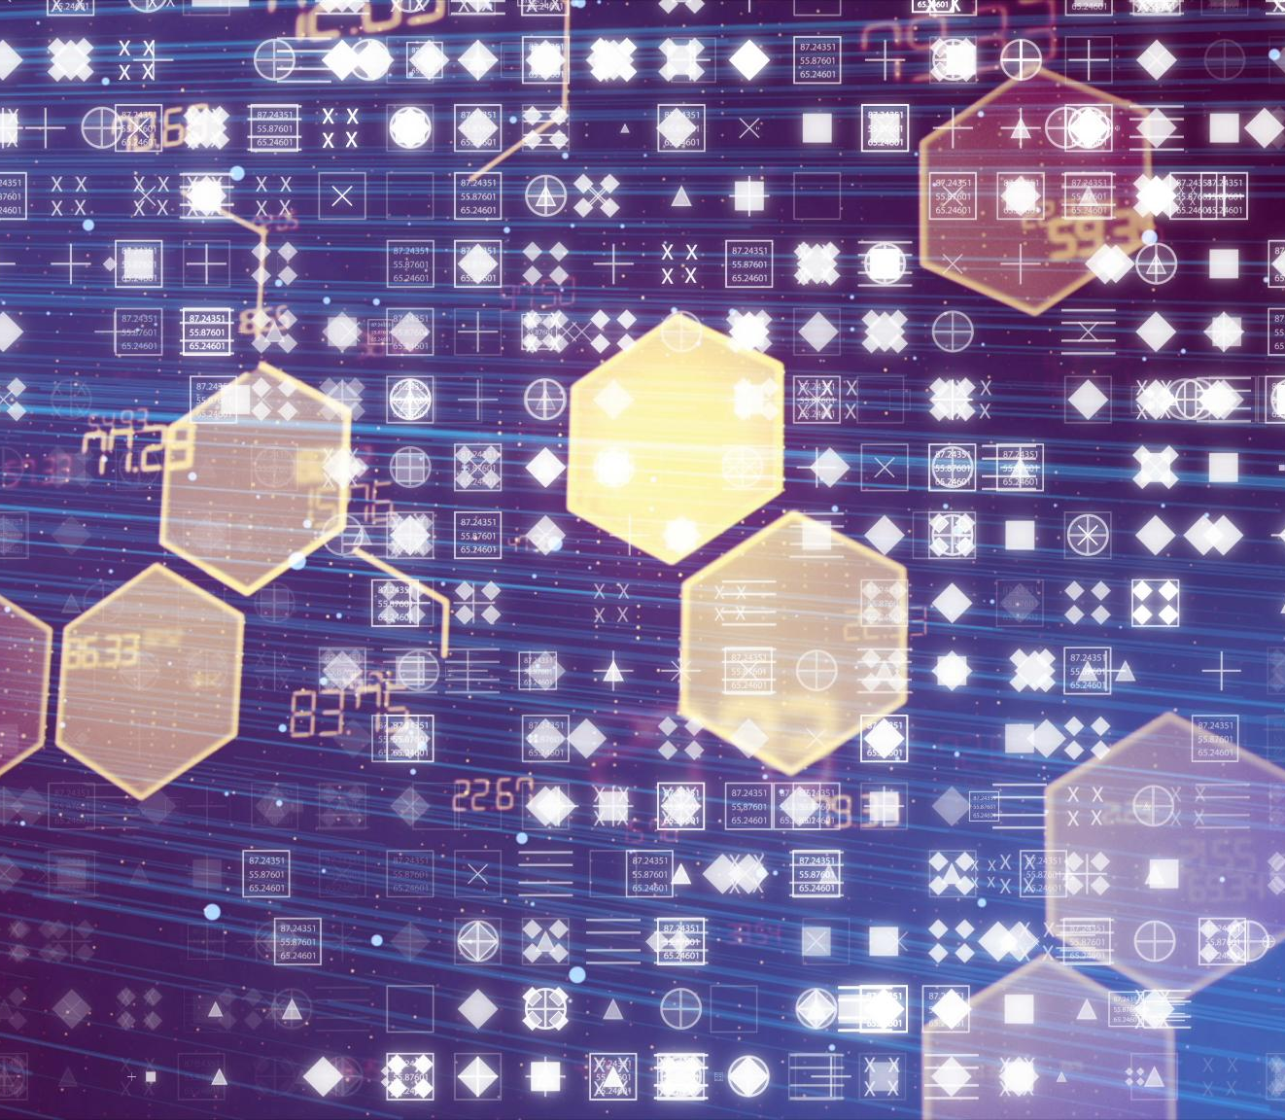
Agentic and Memory-Driven RAG
Agentic RAG Architecture
Agentic RAG enables autonomous AI agents to dynamically handle queries and workflows with multi-step reasoning.
Memory-Driven RAG
Memory RAG stores past interactions to maintain context and provide personalized, context-aware responses.
Combined Adaptive Systems
Integrating agentic and memory-driven RAG creates highly adaptive AI systems for complex and personalized tasks.
Notes:
Agentic RAG introduces autonomous decision-making capabilities into the retrieval process. In this architecture, an AI agent determines how to handle queries, including rewriting them, selecting retrieval strategies, and invoking tools. For example, an enterprise assistant may decide to query a database, retrieve documents, and perform calculations before generating a response. This approach enables multi-step reasoning and dynamic workflows, making it ideal for complex enterprise tasks. Memory RAG, on the other hand, focuses on storing and utilizing past interactions to provide personalized responses. It allows systems to maintain context across sessions, improving user experience. For instance, a customer service chatbot can remember previous interactions and provide tailored support. Combining agentic and memory-driven approaches creates highly adaptive systems capable of handling diverse scenarios. However, these architectures require careful design to manage complexity and ensure reliability. Tools like LangGraph are often used to implement agentic workflows, while vector databases store memory embeddings. These advanced RAG techniques represent the future of AI systems, enabling more intelligent, context-aware, and personalized interactions.

Slide 16
Alternatives to RAG
Notes:
Fine-Tuning Large Language Models, Knowledge Graphs as an Alternative, Hybrid Approaches Combining RAG and Fine-Tuning, SQL and Database-Driven AI Systems

Slide 17
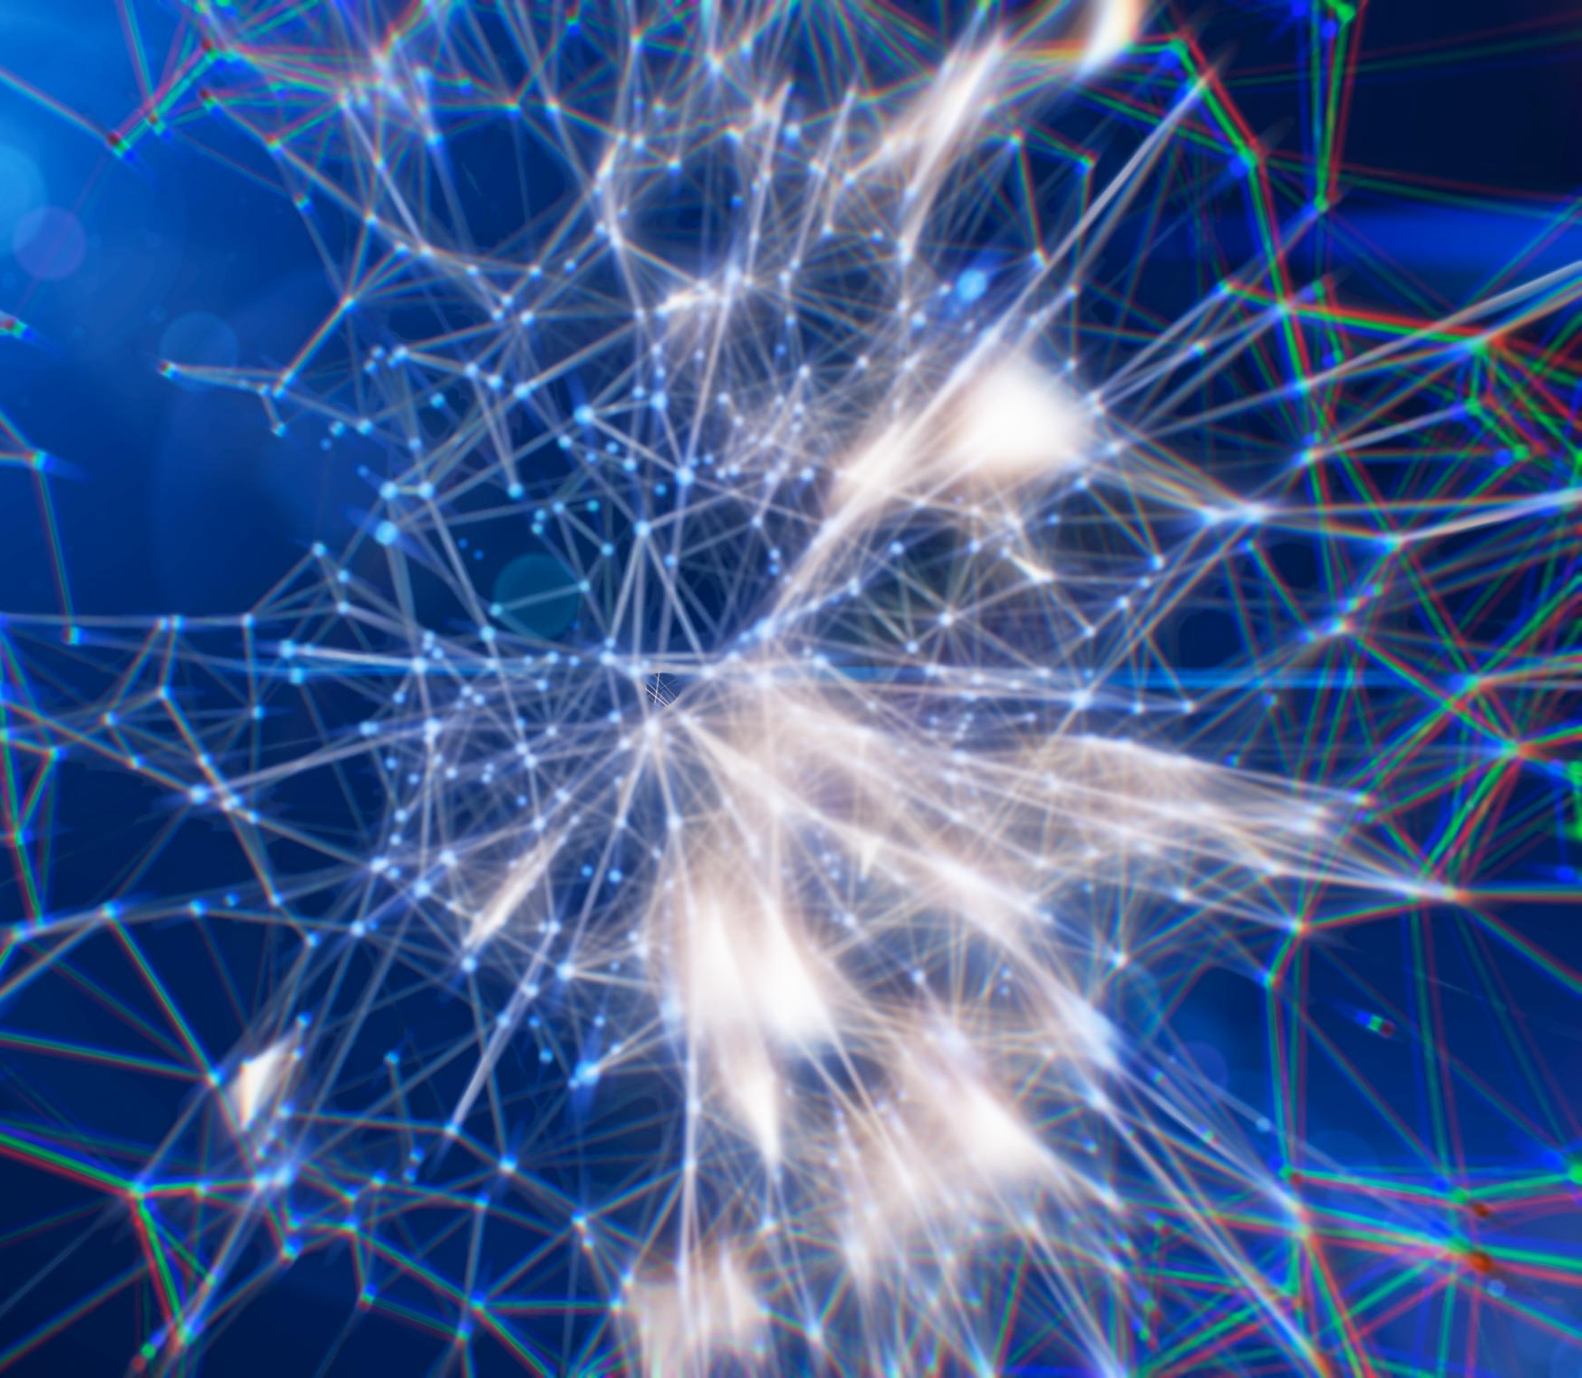
Fine-Tuning Large Language Models
Purpose of Fine-Tuning
Fine-tuning adapts pre-trained models to specific tasks using domain-specific data for improved accuracy.
Strengths of Fine-Tuning
Effective for structured tasks requiring consistent output style and specialized knowledge in specific domains.
Limitations and Challenges
Requires large labeled datasets and computational resources; updating needs costly retraining and lacks real-time data access.
Combining Fine-Tuning and RAG
Organizations combine fine-tuning with RAG to balance domain expertise and dynamic factual accuracy.
Notes:
Fine-tuning involves training a pre-existing language model on domain-specific data to improve its performance for particular tasks. Unlike RAG, which retrieves external information dynamically, fine-tuned models rely on internalized knowledge learned during training. This approach is particularly effective for structured tasks such as classification, sentiment analysis, or domain-specific language generation. For example, a healthcare organization may fine-tune a model on medical records to improve diagnostic recommendations. However, fine-tuning has limitations, including the need for large labeled datasets and significant computational resources. Additionally, updating knowledge requires retraining the model, which can be costly and time-consuming. Fine-tuning also struggles with dynamic information, as it cannot access real-time data. Despite these challenges, it remains a powerful technique for tasks requiring consistent output style or specialized knowledge. Many organizations use fine-tuning in combination with RAG to achieve the best of both worlds, leveraging RAG for factual accuracy and fine-tuning for domain-specific behavior.

Slide 18
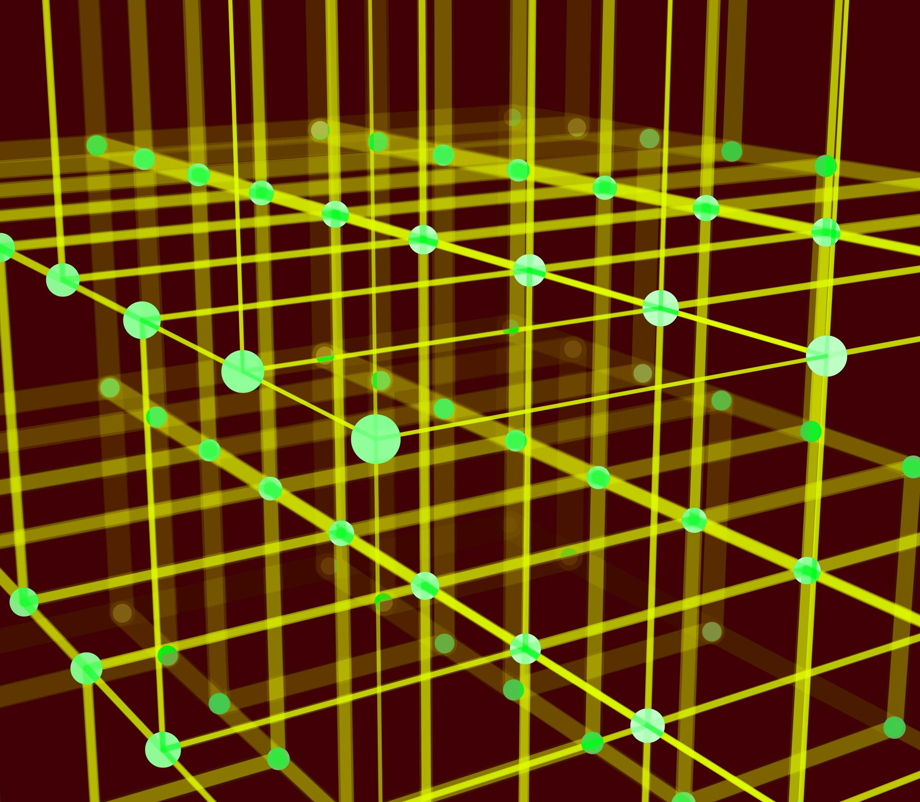
Knowledge Graphs as an Alternative
Structured Information Representation
Knowledge graphs organize data with explicit relationships, enabling precise and explainable reasoning.
Domain Suitability
They are ideal for finance, compliance, and telecom domains where explicit dependencies enhance troubleshooting.
Challenges and Limitations
Building and maintaining knowledge graphs requires data curation and ontology design, and they lack flexibility with unstructured data.
High Accuracy and Explainability
Explicitly defined relationships ensure knowledge graphs offer reliable and interpretable results for structured reasoning.
Notes:
Knowledge graphs provide a structured approach to representing information, capturing relationships between entities in a way that enables precise reasoning. Unlike RAG, which relies on unstructured text retrieval, knowledge graphs focus on explicit relationships. This makes them particularly suitable for domains such as finance, compliance, and telecommunications. For example, a telecom company may use a knowledge graph to map network components and dependencies, enabling efficient troubleshooting. Knowledge graphs offer high accuracy and explainability, as relationships are explicitly defined. However, building and maintaining them requires significant effort, including data curation and ontology design. They also lack the flexibility of RAG when dealing with unstructured data. Despite these limitations, knowledge graphs remain a valuable alternative for applications requiring structured reasoning and high reliability.

Slide 19
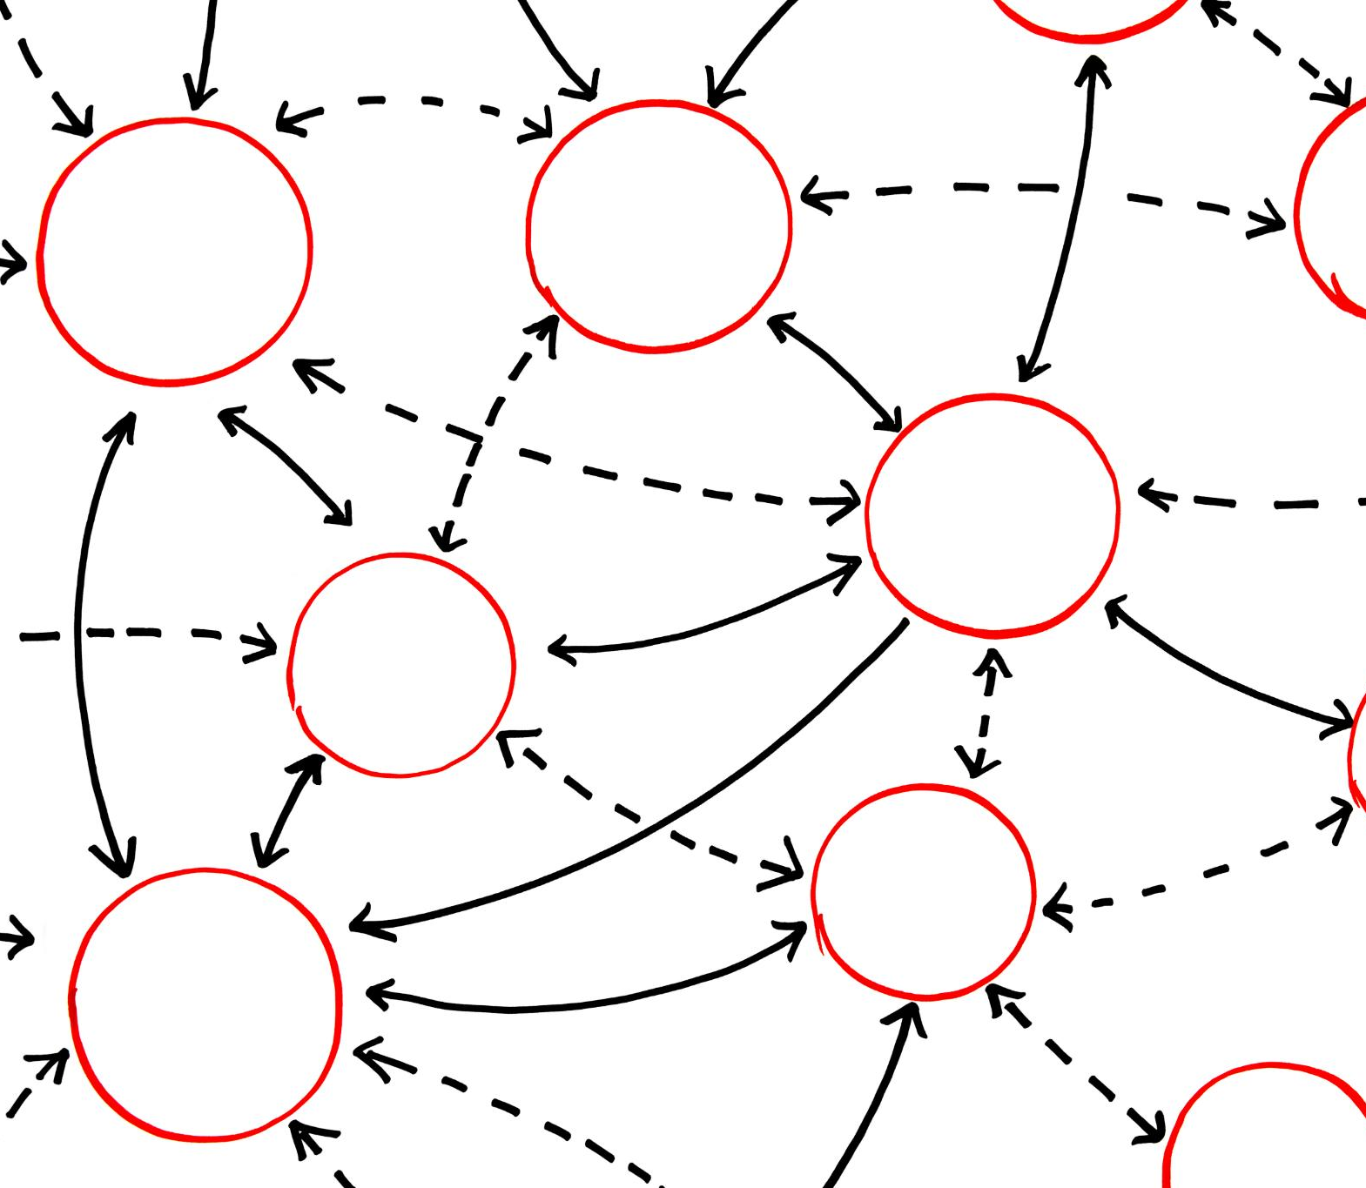
Hybrid Approaches Combining RAG and Fine-Tuning
Leveraging Strengths of RAG and Fine-Tuning
Hybrid methods combine RAG's real-time knowledge access with fine-tuning’s consistent style and domain behavior for better results.
Practical Application Example
Financial advisory systems use RAG for current market data and fine-tuned models for professional, domain-specific responses.
Implementation Challenges
Hybrid systems require careful integration to balance retrieval speed, accuracy, and model training costs efficiently.
Notes:
Hybrid approaches combine RAG with fine-tuning to leverage the strengths of both methods. In this setup, RAG provides real-time access to external knowledge, while fine-tuning ensures consistent style and domain-specific behavior. For example, a financial advisory system may use RAG to retrieve up-to-date market data while relying on a fine-tuned model to generate responses in a professional tone. This approach addresses the limitations of each method individually, offering improved accuracy and flexibility. However, implementing hybrid systems requires careful integration and optimization. Organizations must balance retrieval performance with model training costs, ensuring that both components work seamlessly together.

Slide 20
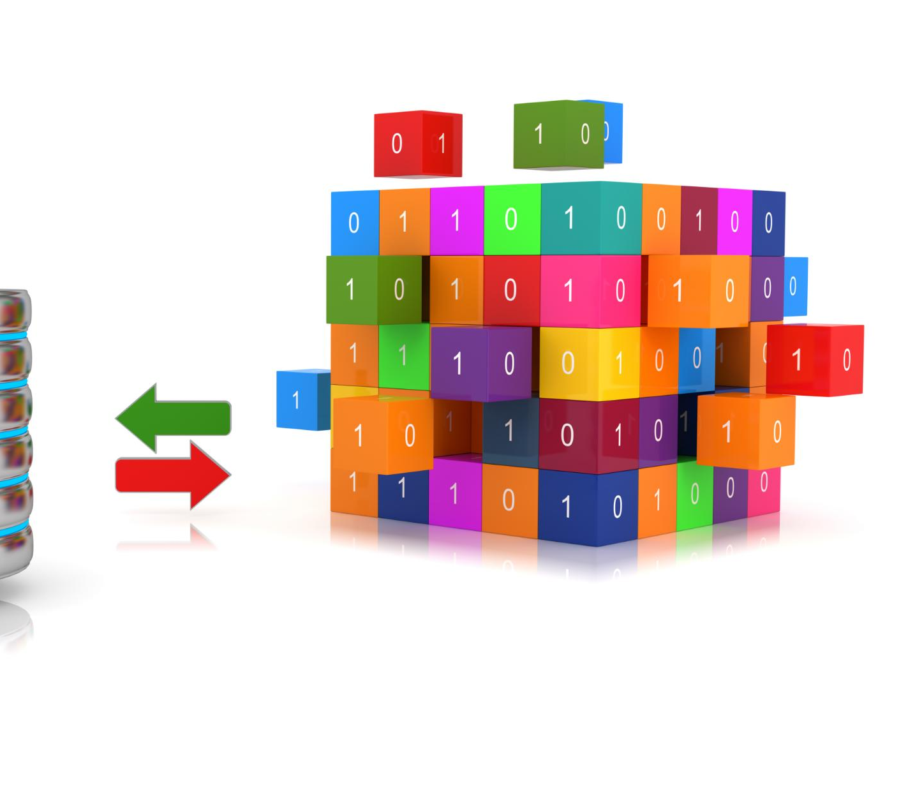
SQL and Database-Driven AI Systems
SQL Query Generation
AI models translate user input into SQL queries to fetch precise data from structured databases.
Eliminating Hallucinations
Grounding responses in verified database results eliminates AI hallucinations and ensures accuracy.
Use Case in Business Intelligence
SQL-driven AI enables natural language queries on sales data, offering precise business insights.
Limitations of SQL-Based AI
This approach is limited to structured data and lacks flexibility compared to retrieval augmented generation.
Notes:
SQL-based AI systems represent another alternative to RAG, particularly for structured data environments. In this approach, the language model generates SQL queries based on user input, which are executed against a database to retrieve exact results. This eliminates hallucinations, as responses are grounded in verified data. For example, a business intelligence system may allow users to query sales data using natural language, with the LLM translating queries into SQL. While this approach ensures accuracy, it is limited to structured datasets and lacks the flexibility of RAG for unstructured information. Nevertheless, it is widely used in enterprise applications where precision is critical.

Slide 21
Local RAG Tools and Stack
Notes:
Local Vector Databases, Embedding Models for Local Deployment, Local LLM Runtimes and Frameworks, Recommended Enterprise Local RAG Stack

Slide 22

Local Vector Databases
High Performance Options
FAISS offers high performance and scalability, while Qdrant provides fast operations and advanced filtering for production use.
Ease of Use and Scalability
ChromaDB features a Python-native interface, and Milvus supports distributed deployments to scale large datasets.
Hybrid and Lightweight Solutions
Weaviate enables hybrid vector and keyword search, whereas Annoy and HNSWlib are lightweight for smaller projects.
Offline Privacy and Compliance
Local vector databases support fully offline RAG systems, ensuring data privacy and regulatory compliance.
Notes:
Local vector databases are a critical component of non-cloud RAG systems, enabling efficient storage and retrieval of embeddings. Popular options include FAISS, which is known for its high performance and scalability, and ChromaDB, which offers ease of use with a Python-native interface. Qdrant, built in Rust, provides high-speed operations and advanced filtering capabilities, making it suitable for production environments. Milvus supports distributed deployments, allowing organizations to scale their systems for large datasets. Weaviate offers hybrid search capabilities, combining vector and keyword-based retrieval. Lightweight options like Annoy and HNSWlib are ideal for smaller projects with limited hardware resources. Choosing the right database depends on factors such as dataset size, performance requirements, and deployment constraints. These tools enable organizations to build fully offline RAG systems, ensuring data privacy and compliance.

Slide 23
Best Enterprise RAG Frameworks
Tool | Strength
LlamaIndex | Best Enterprise RAG
Haystack | Mature Enterprise Search
LangChain | General Purpose
DSPy | Optimization & Evaluation
Notes:
Embedding models convert textual data into numerical vectors, forming the foundation of RAG systems. Popular local models include BGE Large, E5 Large, and GTE Large, which offer high accuracy for semantic search tasks. Lightweight options like MiniLM are suitable for environments with limited computational resources. Nomic Embed provides a balance between performance and efficiency, making it a versatile choice. These models can run on CPU or GPU, enabling flexible deployment in enterprise environments. Selecting the right embedding model is crucial, as it directly impacts retrieval accuracy and system performance.

Slide 24
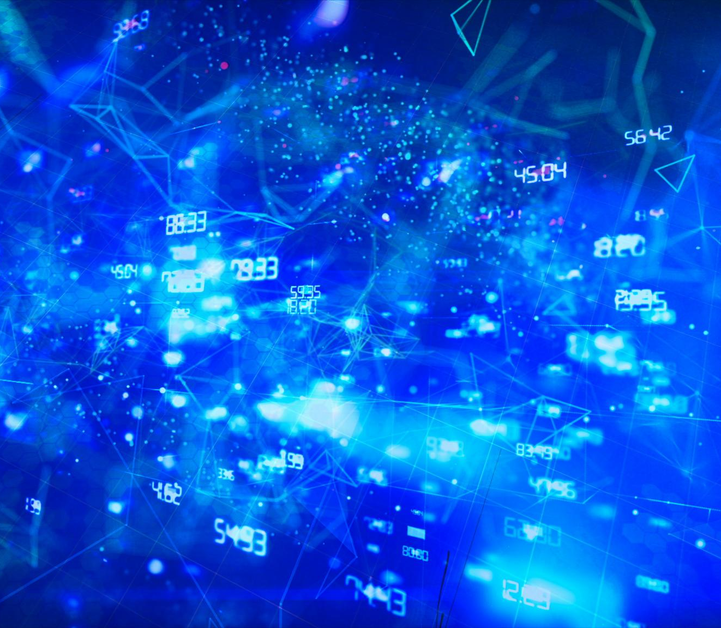
Local LLM Runtimes and Frameworks
Local Model Deployment Tools
Ollama and LM Studio provide user-friendly interfaces for deploying language models locally without cloud dependence.
CPU-Friendly and High-Performance Runtimes
GPT4All offers CPU-optimized options, while vLLM supports efficient inference for large-scale local deployments.
RAG Development Frameworks
Frameworks like LangChain, LangGraph, and LlamaIndex provide modular components for retrieval-augmented generation pipelines.
Production-Ready AI Solutions
Haystack and FastRAG deliver advanced, scalable, and secure solutions for fully offline AI system development.
Notes:
Local LLM runtimes enable organizations to run language models without relying on cloud services. Tools like Ollama and LM Studio provide user-friendly interfaces for deploying models locally, while GPT4All offers CPU-friendly options. High-performance runtimes like vLLM support efficient inference for large-scale deployments. Frameworks such as LangChain, LangGraph, and LlamaIndex facilitate the development of RAG pipelines, providing modular components for ingestion, retrieval, and generation. Haystack and FastRAG offer production-ready solutions with advanced features. These tools allow enterprises to build scalable, secure, and fully offline AI systems.

Slide 25
Enterprise RAG Architecture and Optimization
Notes:
RAG Overview and Core Concept, Types of RAG Systems in Practice, Best Enterprise Vector Databases, Open-Source Pipeline Management Tools, LlamaIndex for Enterprise RAG, RAG Tooling and Design Patterns, Best Practices for Enterprise RAG, Enterprise RAG System Architecture, Recommended Enterprise RAG Stack

Slide 26

RAG Overview and Core Concept
RAG Architecture Explained
RAG integrates large language models with external retrieval to create accurate and context-aware responses.
Vector Embeddings and Databases
Documents are transformed into vector embeddings stored in databases to enable semantic search and retrieval.
Use Cases in Industry
RAG supports domains like banking and healthcare by providing accurate, compliant, and context-rich information.
Benefits and Security
RAG reduces hallucination, enhances accuracy, and supports secure, on-premise AI deployments respecting privacy.
Notes:
Retrieval-Augmented Generation (RAG) is a modern AI architecture that combines large language models (LLMs) with external knowledge retrieval systems to produce accurate, context-aware responses. Instead of relying solely on pretrained knowledge, which can become outdated or incomplete, RAG dynamically retrieves relevant information from documents or databases before generating a response. The process typically begins by converting documents into vector embeddings using models like BGE or E5, which capture semantic meaning. These embeddings are then stored in a vector database such as Qdrant or Milvus. When a user submits a query, it is also embedded and compared against stored vectors to retrieve the most relevant chunks. These retrieved pieces are passed into the LLM as context, ensuring grounded and factual responses. For example, in enterprise environments such as banking in the UAE, RAG can retrieve compliance documents and generate accurate regulatory answers. Similarly, in healthcare, it can pull patient guidelines for clinical decision support. The key advantage of RAG is that it reduces hallucination, improves accuracy, and allows systems to remain updated without retraining models. As organizations shift toward on-premise AI deployments, especially in regions with strict data privacy regulations like Dubai and the EU, RAG provides a scalable, secure, and efficient approach to leveraging AI while keeping sensitive data local.

Slide 27
Types of RAG Systems in Practice
Basic RAG
Basic RAG uses simple vector similarity search, ideal for small datasets with minimal reasoning requirements.
Advanced RAG
Advanced RAG includes re-ranking, query rewriting, and hybrid search combining keyword and vector methods.
RAG Fusion
RAG Fusion generates multiple query variations, merges results to improve recall accuracy.
Graph and Agentic RAG
Graph RAG builds knowledge graphs for entity relationships; Agentic RAG uses autonomous agents for multi-step reasoning.
Memory RAG
Memory RAG stores past interactions for long-term context, enabling personalized, context-aware responses.
Notes:
RAG systems have evolved beyond basic retrieval pipelines into sophisticated architectures designed to handle complex enterprise requirements. Basic RAG involves simple vector similarity search and is suitable for small datasets with minimal reasoning needs. Advanced RAG introduces enhancements such as re-ranking retrieved results, query rewriting, and hybrid search that combines keyword-based (BM25) and vector similarity approaches. RAG Fusion further improves retrieval by generating multiple query variations, retrieving results for each, and merging them to increase recall accuracy. Graph RAG introduces structured knowledge representation by building knowledge graphs from documents, making it ideal for enterprise sectors like telecom and finance, where relationships between entities matter. Agentic RAG takes it further by incorporating autonomous agents that can decide which tools to use, rewrite queries, and perform multi-step reasoning, often using frameworks like LangGraph. Memory RAG enables long-term context retention by storing past interactions, allowing systems to personalize responses over time. For example, a customer support chatbot in a telecom company can remember previous issues and offer context-aware solutions. Each type of RAG represents a step toward more intelligent, adaptive, and enterprise-ready AI systems. Choosing the right type depends on data complexity, scale, and use case requirements.

Slide 28
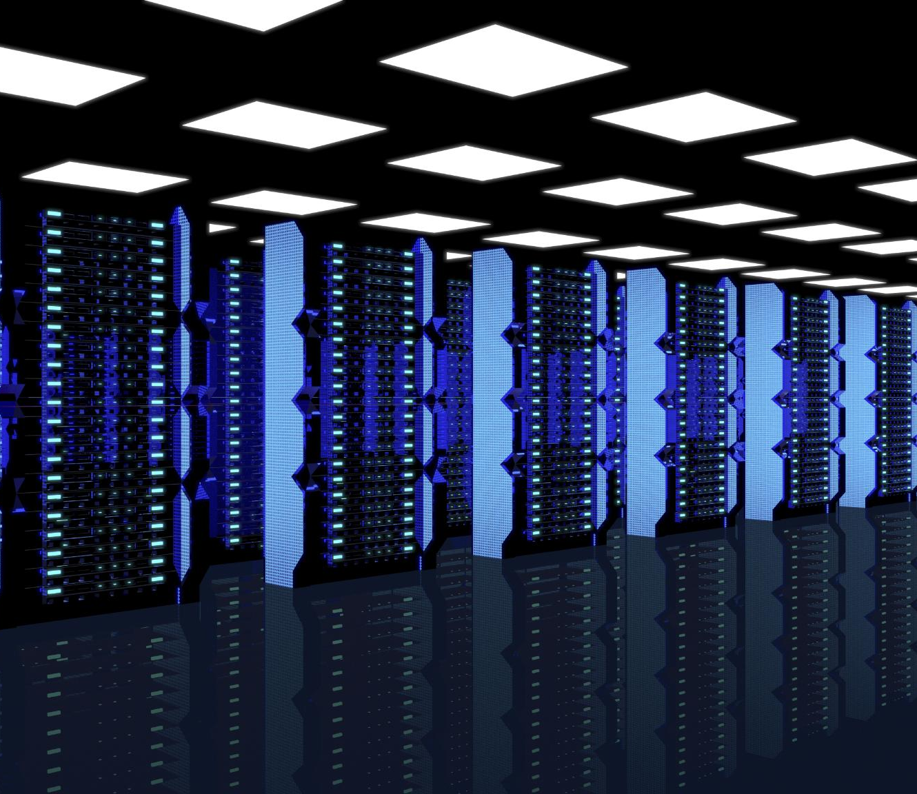
Best Enterprise Vector Databases
Qdrant Advantages
Qdrant offers high performance with efficient Rust architecture and supports filtering plus hybrid search natively.
Milvus for Large Scale
Milvus provides distributed architecture and high throughput, ideal for large telecom and banking datasets.
Weaviate Flexibility
Weaviate features hybrid search and modular design for easy integration of machine learning components.
ChromaDB and FAISS Use Cases
ChromaDB suits prototyping with Python-native design; FAISS excels in fast local search but lacks orchestration.
Notes:
Choosing the right vector database is critical for enterprise RAG performance, scalability, and reliability. Qdrant is widely considered one of the best overall options due to its high performance, efficient Rust-based architecture, and native support for filtering and hybrid search. Milvus is another strong choice for large-scale deployments, offering distributed architecture and high throughput, making it suitable for telecom or large banking datasets. Weaviate stands out for its hybrid search capabilities and modular architecture, allowing developers to integrate additional machine learning components easily. ChromaDB is ideal for development and prototyping due to its simplicity and Python-native design, but it may not scale as well as enterprise-grade solutions. FAISS, developed by Meta, is extremely fast for local vector search but lacks built-in orchestration and persistence features, making it better suited as a backend component rather than a full solution. Enterprises in regions like the UAE often prioritize on-premise solutions, making Qdrant and Milvus particularly attractive due to their strong local deployment support. Factors to consider when selecting a vector database include latency, scalability, filtering capabilities, hybrid search support, and ease of integration with RAG frameworks. Proper selection can significantly impact retrieval accuracy and system efficiency.

Slide 29
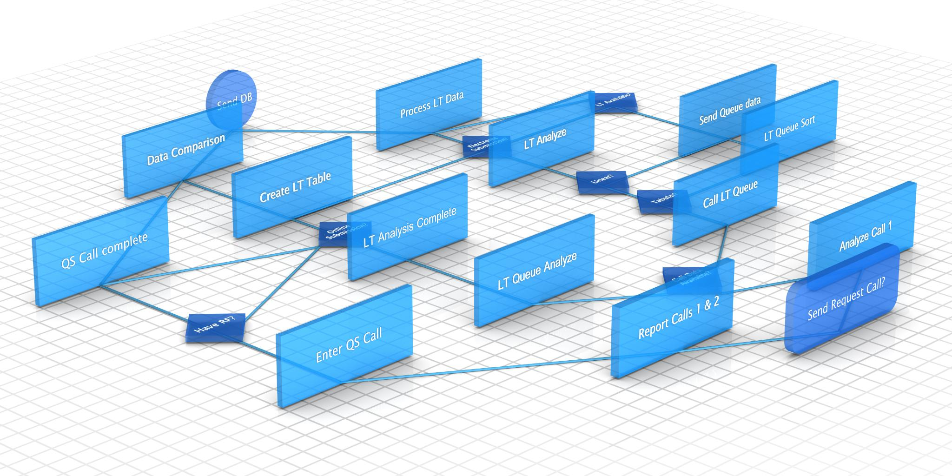
Open-Source Pipeline Management Tools
Agentic Pipeline Frameworks
LangGraph enables multi-step reasoning pipelines with decision-making for dynamic AI agent interaction.
Data Ingestion and Indexing
LlamaIndex handles data ingestion, indexing, and query orchestration for robust enterprise RAG systems.
Production-Grade Pipeline Frameworks
Haystack offers modular components for retrieval, ranking, and generation in production pipelines.
Workflow Orchestration Tools
Apache Airflow and Prefect provide scheduling, monitoring, and scalable workflow orchestration for enterprise pipelines.
Notes:
Pipeline management is essential for orchestrating RAG workflows, especially in complex enterprise environments. LangGraph has emerged as a leading framework for building agentic pipelines, enabling developers to create multi-step reasoning systems with decision-making capabilities. It is particularly useful for constructing AI agents that can dynamically interact with tools, APIs, and databases. LlamaIndex plays a complementary role by focusing on data ingestion, indexing, and query orchestration, making it an ideal backbone for enterprise RAG systems. Haystack is another robust framework designed for production-grade pipelines, offering modular components for retrieval, ranking, and generation. For broader workflow orchestration beyond AI-specific tasks, tools like Apache Airflow and Prefect are highly effective. Airflow is widely used for scheduling and managing data pipelines, while Prefect offers a more modern approach with better developer experience and observability features. In enterprise scenarios such as financial institutions, these tools enable structured workflows that ensure reliability, monitoring, and scalability. For example, a pipeline could include document ingestion, embedding generation, indexing, retrieval, and response generation, all orchestrated through these tools. Selecting the right pipeline management solution ensures that RAG systems remain maintainable, scalable, and production-ready.

Slide 30
Database | Scale | Enterprise
Qdrant | ⭐⭐⭐⭐⭐ | ⭐⭐⭐⭐⭐
Weaviate | ⭐⭐⭐⭐⭐ | ⭐⭐⭐⭐⭐
Milvus | ⭐⭐⭐⭐⭐ | ⭐⭐⭐⭐⭐
Chroma | ⭐⭐ | ⭐⭐
FAISS | ⭐⭐⭐ | ⭐⭐⭐

Slide 31
Best Embedding Models
Model | Local | Quality
bge-m3 | ✅ | ⭐⭐⭐⭐⭐
jina-embeddings-v3 | ✅ | ⭐⭐⭐⭐⭐
nomic-embed-text | ✅ | ⭐⭐⭐⭐
mxbai-embed-large | ✅ | ⭐⭐⭐⭐

Slide 32
� Enterprise Local RAG Stack (Document Parsing + Search)
Focus:
Enterprise RAG (on-prem / private cloud)
PDF + Office + Email ingestion
Vector search + hybrid retrieval

Slide 33
� Enterprise Local RAG Stack (Document Parsing + Search)
Why We Need This Stack
Enterprises struggle with:
📄 Unstructured PDFs, DOCX, PPTX
🔍 Poor semantic search in legacy systems
🧠 No AI-ready document pipelines
🔐 Data privacy restrictions (no cloud dependency)
⚡ Slow retrieval from traditional search engines

Slide 34
Top Open Source Tools
🥇 Docling (Best Enterprise Choice)
Layout-aware parsing
Tables + structured JSON output
Fully local
Best for enterprise PDFs
⚡ PyMuPDF
Fast PDF extraction
Lightweight
Best for text-heavy documents
🧠 Unstructured.io
Multi-format ingestion (PDF, HTML, email)
Strong ETL pipelines
📊 PaddleOCR
Best for scanned documents
OCR-heavy workloads

Slide 35
Top Open Source Tools
Tool | Accuracy | Speed | Enterprise | Best Use
Docling | ⭐⭐⭐⭐⭐ | ⭐⭐⭐⭐ | Yes | Enterprise PDFs
Unstructured | ⭐⭐⭐⭐ | ⭐⭐⭐ | Yes | Multi-format ETL
PyMuPDF | ⭐⭐⭐ | ⭐⭐⭐⭐⭐ | Medium | Fast extraction
PaddleOCR | ⭐⭐⭐⭐ | ⭐⭐⭐ | Yes | Scanned docs

Slide 36

LlamaIndex for Enterprise RAG
Flexible Data Integration
LlamaIndex connects diverse data sources like PDFs, databases, APIs, and cloud storage to centralize knowledge.
Multiple Indexing Strategies
Supports vector, tree, and keyword indexes for customized data retrieval in various scenarios.
Custom Query Engines
Enables developers to build tailored retrieval pipelines integrating with vector databases like Qdrant and Milvus.
Privacy and Advanced Features
Compatible with various LLMs ensuring data privacy; supports metadata filtering and contextual compression for accuracy.
Notes:
LlamaIndex has become a cornerstone technology for building enterprise RAG systems due to its powerful data indexing and query capabilities. It provides a flexible framework for connecting various data sources, including PDFs, databases, APIs, and cloud storage, allowing organizations to centralize their knowledge base. One of its key strengths is its support for multiple indexing strategies, such as vector indexes, tree indexes, and keyword indexes, enabling tailored retrieval approaches for different use cases. LlamaIndex also offers query engines that allow developers to build custom retrieval pipelines, integrating seamlessly with vector databases like Qdrant and Milvus. In real-world applications, companies use LlamaIndex to build internal knowledge assistants that can retrieve HR policies, legal documents, or technical manuals. Another advantage is its compatibility with various LLMs and embedding models, making it highly adaptable to on-premise deployments. For example, pairing LlamaIndex with Ollama and Qwen models allows enterprises to maintain full data privacy. Additionally, LlamaIndex supports advanced features like metadata filtering and contextual compression, which improve retrieval accuracy and efficiency. Overall, it serves as a critical layer in enterprise RAG architectures, enabling efficient data handling and intelligent query processing.

Slide 37
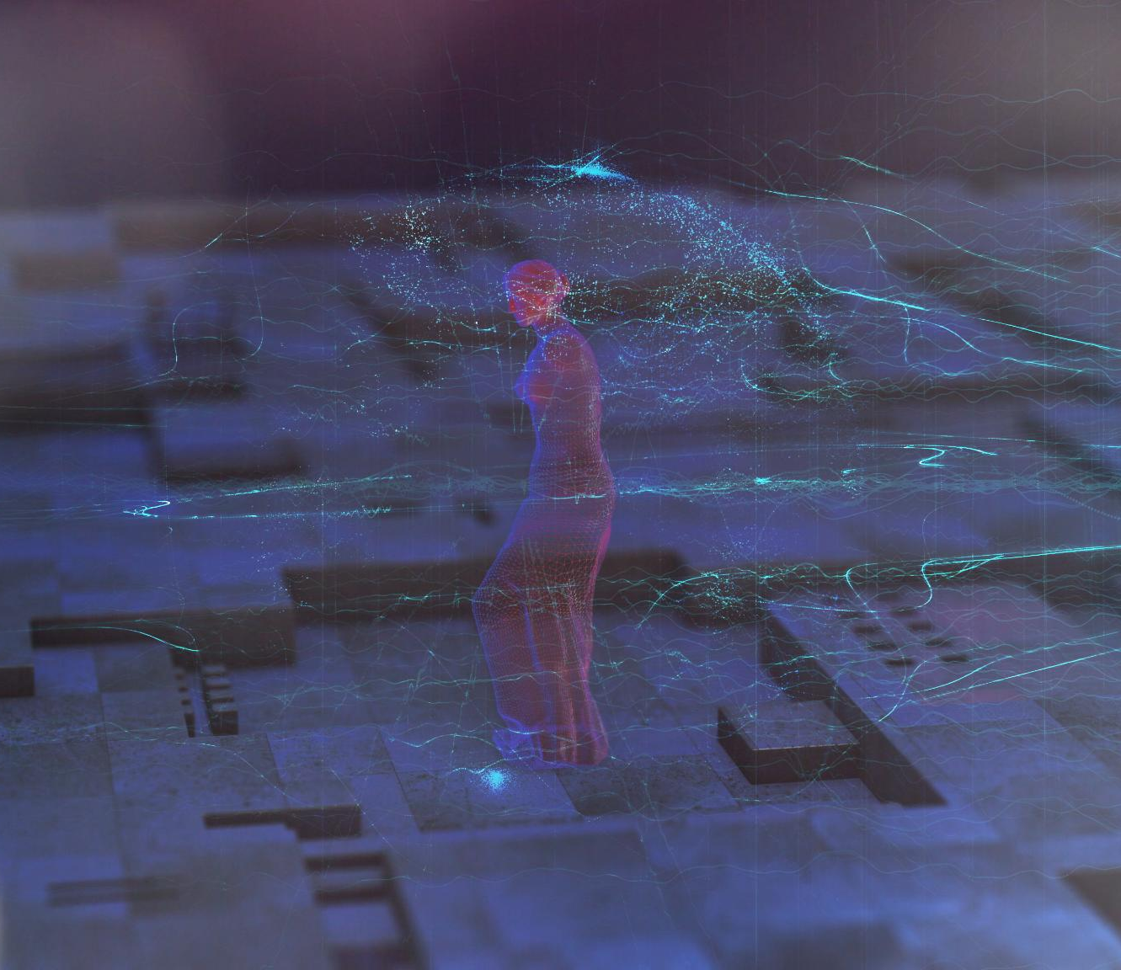
RAG Tooling and Design Patterns
Retriever Plus Re-ranker
Initial results are retrieved by vector similarity and refined with re-ranking for improved relevance.
Multi-Query RAG
Generating multiple query variations enhances recall and handles complex enterprise queries effectively.
Hybrid Search Methods
Combining keyword-based BM25 with vector similarity captures both lexical and semantic relevance.
Tool-Augmented Agents
RAG systems integrating external tools like APIs and databases extend retrieval capabilities.
Notes:
Effective RAG implementations rely on proven design patterns that enhance retrieval accuracy and system performance. One common pattern is the retriever plus re-ranker approach, where initial results are retrieved using vector similarity and then refined using a re-ranking model for better relevance. Multi-query RAG is another powerful pattern, where multiple variations of a query are generated to improve recall, particularly useful in complex enterprise queries. Hybrid search combines keyword-based methods like BM25 with vector similarity to capture both lexical and semantic relevance. Tool-augmented agents represent a growing trend, where RAG systems integrate with external tools such as APIs or databases to perform tasks beyond simple retrieval. Another emerging pattern is combining graph-based and vector-based retrieval, enabling systems to leverage both structured and unstructured data. For example, a telecom company might use graph RAG to understand customer relationships and vector search to retrieve support documents. These patterns are essential for building robust AI systems capable of handling diverse and complex queries. By adopting these strategies, organizations can significantly improve the effectiveness, scalability, and reliability of their RAG implementations.

Slide 38
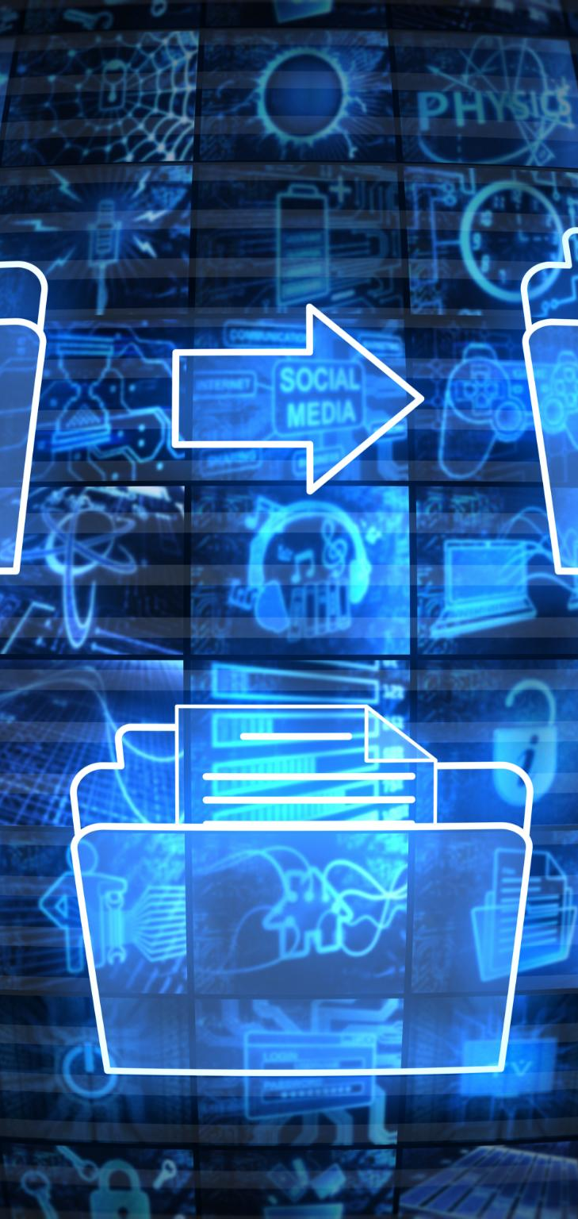
Best Practices for Enterprise RAG
Chunking Strategy
Divide documents into 300 to 800 token segments to optimize context and retrieval accuracy.
Metadata Tagging
Use metadata to filter results by attributes like date, source, or category for precise retrieval.
Hybrid Search Methods
Combine keyword and semantic search to ensure comprehensive and accurate information retrieval.
Evaluation and Monitoring
Use tools like Ragas to measure retrieval quality and monitor latency and recall rates continuously.
Notes:
Implementing RAG effectively requires adherence to best practices that optimize performance and accuracy. One critical factor is chunking strategy, where documents are divided into segments of approximately 300 to 800 tokens to balance context and retrieval precision. Metadata tagging is another essential practice, allowing systems to filter results based on attributes such as date, source, or category. Hybrid search should be used whenever possible to combine keyword and semantic retrieval, ensuring comprehensive coverage. Evaluation is equally important, and tools like Ragas enable organizations to measure retrieval quality, faithfulness, and answer relevance. Monitoring system performance, including latency and recall rates, is crucial for maintaining a high-quality user experience. Additionally, embedding model selection plays a significant role, with models like BGE Large providing strong semantic representations. Security and privacy considerations are also paramount, especially for on-premise deployments in regions with strict regulations. For example, enterprises in Dubai often require fully local solutions to comply with data sovereignty laws. By following these best practices, organizations can build reliable, scalable, and high-performance RAG systems that meet enterprise standards.

Slide 39
Enterprise RAG System Architecture
Ingestion Layer
Collects and preprocesses data from documents, databases, and APIs to prepare for embedding.
Embedding and Storage
Converts data into vector embeddings stored in a vector database for efficient retrieval.
Retrieval and Orchestration
Manages query processing and retrieval logic using frameworks to interact with large language models.
Inference Layer
Generates responses based on retrieved data using local large language model runtimes.
Notes:
A well-designed enterprise RAG architecture consists of multiple layers that work together to deliver accurate and scalable AI solutions. The ingestion layer is responsible for collecting and preprocessing data from various sources, such as documents, databases, and APIs. The embedding layer converts this data into vector representations using models like BGE or E5. These embeddings are stored in a vector database, which forms the core retrieval layer. The retrieval and orchestration layer uses frameworks like LangGraph or LlamaIndex to manage query processing, retrieval logic, and interactions with the LLM. Finally, the inference layer, powered by local LLM runtimes such as Ollama or vLLM, generates responses based on retrieved context. This layered architecture ensures modularity, scalability, and maintainability. For example, a bank in the UAE could use this architecture to build a secure internal knowledge assistant that retrieves compliance documents and generates accurate responses in real time. The modular design also allows organizations to upgrade individual components without affecting the entire system. By adopting this structured approach, enterprises can build robust RAG systems that meet performance, security, and scalability requirements.

Slide 40
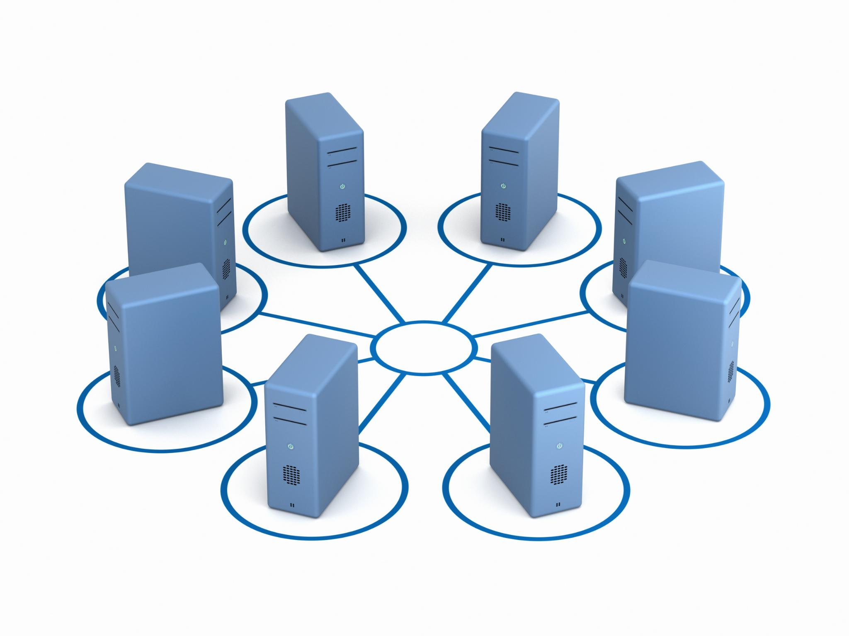
Recommended Enterprise RAG Stack
Local LLM Runtime
Ollama provides a local large language model runtime, enabling inference without cloud dependency.
Efficient Vector Database
Qdrant offers fast vector search with filtering and easy deployment for enterprise use.
Orchestration and Workflows
LangGraph manages orchestration, enabling dynamic, agentic workflows for complex queries.
Data Management and Evaluation
LlamaIndex handles data ingestion and indexing, while Ragas provides system evaluation insights.
Notes:
A recommended enterprise-grade RAG stack focuses on performance, scalability, and full local deployment capabilities. At the core, Ollama serves as the local LLM runtime, enabling efficient inference without relying on cloud services. Models like Qwen 7B or 14B provide a strong balance between performance and resource usage, making them suitable for enterprise environments. For embeddings, BGE Large is a top choice due to its high accuracy and support for multiple languages. Qdrant is recommended as the vector database because of its speed, filtering capabilities, and ease of deployment. LangGraph handles orchestration and enables agentic workflows, allowing systems to dynamically adapt to complex queries. LlamaIndex complements this by managing data ingestion and indexing, ensuring efficient retrieval. Finally, Ragas is used for evaluation, providing insights into system performance and helping teams optimize their pipelines. This stack is particularly well-suited for enterprises in regions like the UAE and the UK, where data privacy and on-premise deployment are critical. By using this combination of tools, organizations can build a fully local, scalable, and high-performance RAG system that meets modern enterprise requirements.

