Slide 1
Biweekly Update Presentation 05
Berkay Ipek – ARPLab 04/09/2025

Slide 2
Outline
What is done
Final Checking
Number of Harmonics Problem
Approaching an ideal calibration
Plans for the next weeks
PRBS Signal Reading cont.
Approaching an ideal calibration cont.

Slide 3
Final Checking : Set Up

Slide 4
Final Checking – Set Up
Purpose: Based on previous results, using a polynomial order of 9 and a memory order of 5 provides approximately 80 dB THD at 2 GHz, which matches our target. We need to verify whether this configuration is suitable for other frequencies as well.
Step 1: Take the signal of input and output @ 1 GHz, 1.5GHz and 2 GHz.
Step 2: Perform calibration with varying memory orders while keeping the polynomial order fixed at 9.
Step 3: Calculate THD values for the input, output and calibrated waveforms.
Step 4: Plot and compare all results in a plot.

Slide 5
Final Checking: Results

Slide 6
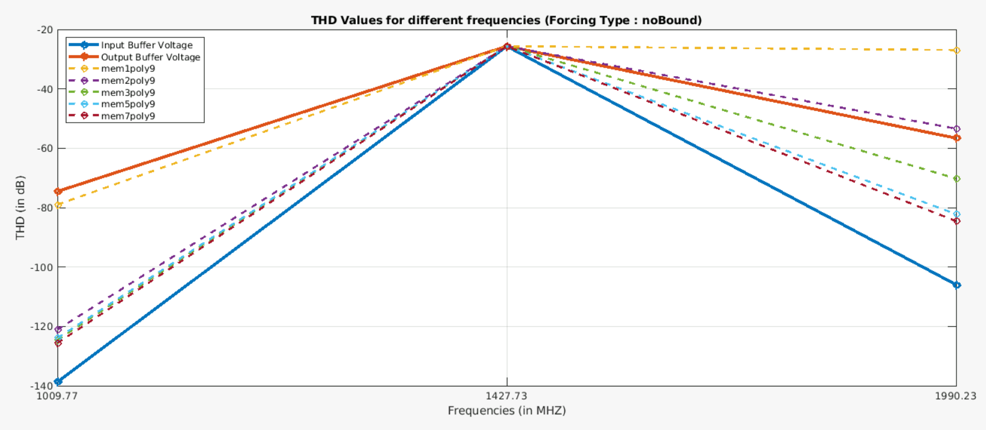
Final Checking - Results

Slide 7
Final Checking - Results

Slide 8
Final Checking: Problem @1.5 GHz

Slide 9
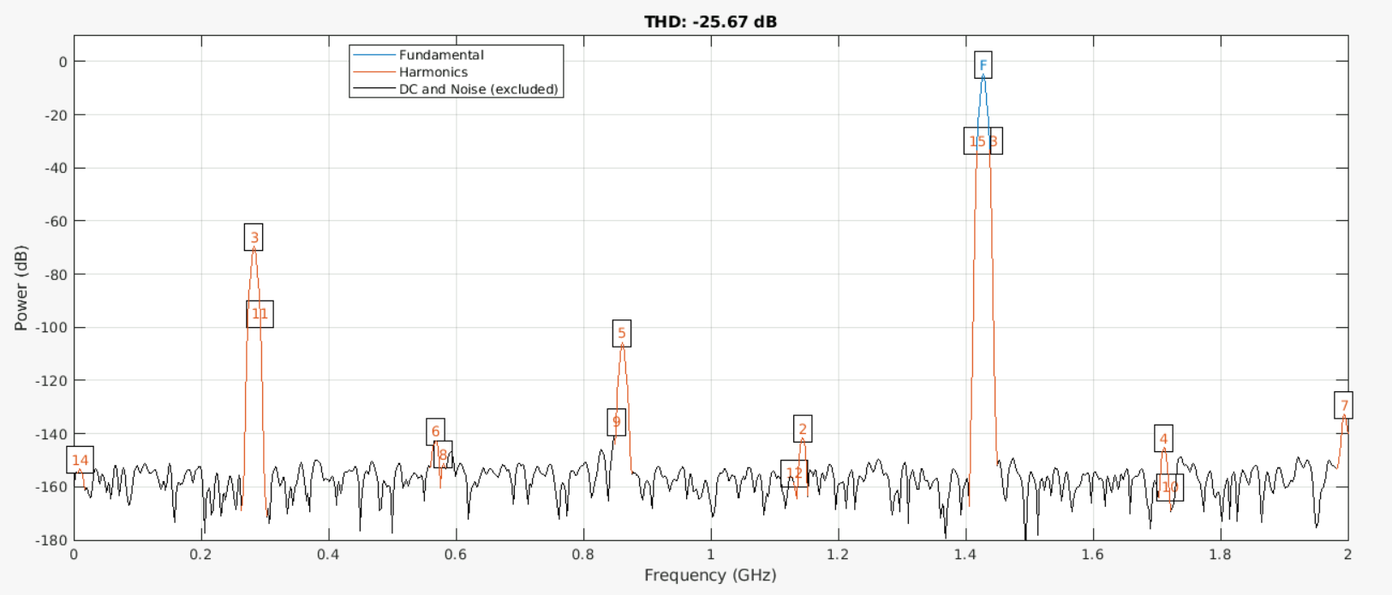
Final Checking - Problem @1.5 GHz
Here is the output voltage waveform :

Slide 10
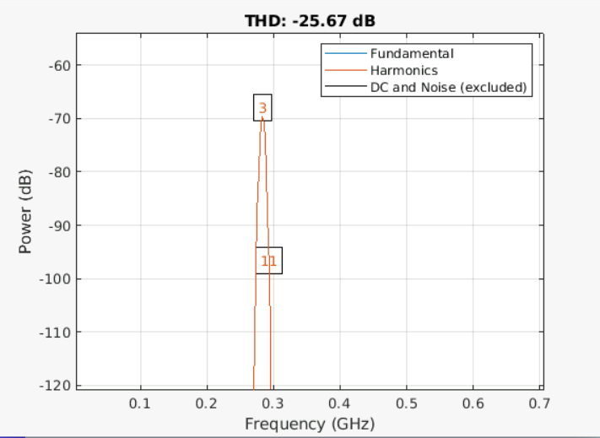
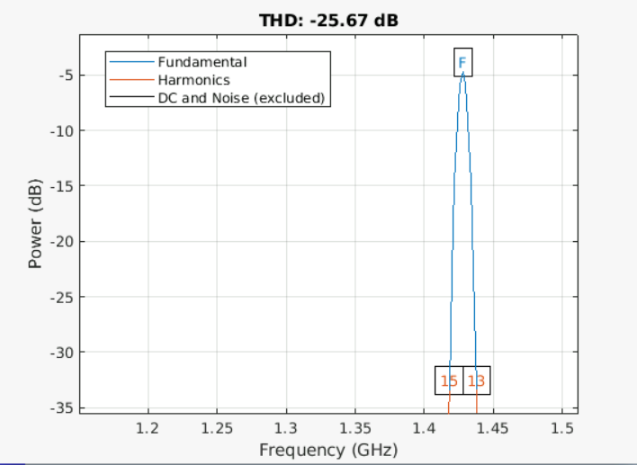
Final Checking - Problem @1.5 GHz
Here is the output voltage waveform :

Slide 11
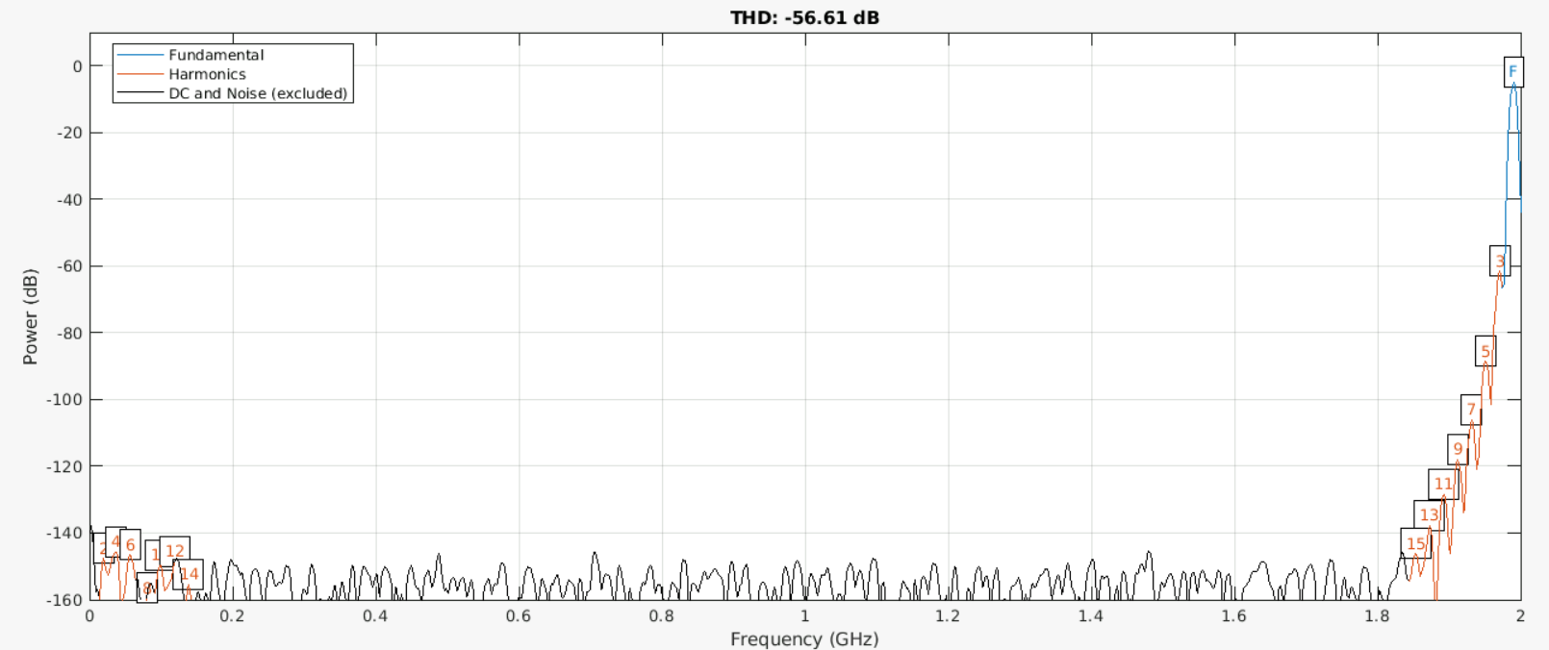
Final Checking - Problem @1.5 GHz
What about @ 2 GHz:

Slide 12
Final Checking - Problem @1.5 GHz
Here is the output voltage waveform :

Slide 13
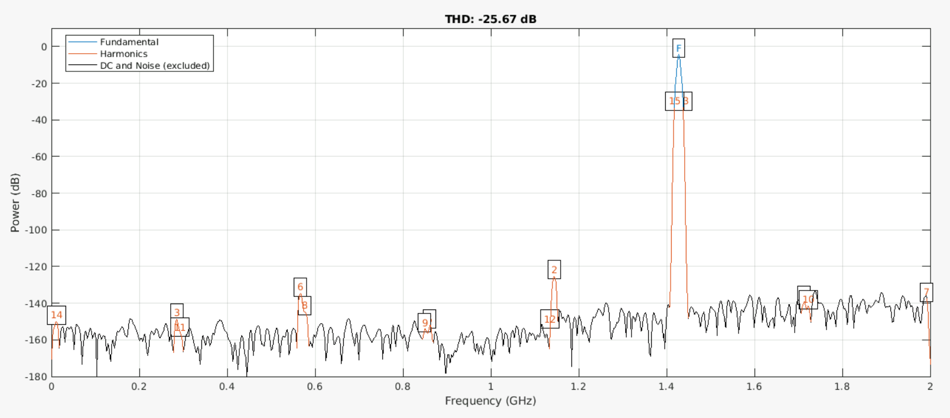
Final Checking - Problem @1.5 GHz
Therefore, calibration seems that it does not working @ 1.5 GHz:

Slide 14
Final Checking: Solution @1.5 GHz

Slide 15
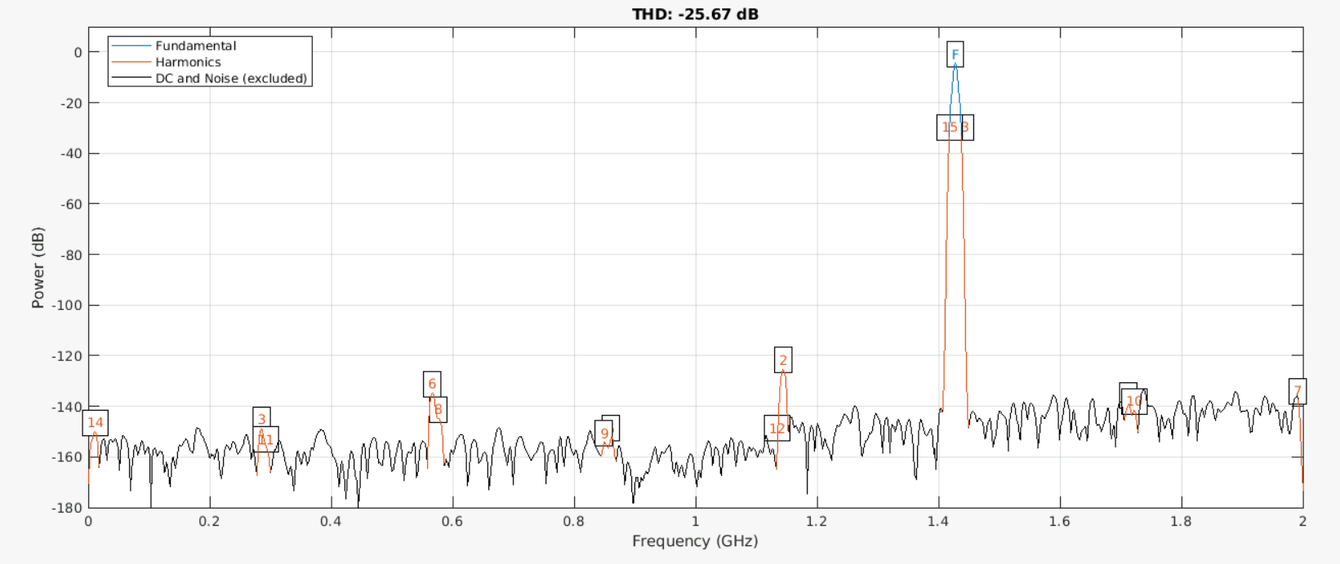
Final Checking - Solution @1.5 GHz
thd(calibratedWave, fs, #ofHarmonics, ‘aliased’); where #ofHarmonics = 15

Slide 16
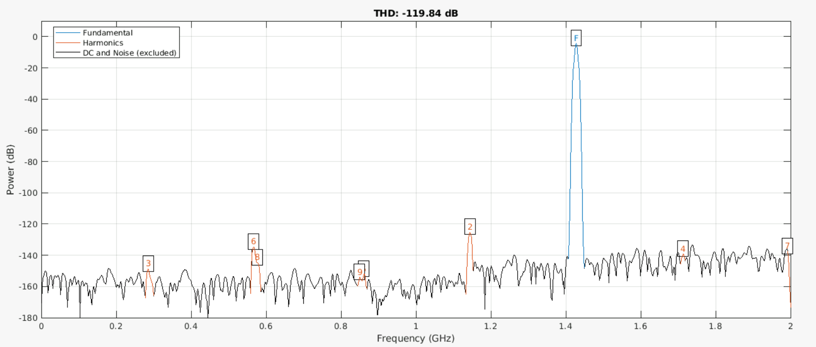
Final Checking - Solution @1.5 GHz
thd(calibratedWave, fs, #ofHarmonics, ‘aliased’); where #ofHarmonics = 9

Slide 17
Final Checking: Set Up - Revised

Slide 18
Final Checking: Set Up - Revised
Purpose: Based on previous results, using a polynomial order of 9 and a memory order of 5 provides approximately 80 dB at 2 GHz, which matches our target. We need to verify whether this configuration is suitable for other frequencies as well.
Step 1: Take the signal of input and output @ 1 GHz, 1.5GHz and 2 GHz.
Step 2: Perform calibration with varying memory orders while keeping the polynomial order fixed at 9.
Step 3: Calculate THD values for the input, output and calibrated waveforms. (#ofHarmonics is 9 @1.5 GHz, 15 otherwise)
Step 4: Plot and compare all results in a plot.

Slide 19
Final Checking: Results - Revised

Slide 20
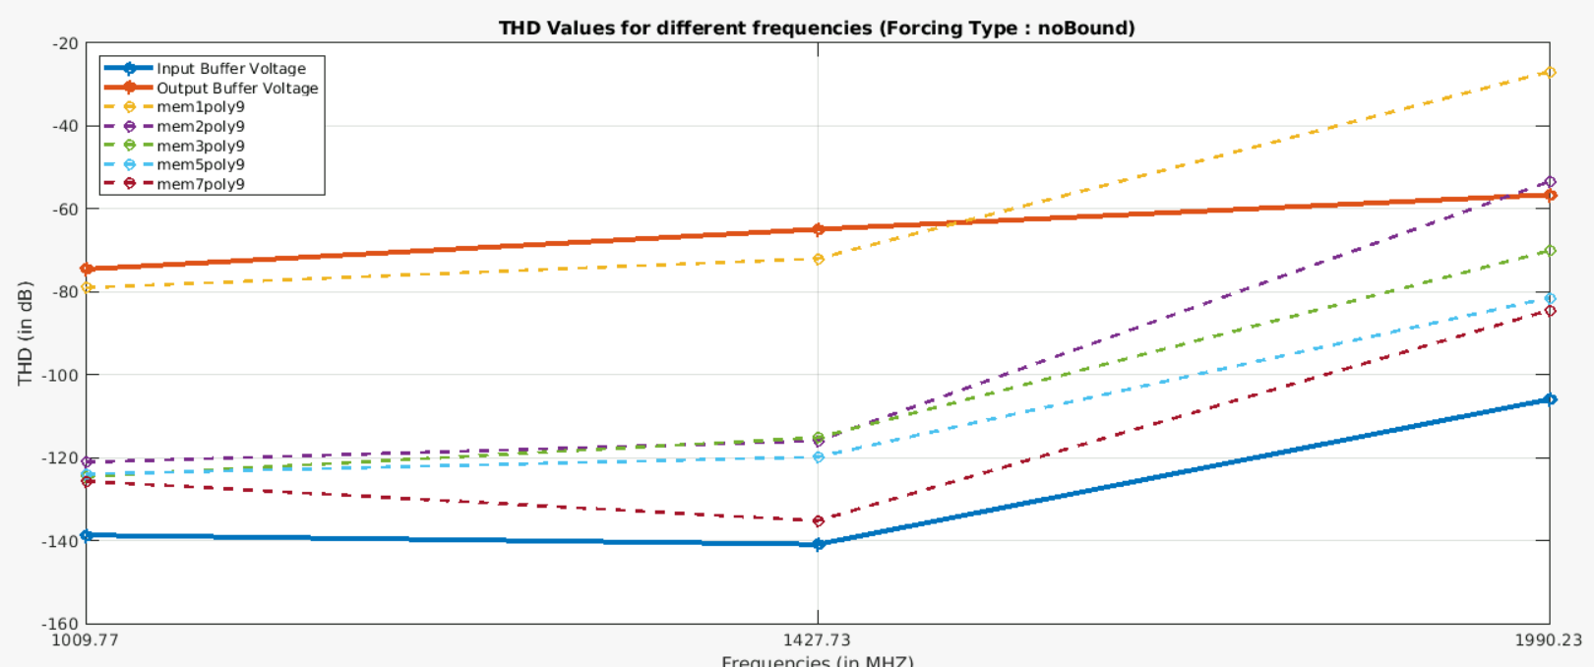
Final Checking – Results - Revised

Slide 21
Approaching an ideal calibration: Set Up

Slide 22
Approaching an ideal calibration: Set Up
Purpose: We want to make sure that the signal can be reversed by using an ideal calibration (infinite number of coefficients) .
Step 1: Take the signal of input and output @ 1 GHz, 1.5GHz and 2 GHz.
Step 2: Perform calibration with varying memory orders while keeping the polynomial order fixed at 9.
Step 3: Calculate THD values for the input, output and calibrated waveforms. (#ofHarmonics is 9 @1.5 GHz, 15 otherwise)
Step 4: Plot and compare all results in a plot.

Slide 23
Approaching an ideal calibration: Results

Slide 24
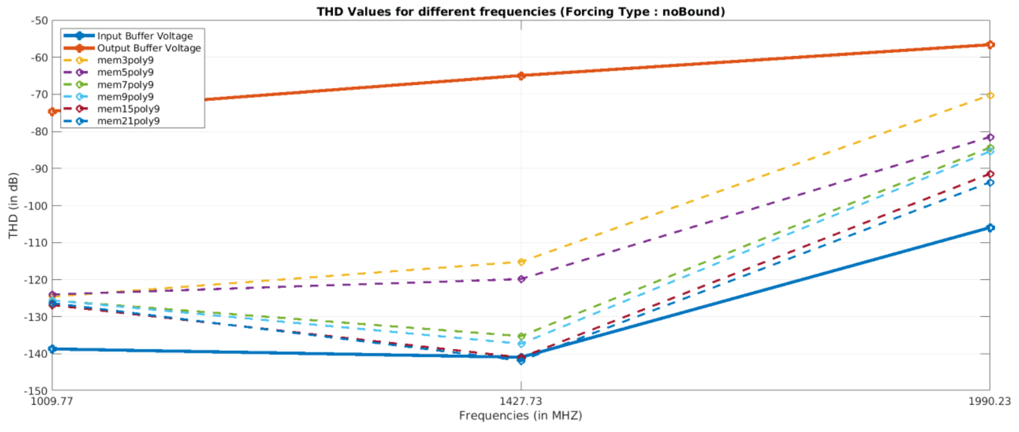
Approaching an ideal calibration - Results

Slide 25
Approaching an ideal calibration: Set Up - Reviewed

Slide 26
Approaching an ideal calibration: Set Up - Reviewed
Purpose: We want to make sure that the signal can be reversed by using an ideal calibration (infinite number of coefficients) .
Step 1: Take the signal of input and output @ 1 GHz, 1.5GHz and 2 GHz.
Step 2: Perform calibration with really high memory orders while keeping the polynomial order fixed at 9.
Step 3: Calculate THD values for the input, output and calibrated waveforms. (#ofHarmonics is 9 @ all cases)
Step 4: Plot and compare all results in a plot.

Slide 27
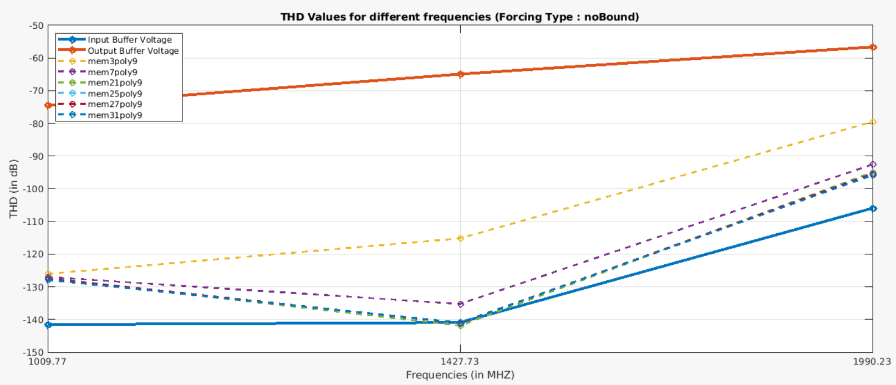
Approaching an ideal calibration – Results - Reviewed

Slide 28
Approaching an ideal calibration: Problem @1GHz

Slide 29
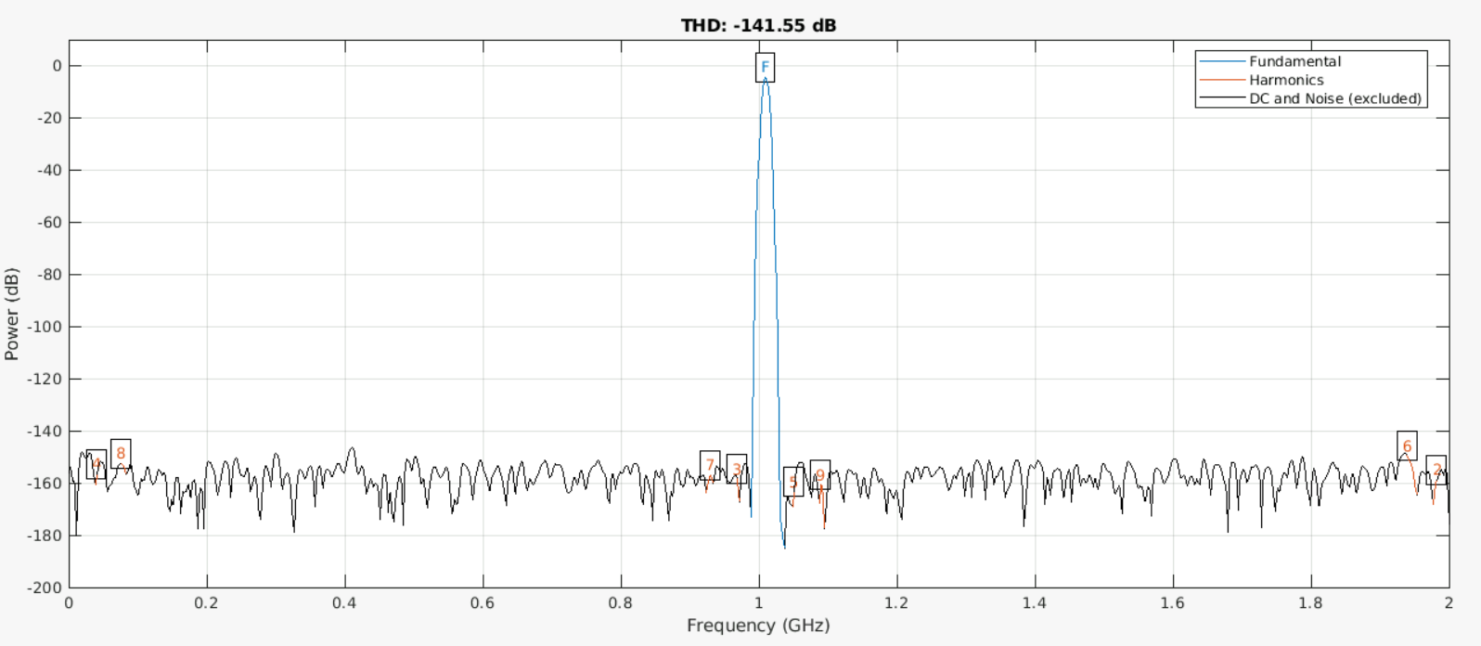
Approaching an ideal calibration – Problem @1GHz
Input Voltage Waveform @1GHz

Slide 30
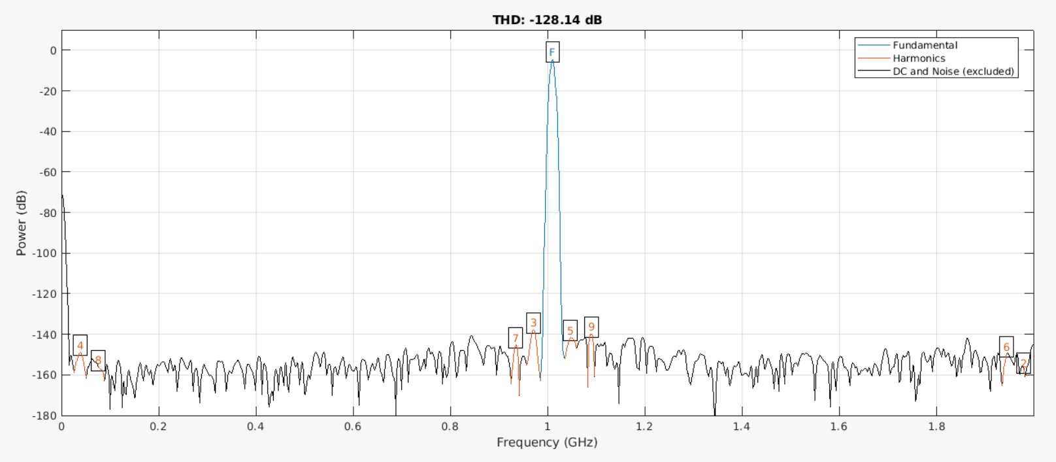
Approaching an ideal calibration – Problem @1GHz
Calibrated Voltage Waveform @1GHz

Slide 31
Approaching an ideal calibration: Solution @1GHz

Slide 32
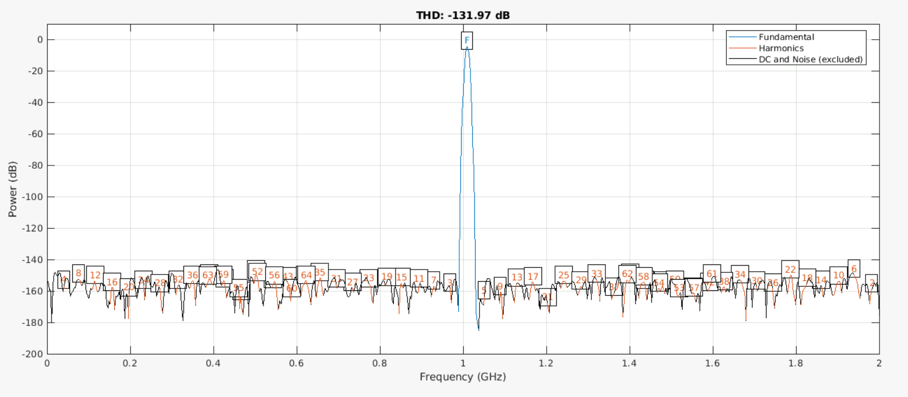
Approaching an ideal calibration – Solution @1GHz
Input Voltage Waveform @1GHz (#ofHarmonics = 64)

Slide 33
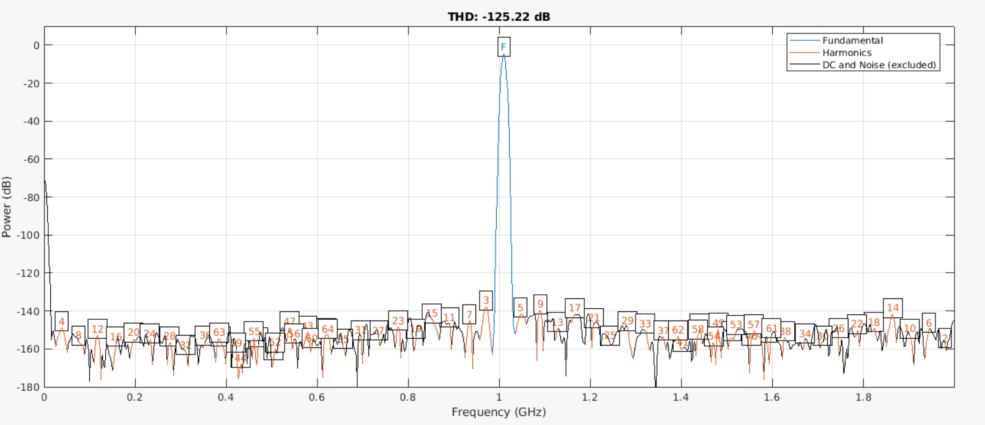
Approaching an ideal calibration – Solution @1GHz
Calibrated Voltage Waveform @1GHz (#ofHarmonics = 64)

Slide 34
Approaching an ideal calibration: Problem @2GHz

Slide 35
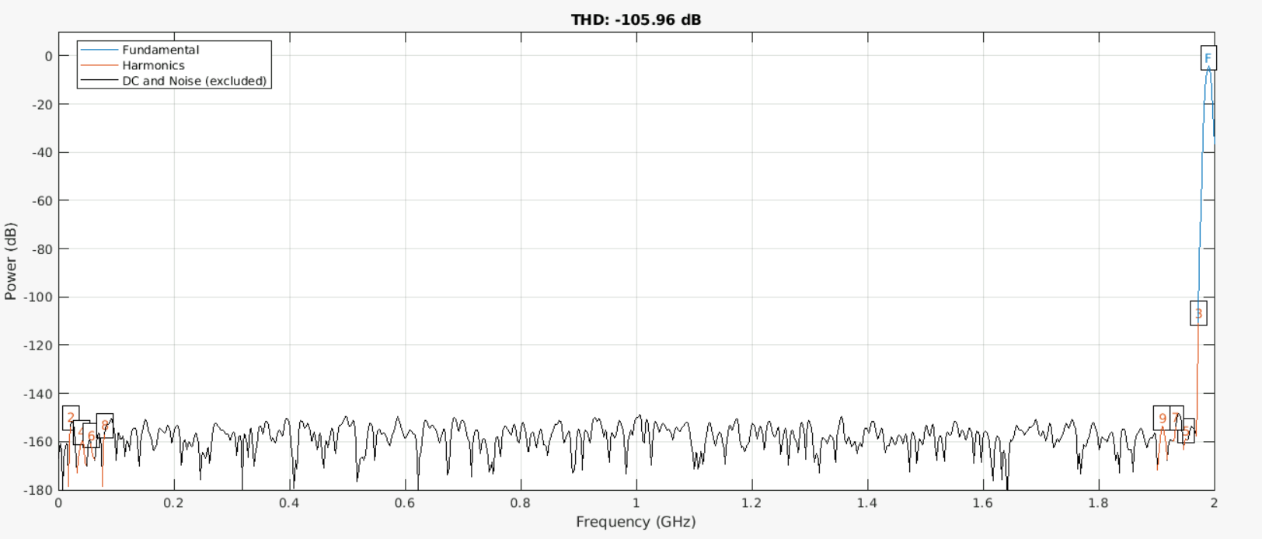
Approaching an ideal calibration – Problem @2GHz
Input Voltage Waveform @2GHz

Slide 36
Plans for the next weeks

Slide 37
Plans for the next weeks
Try to fix problem of ideal calibration @2GHz.
Determine how many levels of PRBS signal is required to obtain similar coefficients
My final exam is on 12th September.

