Slide 1
Sampler non-linearity calibration
Alessia Ceroni
8/5/2025

Slide 2
Project status
Issues involved in choosing to increase fs from 2GHz to 4GHz
Channels speed
Can the channels, as they are, achieve the required speed (1GS/s)? What is the bottleneck to their speed?
Responsible Albezzano
Strategy
simulate the individual stages to get a good understanding of which may be limiting the speed
simulate the whole core to realistically test the pipeline handshake
redesign the limiting blocks
Clk chain
As fs increases, the maximum tolerable jitter on the clk reduces
Responsible Tombolan
Strategy
redesign of the clk resampler
eliminate the p-part of the clk chain (unused) to halve the consumption of the clk chain
move the phase generator from the clkgen (internal to each channel) and place it in common to all the cores to avoid problems with their rst (possibility of replacing it with the one presented by Airoldi)
Front-end non linearities and digital calibrations
Responsible Ceroni
Strategy
Testing sampler and input-buffer performance for fin up to 2GS/s
Possible redesign of blocks and/or implementation of a calibration to improve performance
Digital routine for random interleaving
Handling digital @ 1GS/s: downsampling necessary? (Thanks Michele for the hint)

Slide 3
Virtuoso
V_{in} V_{sampler} D_{out}
Digital calibration
V_{in}
h_{i}(j) [coefficients of the Volterra series miming the behavior fo the sampler] D_{out}
h_{i}(j) D_{out,cal}
D_{out}
ADC
LMS loops
inverse of Volterra series miming the sampler

Slide 4
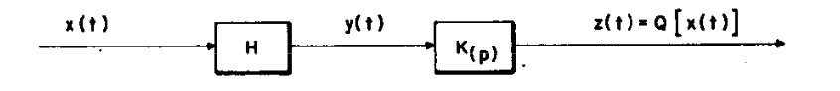


Problem Inversion of the Volterra Series
Starting from the tandem conncections of 2 non-linear systems
To derive K as the inverse of H we have to impose
S₁[x(n)] = [s₁(0) + s₁(1)*z⁻¹ + … + s₁(m)*z^{-m}]*x(z)
S₂[x(n)] = s₂(0,0)*Z{x²(n)} + … + s₂(m,m)*Z{x²(n-m)} + [s₂(0,1) + s₂(1,0)]*Z{x(n)x(n-1)} + … +
[s2(0,m) + s2(m,0)]*Z{x(n)x(n-m)} + … + [s2(i,j) +s2(j,i)]* Z{x(n-i)x(n-j)}

Slide 5
Q₁[x(n)] = Q₁(z)*x(z) = H₁(z)*K₁(z)*x(z) = x(z) K₁(z) = 1/H₁(z)
NB K₁(z) is implementable only if 1/H₁(z) is stable and causal
Q₂[x(n)] = K₁(z)*H₂(z)*x(z) + K₂(z)*H₁(z)*x(z) = 0 K₂(z) = H₁⁻¹(z)*H₂(z)*H₁⁻¹(z)
…

Slide 6
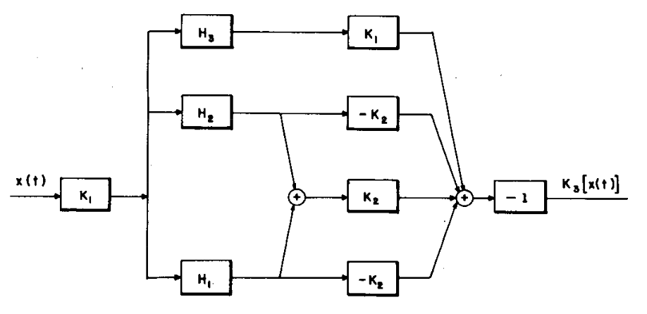
As the order of the polynomial p increases, the expression of K_{p}(z) becomes more complex For example, K₃(z) is
As p increases we have two degrees of complexity:
The number of coefficients h_{i}(j) of the Volterra Series increases, it is NOT that simple to ensure the of the loops for the estimate
Deriving the inverse of the Volterra series is extremely complex

Slide 7
To simplify the calibration problem, we can exploit the fact that K is a Volterra Series with the same polinomial order p and the same memory of H, the Volterra Series miming the behavior of the sampler
Thus, we may estimate only the coefficients k_{i}(j) of the Volterra Series to apply on Dout to retrieve Vin.
Digital calibration
V_{in}
k_{i}(j) [coefficients of the Volterra to apply to Dout to obtain Vin] D_{out}
k_{i}(j) D_{out,cal}
D_{out}
LMS loops
Volterra series
Implemented as k_{j}(i)[n+1] = k_{j}(i)[n] + 𝝀|K[Vsampler] – Vin|^2

Slide 8
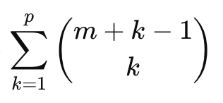
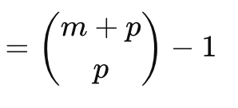
The number of coefficients of a Volterra series is
Observing the spectrum of Vsampler non-linearities up to the 7th order can be noted => p = 7
Considering a memory of 3 elements, we have m = 4 (current element + 3 past elements)
In these conditions, the overall number of coefficients for the Volterra series is 330
As the number of coefficients increase with p or m, it is difficult to guarantee the convergence of the LMS loops that estimate k_{i}(j). To reduce the number of coefficients to estimate while keeping the complexity of the model, Memory Polinomials are implemented instead of Volterra Series

Slide 9
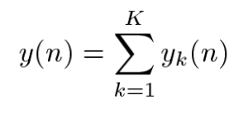
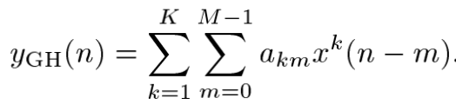
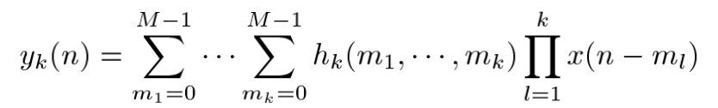
In the following formulas K si the order of the polynomial (called p in these slides), M is the memory (called m in these slides)
Volterra Series Memory Polinomials
Memory polynomials are a special case of Volterra
series; specifically, they are obtained by setting to zero the coefficients of all terms involving the product of input samples at different time instants.
For a memory polynomial of order p and memory m, the number of coefficients N_{c} is m*p.

Slide 10
2-tones test
P = 21 M = 33 (N_{c} = 693) P = 7 M = 33 (N_{c} = 231)
P = 21 M = 7 (N_{c} = 147) P = 7 M = 7 (N_{c} = 49)
fs = 500MHz
Nfft = 2^10
Ain₁ = Ain₂ = 0.45*Vdd
𝜙₁ = 𝜙₂ = 42°

Slide 11
2-tones test
N = 7 M = 33 (N_{c} = 231)
fs = 500MHz
Nfft = 2^10
Ain₁ = Ain₂ = 0.45*Vdd
𝜙₁ = 𝜙₂ = 42°

Slide 12
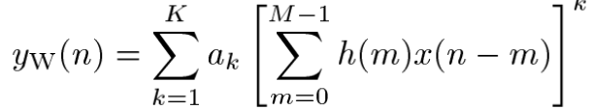
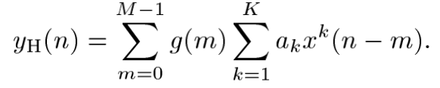
Even with memory polynomials, we still have to implement some strategies to reduce the number of coefficients due to the long memory needed to effectively have an enhancement of the SFDR/THD
1st strategy Use a simpler model instead of memory polynomials
Wiener model
Linear filter to take into account the memory effects of the system followed by a memory-less non-linear filter
Hammerstein model
Memory-less non-linear filter followed by a linear filter to take into account the memory effects of the system
In both cases, the parameters of the model are only (p + m).
Unfortunately, both models gave delusionals results, even with large polynomial order p and memory m

Slide 13
2nd strategy
Consider only some orders of the polynomials (potentially the orders considered for the current sample can be different with respect to the ones considered for the past samples) and some samples of the selected memory
Best results
 | P_{CURRENT} | P_{PREVIOUS} | M | SFDR | THD | N_{COEFF}
fin₁ = 200MHz, fin₂ = 210MHz | 21 (odd only) | 1 & [6:10] | 1 & [4:7] & [9:12] & [15:17] & [20:22] & [25:27] | 83.7→86.3dB |  | 119 (-48.5%)
fin₁ = 800MHz, fin₂ = 810MHz | 7 | 3 | 21 | 71→82.7dB |  | 70 (-69.7%)
fin₁ = 980MHz, fin₂ = 990MHz | 7 | 7 | 33 \ {7,8,21,22,23} | 76→83.1dB |  | 203 (-12.1%)

Slide 14
fs = 500MHz
Nfft = 2^10
Ain₁ = 0.9*Vdd
𝜙₁ = 42°
Single-tone test

Slide 15
Can obtain the same SFDR considering only odd orders polynomial for p = 15 and m = 5
fs = 500MHz
Nfft = 2^10
Ain₁ = 0.9*Vdd
𝜙₁ = 42°
Single-tone test
Can obtain the same SFDR considering only odd orders polynomial for p = 7 and m = 4
Can obtain the same SFDR considering m = 6
Can obtain the same SFDR considering m = 5
Can reach 94.8dB with m = 21

Slide 16
fs = 500MHz
Nfft = 2^10
Ain₁ = 0.9*Vdd
𝜙₁ = 42°
Single-tone test

Slide 17
fs = 500MHz
Nfft = 2^10
Ain₁ = 0.9*Vdd
𝜙₁ = 42°
Single-tone test
Can obtain the same THD considering m = 6
Can obtain the same THD considering only odd orders polynomial for p = 15 and m = 5
Can obtain the same THD considering m = 5

Slide 18
fs = 1GHz
Nfft = 2^11
Ain₁ = 0.9*Vdd
𝜙₁ = 42°
Single-tone test

Slide 19
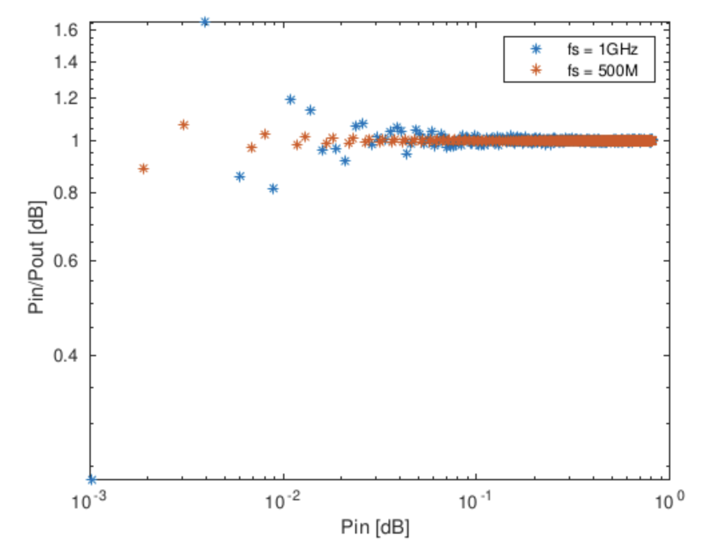
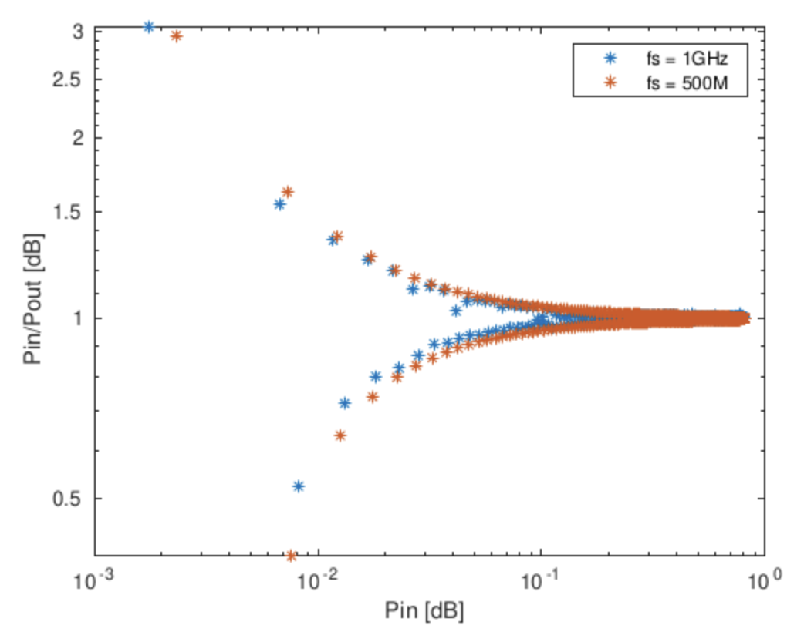
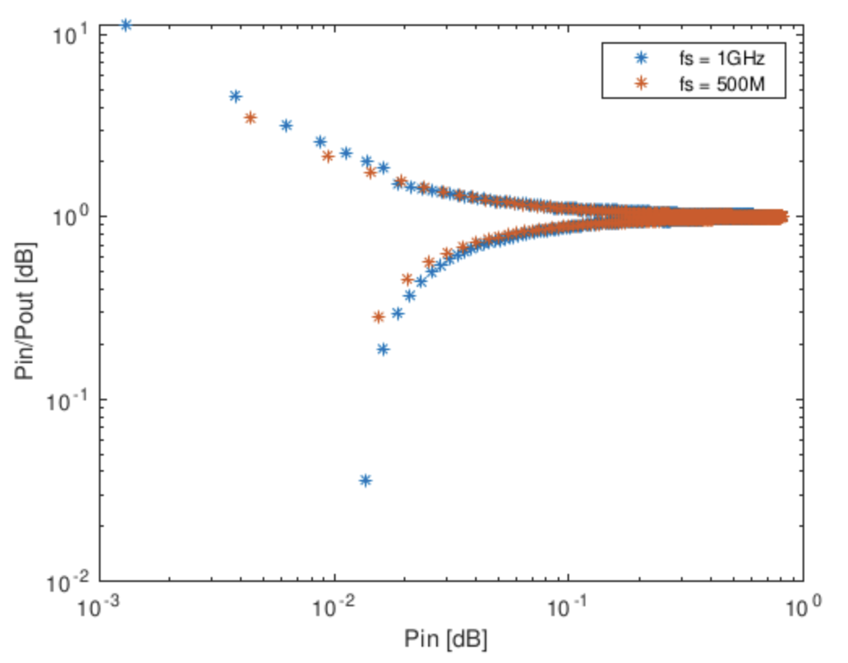
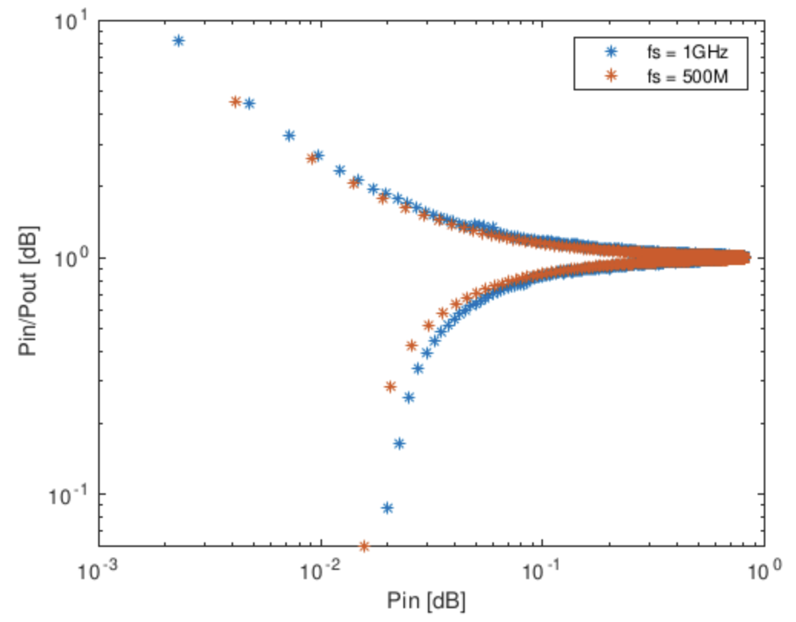
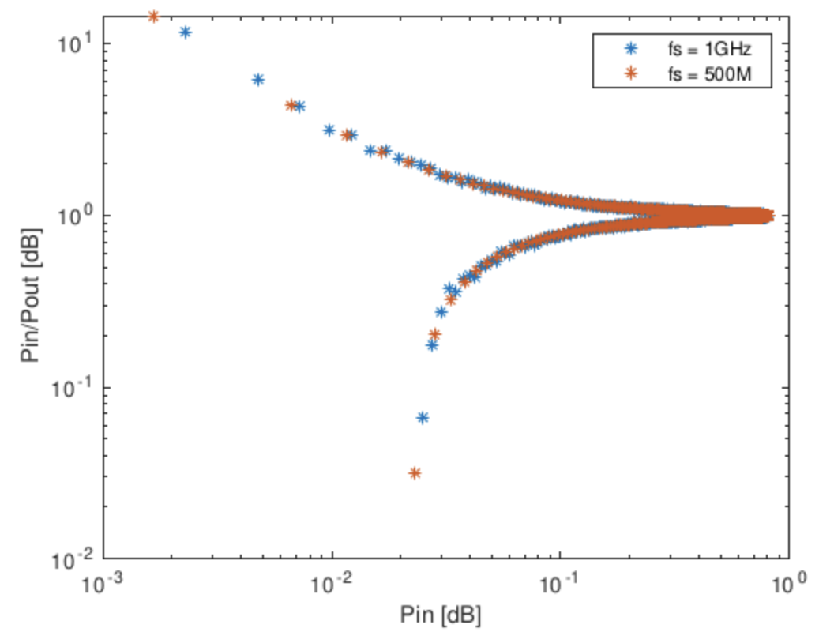
Why do I need such a long memory?
PA-like plots single tone
fin = 10MHz fin = 200MHz fin = 490MHz
fin = 650MHz fin = 990M

Slide 20
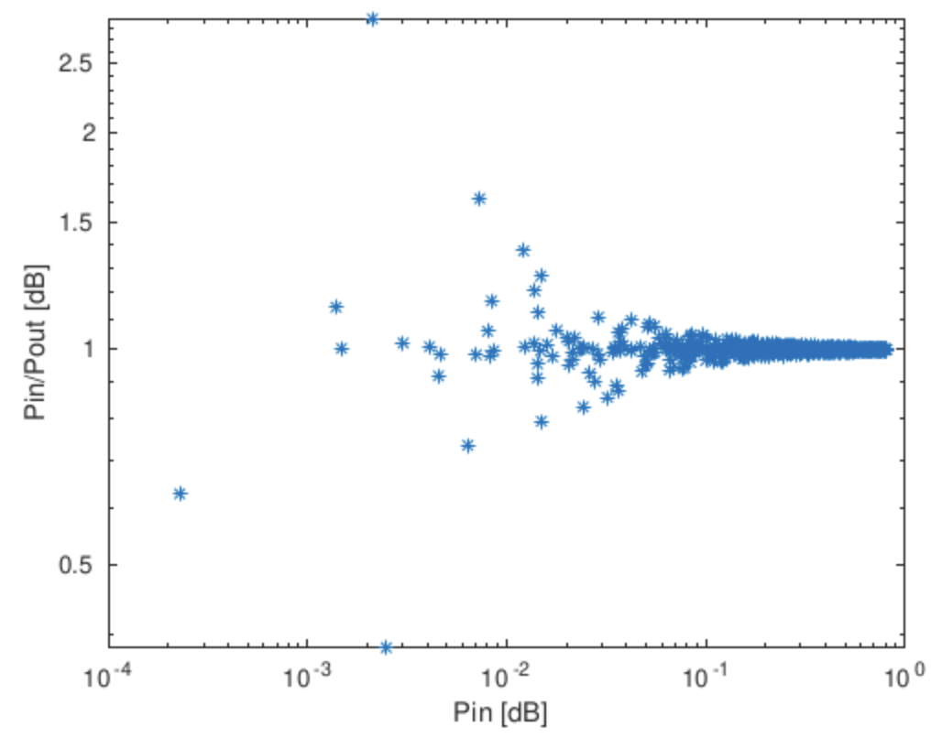
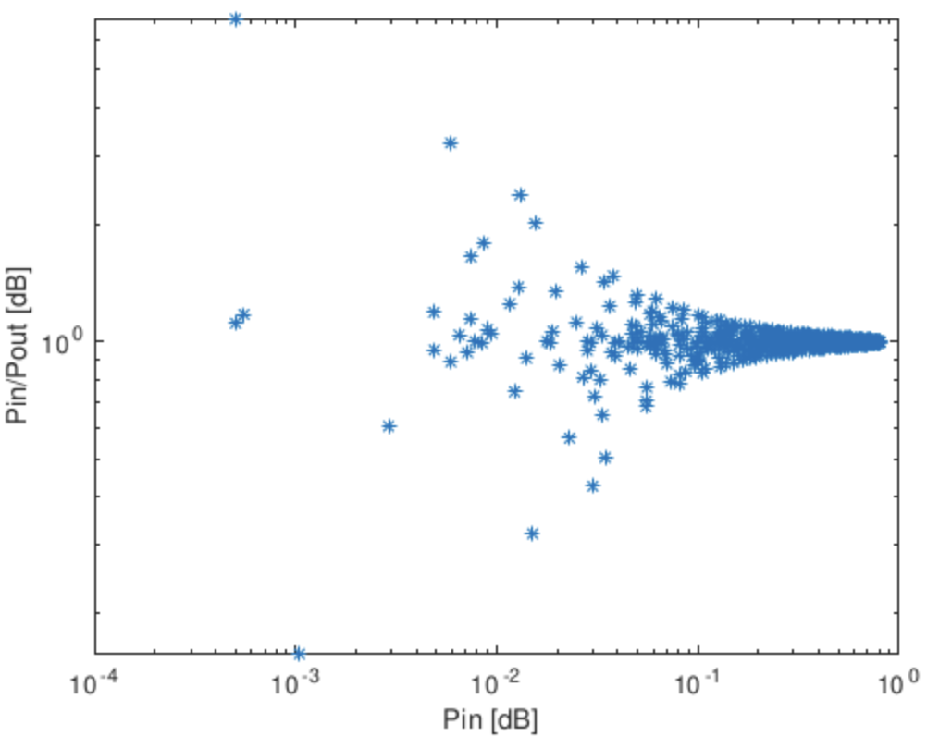
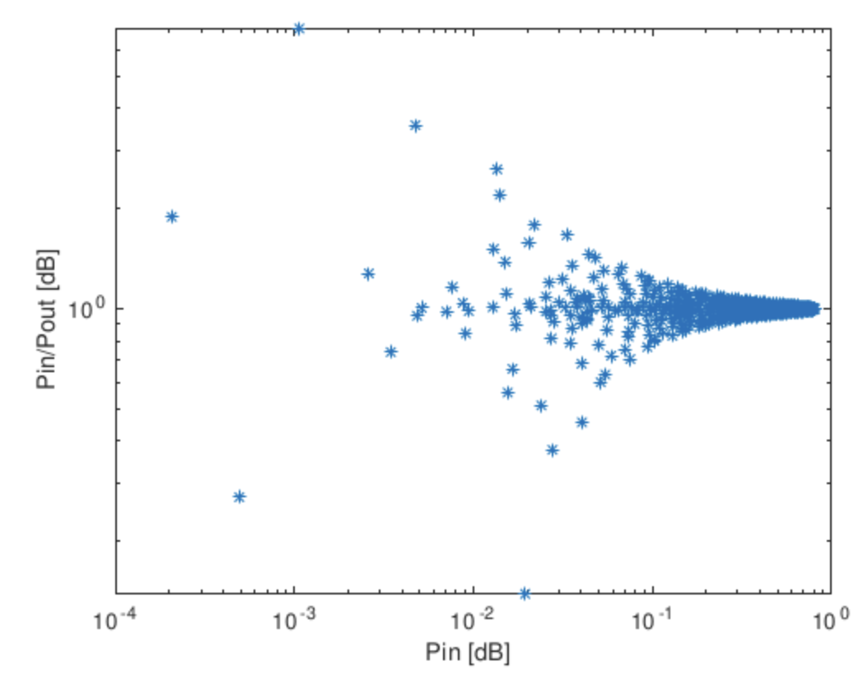
Why do I need such a long memory?
PA-like plots two tones
fin = 200MHz fin = 800MHz fin = 980MHz

Slide 21
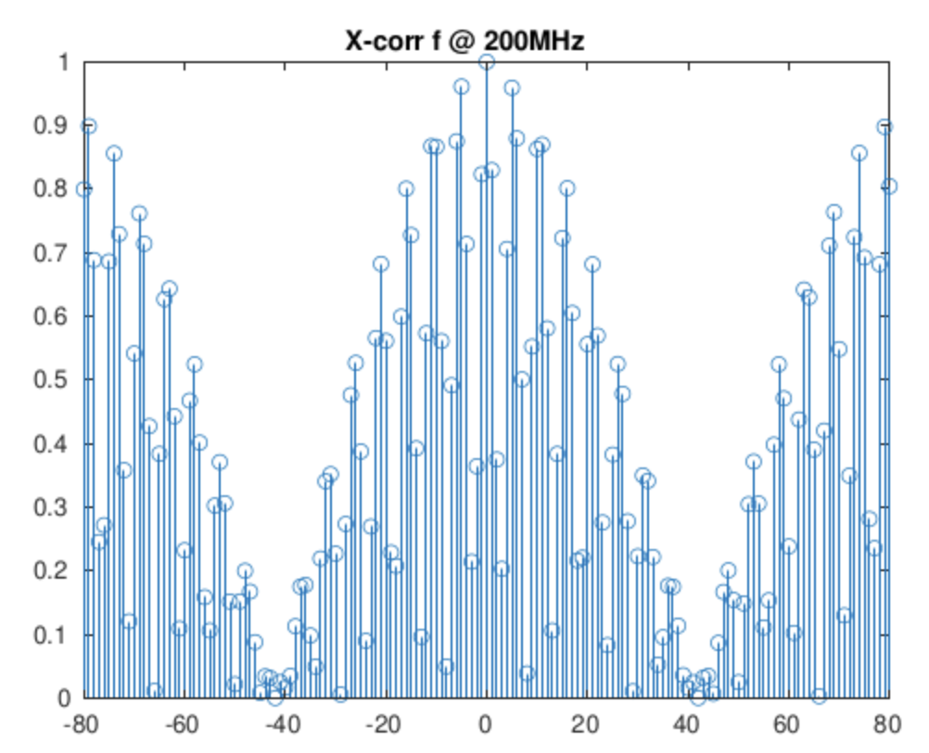
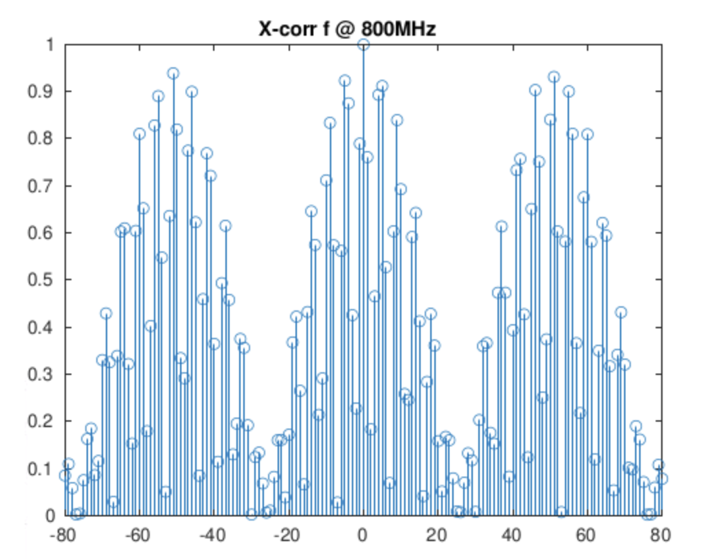
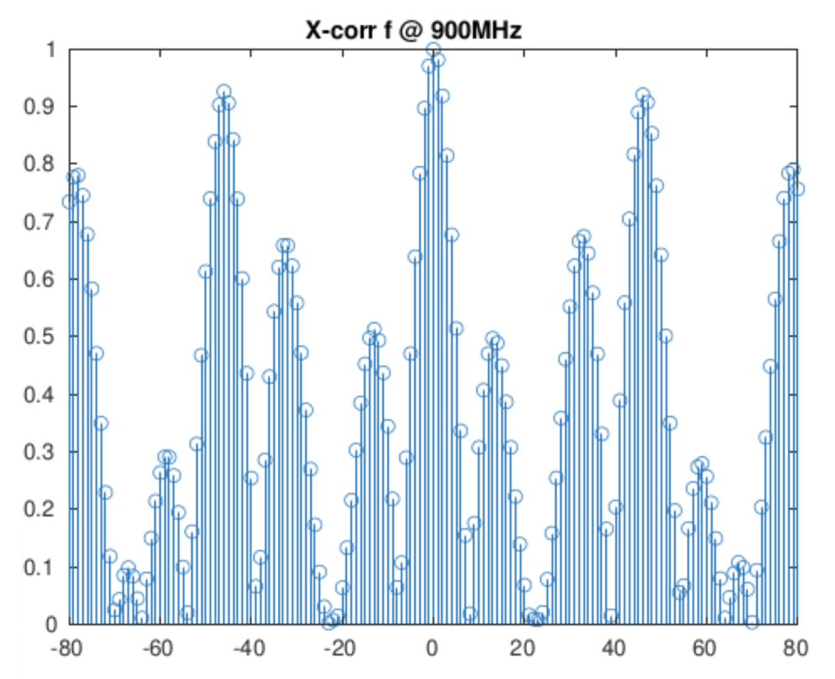
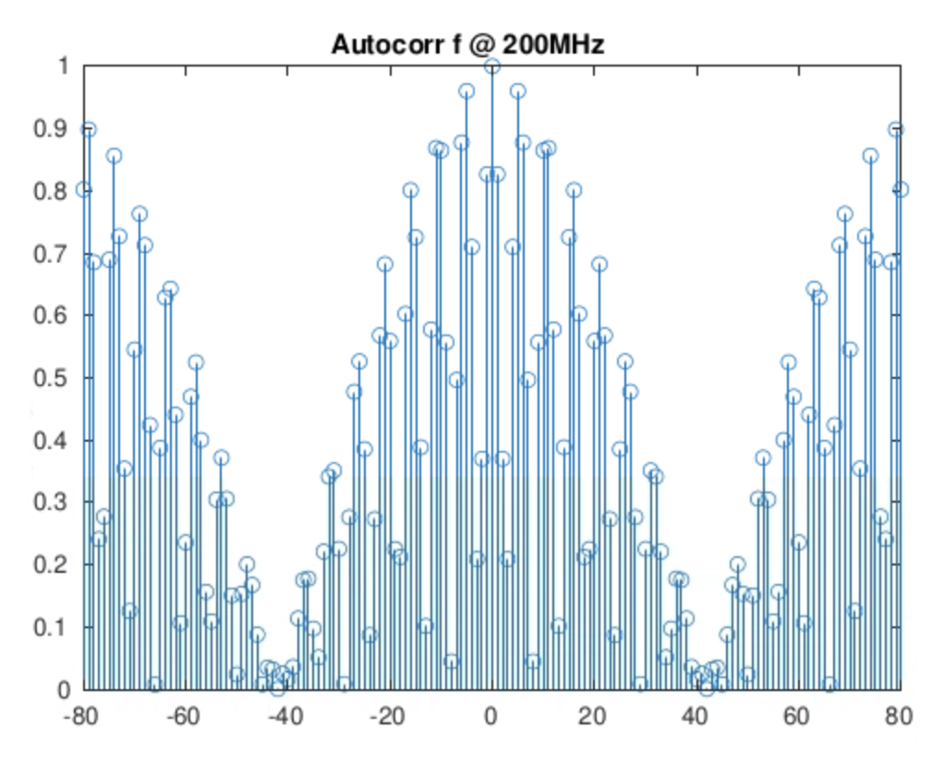
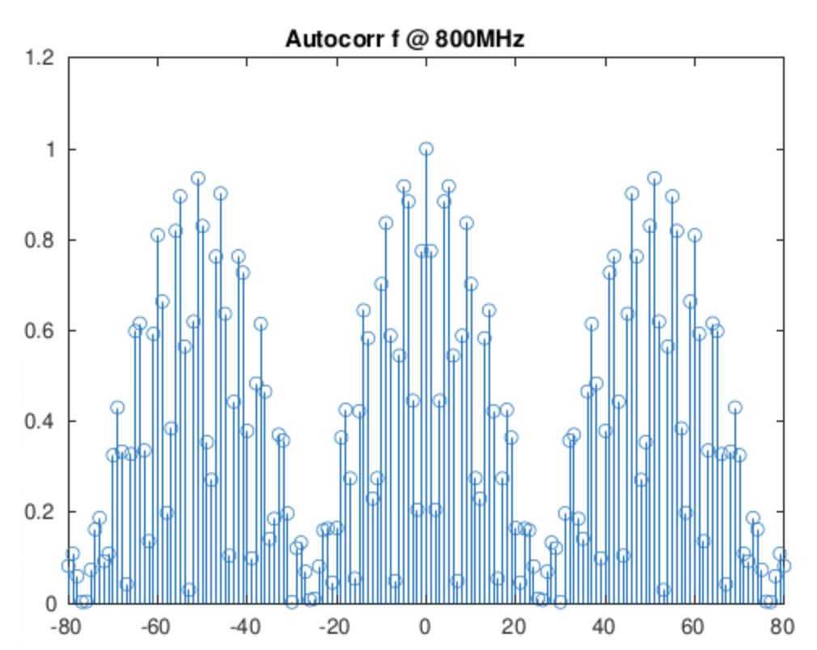
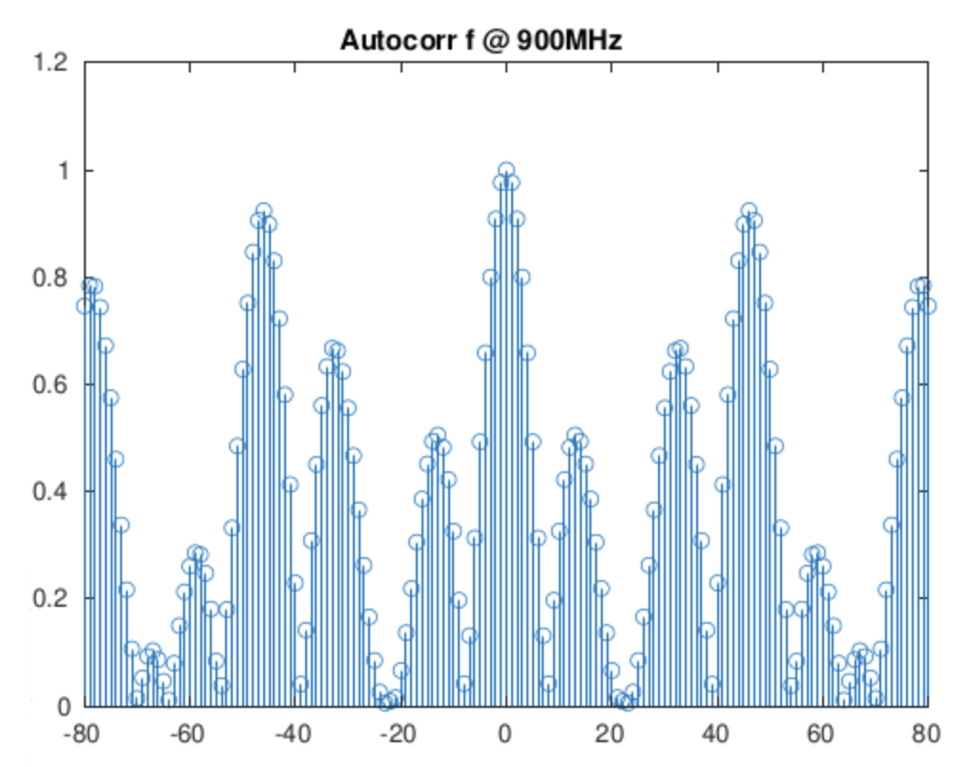
Why do I need such a long memory?
2 tones
Cross-correlation between Vin and Vout of the sampler
Auto-correlation of Vin

Slide 22
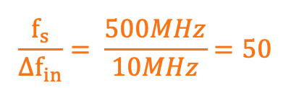
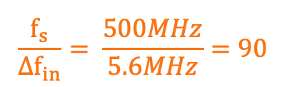
Why do I need such a long memory?
2 tones
Cross-correlation between Vin and Vout of the sampler
$$\frac{f_{s}}{{∆f}_{in}}= \frac{500MHz}{5.6MHz}=90$$
$$\frac{f_{s}}{{∆f}_{in}}= \frac{500MHz}{10MHz}=50$$

Slide 23
Why do I need such a long memory?
2 tones
Possible conclusion: the width of the first lobe of the cross-correlation of Vsampler and Vin sets the memory length
Tried to increse ∆fin to reduce the cross-correlation between Vin and Vsampler, but still need a long memory → false conclusion

Slide 24
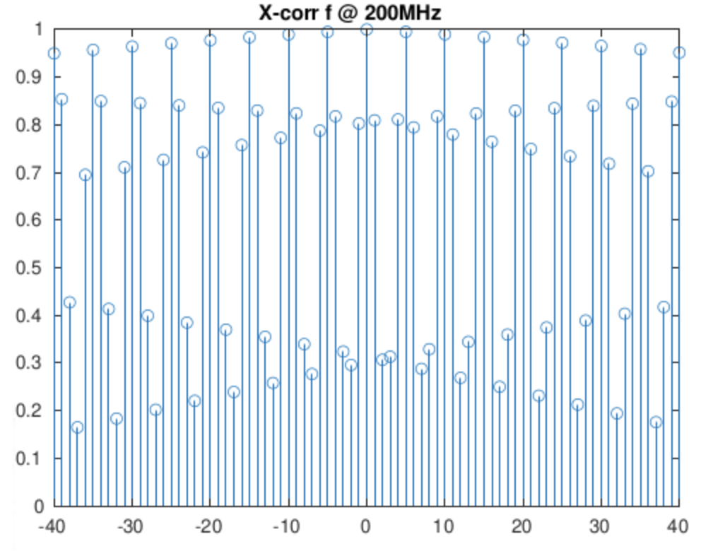
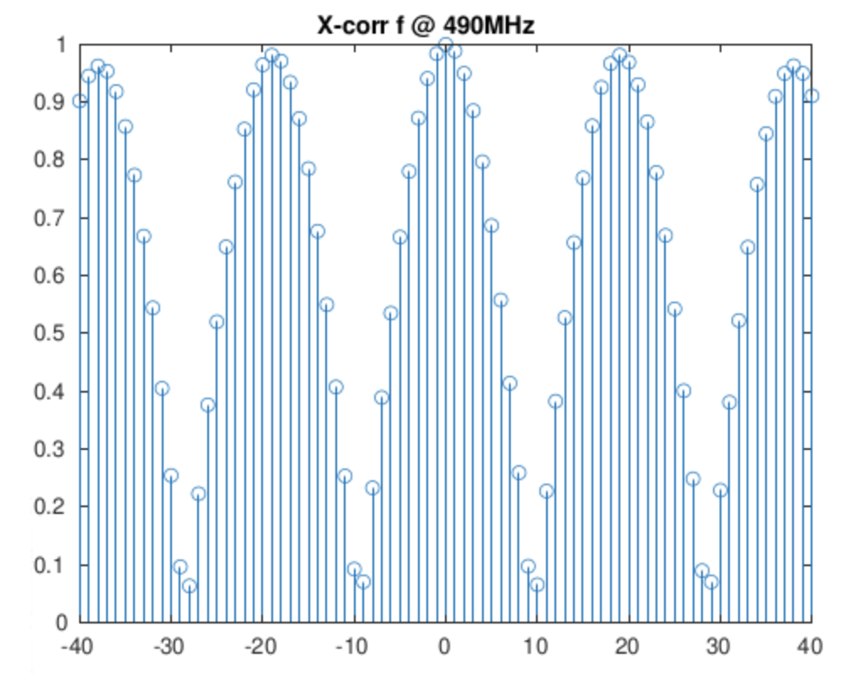
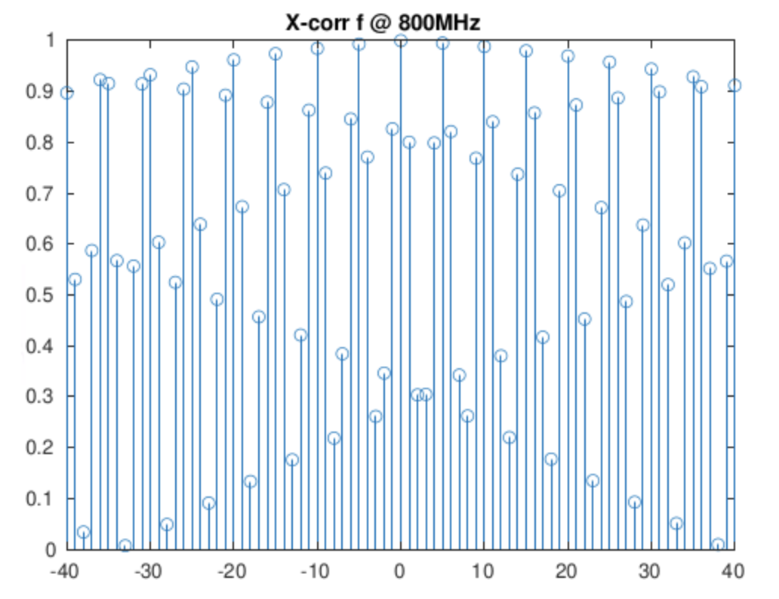
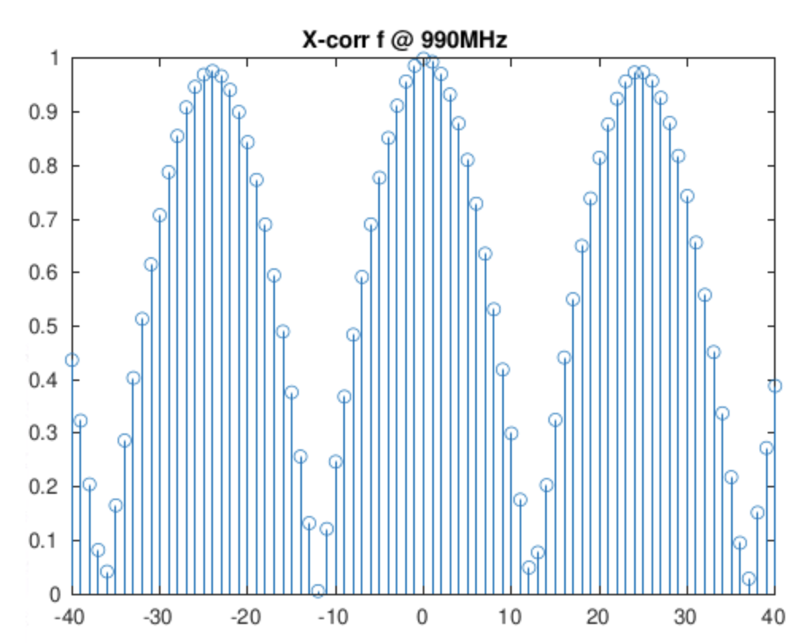
Why do I need such a long memory?
single tone
Cross-correlation between Vin and Vout of the sampler
With the single tone, it seems we have no dependence between the width of the first lobe of the cross-correlation of Vsampler and Vin with the needed memory

Slide 25
Performance of the sampler with fs_core = 1GHz [The start delay and all ctrls of loop delay are minimum + the amplification phase is 300ps (ctrl = 3)]

Slide 26
Other problems
Coefficients derived at a certain frequency cannot correct the behavior of the sampler at other frequencies
Coefficients derived with a PRBS at the input of the sampler cannot correct the behavior of the sampler when a sinusoidal input is applied

