Slide 1
Biweekly Update Presentation 01
Berkay Ipek – ARPLab 29/05/2025

Slide 2
Outline
What is done
Tutorials, Dynamic Calibration of the Buffer
What is the current status
Invertibility
Plans for the next weeks

Slide 3
What is done - Tutorials
Virtuoso
Ring Oscillator
MATLAB
SARADC
VHDL
SARADC
SARADC (in a modular way)
A simple bash script (list.f and cds.lib)
Papers

Slide 4
What is done – Dynamic Calibration : Recap
Virtuoso
V_{in} V_{buffer} D_{out}
Digital calibration
V_{buffer}
h_{i}(j) [coefficients of the Volterra series miming the behavior fo the buffer] V_{in}
h_{i}(j) V_{buffer,cal} (ideally, V_{in})
V_{buffer}
ADC
LMS loops
in
out
inverse of Volterra series miming the buffer
Taken from Alessia’s Slides

Slide 5
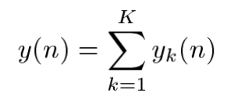
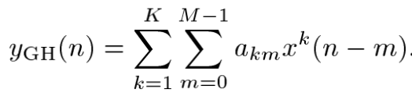
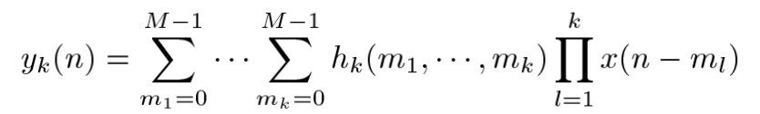
What is done – Dynamic Calibration : Recap
Volterra Series Memory Polinomials
Memory polynomials are a special case of Volterra
series; specifically, they are obtained by setting to zero the coefficients of all terms involving the product of input samples at different time instants.
For a memory polynomial of order p and memory m, the number of coefficients N_{c} is m*p.
Taken from Alessia’s Slides

Slide 6
What is done – Dynamic Calibration : Recap
Example for M=2 & P=2
Volterra Series
Y_{k}(n) = h(0)*y(n) + h(1)*y(n-1) + h(2)*y(n-2)
+ h(3)*y(n)*y(n) + h(4)*y(n)*y(n-1) + h(5)*y(n)*y(n-2)
+ h(6)*y(n-1)*y(n-1) + h(7)*y(n-1)*y(n) + h(8)*y(n-1)*y(n-2)
+ h(9)*y(n-2)*y(n-2) + h(10)*y(n-2)*y(n) + h(11)*y(n-2)*y(n-1) Total Number of Coefficients = 12 = (M+1)^{P}
Memory Polinomials
Y_{k}(n) = h(0)*y(n) + h(1)*y(n-1) + h(2)*y(n-2)
+ h(3)*y(n)*y(n)
+ h(4)*y(n-1)*y(n-1)
+ h(5)*y(n-2)*y(n-2)
Total Number of Coefficients = 6 = (M+1)*P

Slide 7
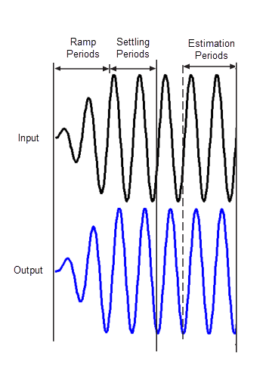
What is done – Dynamic Calibration : Buffer
During Virtuoso
Problem 1: Settling time
Problem 2: THD and SFDR values for NFFT
During MATLAB
Problem 1: Memorial Effect
Problem 2: Coefficient values
Problem 3: Assuming system can be irreversible using a type of series

Slide 8
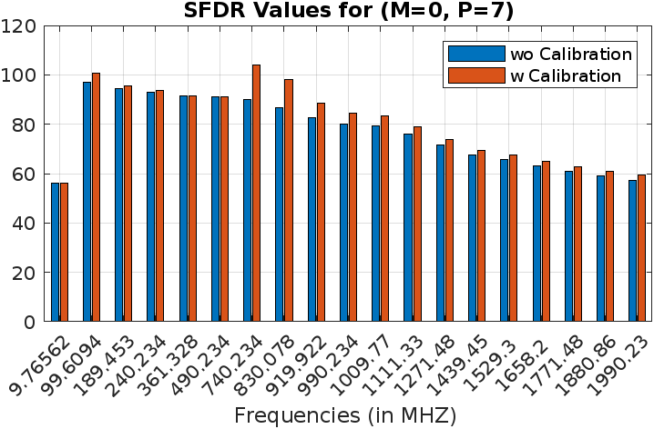
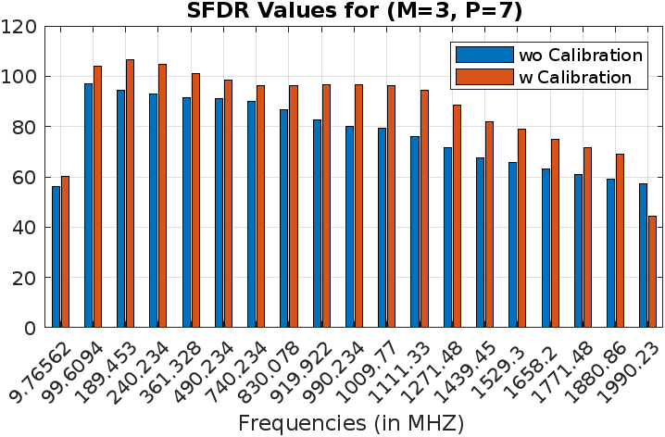
What is done – Dynamic Calibration : Memory-SFDR
Polynomial orders = x¹ x³ x⁵ x⁷

Slide 9
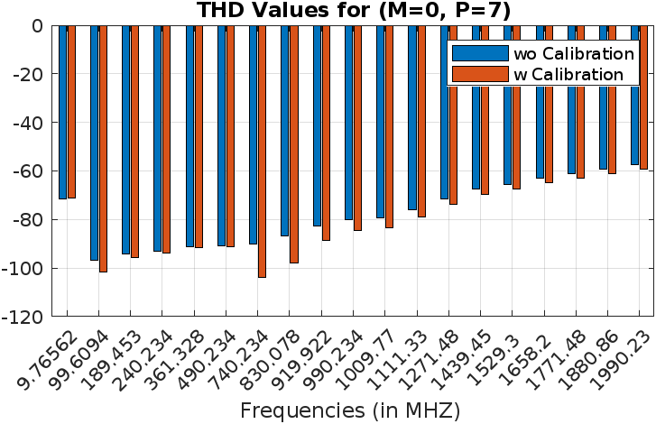
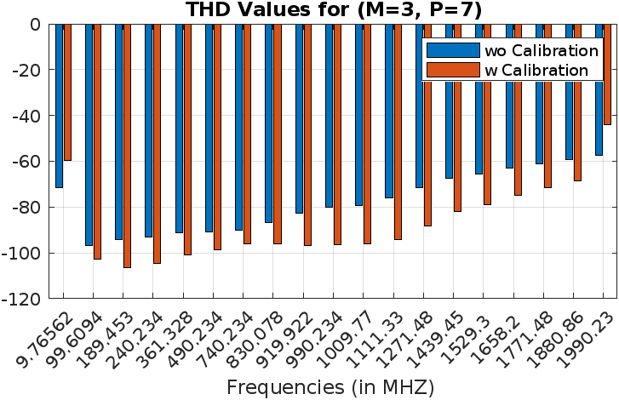
What is done – Dynamic Calibration : Memory-THD
Polynomial orders = x¹ x³ x⁵ x⁷

Slide 10
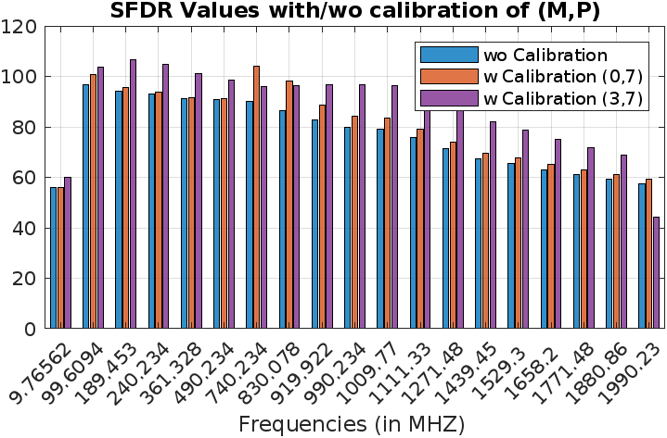
What is done – Dynamic Calibration : Memory-SFDR
Polynomial orders =
x¹ x³ x⁵ x⁷

Slide 11
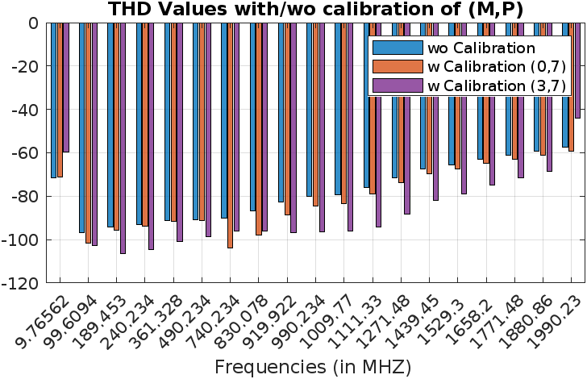
What is done – Dynamic Calibration : Memory-THD
Polynomial orders =
x¹ x³ x⁵ x⁷

Slide 12
What is the current status - Invertibility
Transfer Function of the buffer
V_{in} V_{buffer}
Mimicing the Transfer Function
V_{in}
k_{i}(j) (coefficients of H(s)) V_{buffer}
k_{i}(j) V_{out}(ideally V_{buffer})
V_{in}
H(s)
in
out
LMS loops
in
out
Volterra series miming the buffer

Slide 13
What is the current status - Invertibility
Transfer Function of the buffer
Dynamic Calibration
H(s)
V_{in}
in
out
V_{buffer}
where k_{i}(j) (coefficients of H(s))
H_{calib}(s)
V_{in}
in
out
V_{buffer}
in
out
V_{buffer} (calibrated, ideally V_{in})
How to find coefficients for H_{calib}(s) ?

Slide 14
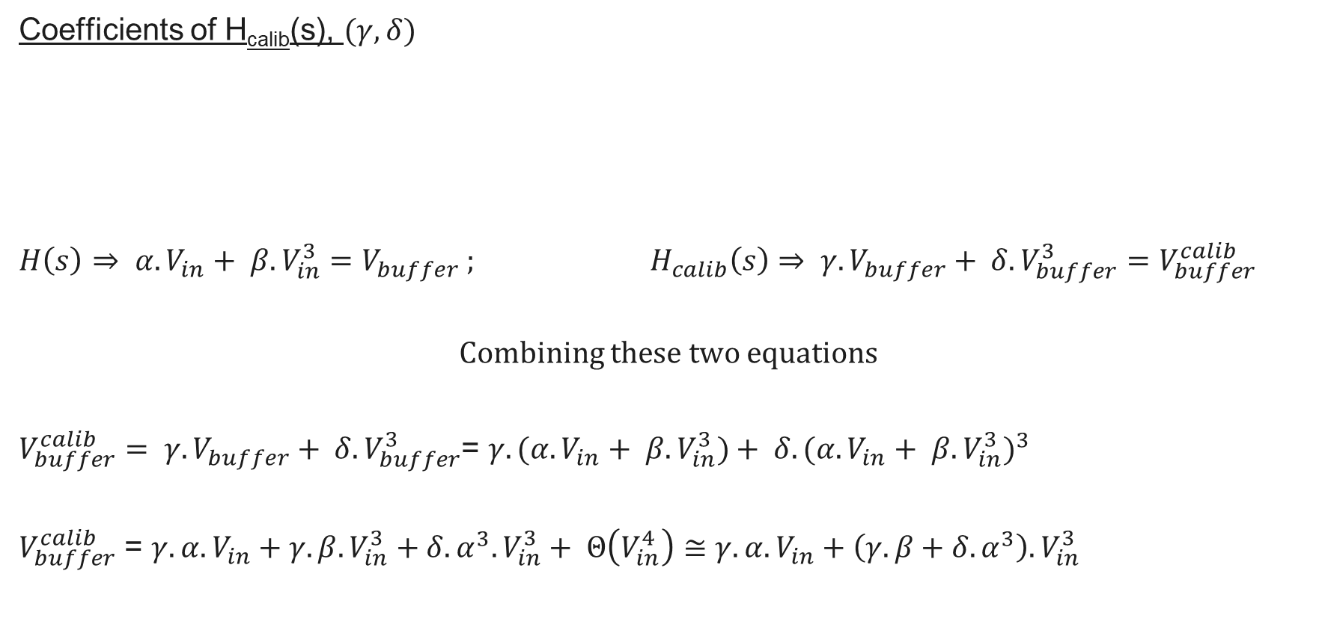
What is the current status – Invertibility: H_{calib}(s)
Coefficients of H_{calib}(s), $(γ,δ)$
$$H\left(s\right)⇒ α. V_{in}+ β.V_{in}^{3}=V_{buffer} ; H_{calib}\left(s\right)⇒ γ.V_{buffer}+ δ.V_{buffer}^{3}=V_{buffer}^{calib}$$
Combining these two equations
$V_{buffer}^{calib}= γ.V_{buffer}+ δ.V_{buffer}^{3}$= $γ.(α. V_{in}+ β.V_{in}^{3})+ δ.{(α. V_{in}+ β.V_{in}^{3})}^{3}$
$V_{buffer}^{calib}$ = $γ.α. V_{in}+γ.β.V_{in}^{3}+δ.α^{3}. V_{in}^{3}+ Θ\left(V_{in}^{4}\right)≅γ.α. V_{in}+\left(γ.β+δ.α^{3}\right). V_{in}^{3}$
H_{calib}(s)
V_{in}
in
out
V_{buffer}
in
out
V_{buffer} (calibrated, ideally V_{in})

Slide 15

What is the current status – Invertibility: H_{calib}(s)
Coefficients of H_{calib}(s), $(γ,δ)$
$$H\left(s\right)⇒ α. V_{in}+ β.V_{in}^{3}=V_{buffer} ; H_{calib}\left(s\right)⇒ γ.V_{buffer}+ δ.V_{buffer}^{3}=V_{buffer}^{calib}$$
$V_{buffer}^{calib}$ = $γ.α. V_{in}+\left(γ.β+δ.α^{3}\right). V_{in}^{3}$ $V_{buffer}^{calib}$ = $V_{in}$
Results
$γ.α=1⇒γ=\frac{1}{α}$ $γ.β+δ.α^{3}=0⇒δ=−\frac{γ.β}{α^{3}}=−\frac{β}{α^{4}}$
H_{calib}(s)
V_{in}
in
out
V_{buffer}
in
out
V_{buffer} (calibrated, ideally V_{in})

Slide 16
Plans for the next weeks
Cont. to work on validity of invertibility of the buffer
Final exams during the second week of June :(

