Slide 1
Biweekly Update Presentation 04
Berkay Ipek – ARPLab 13/08/2025

Slide 2
Outline
What is done
Linear Memory Analysis
Memory Sweep Analysis
Advanced Memory Sweep Analysis
Plans for the next weeks
PRBS Signal

Slide 3
What is done: Linear Memory Analysis

Slide 4
Linear Memory Analysis: Set up

Slide 5
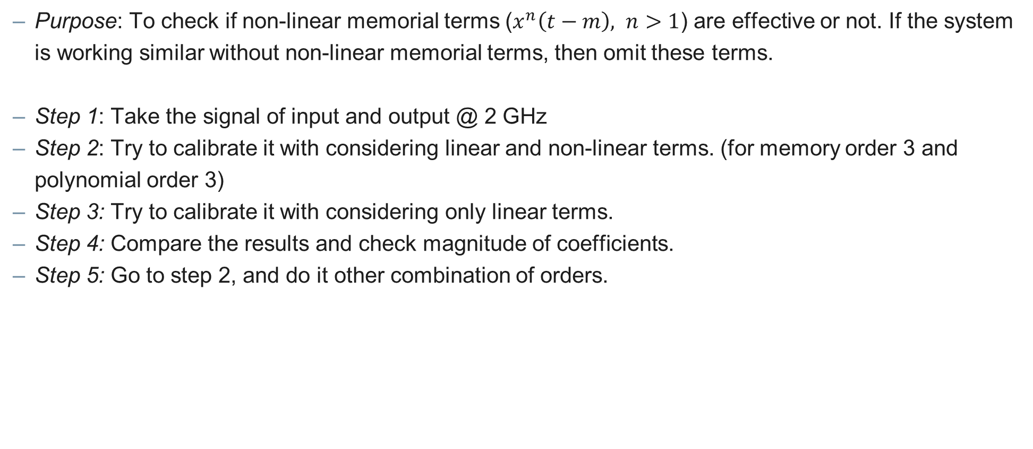
Linear Memory Analysis – Set Up
Purpose: To check if non-linear memorial terms ($x^{n}\left(t−m\right), n>1$) are effective or not. If the system is working similar without non-linear memorial terms, then omit these terms.
Step 1: Take the signal of input and output @ 2 GHz
Step 2: Try to calibrate it with considering linear and non-linear terms. (for memory order 3 and polynomial order 3)
Step 3: Try to calibrate it with considering only linear terms.
Step 4: Compare the results and check magnitude of coefficients.
Step 5: Go to step 2, and do it other combination of orders.

Slide 6
Linear Memory Analysis: Results

Slide 7
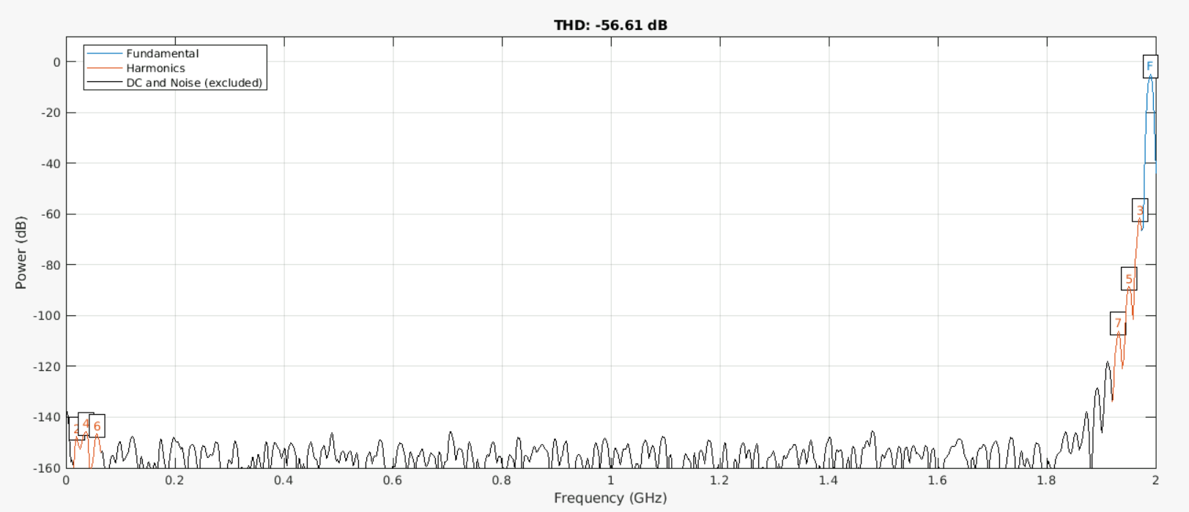
Linear Memory Analysis – Results
Spectrum of output waveform in the buffer :

Slide 8
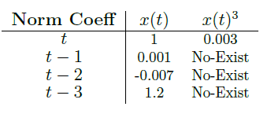
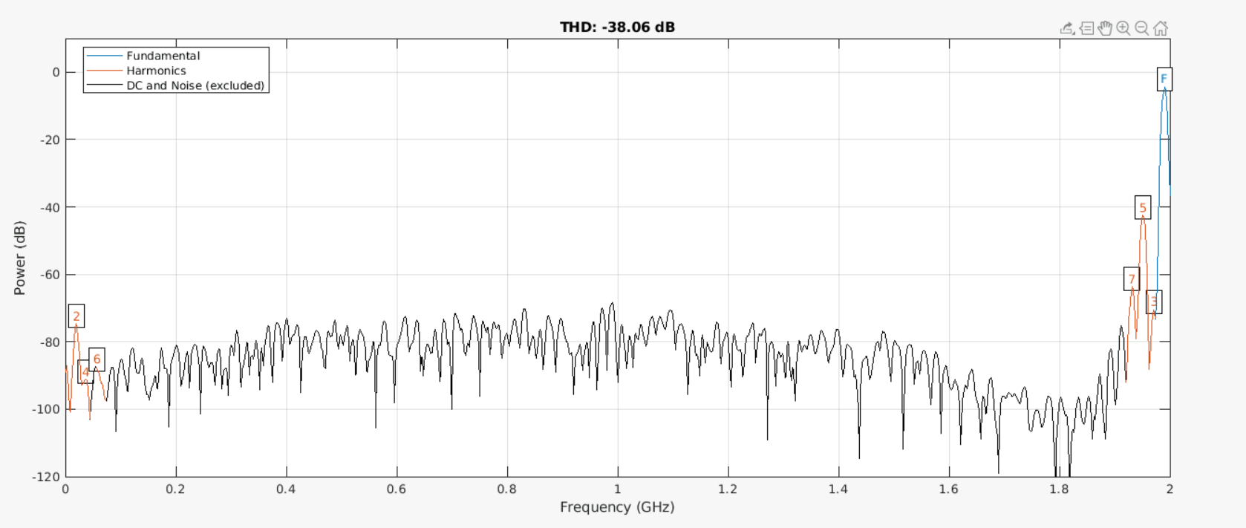
Linear Memory Analysis – Results
Memory order 3 & Polynomial order 3 :
Both linear and nonlinear: -38 dB | Only linear : -52.3 dB

Slide 9
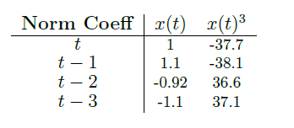
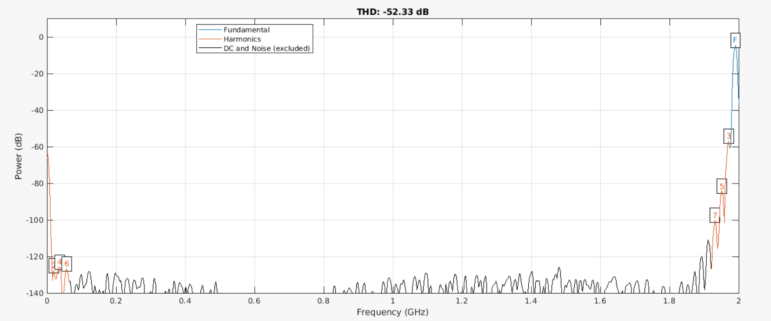
Linear Memory Analysis – Results
Memory order 3 & Polynomial order 3 :
Both linear and nonlinear: -38 dB | Only linear : -52.3 dB

Slide 10
So, is it working ??

Slide 11
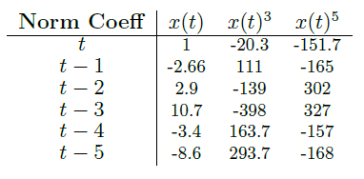
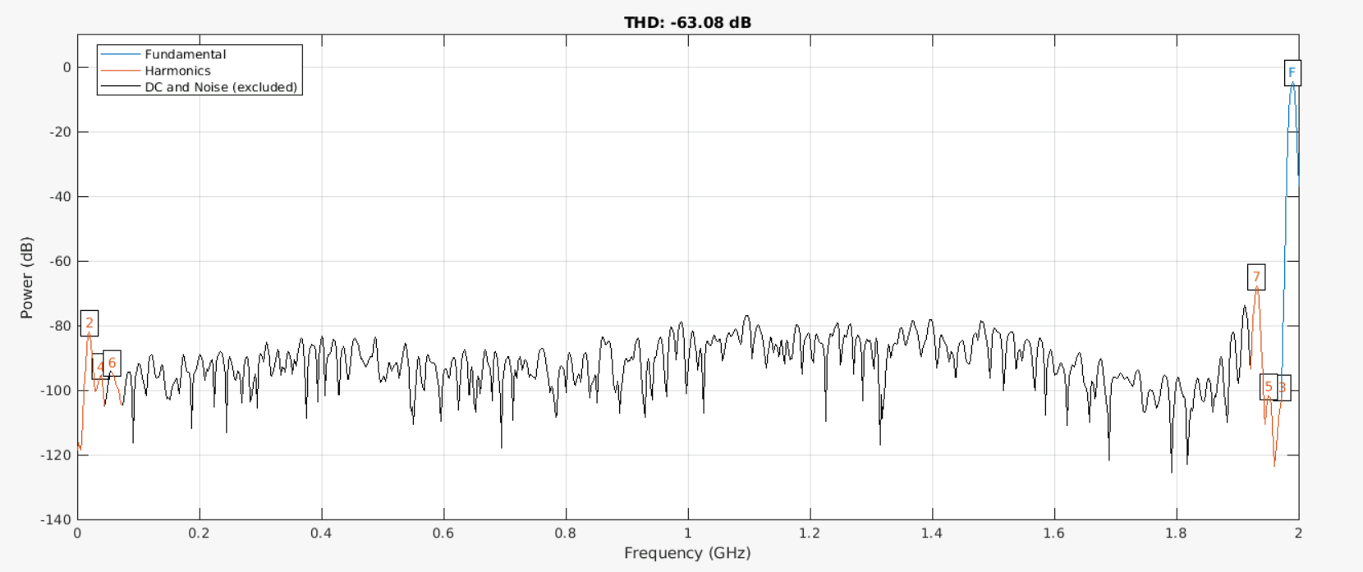
Linear Memory Analysis – Results
Memory order 5 & Polynomial order 5 :
Both linear and nonlinear: -63.1 dB | Only linear : -48.5 dB

Slide 12
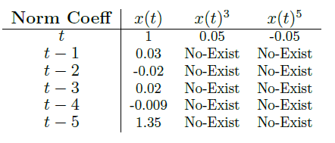
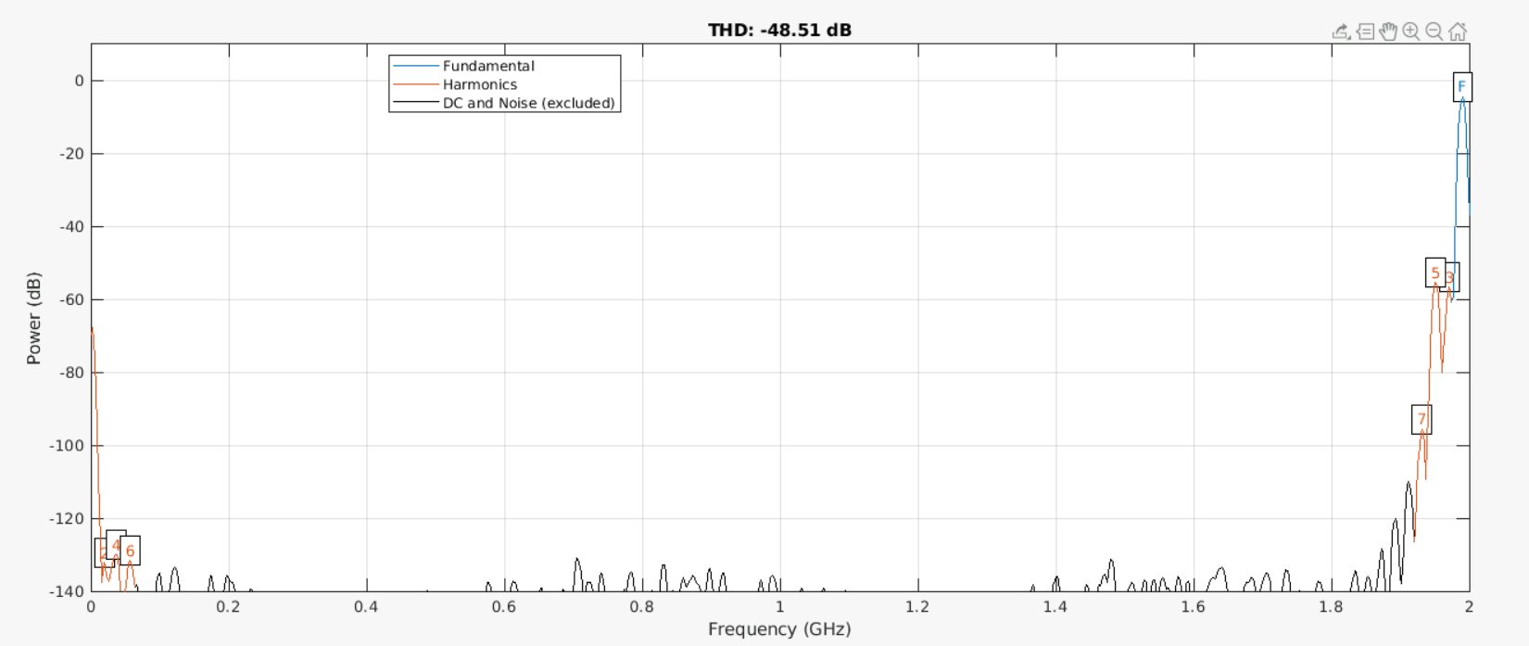
Linear Memory Analysis – Results
Memory order 5 & Polynomial order 5 :
Both linear and nonlinear: -63.1 dB | Only linear : -48.5 dB

Slide 13
Linear Memory Analysis: Results Comparing

Slide 14


Linear Memory Analysis – Results
Memory order 3 & Polynomial order 3 :
Both linear and nonlinear: -38 dB | Only linear : -52.3 dB
Memory order 3 & Polynomial order 5 :
Both linear and nonlinear: -56.8 dB | Only linear : -48.6 dB
Memory order 5 & Polynomial order 3 :
Both linear and nonlinear: -38.5 dB | Only linear : -52.25 dB
Memory order 5 & Polynomial order 5 :
Both linear and nonlinear: -63.1 dB | Only linear : -48.5 dB
Memory order 5 & Polynomial order 7 :
Both linear and nonlinear: -82.8 dB | Only linear : -45.8 dB
Memory order 7 & Polynomial order 7 :
Both linear and nonlinear: -88.2 dB | Only linear : -45.74 dB

Slide 15
What is done: Memory Sweep Analysis

Slide 16
Memory Sweep Analysis: Set up

Slide 17
Memory Sweep Analysis – Set Up
Purpose: To check every possible cases to see which memorial coefficients can be omitted by doing a sweep.
Step 1: Take the signal of input and output @ 2 GHz
Step 2: Try to calibrate it with considering all terms. (@ fix memory order 5)
Step 3: Try to calibrate it with ignoring every possible memorial terms in the system (see next slides).
Step 4: Plot the results to detect which one has an interesting result.
Step 5: Go to step 2, and do it other combination of polynomial order.

Slide 18
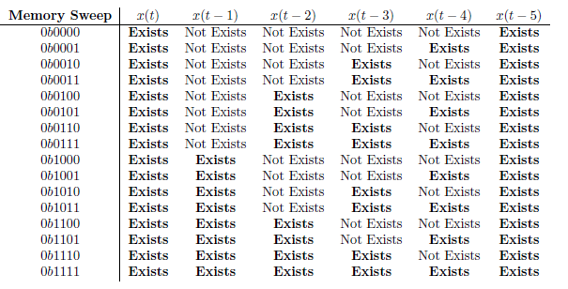
Memory Sweep Analysis – Set Up
Table for Memory Sweep

Slide 19
Memory Sweep Analysis: Results

Slide 20
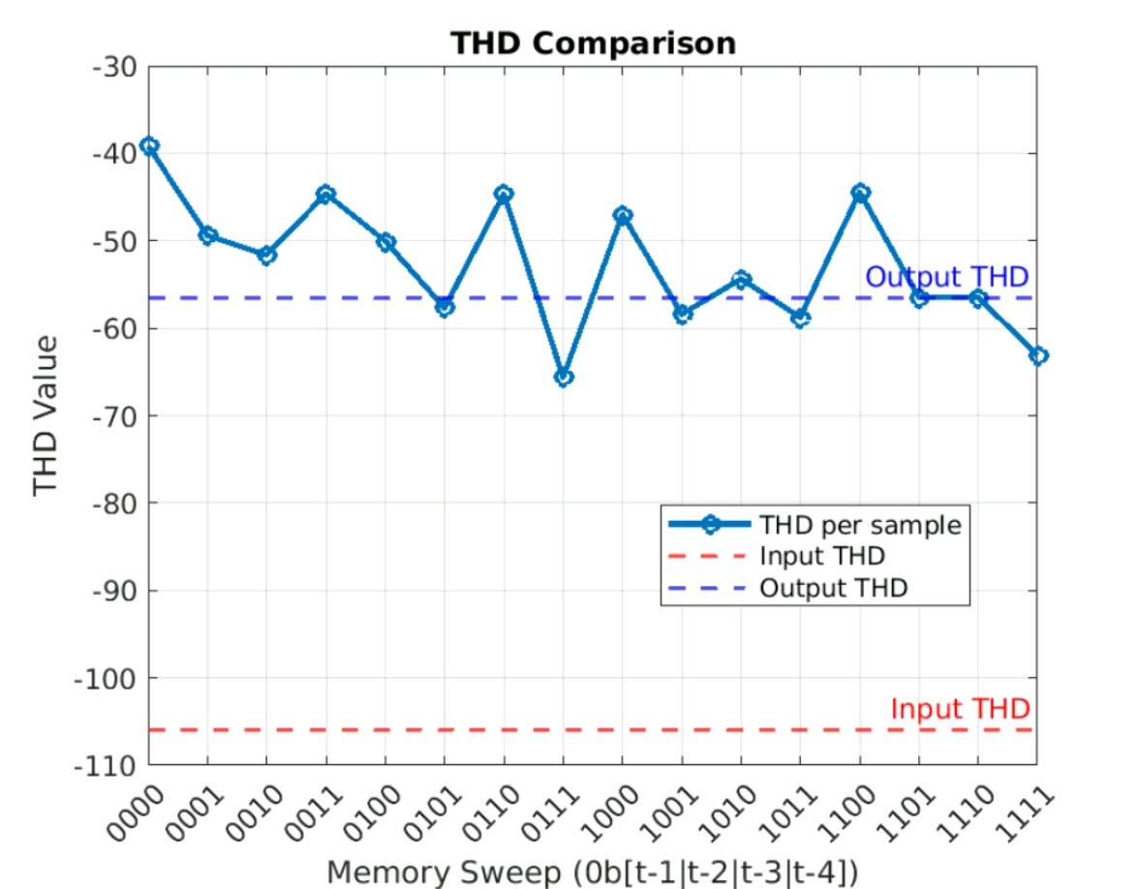
Memory Sweep Analysis – Results
Polynomial order 5

Slide 21
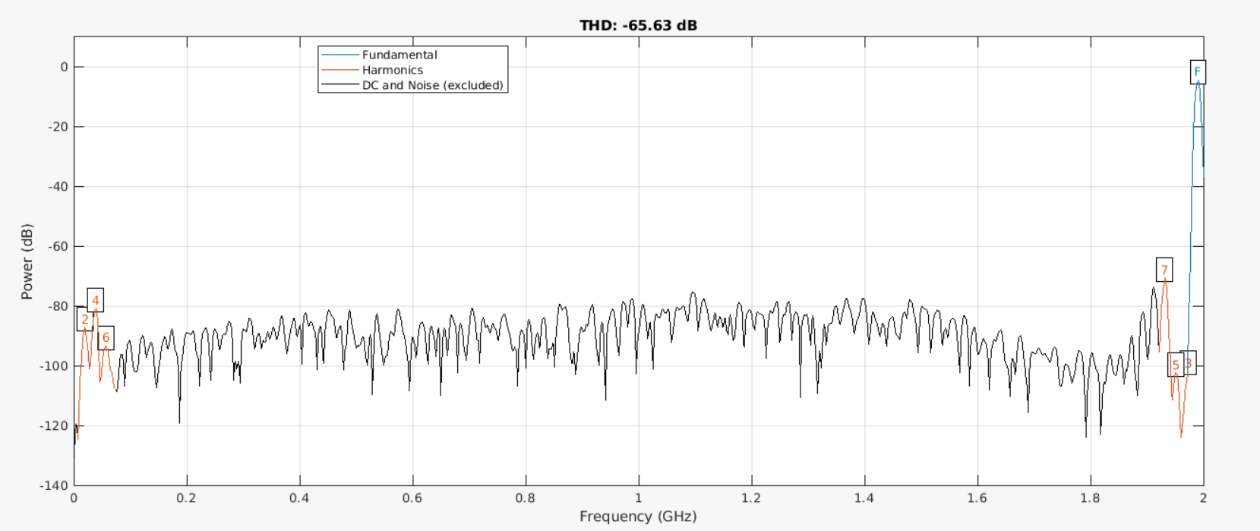
Memory Sweep Analysis – Results
Polynomial order 5 (Memory Sweep 0111)

Slide 22
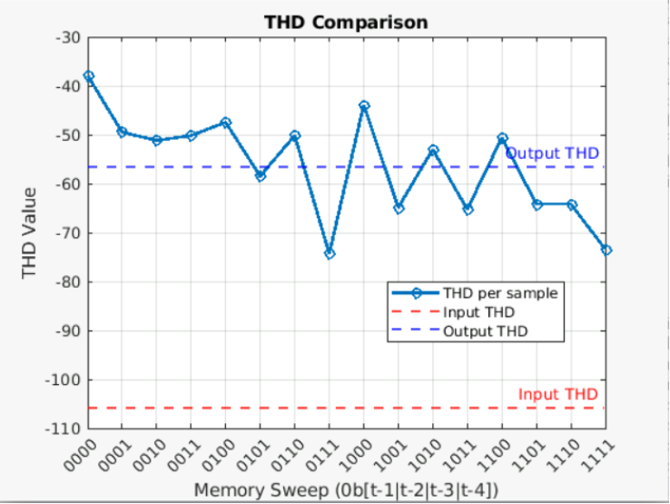
Memory Sweep Analysis – Results
Polynomial order 7

Slide 23
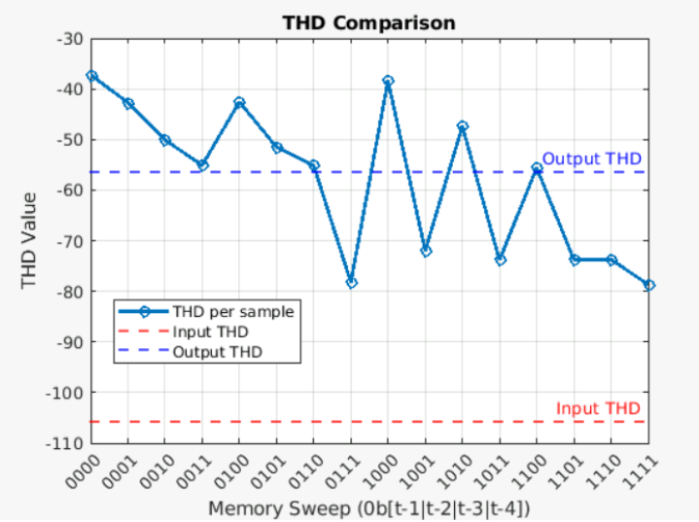
Memory Sweep Analysis – Results
Polynomial order 9
Less # of coeffs

Slide 24
What is done: Advanced Memory Sweep Analysis

Slide 25
Advanced Memory Sweep Analysis– Set Up
Purpose: To check every possible cases to see which memorial coefficients can be omitted by doing a sweep.
Step 1: Take the signal of input and output @ 2 GHz
Step 2: Try to calibrate it with considering all terms. (@ fix memory order 7)
Step 3: Try to calibrate it with ignoring every possible memorial terms in the system (see next slides).
Step 4: Plot the results to detect which one has an interesting result.
Step 5: Go to step 2, and do it other combination of polynomial order.

Slide 26
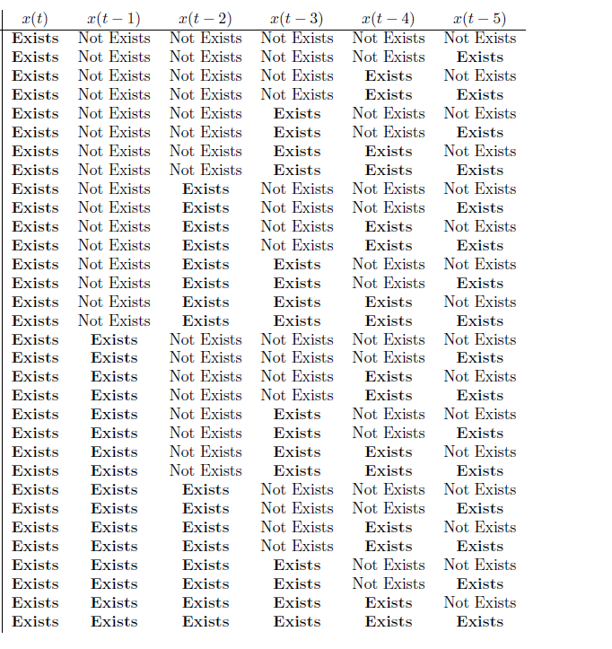
Memory Sweep Analysis – Set Up
…. x(t-7)
Table for Memory Sweep
Do it for up to x(t-7)
Total of 128 cases, so only best 50 cases
will be plotted.
….

Slide 27
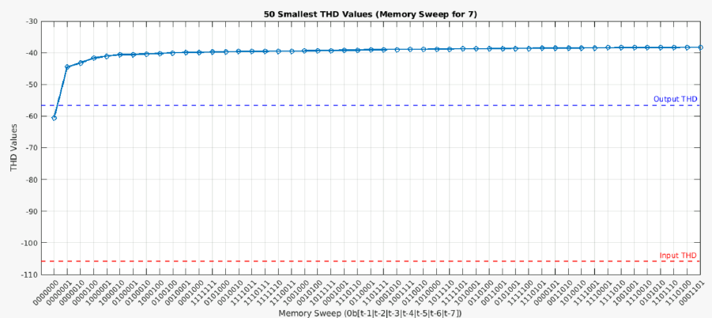
Memory Sweep Analysis – Results
Polynomial order 3

Slide 28
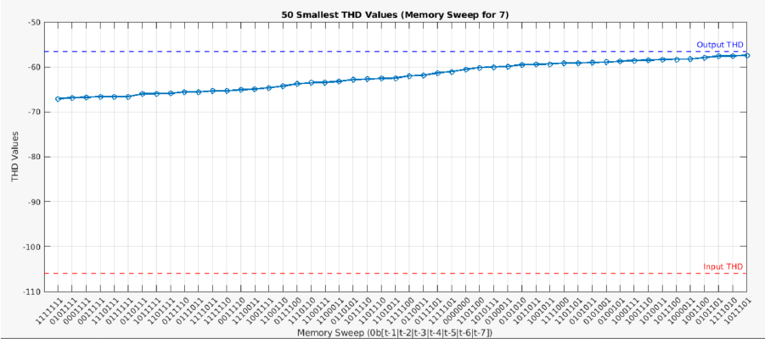
Memory Sweep Analysis – Results
Polynomial order 5

Slide 29
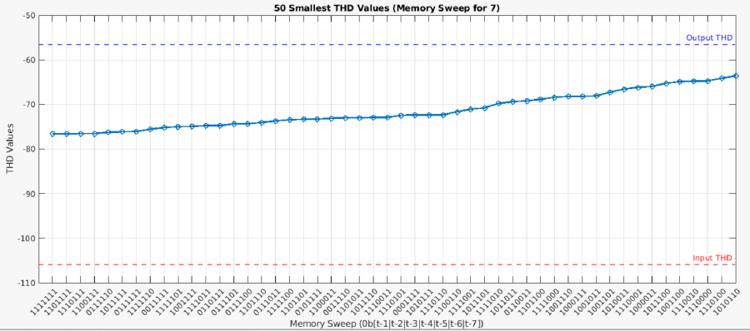
Memory Sweep Analysis – Results
Polynomial order 7

Slide 30
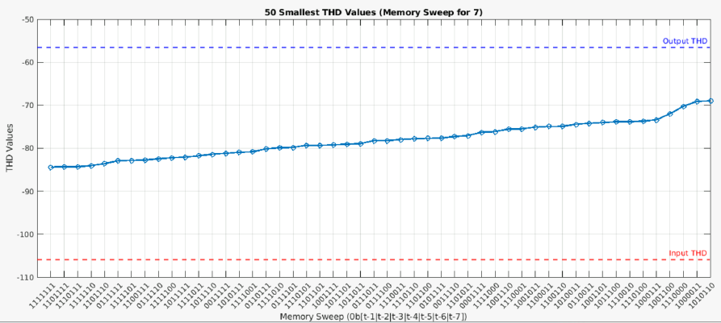
Memory Sweep Analysis – Results
Polynomial order 9

Slide 31
Plans for the next weeks

Slide 32
Plans for the next weeks
Now, we decided which order is going to be used.
For the next week, implementation in digital domain will be analyzed and discussed.

