Slide 1
Biweekly Update Presentation 06
Berkay Ipek – ARPLab 02/10/2025

Slide 2
Outline
What is done
Problem @ 2GHz (Previously done)
Quantization
Precision of Coefficients
Amplitude Problem
Plans for the next weeks
Done all # of simulation points

Slide 3
Problem @ 2GHz : Recap

Slide 4
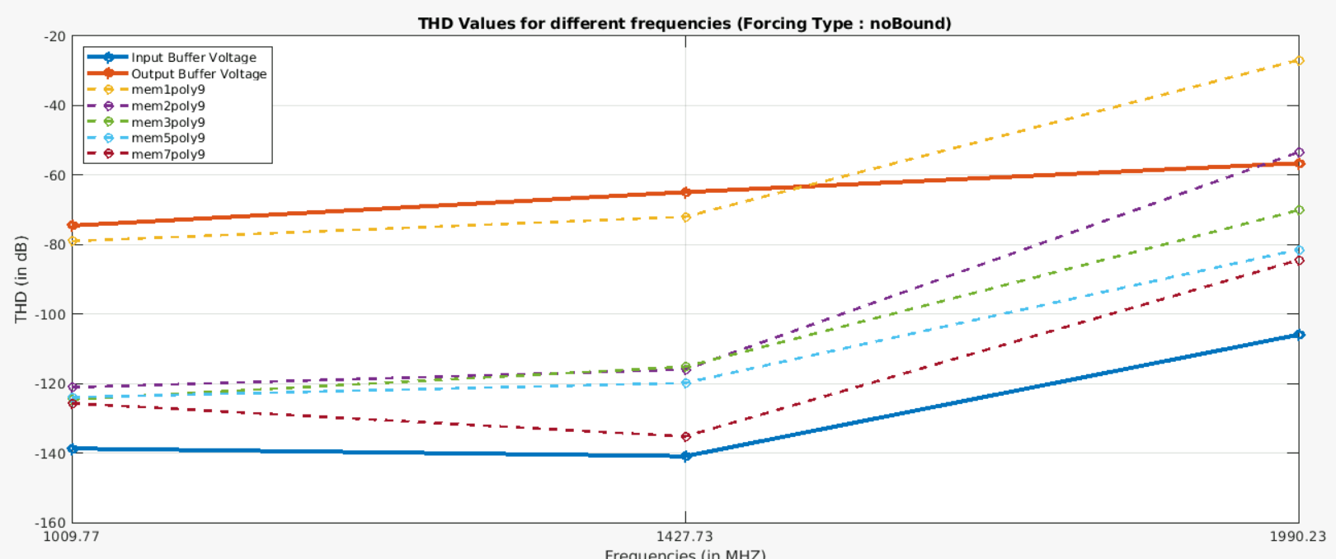
Problem @ 2GHz – Recap

Slide 5
Problem @ 2GHz : Solution

Slide 6
Problem @ 2GHz – Solution
ADD PLOT FOR HIGH NUMBER OF SIMULATION POINTS

Slide 8
Quantization : Set up

Slide 9
Quantization – Set Up
Purpose: Implementing a LUT requires converting analog voltage into a digital voltage, which introduces quantization noise into the signal. Therefore, it is required to determine the number of bits for quantization.
Step 1: Take the signal of input and output waveforms @ 14 different frequencies.
Step 2: Add a quantized signal based on n-bits. (n is initially 10)
Step 3: Calculate and store THD values for quantized and non-quantized (input and output) signals.
Step 4: Go to step 2 do it for (n=10,12,14,16).
Step 5: Plot and compare all results.

Slide 10
Quantization : Results

Slide 11
Quantization – Results – 10-bit Quantization

Slide 12
Quantization – Results – 12-bit Quantization

Slide 13
Quantization – Results – 14-bit Quantization

Slide 14
Quantization – Results – 16-bit Quantization

Slide 15
Quantization – Results
Among the results, when the number of bits is 14 or higher, there is an enough separation between the quantized output and the input voltage signals at high frequencies, which is a requirement for proper calibration. The reason is that calibration is primarily needed at high frequencies, where higher-order harmonics become more dominant.
Therefore, we’ve decided to use a 14-bit quantized signal will be used during the calibration process.
The results for the calibration of quantized signals is present in the next slide:

Slide 16
Quantization – Results
ADD A NEW PLOT FOR THE CALIBRATION !!!!!

Slide 18
Precision of Coefficients: Introduction

Slide 19
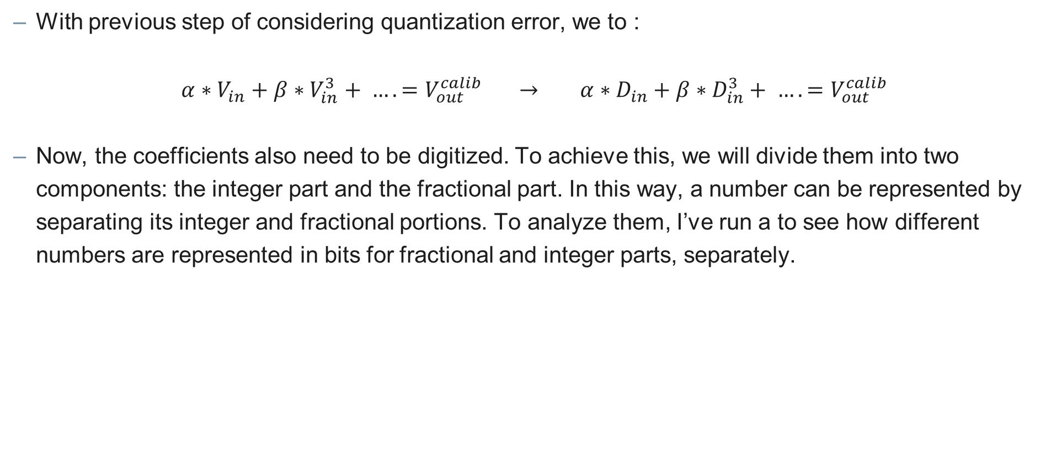
Precision of Coefficients - Introduction
With previous step of considering quantization error, we to :
$$α∗V_{in}+β∗V_{in}^{3}+ ….=V_{out}^{calib} → α∗D_{in}+β∗D_{in}^{3}+ ….=V_{out}^{calib}$$
Now, the coefficients also need to be digitized. To achieve this, we will divide them into two components: the integer part and the fractional part. In this way, a number can be represented by separating its integer and fractional portions. To analyze them, I’ve run a to see how different numbers are represented in bits for fractional and integer parts, separately.

Slide 20
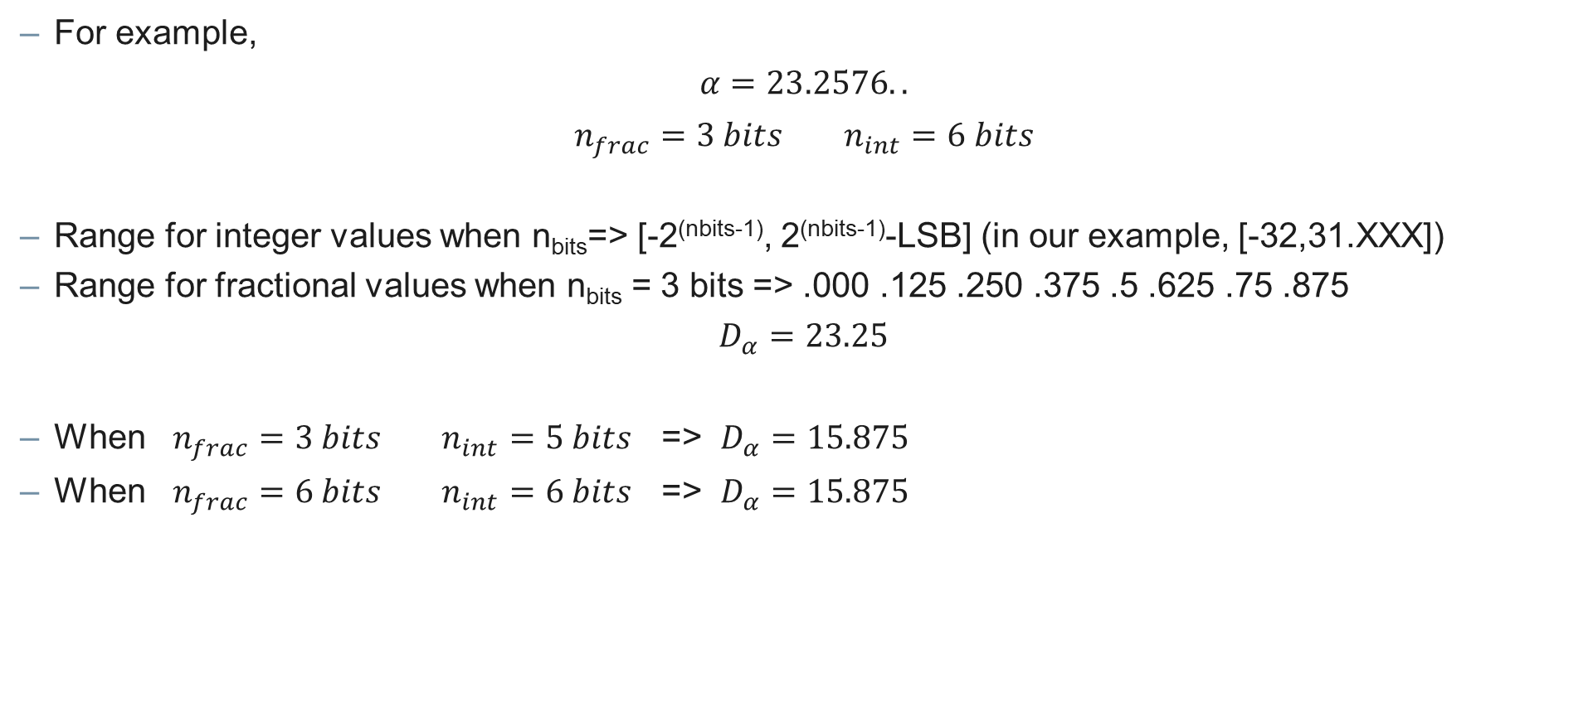
Precision of Coefficients – Introduction
For example, $α=23.2576..$
$$n_{frac}=3 bits n_{int}=6 bits$$
Range for integer values when n_{bits}=> [-2^{(nbits-1)}, 2^{(nbits-1)}-LSB] (in our example, [-32,31.XXX])
Range for fractional values when n_{bits} = 3 bits => .000 .125 .250 .375 .5 .625 .75 .875
$$D_{α}=23.25$$
When $n_{frac}=3 bits n_{int}=5 bits$ => $D_{α}=15.875$
When $n_{frac}=6 bits n_{int}=6 bits$ => $D_{α}=15.875$

Slide 21
Precision of Coefficients: Set Up (Fractional Only)

Slide 22
Precision of Coefficients – Set Up (Fractional Only)
Purpose: Our goal is to minimize the floating-point precision of the coefficients as much as possible while ensuring that the THD remains at or below –80 dB. To achieve this, we will determine the number of bits required to represent the fractional part, keeping the integer part unchanged.
Step 1: Take the signal of quantized input and output waveforms @ 30 different frequencies.
Step 2: Find and store the coefficients by using lsqcurvefit.
Step 3: Truncate the fractional part of coefficients with respect to n bits. (n=1 initially)
Step 4: Apply truncated coefficients to the quantized output voltage.
Step 5: Record the calibrated output voltage waveform and calculate its THD value.
Step 6: Go to step 3 do it for (n=[1,12]).
Step 7: Plot and compare all results.

Slide 23
Precision of Coefficients: Results (Fractional Only)

Slide 24
Precision of Coefficients – Results (Fractional Only)
ADD A NEW PLOT FOR THE CALIBRATION !!!!!

Slide 25
Precision of Coefficients – Results (Fractional Only)
ADD A NEW PLOT FOR THE CALIBRATION !!!!!

Slide 26
Precision of Coefficients – Results (Fractional Only)
ADD A NEW PLOT FOR THE CALIBRATION !!!!!

Slide 27
Precision of Coefficients: Set Up (Fractional & Integer)

Slide 28
Precision of Coefficients – Set Up (Fractional & Integer)
Purpose: Our goal is to minimize the integer precision of the coefficients as much as possible while ensuring that the THD remains at or below –80 dB. To achieve this, we will determine the number of bits required to represent the fractional part, keeping the fractional bits assumed to be 12.
Step 1: Take the signal of quantized input and output waveforms @ 30 different frequencies.
Step 2: Find and store the coefficients by using lsqcurvefit.
Step 3: Truncate the fractional part of coefficient with respect to 12 bits.
Step 4: Truncate the integer part of coefficients with respect to n bits. (n=1 initially)
Step 5: Apply truncated coefficients to the quantized output voltage.
Step 6: Record the calibrated output voltage waveform and calculate its THD value.
Step 7: Go to step 4 do it for (n=[1,12]).
Step 8: Plot and compare all results.

Slide 29
Precision of Coefficients: Results (Fractional & Integer)

Slide 30
Precision of Coefficients – Results (Fractional & Integer)
ADD A NEW PLOT FOR THE CALIBRATION !!!!!

Slide 31
Precision of Coefficients – Results (Fractional & Integer)
ADD A NEW PLOT FOR THE CALIBRATION !!!!!

Slide 32
Precision of Coefficients – Results (Fractional & Integer)
ADD A NEW PLOT FOR THE CALIBRATION !!!!!

Slide 33
Amplitude Problem: Set Up

Slide 34
Amplitude Problem – Set Up
Problem: Due to bad THD values, the amplitude of the signal is dropped to (Ain=650mV), which solved our input THD values.
Purpose: If we ran the simulation with proper amplitude (Ain = 850mV) for a really long time, does the result change?
Step 1: Take the signal of quantized input and output waveforms @ 8 different frequencies with increased and normal delay time.
Step 2: Find and store the coefficients by using lsqcurvefit for both cases.
Step 3: Apply these coefficients to the output voltage for both cases.
Step 4: Record the calibrated output voltage waveform and calculate its THD value for both cases.
Step 5: Plot and compare all results.

Slide 35
Amplitude Problem: Results

Slide 36
Amplitude Problem – Results
ADD A NEW PLOT FOR THE CALIBRATION !!!!!

Slide 38
Plans for the next weeks

Slide 39
Plans for the next weeks
Try to fix the problem of ideal calibration @2GHz.
Determine how many levels of PRBS signal is required to obtain similar coefficients.
My final exam is on 12th September.

