Slide 1
Biweekly Update Presentation 05
Berkay Ipek – ARPLab 04/09/2025

Slide 2
Outline
What is done
Final Checking
Number of Harmonics Problem
Approaching an ideal calibration
Plans for the next weeks
PRBS Signal Reading cont.

Slide 3
Final Checking : Set Up

Slide 4
Final Checking – Set Up
Purpose: Based on previous results, using a polynomial order of 9 and a memory order of 5 provides approximately 80 dB THD at 2 GHz, which matches our target. We need to verify whether this configuration is suitable for other frequencies as well.
Step 1: Take the signal of input and output @ 1 GHz, 1.5GHz and 2 GHz.
Step 2: Perform calibration with varying memory orders while keeping the polynomial order fixed at 9.
Step 3: Calculate THD values for the input, output and calibrated waveforms.
Step 4: Plot and compare all results in a plot.

Slide 5
Final Checking: Results

Slide 6
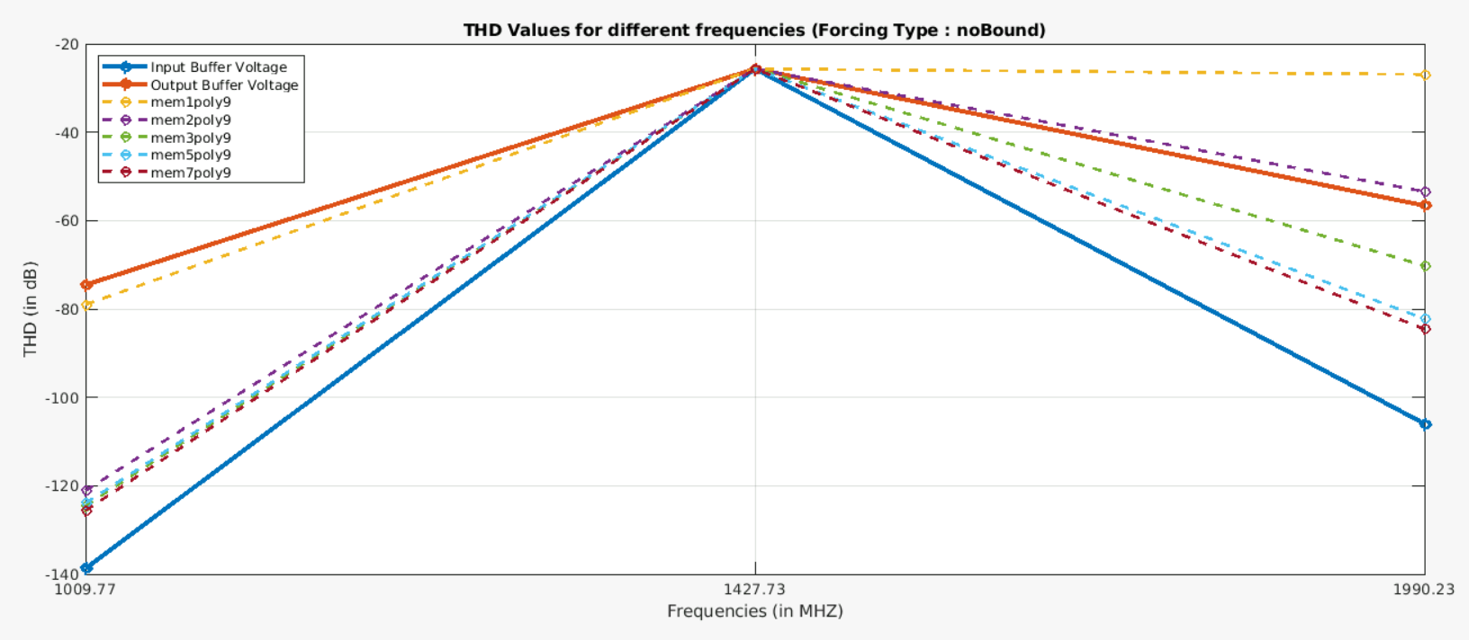
Final Checking - Results

Slide 7
Final Checking - Results

Slide 8
Final Checking: Problem @1.5 GHz

Slide 9
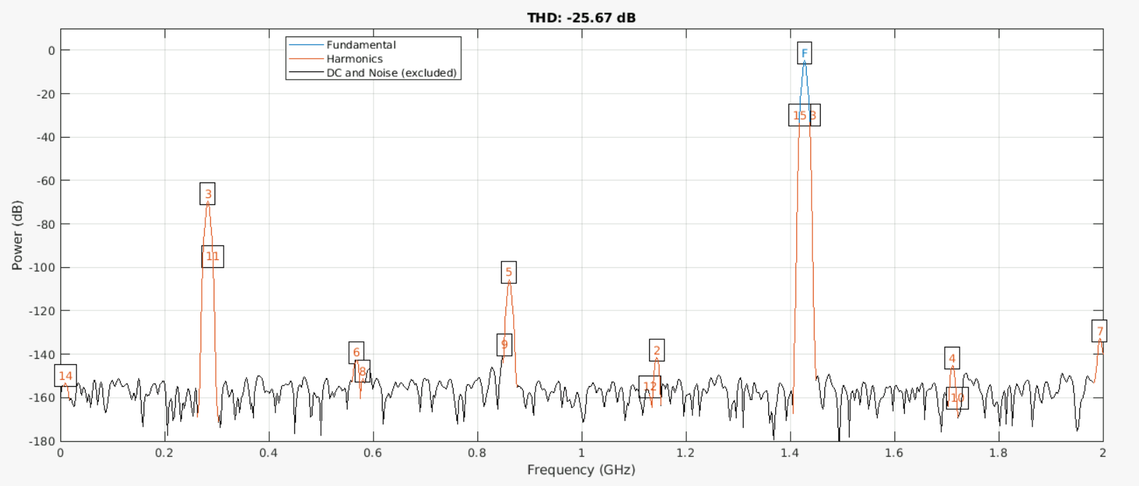
Final Checking - Problem @1.5 GHz
Here is the output voltage waveform :

Slide 10
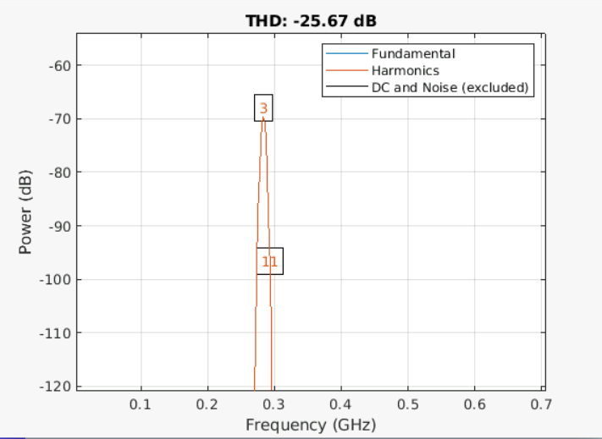
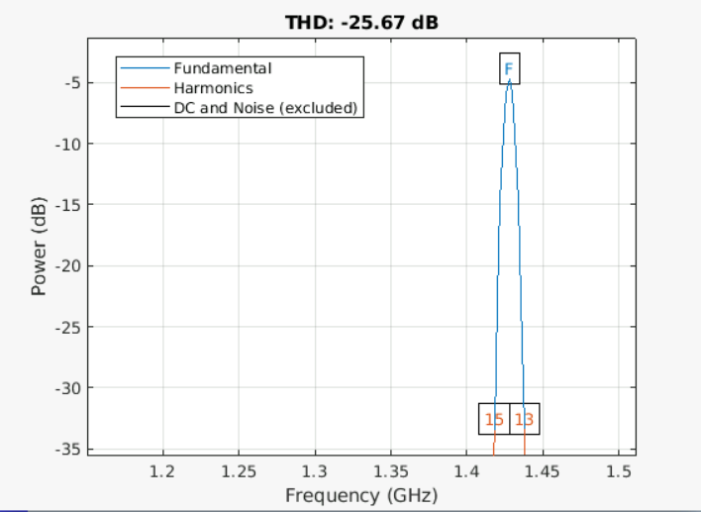
Final Checking - Problem @1.5 GHz
Here is the output voltage waveform :

Slide 11
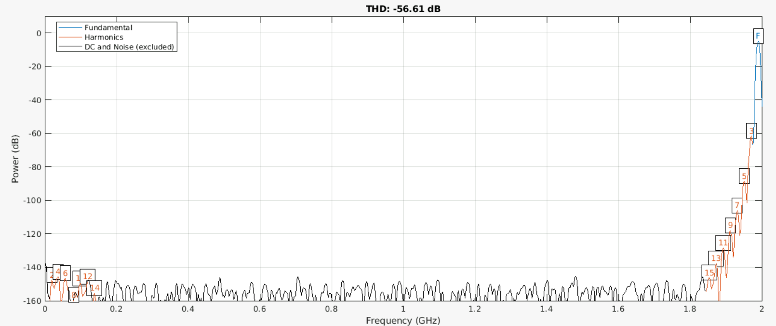
Final Checking - Problem @1.5 GHz
What about @ 2 GHz:

Slide 12
Final Checking - Problem @1.5 GHz
Here is the output voltage waveform :

Slide 13
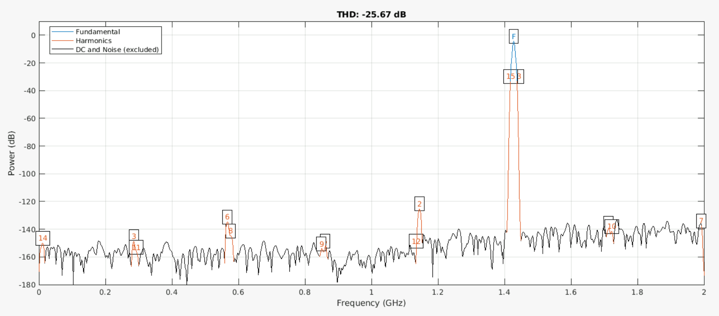
Final Checking - Problem @1.5 GHz
Therefore, calibration seems that it does not working @ 1.5 GHz:

Slide 14
Final Checking: Solution @1.5 GHz

Slide 15
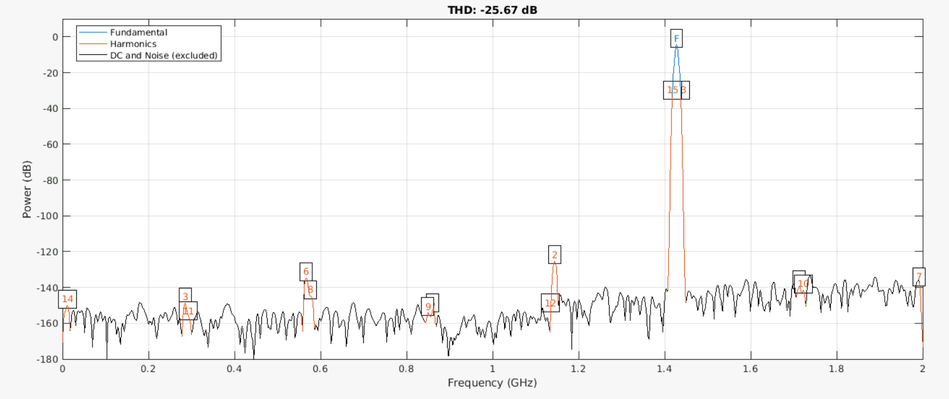
Final Checking - Solution @1.5 GHz
thd(calibratedWave, fs, #ofHarmonics, ‘aliased’); where #ofHarmonics = 15

Slide 16
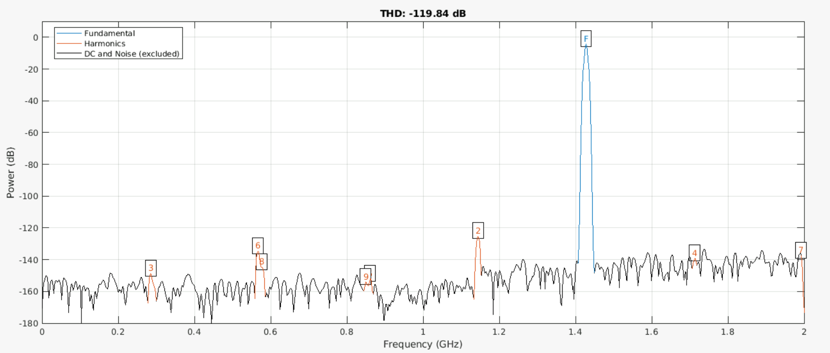
Final Checking - Solution @1.5 GHz
thd(calibratedWave, fs, #ofHarmonics, ‘aliased’); where #ofHarmonics = 9

Slide 17
Final Checking: Set Up - Revised

Slide 18
Final Checking: Set Up - Revised
Purpose: Based on previous results, using a polynomial order of 9 and a memory order of 5 provides approximately 80 dB at 2 GHz, which matches our target. We need to verify whether this configuration is suitable for other frequencies as well.
Step 1: Take the signal of input and output @ 1 GHz, 1.5GHz and 2 GHz.
Step 2: Perform calibration with varying memory orders while keeping the polynomial order fixed at 9.
Step 3: Calculate THD values for the input, output and calibrated waveforms. (#ofHarmonics is 9 @1.5 GHz, 15 otherwise)
Step 4: Plot and compare all results in a plot.

Slide 19
Final Checking: Results - Revised

Slide 20
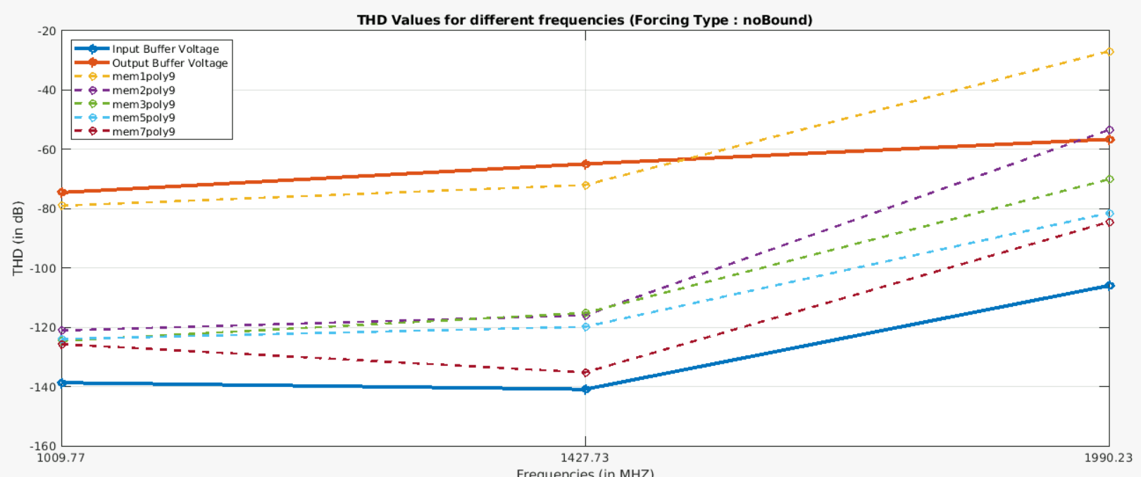
Final Checking – Results - Revised

Slide 21
Approaching an ideal calibration: Set Up

Slide 22
Approaching an ideal calibration: Set Up
Purpose: We want to make sure that the signal can be .
Step 1: Take the signal of input and output @ 1 GHz, 1.5GHz and 2 GHz.
Step 2: Perform calibration with varying memory orders while keeping the polynomial order fixed at 9.
Step 3: Calculate THD values for the input, output and calibrated waveforms. (#ofHarmonics is 9 @1.5 GHz, 15 otherwise)
Step 4: Plot and compare all results in a plot.

Slide 23
Approaching an ideal calibration: Results

Slide 24
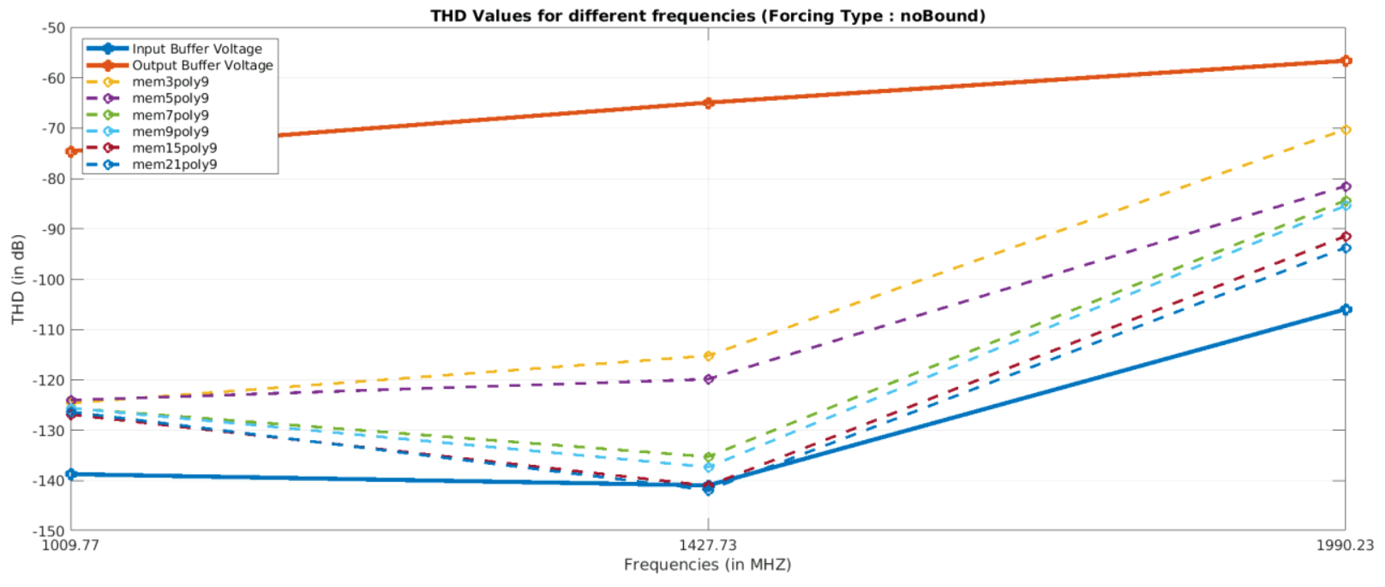
Approaching an ideal calibration - Results

Slide 25
Approaching an ideal calibration: Set Up - Reviewed

Slide 26
Approaching an ideal calibration: Set Up - Reviewed
Purpose: We want to make sure that the signal can be .
Step 1: Take the signal of input and output @ 1 GHz, 1.5GHz and 2 GHz.
Step 2: Perform calibration with really high memory orders while keeping the polynomial order fixed at 9.
Step 3: Calculate THD values for the input, output and calibrated waveforms. (#ofHarmonics is 9 @ all cases)
Step 4: Plot and compare all results in a plot.

Slide 27
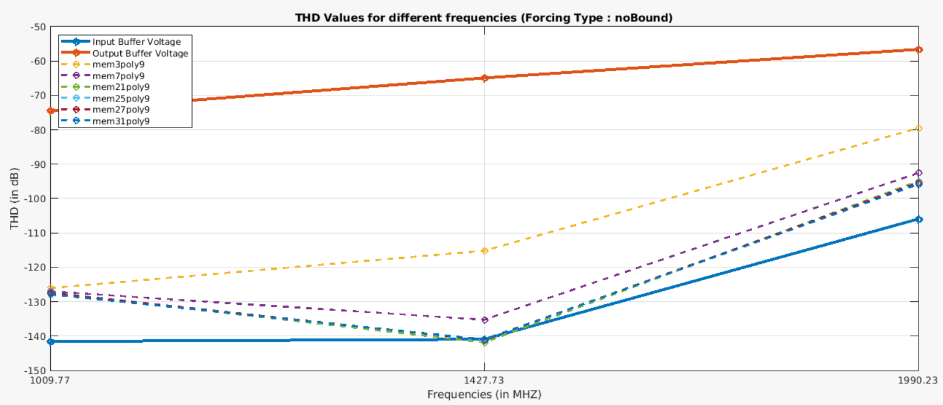
Approaching an ideal calibration – Results - Reviewed

Slide 28
Approaching an ideal calibration: Problem @1GHz

Slide 29
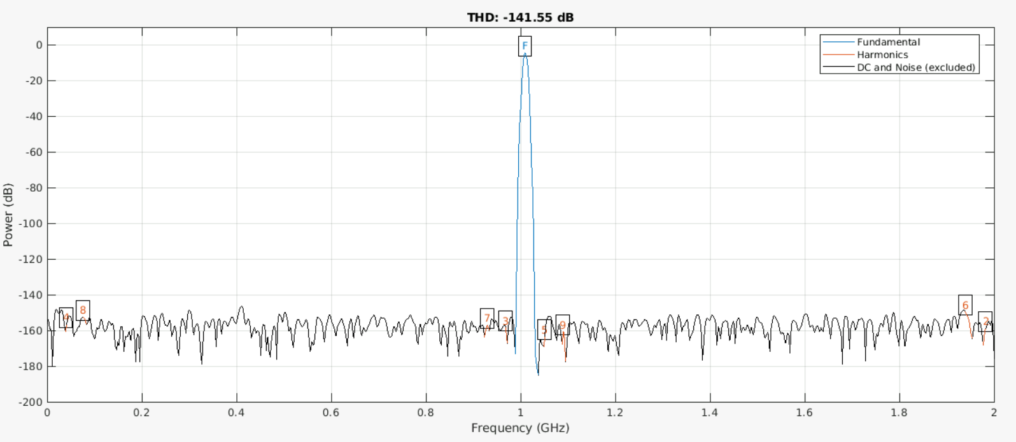
Approaching an ideal calibration – Problem @1GHz
Input Voltage Waveform @1GHz

Slide 30
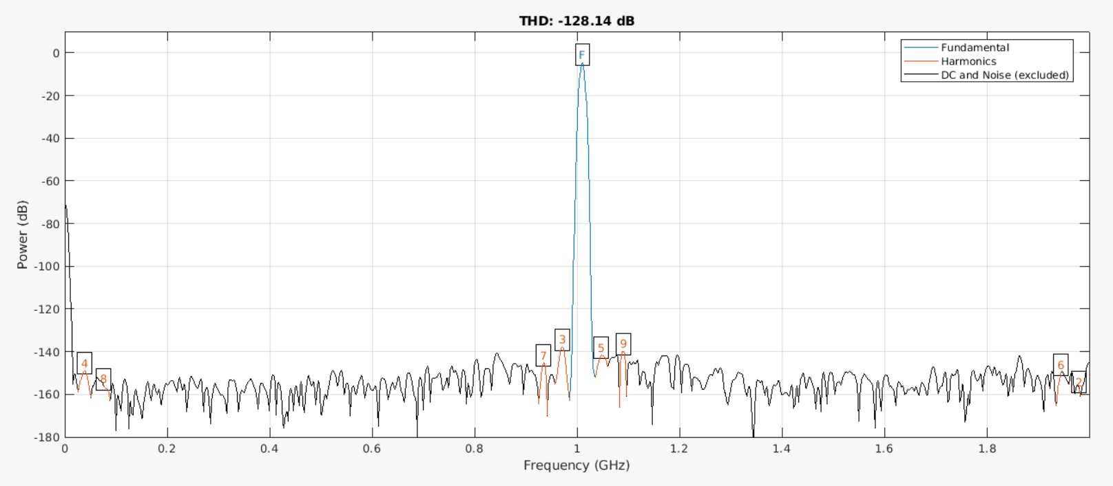
Approaching an ideal calibration – Problem @1GHz
Calibrated Voltage Waveform @1GHz

Slide 31
Approaching an ideal calibration: Solution @1GHz

Slide 32
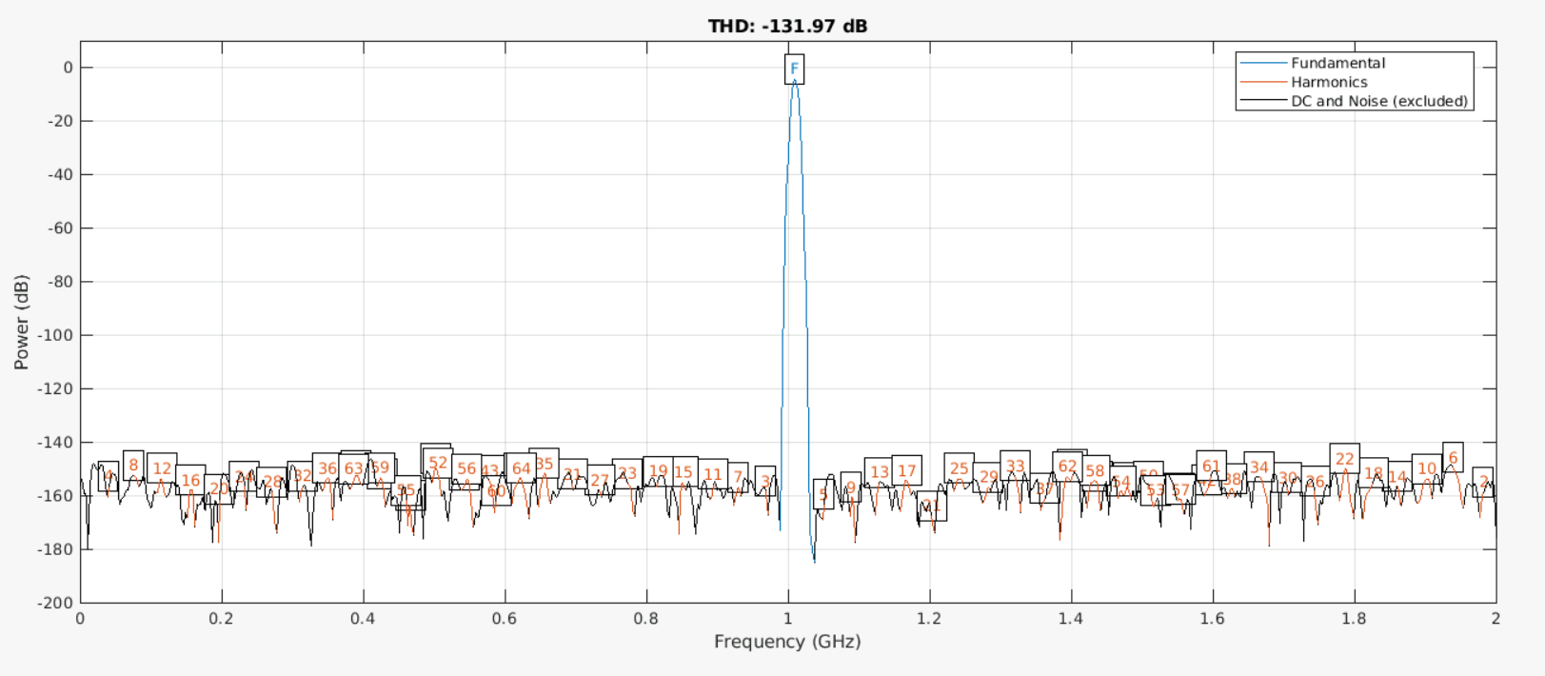
Approaching an ideal calibration – Solution @1GHz
Input Voltage Waveform @1GHz (#ofHarmonics = 64)

Slide 33
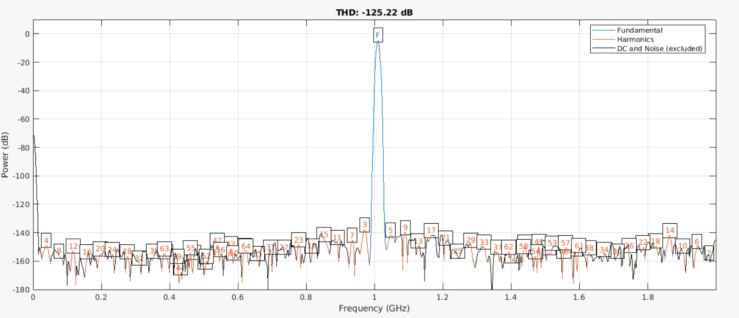
Approaching an ideal calibration – Solution @1GHz
Calibrated Voltage Waveform @1GHz

Slide 34
Approaching an ideal calibration: Problem @2GHz

Slide 35
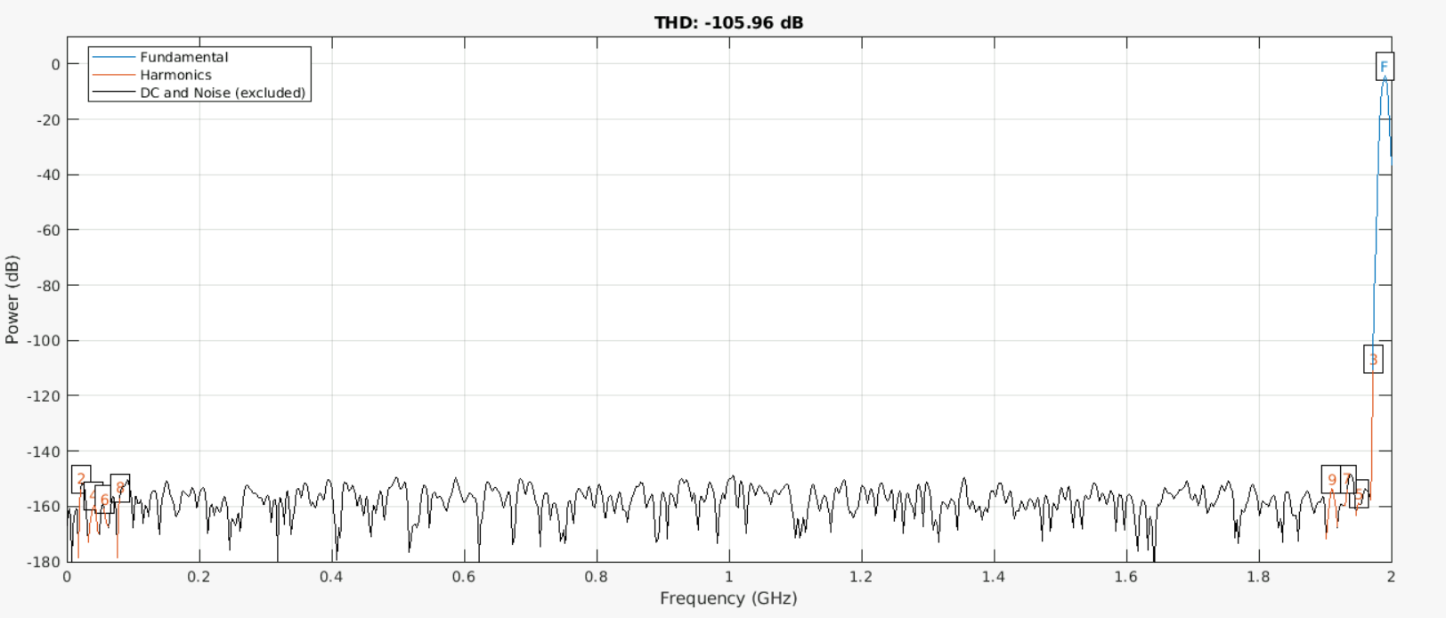
Approaching an ideal calibration – Problem @2GHz
Input Voltage Waveform @2GHz

Slide 36
Plans for the next weeks

Slide 37
Plans for the next weeks
For the next week, determine how many levels of PRBS signal is required to obtain similar coefficients
My final exam is on 12th September.

