Slide 1
Biweekly Update Presentation 06
Berkay Ipek – ARPLab 02/10/2025

Slide 2
Outline
What is done
Problem @ 2GHz (Solved)
Quantization
Precision of Coefficients
Plans for the next weeks
Done all # of simulation points

Slide 3
Problem @ 2GHz : Recap

Slide 4
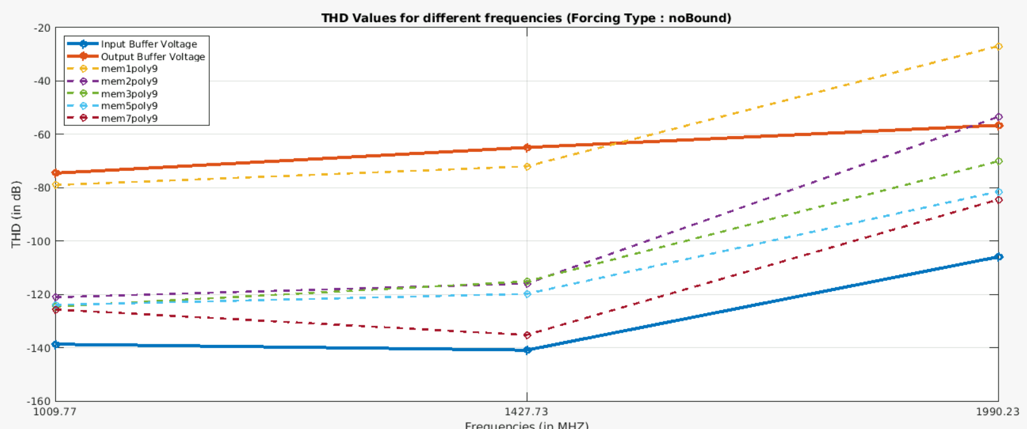
Problem @ 2GHz – Recap

Slide 5
Problem @ 2GHz : Solution

Slide 6
Problem @ 2GHz – Solution
ADD PLOT FOR HIGH NUMBER OF SIMULATION POINTS

Slide 8
Quantization : Set up

Slide 9
Quantization – Set Up
Purpose: Implementing a LUT requires converting analog voltage into a digital voltage, which introduces quantization noise into the signal. Therefore, it is required to determine the number of bits for quantization.
Step 1: Take the signal of input and output waveforms @ 30 different frequencies.
Step 2: Add a quantized signal based on 10-bits.
Step 3: Calculate and store THD values for quantized and non-quantized signals.
Step 4: Go to step 2 do it for (n=10,12,14,16).
Step 5: Plot and compare all results.

Slide 10
Quantization : Results

Slide 11
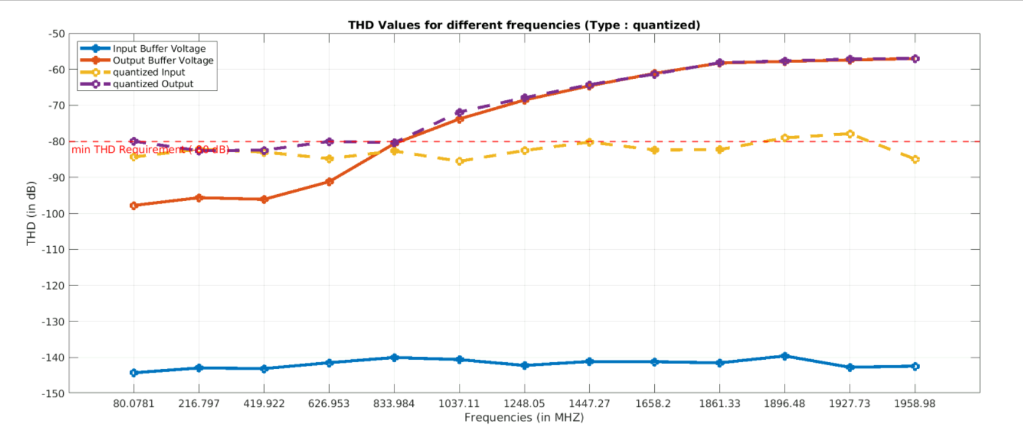
Quantization – Results – 10-bit ADC

Slide 12
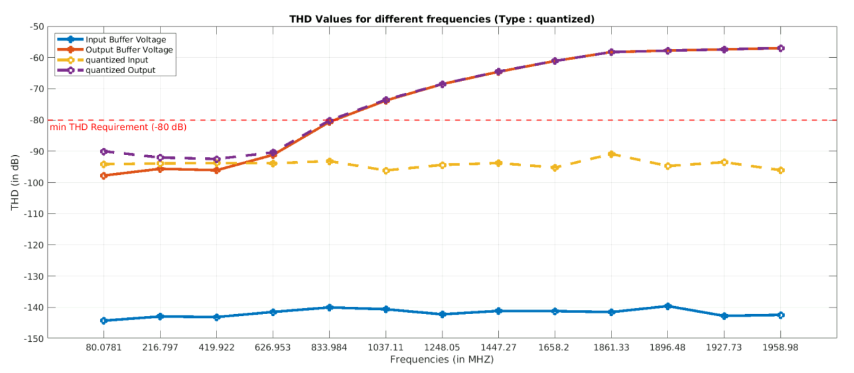
Quantization – Results – 12-bit ADC

Slide 13
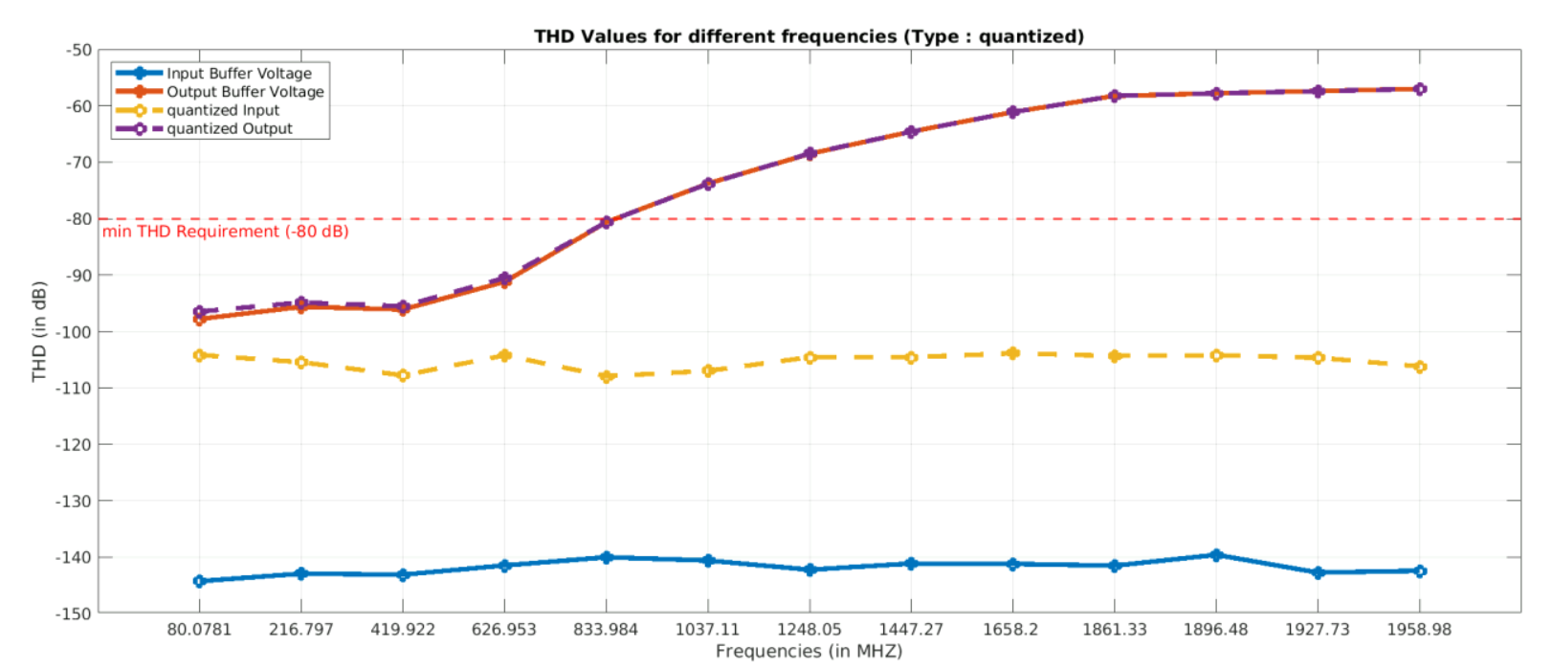
Quantization – Results – 14-bit ADC

Slide 14
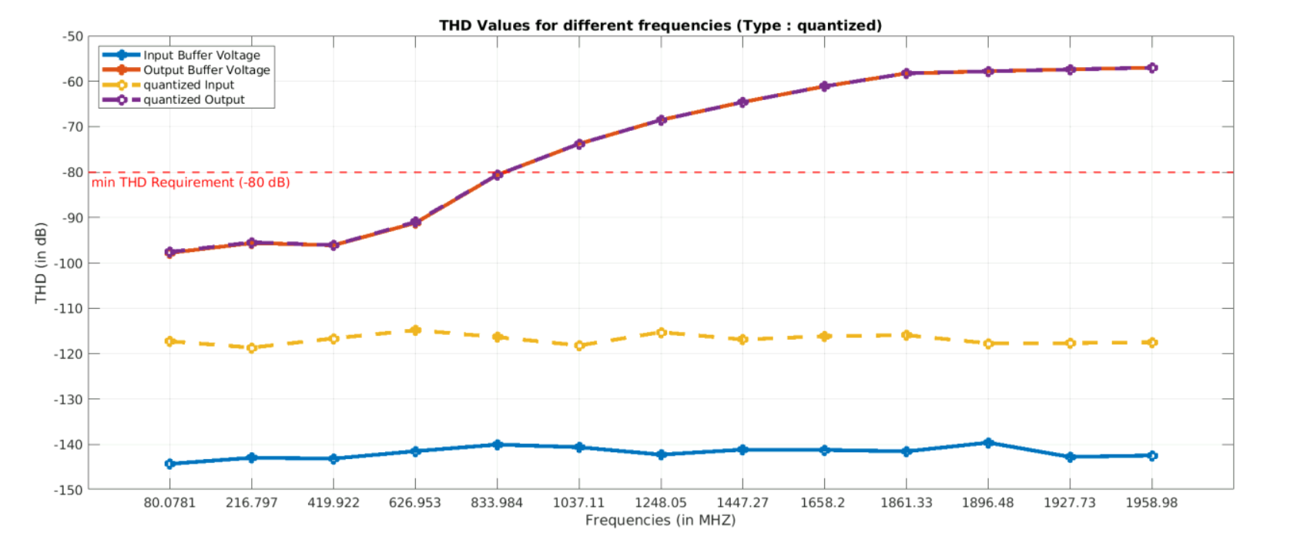
Quantization – Results – 16-bit ADC

Slide 15
Quantization – Results
Among the results, when the number of bits is 14 or higher, there is an enough separation between the quantized output and the input voltage signals at high frequencies, which is a requirement for proper calibration. The reason is that calibration is primarily needed at high frequencies, where higher-order harmonics become more dominant.
Therefore, we’ve decided to use a 14-bit quantized signal will be used during the calibration process.
The results for the calibration of quantized signals is present in the next slide:

Slide 16
Quantization – Results
ADD A NEW PLOT FOR THE CALIBRATION !!!!!

Slide 18
Precision of Coefficients: Set up

Slide 19
Precision of Coefficients – Set Up
Purpose: .
Step 1: Take the signal of input and output waveforms @ 30 different frequencies.
Step 2: Add a quantized signal based on 10-bits.
Step 3: Calculate and store THD values for quantized and non-quantized signals.
Step 4: Go to step 2 do it for (n=10,12,14,16).
Step 5: Plot and compare all results.

Slide 21
Final Checking – Set Up (Review)
Purpose: Based on previous results, using a polynomial order of 9 and a memory order of 5 provides approximately -80 dB THD at 2 GHz, which matches our target. We need to verify whether this configuration is suitable for other frequencies as well.
Step 1: Take the signal of input and output @ 1 GHz, 1.5GHz and 2 GHz.
Step 2: Perform calibration with varying memory orders while keeping the polynomial order fixed at 9.
Step 3: Calculate THD values for the input, output and calibrated waveforms.
Step 4: Plot and compare all results in a plot.

Slide 22
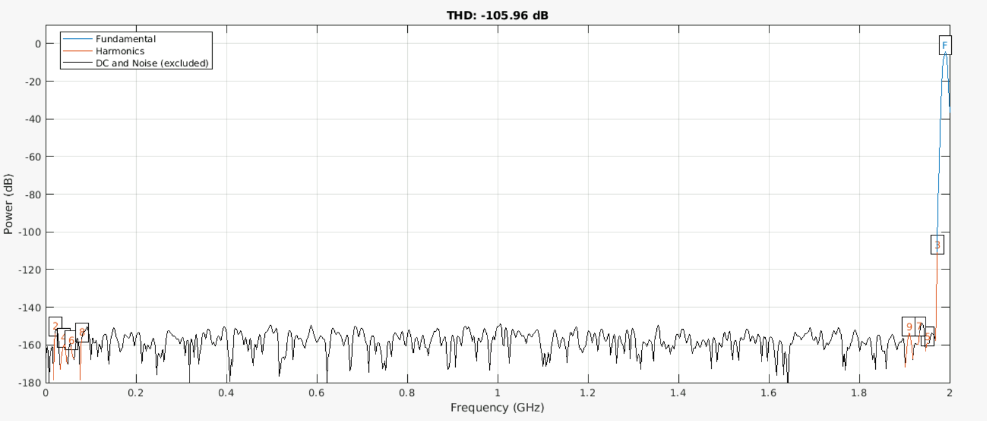
Final Checking – Results – Problem @ 2GHz (Review)
Input Voltage Waveform @2GHz

Slide 23
Problem @ 2GHz : Solution #1 Changing Windowing

Slide 24
Final Checking – Set Up (Review)
Purpose: To eliminate 2 GHz, try to change the windowing to .
Step 1: Take the signal of input and output @ 1 GHz, 1.5GHz and 2 GHz.
Step 2: Perform calibration with varying memory orders while keeping the polynomial order fixed at 9.
Step 3: Calculate THD values for the input, output and calibrated waveforms.
Step 4: Plot and compare all results in a plot.

Slide 28
Final Checking: Results

Slide 29
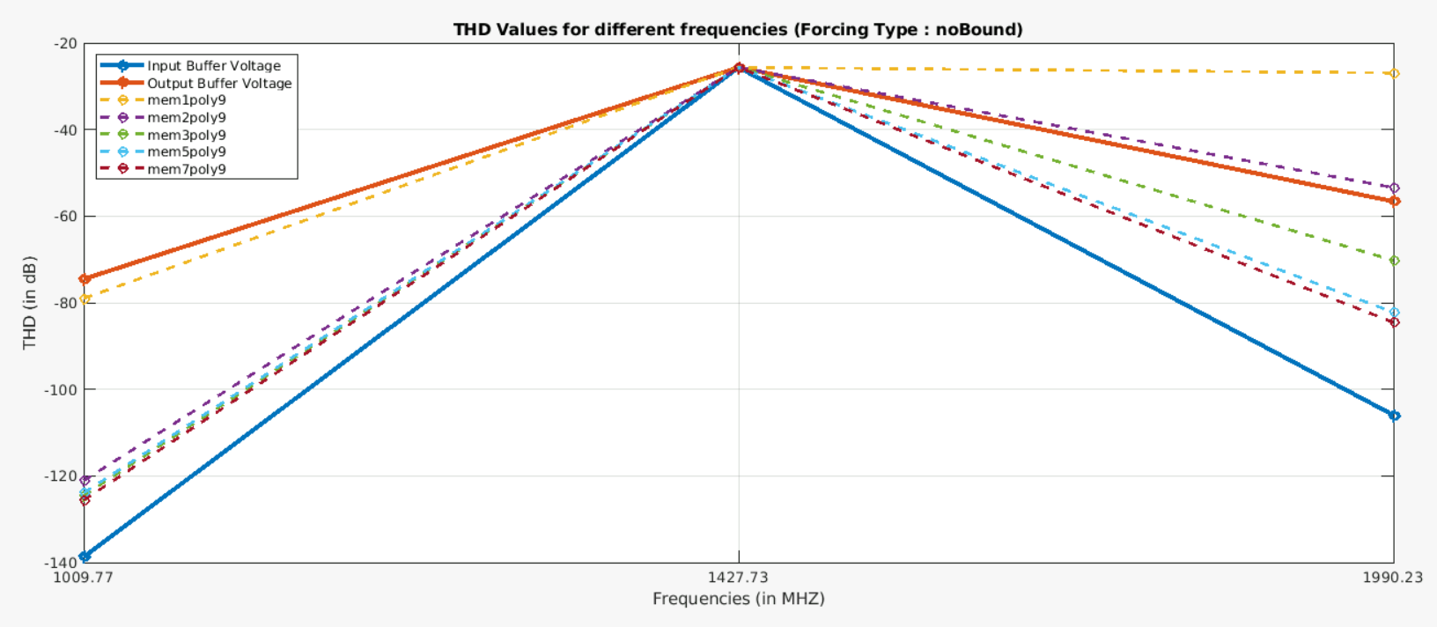
Final Checking - Results

Slide 30
Final Checking - Results

Slide 31
Final Checking: Problem @1.5 GHz

Slide 32
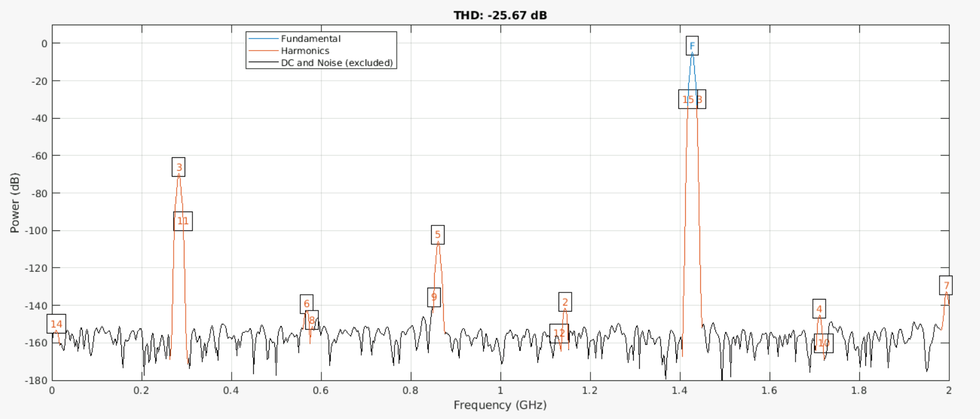
Final Checking - Problem @1.5 GHz
Here is the output voltage waveform :

Slide 33
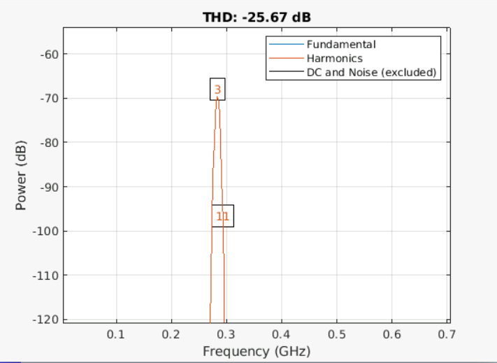
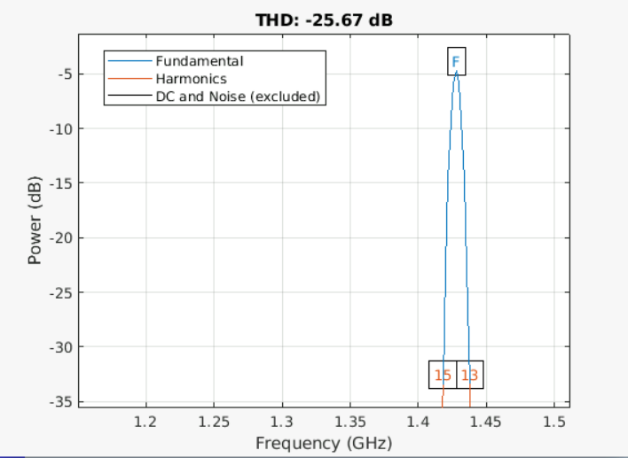
Final Checking - Problem @1.5 GHz
Here is the output voltage waveform :

Slide 34
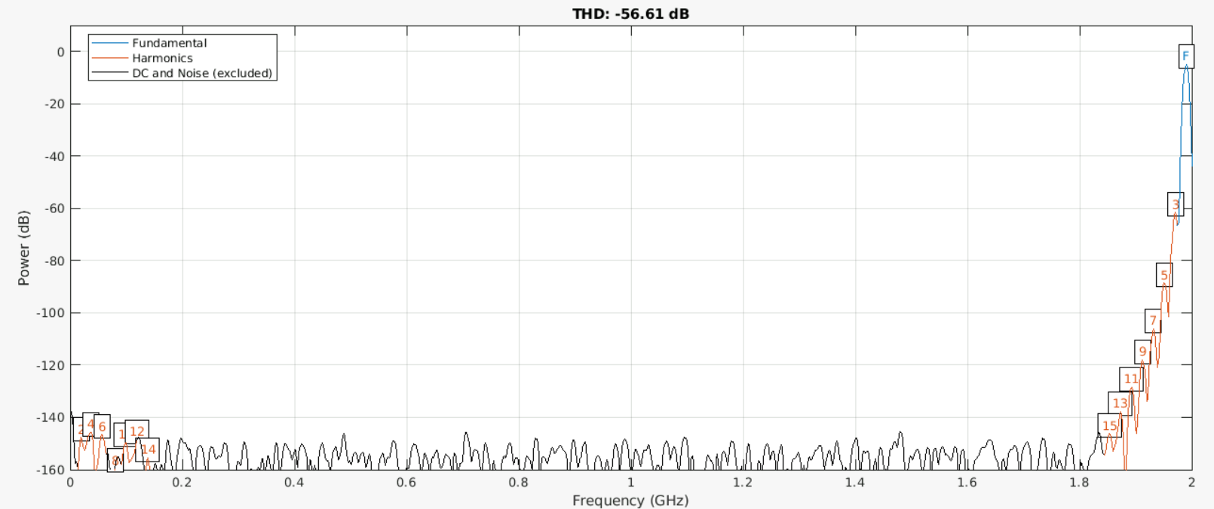
Final Checking - Problem @1.5 GHz
What about @ 2 GHz:

Slide 35
Final Checking - Problem @1.5 GHz
Here is the output voltage waveform :

Slide 36
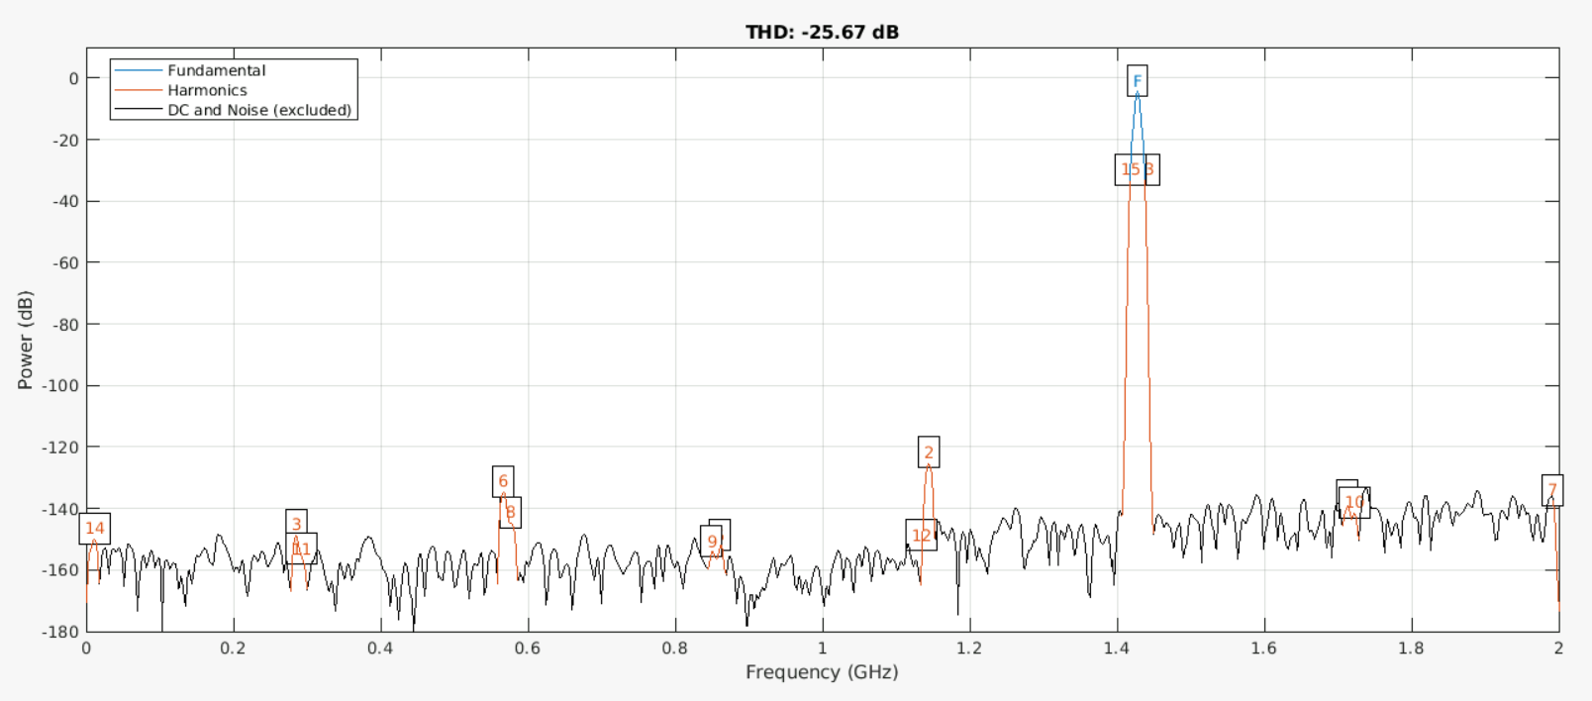
Final Checking - Problem @1.5 GHz
Therefore, calibration seems that it does not working @ 1.5 GHz:

Slide 37
Final Checking: Solution @1.5 GHz

Slide 38
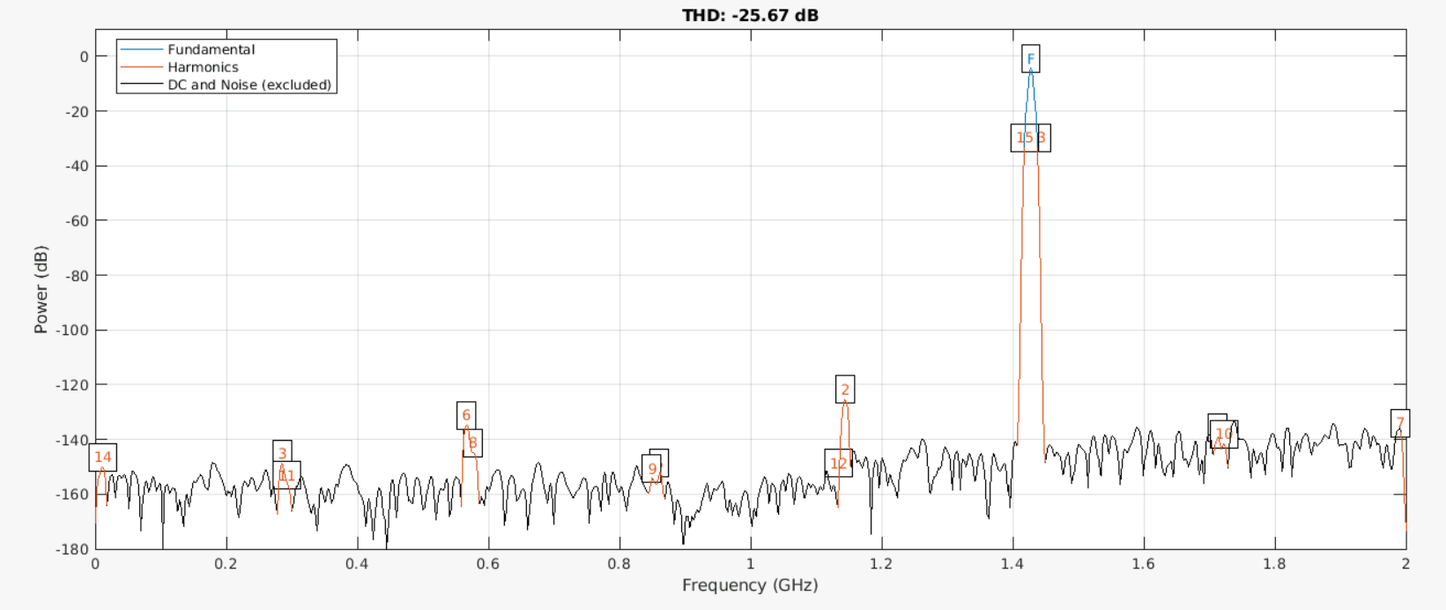
Final Checking - Solution @1.5 GHz
thd(calibratedWave, fs, #ofHarmonics, ‘aliased’); where #ofHarmonics = 15

Slide 39
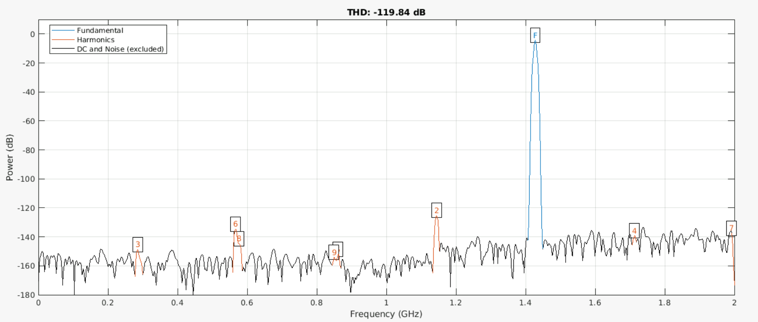
Final Checking - Solution @1.5 GHz
thd(calibratedWave, fs, #ofHarmonics, ‘aliased’); where #ofHarmonics = 9

Slide 40
Final Checking: Set Up - Revised

Slide 41
Final Checking: Set Up - Revised
Purpose: Based on previous results, using a polynomial order of 9 and a memory order of 5 provides approximately -80 dB at 2 GHz, which matches our target. We need to verify whether this configuration is suitable for other frequencies as well.
Step 1: Take the signal of input and output @ 1 GHz, 1.5GHz and 2 GHz.
Step 2: Perform calibration with varying memory orders while keeping the polynomial order fixed at 9.
Step 3: Calculate THD values for the input, output and calibrated waveforms. (#ofHarmonics is 9 @1.5 GHz, 15 otherwise)
Step 4: Plot and compare all results in a plot.

Slide 42
Final Checking: Results - Revised

Slide 43
Final Checking – Results - Revised

Slide 44
Approaching an ideal calibration: Set Up

Slide 45
Approaching an ideal calibration: Set Up
Purpose: We want to make sure that the signal can be reversed by using an ideal calibration (infinite number of coefficients) .
Step 1: Take the signal of input and output @ 1 GHz, 1.5GHz and 2 GHz.
Step 2: Perform calibration with varying memory orders while keeping the polynomial order fixed at 9.
Step 3: Calculate THD values for the input, output and calibrated waveforms. (#ofHarmonics is 9 @1.5 GHz, 15 otherwise)
Step 4: Plot and compare all results in a plot.

Slide 46
Approaching an ideal calibration: Results

Slide 47
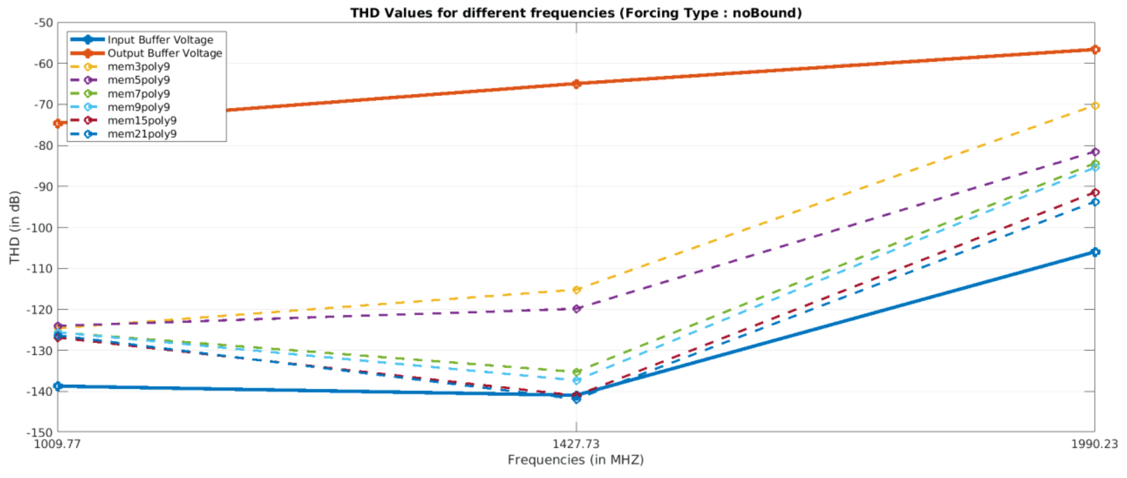
Approaching an ideal calibration - Results

Slide 48
Approaching an ideal calibration: Set Up - Reviewed

Slide 49
Approaching an ideal calibration: Set Up - Reviewed
Purpose: We want to make sure that the signal can be reversed by using an ideal calibration (infinite number of coefficients) .
Step 1: Take the signal of input and output @ 1 GHz, 1.5GHz and 2 GHz.
Step 2: Perform calibration with really high memory orders while keeping the polynomial order fixed at 9.
Step 3: Calculate THD values for the input, output and calibrated waveforms. (#ofHarmonics is 9 @ all cases)
Step 4: Plot and compare all results in a plot.

Slide 50
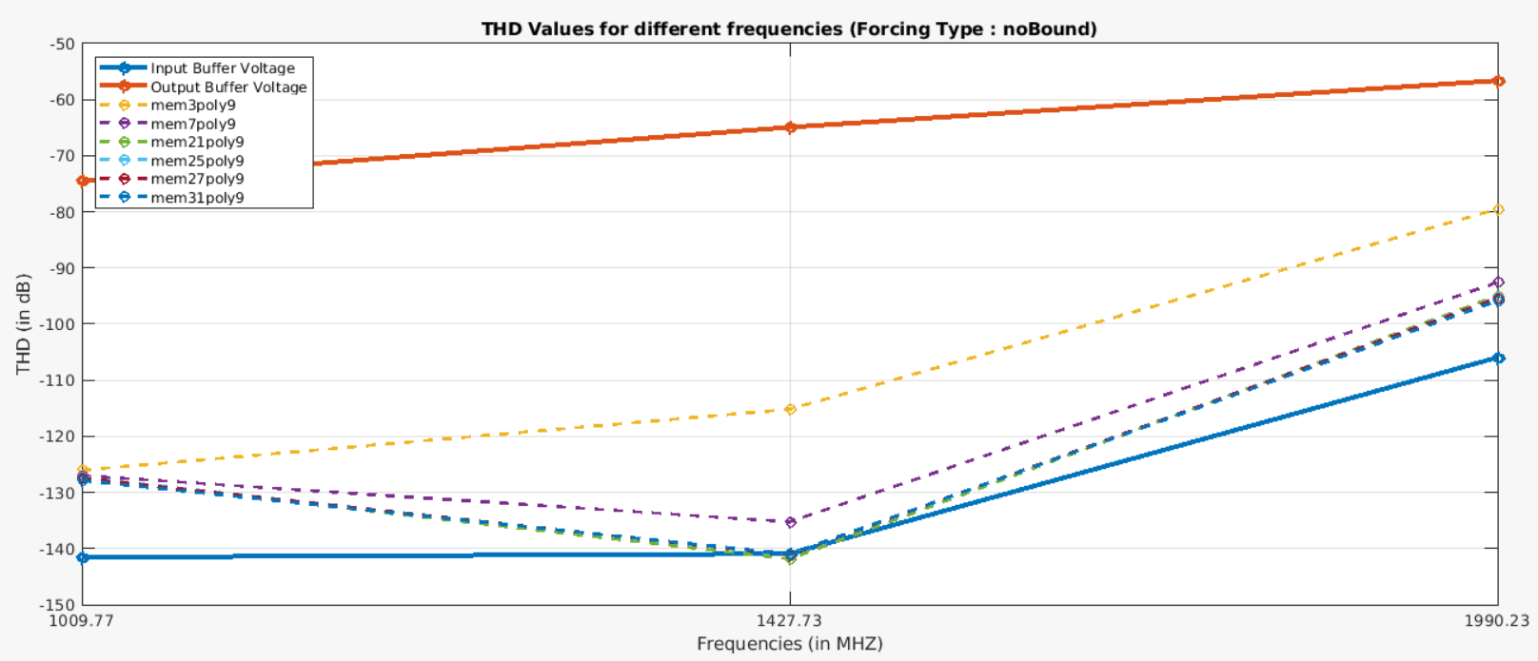
Approaching an ideal calibration – Results - Reviewed

Slide 51
Approaching an ideal calibration: Problem @1GHz

Slide 52
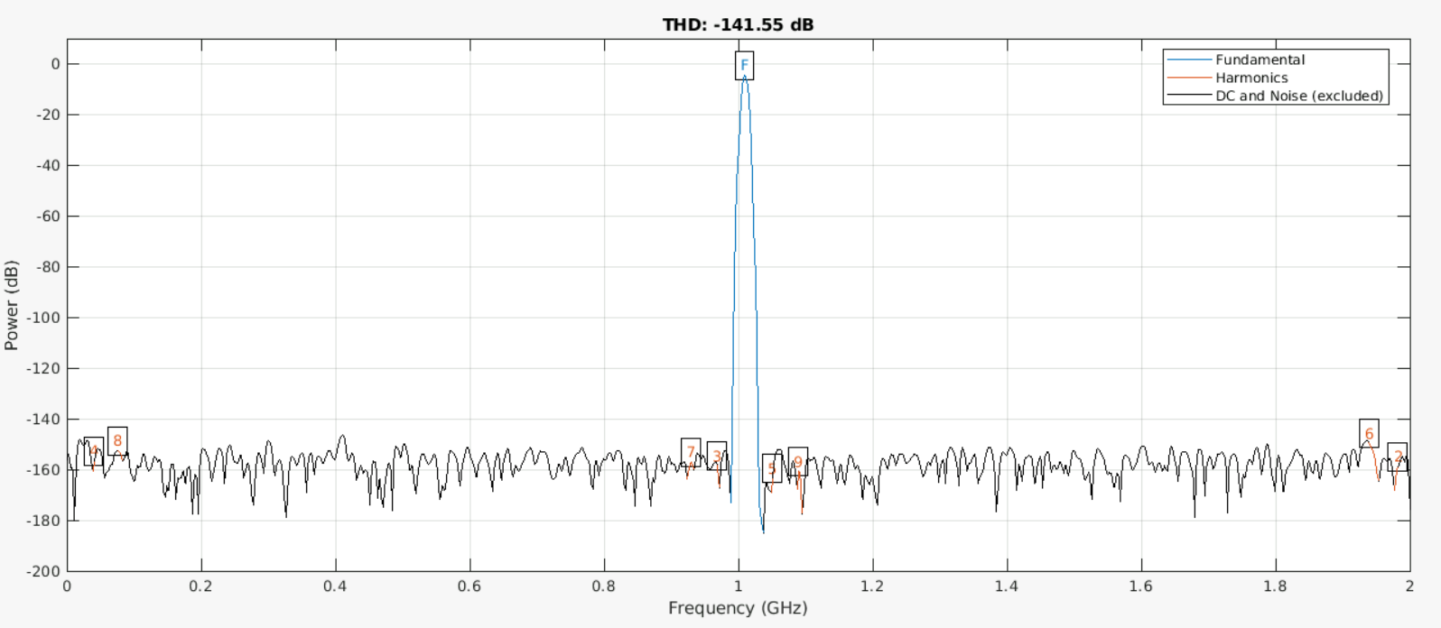
Approaching an ideal calibration – Problem @1GHz
Input Voltage Waveform @1GHz

Slide 53
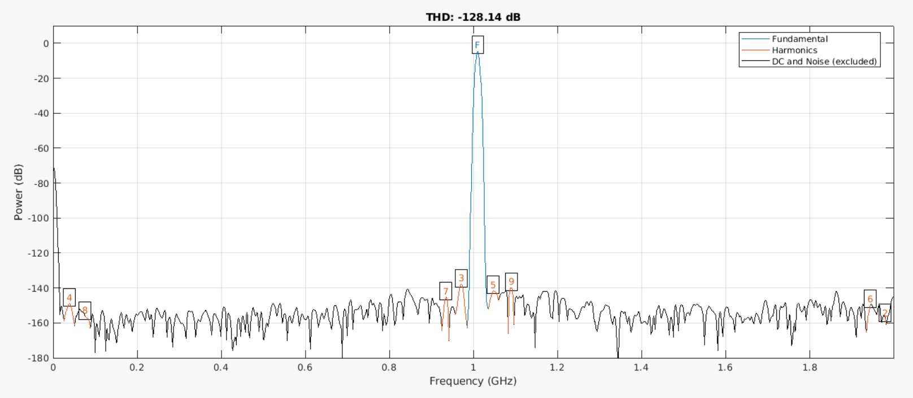
Approaching an ideal calibration – Problem @1GHz
Calibrated Voltage Waveform @1GHz

Slide 54
Approaching an ideal calibration: Solution @1GHz

Slide 55
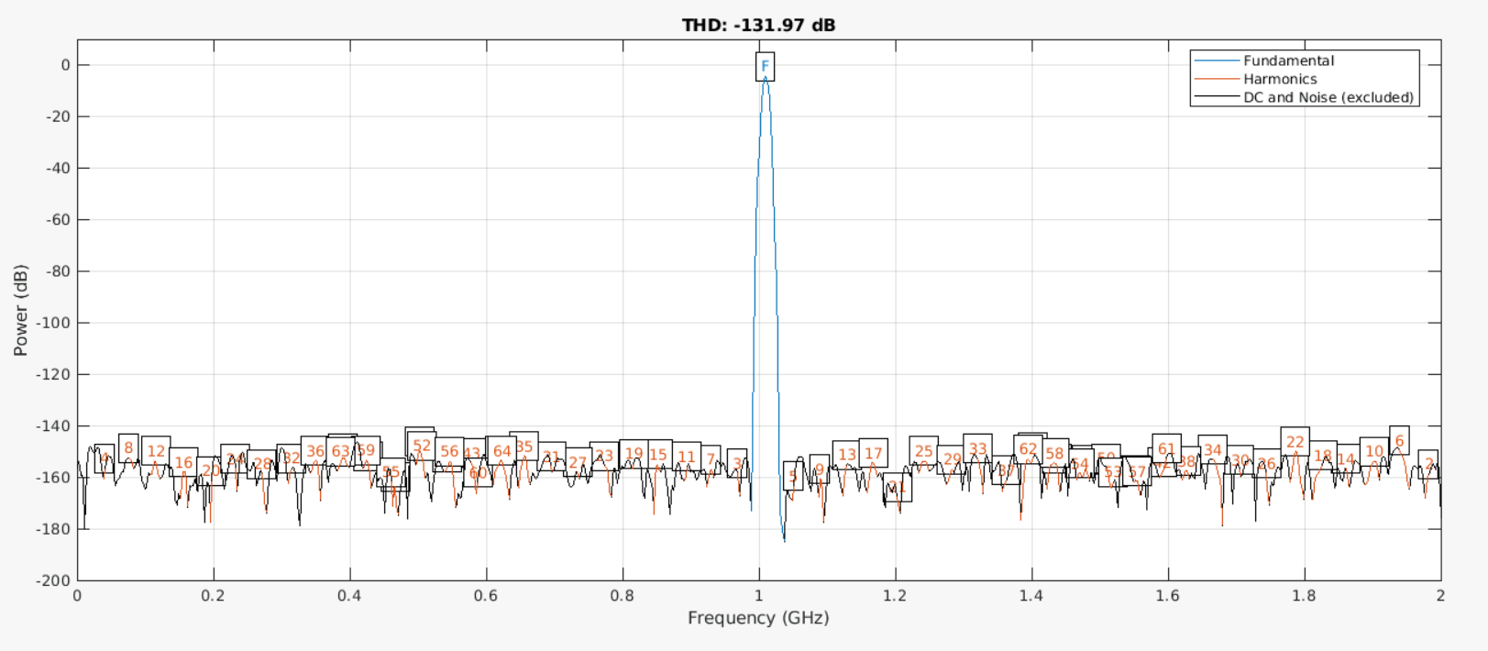
Approaching an ideal calibration – Solution @1GHz
Input Voltage Waveform @1GHz (#ofHarmonics = 64)

Slide 56
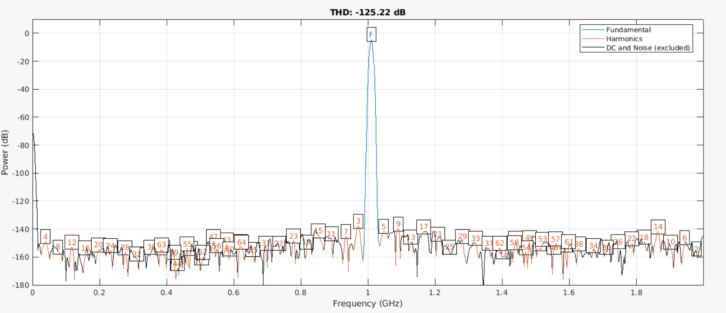
Approaching an ideal calibration – Solution @1GHz
Calibrated Voltage Waveform @1GHz (#ofHarmonics = 64)

Slide 57
Approaching an ideal calibration: Problem @2GHz

Slide 58
Approaching an ideal calibration – Problem @2GHz
Input Voltage Waveform @2GHz

Slide 59
Plans for the next weeks

Slide 60
Plans for the next weeks
Try to fix the problem of ideal calibration @2GHz.
Determine how many levels of PRBS signal is required to obtain similar coefficients.
My final exam is on 12th September.

