Slide 1
Biweekly Update Presentation 03
Berkay Ipek – ARPLab 25/07/2025

Slide 2
Outline
What is done
Linear Memory Analysis
Memory Sweep Analysis
What is the current status
Plans for the next weeks

Slide 3
What is done: Linear Memory Analysis

Slide 9
What is done: Custom THD function Problem Definition

Slide 10
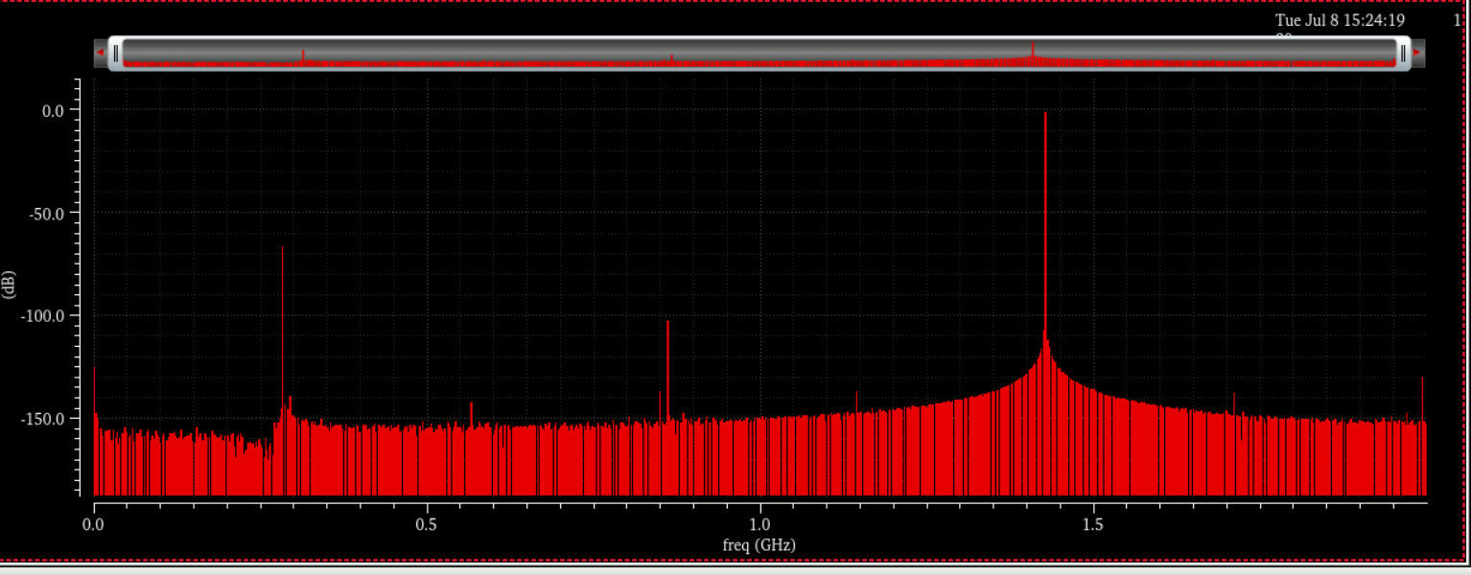
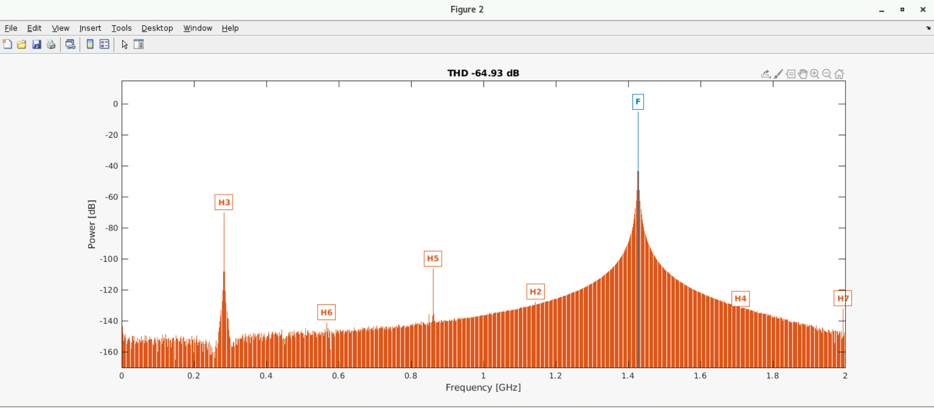
Custom THD function – Problem Definition
While calculating THD of a signal, the custom function, thd, (under metrics folder) has been used.
This function is assumed to be valid since it produces THD and SFDR values that closely match those obtained from Virtuoso simulations.

Slide 11
Custom THD function – Problem Definition
While calculating THD of a signal, the custom function, thd, (under metrics folder) has been used.
This function is assumed to be valid since it produces THD and SFDR values that closely match those obtained from Virtuoso simulations.
Problem: When the voltage waveform is trying to be calibrated, the custom THD function gives unrealistic spectrum results and THD values.
V_{out}
LMS loops
in
h_{i}(j)
h_{i}(j) : Coefficients (V_{out} V_{in})
V_{in}
out
V_{out}
Calibration
V_{calib}
h_{i}(j)

Slide 12
What is done: Calibrated Waveform Custom THD function

Slide 13
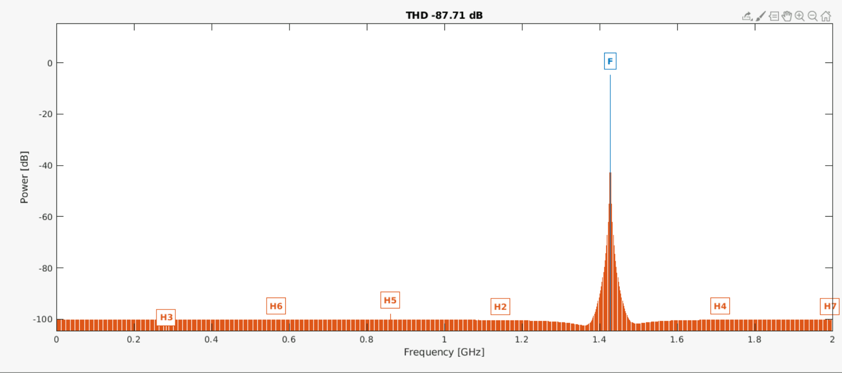
Calibrated Waveform - Custom THD function

Slide 14
What is done: Calibrated Waveform MATLAB Function

Slide 15
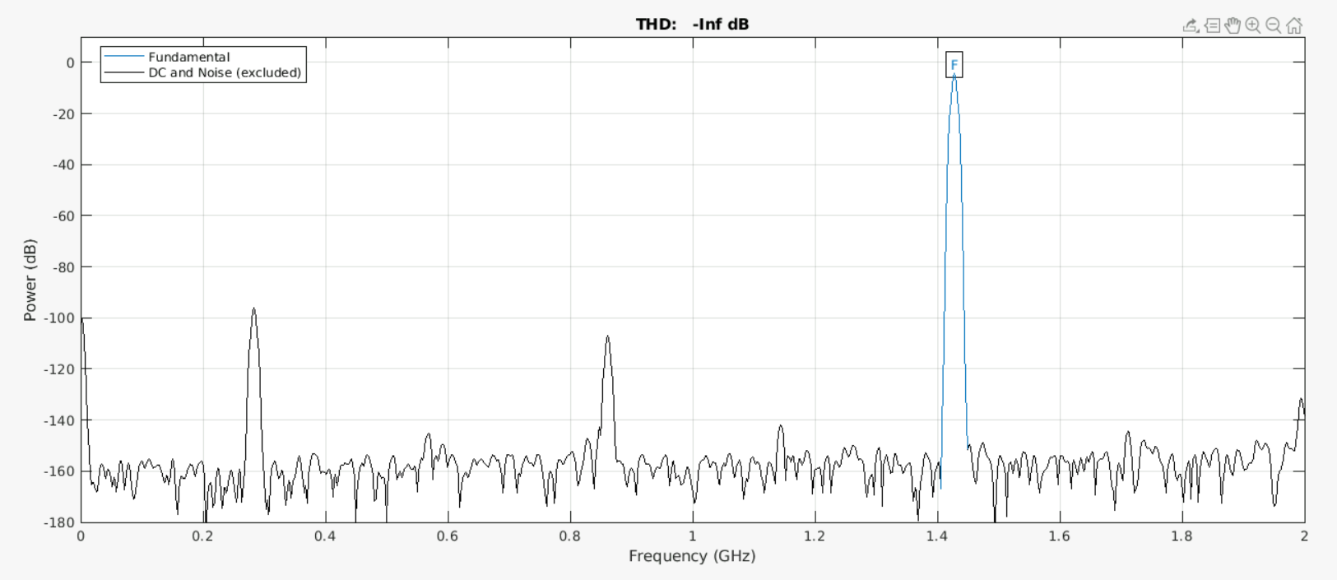
Calibrated Waveform - MATLAB Function

Slide 16
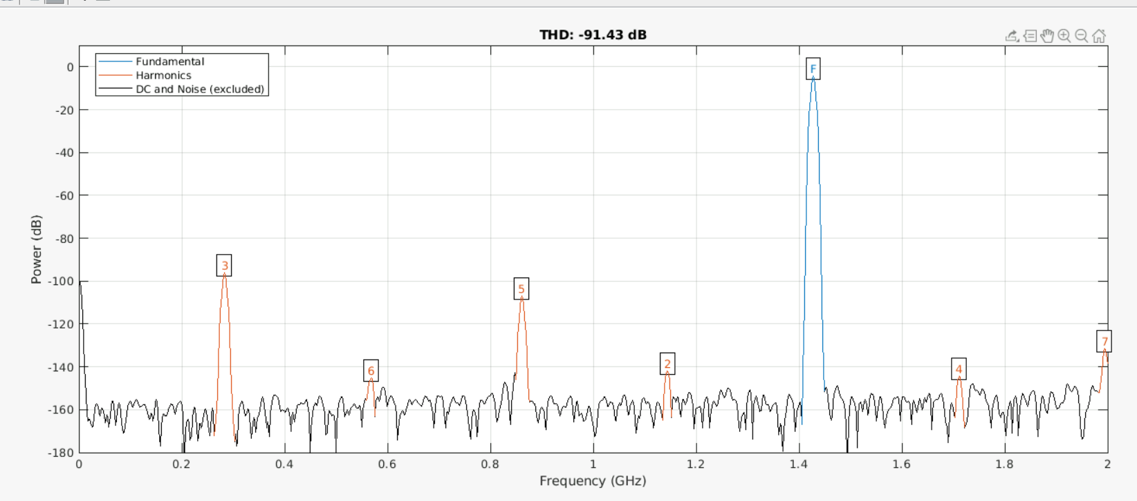
Calibrated Waveform - MATLAB Function (Aliased option)

Slide 17
What is done: Results

Slide 18
What is done: Results
No more custom THD (or SFDR) function is going to be used to analyze a waveform.
Only MATLAB default functions for SFDR and THD will be used.
The option, “aliased”, should be set when MATLAB default function are used.

Slide 19
What is the current status: Reanalyze direct calibration

Slide 20
Reanalyze direct calibration
How to determine coefficients? Should we include the number of memorial terms? If so, how much?
What about polynomial ones?
How to find optimal number of coefficients?
V_{out}
LMS loops
in
h_{i}(j)
h_{i}(j) : Coefficients (V_{out} V_{in})
V_{in}
out
V_{out}
Calibration
V_{calib}
h_{i}(j)

Slide 21
What is the current status: Reanalyze direct calibration Setup

Slide 22
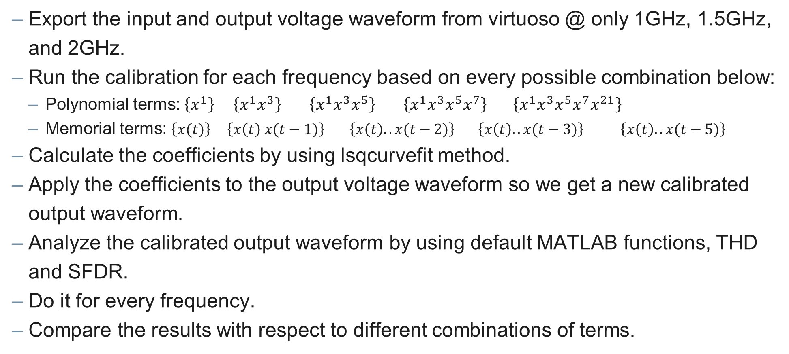
Reanalyze direct calibration - Setup
Export the input and output voltage waveform from virtuoso @ only 1GHz, 1.5GHz, and 2GHz.
Run the calibration for each frequency based on every possible combination below:
Polynomial terms: $\left\{x^{1}\right\}$ $\left\{x^{1}x^{3}\right\}$ $\left\{x^{1}x^{3}x^{5}\right\}$ $\left\{x^{1}x^{3}x^{5}x^{7}\right\} \left\{x^{1}x^{3}x^{5}x^{7}x^{21}\right\}$
Memorial terms: $\left\{x(t)\right\}$ $\left\{x\left(t\right) x(t−1)\right\}$ $\left\{x\left(t\right).. x(t−2)\right\} \left\{x\left(t\right).. x(t−3)\right\} \left\{x\left(t\right).. x(t−5)\right\}$
Calculate the coefficients by using lsqcurvefit method.
Apply the coefficients to the output voltage waveform so we get a new calibrated output waveform.
Analyze the calibrated output waveform by using default MATLAB functions, THD and SFDR.
Do it for every frequency.
Compare the results with respect to different combinations of terms.

Slide 23
What is the current status: Reanalyze direct calibration Polynomial Terms

Slide 24
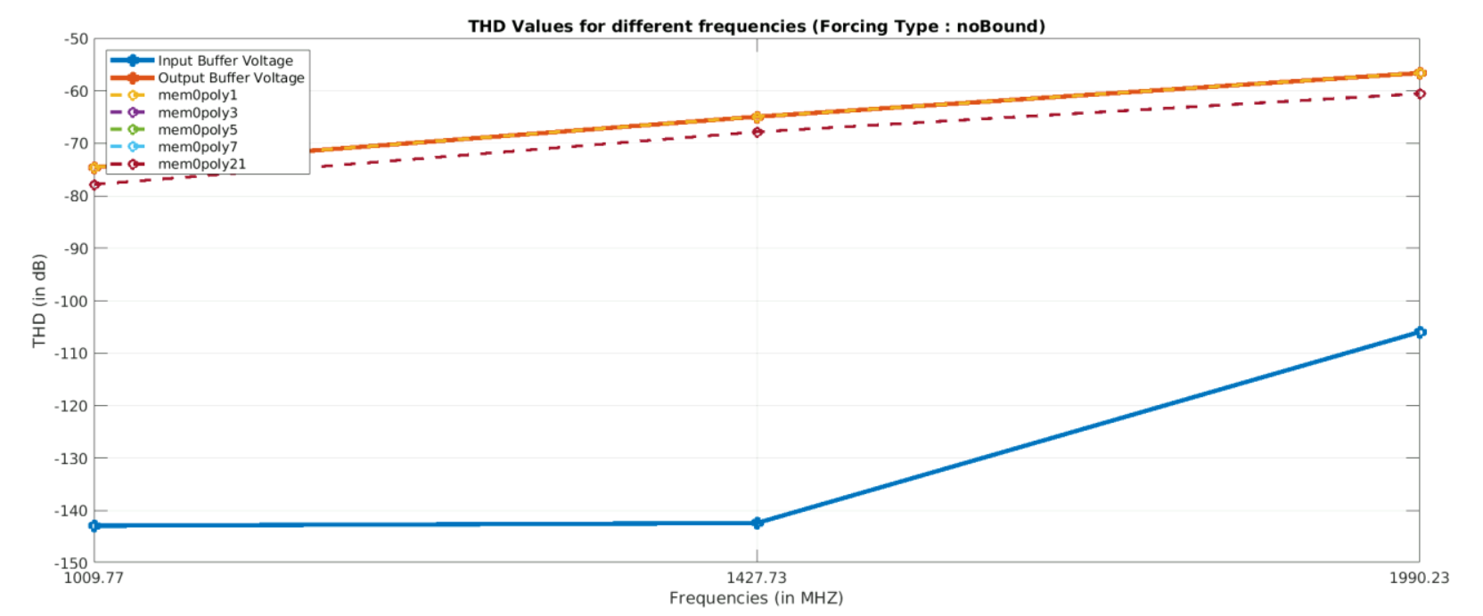
Reanalyze direct calibration - Polynomial Terms (no Mem)

Slide 25
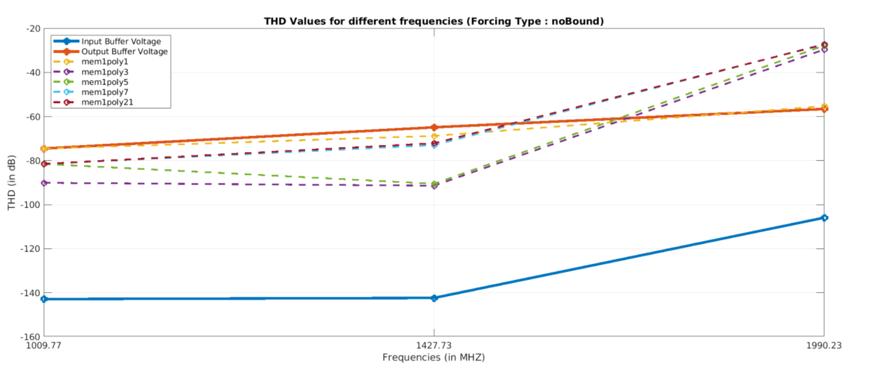
Reanalyze direct calibration - Polynomial Terms (M = 1)

Slide 26
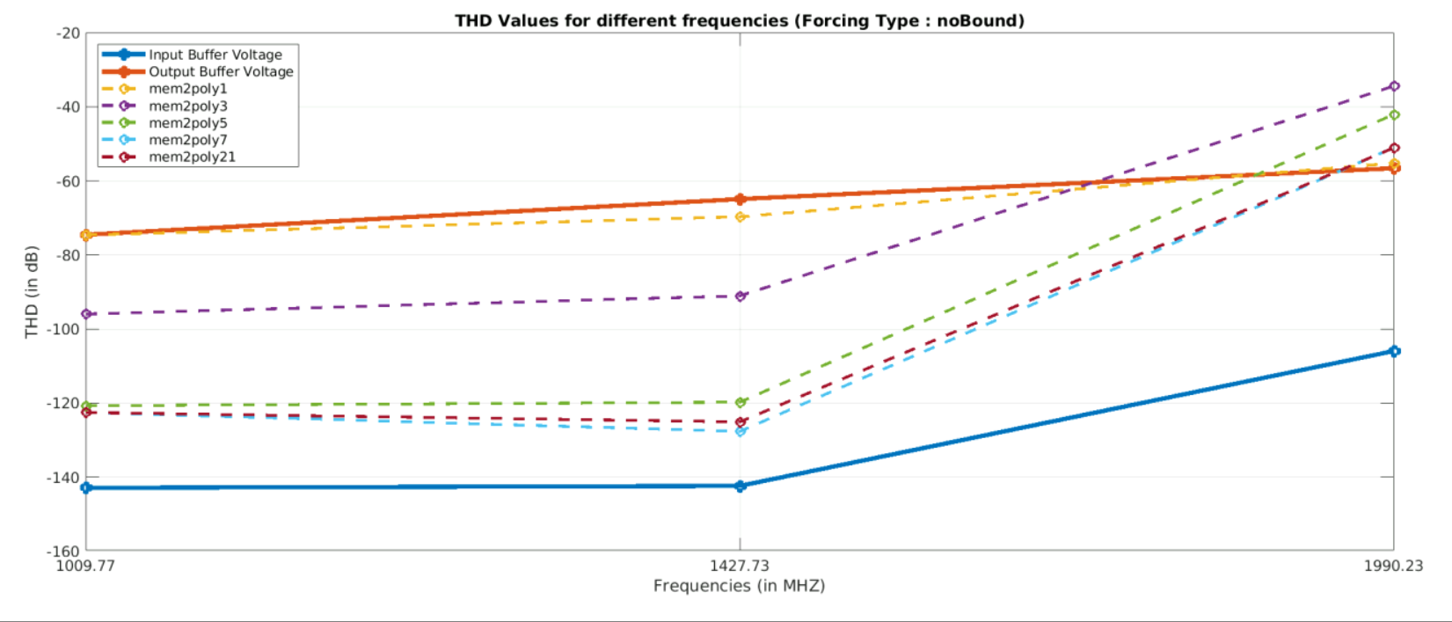
Reanalyze direct calibration - Polynomial Terms (M = 2)

Slide 27
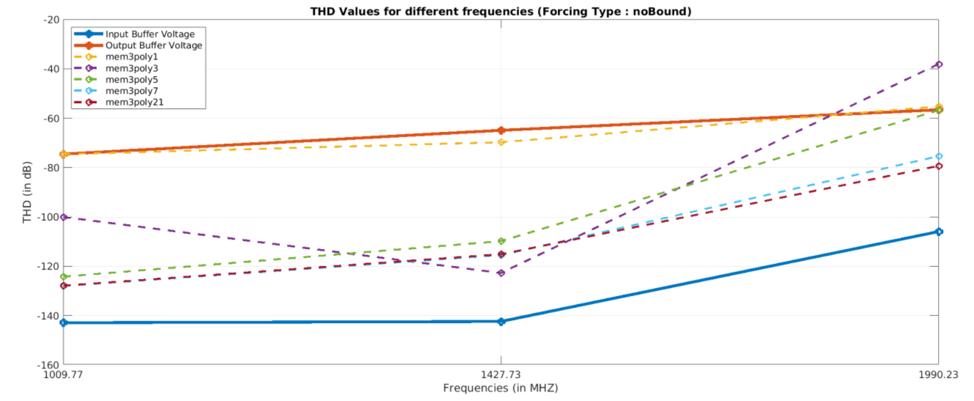
Reanalyze direct calibration - Polynomial Terms (M = 3)

Slide 28
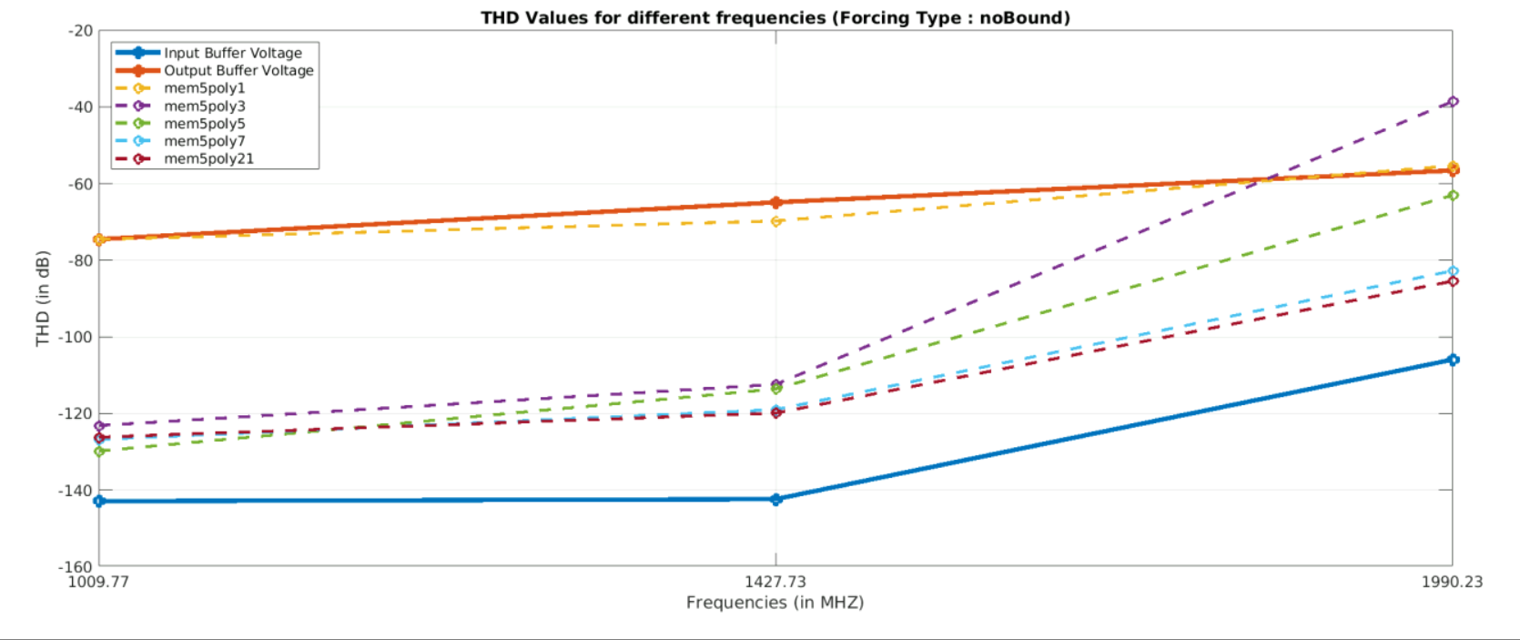
Reanalyze direct calibration - Polynomial Terms (M = 5)

Slide 29
What is the current status: Reanalyze direct calibration Memorial Terms

Slide 30
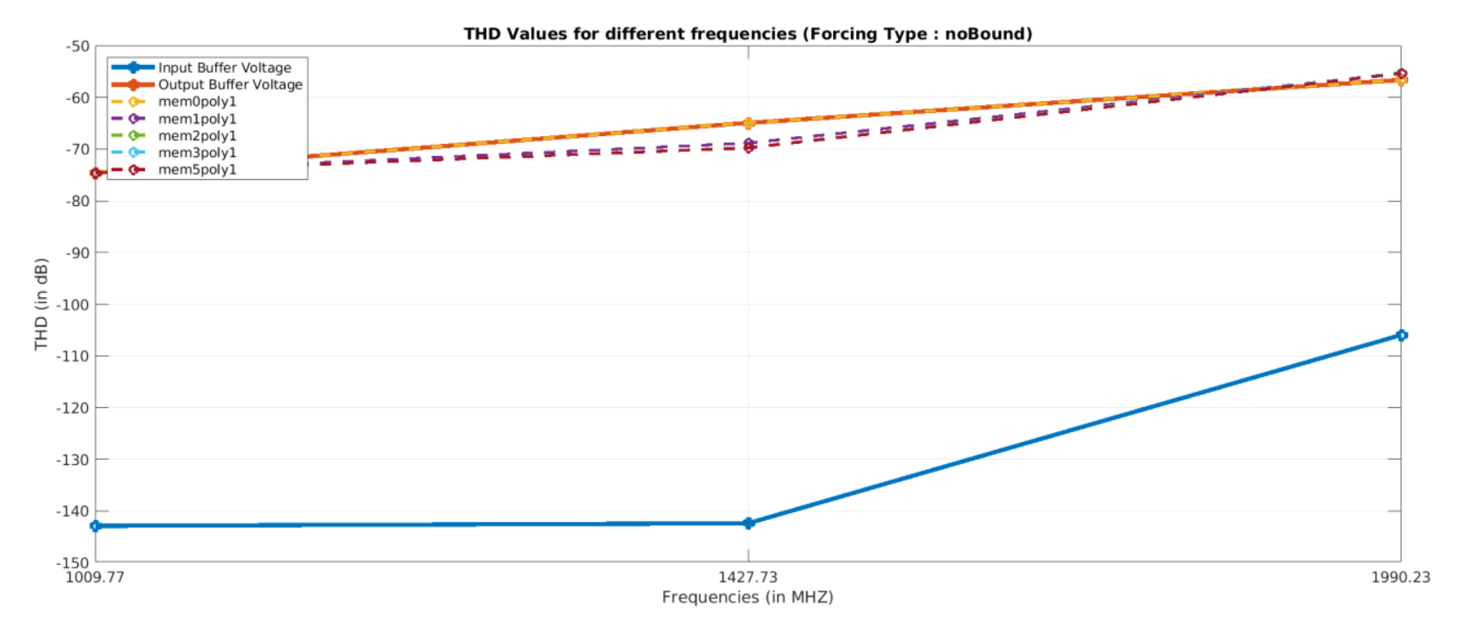
Reanalyze direct calibration - Memorial Terms (P=1)

Slide 31
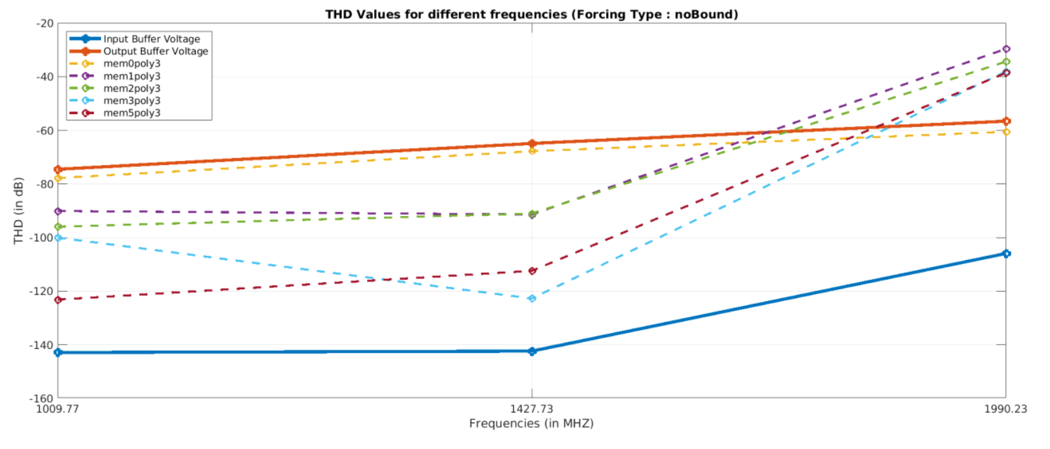
Reanalyze direct calibration - Memorial Terms (P=3)

Slide 32
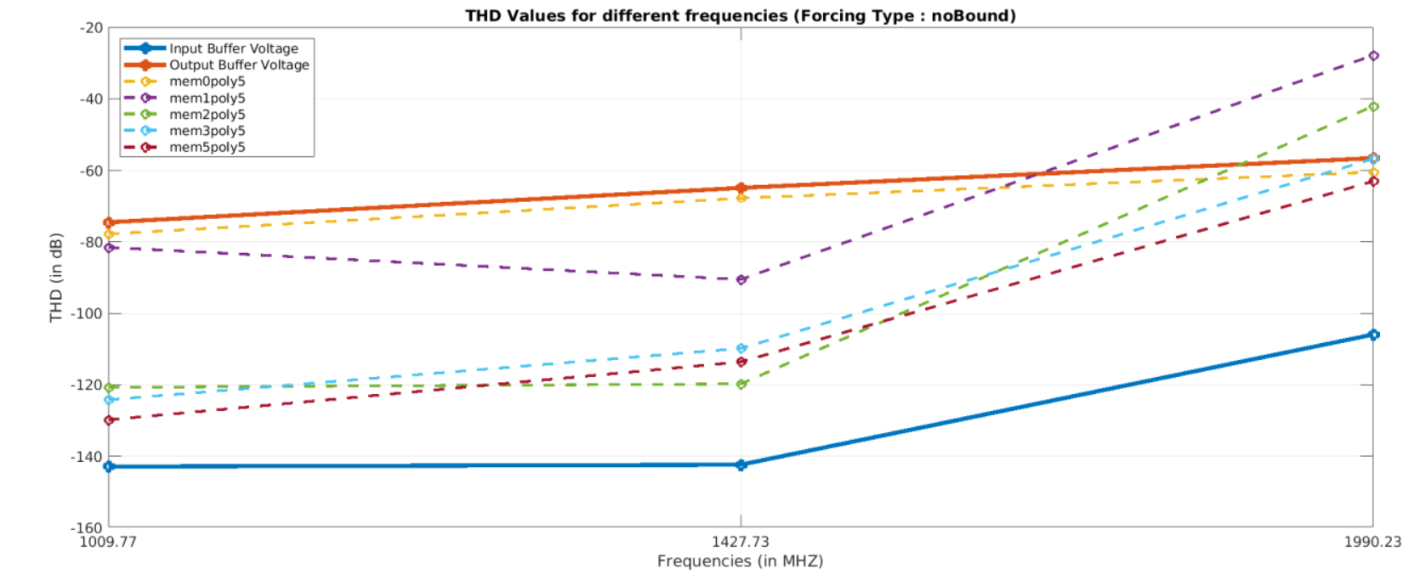
Reanalyze direct calibration - Memorial Terms (P=5)

Slide 33
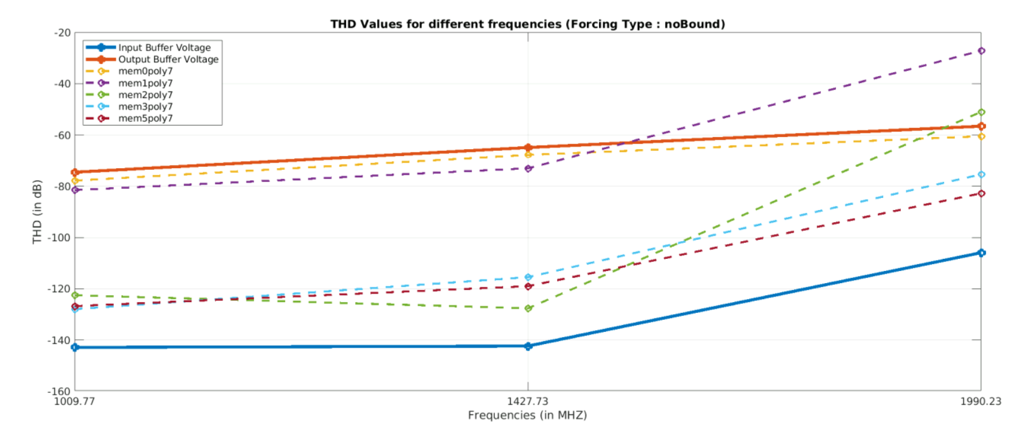
Reanalyze direct calibration - Memorial Terms (P=7)

Slide 34
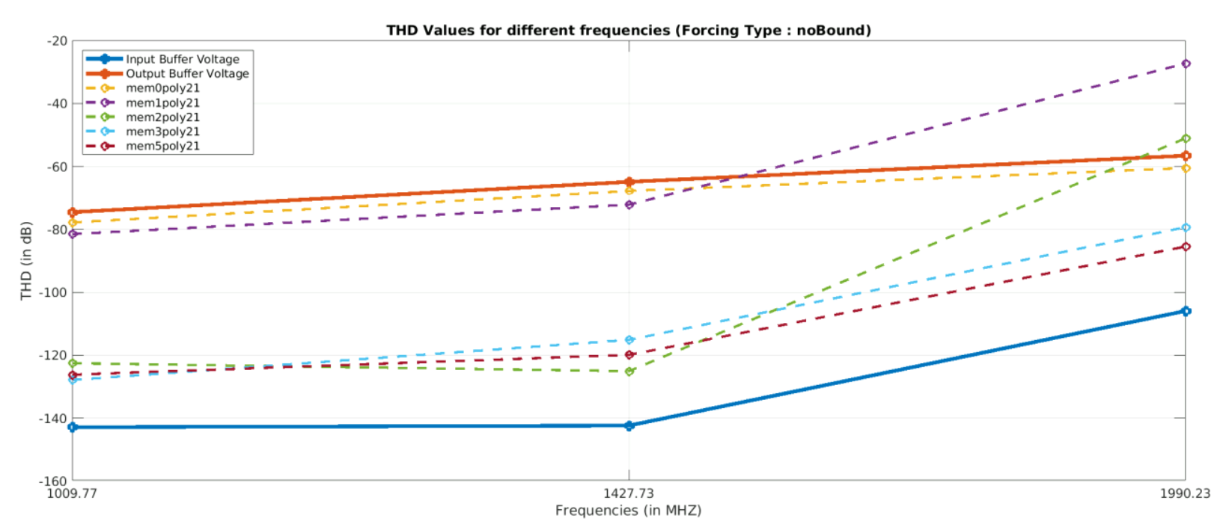
Reanalyze direct calibration - Memorial Terms (P=21)

Slide 35
What is the current status: Reanalyze direct calibration in High Frequency

Slide 36
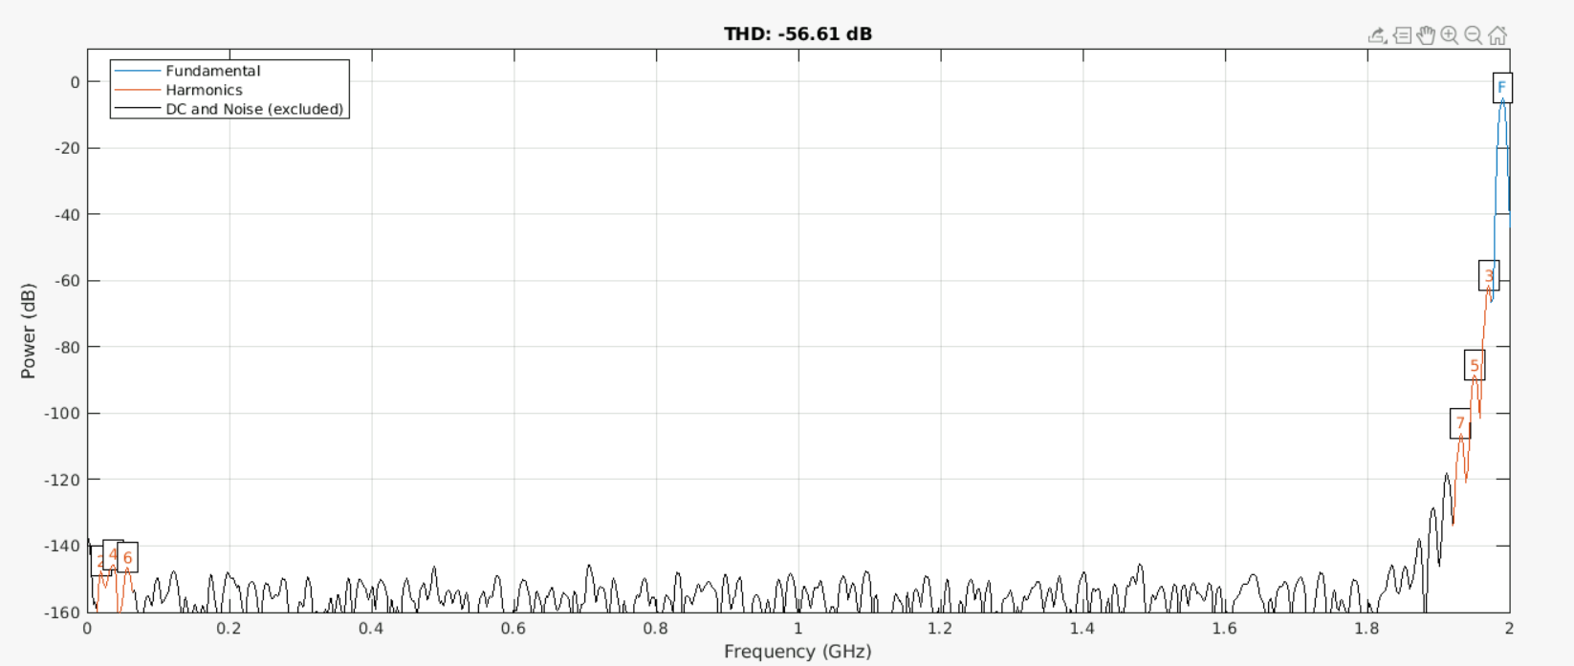
Reanalyze direct calibration - High Frequency V_{out}

Slide 37
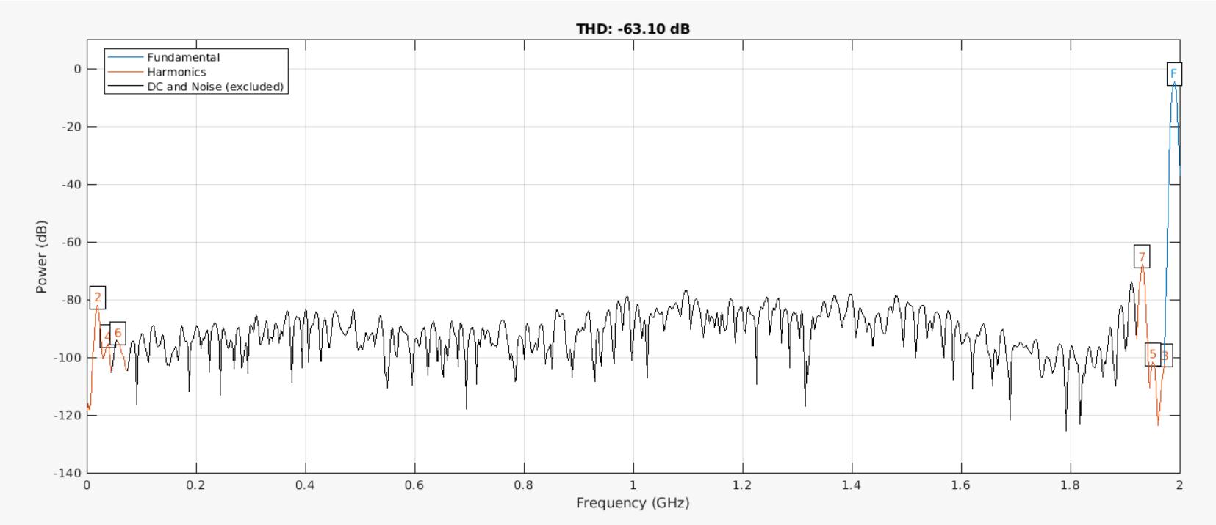
Reanalyze direct calibration - High Frequency V_{calib}(P,M=5)

Slide 38
Plans for the next weeks: Analyzing the coefficients

Slide 39
Plans for the next weeks – Analyzing the coefficients
If we focus on the high frequency, the result seems that it is important to put at least memory order 5 and polynomial order of 5. (Total number of coefficients = 30)
We will focus on the magnitude of these coefficients to see which one is the most important one and try to eliminate some terms if possible.

