Slide 1
DCIM Technology Adoption
Capability Envisioning…
Increase role-based workflow automation!
Roles + Workflow + Automation
Business Insights
Analytics Management
Tenancy Management
Reservations Management
Metrics
Data Consistency
Capacity Management
Cable/Network Management
Power Management
Ops-Workflow Management
How do we increase Operational Consistency to gain Business Insights?
Asset Management
Site Management
Operational Consistency
Notes:
KEY POINT : We need to increase our Operational Consistency by applying even more Automation!
Everyone naturally expects consistent data. Good business decisions depend upon insights gained from consistent business operations analytics. Even so, few seem to understand the intrinsic relationship between business operations capability and resultant quality of analytical information. Business sponsors often expect consistency in reporting that would be impossible without corresponding prior operations enablement.
The following illustration depicts this correspondence. You may recognize that the shape of the curve between the axis is exponential and not directly proportional. This shape works in our favor per the following observations.
• A slight increase in Operational Consistency (i.e. a movement to the right along the horizontal axis) results in a dramatic increase in Data Consistency (i.e. upward movement along the vertical axis). In other words, a small operational improvement can go a long way.
• How can we know our consistency position on this curve? That’s a function of metrics. Operational Consistency measurements provide insights into where we are at any point in time.
• How can we improve our consistency position? That’s the art and science of Operations Management involving People, Processes, and Technologies. Or, more specifically, the organizational application of Roles, Workflow, and Automation to business processes.

Slide 2
DCIM Onboarding Plan Technology Adoption by Capability-Area and User-Role
People + Process + Tools = Roles + Workflow + Automation
Asset Management
Tenant Manager
Change Management
Site Manager
Power Management
Capacity Management
Cable Management
Environmental Management
Reservations Manager
Operations Manager
Power Manager
Site Manager
Site Manager
QA Manager
Reservations Manager
Catalog Manager
Reservations Manager
Site Manager
Reservations Manager
Operations Manager
QA Manager
QA Manager
Operations Manager
Power Manager
Operations Manager

Slide 3
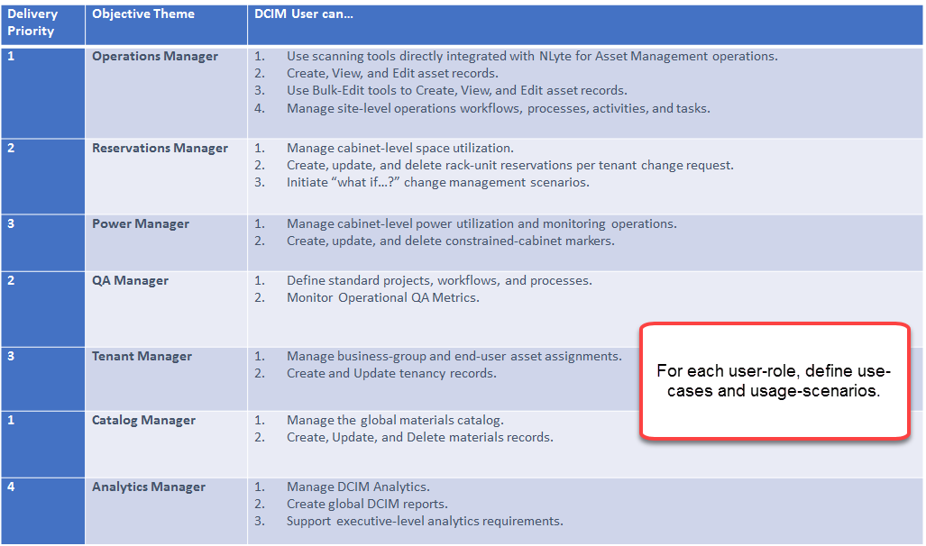
DCIM Logical Use-Cases per User-Role
Define User-Role-Groups + Usage-Scenarios

Slide 4
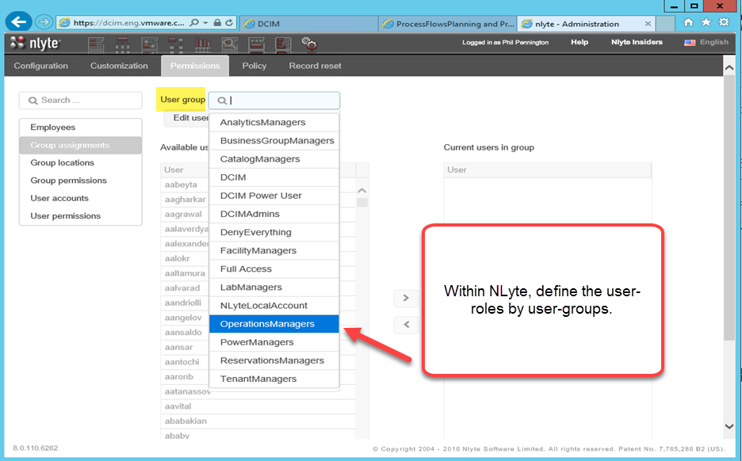
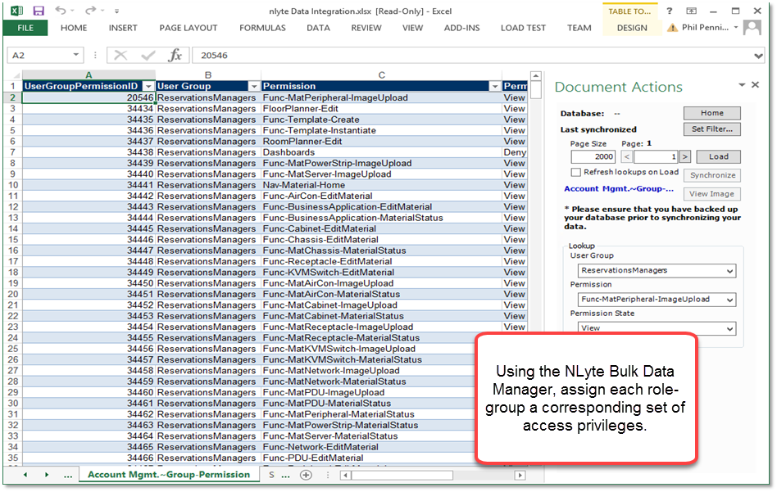
DCIM User Role Configuration
Customize NLyte to Recognize Users by Role

Slide 5
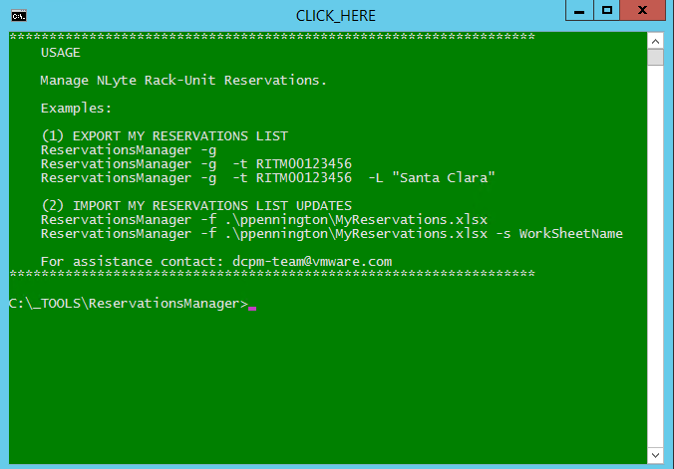
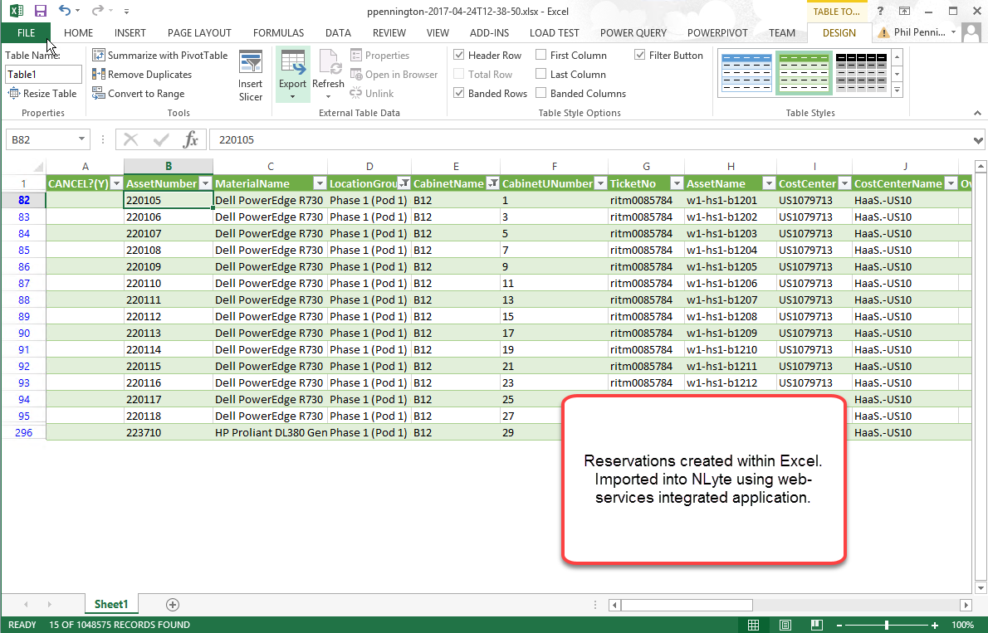
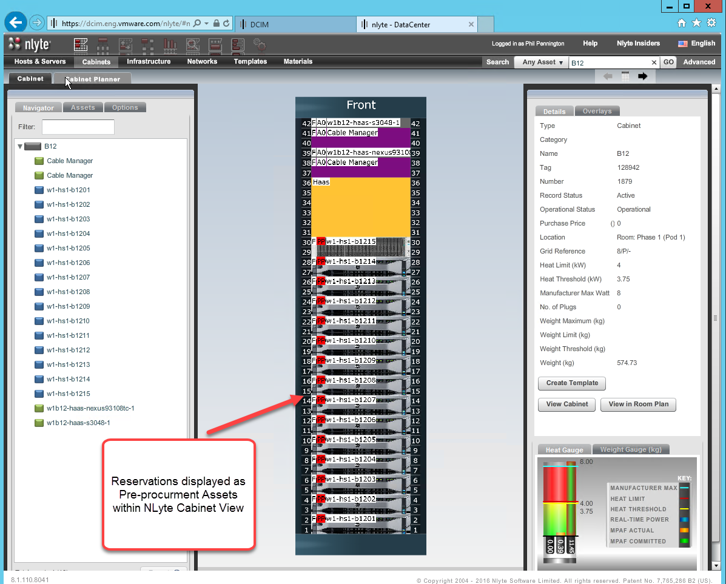
Example: Reservations Manager – Reserve RU
User-Role + Usage-Scenarios

Slide 6
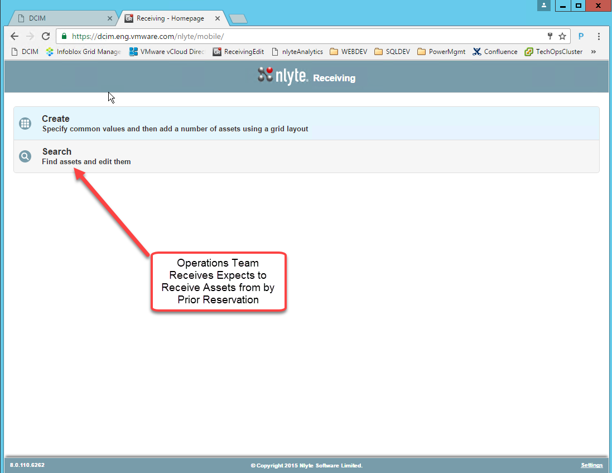
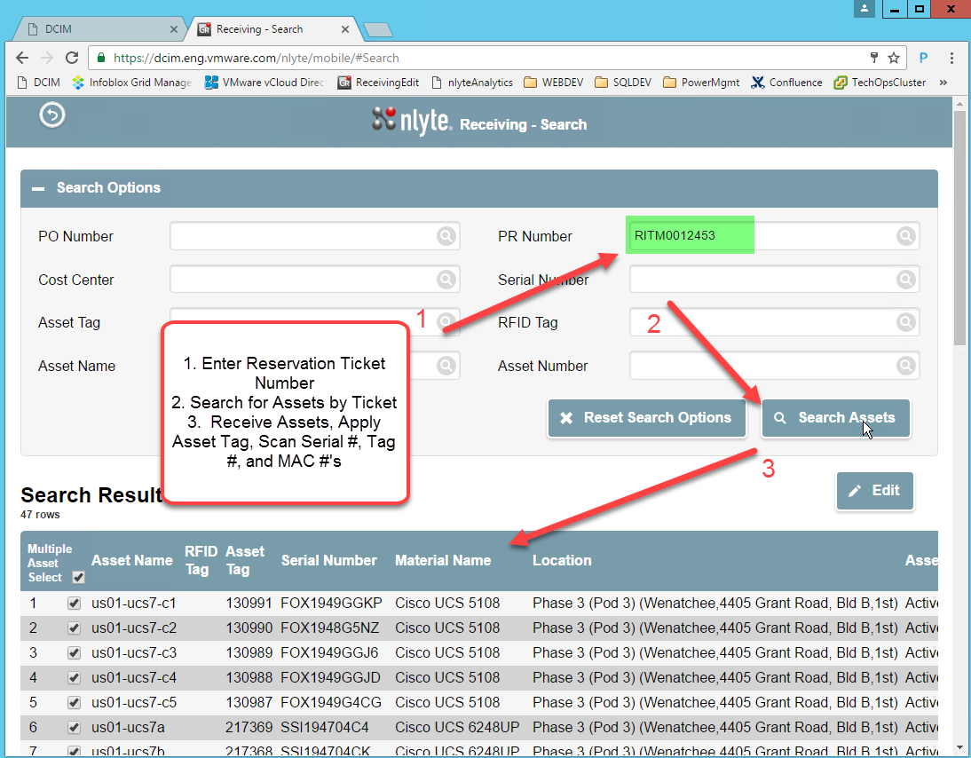
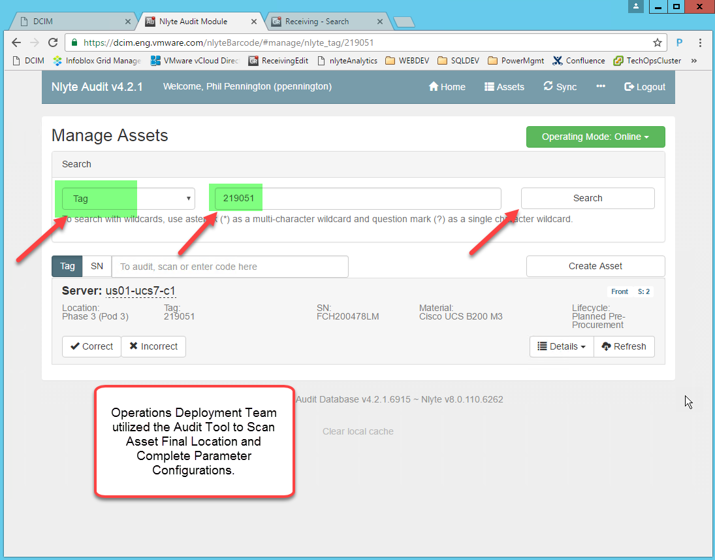
Example: Operations Manager – Receive Assets
User-Role + Usage-Scenarios

Slide 7
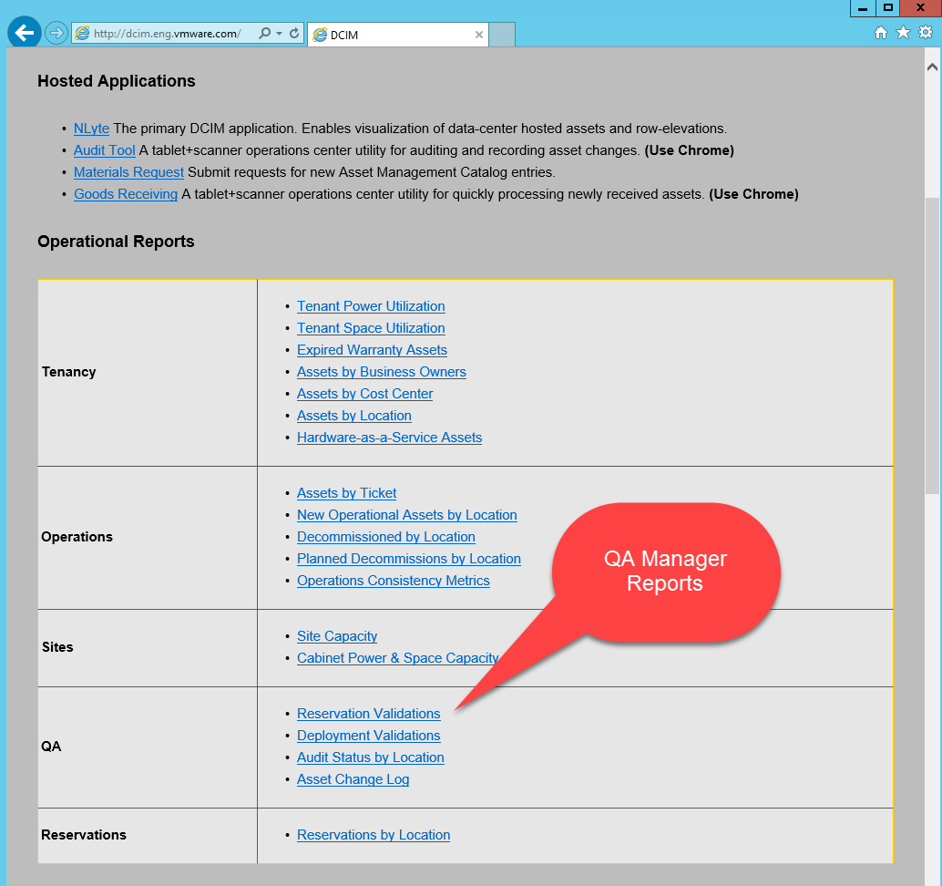
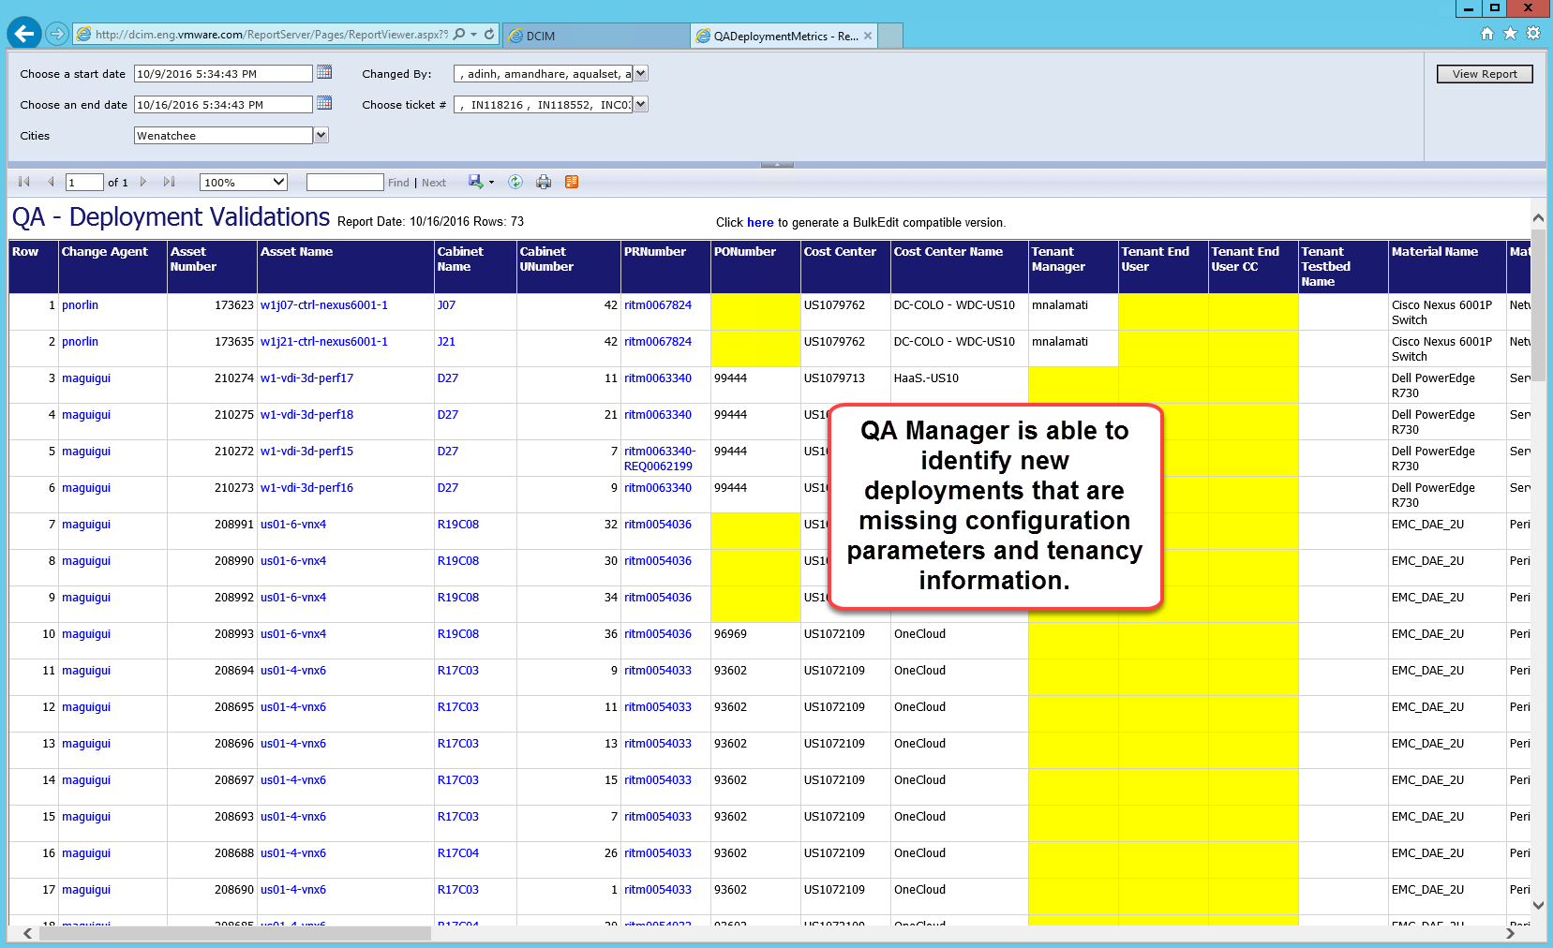
Example: QA Manager – Validate Deployments
User-Role + Usage-Scenarios

Slide 8
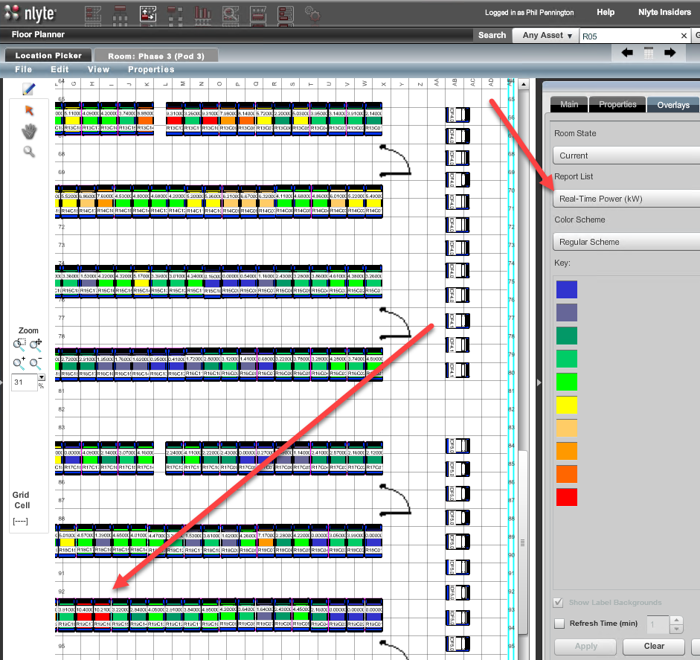
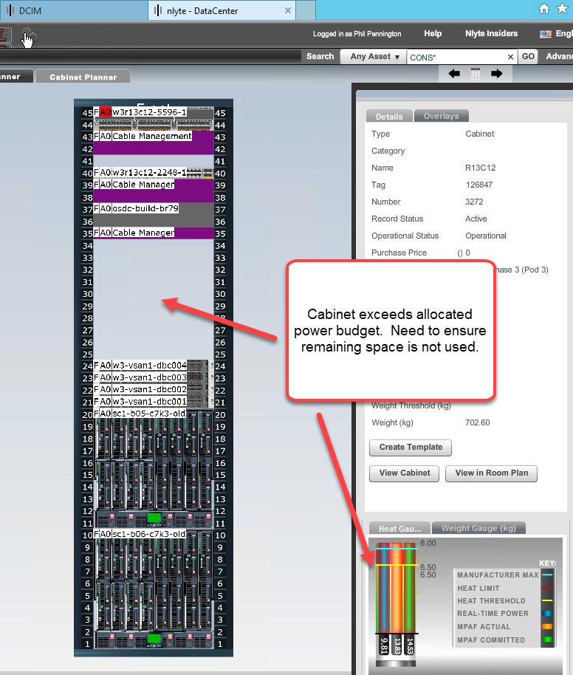
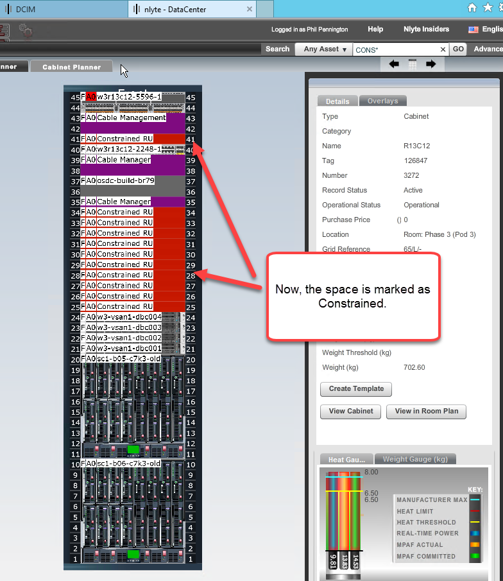
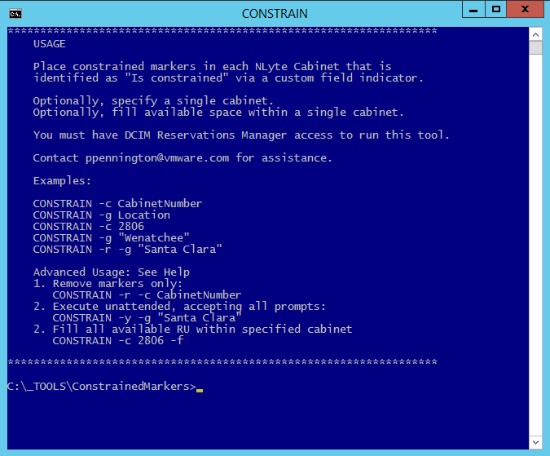
Example: Power Manager – Constrain Cabinet Space
User-Role + Usage-Scenarios

Slide 9
DCIM Onboarding Plan Technology Adoption by Capability Area
Asset Management
Scoping
Change Management
Sensor Network
Power Management
Capacity Management
Cable Management
Environmental Management
Tools Training
Tenancy
Scoping
Analytics
Discovery
Floor Plans
Data Migration
Operations
Workflows
Automation
Validations
Discovery
PDU Network
SNMP Polling
Operations
Inventory
Alerts
Reservations
Forecasts
Port Inventory
NIC/HBA Configuration
Switch-Port Map
DNS Validation
Monitoring
Alerts
Analytics

Slide 10
DCIM Onboarding – Asset Management SITE = <NAME HERE>
Contributors
DCIM Champion <NAME>
DCIM Solutions Consultant <NAME>
[Role] Managers <TBD>
Stakeholders
Site Manager <NAME>
Operations Leads <NAMES>
DCIM Consumers <NAMES>
Scoping
(1 week)
Roles
Floor Plans
(2 weeks)
CAD Import
Migration
(1-N weeks)
Cleaning
Schedule
Data-Sources
Operations
(continuous)
Cabinets
Tools
(1 week)
NLyte
Tools VM
Access
Training
Mapping
Import
Exceptions
Maintenance
Workflow
Validations
Validations
Audits
Improvement
Tasks | Status | Start/End | Issues | Owner

Slide 11
DCIM Onboarding – Power Management SITE = <NAME HERE>
Contributors
DCIM Champion <NAME>
DCIM Solutions Consultant <NAME>
[Role] Managers <TBD>
Stakeholders
Site Manager <NAME>
Operations Leads <NAMES>
DCIM Consumers <NAMES>
Scoping
(1 week)
Roles
PDU Network
(2-N weeks)
Network Subnets
SNMP Polling
(1 week)
NLyte Polling Services
Schedule
Data-Sources
Operations (continuous)
Inventory
(2-N weeks)
PDU Models
Testing and Diagnostics
Cabinet/PDU Assignment
Data Import
PDU Configure
DNS IP Ranges
Routing
Management Software Integration
Operations Center
Reports
Validations
Constraint Detection
Tasks | Status | Start/End | Issues | Owner

Slide 12
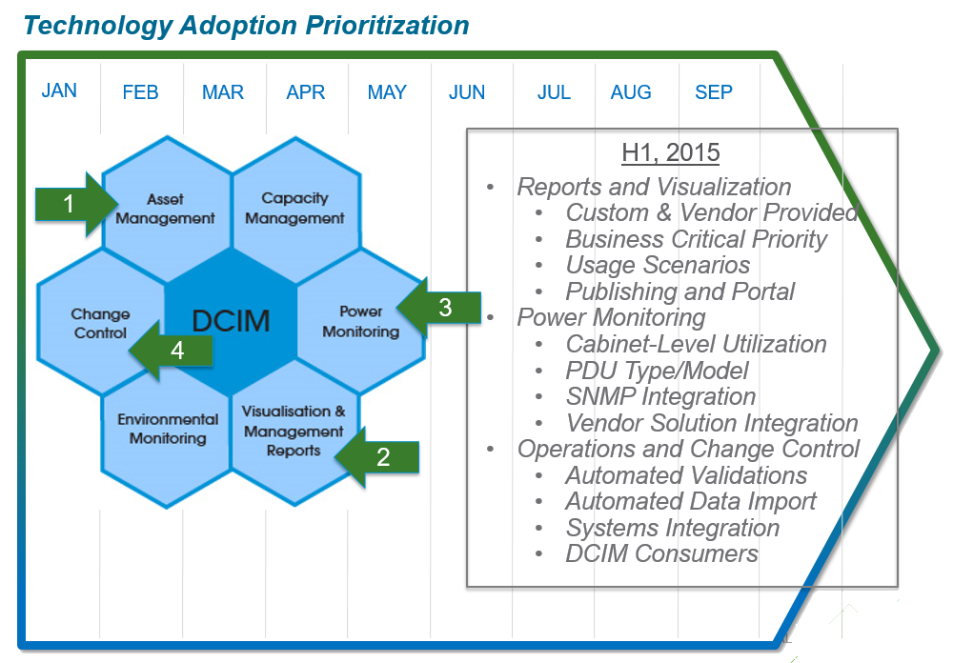
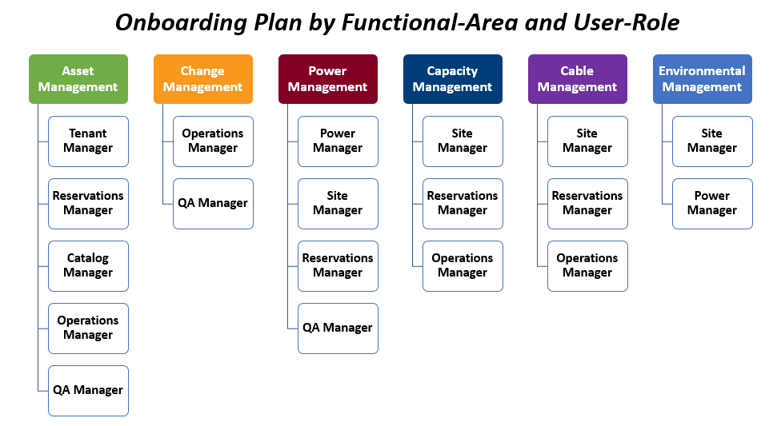
DCIM – Key Technology Adoption Success Criteria Summary Points
Sponsorship Level | Enterprise Roles | Accountability
Executive | Vice-President CxO | Signature sponsors of the corporate “DCIM Initiative” Evangelizes corporate initiatives Chair of major milestone project reviews
Business | Sr. Directors General Managers Regional Directors | Business stakeholders Enable cross-team collaboration Approve project objectives, plans, and deliverables Assign and enable technical resources
Technical | Operations Managers DCIM Solutions Consultants Technical IT Operations Staff | Execute the DCIM Onboarding Plan Establish Operations team roles Establish Operations workflows Implement technical solutions Achieve project milestone deliverables Scale-out via training and role enablement

Slide 13
EXTRA TOPICS FOLLOW…

Slide 14
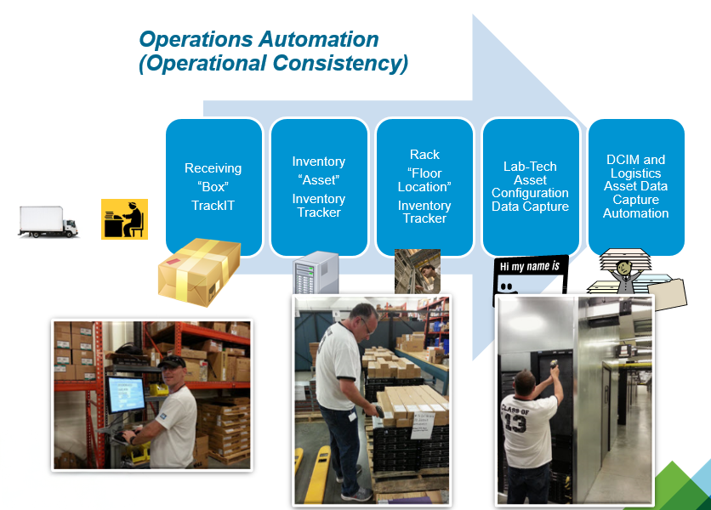
DCIM Onboarding – Change Management Functional Capability
Tenant Projects
Elevation Changes by Customer Requirement
Operations Automation
Software Assisted Operations Use-Cases
Change Validations
Software Driven Validations
Change Discovery
Operations Workflows
Site-Level Operations Use-Cases
Software Driven Continuous Validations of Device Configuration
Integration with OrderNow
PSC Decision Support
Receive
Deploy
Move
Decom
RMA
Receive
Deploy
Move
Decom
RMA
Audit
OrderNow
DNS
Change Notifications
Discrepancy Reports

Slide 15
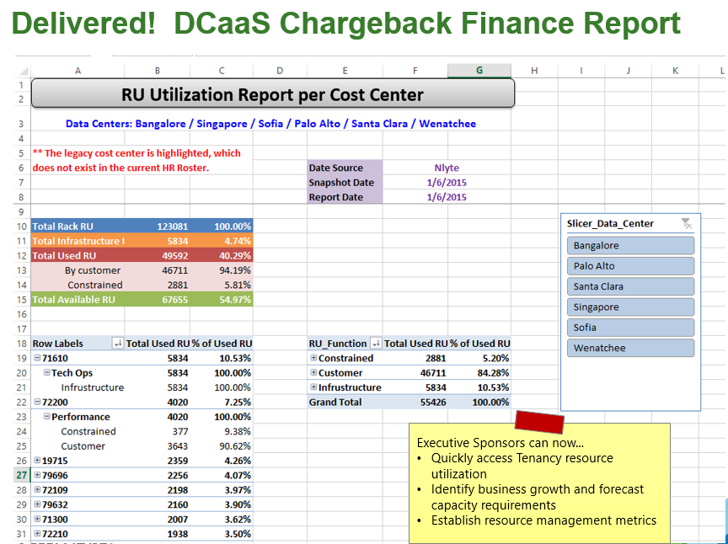
DCIM Onboarding – Capacity Management Functional Capability
Analytics
NLyte Reports
Tenancy Services
Elevation Operations (View, Change)
Forecasts
Facility Planning Analytics
Automated Cautions
Software Driven Cautionary Reports
Custom Reports
DCIM Portal
Power Threshold
Space Threshold
Change Request
Notifications

Slide 16
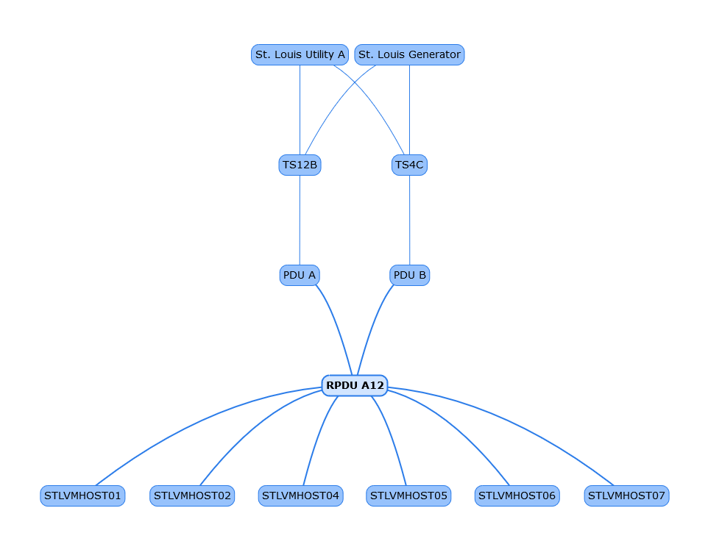
DCIM Onboarding – Cable Management Functional Capability
Discovery
(Automated)
Software Driven Discovery of Devices, Network Cards, and Port Type
Cards Configured
Software Driven Mounting of Network Cards within NLyte Asset Records
Connection Points
Software Driven Association of Connections between Devices
DNS Validations
Port Inventory
Software Driven Inventory of Ports per Card per Device
Continuous Validations of Device Configuration

